Slide 1
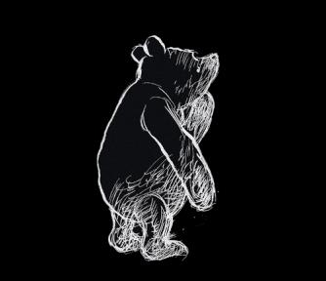
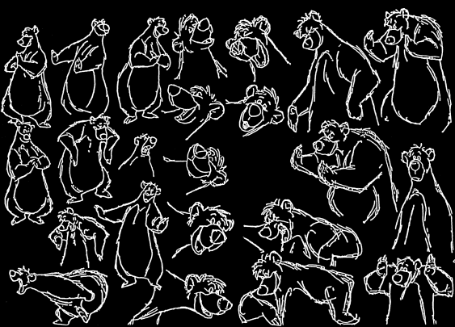
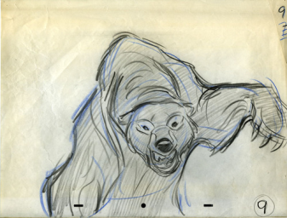
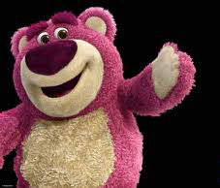
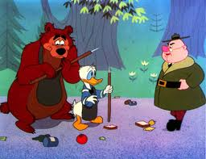
Bears: Anatomy, Locomotion, Behavior
Stuart S. Sumida
ssumida@csusb.edu
www.stuartsumida.com

Slide 2
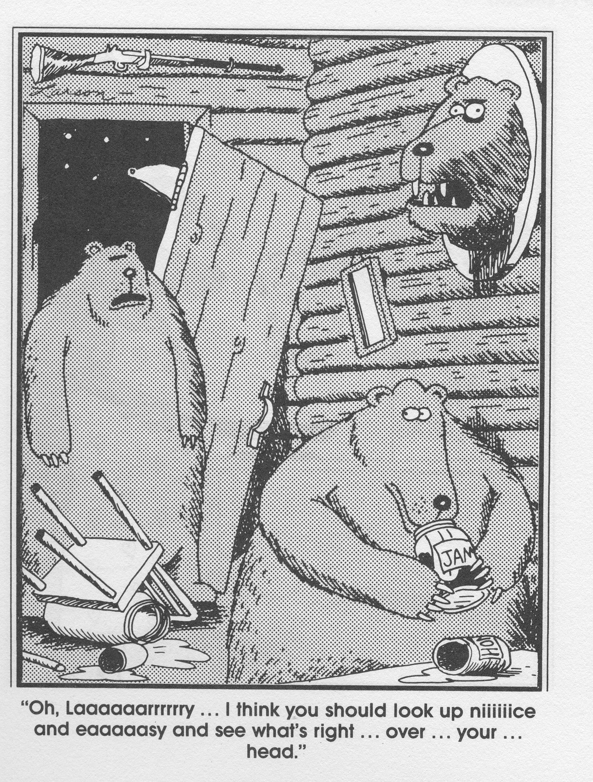
BEARS:
Basic Anatomy

Slide 3
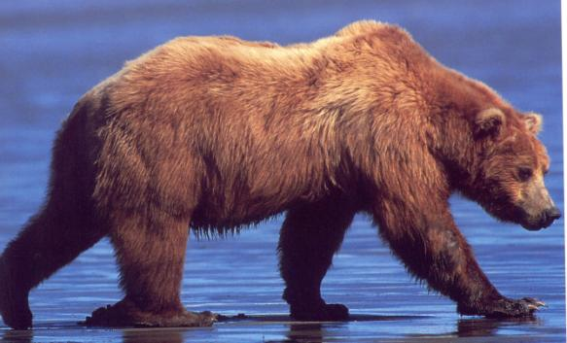
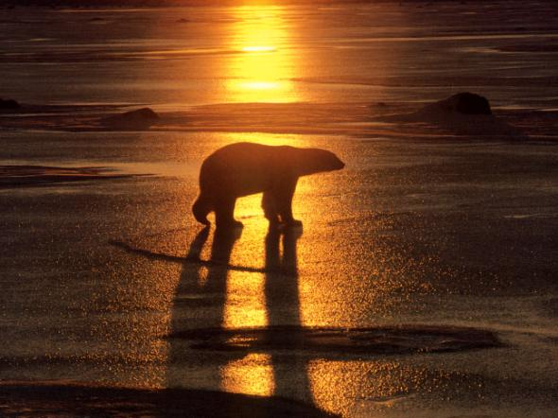
BEAR ANATOMY
BODY OUTLINE-1
In general, the highest point on a brown or grizzly bear will be the shoulder…
…whereas in a polar bear the highest point will be the hip

Slide 4
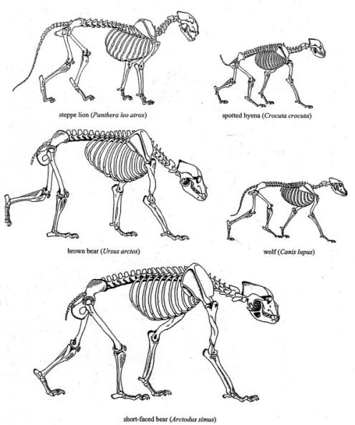
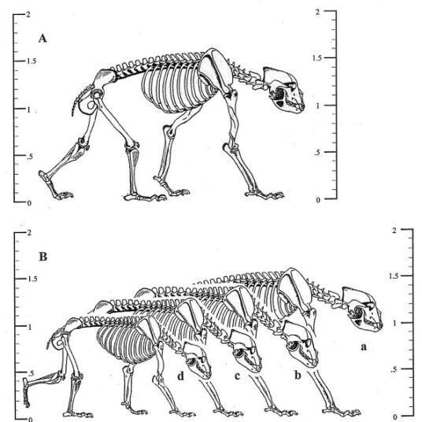

Slide 5
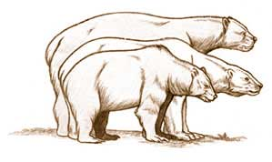
Extinct Short-faced Bear
Polar Bear
Grizzley Bear

Slide 6
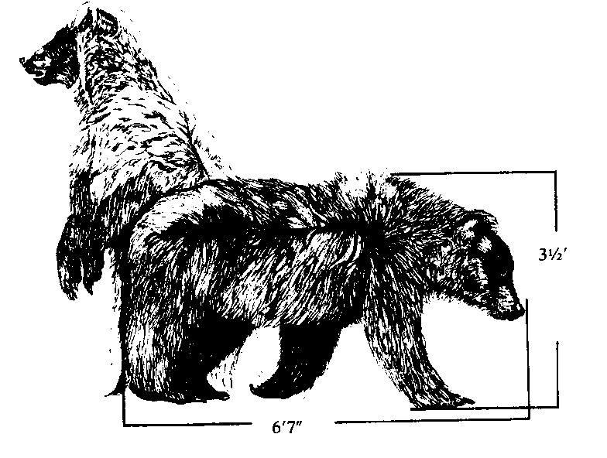

Slide 7
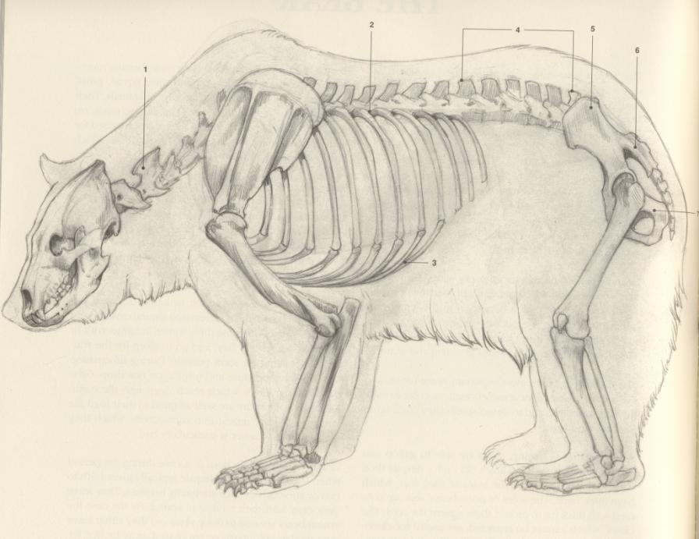

Slide 8
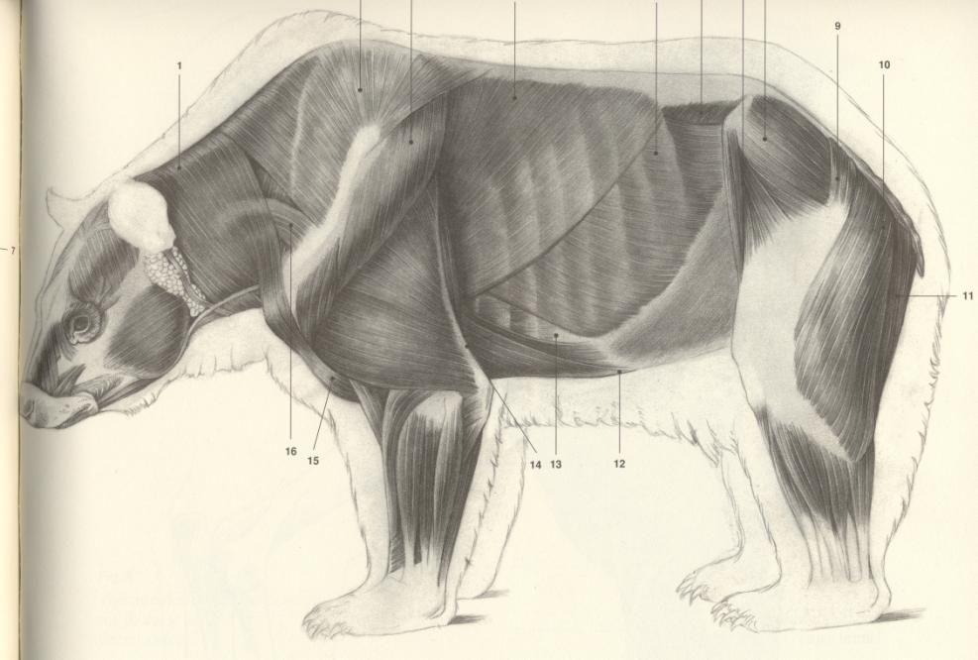

Slide 9
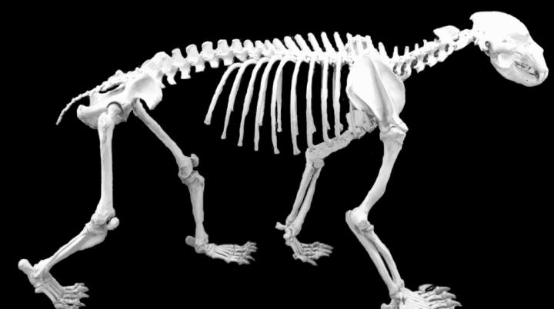
BEAR ANATOMY – SKELETON AND BACKBONE – 1
In a comparison of skeletons (i.e. the internal rigs) the backbone of a bear is somewhat intermediate between that of a carnivore on the one hand and an herbivore on the other.

Slide 10
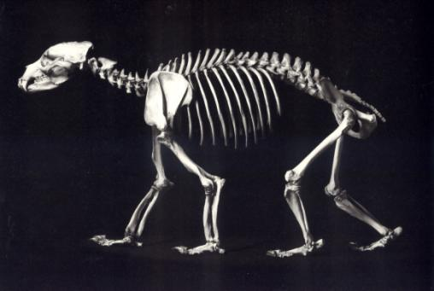
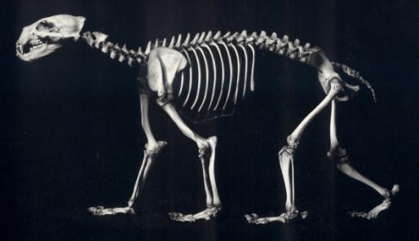
Grizzly Bear – Ursus arctos Polar Bear – Ursus maritimus

Slide 11
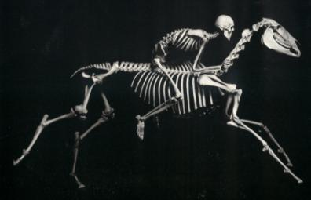
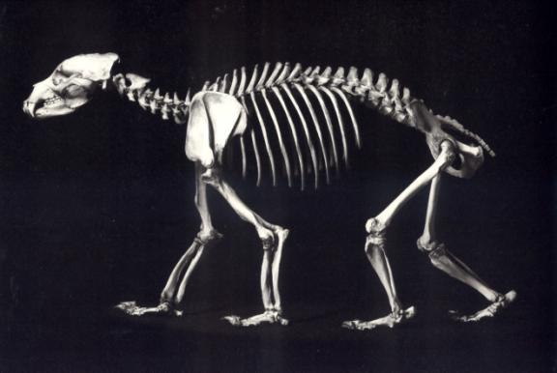
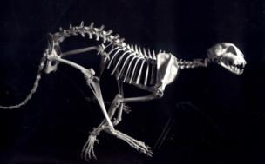
BEAR ANATOMY – SKELETON AND BACKBONE – 2
Technically, bears are classified as carnivores, but in terms of feeding they are essentially omnivores. So, you will note that the degree of curvature of the backbone is in fact intermediate between that of an obligate carnivore and an obligate herbivore.

Slide 13
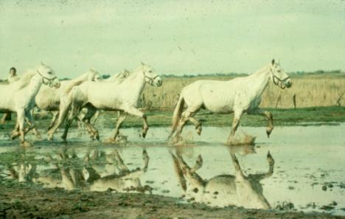
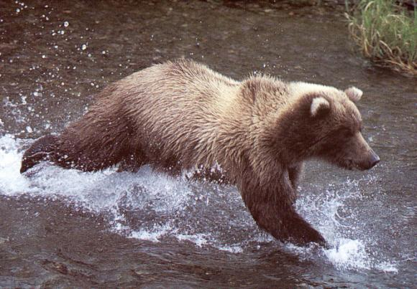
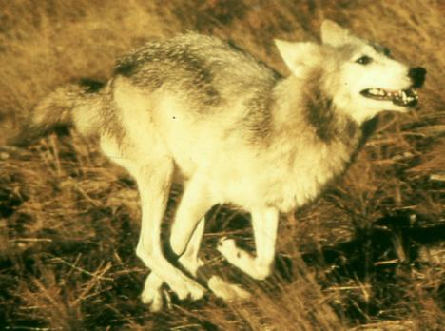
BEAR ANATOMY – SKELETON AND BACKBONE – 3
Bears have a moderately flexible back, but not so much as a high speed carnivore.

Slide 14
Atlas Axis
BEAR ANATOMY – NECK – 1
All mammals have specific movements associated with the first two joints of the neck, known as the “atlas” and “axis” vertebrae (i.e the atlas-axis) complex.
Greatest degrees of movements take place at base of neck and atlas-axis.
Skull-Atlas Joint
(nodding, up-down motion of skull)
Atlas-Axis Joint
(rotatory movement of skull)

Slide 15
Atlas Axis
BEAR ANATOMY – NECK – 1
All mammals have specific movements associated with the first two joints of the neck, known as the “atlas” and “axis” vertebrae (i.e the atlas-axis) complex.
Greatest degrees of movements take place at base of neck and atlas-axis.
Skull-Atlas Joint
(nodding, up-down motion of skull)
Atlas-Axis Joint
(rotatory movement of skull)

Slide 16
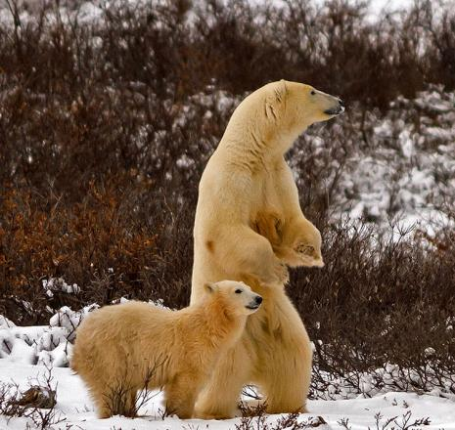
BEAR ANATOMY – NECK – 2
Polar Bears have a relatively longer neck and greater degree of mobility of the neck. They can bend it more from side to side. (This is thought to be associated with swimming ability.)

Slide 17
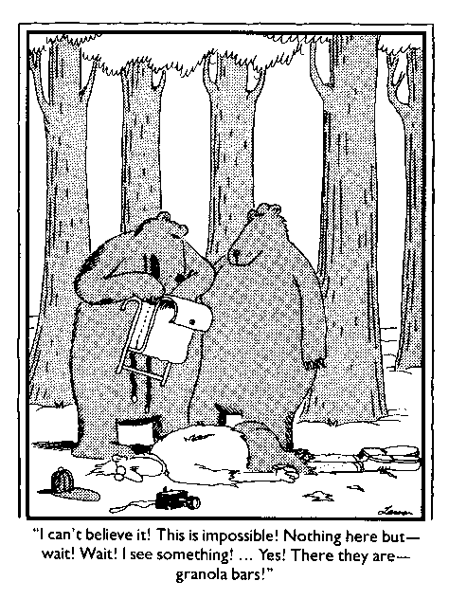
Limbs, hands,
and feet...

Slide 18
BEAR ANATOMY – LIMBS 1
Key features of bears:
“Plantigrade” – flat-footed and palmed
Limbs very close to columnar in orientation – much like humans.
Extremely robust should & hip, upper arm & thigh.

Slide 19
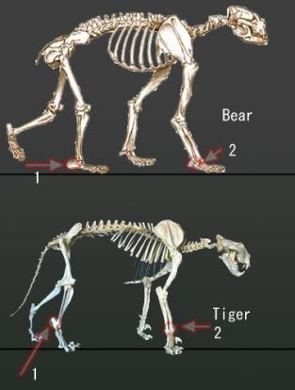
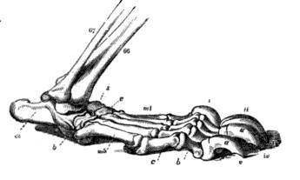
BEAR ANATOMY – LIMBS 2
Both bears and humans are “flat-footed” or “plantigrade” with heel in contact with the ground.
Additionally, bear hind limbs are oriented in an almost columnar manner, much like humans. (However, note, we will see that hip orientation is different – this is key for standing on two limbs.)

Slide 20
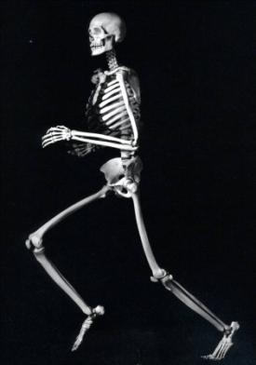
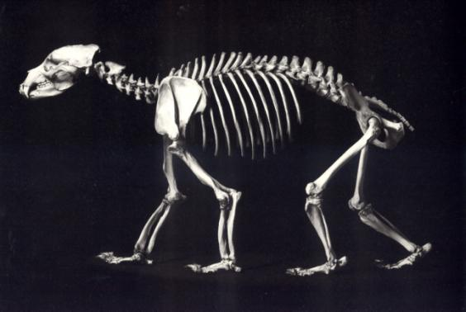
BEAR ANATOMY – LIMBS 3
Human forelimbs hang, whereas those of bears are weight-bearing.
Bears forelimbs are attached via a muscular sling to the side of the ribcage whereas those of humans attach to the back/dorsal side of the body with partial skeletal support via the clavicle.

Slide 21
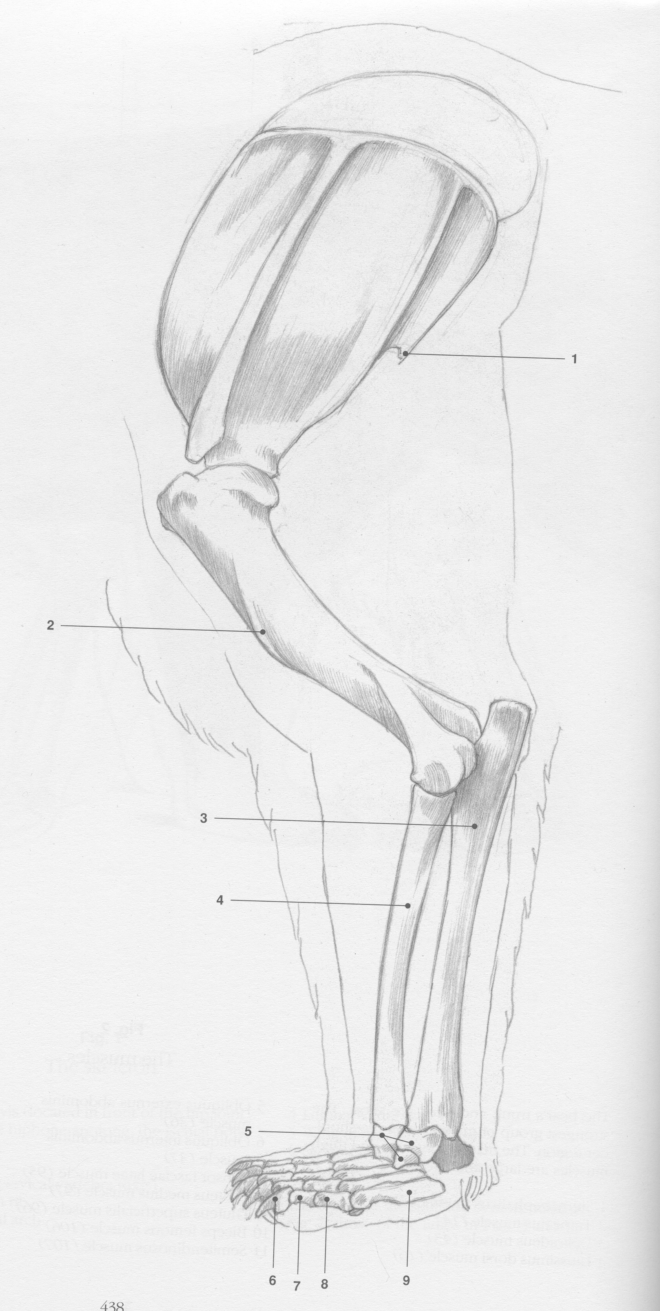

Slide 23
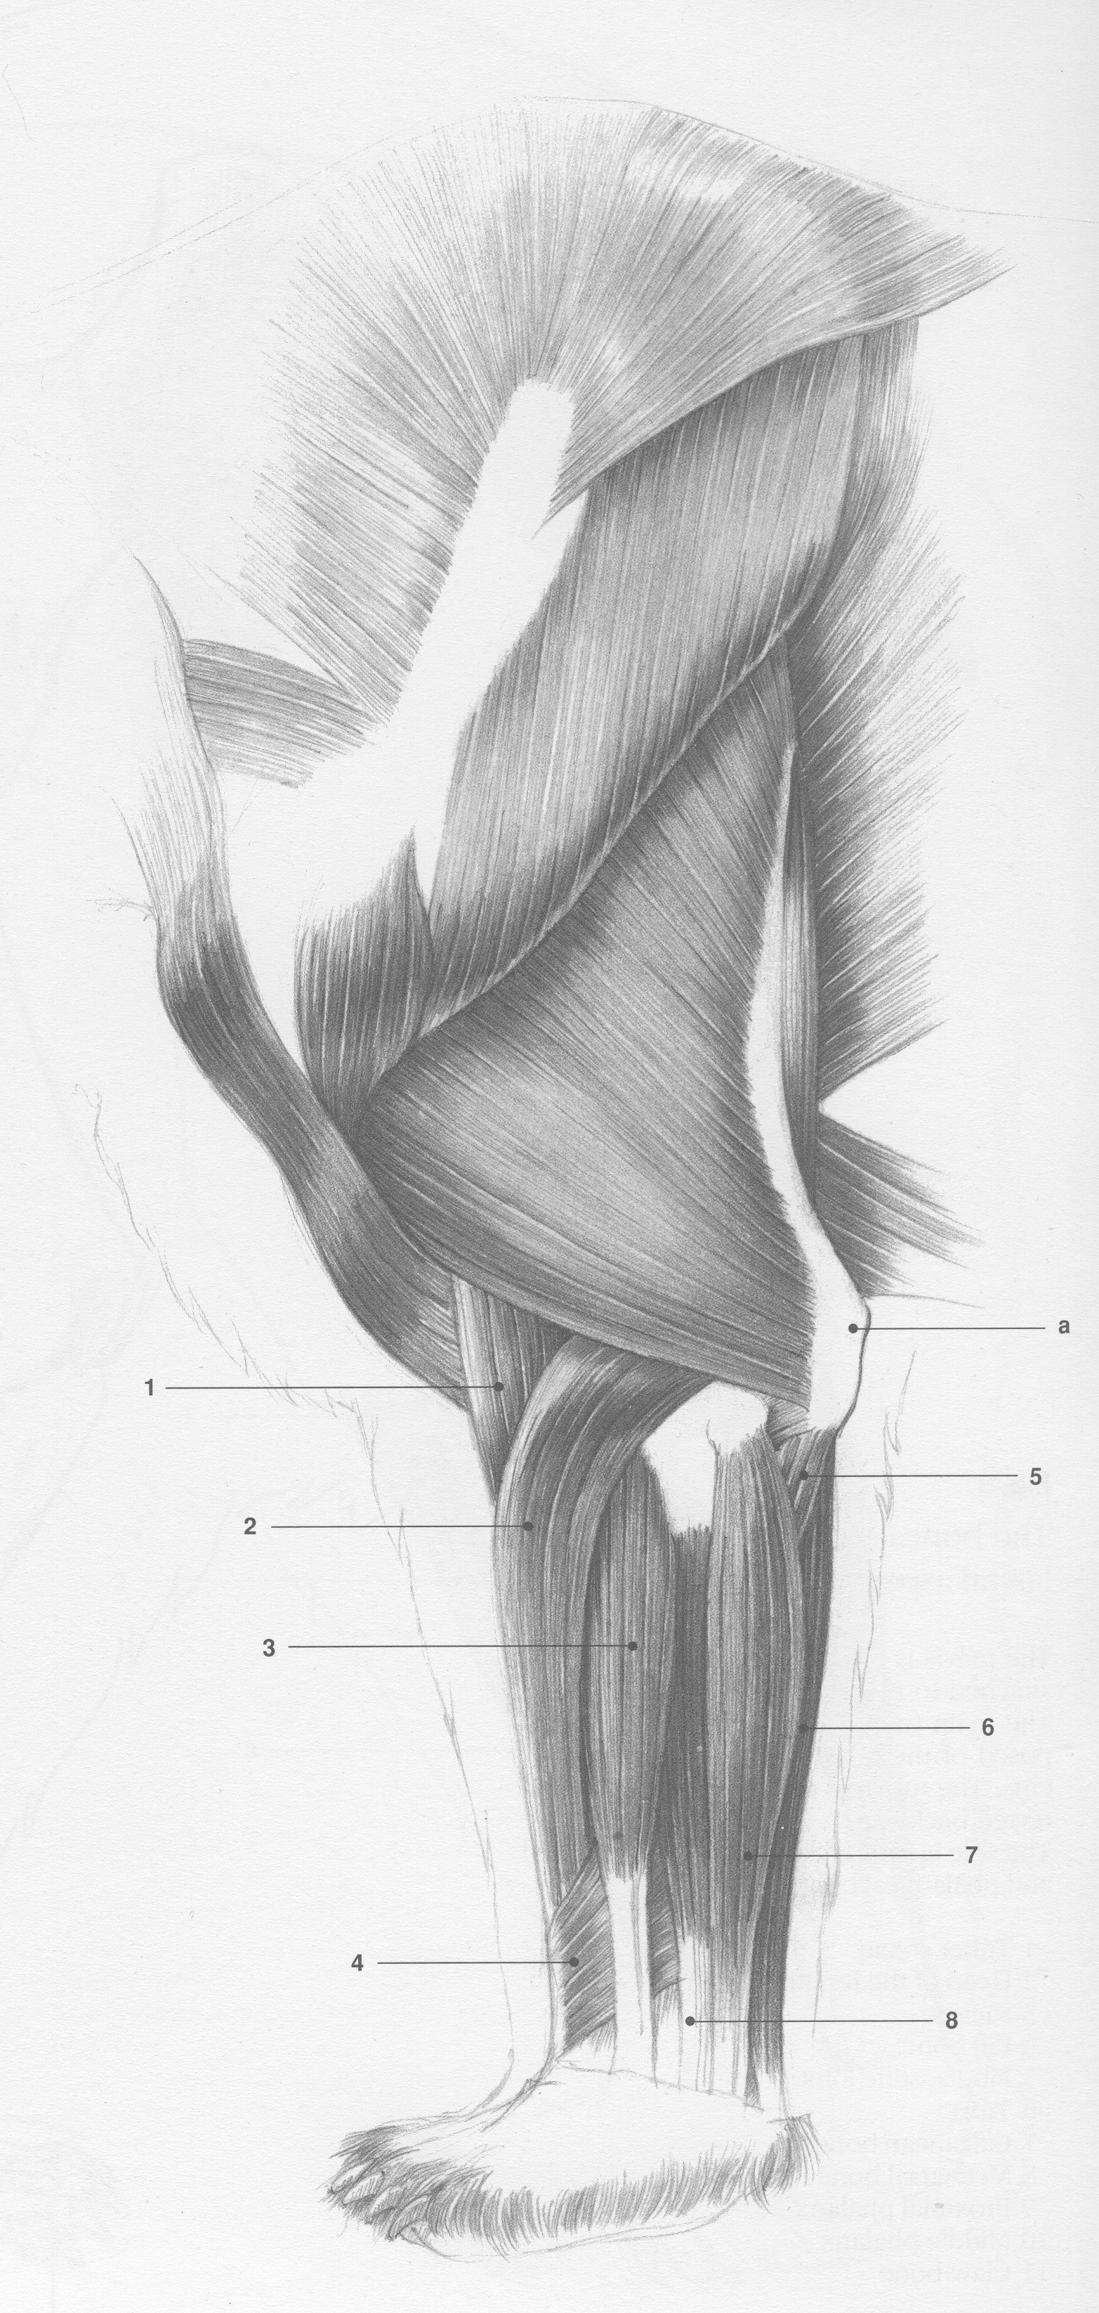

Slide 25
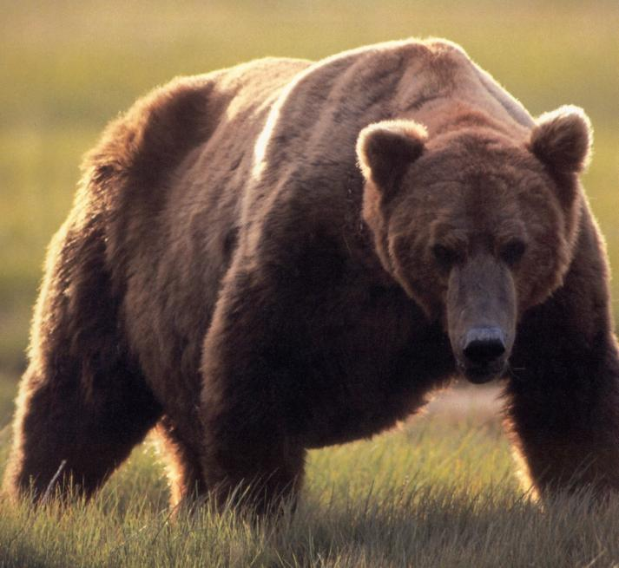

Slide 26
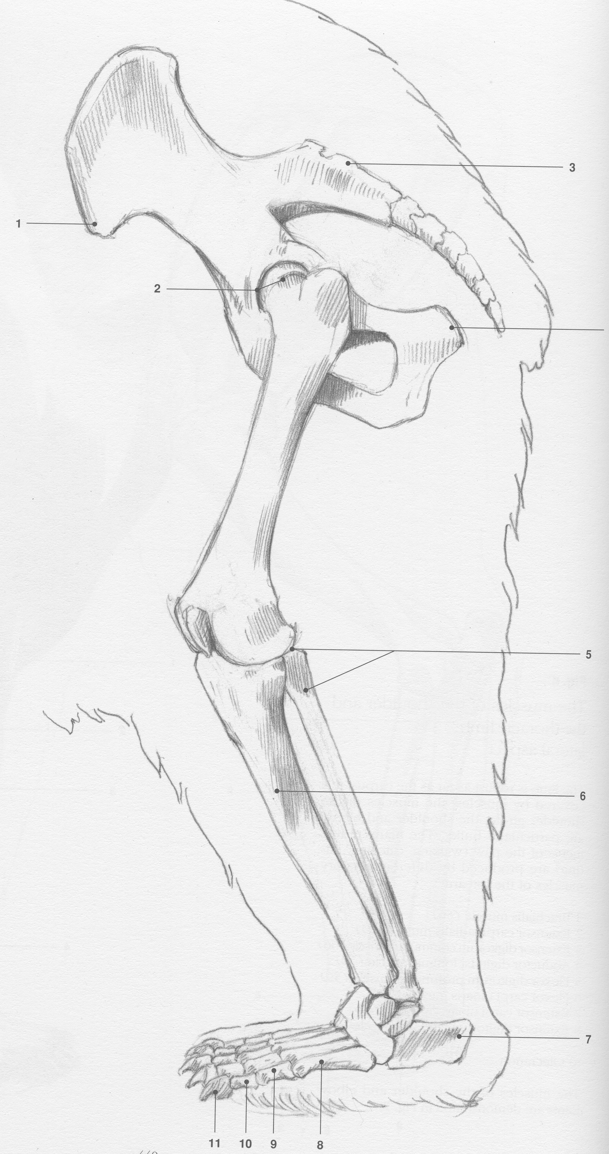

Slide 28
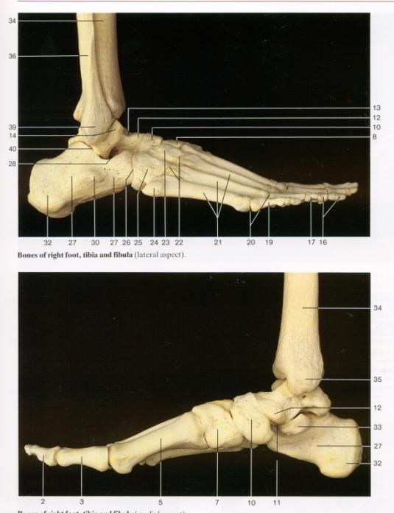

Slide 29
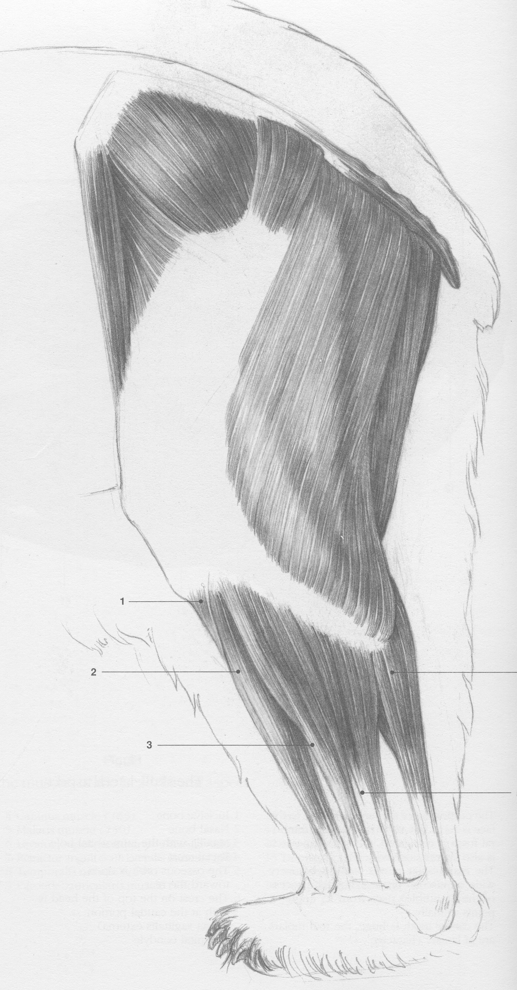

Slide 31
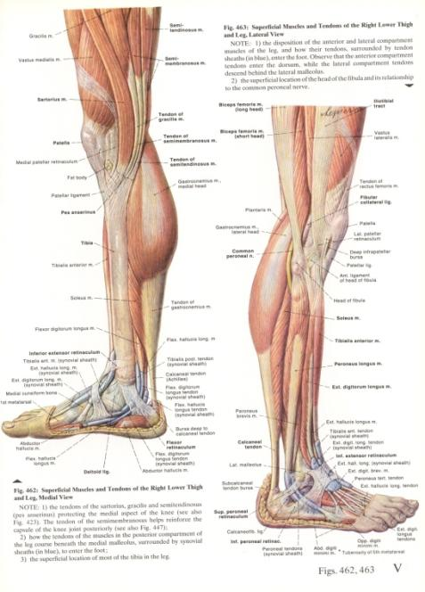

Slide 32
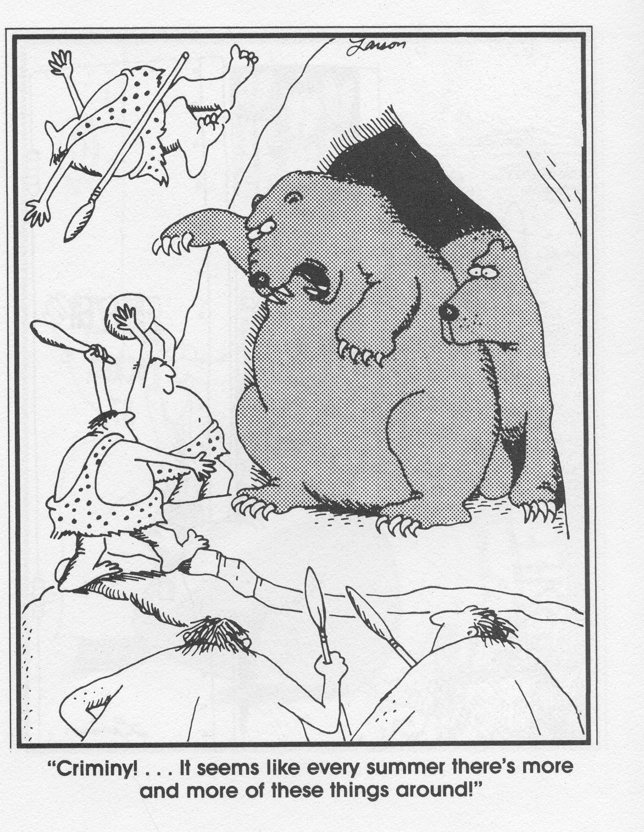
Paws and
Claws...

Slide 33
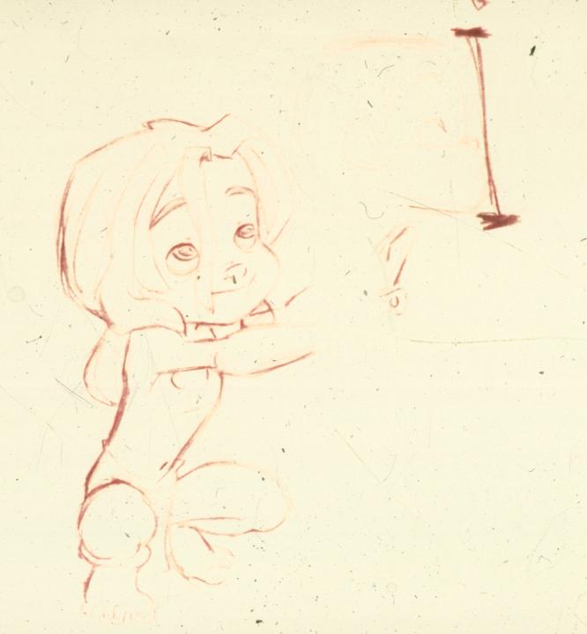

Slide 34
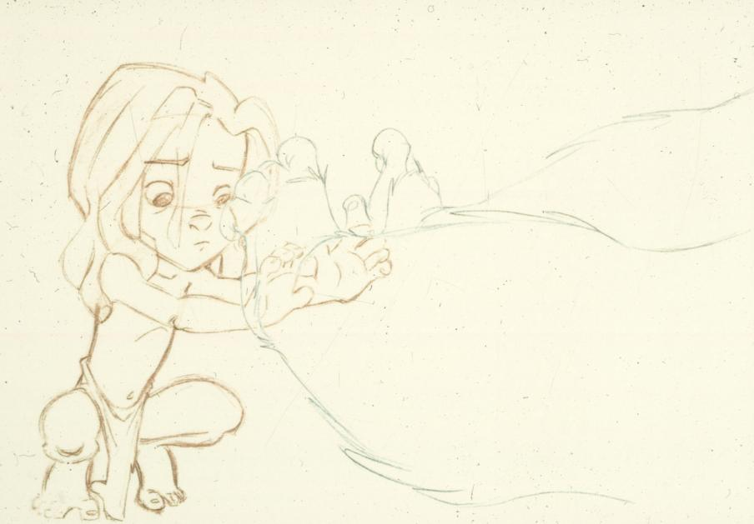

Slide 35
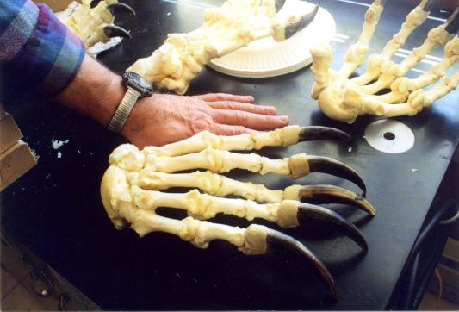

Slide 36
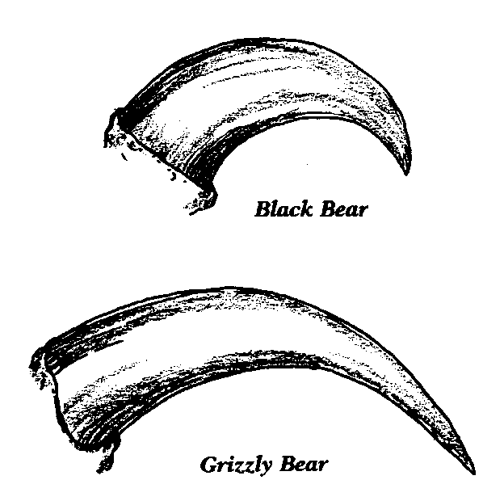
BEAR ANATOMY – PAWS AND CLAWS – 1
Grizzly Bear claws are extremely long.
Regular brown and black bear claws shorter and more hooked.
Polar Bear claws are slightly smaller and sharper.

Slide 37
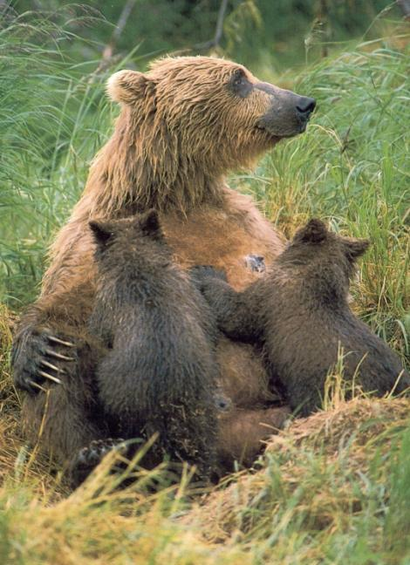

Slide 38
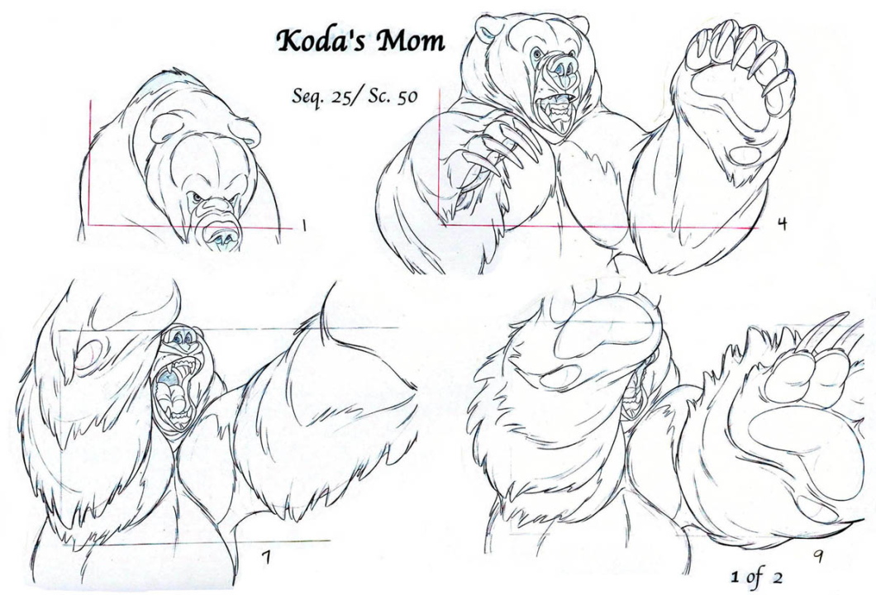

Slide 39
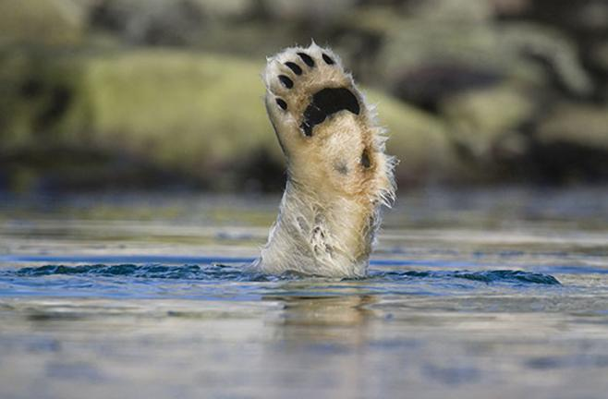
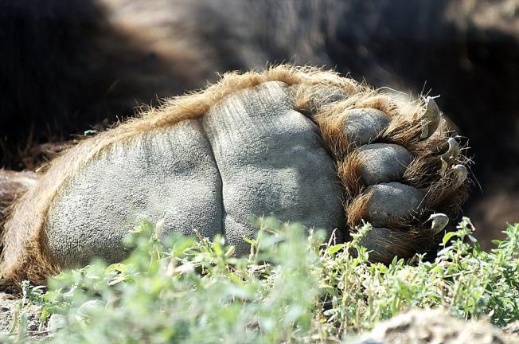
BEAR ANATOMY – PAWS AND CLAWS – 2
Note that polar bears have much less friction padding on their feet.
Due to adaptation to extreme cold, they even have fur on the underside of their feet and between toes.

Slide 40
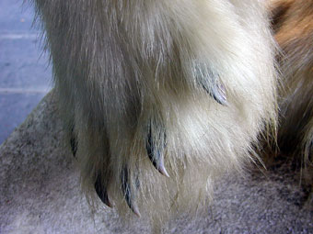
BEAR ANATOMY – PAWS AND CLAWS – 2
Note that polar bears have much less friction padding on their feet.
Due to adaptation to extreme cold, they even have fur on the underside of their feet and between toes.

Slide 41
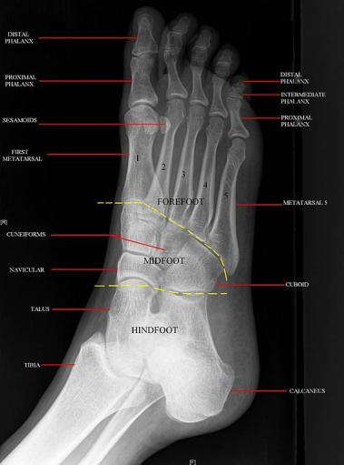
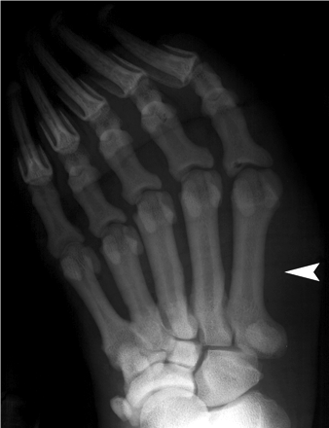
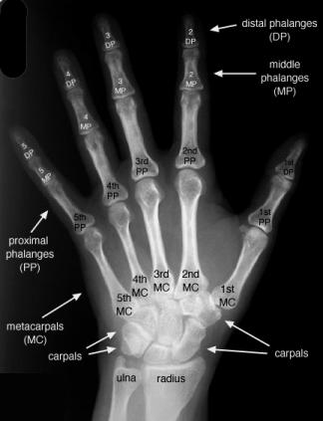
BEAR ANATOMY – PAWS AND CLAWS – 3
Due to the plantigrade strategy of locomotion of bears, their hands (forepaws) take on a morphology much like that of a foot.
Note that the fifth metacarpal is longest – more like the human foot than hand.
4
3
5
2
1

Slide 42
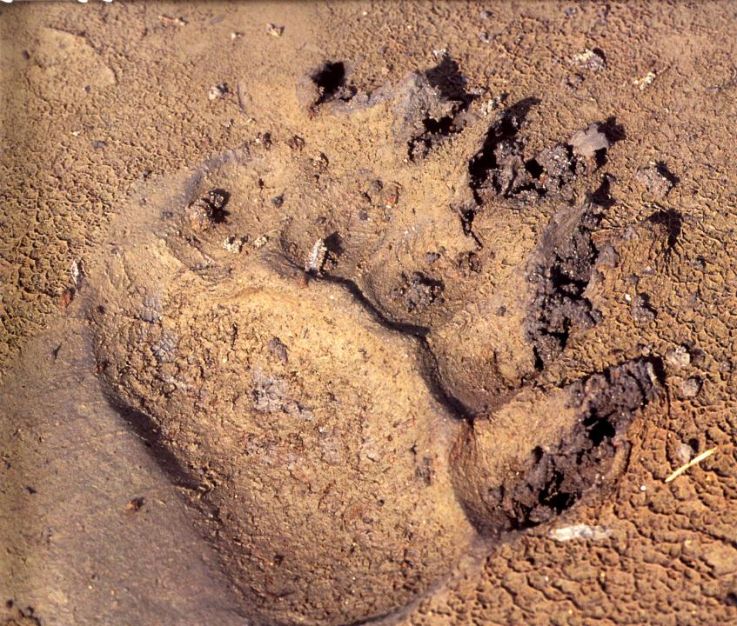

Slide 45
Skulls, Jaws, and Feeding

Slide 47
BEAR ANATOMY SKULLS – GENERAL – 1
Bears are evolutionarily a part of the Carnivora, but secondarily omnivorous. They retain the typical carnivoran jaw apparatus – note the jaw joint is directly in line with the tooth row (like a scissors).

Slide 48
BEAR ANATOMY SKULLS – GENERAL – 1
Bears are evolutionarily a part of the Carnivora, but secondarily omnivorous. They retain the typical carnivoran jaw apparatus – note the jaw joint is directly in line with the tooth row (like a scissors).

Slide 51
Ursus arctos – Grizzly Bear Ursus maritimus – Polar Bear

Slide 52
Ursus arctos – Grizzly Bear Ursus maritimus – Polar Bear

Slide 53
Ursus arctos – Grizzly Bear Ursus maritimus – Polar Bear

Slide 54
Ursus arctos – Grizzly Bear Ursus maritimus – Polar Bear

Slide 55
Ursus arctos – Grizzly Bear Ursus maritimus – Polar Bear

Slide 56
Ursus arctos – Grizzly Bear
Forehead area concave
Back teeth flatter for grinding.
Lower jaw convex
Ursus maritimus – Polar Bear
Overall skull rectilinear. Primarily due to very large nasal cavity for [re]warming air as it enters during breathing.
Back teeth narrower. Sharper.

Slide 57
Ursus arctos – Grizzly Bear
Ursus maritimus – Polar Bear
Skull – roll
Skull – pitch
Skull – yaw
Slice – coronal
Slice – horizontal
Slice - sagittal
Skull – roll
Skull – pitch
Skull – yaw
Slice – coronal
Slice – horizontal
Slice - sagittal

Slide 62
Ursus arctos

Slide 72
Postures

Slide 73
POSTURE – NORMAL
Normal posture is “pronograde” (as opposed to orthograde like humans).
Posture is not “bipedal” – this is just the number of limbs touching ground.
Bears are pronograde quradrupeds (normally).

Slide 74
POSTURE – UNUSUAL/STANDING – 1
Because of their strong leg musculature and columnar legs, standing is not unusual for bears.
NOTABLY: When human stand up from our quadrupedal condition we do so by bending our lower backs (called the lumbar curve), whereas bears do so by rotating at the hip socket-femur joint.

Slide 76
POSTURE – UNUSUAL/STANDING – 2
Because their forelimbs are attached to the side (not back) of their ribcage, bears typically hold their forelimbs hanging in front of them when they stand on their hind limbs.

Slide 78
POSTURE – UNUSUAL/STANDING – 3
Because of their thick, columnar legs, bipedal bears usually hold their legs quite straight.
If knees are bent, usually to the outside.
Other quadrupeds usually have to drop their hips quite drastically and bend their knees significantly to hold heir backbones close to erect.
Bears can lock their knees

Slide 79
POSTURE – UNUSUAL/STANDING – 4
Because bears can stand on their hind limbs readily, they can be trained to walk that way. When they do, they tend to set feet down flat, as opposed to the heel-toe strike of their normal quadrupedal locomotion or as we do when waking.

Slide 87
POSTURE – UNUSUAL/SITING – 1
Bears can assume a number of different positions when sitting.
Sitting position typical of dogs and cats.
Slightly “less dignified” position with legs abducted (splayed).
Elbows on knees

Slide 88
POSTURE – UNUSUAL/SITING – 2
Sitting position typical of dogs and cats.
Backbone is relatively straight, angled forward from hips.
Knees hyper flexed.
Forelimbs straight/columnar; usually between hind limbs in position.
Will frequently do so with one knee or other splayed to one side.

Slide 91
POSTURE – UNUSUAL/SITING – 3
Elbows on knees.
Break at elbow and wrist.
Knees hyper flexed.
Lower back (lumbar region) curved.

Slide 92
POSTURE – UNUSUAL/SITING – 4
Slightly “less dignified” position with legs abducted (splayed).

Slide 93
Locomotion...

Slide 94
BEAR LOCOMOTION – 1
WALKING
Bears employ the standard mammalian gait.
Left hind
Left front
Right hind
Right front
Repeat
4 2 1 3

Slide 95
Because of their plantigrade foot/hand position, bears have a heel-strike and toe-off much like that of a human.

Slide 96
BEAR LOCOMOTION – 2
MODERATE SPEED GAIT – TROTTING
Bears can employ either a two-beat trot or a four beat trot depending on speed and terrain.
Two-beat trot – diagonal limb couplets strike at exactly same time.
Four-beat-trot – diagonal couplets still employed, but hind foot strikes a split second before forefoot.

Slide 97
TROT
Trotting is dominated by alternating contact with the ground of [right-hind+left-front] and [left-hind+right-front].

Slide 98
2-Beat Trot

Slide 99
Two-beat trot – diagonal limb couplets strike at exactly same time.

Slide 100
Tramp demonstrates a classic 2-beat TROT
Trotting is dominated by alternating contact with the ground of [right-hind+left-front] and [left-hind+right-front].

Slide 101
Four-beat-trot – diagonal couplets still employed, but hind foot strikes a split second before forefoot.

Slide 102
TRACKING AT MODERATE SPEED
Carnivores are known to “single track”, “double track”, and “triple track”, depending on the situation.

Slide 103
Single tracking requires moderate adduction of the limbs to the midline under the animal’s body. Bears generally do not do this.

Slide 104
Double tracking occurs in medium speed trots.
All four limbs project approximately straight down to the ground, perpendicular to ground.
Bears can do this.

Slide 105
Triple tracking is done at the higher trotting speeds to that limbs don’t bump into one another.
Some animals keep one couplet central, others the other couplet.
Again, all four limbs project approximately straight down to the ground, perpendicular to ground.
Bears frequently do this.

Slide 106
BEAR LOCOMOTION – 3
HIGHER SPEED GAIT – GALLOPING
When galloping, bears generally employ a rotary gallop.
i.e. left hind, left front, right front, right hind, repeat
(or right hind, right front, left front, left hind repeat)
They are generally too large to have a significant floating phase to their locomotion.

Slide 108
4
1
2
3
Rotary Footfall Pattern

Slide 110
BEAR LOCOMOTION – 4
SWIMMING
Polar bears are excellent swimmers, though other bear species are adept at swimming as well.
Generally forelimbs are a bit more active than hindlimbs in slow swimming.
Forepaws are usually slightly in-turned (“pigeon-toed”) when swimming.
Higher speed swimming involves diagonal couplets paddling in unison.

Slide 111
Low Speed Swimming

Slide 112
Notice how manus/hand supinates during swimming.

Slide 113
Higher speed swimming

Slide 114
HUMAN AND BEAR ANATOMY COMPARED – 1
Similar features:
Columnar hind limbs
Plantigrade foot position
Basic foot anatomy
Movement at base of neck

Slide 115
HUMAN AND BEAR ANATOMY COMPARED – 2
Differing features:
Forelimb attachment to body wall
Attachment of skull relative to visual axis and backbone.
Hip orientation when bipedal.
Position of jawjoint.
Visual axis

Slide 117
Behavior

Slide 118
BEAR BEHAVIOR – 1
POSTURAL
Standing A bear standing on his hind legs is typically not expressing aggression. Bears generally stand on their hind legs to gain more information visually and through smell
Stationary Orientation A bear may stand broadside to assert itself in some instances. In encounters with humans, it has usually been interpreted as a demonstration of size.
Stationary Facing You If a bear is standing and facing you, it is certainly not being submissive. This is an aggressive position and may signal a charge. It is likely waiting for you to withdraw.

Slide 119
BEAR BEHAVIOR – 2A
VOCALIZATIONS
Huffs When a bear is tense, it may forcible exhale a series of several sharp, rasping huffs. A mother may also huff in order to gain the attention of her young. This is frequently accompanied by stomping or slapping of one or both feet on the ground. Huffing is concurrent with slap. Generally a threat behavior.
Woofing A startled bear may emit a single sharp exhale called a woof which lacks the harsh quality of a huff. If her cubs woof, a mother will become alert to the situation.

Slide 120
BEAR BEHAVIOR – 2B
VOCALIZATIONS
Popping Sounds Females with young often emit a throaty popping sound, apparently to beckon their cubs when danger is sensed. A mother vocalizing in this manner should be considered nervous and extremely stressed. Bears other than sows also jaw-pop. The movement is a snapping of the jaws and popping of the lips. Frequently a threat behavior.
Growling A clear indication of intolerance and possible aggression is coming when growls, snarls, and roars are heard.
Bellowing
A hoarse, pulsing sound resembling the starter of a balky car that won’t start. Generally a threat behavior.
Yawn Indicates tension. This behavior may result from the close proximity of another bear or human presence.

Slide 121
BEAR BEHAVIOR – 3
Non-rabid Salivation A clear sign of tension, excessive salivation may appear as white foam around the bear's mouth. Only severely distressed bears exhibit this characteristic.
Stiff-legged Walking
This is sometimes associated with urination and may be part of territory marking or declaration.
Charging
The vast majority of charges are false charges one in which the bear stops before making final contact. The intensity of the charge or associated vocalizations may vary, but it is distinct in that it is an aggressive or defensive act clearly directed at another bear or human. Bears may charge immediately, as a sow fearing for her cubs, or may emit stressed or erratic behavior before charging.

Slide 122
BEAR BEHAVIOR – 4
CURIOSITY
Bears are normally curious animals, generally holding their ears erect.
They frequently stand upright when curious, and the most frequent behavior is smelling and sniffing.
Bears will generally smell a novel object or situation first. Manipulation with forepaws follows.
Exploration of novel objects almost always involves chewing on it.

Slide 124
BEAR BEHAVIOR – 5
FACIAL EXPRESSIONS
Unlike other carnivores, bears do not have their lips attached to their gums. This means that they can make facial expressions and use their lips to suck in food, such as insects or honey.
Eyes gently closed is generally an indicator of lack of threat, calm.
Nose is very flexible, and can assume a variety of positions.
Unlike a human’s lips, which border our teeth – bear’s lips are large and extend greatly away from their teeth. Grizzly bear lips are highly dexterous, and can be used to grasp and manipulate objects

Slide 126
The key is the exposure of the canine.

Slide 128
RABIES IN BEARS
Bears rarely get rabies. The few records of rabies in bears are in polar bears.
Sequence of symptoms in rabid bears:
If infected, rabies incubation is a fairly long period – as little as five days, but much as a month.

Slide 129
Sequence of symptoms in rabid bears:
Initial symptoms include irritability and aggressive behavior – this frequently precedes stereotypical salivation.
Excessive salivation
Lethargy plus salivation. Mouth hanging open and tongue hanging. Lips flaccid.
If there is movement, head is generally carried lower, and hind legs spread farther apart than normal.
Increase in respiration frequency.
Paralysis, generally of the hind limbs – they try to pull themselves along with only forelimbs.
Convulsions.
Convulsions and seizures.
Elevated temperature, panting, continued heavy salivation.
Death.

Slide 130
Hunting

Slide 131
HUNTING OF BEARS – 1
Medieval – use of bear spear. Also used groups of dogs.
Norse – Knifing, considered a rite of passage.
Russian Far East – snaring - lasso-like rope loop is hung across a path which bears are known to frequent; its end is tied to a tree. The bear passes through the rope as it walks by and the lasso tightens around its body as it continues to move. Eventually the bear becomes so entangled within the rope that it can no longer move. After a few days, the hunter arrives to finish off the immobilized animal.
Modern – firearms and archery.

Slide 132
HUNTING OF BEARS – 2
The Bear Spear is often characterized as being shaped like a “bay leaf”.

Slide 133
HUNTING OF BEARS – 3
Bears have few if any natural predators, therefore, when threatened, they often stand upright for clearer view
This is clearly disadvantageous when being hunted by humans with weapons.

Slide 134
HUNTING OF BEARS – 4
Medieval Hunting of Bears
Generally gentleman hunters on horseback were accompanied by servants on foot with bear spears.
They were frequently accompanied by dogs; ether very robust dogs (e.g. mastiffs) or very fast dogs (e.g.greyhounds).

Slide 137
HUNTING OF BEARS – 5
Modern: Archery and Firearms

Slide 139
Bears Hunting Behavior

Slide 140
BEAR HUNTING BEHAVIOR – BROWN/GRIZZLY
Omnivores that can derive as much as 85-90% of food energy from vegetable matter.
However, will gorge when meat/fish are available.
Will occasionally prey on large mammals, but will preferentially attack smaller and weaker individuals.
When hunting, bear frequently pins prey to ground and tears or eats prey alive.
Rarely kill by hitting with powerful forearm mass to stun prey or break the neck.
Will feed on carrion.
Frequently steal food from smaller predators such as wolves or others.

Slide 146
BEAR HUNTING BEHAVIOR – POLAR
Polar bears’ main prey and favorite food is the ringed seal. Polar bears usually catch ringed seals when seals surface to breathe at openings (leads) in the ice or at breathing holes called aglus
.
They will also stalk seals, mostly after determining their sleep/wake cycles.
They will feed on carrion, particularly that of walruses and whales that get trapped in small openings in pack ice.
ICE IS CRITICAL FOR ACCESS TO PREY.

Slide 148
Polar bears’ main prey and favorite food is the ringed seal.

Slide 149
They will feed on carrion.

