Slide 1
Biology 323
Human Anatomy for Biology Majors
Lecture 10
Dr. Stuart S. Sumida
Heart: Structure, Function, Development

Slide 2
The first blood vessels of the embryo form inside the embryonic disc even before somites appear. They form near the edge of the yolksac (a primitive condition inherited from macrolecithal organisms that stored yolk for food).

Slide 3
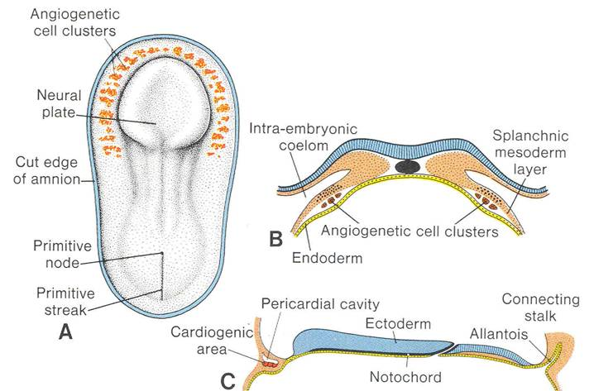
Angiogenetic cell clusters extend in an arc around the head end of the ventral opening of the yolk sac. Initially, this means that the angiogenetic cell clusters (and the blood vessel that forms from them) have the pattern of a "horseshoe" if viewed from a dorsal or ventral perspective.

Slide 4
An important point to understand is that the coelom runs up and down either side of the body.
At the head end, right underneath the developing pharynx, the coelom on the left communicates with the coelom on the right.
Thus, the coelom cuts across the midline here.

Slide 5
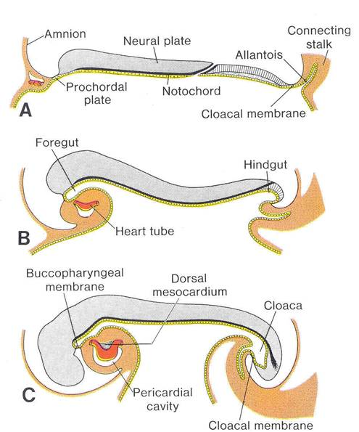
The brain grows at an incredible rate. It grows so fast that it makes the head bend around under the embryo's body.
This is why the heart winds up on the VENTRAL SIDE of the body.

Slide 6
The part of the heart ventral to the gut tube is a single tube itself.
The tube exiting the heart at its cranial end is the ventral aorta.
However, the heart cannot remain a simple tube (like a fish), so it must be subdivided into a right and left side.
A septum subdivides the heart into a left and right side.

Slide 7
The tube exiting the heart at its cranial end is the ventral aorta.
It also subdivides:
The right side connects with the lungs.
The left side supplies the body.
(More later…)

Slide 8
Anatomy of the Postnatal Heart

Slide 9
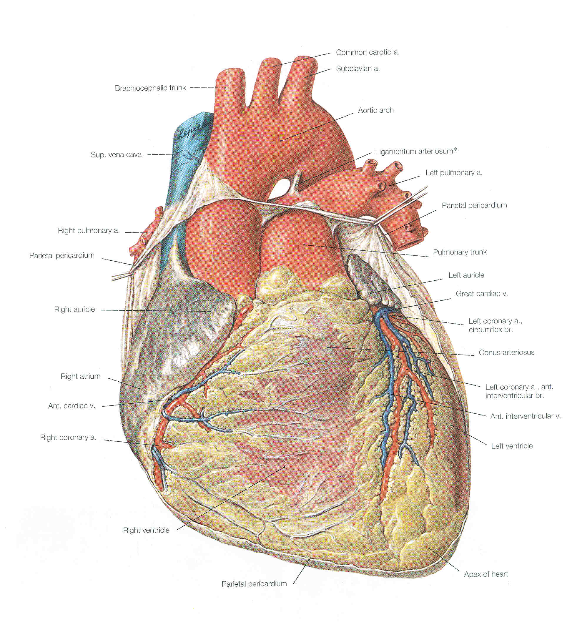
Heart in VENTRAL view.
(You see mostly right ventricle!)

Slide 10
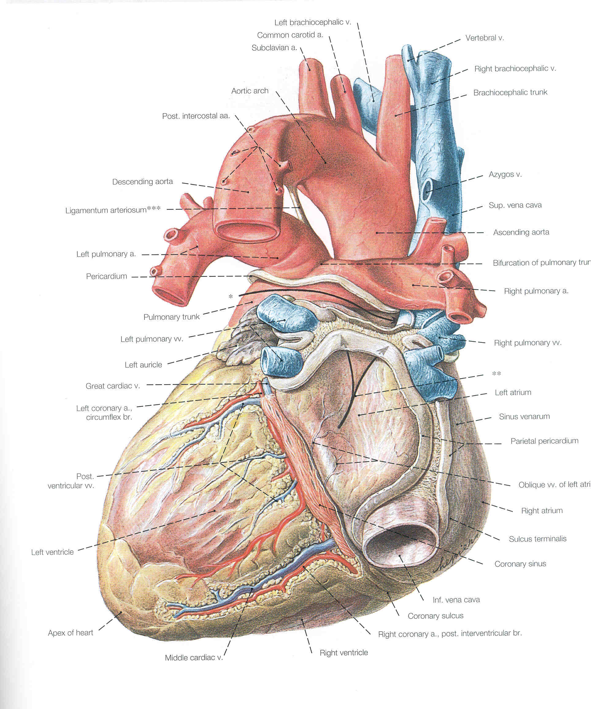
Heart in DORSAL view.
(You see mostly left ventricle.)

Slide 11
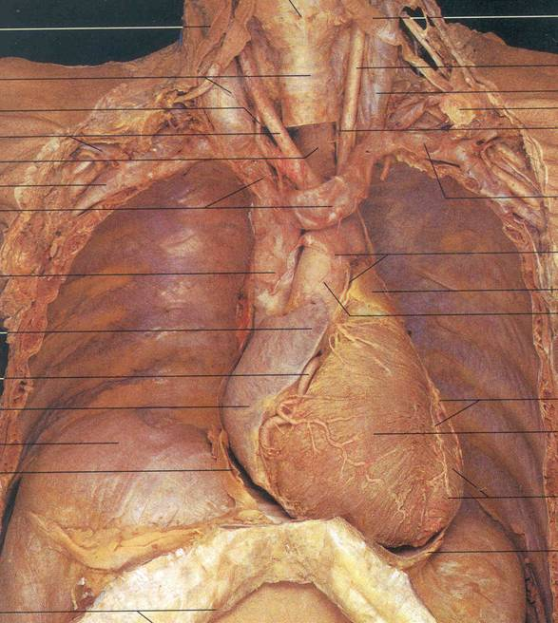
HEART
The real thing in ventral view.
Lungs have been removed.

Slide 12
Gross Anatomy of Heart
Right Atrium: Receives deoxygenated blood from body.
Left Atrium: Receives oxygenated blood from lungs.
Right Ventricle: Receives deoxygenated blood from right atrium and sends it to lungs.
Left Ventricle: Receives oxygenated blood from left atrium and sends it to body.

Slide 13
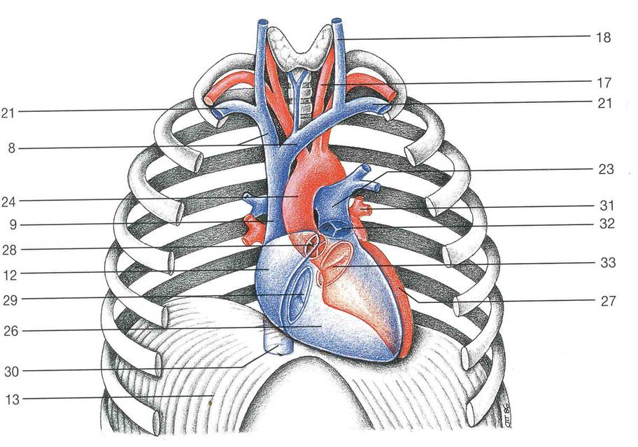

Slide 14
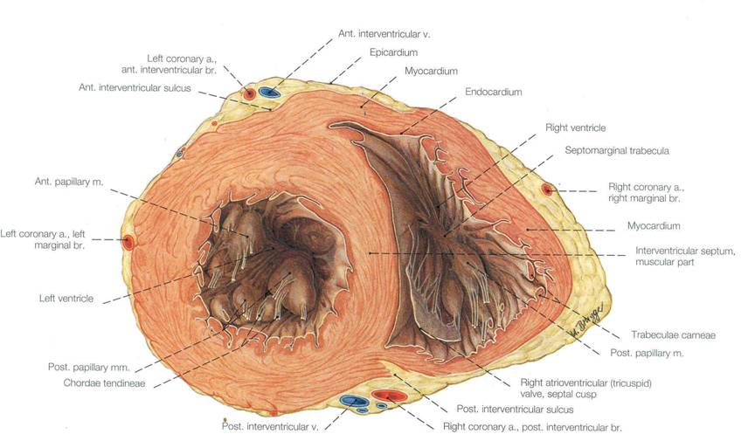
Walls of the ventricles:
Left wall is thicker!

Slide 15
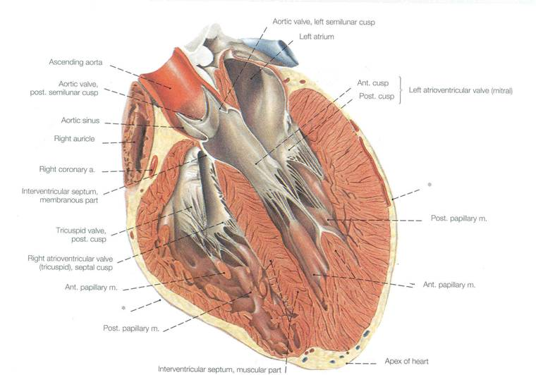
Bicuspid
valve
Chordae
Tendonae
Trabeculae carnae Papillary muscles

Slide 16
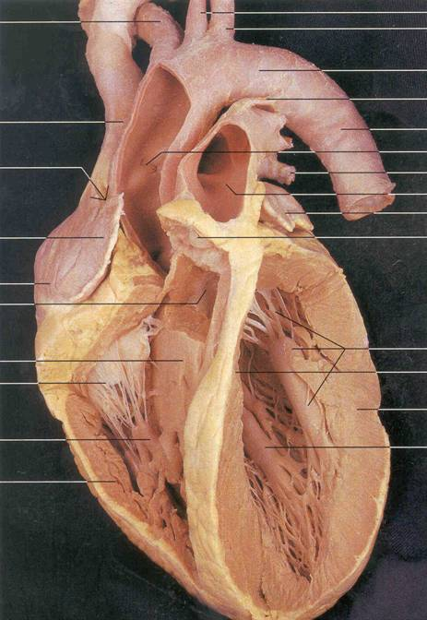
Find:
1. Walls of the ventricles
2. Auricles
3. Inner walls of the atria
4. Fossa ovalis
5. Trabeculae carnae
6. Atrioventricular valve
(a) "Bicuspid valve"
(b) "Tricuspid valve"
7. Chordae tendonae
8. Papillary muscles
9. Aortic & pulmonary valves

Slide 17
Blood Supply of the Heart Wall
1. Coronary arteries
(a) Left coronary artery
(b) Right coronary artery
(c) Interventricular branches
(d) Right marginal branch
2. Cardiac veins

Slide 18
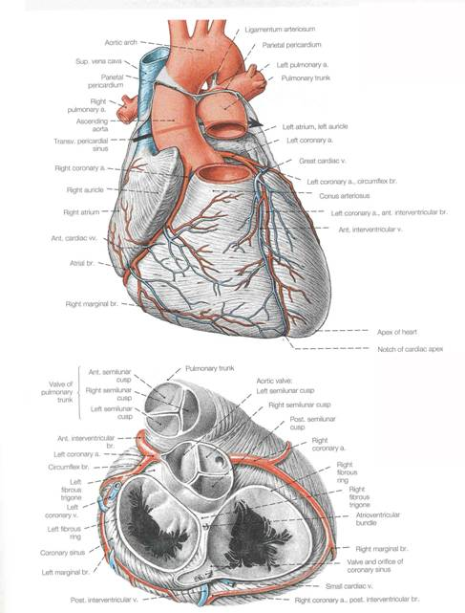
Coronary arteries are the FIRST branches of the aorta!
1. Coronary arteries
(a) Left coronary artery
(b) Right coronary artery
(c) Interventricular branches
(d) Right marginal branch
2. Cardiac veins

Slide 19
Function of the Heart & Control of Heartbeat
1. Contracts spontaneously; does not need nervous stimulation to contract.
2. Motor nerves that supply the human heart = modulate heart rate.
3. Sympathetic motor impulses speed up heart rate & parasympathetic motor impulses slow it down.
SYMPATHETIC: UPPER THORACIC SEGMENTS (T3-T4) GO UP TO THE NECK, AND COME BACK DOWN TO THE HEART. Why would it do this?!?
PARASYMPATHETIC: VAGUS NERVE (X)

Slide 20
Intrinsic regulation of heart beat
System made up of cells called Purkinje fibers (insulated from surrounding cells of heart.
Sinoatrial node is PACEMAKER OF HEART, and beginning of process. Geenrates periodic impulses that initiate contraction of right atrium.
Signal then runs to Atrioventricular node. Message is passed along a track of Purkinje fibers called the...
Atrioventricular bundle. Atrioventricular bundle then splits into right and left limbs/branches that pass to individual inner ventricular walls on right and left.

Slide 21
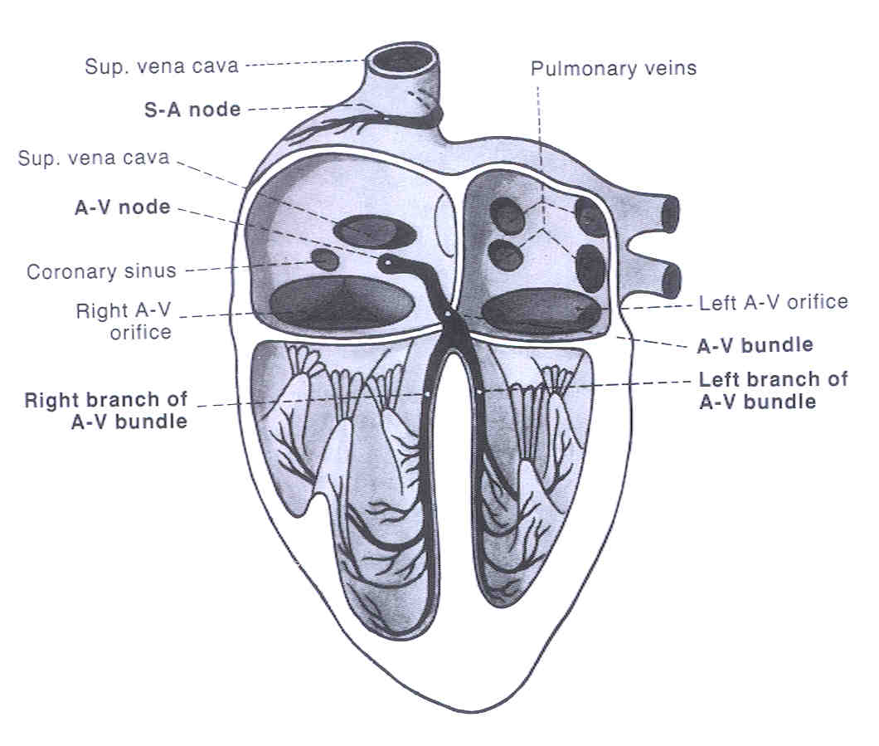
Intrinsic regulation of heart beat
Sinoatrial node is PACEMAKER OF HEART, and beginning of process. Geenrates periodic impulses that initiate contraction of right atrium.
Signal then runs to Atrioventricular node. Message is passed along a track of Purkinje fibers called the...
Atrioventricular bundle. Atrioventricular bundle then splits into right and left limbs/branches that pass to individual inner ventricular walls on right and left.
1
2
3 A-V bundle path shown with blue arrows

Slide 22
Intrinsic regulation of heart beat
Sinoatrial node is PACEMAKER OF HEART, and beginning of process. Geenrates periodic impulses that initiate contraction of right atrium.
Signal then runs to Atrioventricular node. Message is passed along a track of Purkinje fibers called the...
Atrioventricular bundle. Atrioventricular bundle then splits into right and left limbs/branches that pass to individual inner ventricular walls on right and left.
1
2
3 A-V bundle path shown with blue arrows

Slide 23
Intrinsic regulation of heart beat
Sinoatrial node is PACEMAKER OF HEART, and beginning of process. Geenrates periodic impulses that initiate contraction of right atrium.
Signal then runs to Atrioventricular node. Message is passed along a track of Purkinje fibers called the...
Atrioventricular bundle. Atrioventricular bundle then splits into right and left limbs/branches that pass to individual inner ventricular walls on right and left.
1
2
3 A-V bundle path shown with blue arrows

Slide 24
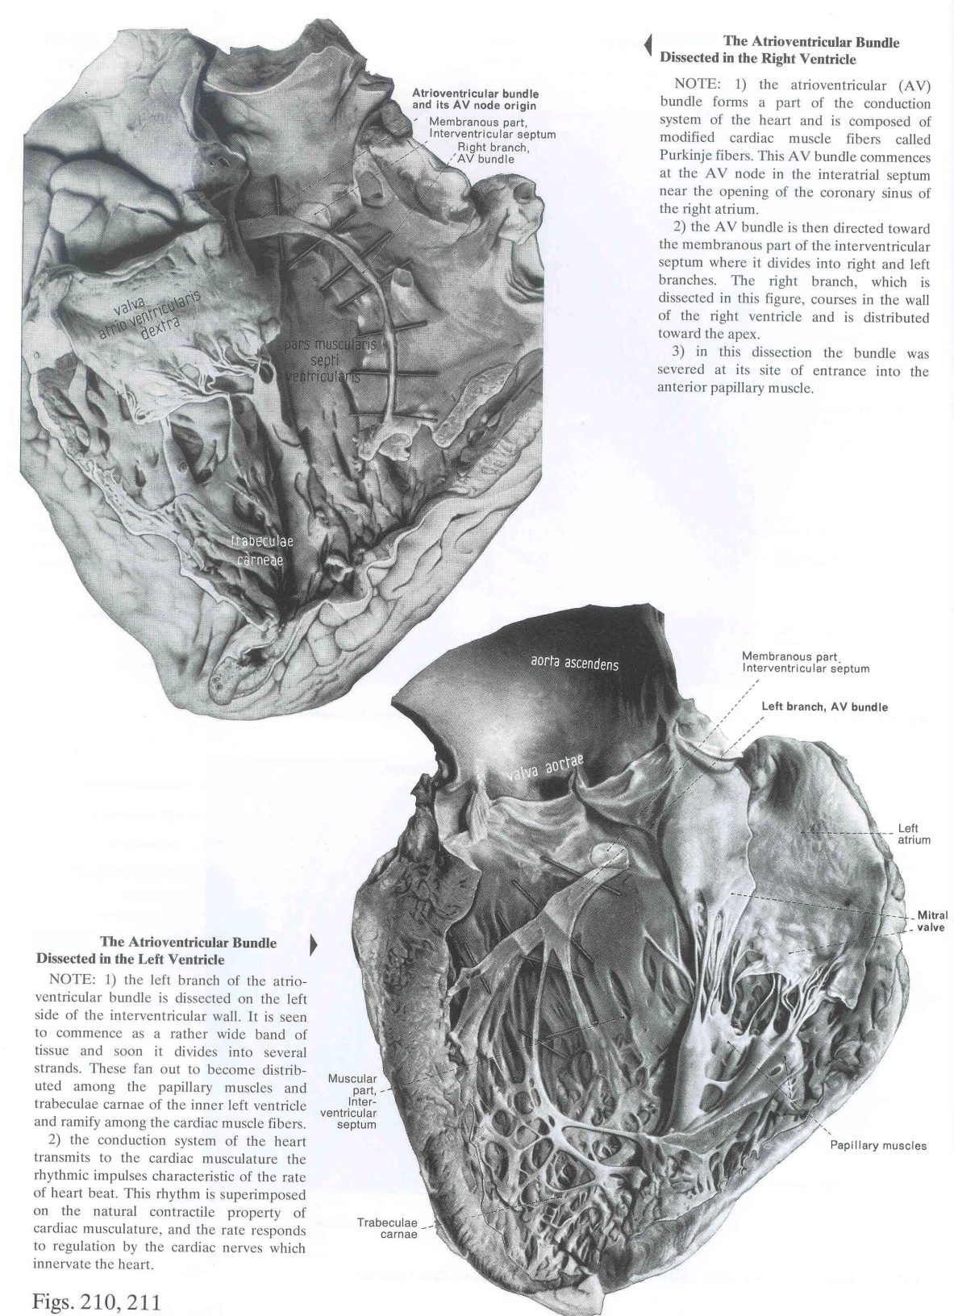

Slide 25
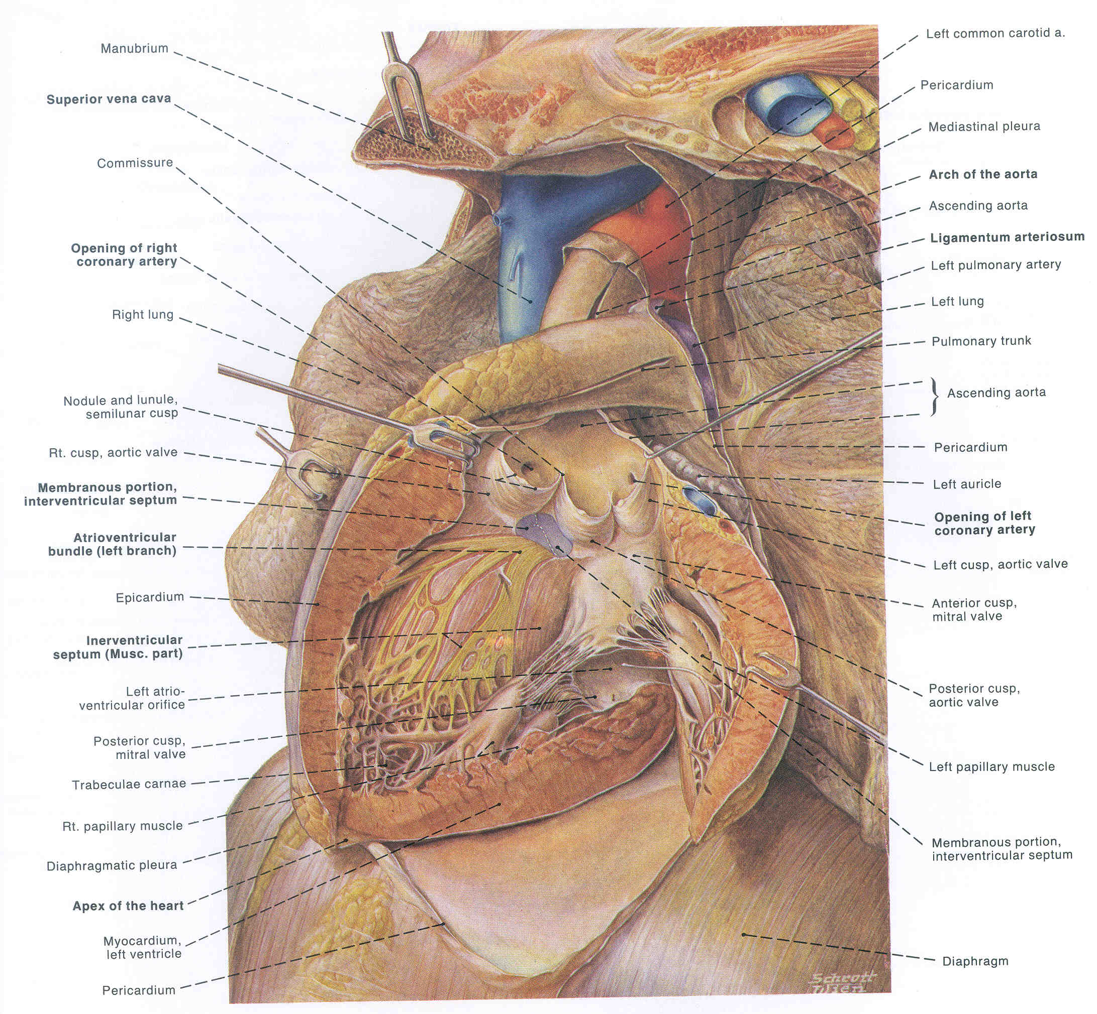

Slide 26
The Great Vessels of the thorax are a logical extension of the heart
Embryonic Origin of Great Vessels: They are derivatives of the aortic arches.

Slide 27
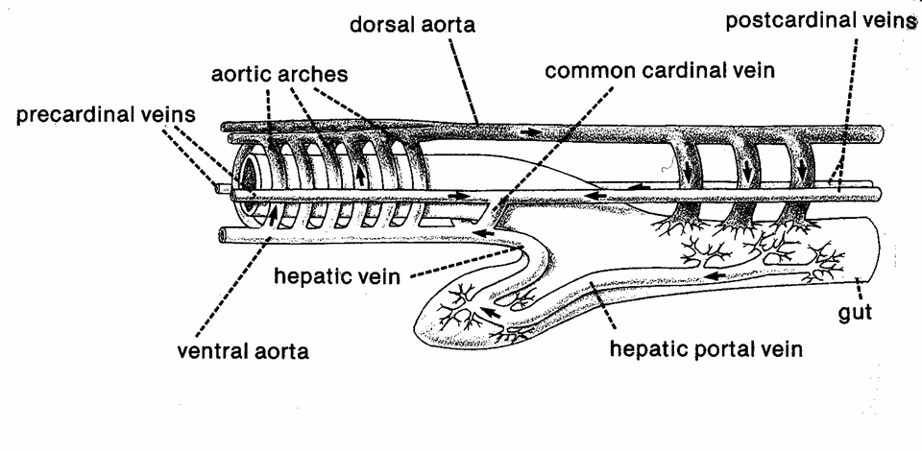

Slide 28
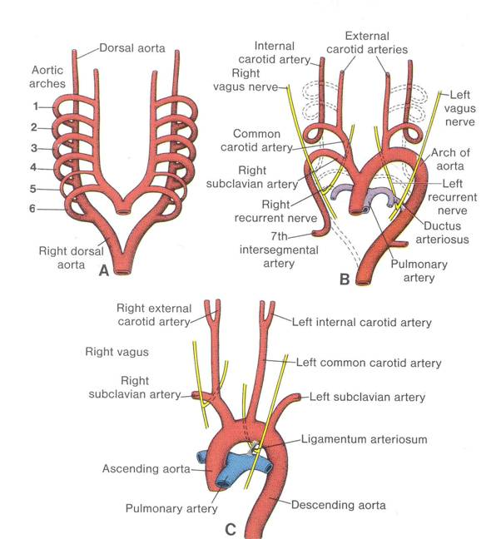

Slide 29
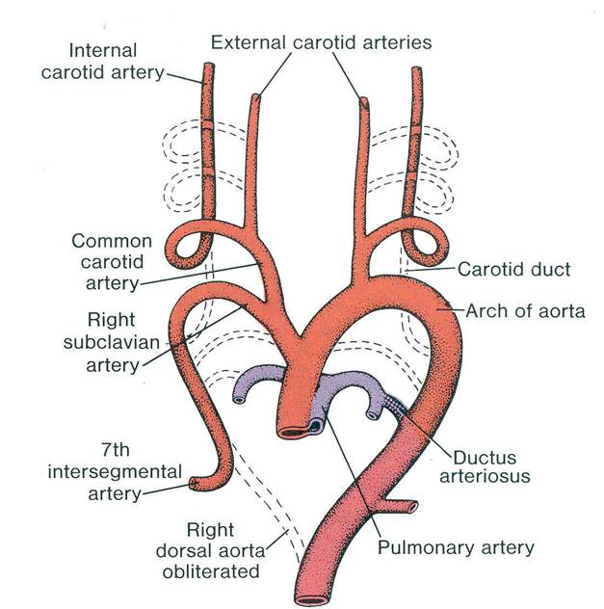
This is in your lab manual!

Slide 30
Aortic Arch Summary:
Arch I: Mostly disappears ( a small part becomes a bit of the maxillary artery).

Slide 31
Aortic Arch Summary:
Arch II: DISAPPEARS

Slide 32
Aortic Arch Summary:
Arch III: CAROTID ARCH – becomes part of carotid arteries.

Slide 33
Aortic Arch Summary:
Arch IV: AORTIC ARCH -- Right side disappears. Left side becomes ARCH OF AORTA.

Slide 34
Aortic Arch Summary:
Arch v: DISAPPEARS

Slide 35
Aortic Arch Summary:
Arch VI: PULMONARY ARCH – Becomes pulmonary artery to lungs.

Slide 36
Great Veins of the Thorax
1. Venous blood dumps in the right atrium of the heart.
(a) Blood from the cranial region enters via superior vena cava
(b) Body blood enters via inferior vena cava
2. Inferior vena cava - passes through the diaphragm after receiving blood from the abdominal gut.
3. Superior vena cave & its 3 tributaries:
(a) Azygous vein
(b) Right brachiocephalic vein
(c) Left brachiocephalic vein

Slide 37
H
The embryological Cardinal Veins look like a big letter “H”.
Head
Right anterior cardinal Left anterior cardinal
Right common cardinal Sinus left common cardinal
venosus
Right posterior cardinal Left posterior cardinal
(ventral view)

Slide 38
H
The embryological Cardinal Veins look like a big letter “H”.
Head
Right anterior cardinal Left anterior cardinal
Right common cardinal Sinus left common cardinal
venosus
Right posterior cardinal Left anterior cardinal
(ventral view)
new
Becomes superior vena cava.
Becomes azygous vein
(last tributary of SVC).
Becomes left brachiocephalic vein.
Becomes hemiazygous vein.
Left posterior cardinal
Becomes part of wall of right atrium.

Slide 39
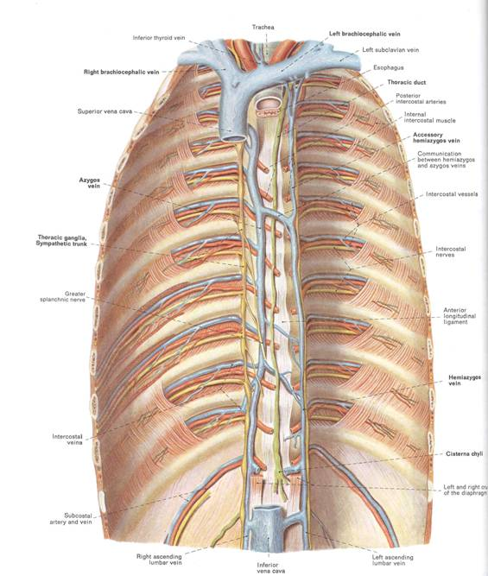
Superior
Vena Cava
Azygous
Vein
Hemiazygous
Vein

Slide 40
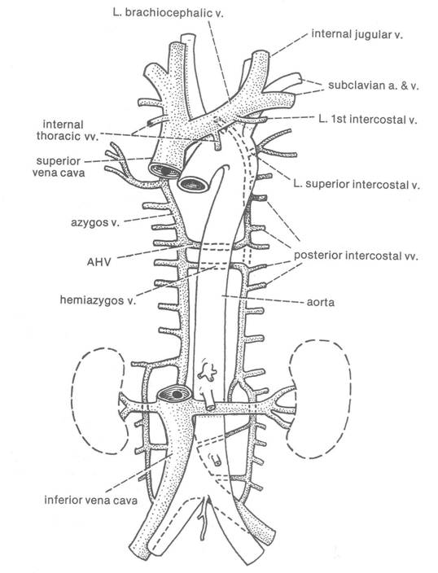

Slide 41
Great Veins of the Thorax
1. Venous blood dumps in the right atrium of the heart.
(a) Blood from the cranial region enters via superior vena cava
(b) Body blood enters via inferior vena cava
2. Inferior vena cava - passes through the diaphragm after receiving blood from the abdominal gut.
3. Superior vena cave & its 3 tributaries:
(a) Azygous vein
(b) Right brachiocephalic vein
(c) Left brachiocephalic vein

