Slide 1
Biology 323
Human Anatomy for Biology Majors
Lecture 11
Dr. Stuart S. Sumida
Peripheral Circulation

Slide 2
Structures of the Splanchnopleure: receive unpaired vessels of the abdominal aorta.
Structures of the Somatopleure: receive PAIRED vessels of the abdominal aorta.

Slide 3
Structures of the Splanchnopleure: receive unpaired vessels of the abdominal aorta.

Slide 4
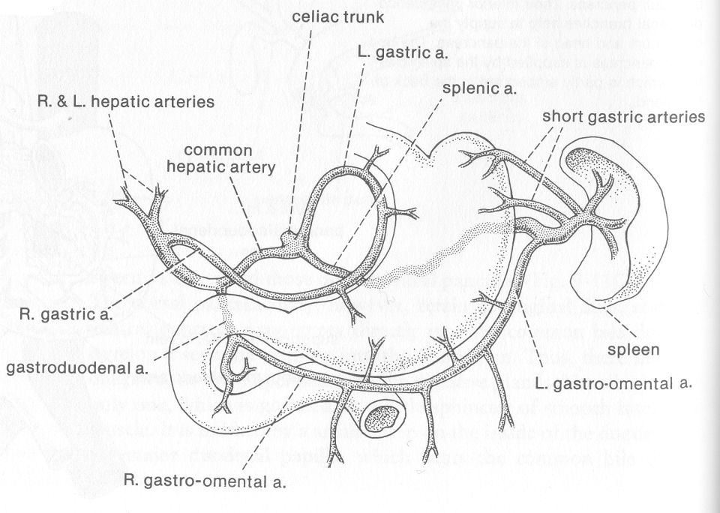

Slide 5
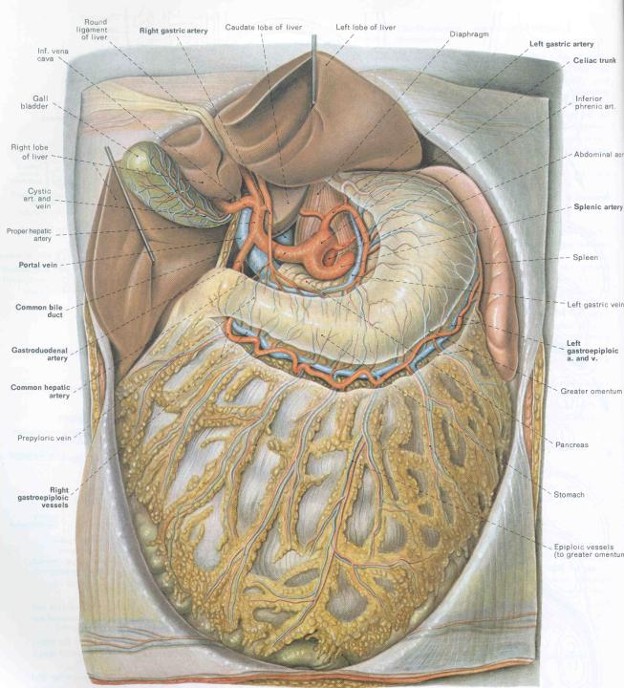

Slide 6
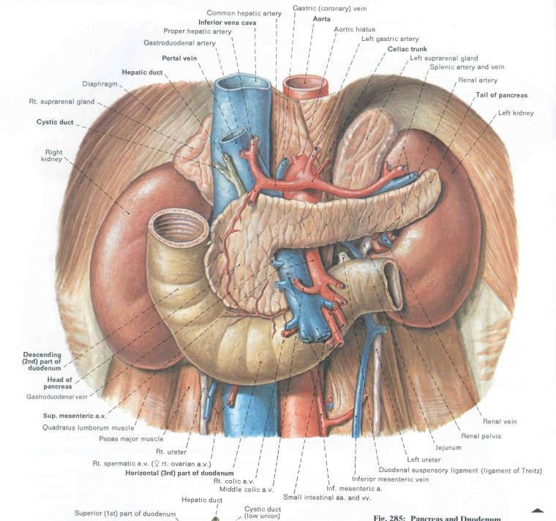

Slide 7
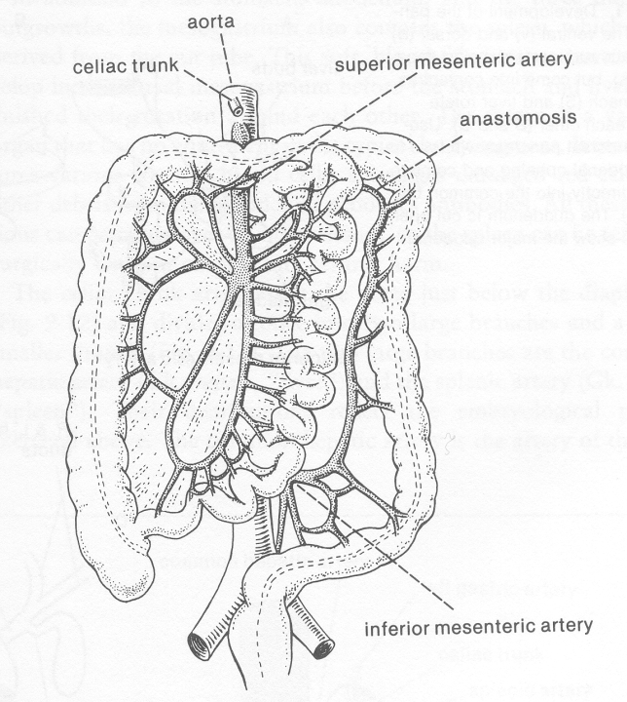

Slide 8
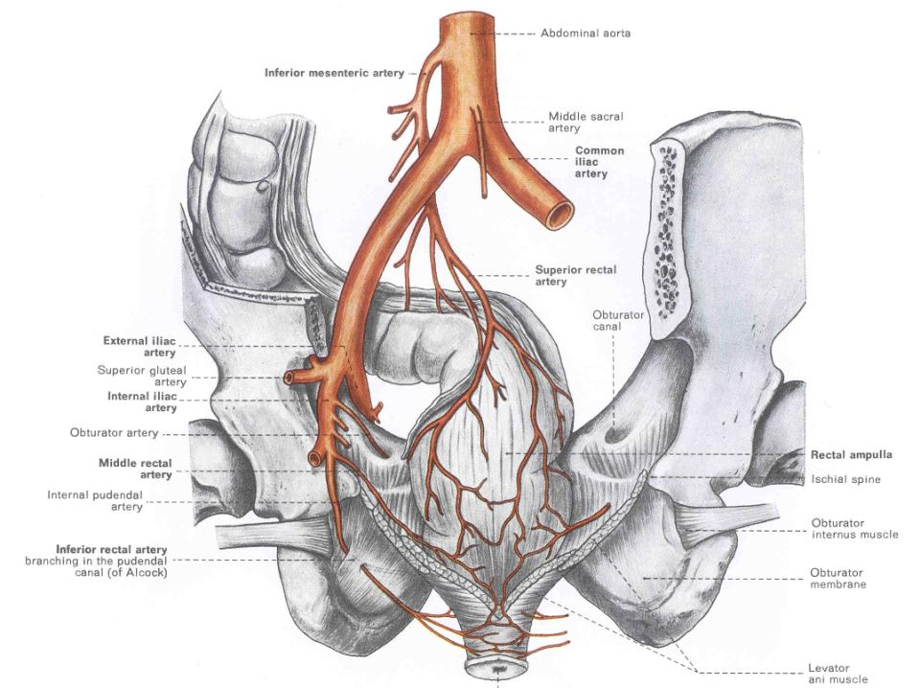

Slide 9
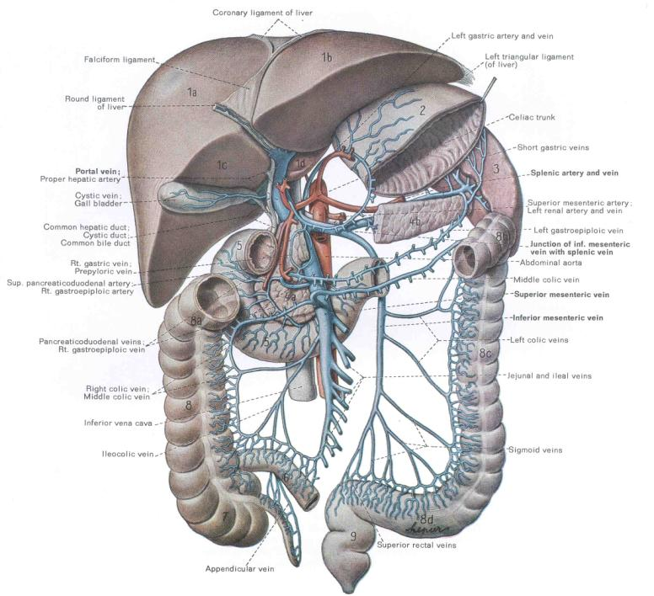

Slide 10
Structures of the Somatopleure: receive paired vessels of the aorta.

Slide 11
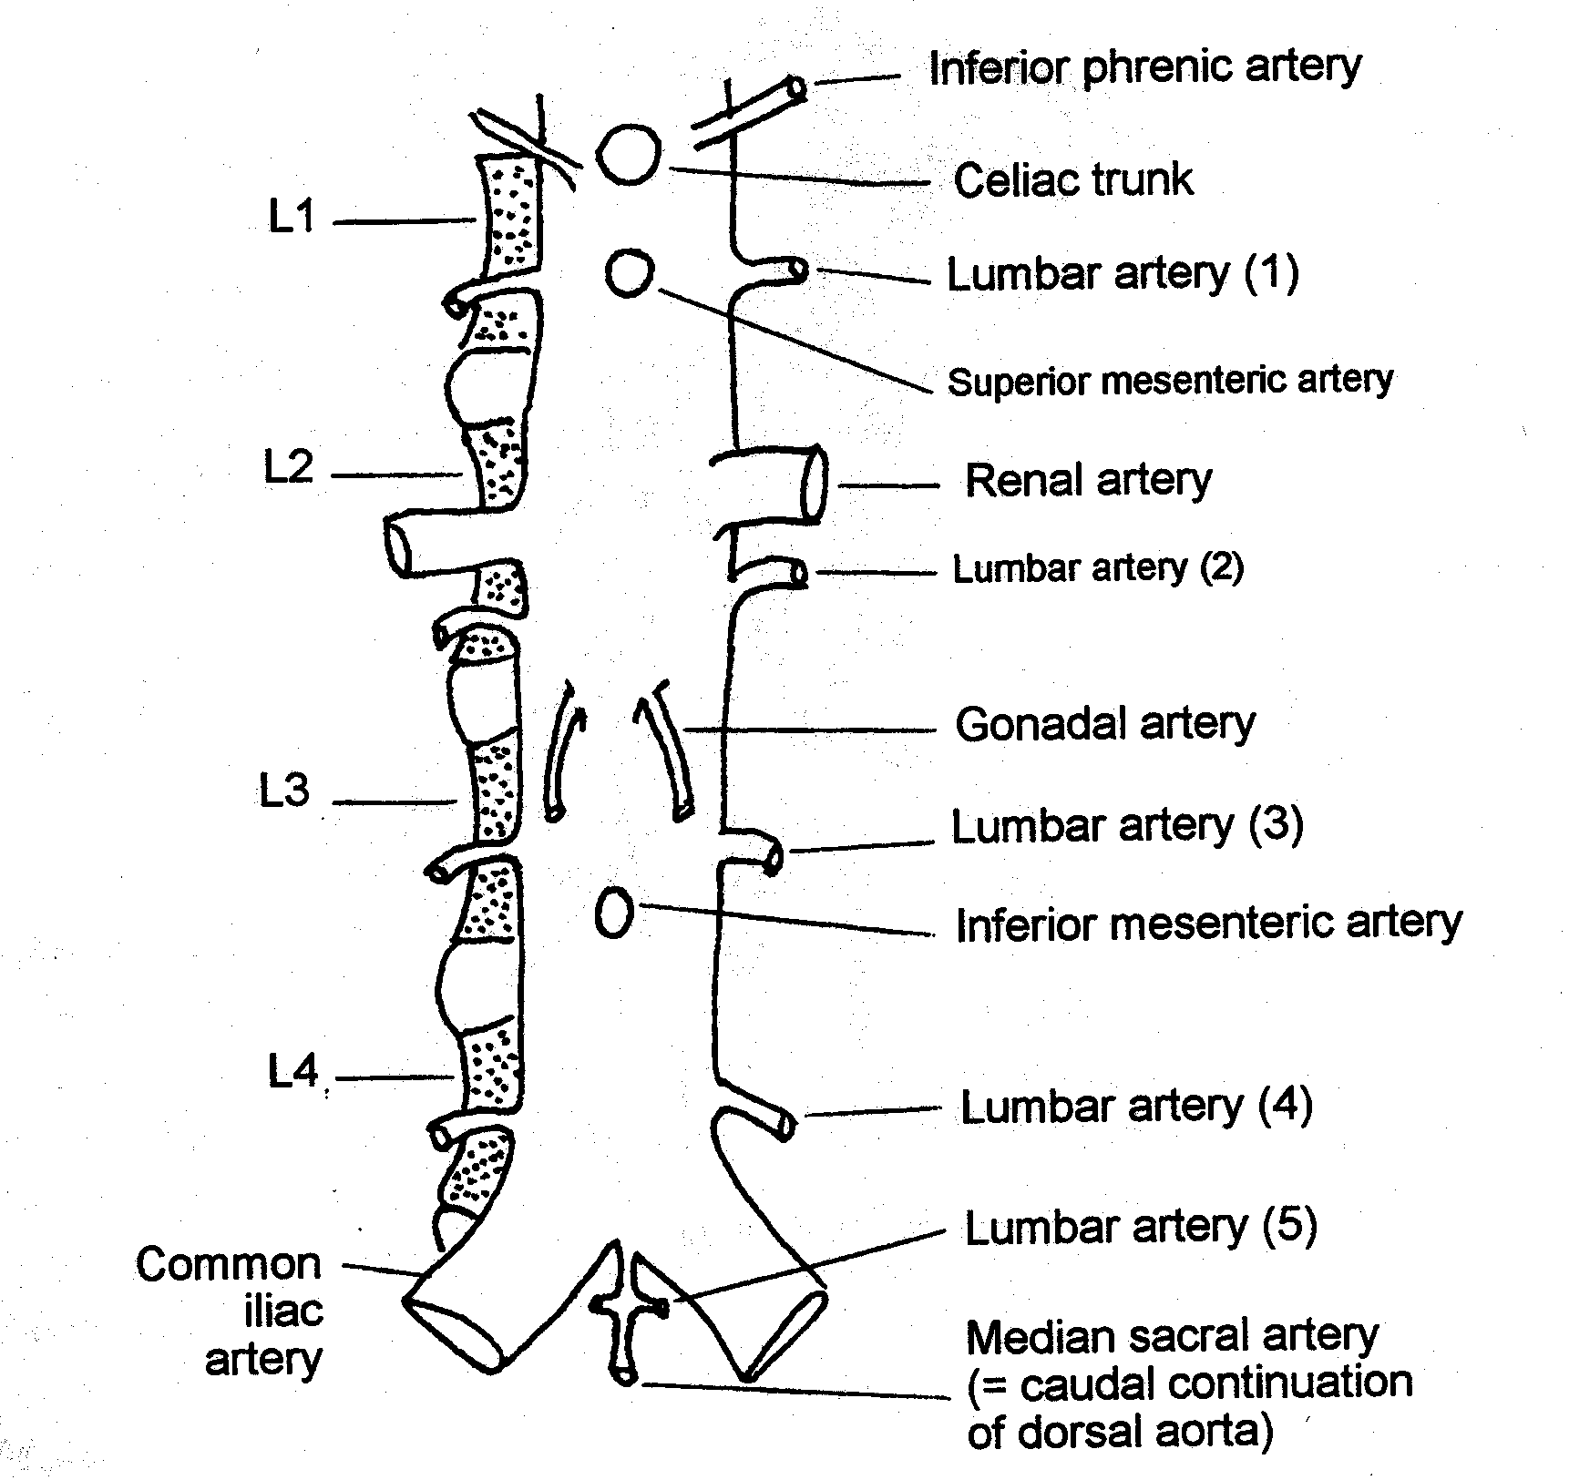

Slide 12
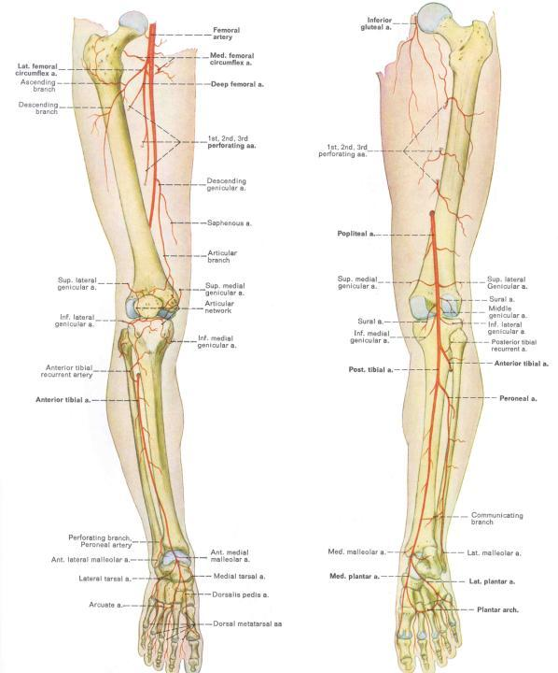

Slide 13
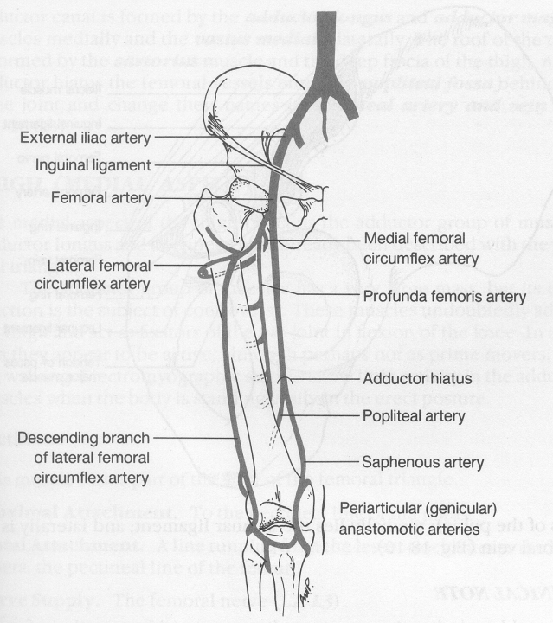
Major Arteries of Leg:
External Iliac Artery
↓
Femoral Artery
Profunda femoris
Medial femoral circumflex
Lateral femoral circumflex
Popliteal and
Saphenous AA.
Descending branch
lateral femoral
circumflex

Slide 14
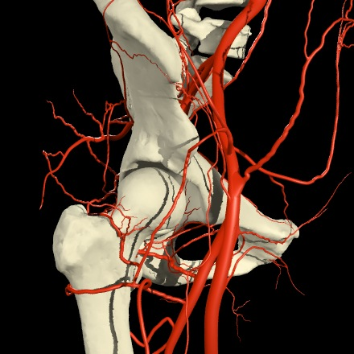
Arteries & nerves of gluteal region
Trochanteric Anastomosis
anastomotic ring of arteries found in the trochanteric fossa and around the neck of the femur.
Formed by the union of branches from:
1) medial circumflex femoral artery.
2) ascending branch of the lateral circumflex femoral artery.
3) inferior gluteal artery.
4) superior gluteal artery.
4
3
2
1

Slide 15
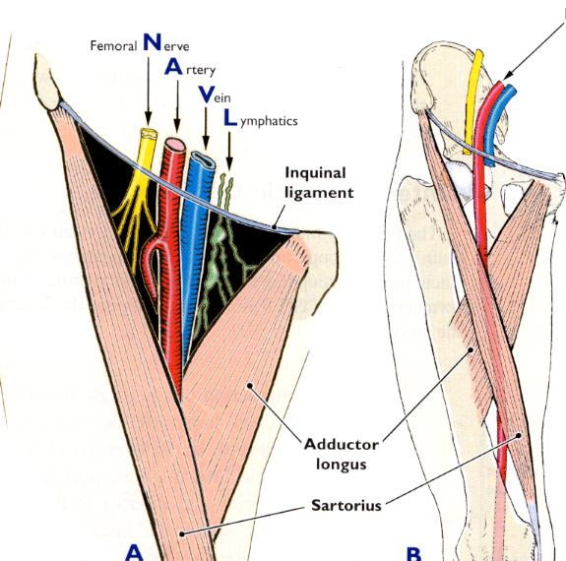
Femoral triangle / RELATIONS
Deep contents
Femoral a. & v. surrounded by femoral sheath
Profunda femoris a. – principal artery of thigh
Lat and med. femoral circumflex aa.
Deep external pudendal a.
Femoral n.
A few deeper lymph nodes --
Anterior view

Slide 16
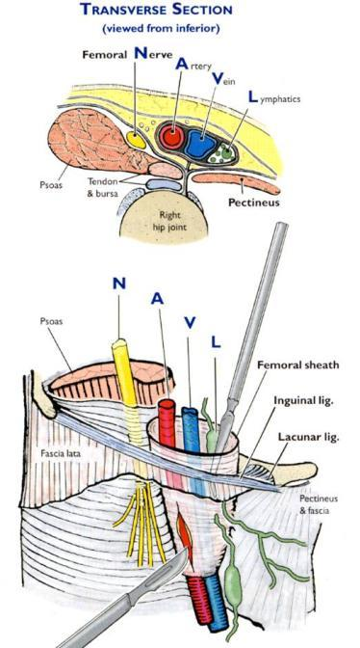
Femoral triangle / RELATIONS
Anterior view

Slide 17
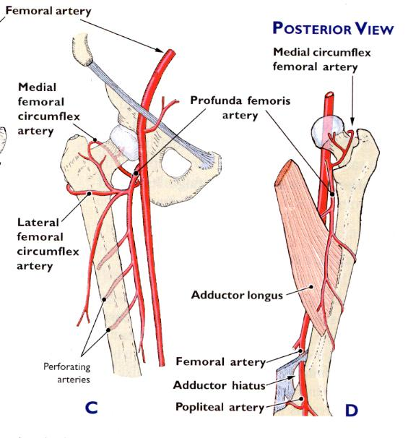
Femoral triangle / PRINCIPAL VASCULATURE OF THIGH

Slide 18
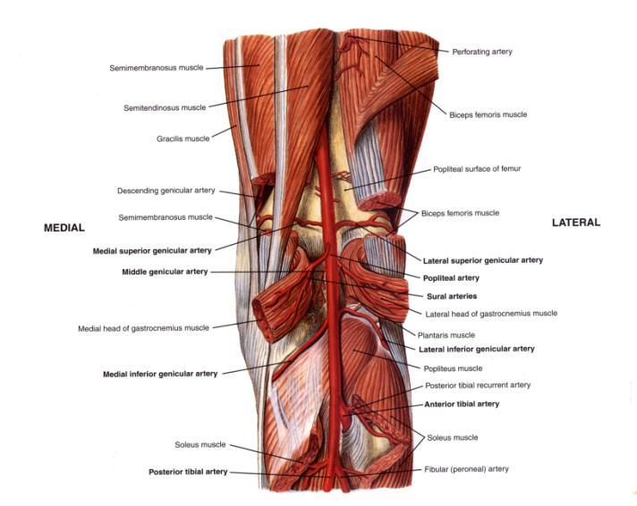
Region of Popliteal Fossa
Femoral
Popliteal
Posterior Anterior
Tibial A. Tibial A.
Peroneal A.
Anastomosing branches of Popliteal Artery:
Medial and lateral superior geniculate aa.
Medial and lateral sural aa.
Medial and lateral inferior geniculate aa.

Slide 19
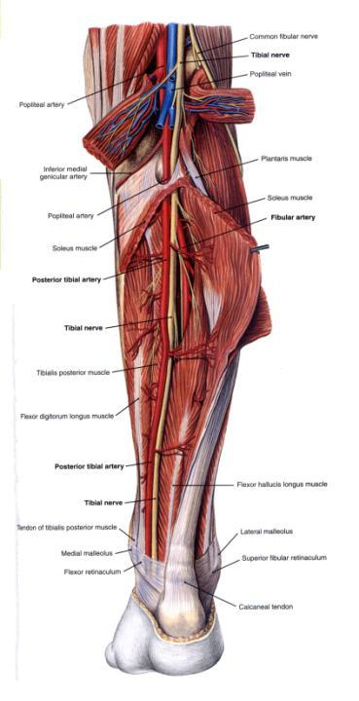
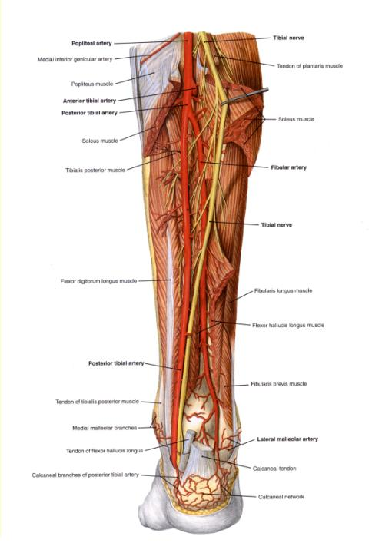

Slide 20
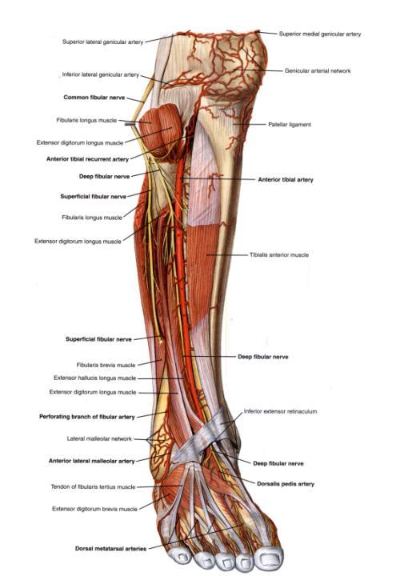
Tibialis Anterior Artery running in anterior compartment next to tibialis anterior muscle.

Slide 21
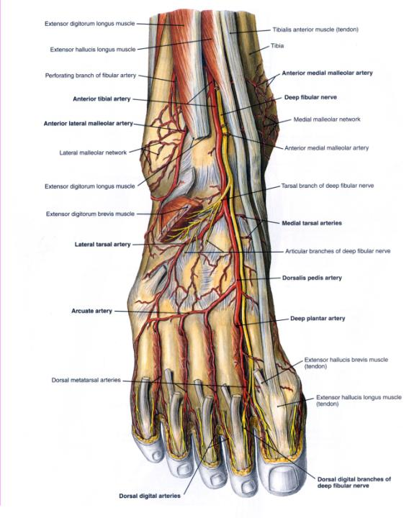
Anterior Tibial Artery
Dorsalis pedis artery
Deep plantar artery

Slide 22
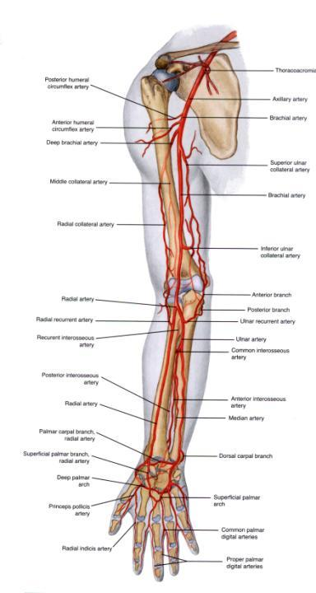
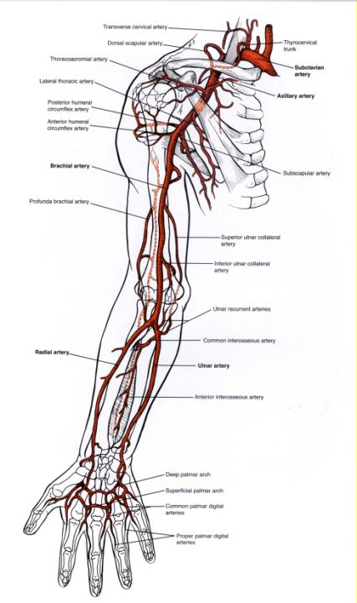

Slide 23
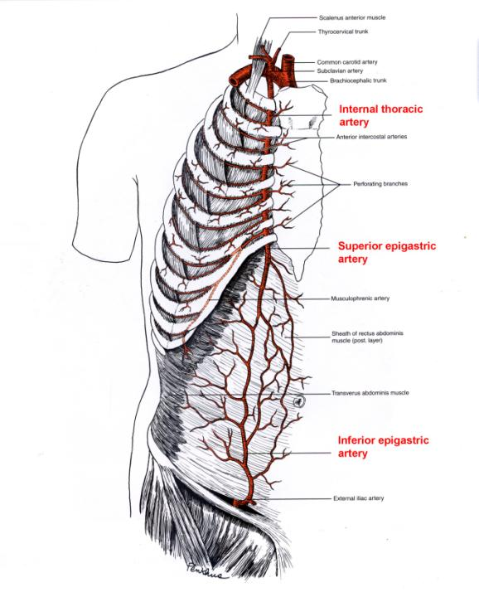
Anastomosis of Internal Thoracic Artery with External Iliac Artery

Slide 24
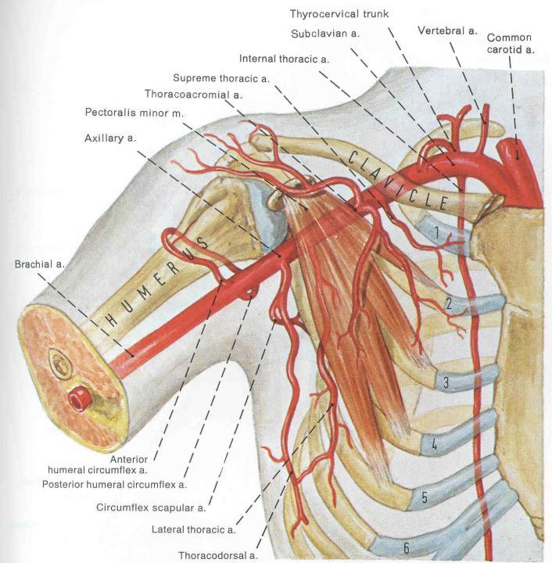
Sublcavian AA.
pass into each arm, becomin Axillary A. past clavicle.
Subclavian
Branches:
Vertebral A.
Internal Thoracic A.
Thyrocervical trunk

Slide 25
What is the Axilla?
A region (the axillary space) associated with the armpit.
It actually begins around the cervicoaxillary canal, at the edge of the first rib.
It continues to the armpit, with the bottom being the axillary fascia. (remember? The lower attachment of the clavipectoral membrane?)
It has musculoskeletal boundaries that are lateral, medial, anterior and posterior.

Slide 26
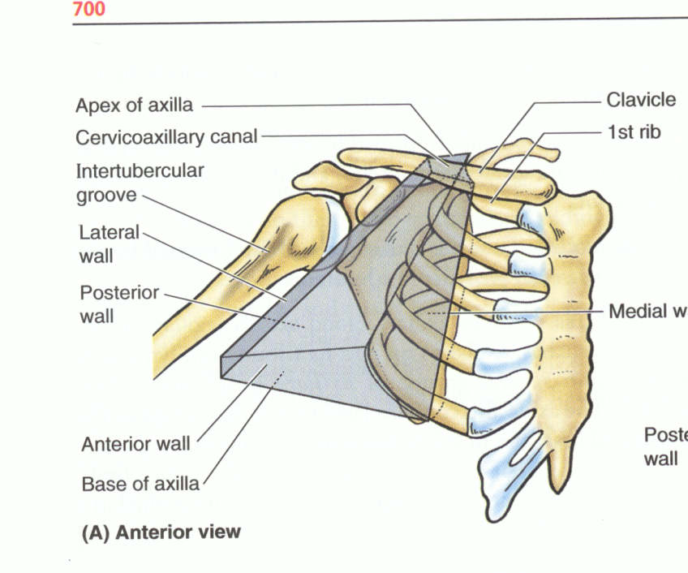
AXILLARY SPACE

Slide 27
Walls of the axillary space
Medial—Serratus anterior muscle
Lateral—Intertubercular sulcus.
Anterior—Pectoralis major and minor MM.
Posterior—Scapula with subscapularis M.; in places, latisimus dorsi M. and teres major M.
Apex—clavicle.
Base—Axillary fascia.

Slide 28
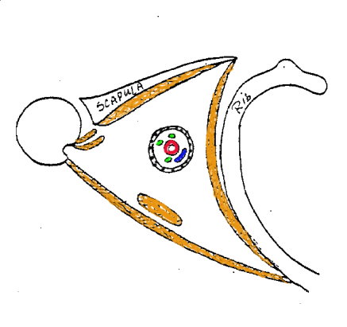
MUSCLES
Major structures inside: Axillary sheath and contents!
Subscapularis M
Latissimus dorsi M
Teres major M
Most of the rest of the space is adipose tissue.
Pectoralis major M
Serratus anterior M
Pectoralis minor M

Slide 29
Axillary sheath
Derived, at least in part, from anterior and middle scalene muscle fascia.
Covers over a series of contents:
Axillary artery
Axillary vein
Brachial plexus and nerves derived from it.
The axillary sheath is just the fascia surrounding these structures. You will open it up in lab to see them.

Slide 30
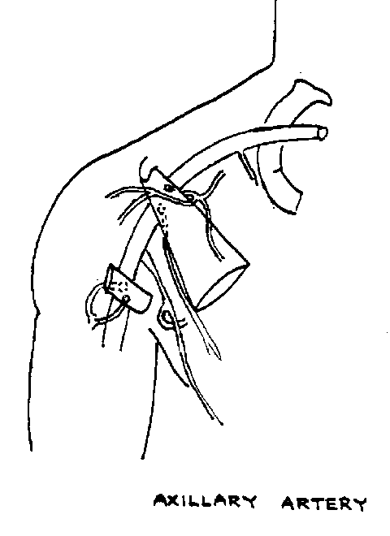
Axillary Artery: divided into three parts
Subclavian A.
Part 1 (proximal) one branch
Part 2 (intermediate) two branches.
Brachial A.
Part 3 (distal) three branches.

Slide 31
Axillary Artery: First Part
From lateral border of 1st rib to medial border of Pectoralis Major M.
Named Branch:
Supreme Thoracic A. (to external thoracic body wall)
Supplies blood to first and second intercostal spaces

Slide 32
Axillary Artery: Second part
Deep to the pectoralis minor M.
Thoracoacromial trunk
Branches to: Clavicular area Pectoralis region Acromion of Scapula Deltoid Muscle.
Lateral Thoracic Artery
Bbr. to Serratus Ant. M.

Slide 33
Axillary Artery: third part
Lateral border of Pectoralis minor M. to lateral border of Teres major M.
Posterior circumflex humeral A.
Subscapular A.: Branches:
1.
Circumflex scapular A. (to multiple muscles associated with the scapula)
Anterior circumflex humeral A.
2.
Thoracodorsal A. (to Latissimus dorsi M.)
How it will look in lab

Slide 34
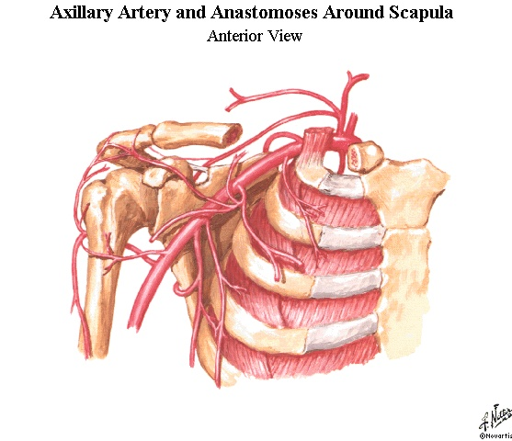
Thoracoacromial A.
Lateral thoracic A.
Supreme thoracic A.
Subscapular A.
Post. Circumflex humoral A.
Ant. Circumflex humoral A.
Note, there is a broad anastamosis of the entire scapular region including circumflex humorals, subscapular, dorsal scapular, and suprascapular AA.

Slide 35
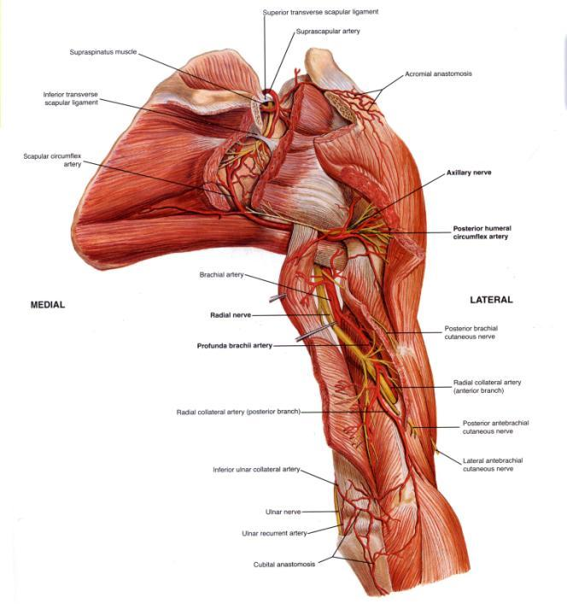

Slide 36
Arteries of Proximal Arm
The arterial pattern has one major vessel, with several important branches, which can supply muscles:
Deep brachial A. to posterior compartment (branches to medial collateral and radial collateral AA).
Superior ulnar collateral A.
Inferior ulnar collateral A.
Note, many muscles are supplied directly by unnamed muscular branches. Do not even think of giving all the vessels you see a distinct name.

Slide 37
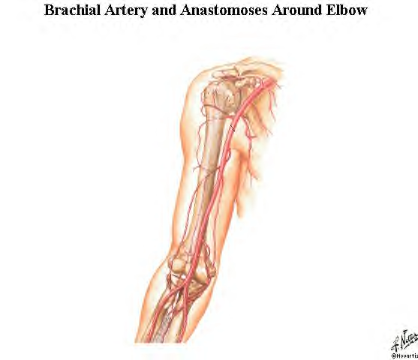
Axillary A.
Brachial A.
Radial collateral A. (a branch of the deep brachial A.)
Deep brachial A.
Superior ulnar collateral A.
Not seen, middle collateral A., another branch of the deep brachial A.
Inferior ulnar collateral A.

Slide 38
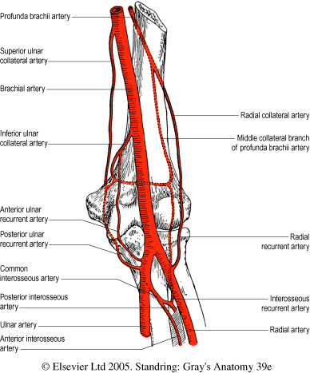
Collateral anastomosis around elbow.

Slide 39
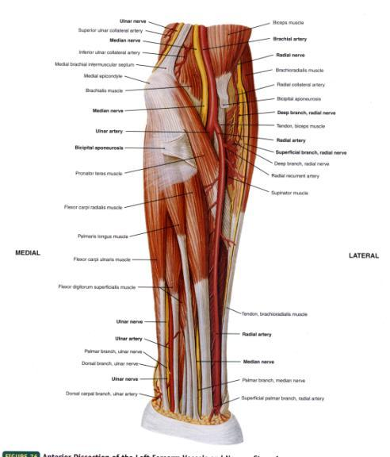
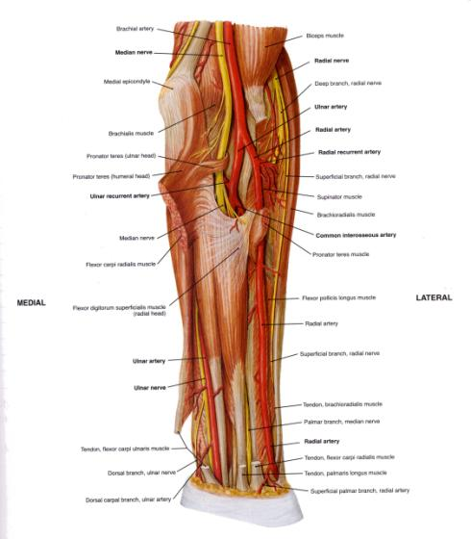
Antebrachium – Major Arteries
Superficial Deeper Dissection

Slide 40
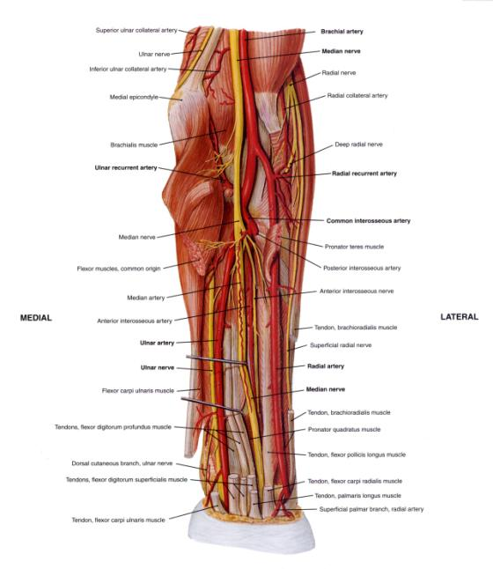
Antebrachium – Major Arteries (Deepest Dissection)
Brachial Artery
Radial Artery
Ulnar Artery
Common Interosseous A.
Anterior Posterior
Interosseus Interosseus
Artery Artery

Slide 41
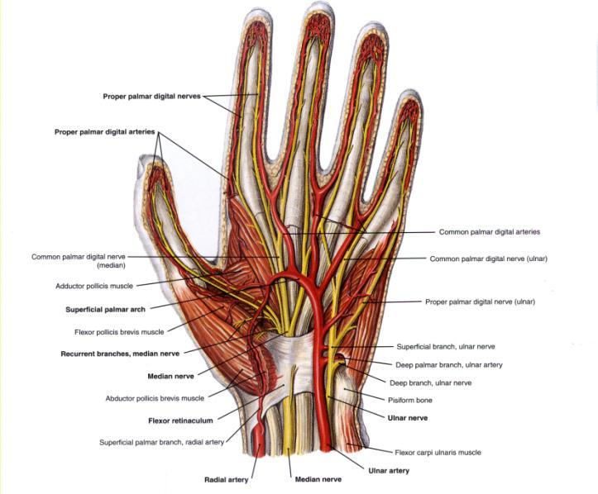
Manus – Major Arteries of Palmar Aspect
Ulnar & Radial AA
Superficial Palmar
Arch
Common Palmar
Digital AA.

Slide 42
Lymphatic System

Slide 43
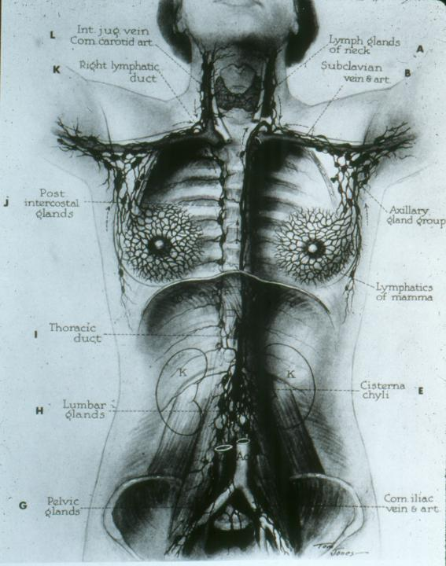

Slide 44
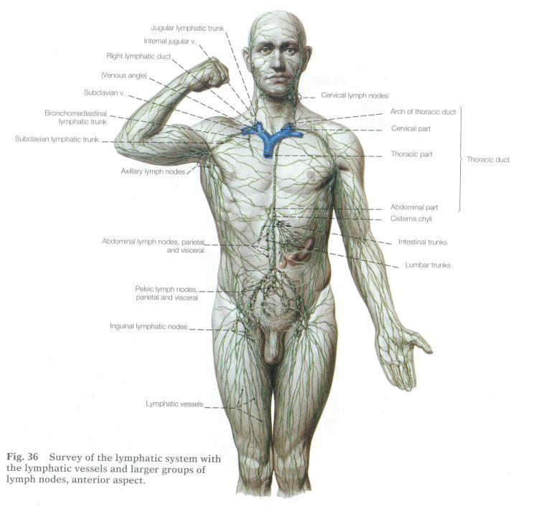

Slide 45
STRUCTURAL & MORPHOLOGICAL ORGANIZATION
Generally run parallel to arteries and/or veins.
Over three-fourths of the body dump into the thoracic duct – which runs on the inside or the dorsal body wall (retroperitoneal).

Slide 46
THORACIC DUCT
Begins as a loosely dilated sac and connections in the abdomen called the CYSTERNA CHYLI.
Drains both legs, and left side of body.
Goes through thorax, receives tributaries from: LEFT SUBCLAVIAN TRUNK (from left arm) and LEFT JUGULAR TRUNK (left side of head and neck).
Dumps into venous circulation at junction between left subclavian vein and left jugular vein. (Technically into left brachiocephalic vein.)

Slide 47
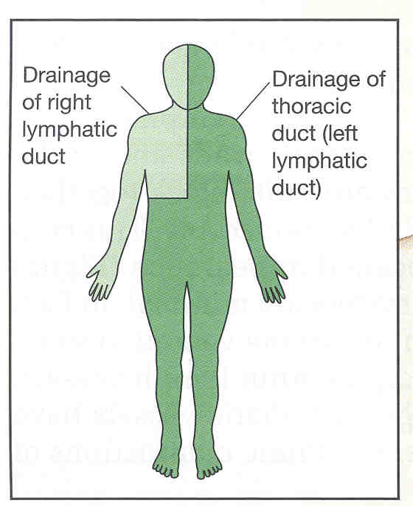
THORACIC DUCT
Begins as a loosely dialated sac and connections in the abdomen called the CYSTERNA CHYLI.
Drains both legs, and left side of body.
Goes through thorax, receives tributaries from: LEFT SUBCLAVIAN TRUNK (from left arm) and LEFT JUGULAR TRUNK (left side of head and neck).
Dumps into venous circulation at junction between left subclavian vein and left jugular vein. (Technically into left brachiocephalic vein.)

Slide 48
RIGHT LYMPHATIC DUCT
Upper right quadrant is drained by right lymphatic duct.
It dumps into venous circulation at junction between right subclavian vein and right jugular vein. (Technically into right brachiocephalic vein.)

Slide 49
RIGHT LYMPHATIC DUCT
Upper right quadrant is drained by right lymphatic duct.
It dumps into venous circulation at junction between right subclavian vein and right jugular vein. (Technically into right brachiocephalic vein.)

Slide 50
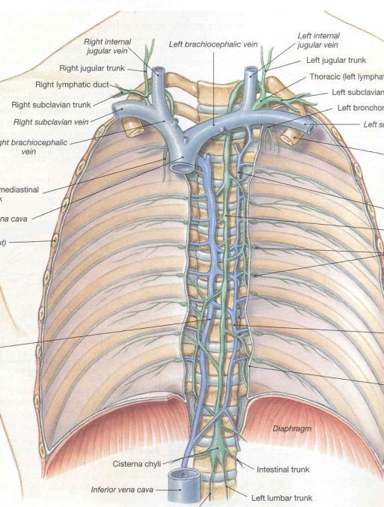

Slide 51
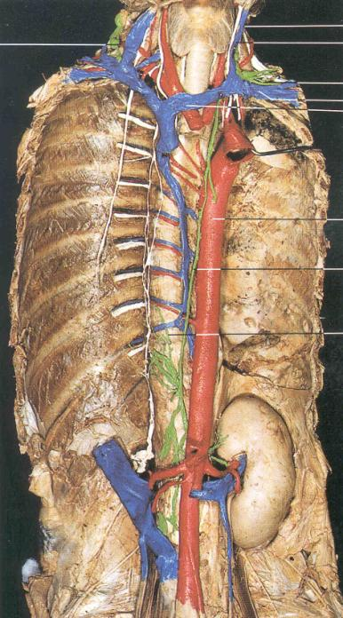

Slide 52
OTHER LYMPHATIC STRUCTURES
Lymph Nodes
Tonsils
Spleen
Thymus Gland
Pyer’s Patches

Slide 53
LYMPH NODES
Scattered along lymph vessels are concentrated masses of lymph tissue called "lymph nodes."
Usually 1-25 mm in length, but they can be larger.
Greatest concentration near groin, axilla, neck, thorax, and along gut tube in abdomen. In women, near mammary glands.
Macrophages and lymphocytes resident in the outer ("cortex") region of a lymph node. Thus, the nodes can act as filters.
Afferent (entering) vessels bring lymph in; lymph is filtered through cortex.
"Medulla" is the inner collecting area.
Efferent (exiting) vessel leaves at the "hilus."

Slide 54
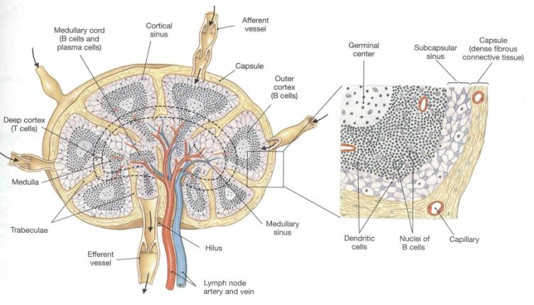
Usually 1-25 mm in length, but they can be larger.
Greatest concentration near groin, axilla, neck, thorax, and along gut tube in abdomen.
Macrophages and lymphocytes resident in the outer ("cortex") region of a node.
Afferent (entering) vessels bring lymph in; lymph is filtered through cortex.
"Medulla" is the inner collecting area.
Efferent (exiting) vessel leaves at the "hilus."

Slide 55
TONSILS
(Sort of like large, glorified lymph nodes, but…)
They don’t act as filters.
Only produce lymphocytes for export.
Phayrngeal tonsils, palatine tonsils, and lingual tonsils are defensive structures at the mouth, entrance to digestive and respiratory systems.

Slide 56
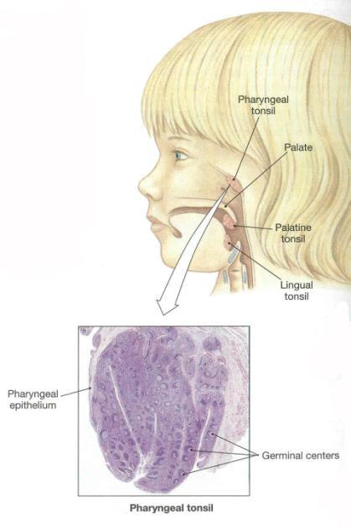
TONSILS
They don’t act as filters.
Only produce lymphocytes for export.
Pharyngeal tonsils, palatine tonsils, and lingual tonsils are defensive structures at the mouth, entrance to digestive and respiratory systems.

Slide 57
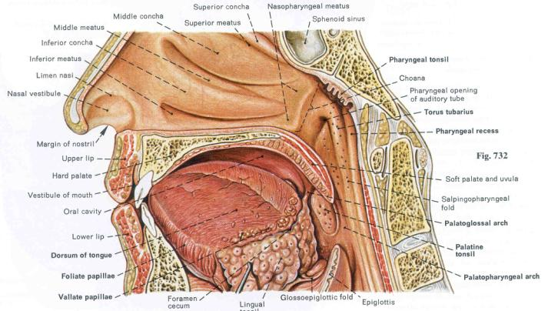
TONSILS
They don’t act as filters.
Only produce lymphocytes for export.
Pharyngeal tonsils, palatine tonsils, and lingual tonsils are defensive structures at the mouth, entrance to digestive and respiratory systems.

Slide 58
SPLEEN
Not part of the gut (just near it).
Largest lymphoid organ of body.
Highly vascularized (perfect for a filter).
In spleen, BLOOD passes resident macrophages and lymphocytes.
Not strictly a lymph filter, but its interaction with blood can stimulate production and action of materials normally found in lymph.
Macrophages abundant: help to scavenge spent red blood cells and recycle hemoglobin.
Antigens (nasty stuff) in blood active lymphocytes in spleen for antibody production.
Produces red blood cells in fetus, can be called back into action in adults under stressful conditions.

Slide 59
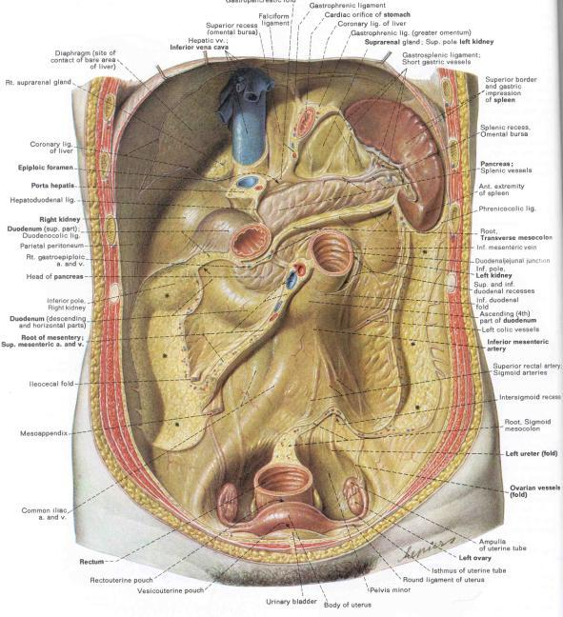
Highly vascularized.
In spleen, BLOOD passes resident macrophages and lymphocytes.
Not strictly a lymph filter, but its interaction with blood can stimulate production and action of materials normally found in lymph.
Macrophages abundant: help to scavenge spent red blood cells and recycle hemoglobin.
Antigens (nasty stuff) in blood active lymphocytes in spleen for antibody production.
SPLEEN

Slide 60
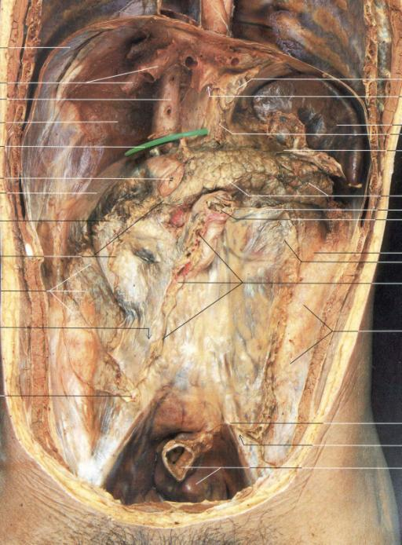
SPLEEN

Slide 61
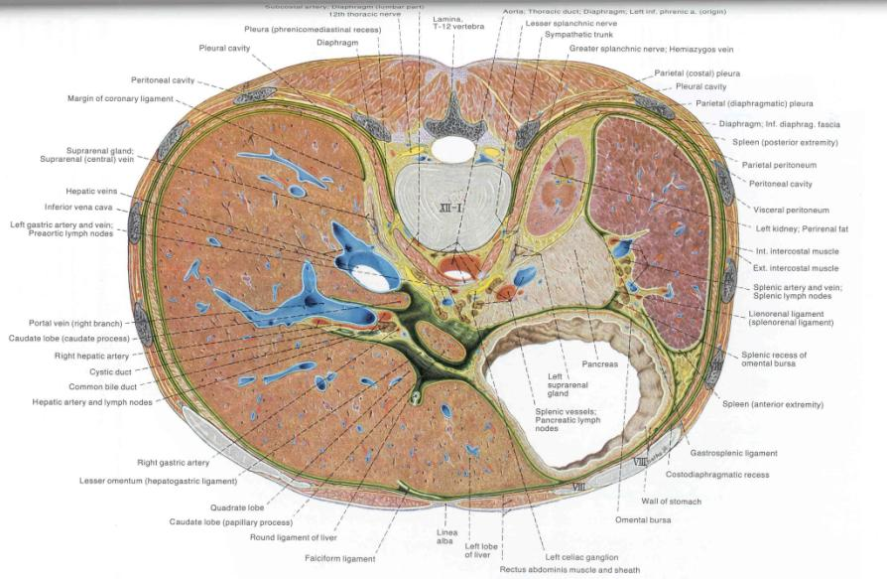

Slide 62
THYMUS GLAND
Ventral to heart and laryngeal structures.
Has outer cortex (containing many lymphocytes) and inner medulla.
Fetal thymus: transforms undifferentiated lymphocytes from bone marrow into T-lymphocytes.
(More later…)

Slide 63
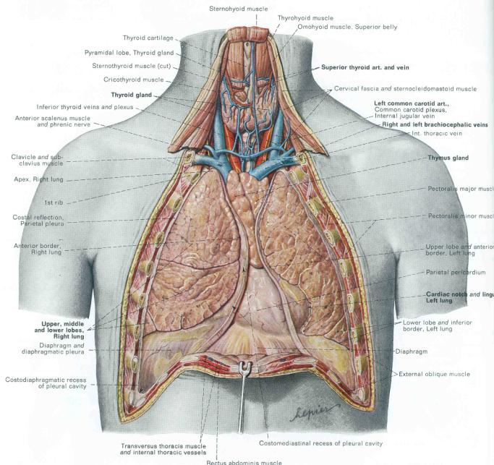
Adult
THYMUS

Slide 64
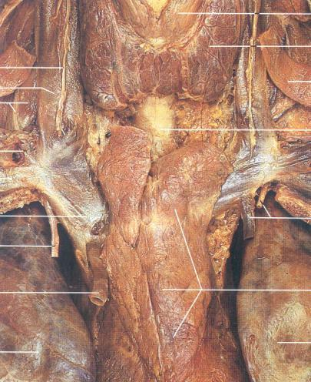
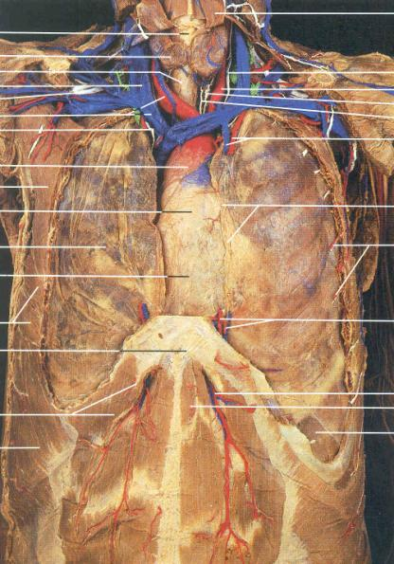
Adult
THYMUS

Slide 65
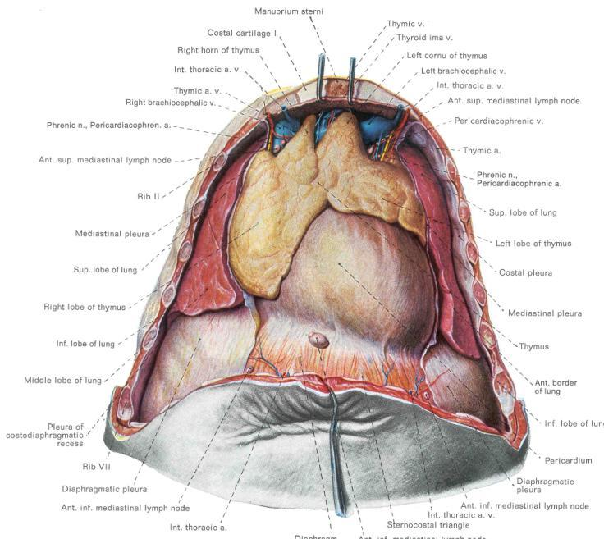
One-year
old
THYMUS

Slide 66
PYER’S PATCHES
(Also known as aggregated lymph nodes.)
Clusters of lymphoid tissue without a fibrous capsule.
Common in tonsils, small intestine, and appendix.
Secrete antibodies in response to antigens in gut tube, particularly ingested viruses and bacteria.

