Slide 1
Biology 323
Human Anatomy for Biology Majors
Lecture 6
Dr. Stuart S. Sumida
Axial Musculature

Slide 2
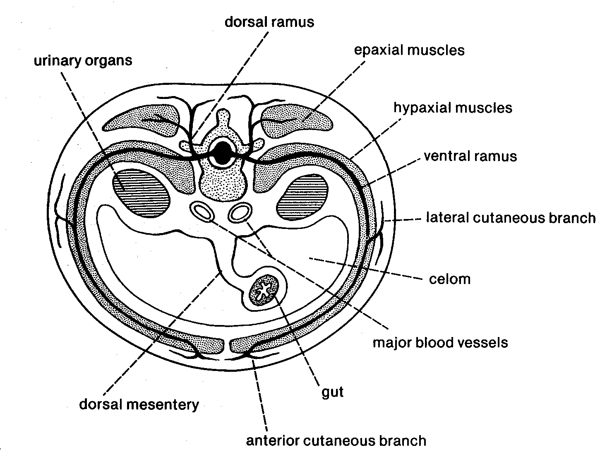

Slide 3
EPAXIAL MUSCLES (AXIAL MUSCLES)
The “Erector Spinae” Muscles
Iliocostalis – lateral-most group
Iliocostalis lumborum
Iliocostalis thoracis
Iliocostalis cervicis
Longissimus Dorsi – middle of superficial epaxial group
Longissimus thoracis
Longissimus cervicis
Longissimus capitus
Transversospinalis – medial-most group
Spinalis thoracis
Spinalis cervicis

Slide 4
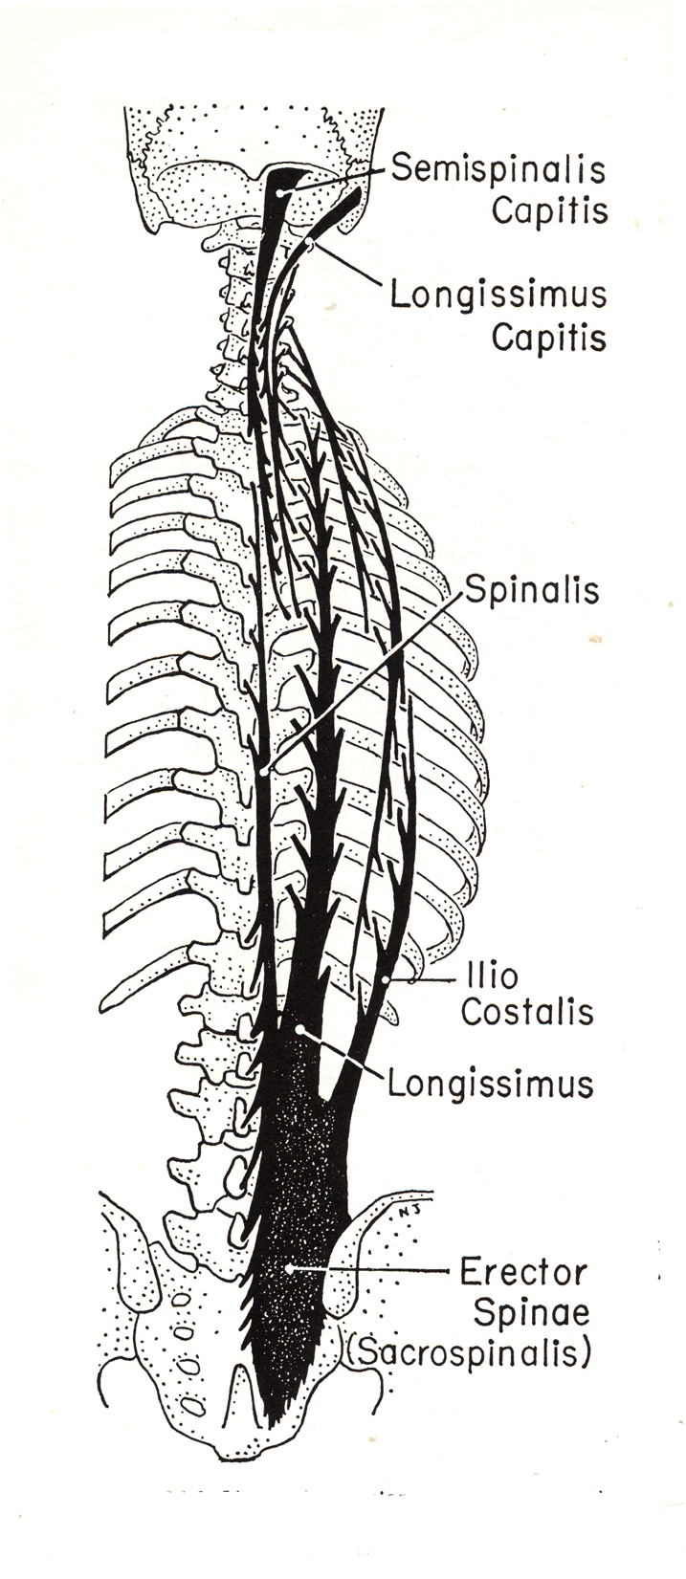
Diagrammatic plan of organization of major components of the erector spinae.

Slide 5
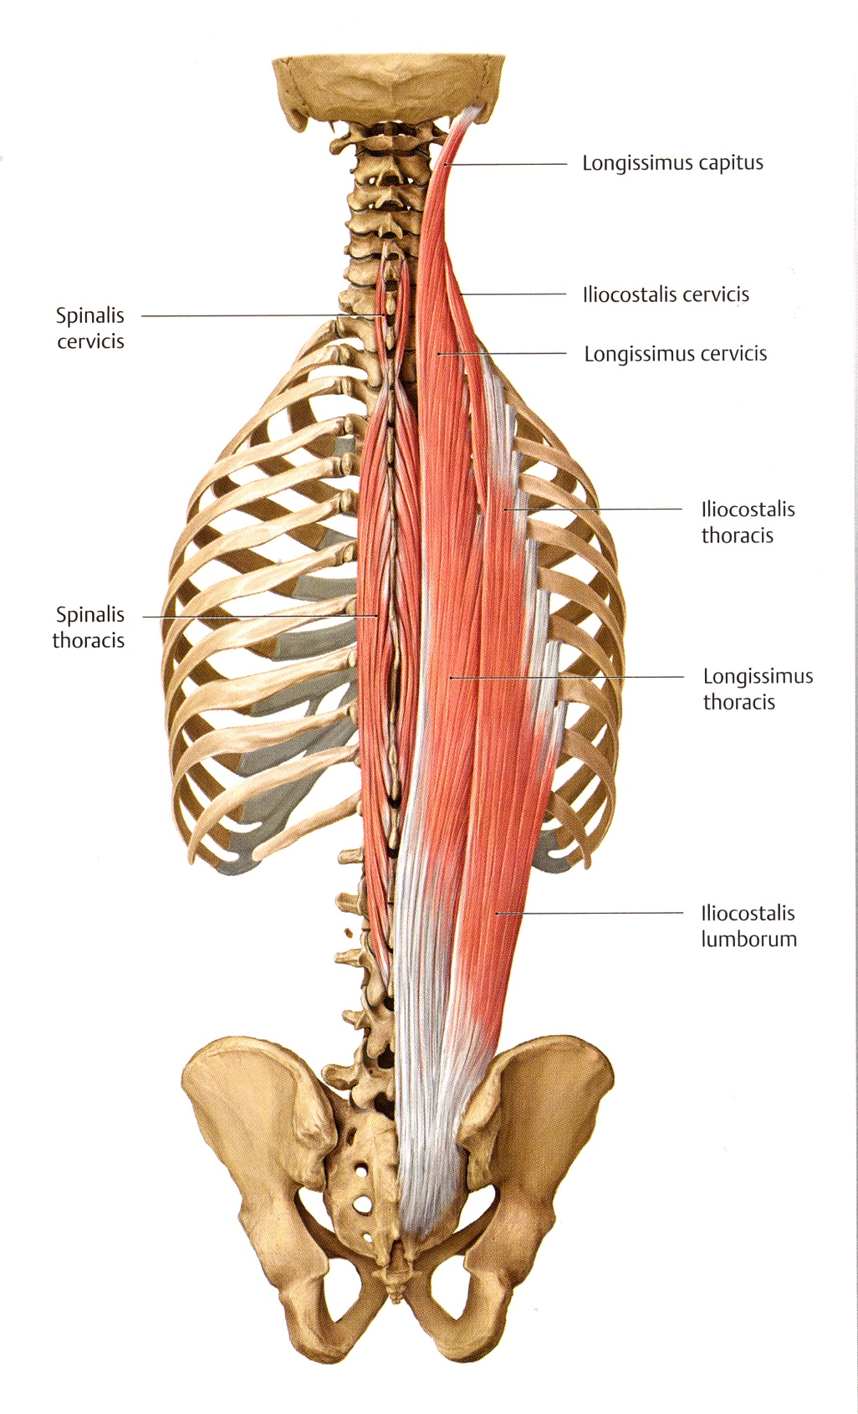
Iliocostalis Group – lateralmost of erector spinae
Iliocostalis cervicis
Origin: Ribs 3-7
Insertion: Transverse processes of C4-C6
Innervation: Spinal nerves C8-T1
Iliocostalis thoracis
Origin: Rib 7-12
Insertion: Ribs 1-6
Innervation: Spinal nerves C8-T1
Iliocostalis lumborum
Origin: Sacrum, Iliac crest, thoracolumbar fascia
Insertion: Transverse processes of upper lumbar vertebrae, ribs 6-12.
Innervation: Spinal nerves C8-T1
Function: Bilateral – extend spine; Unilateral – bend spine laterally to same side.

Slide 6
Longissimus Dorsi Group
(The only group of erector spinae muscles to actually reach the skull.)
Longissimus capitus
Origin: Transverse processes of C4-T3
Insertion: Mastoid process of temporal bone
Innervation: Spinal nerves C1-T5
Longissimus cervicis
Origin: Transverse processes of T1-T6.
Insertion: Transverse processes of C2-C5.
Innervation: Spinal nerves C1-T5
Longissimus thoracis
Origin: Sacrum, iliac crest, spinous processes of lumbar vertebrae, transverse processes of lower thoracic vertebrae
Insertion: Ribs 2-12, costal processes of lumbar vertebrae, transverse processes of thoracic vertebrae.
Innervation: Spinal nerves C1-T5
Function: Bilateral – extend head and spine; Unilateral – bend spine laterally to same side.

Slide 7
Transversospinalis Group
Spinalis cervicis
Origin: Spinous processes of C5-T2
Insertion: Spinous processes of C2-C5
Innervation: Segmental spinal nerves
Function: Bilateral – extend spine; Unilateral – bend spine laterally to same side
Spinalis thoracis
Origin: Spinous processes of T10-L3
Insertion: Spinous processes of T2-T8
Innervation: Segmental spinal nerves
Function: Bilateral – extend spine; Unilateral – bend spine laterally to same side.

Slide 8
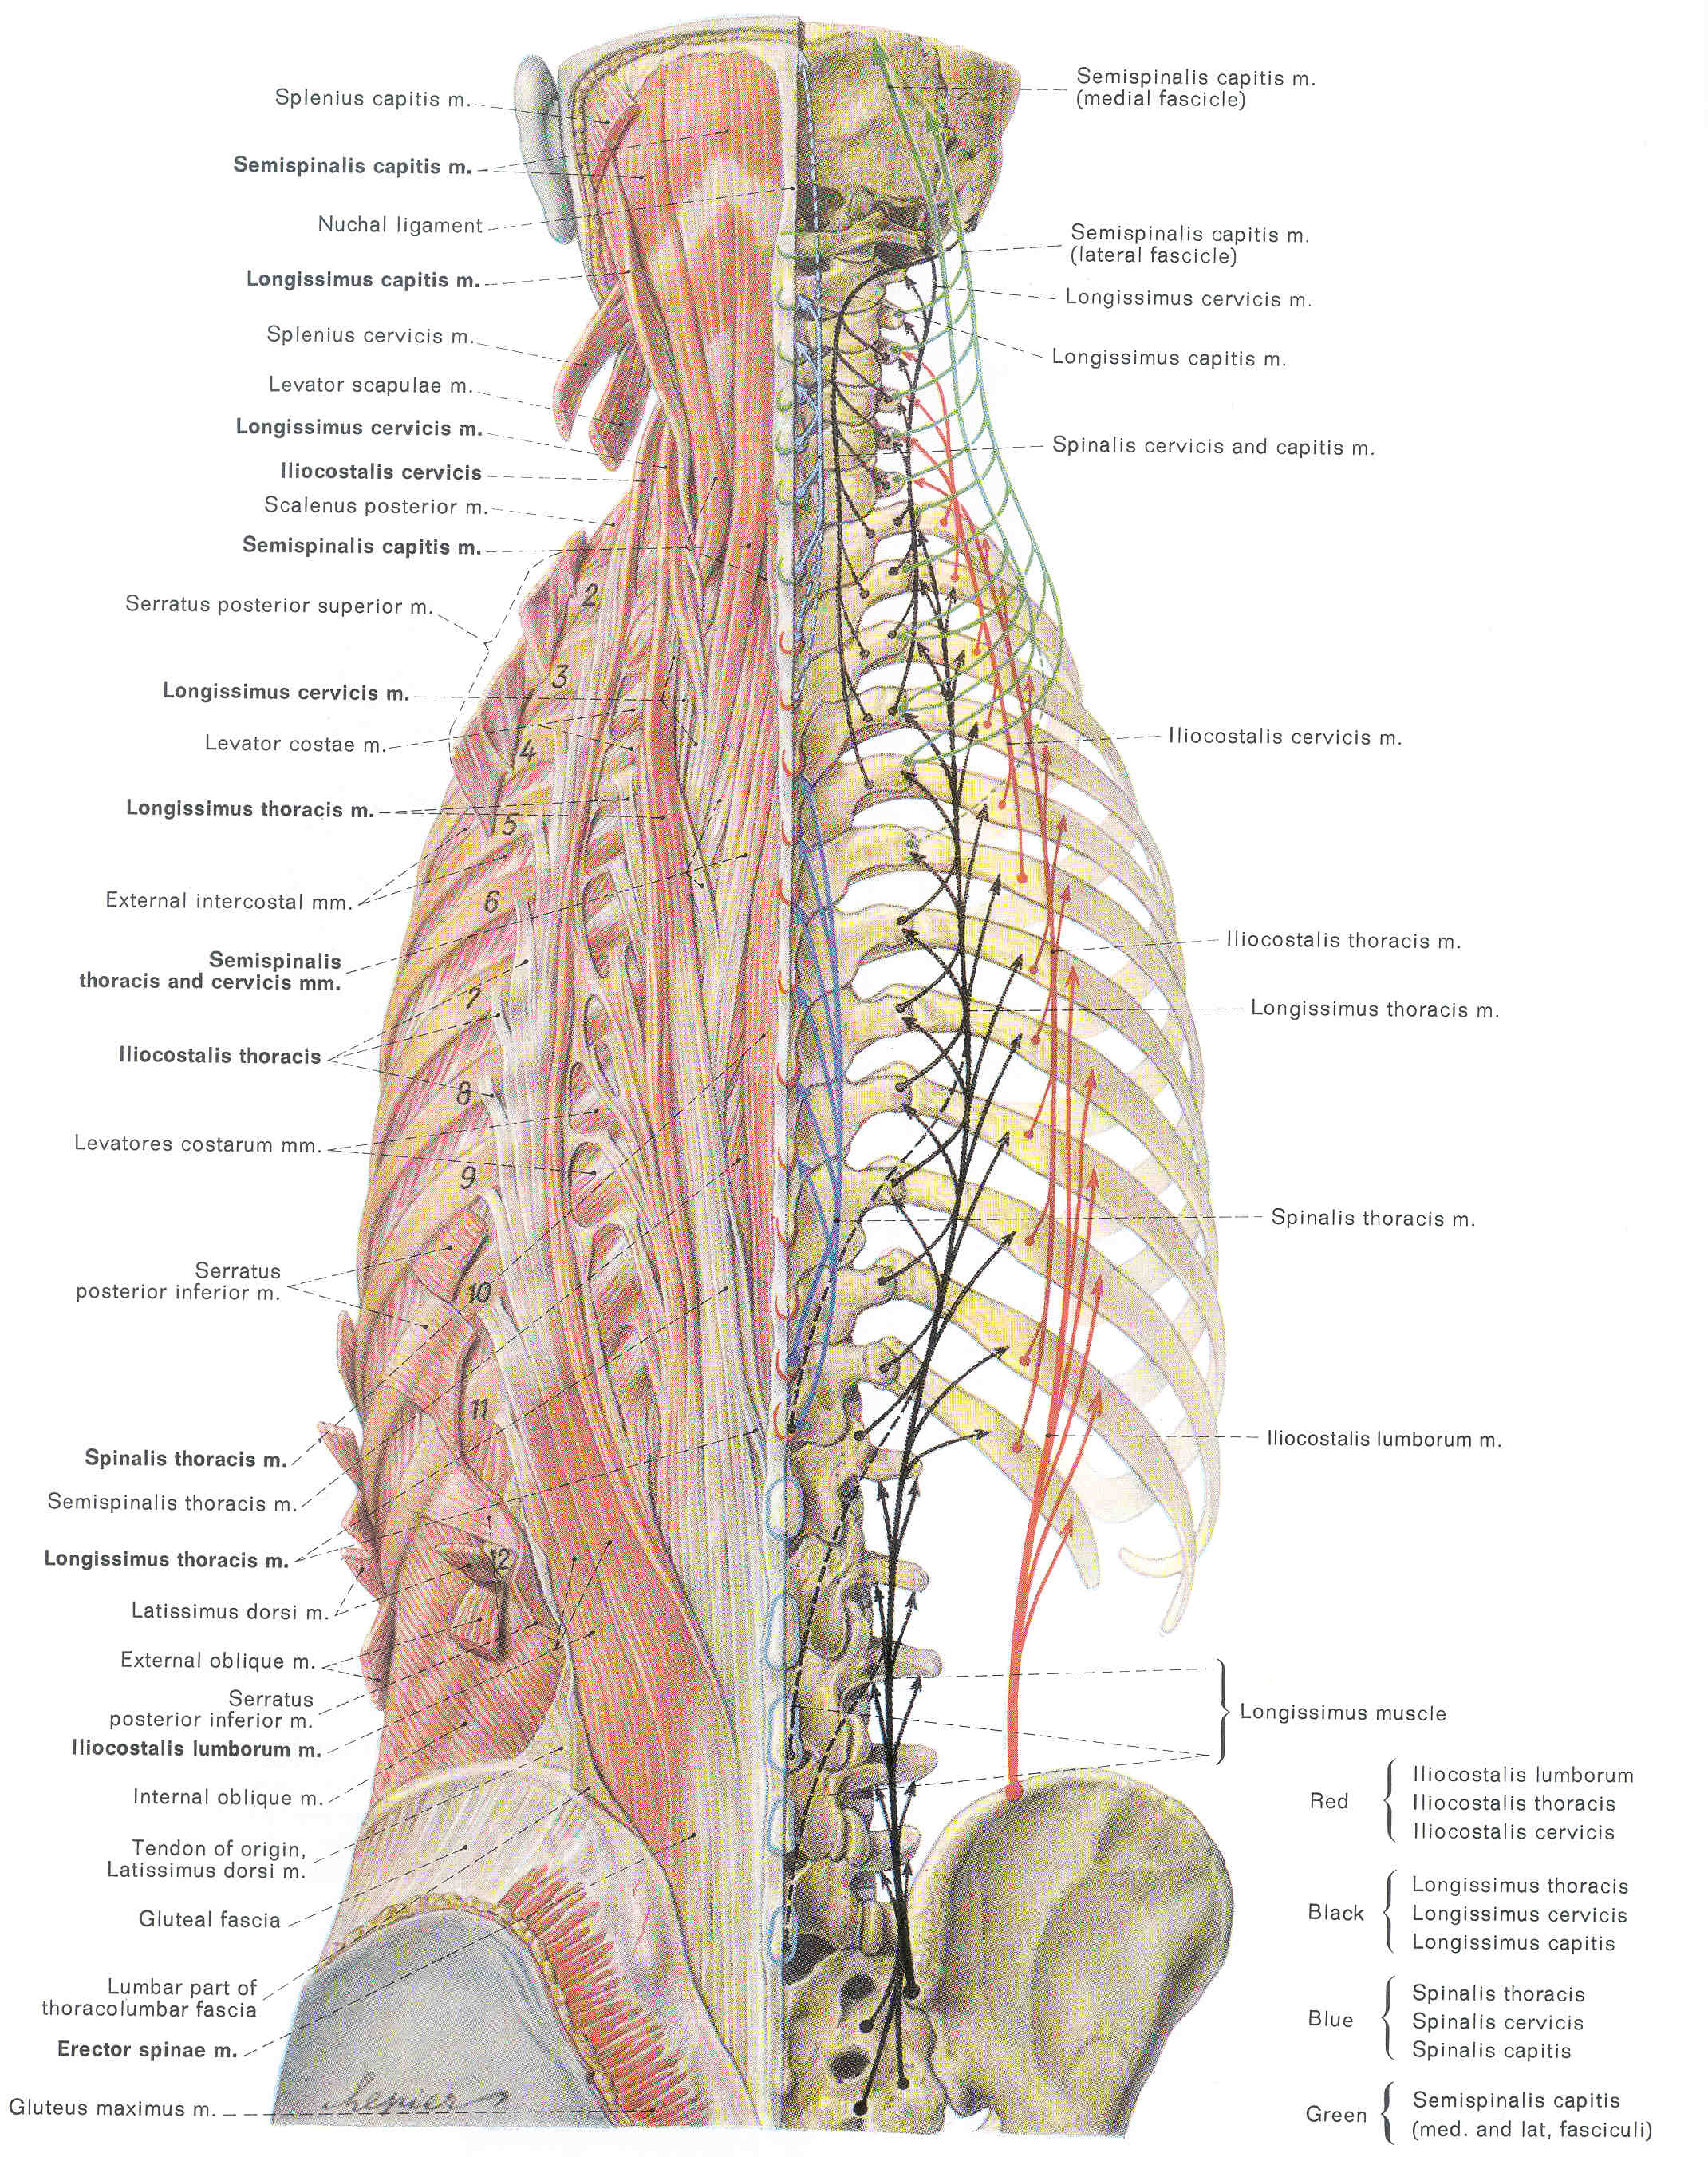

Slide 9
MIDDLE LAYER OF EPAXIAL MUSCLES (AXIAL MUSCLES)
A largely oblique layer, mostly concealed by the erector spinae group.
Semispinalis Group
Multifidus
Rotatores

Slide 10
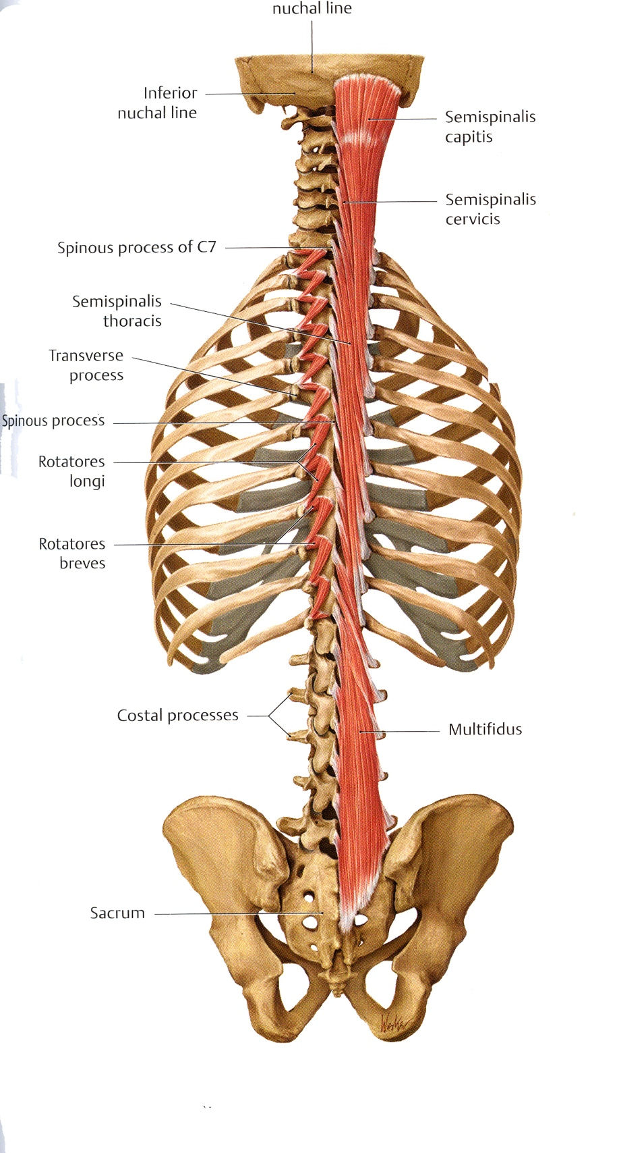
Semispinalis Group
Semispinalis capitis
Origin: Transverse processes of C4-T7
Insertion: Occipital bone between superior and inferior nuchal line.
Innervation: Segmental spinal nerves
Semispinalis cervicis
Origin: Transverse processes of T1-T6
Insertion: Spinous processes of C2-C5
Innervation: Segmental spinal nerves
Semispinalis thoracis
Origin: Transverse processes of T6-T12
Insertion: Spinous processes of C6-T4
Innervation: Segmental spinal nerves
Function: Bilateral – extend spine; Unilateral – bend spine to same side, rotate to opposite side

Slide 11
Rotatores brevis
Origin & Insertion: Between transverse and spinous processes of adjacent vertebrae) of T1-12.
Innervation: Segmental spinal nerves
Rotatores longi
Origin & Insertion: Between transverse and spinous processes skipping one vertebrae) of T1-12.
Innervation: Segmental spinal nerves
Function: Bilateral – extend thoracic spine; Unilateral – bend spine to same side, rotate to opposite side
Multifidus
Origin & Insertion: Between transverse and spinous processes (skipping two to four vertebrae) of C2-sacrum.
Innervation: Segmental spinal nerves
Function: Bilateral – extend spine; Unilateral – bend spine to same side, rotate to opposite side

Slide 12
DEEPEST LAYER OF EPAXIAL MUSCLES (AXIAL MUSCLES)
Interspinales group
Intertransversarii
Levatores costarum group
“Interspinalis Group” – short epaxial muscles that span single vertebral segments.
They are best developed in the cervical and lumbar region; and are largely absent in the thoracic region.

Slide 13
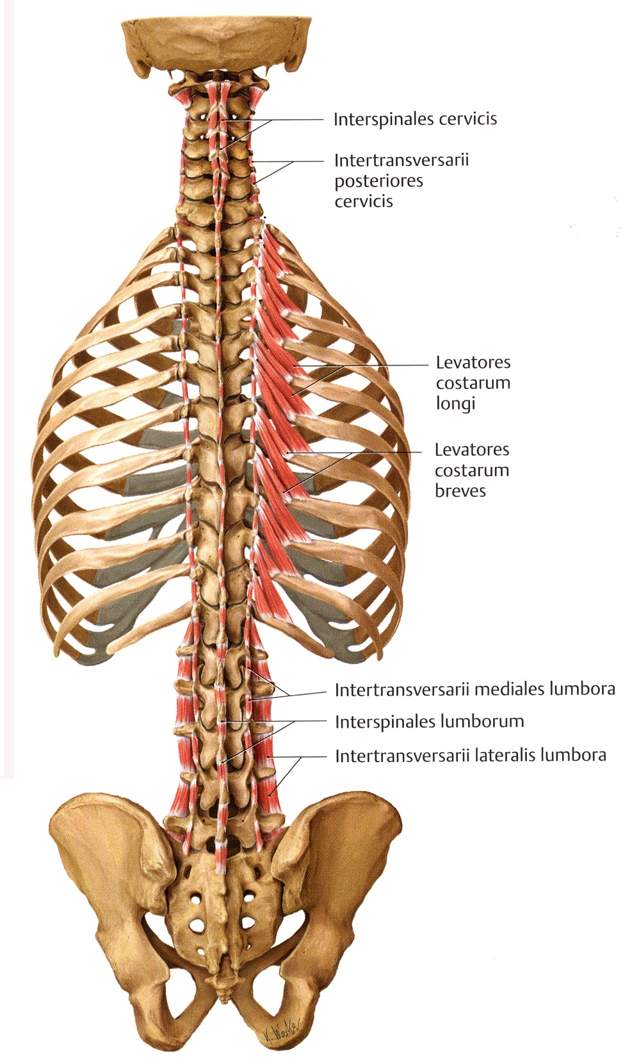
Interspinales
Origin & Insertion: Between spinous processes of adjacent vertebrae from C1-L5
Innervation: Segmental spinal nerves
Function: Extend cervical and lumbar regions of spine.
Intertransversarii
Origin & Insertion: Between transverse processes of adjacent vertebrae from C2-C7 and L1-L5
Innervation: Segmental spinal nerves
Function: Bilateral - stabilize and extend cervical and lumbar regions of spine; Uilateral – bend spine to that side.
Levatores Costorum
Origin: Transverse processes of C7-T11
Insertion: costal angle of next lower rib or rib two segments distal.
Innervation: Segmental spinal nerves
Function: Bilateral - extend thoracic spine; Uilateral – bend thoracic spine to that side, rotate to opposite side.

Slide 14
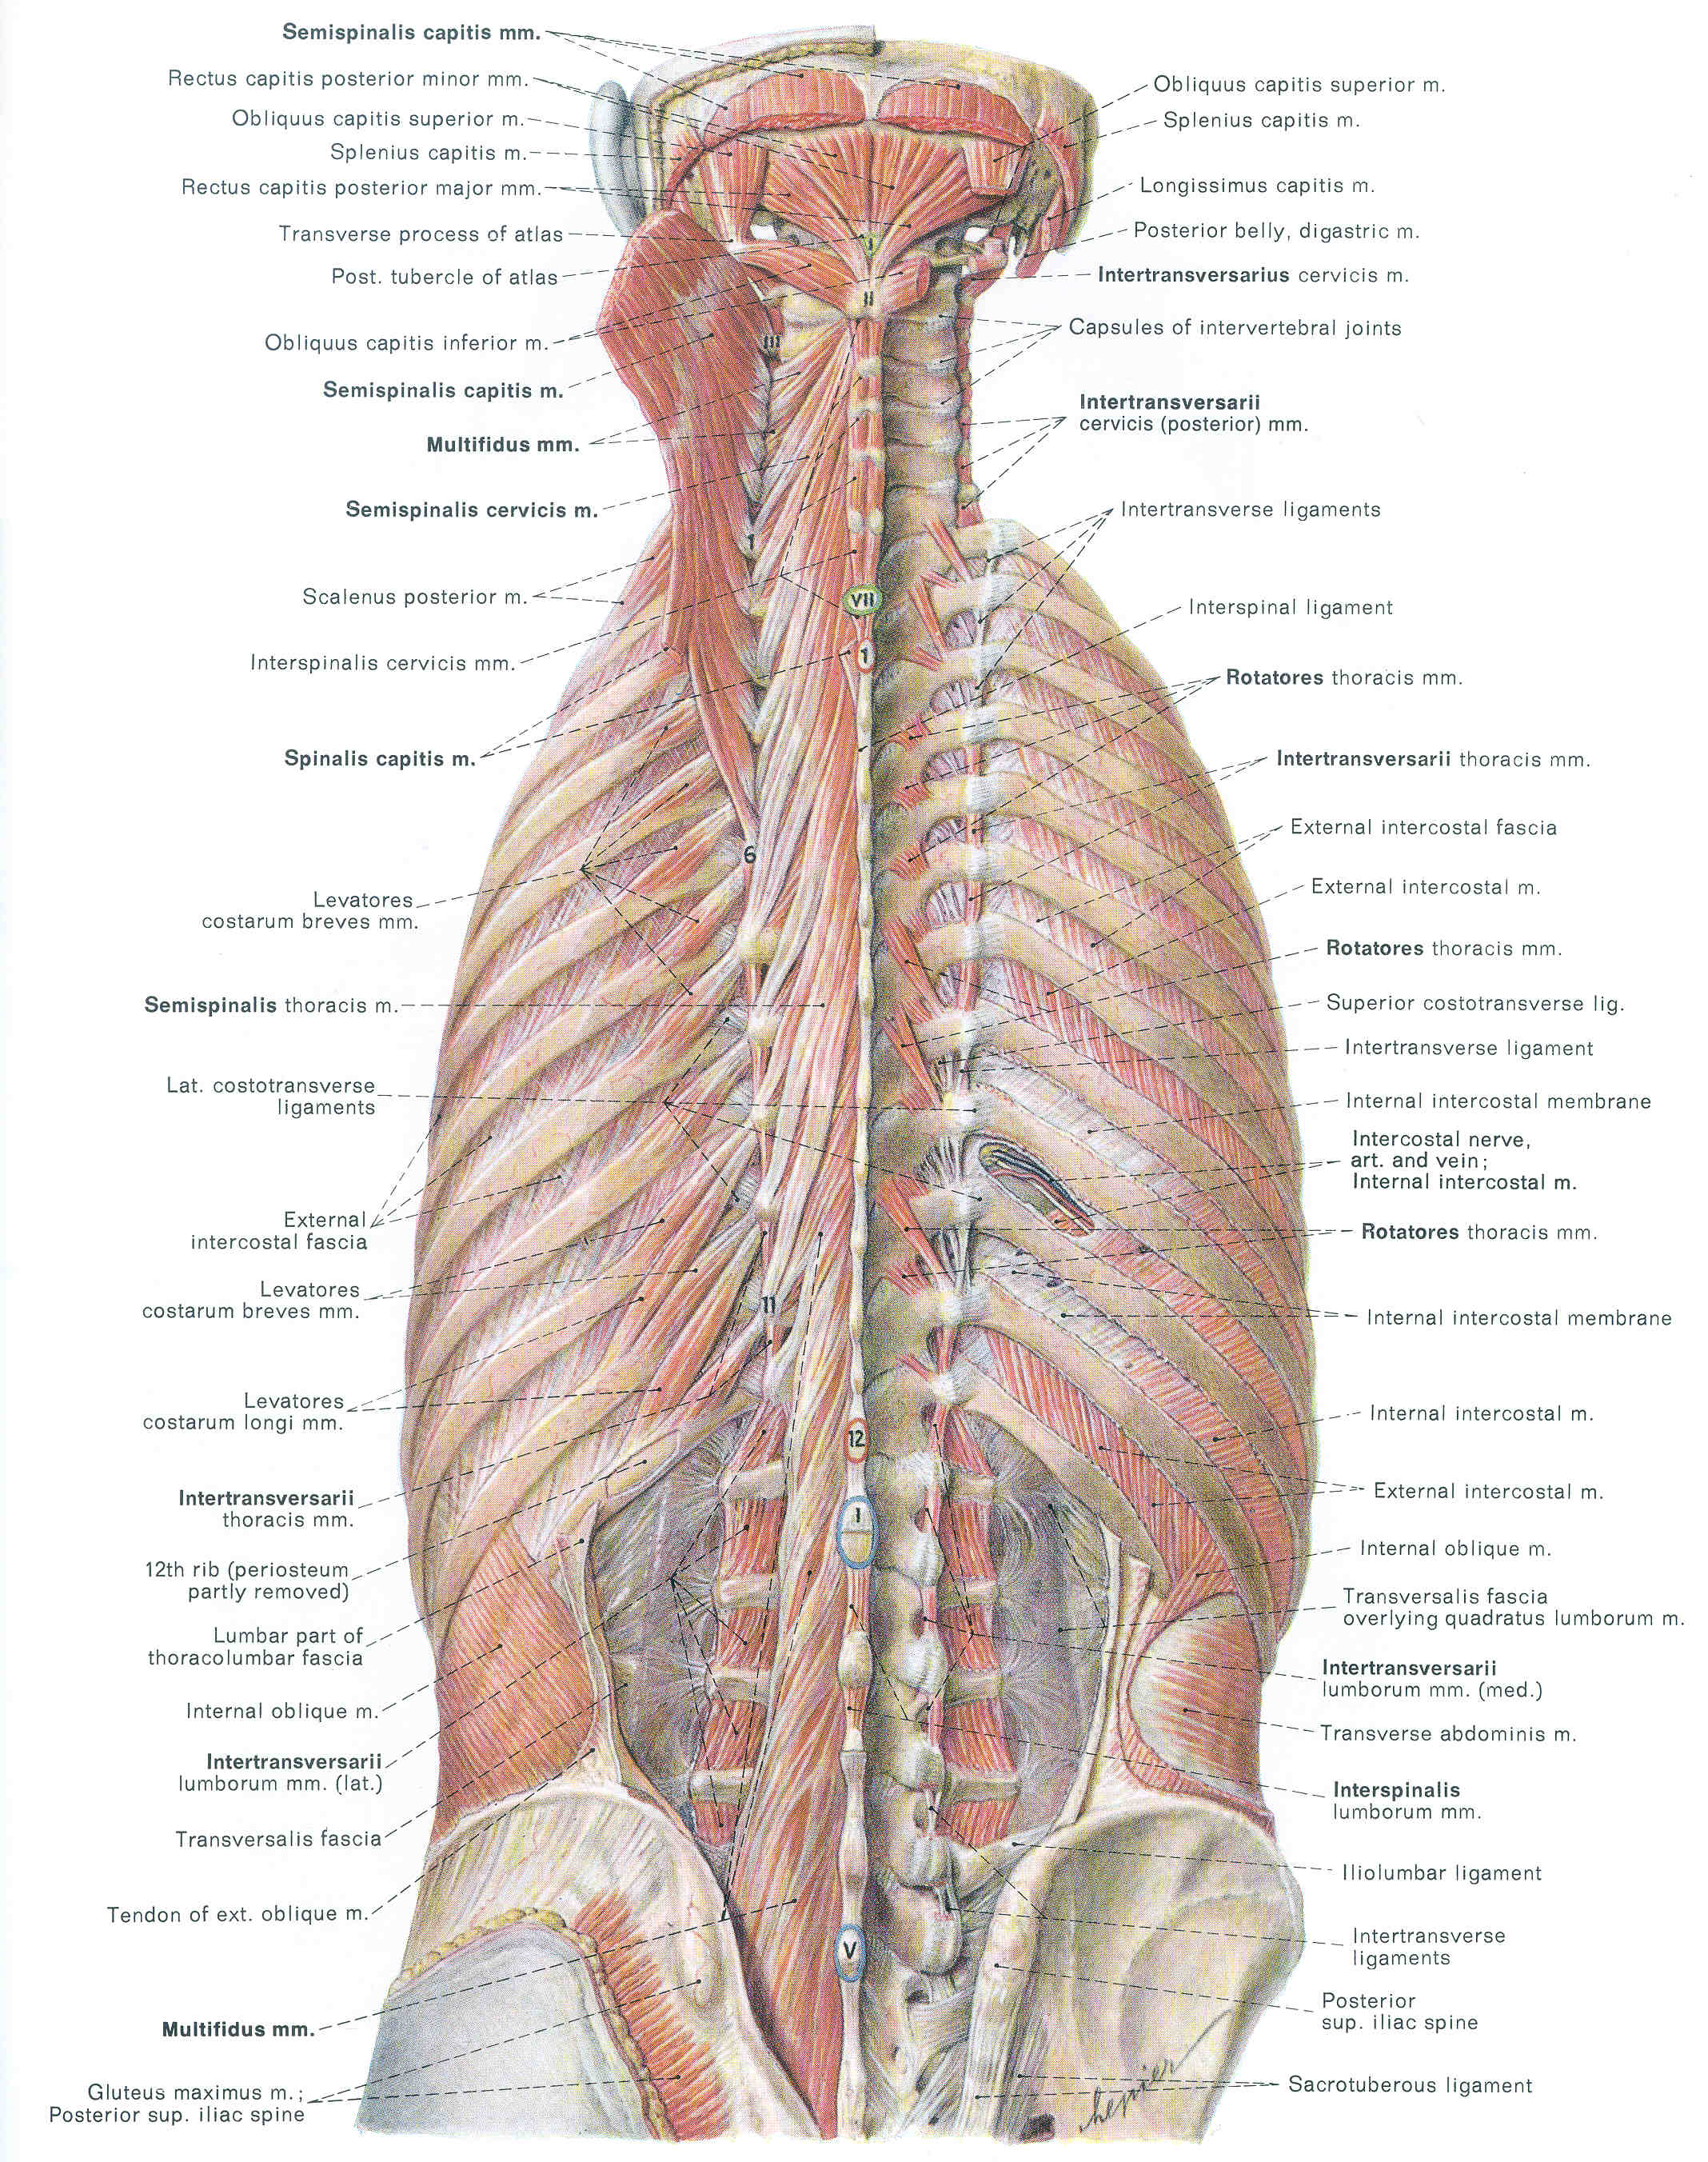

Slide 15
Superficial Layer
Erector Spinae
Origin = sacrum/iliac crest
Iliocostalis
Insertion = ribs

Slide 16
Superficial Layer
Erector Spinae
Origin = sacrum/iliac crest
Longissimus
Insertion = transverse
processes

Slide 17
Superficial Layer
Erector Spinae
Origin = sacrum/iliac crest
Spinalis
Insertion = spinous
processes

Slide 18
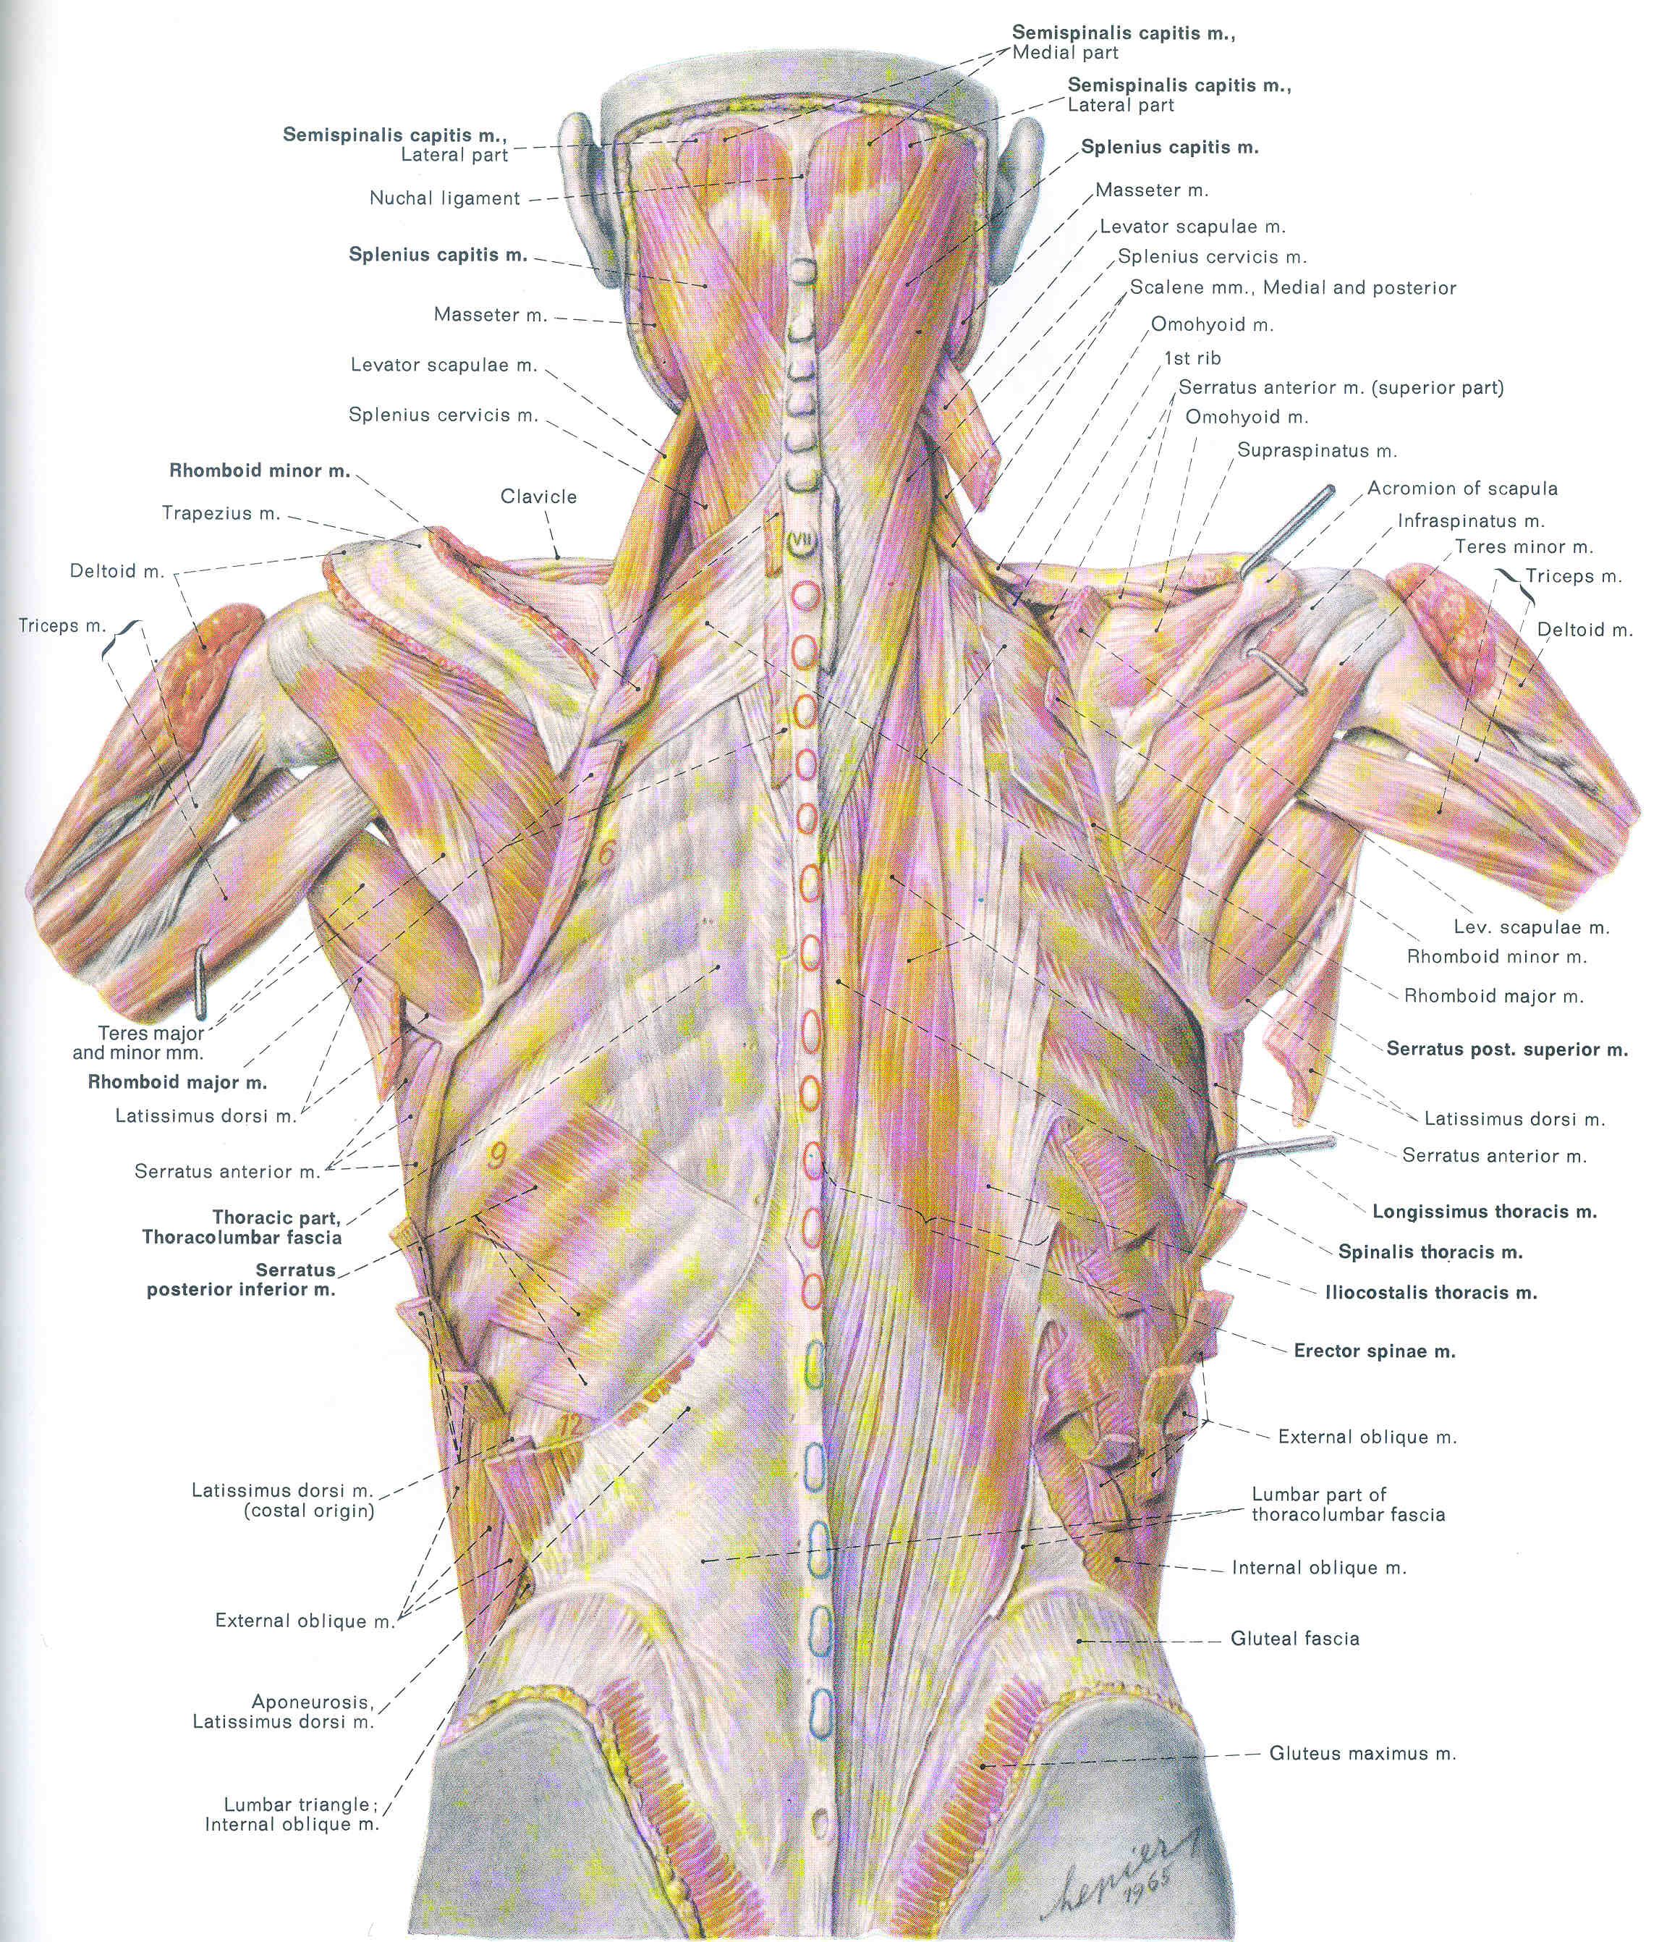

Slide 19
Intermediate Layer
Multifidus
Origin = sacrum/iliac crest
Insertion = spinous processes

Slide 20
Intermediate Layer
Semispinalis
Origin = transverse
processes
Insertion =spinous
processes

Slide 22
Deep Layer
Short slips of muscle, connecting adjacent vertebrae

Slide 24
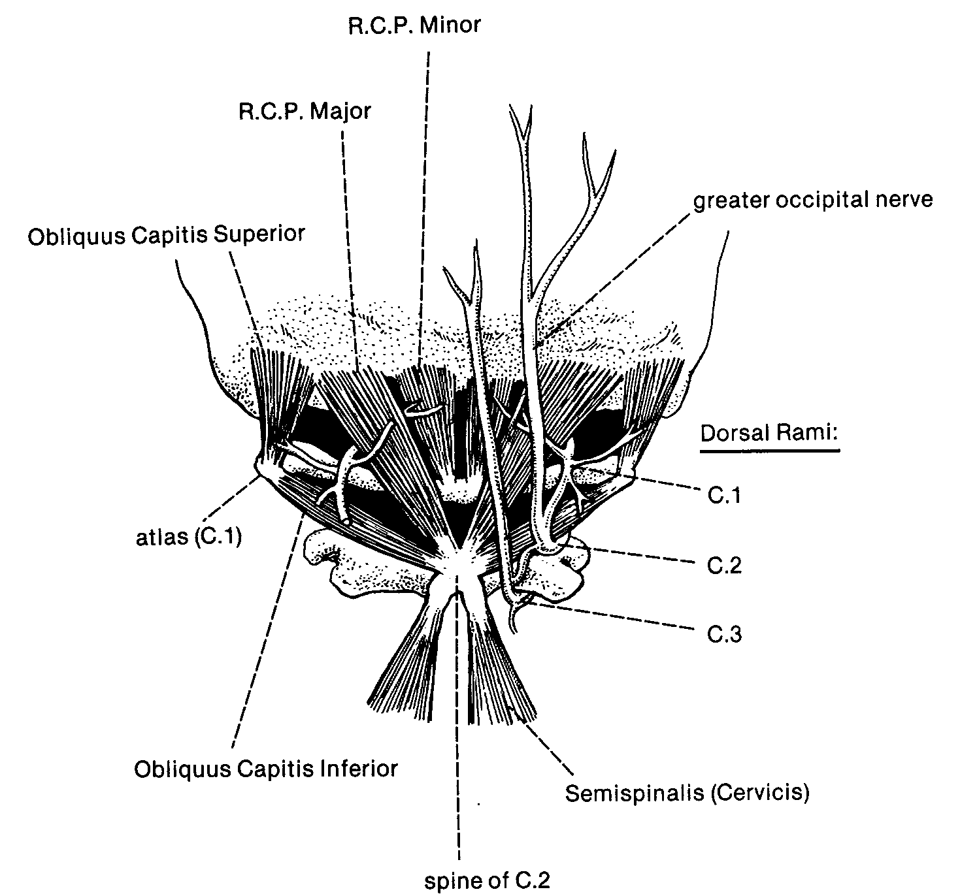

Slide 25
Three Divisions
Body Wall
Limbs
Prevertebral

Slide 26
Subdivision of Body Wall Group
Abdominal
Thoracic
Perineal
Neck

Slide 27
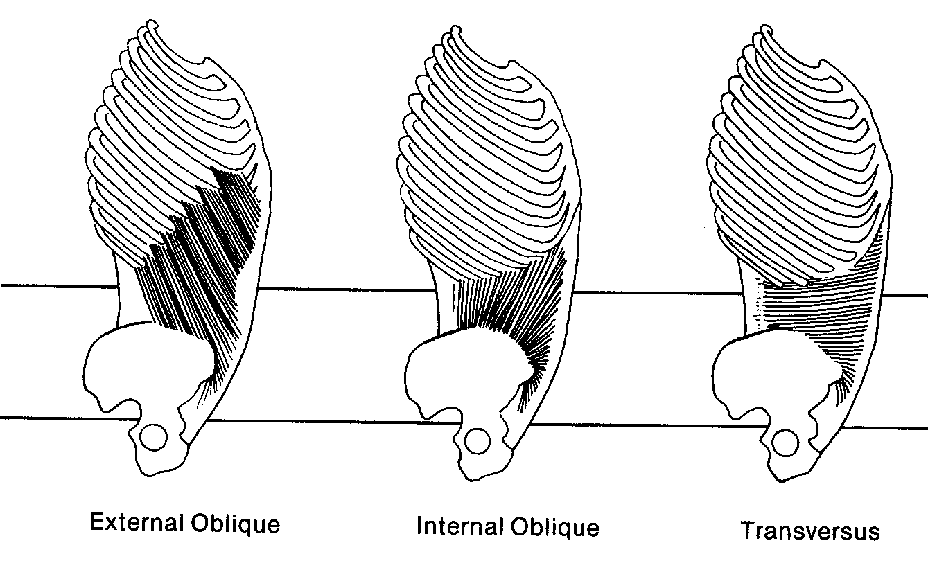

Slide 28
Subdivision of the Abdominal Group
Superficial =
external Oblique
Origin: Lower 8 ribs
Insertion: top of rectus sheath

Slide 29
Subdivision of the Abdominal Group
Intermediate =
Internal Oblique
Origin: Iliac crest
Insertion: Rectus sheath

Slide 30
Subdivision of the Abdominal Group
Deep = Transversus
Origin: Thoracolumbar
fascia
Insertion: Sheath below
abdominus rectus

Slide 31
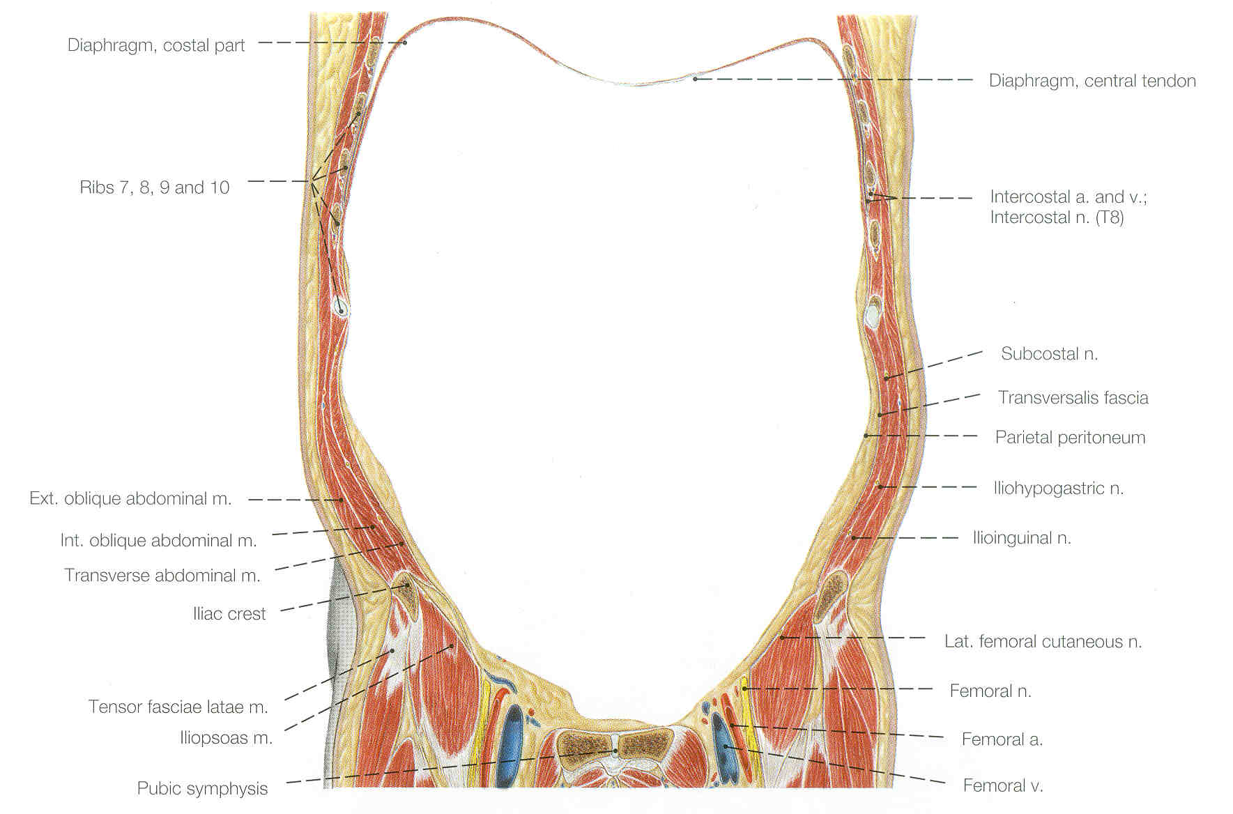

Slide 32
Subdivision of the Thoracic Group
External intercostal
Internal Intercostal
Transversus thoracis

Slide 33
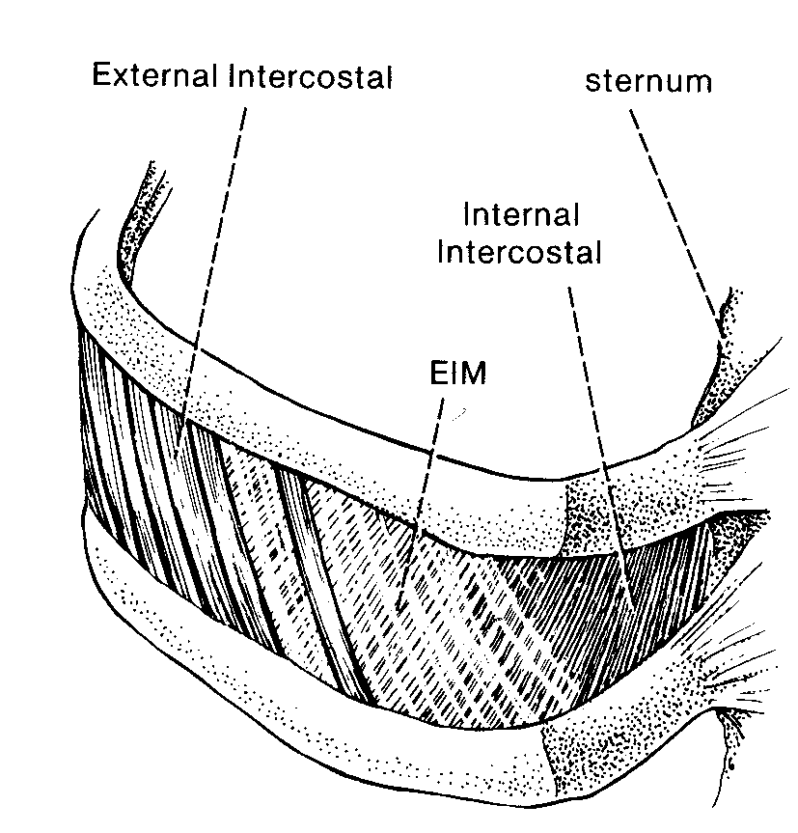

Slide 34
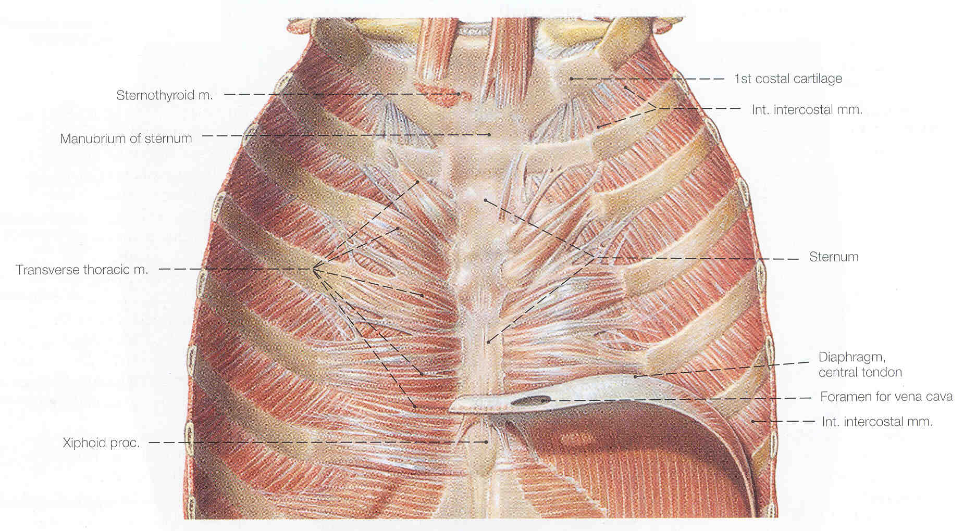

Slide 35
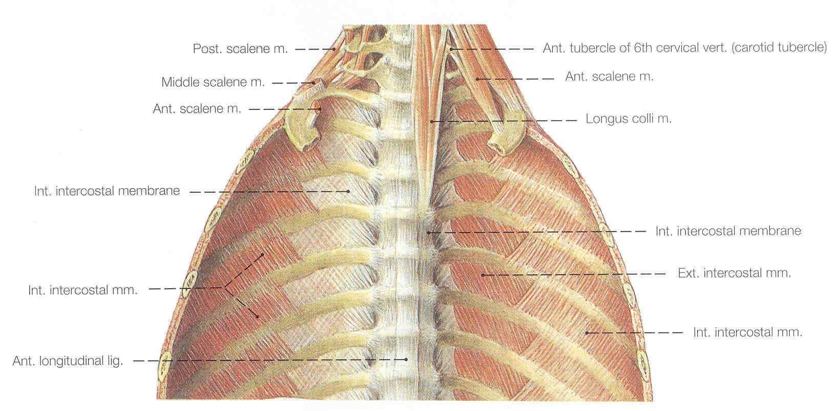

Slide 36
Subdivision of the Perineal Group
Superficial =
Urogenital/anal
external anal
sphinceter

Slide 37
Subdivision of the Perineal Group
Intermediate = Pelvic Diaphragm:
- Coccygeus
- Levator ani

Slide 38
Subdivision of the Perineal Group
Deep = Transversalis Fascia

Slide 39
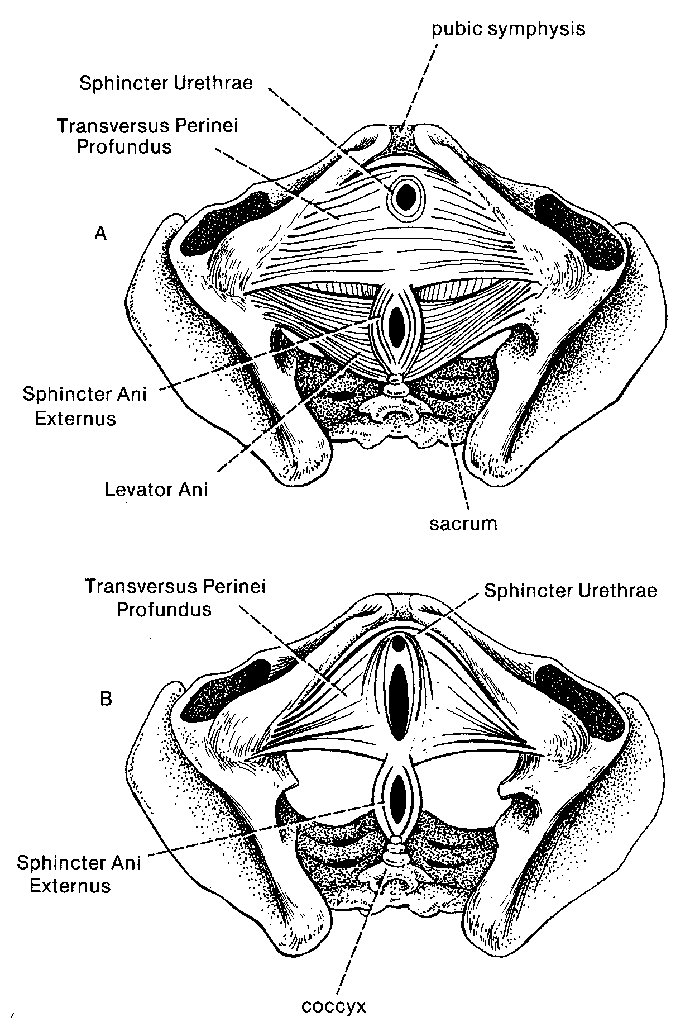

Slide 40
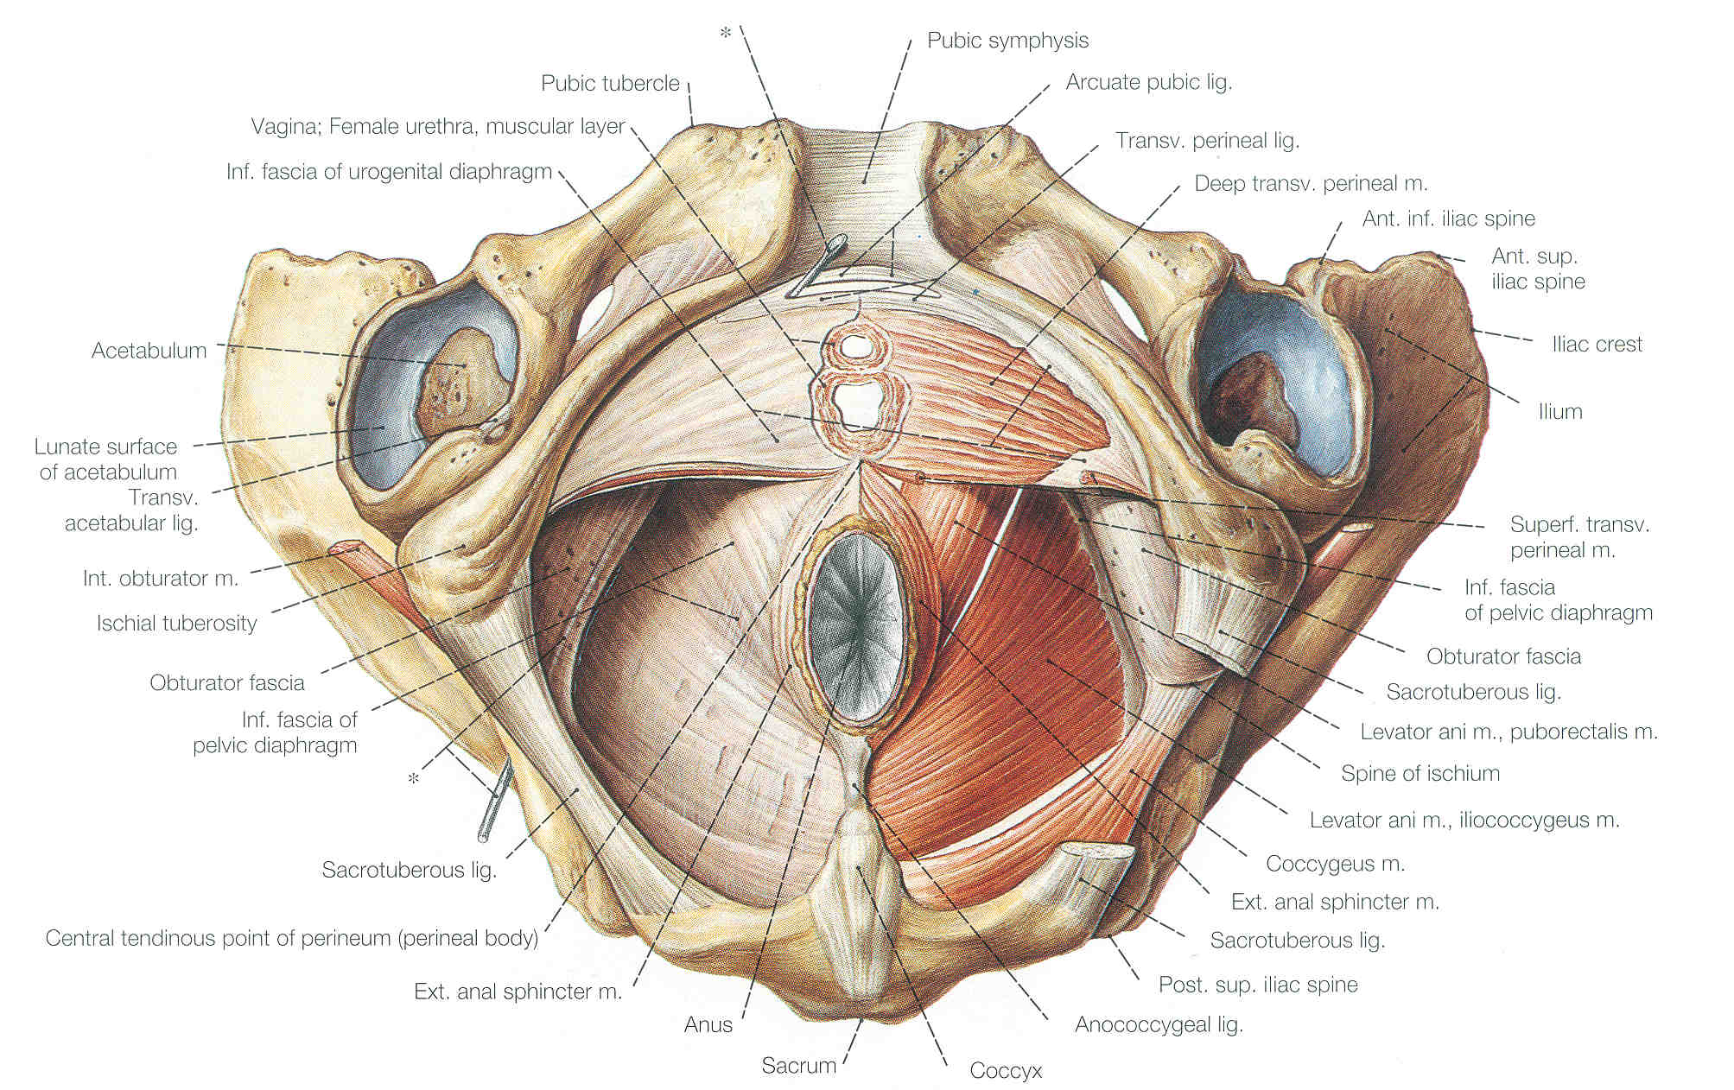

Slide 41
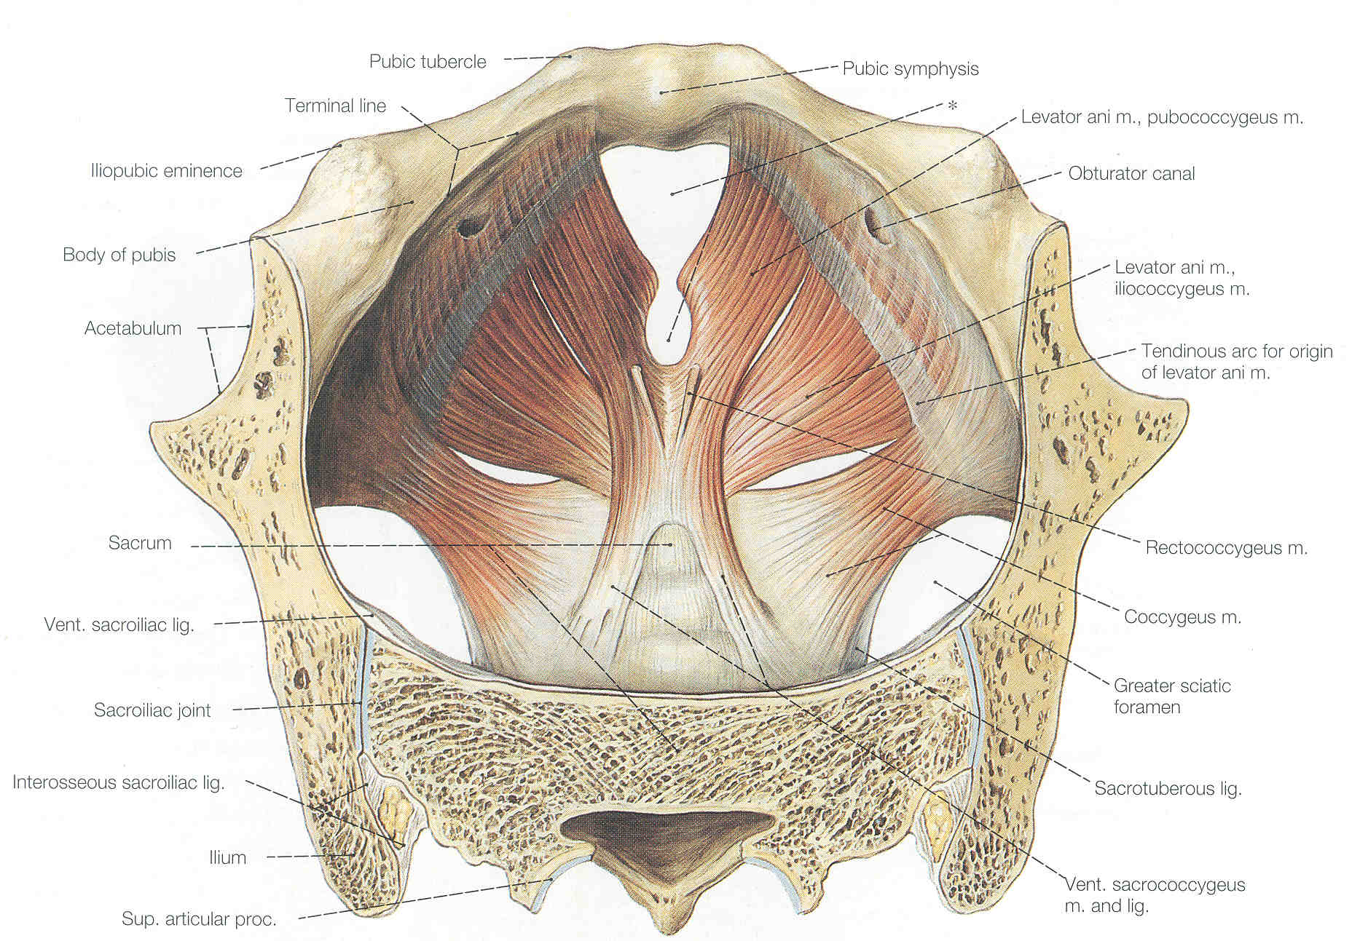

Slide 42
Subdivision of the Neck Region
Diaphragm ripped out early in development
Scalenes are what are left.

Slide 43
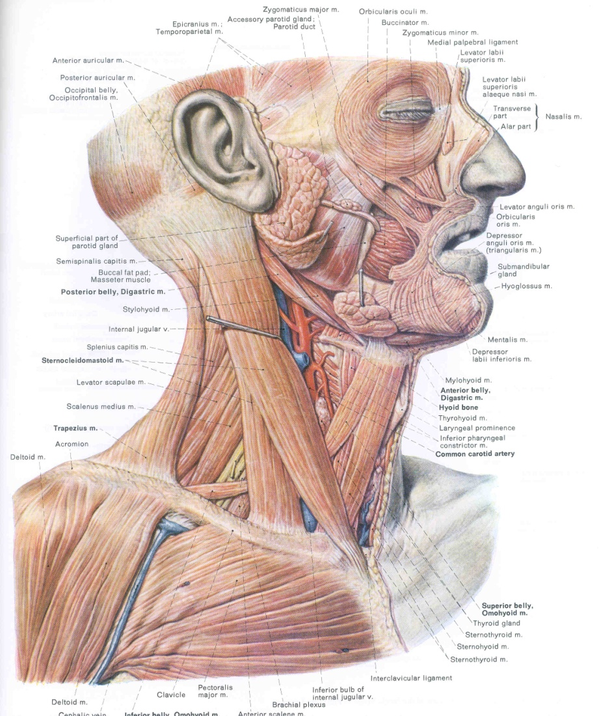
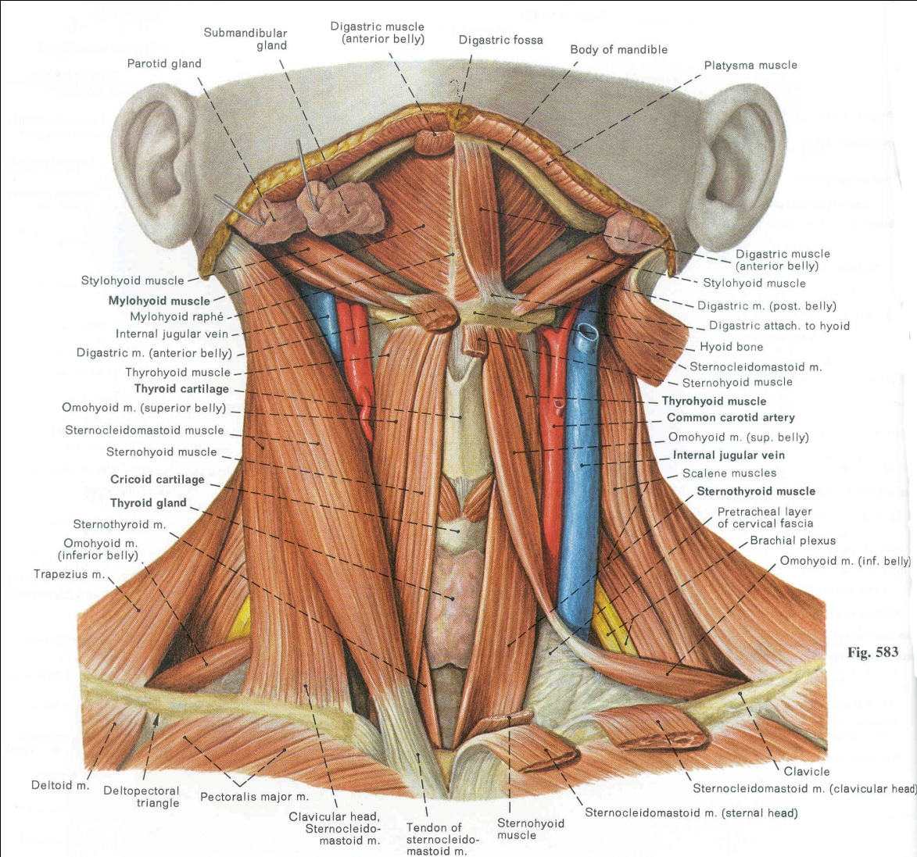

Slide 45
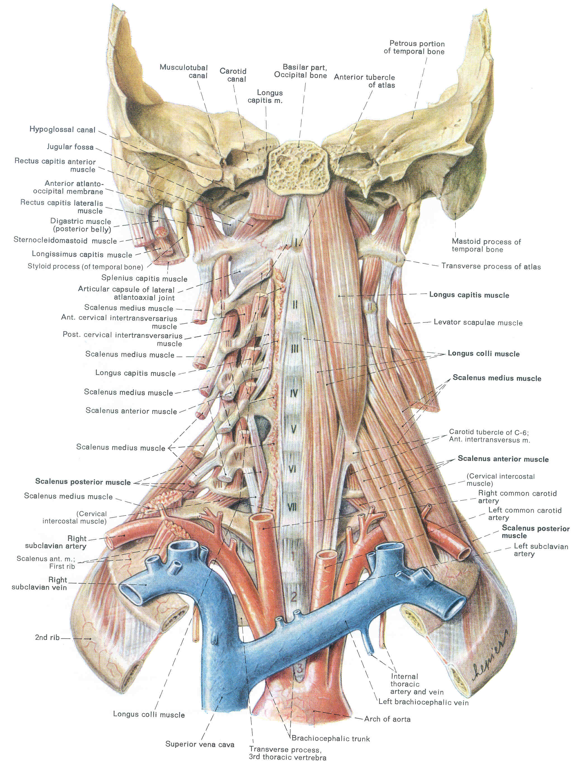

Slide 46
Strap muscles
Rectus Abdominus

Slide 47
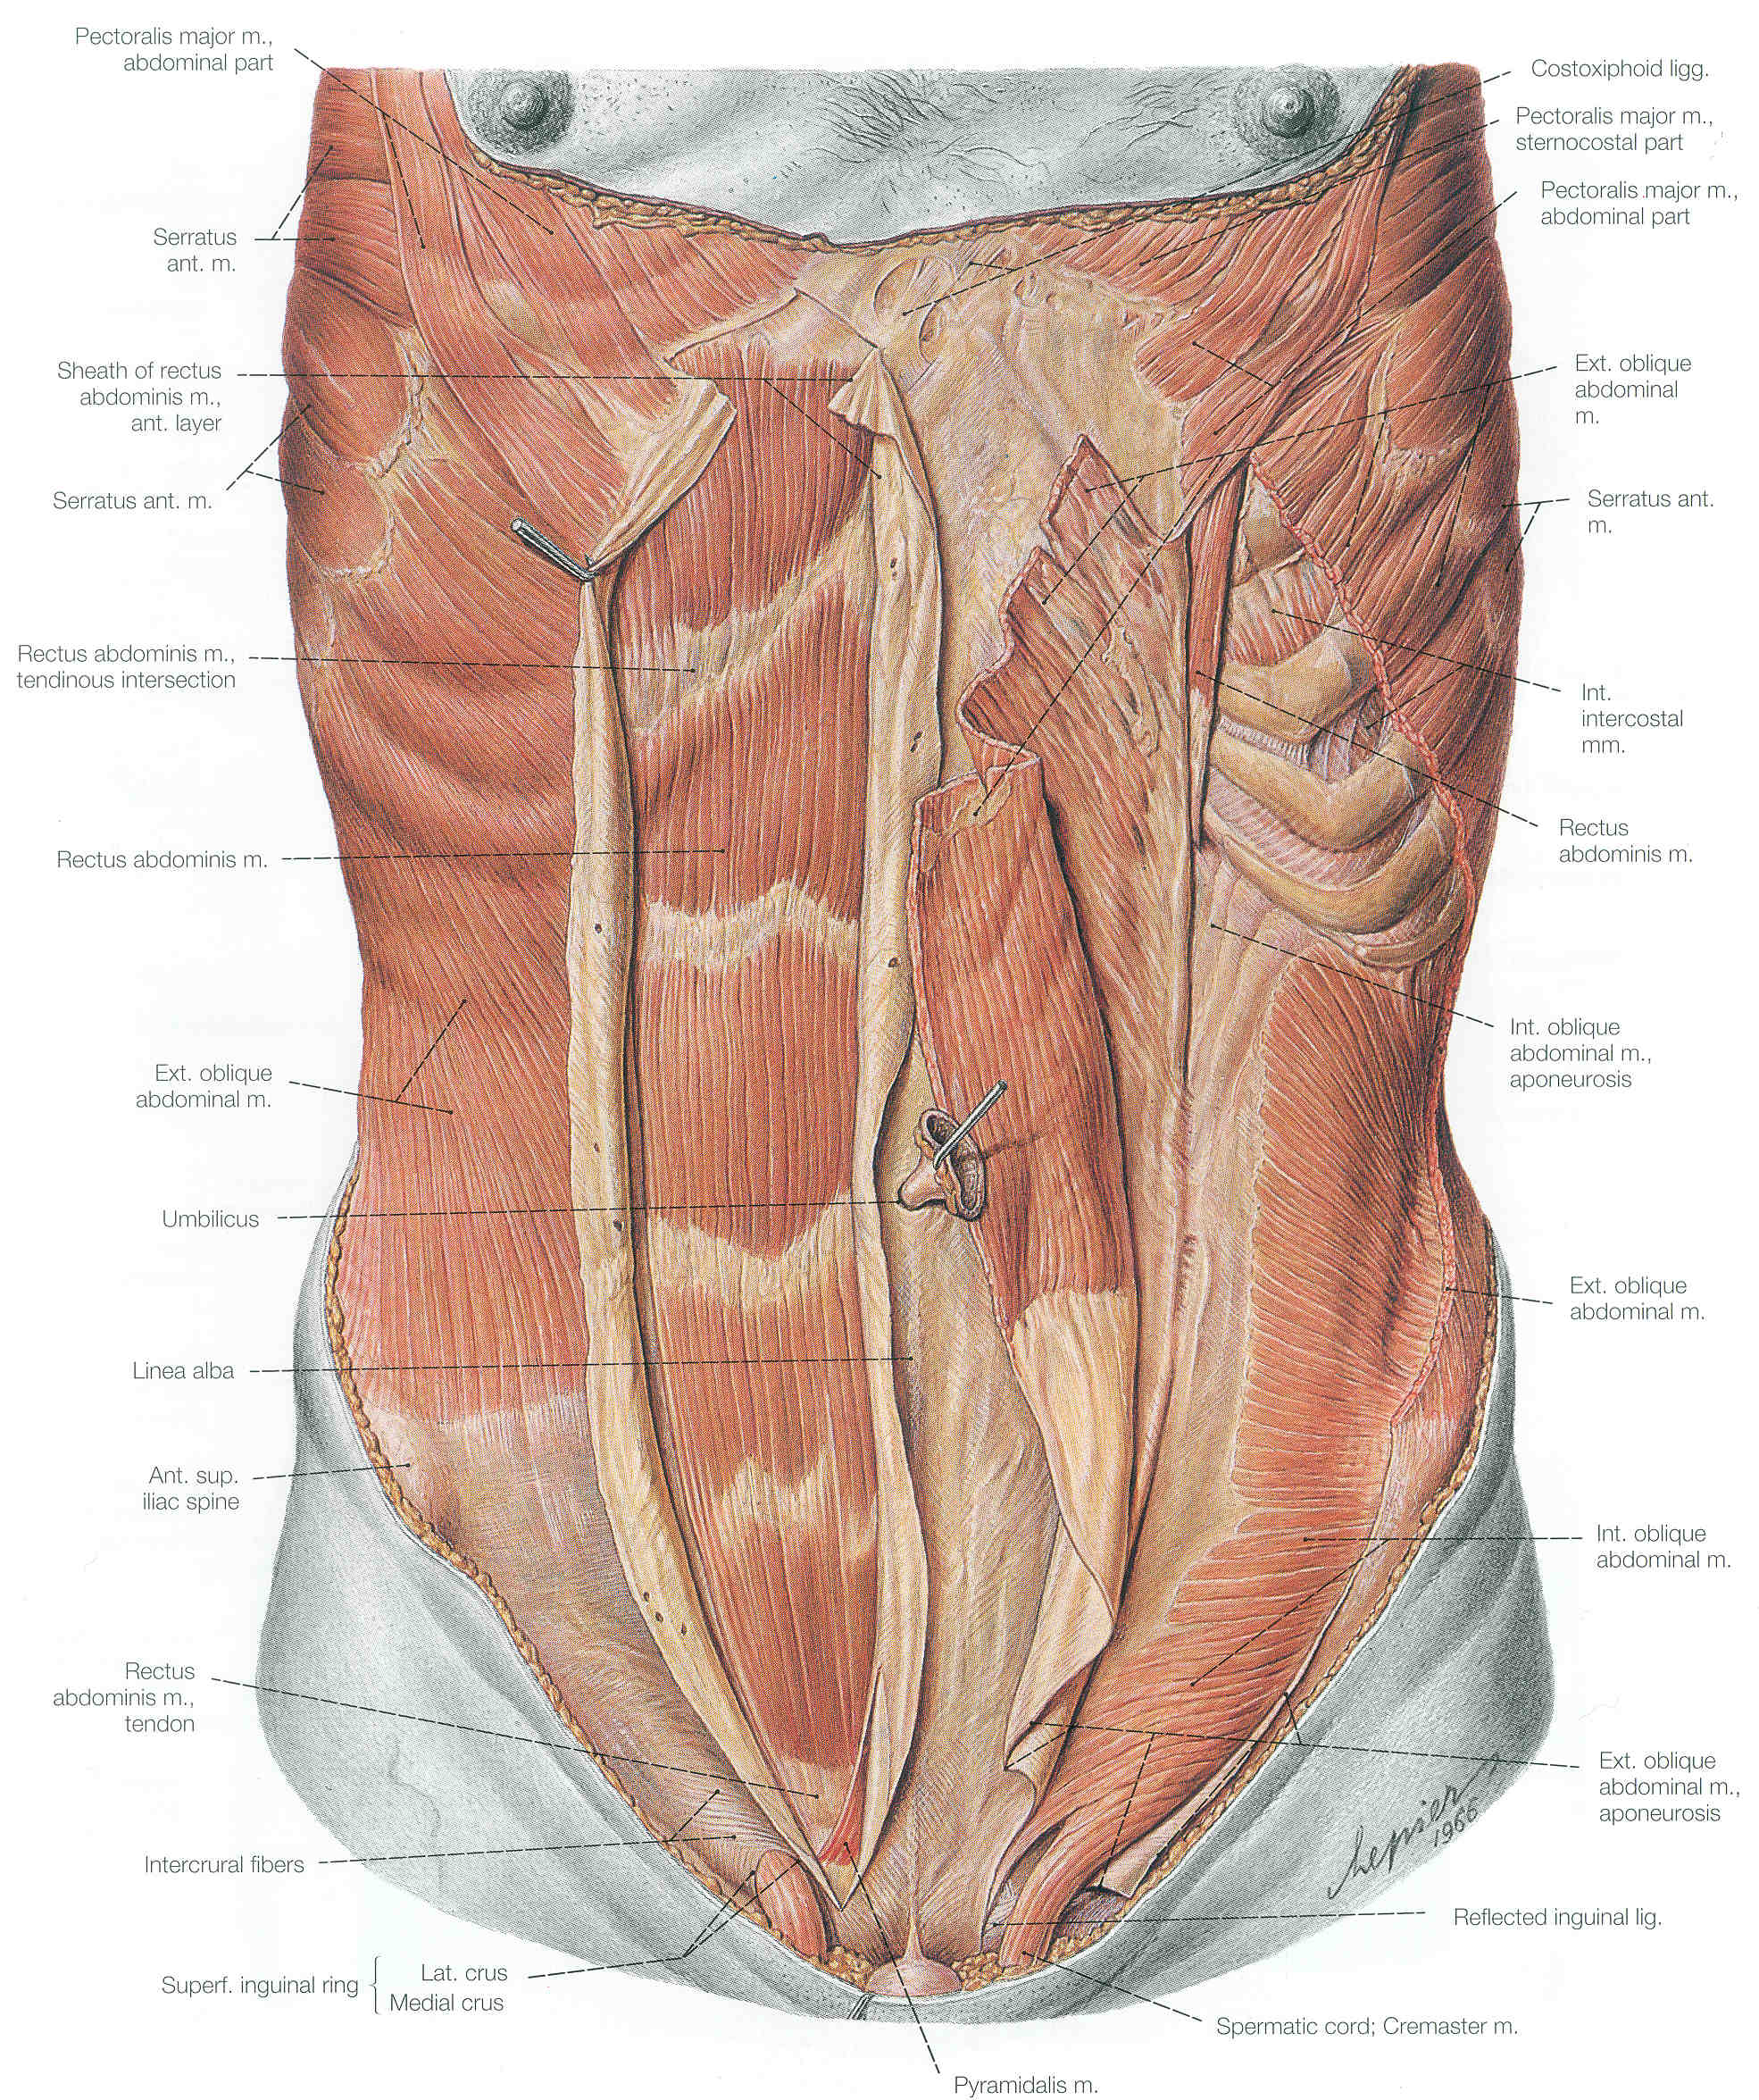

Slide 48
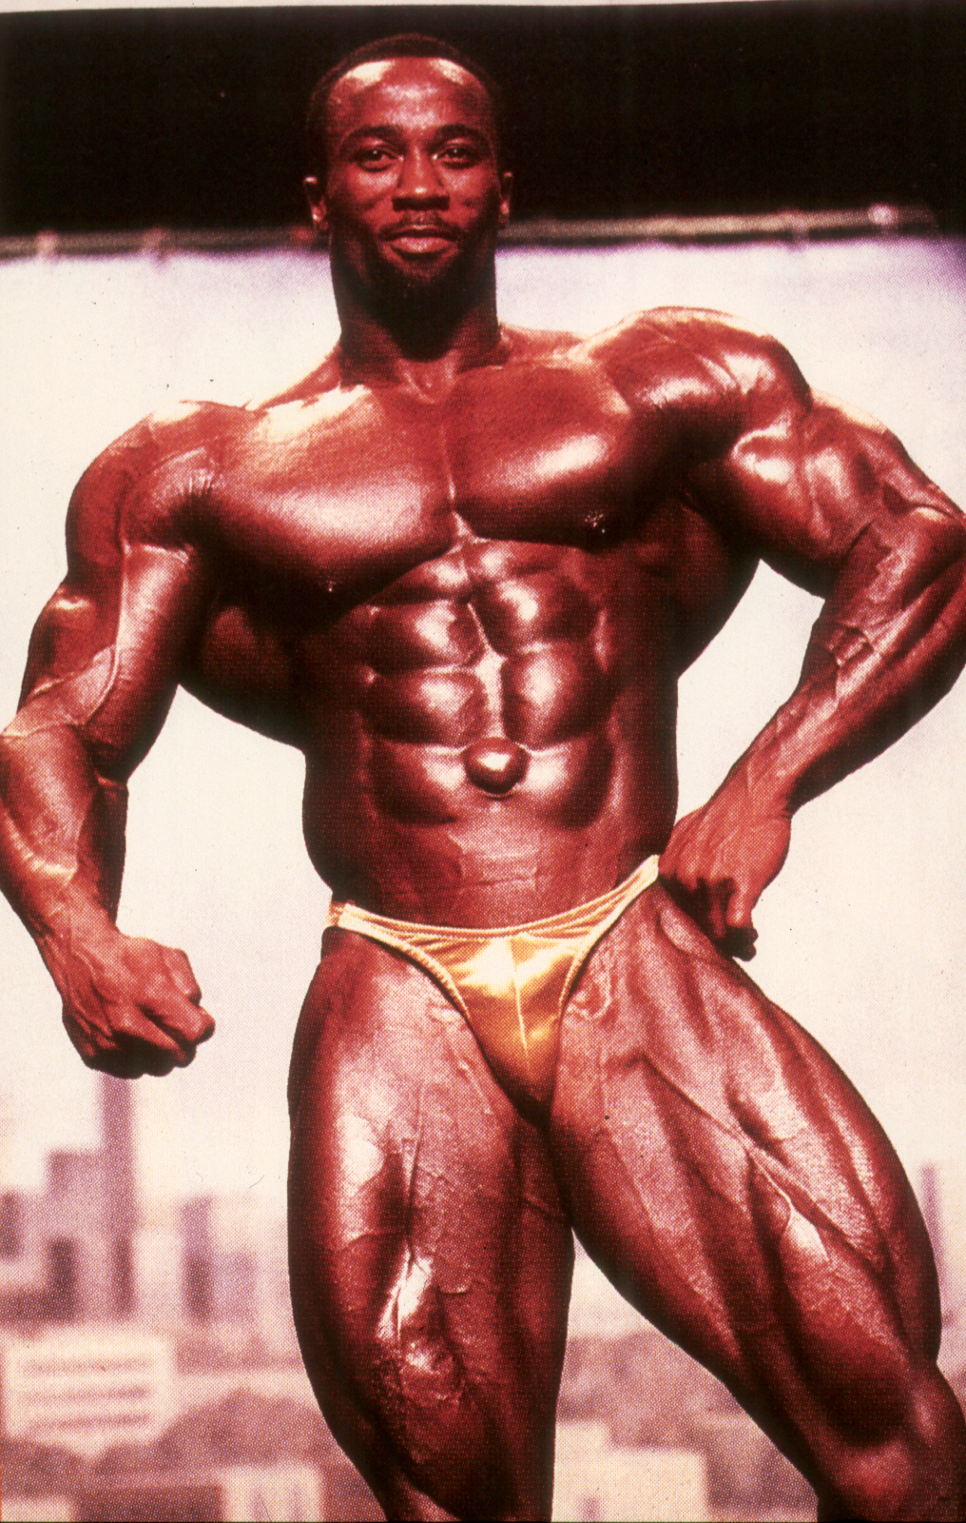

Slide 49
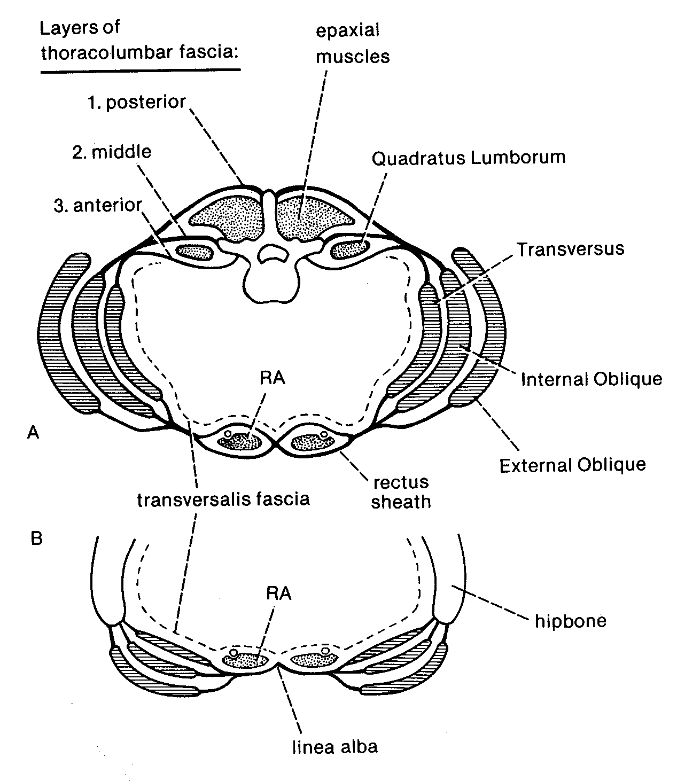

Slide 50
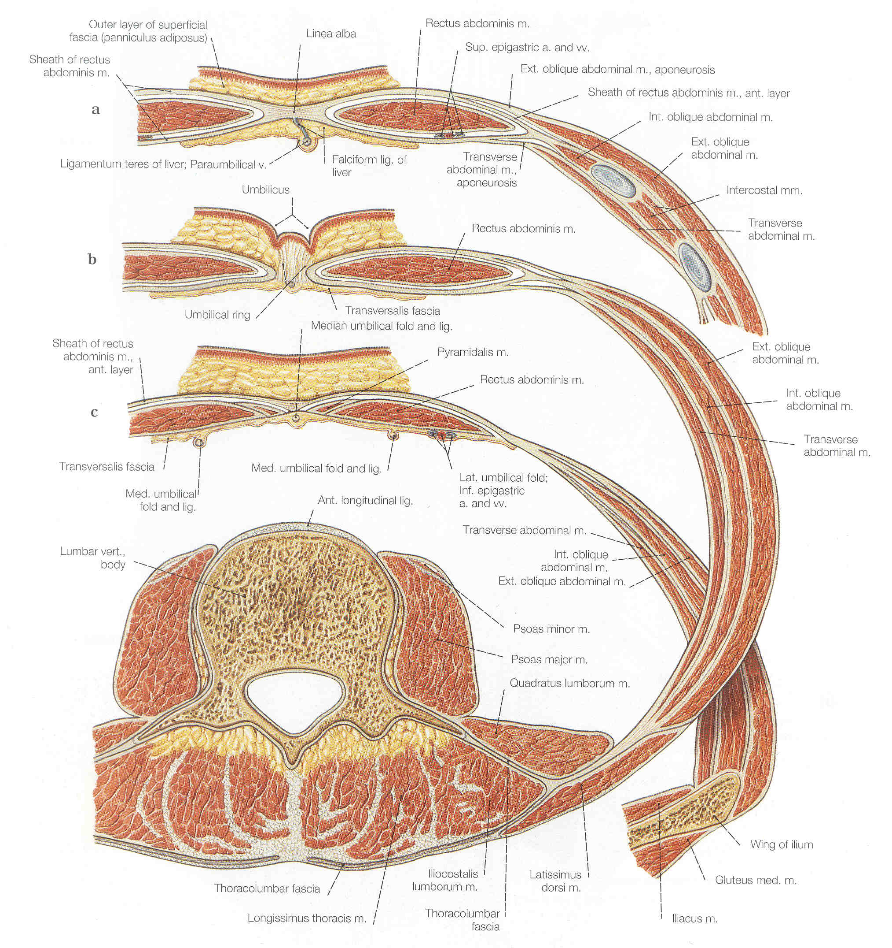

Slide 51
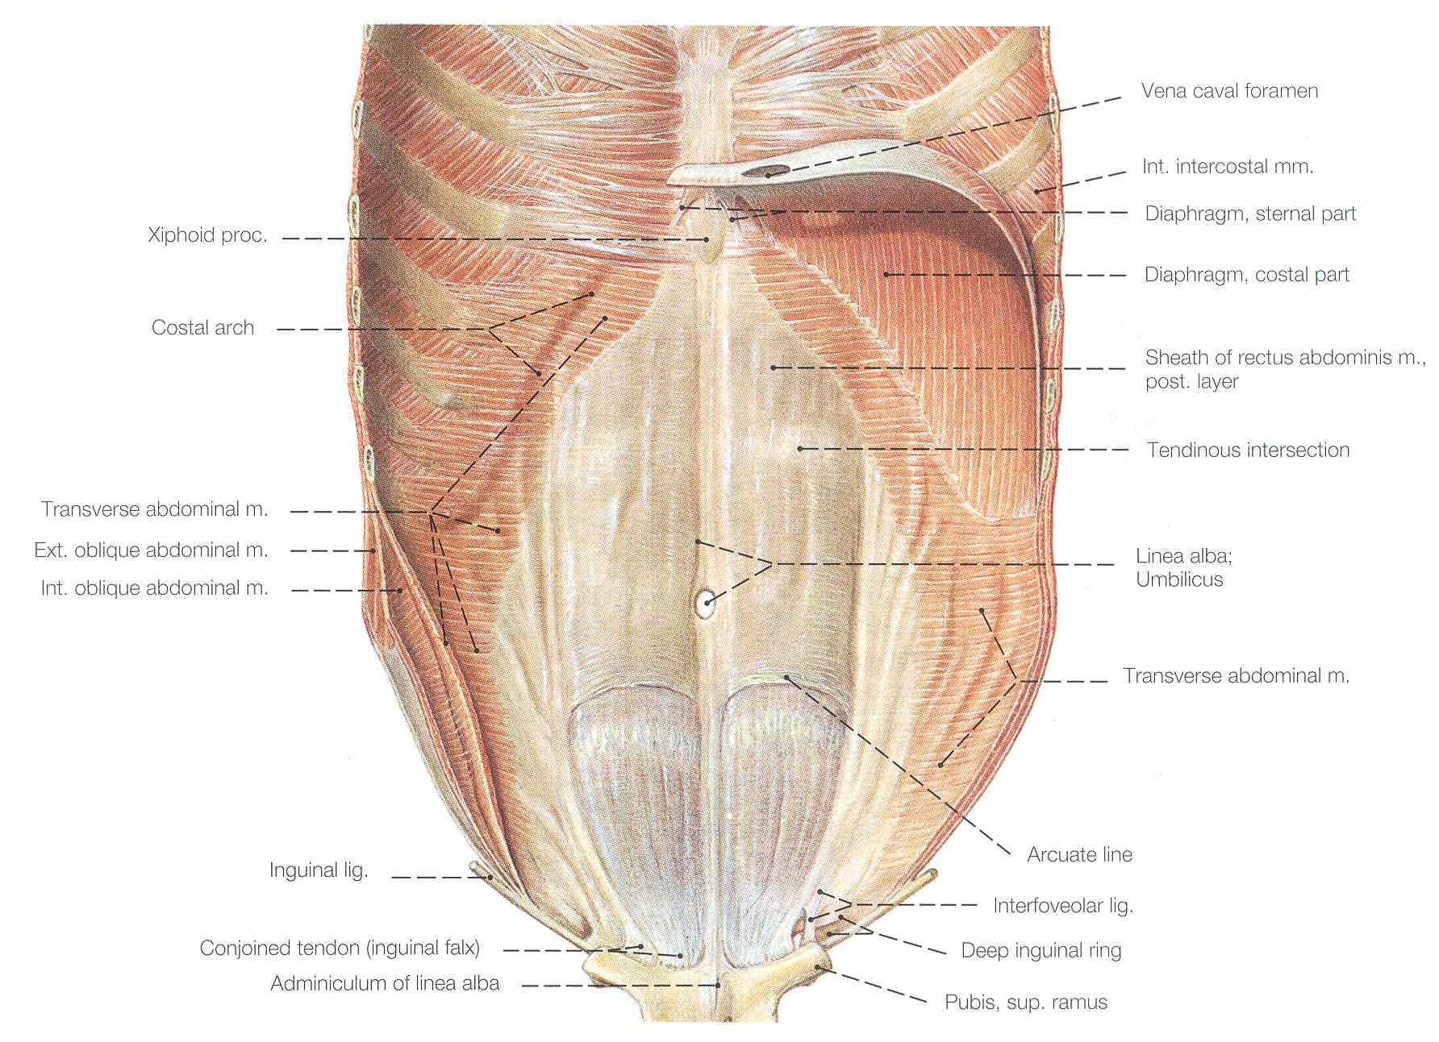

Slide 52
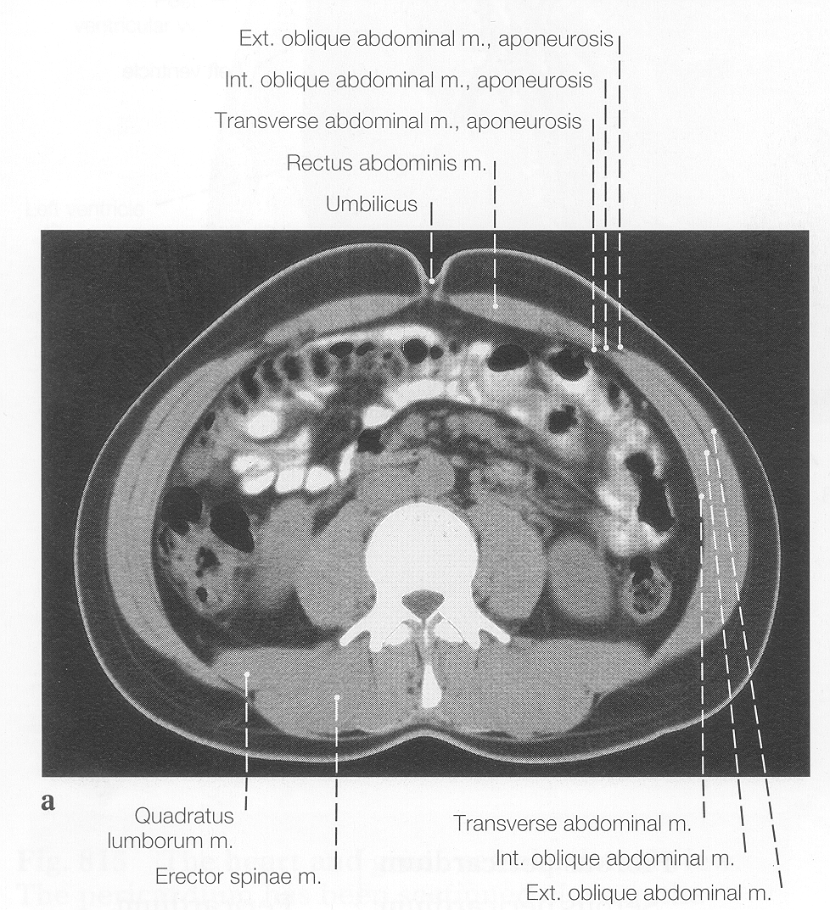

Slide 53
Strap muscles
Rectus Series
Geniohyoid

Slide 54
Strap muscles
Rectus Series
Omohyoid

Slide 55
Strap muscles
Rectus Series
Sternohyoid
Sternothyroid

Slide 56
Strap muscles
Pyramidalis

Slide 57
Appendicular Musculature

Slide 58
Innervation:
Dorsal Ramus
Epaxial
Hypaxial
Distal
Dorsal
Branch
Ventral
Ramus
Distal
Ventral
Branch
Notes:
Limb receives branches from ventral ramus of spinal nerves
Dorsal mass or musculature from distal dorsal branch
Ventral mass from distal ventral branch

Slide 59
Each limb receives more than 1 nerve:
Usually about 6

Slide 60
Posterior branches extend more distally

Slide 61
Limb Quadrants
Notes:
1: Introduction
Limb muscular is very complex.It’s best to look at it on a very simplified level, then add detail
How do we do this?
Most primitive limbs are the fins of fished: musculature is the same as a human embryo

Slide 62
Dorsal Mass
elevates (extends) limb
Ventral Mass
depresses (flexes) limb

Slide 63
Cranial (Superior)
Dorsal (Posterior)
Caudal (Inferior)
Dorsal (Posterior)
Cranial (Superior)
Ventral (Anterior)
Caudal (Inferior)
Ventral (Anterior)
Notes:
Muscles can be subdivided according to where they attach
Each set of muscles is served by a different nerve

Slide 64
Cranial (Superior)
Dorsal (Posterior)
Cranial (Superior)
Ventral (Anterior)
Caudal (Inferior)
Dorsal (Posterior)
Caudal (Inferior)
Ventral (Anterior)
Notes:
Muscles can be subdivided according to where they attach
Each set of muscles is served by a different nerve

Slide 65
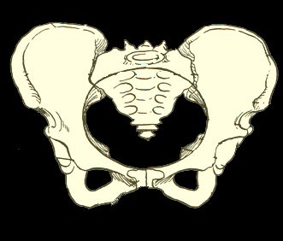

Slide 66
Cranial/Ventral:
(Superior/Anterior)
Attaches to pubic bone

Slide 67
Caudal/Ventral
Inferior/Anterior):
Attaches to Ischium

Slide 68
Cranial/Dorsal
Superior/Posterior):
Attaches to upper part of ilium

Slide 69
Caudal/Dorsal
Inferior/Posterior):
Attaches to lower part of ilium

Slide 70
Cranial/Ventral
Superior/Anterior
Cranial/Dorsal
Superior/Posterior
Caudal/Ventral
Inferior/Anterior
Caudal/Dorsal
Inferior/Posterior

Slide 71
Caudal view
Cranial (Superior)
Ventral (Anterior)
Dorsal view
Cranial (Superior)
Dorsal (Posterior)
Caudal (Inferior)
Dorsal (Posterior)
Caudal (Inferior)
Ventral (Anterior)
Ventral view
Lateral view

Slide 72
Cranial (Superior)
Ventral (Anterior)
Cranial (Superior)
Dorsal (Posterior)
Caudal (Inferior)
Dorsal (Posterior)
Reptiles=
“Sprawling”
Posture
Mammals =
“Non- Sprawling”
Posture
Caudal (Inferior)
Ventral (Anterior)

Slide 73
Ventral
(Anterior)
view
Lateral view

