Slide 1
Biology 323
Human Anatomy for Biology Majors
Lecture 8
Dr. Stuart S. Sumida
Musculature and Innervation of Pectoral Limb

Slide 2
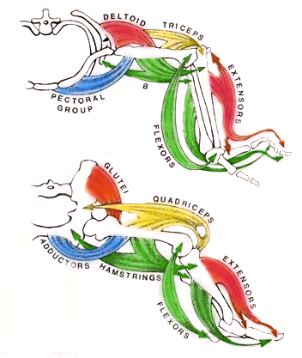
Cranial/dorsal
Triceps =
Quadriceps

Slide 3
Cranial/ventral
Pectoral Group =
Adductors

Slide 4
Caudal/dorsal
Glutei =
Deltoid
Extensors =
Extensors

Slide 5
Caudal/ventral
Hamstrings =
brachii
Flexors =
Flexors

Slide 6
Upper Limb
Complications

Slide 7
1.
Upper limb is not as firmly attached, so has extra muscles to hold it in place

Slide 8
2.
There are several large, fan shaped muscles that do not exist in the lower limb

Slide 9
3
There is more migration of tissues during early development, making the 4 quadrants more complex

Slide 10
4.
There is a large muscle that was not originally appendicular, so it has an unusual innervation and placement

Slide 11
Branchial (Gill Slit) Muscles
Attaching
Scapula to Body
Wall

Slide 12
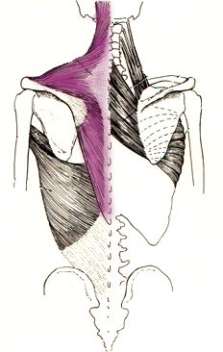
Trapezius
In more primitive species used for opening and closing gills - a
BRANCHIAL muscle.
In humans, used to move scapula and keep head up

Slide 13
Trapezius
Origin:
Occipital bone,
Spines of C7 and T1-12
Insertion:
Acromion
Spine of scapula
Lateral 1/3 of clavicle

Slide 14
Trapezius
Innervation:
Accessory Nerve (Cranial Nerve XI)
Action:
Extension of the head
Elevation and depression of scapula

Slide 15
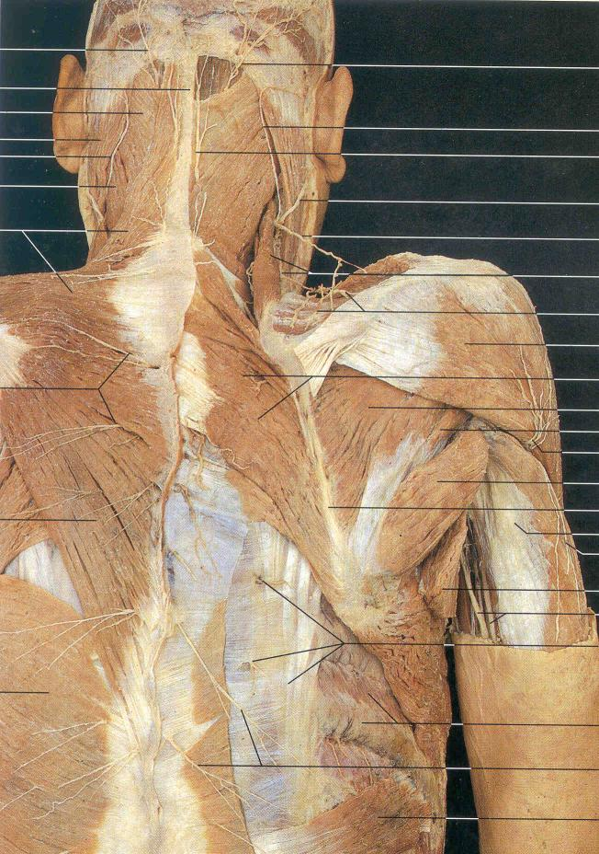
Trapezius

Slide 16
Axial Muscles
Attaching
Scapula to Body
Wall

Slide 17
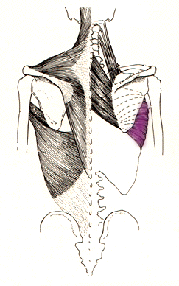
Serratus Anterior
Origin:
First 9 ribs
Insertion:
Medial edge of scapula’s deep surface

Slide 18
Serratus Anterior
Innervation:
Long thoracic nerve
Action:
Rotates scapula
Primitively a BODY WALL MUSCLE

Slide 19
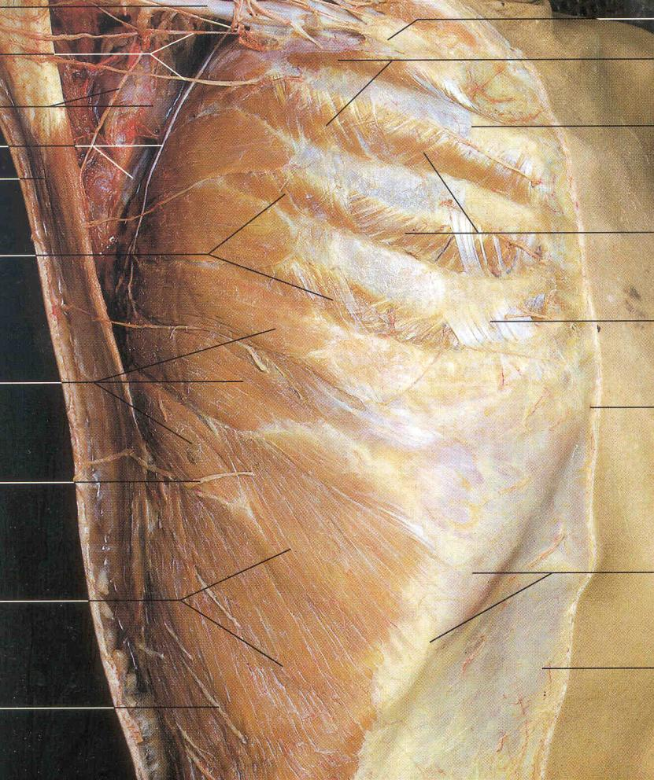
Serratus
Anterior

Slide 20
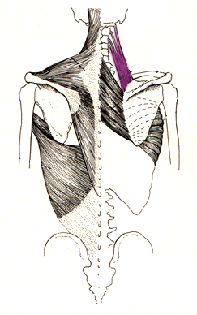
Levator Scapulae
Origin:
Transverse processes of C1-4
Insertion:
Medial edge of scapula

Slide 21
Levator Scapulae
Innervation:
Ventral Rami of C3 and C4
Action:
Retracts scapula Depresses glenoid

Slide 22
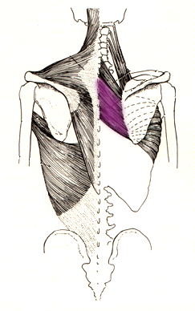
Rhomboidius Major
Origin:
Spines of T2-T5
Insertion:
Medial edge of scapula

Slide 23
Rhomboidius Major
Innervation:
Dorsal Scapula
Action:
Retracts scapula Depresses glenoid

Slide 24
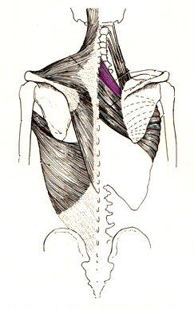
Rhomboidius Minor
Origin:
Spines of C7 and T1
Insertion:
Medial edge of scapula
Note: minor is superior, but SMALLER

Slide 25
Rhomboidius Minor
Innervation:
Dorsal Scapula
Action:
Retracts scapula Depresses glenoid

Slide 26
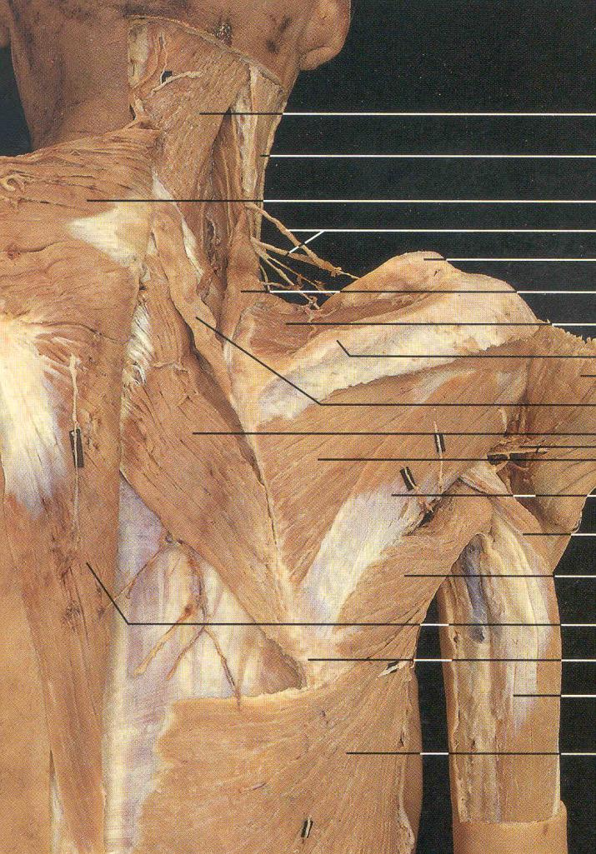
Levator Scapulae
Rhomboid Minor
Rhomboid Major

Slide 27
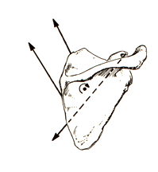
Levator Scapulae
Depression
Rhom-
boids
Pecoralis
Minor

Slide 28
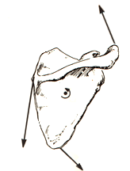
Trapezius
Elevation
Serratus
Anterior
Trapezius

Slide 29
Dorsal and Ventral Appendicular Muscles

Slide 30
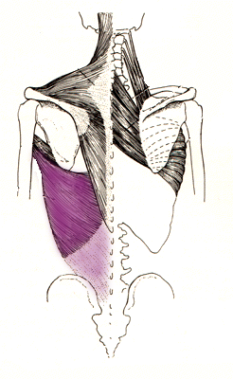
Latissimus Dorsi
Origin:
Spines of T7-T12
Thoracolumbar fascia
Insertion:
Humerus: Inertubecular groove
And lesser tubecular crest
Innervation:
Thoracodorsal Nerve

Slide 31
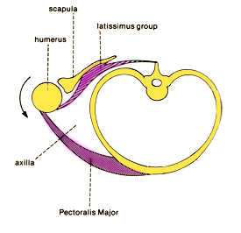
Latissiumus: Extends, adducts and medially rotates humerus
Pectoralis: is large, fan-shaped muscle opposing it ventrally

Slide 32
Ventral Musculature

Slide 33
The Pectoralis Group is a large, fan-shaped group that SPANS cranial-ventral and caudal-ventral regions.

Slide 34
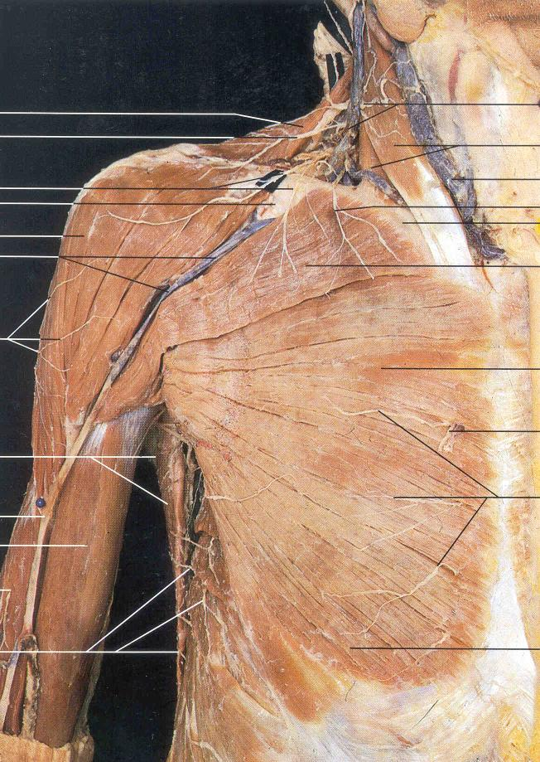
Pectoralis Major:
Clavicular Head:
Origin: inferior margin of clavicle
Insertion: Delto-pectoral crest of HUMERUS
Sternal Head:
Origin: Ventro-lateral margin of sternum
Insertion: Delto-pectoral crest of HUMERUS

Slide 35
Pectoralis Major:
Clavicular Head:
Origin: inferior margin of clavicle
Insertion: Greater tubercular crest of HUMERUS
Innervation: Medial and lateral pectoral nerves

Slide 36
Pectoralis Major:
Sternal Head:
DEPRESSOR, ADDUCTOR of humerus
Origin: Ventro-lateral margin of sternum; costal cartilages 1-6
Insertion: Greater tubercular crest of HUMERUS
Innervation: Medial and lateral pectoral nerves

Slide 37
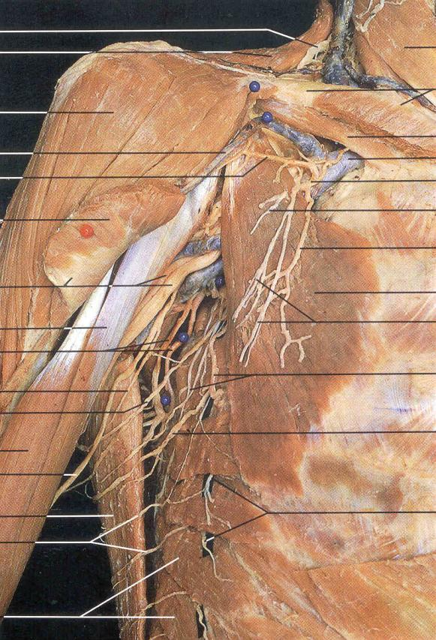
Pectoralis MINOR:
Deep to Pec. Major
Origin:Ribs 3-6.
Insertion: Coracoid Process of Scapula
Innervation:
Function: Stabilization of scapula
Positionally important for understanding location of other structures.

Slide 38
Musculature of the Shoulder:
Muscles Connecting Scapula to Humerus

Slide 39
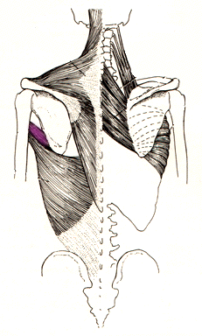
Elevators
Teres Major
Origin: Lower edge of scapula
Insertion: Lesser tubercular crest
Action: Extends, Adducts & Medially rotates humerus
Innervation: Lower scapular

Slide 40
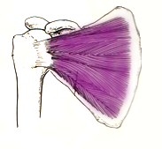
Elevators
Subscapularis
Origin: Deep surface of scapula
Insertion: Lesser tubercle
Action: Medially rotates humerus
Innervation: Upper and lower scapular

Slide 41
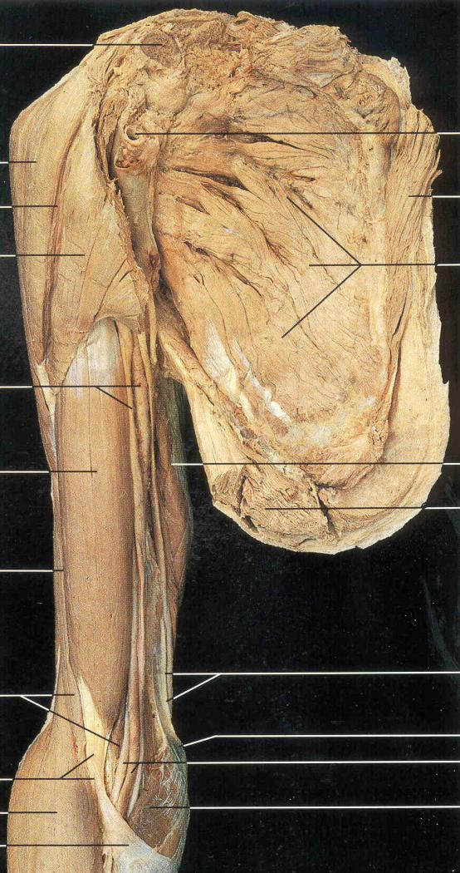
Internal View:
Subscapularis

Slide 42
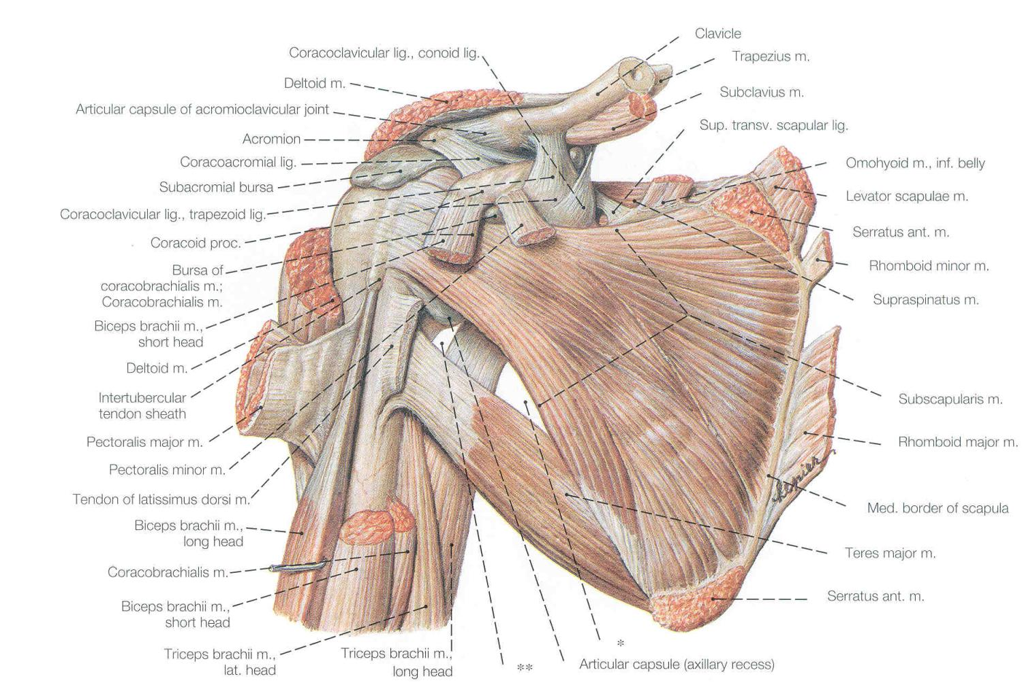

Slide 43
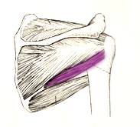
Elevators
Teres Minor
Origin: Lower edge of scapula
Insertion: Greater tubercle
Action: Laterally rotates humerus
Innervation: Axillary

Slide 44
Teres Minor

Slide 45
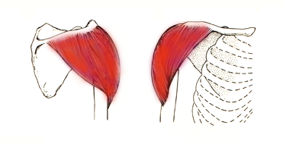
Elevators
Deltoideus
Origin: Lateral half of clavicle , Scapular spine, acromion process
Insertion: Deltoid tuberosity of humerus
Action: Abducts humerus (also flexes, extends, rotates and adducts)
Innervation: Axillary nerve

Slide 46
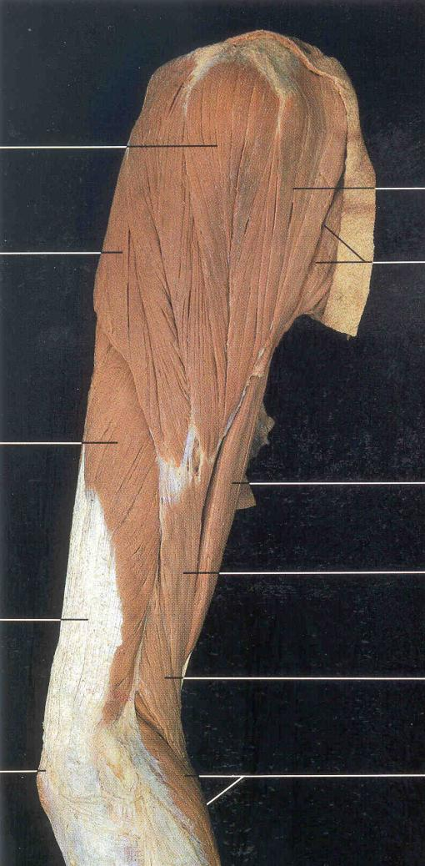
Deltoid

Slide 47
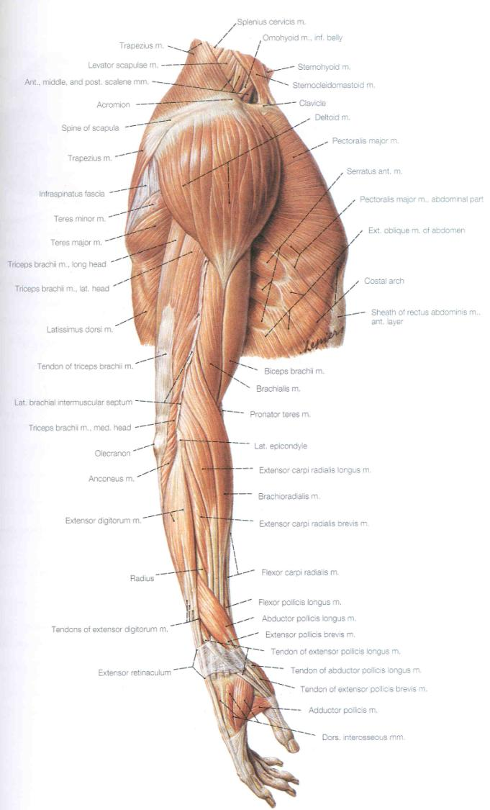

Slide 48
Depressors
Pectoralis Major
(Sternal Head)
Origin: Medial half of clavicle, sternum, costal cartilages 1-6
Insertion: Greater tubercular crest
Action: Medially rotates, flexes and adducts humerus
Innervation: Lateral and medial pectoral

Slide 49
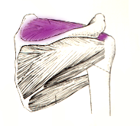
Depressors
Supraspinatus
Origin: Supraspinous fossa of scaupla
Insertion: Greater tubercle of humerus
Action: Abducts humerus
Innervation: Subscapular

Slide 50
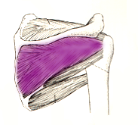
Depressors
Infraspinatus
Origin: Infraspinous fossa of scapula
Insertion: Greater tubercle of humeus
Action: Laterally rotates humerus
Innervation: Subscapular

Slide 51
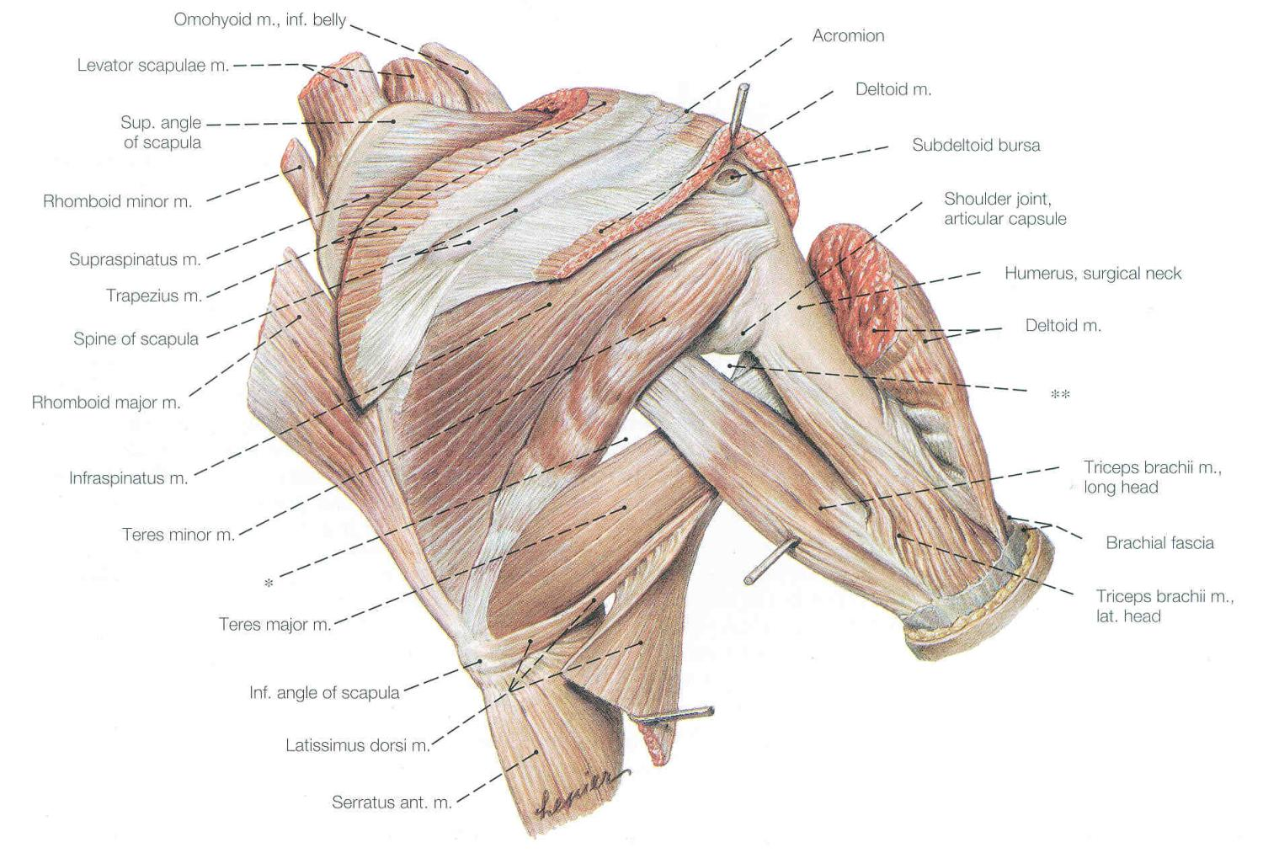

Slide 52
Supraspinatus
Infraspinatus
Teres Minor

Slide 53
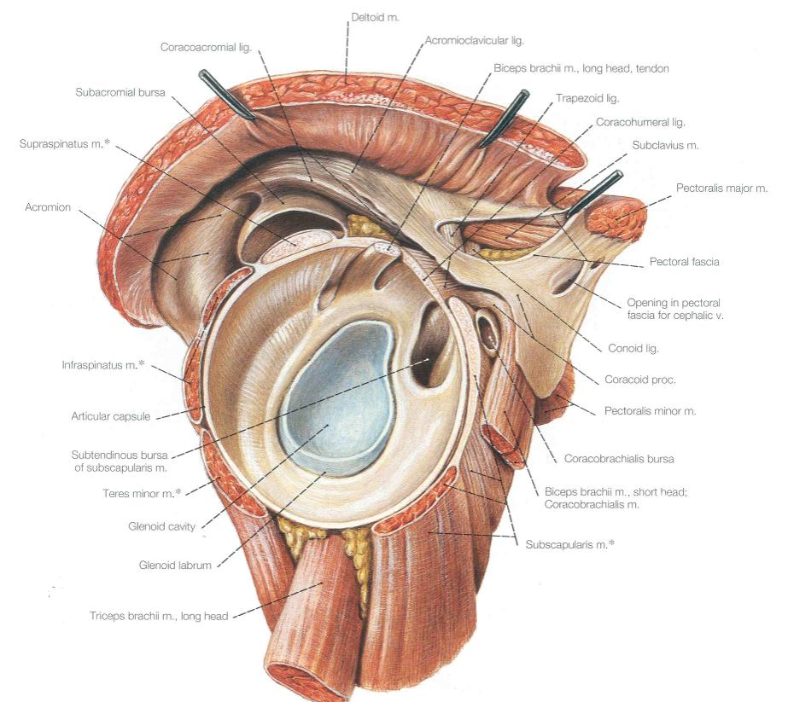
Muscles of the Rotator Cuff
Supraspinatus
Infraspinatus
Teres Minor
Subscapularis

Slide 54
Musculature Crossing the Elbow Joint

Slide 55
Muscles moving the elbow all cross the joint and insert on the bones of the forearm.
They may originate from the scapula or the brachium (humerus).

Slide 56
D
Which muscle is NOT a flexor of the elbow?
C
A
Answer =A
Coracobrachialis
B

Slide 57
The Coracobrachialis makes up part of the mass of the upper arm but doesn’t actually cross the joint (scapula to humerus only).

Slide 58
Origin: coracoid process
Insertion: Humerus
Flexion and adduction
of humerus.
Musculocutaneous nerve

Slide 59
Elbow extensors
Triceps brachii
(Radial Nerve)

Slide 60
Cranial/dorsal
Triceps =
Quadriceps

Slide 61
Origin:
Long Head: Glenoid Fossa
Medial & Lateral Heads:
Posterior surface of humeral shaft
Insertion:
Olecranon process of ulna
Action: Extends elbow

Slide 62
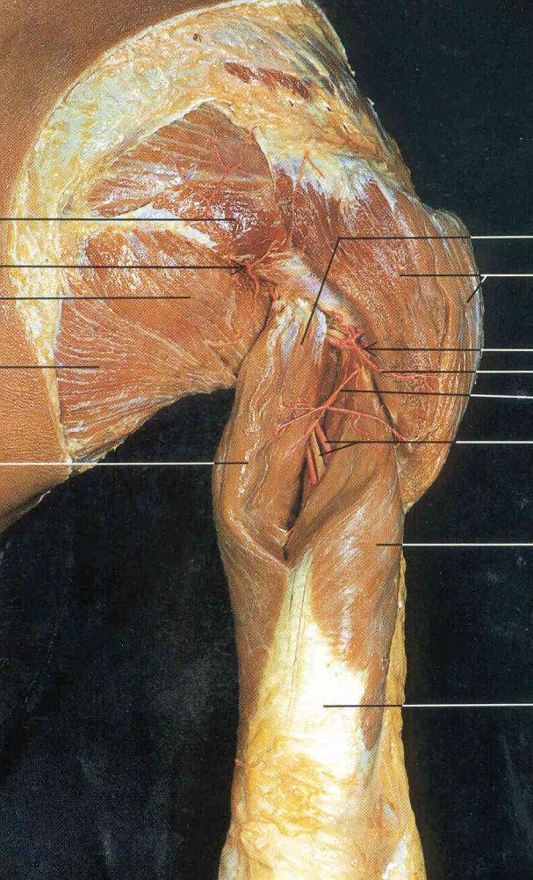
Triceps Long Head
Triceps, Lateral Head

Slide 63
Elbow flexors
Brachii (brachial group)
(Here, spelling counts…)

Slide 64
Caudal/ventral
Hamstrings =
brachii

Slide 65
Biceps brachii (musculocutaneous n.)
Origin:
Short head: coracoid process
Long head; glenoid fossa
Insertion:
Proximal radius
Action:
Flexes elbow
supinates

Slide 66
Brachialis
(musculocutaneous n.)
Origin:
Humeral shaft
Insertion
Proximal ulna
Action: flexes elbow

Slide 67
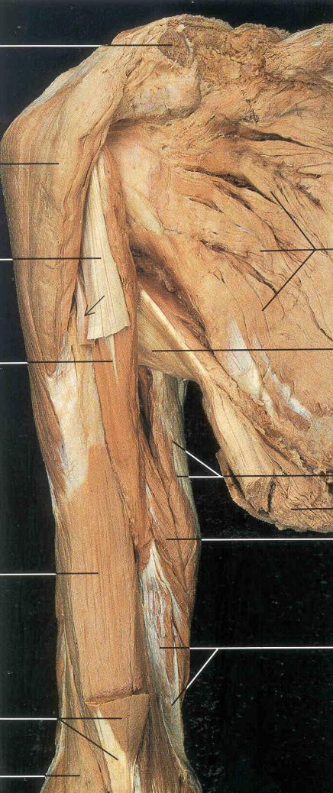
Corcobrachialis
Brachialis
Biceps

Slide 68
Brachioradialis
(Radial n.* exception)
Origin:
distal humerus
Insertion:
Styloid process of ulna
Action:
Flexes elbow

Slide 69
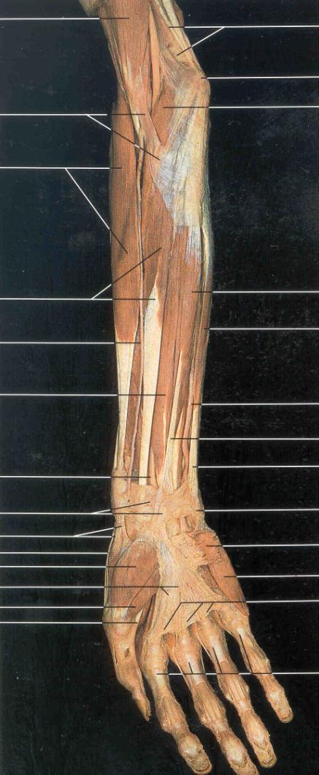
Brachioradialis
Flexor Carpi Radialis
Flexor Digitorum
Superficialis
Flexor Carpi Ulnaris

Slide 70
FLEXORS of the Wrist

Slide 71
Caudal/ventral
Flexors =
Flexors

Slide 72
Superficial Layer
Flexor carpi radialis
Median n.
Origin:
Medial epicondyle of humerus
Insertion:
Base of 2nd & 3rd metacarpals
Action:
Flexes wrist; abducts hand

Slide 73
Superficial Layer
Palmaris longus
Median n.
Origin:
Medial epicondyle of humerus
Insertion:
Palmar aponeurosis
Action:
Flexes wrist

Slide 74
Superficial Layer
Flexor carpi ulnaris
Ulnar n.
Origin:
Medial epicondyle of humerus
Insertion:
Pisiform and base of 5th metacarpal
Action:
Flexes wrist; adducts hand

Slide 75
Intermediate Layer
Flexor digitorum superficialis
Median n
Origin:
Medial epicondyle of humerus
Insertion:
Middle phalanges of fingers 2-5
Action:
Flexes wrist and middle phalanges

Slide 76
Deep Layer
Flexor pollicis longus
Median n
Origin:
Anterior surface of radius
Insertion:
Distal phalanx of thumb
Action:
Flexes distal phalanx of thumb

Slide 77
Deep Layer
Flexor digitorum profundus
Median n
Origin:
Anteromedial surface ulna
Insertion:
Distal phalanges of fingers 2-5
Action:
Flexes distal phalanges

Slide 78
Brachioradialis
Flexor Carpi Radialis
Flexor Digitorum
Superficialis
Flexor Carpi Ulnaris

Slide 79
EXTENSORS of the Wrist

Slide 80
Caudal/dorsal
Extensors =
Extensors

Slide 81
Superficial
Extensor carpi radialis
brevis
Radial n.
Origin:
Lateral epicondyle of
humerus
Insertion:
Base of 3rd metacarpal
Action:
Extends and abducts wrist

Slide 82
Superficial
Extensor digitorum minimi
Radial n.
Origin:
Lateral epicondyle of humerus
Insertion:
Distal phalange of little finger
Action:
Extends little finger

Slide 83
Superficial
Extensor digitorum
Radial n.
Origin:
Lateral epicondyle of humerus
Insertion:
Distal phalange of fingers 2-4
Action:
Extends fingers and wrist;
abduct fingers

Slide 84
Extensor Carpi
Ularis
Extensor Indicis
Extensor Digitorum
Superficialis
Extensor Carpi Radialis
Abductor Pollicis Longus
Extensor Retinaculum

Slide 85
Deep
Extensor indices
Radial n.
Origin:
Posterior surface of distal ulna
Insertion:
Extensor expansion of index finger
Action:
Extends index finger

Slide 86
Deep
Extensor pollicis longus
Radial n.
Origin:
Dorsal shaft of radius and ulna
Insertion:
Base of distal phalanx of thumb
Action:
Extends thumb

Slide 87
Deep
Extensor pollicis brevis
Radial n.
Origin:
Dorsal shaft of radius and ulna
Insertion:
Base of proximal phalanx of thumb
Action:
Extends thumb

Slide 88
Deep
Abductor pollicis longus
Radial n.
Origin:
Posterior surface of radius and
ulna
Insertion:
Base of 1st metacarpal
Action:
Abducts and extends thumb

Slide 89
Muscles of Pronation and Supination

Slide 90
Deep
Abductor pollicis longus
Radial n.
Origin:
Posterior surface of radius and
ulna
Insertion:
Base of 1st metacarpal
Action:
Abducts and extends thumb

Slide 91
Supination:
Movement of the radius and ulna
Lateral rotation of the arm so palm faces superiorally
(anatomical position)

Slide 92
Ulna and Radius are parallel

Slide 93
Pronation:
Opposite of supination
Medial rotation of the arm so palm faces inferiorally
Relaxed position

Slide 94
Ulna and Radius are crossed

Slide 95
Supination
Supinator
Radial n.
Origin:
Lateral epicondyle of humerus
Insertion:
Proximal end of radius
Action:
Supinates forearm
Notes:
1: Introduction
Limb muscular is very complex.It’s best to look at it on a very simplified level, then add detail
How do we do this?
Most primitive limbs are the fins of fished: musculature is the same as a human embryo

Slide 96
Supinator

Slide 97
Supination
Biceps brachii
musculocutaneous n.
Origin:
Short head: coracoid process
Long head; glenoid fossa
Insertion:
Proximal radius
Action:
Flexes elbow
supinates
Notes:
1: Introduction
Limb muscular is very complex.It’s best to look at it on a very simplified level, then add detail
How do we do this?
Most primitive limbs are the fins of fished: musculature is the same as a human embryo

Slide 98
Pronation
Pronator teres
Median n.
Origin:
Medial condyle of humerus
Coronoid process of ulna
Insertion:
Lateral radius (midshaft)
Action:
Pronates forearm
Notes:
1: Introduction
Limb muscular is very complex.It’s best to look at it on a very simplified level, then add detail
How do we do this?
Most primitive limbs are the fins of fished: musculature is the same as a human embryo

Slide 99
Pronation
Pronator quadratus
Median n.
Origin:
Distal portion of anterior ulnar
shaft
Insertion:
Distal surface of anterior radius
Action:
Pronates forearm
Notes:
1: Introduction
Limb muscular is very complex.It’s best to look at it on a very simplified level, then add detail
How do we do this?
Most primitive limbs are the fins of fished: musculature is the same as a human embryo

Slide 100
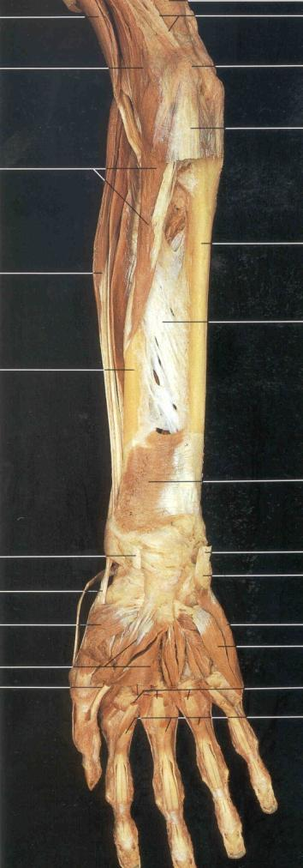
Pronator Teres
Pronator Quadratus

