Slide 1
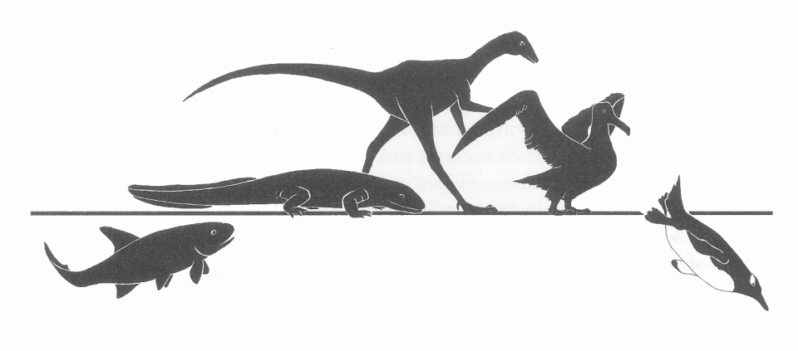
Stuart S. Sumida
Biology 342
Phylogey of Basal Chordata

Slide 2
FEATURES TRADITIONALLY CONSIDERED TO BE SYNAPOMORPHIES OF CHORDATA:
Dorsal Hollow Nerve Cord
Notochord
Pharyngeal Gill Slits or Pouches
Endostyle
Post-anal Tail
Segmented Body Musculature

Slide 3
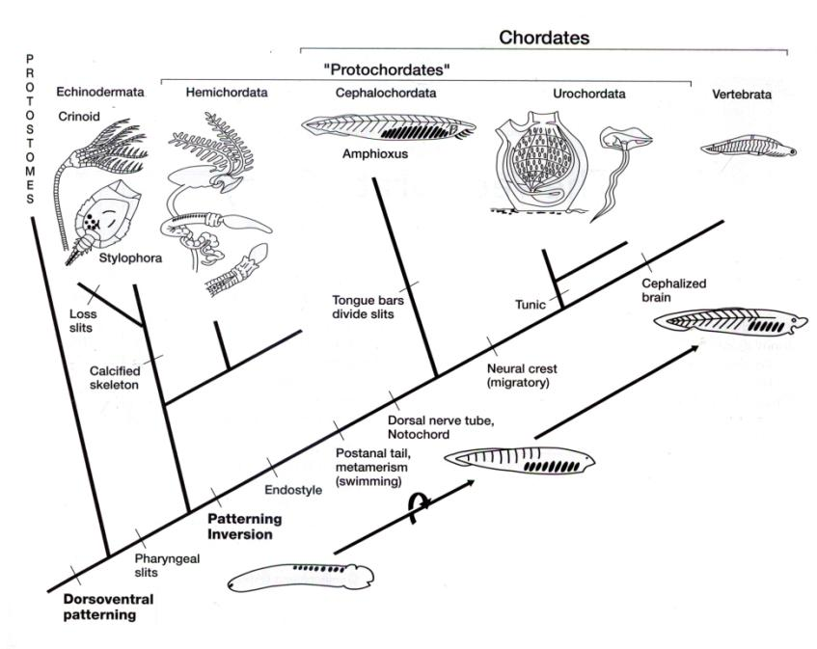

Slide 4
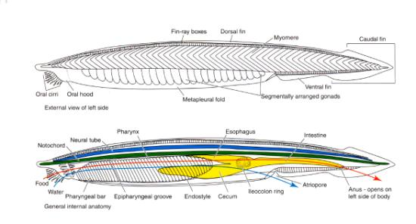
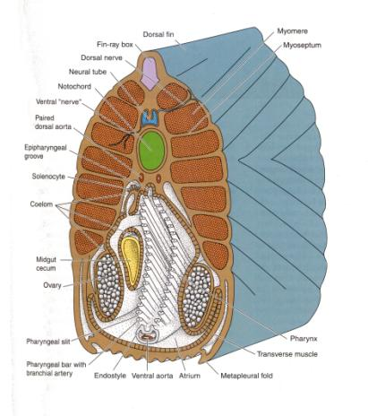
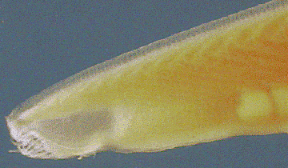

Slide 5
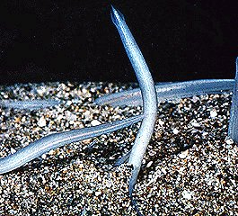
More “fish-like” CEPHALOCHORDATA

Slide 6
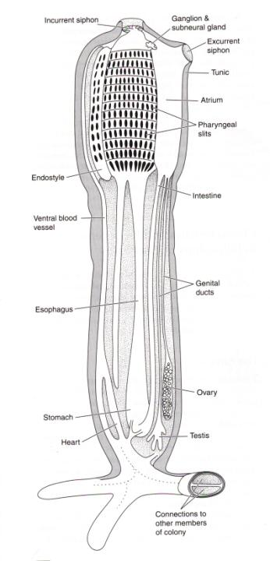

Slide 7
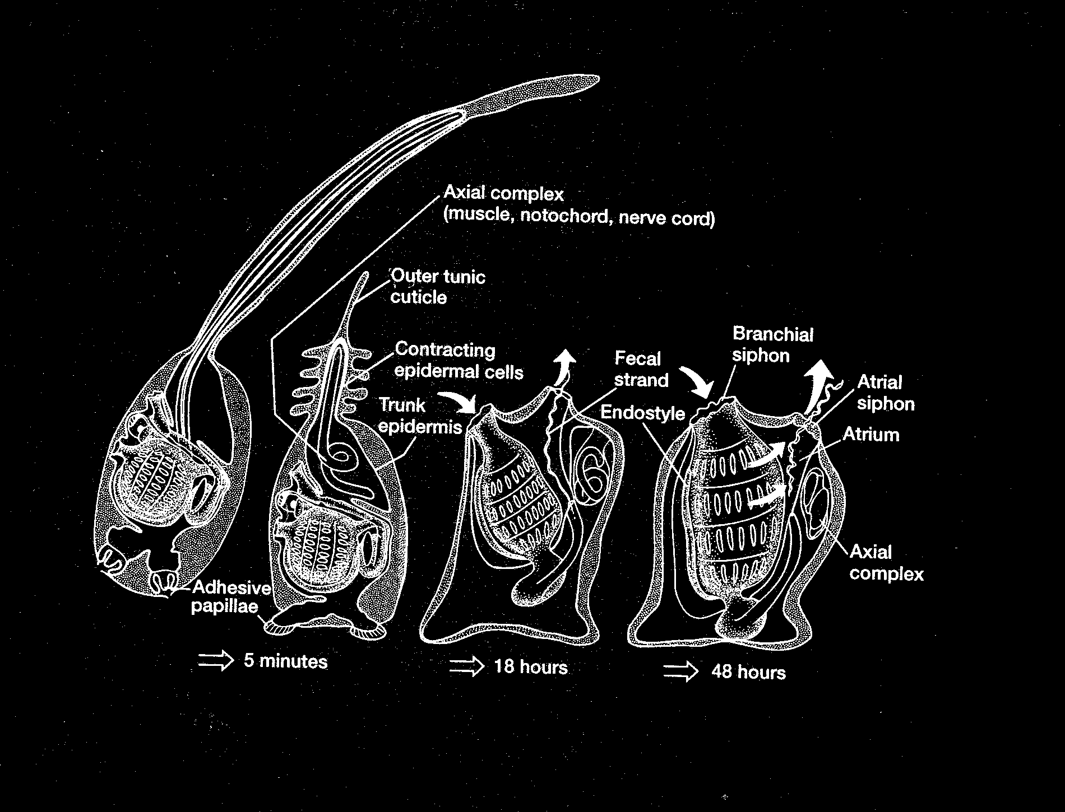
TUNICATE: Metamorphosis from larva to adult

Slide 8
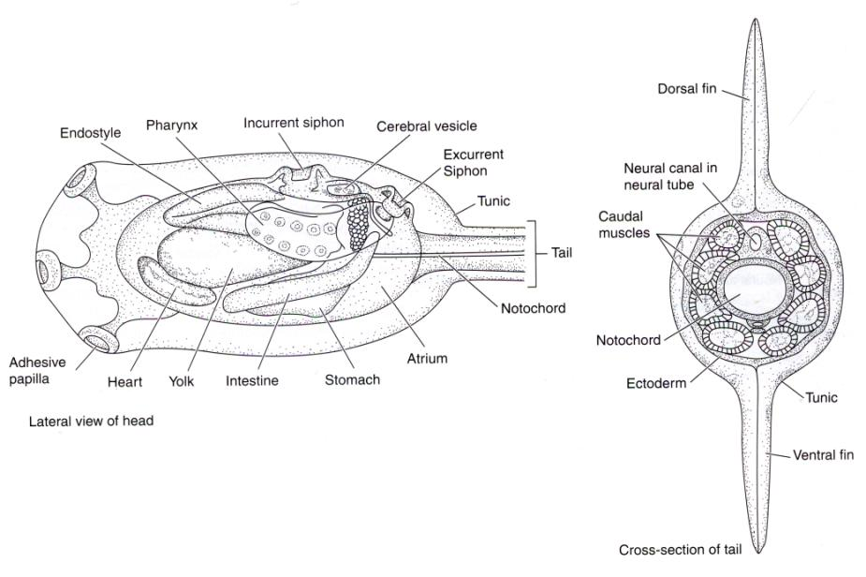

Slide 9
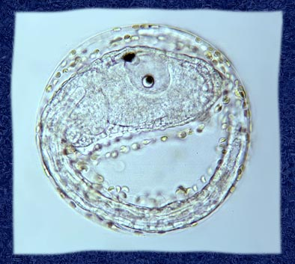

Slide 10
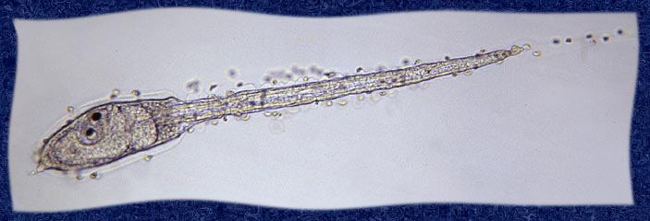
The new larval stage of a urochordate

Slide 11
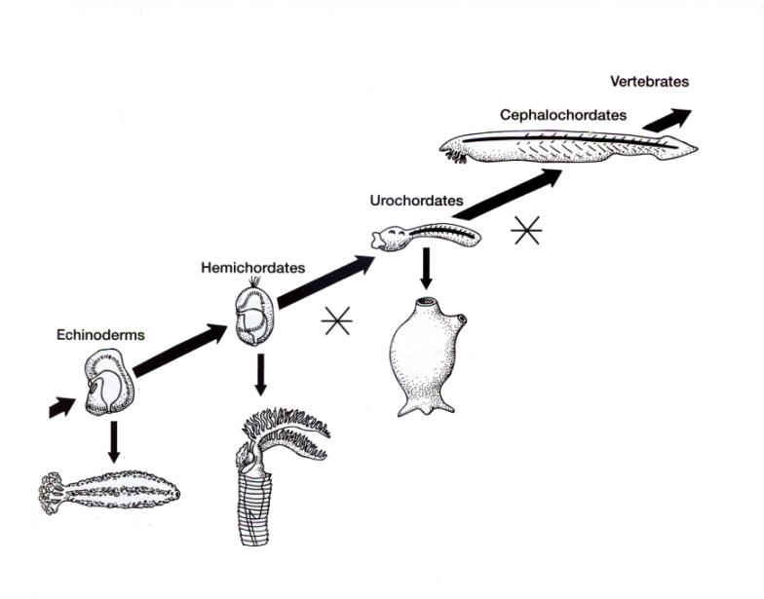

Slide 12
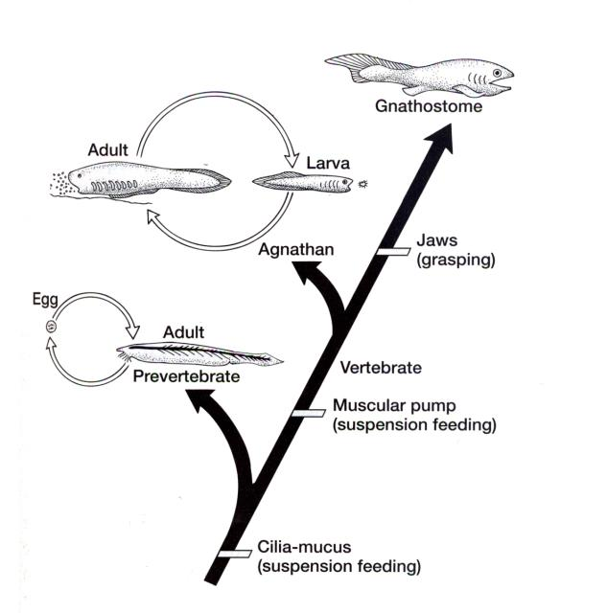

Slide 14
VERTEBRATA (CRANIATA)
Defining Feature(s)
Neural Crest?
Fully expressed and migratory neural crest
Ectodermal placodes that develop into cranial sensory structures.
Nasal placode
Optic placode
Otic placode

Slide 15
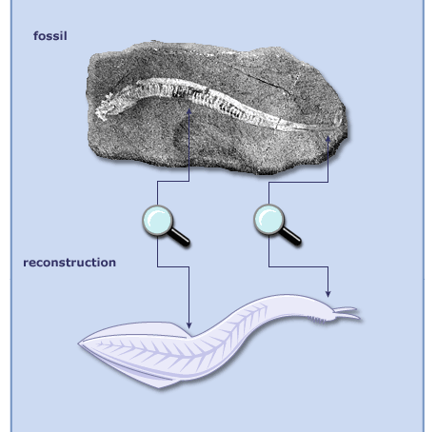
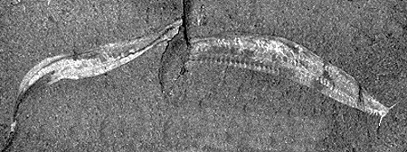
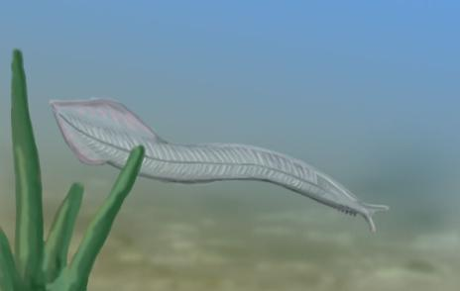
Pikaia is considered by some to the earliest known vertebrate, but some consider it to be a cephalochordate.

Slide 16
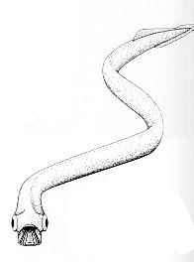
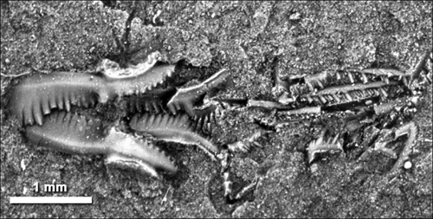
Conodonts were long known from only dental apparatus. They are now thought to be primitive vertebrates. The “tooth plates” are made of tissues only known to develop from neural crest, and whole body fossils are now known.

Slide 17
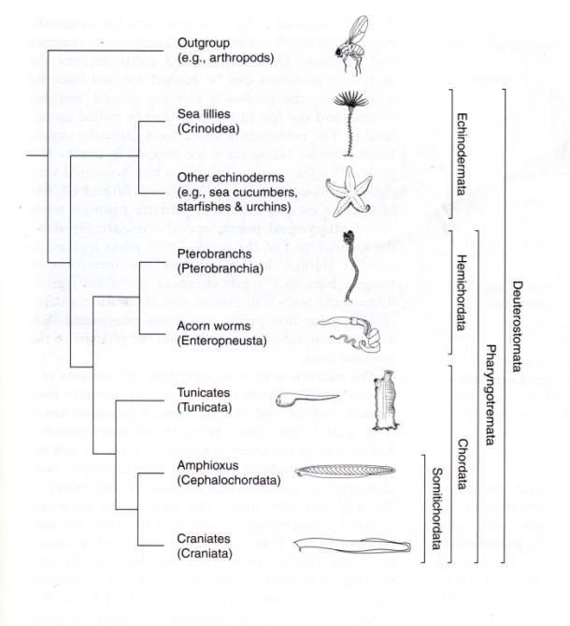
ALTERNATIVE HYPOTHESES OF VERTEBRATE ORIGINS – 1
(a minor difference)
Alternative hypothesis of closest sister group to Vertebrata wherein Cephalochordata are considered closer than Tunicata (= Urochordata)

Slide 18
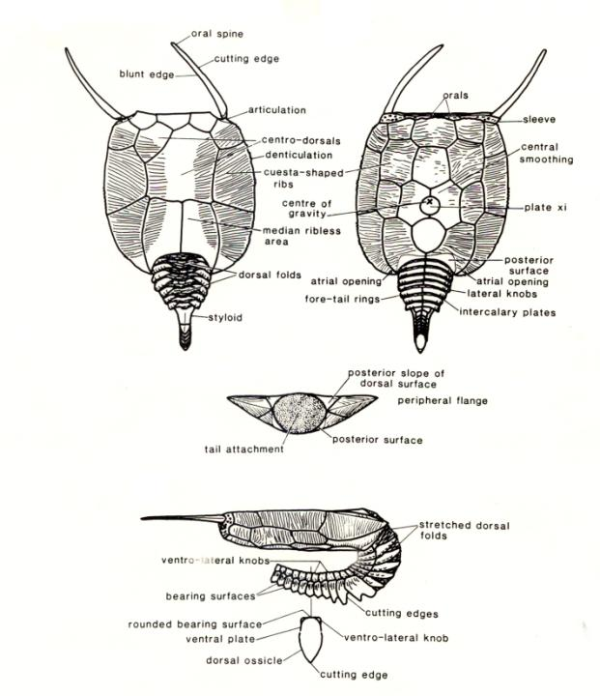
ALTERNATIVE HYPOTHESES OF VERTEBRATE ORIGINS – 2
(a more significant difference)
R. P. S. Jeffries and the “Calcichordata”
Placocystites – a “calcichordate”, a group considered by most to be a group of echonidoerms called “mitrates”.

Slide 19
