Slide 1
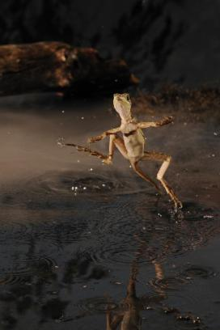
Stuart S. Sumida
Biology 342
Simplified Phylogeny of
Squamate Reptiles

Slide 2
“Amphibia” Amniota
Seymouriamorpha Diadectomorpha Synapsida Parareptilia Captorhinidae Diapsida Archosauromorpha
Reptilia
Amniota

Slide 3
“Amphibia” Amniota
Seymouriamorpha Diadectomorpha Synapsida Parareptilia Captorhinidae Diapsida Archosauromorpha
Reptilia
Amniota

Slide 4
Basal Diapsid: Petrolacosaurus
Note: TWO holes (fenestrae) on side of skull
Known back to Late Pennsylvanian

Slide 5
Diapsida includes:
Many extinct forms
Squamata
Archosauromorpha
Squamata includes living lizards and snakes.

Slide 6
Phylogenetic Relationships of Squamate Reptiles
Rhynchocephalia (including
the extant Sphenodon)
Gekkkota (Geckos)
Scincidae (Skinks)
Amphisbaenia (limbless lizards)
Iguania (Iguanid lizards)
Varanidae (Varanid lizards)
Mosasauridae
Serpentes (Snakes)
Anguimorpha

Slide 7
Phylogenetic Relationships of Squamate Reptiles
Rhynchocephalia (including
the extant Sphenodon)
Gekkkota (Geckos)
Scincidae (Skinks)
Amphisbaenia (limbless lizards)
Iguania (Iguanid lizards)
Varanidae (Varanid lizards)
Mosasauridae
Serpentes (Snakes)
Anguimorpha

Slide 8
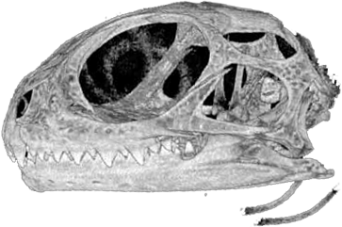
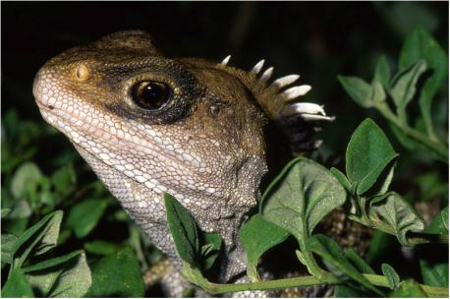
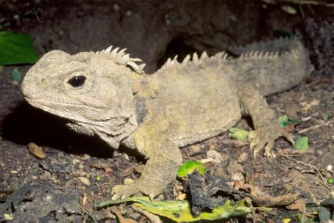
Sphenodon, also known as the “Tuatara”, last living member of Rhyncocephalia, and thus frequently used as an outgroup for phylogenetic analysis of living reptiles. Note primitive condition of two complete temporal openings.

Slide 9
Squamata:
Lizards (including limbless lizards)
Snakes

Slide 10
Phylogenetic Relationships of Squamate Reptiles
Rhynchocephalia (including
the extant Sphenodon)
Gekkkota (Geckos)
Scincidae (Skinks)
Amphisbaenia (limbless lizards)
Iguania (Iguanid lizards)
Varanidae (Varanid lizards)
Mosasauridae
Serpentes (Snakes)
Anguimorpha

Slide 11
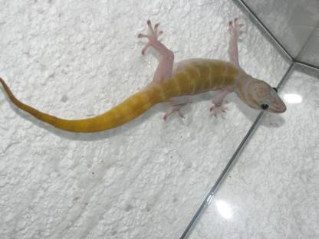
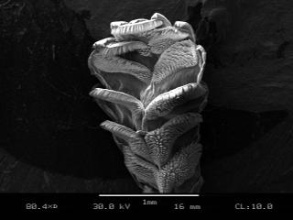
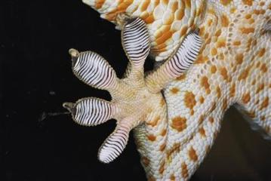
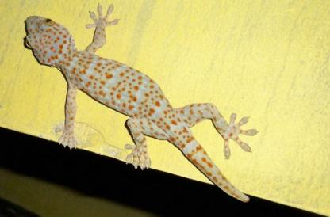
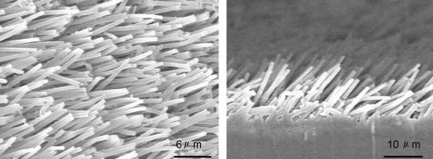
GEKKOTA
Group of lizards characterized by feet with toes particularly adapted for clinging to surfaces.
Toes are not “Sticky”, rather, they are a system of microfibers that engage with the surface when drug along at ~ 45 degrees.
Pressing straight down allows them to walk, whereas dragging them makes them adhere.

Slide 12
Phylogenetic Relationships of Squamate Reptiles
Rhynchocephalia (including
the extant Sphenodon)
Gekkkota (Geckos)
Scincidae (Skinks)
Amphisbaenia (limbless lizards)
Iguania (Iguanid lizards)
Varanidae (Varanid lizards)
Mosasauridae
Serpentes (Snakes)
Anguimorpha

Slide 13
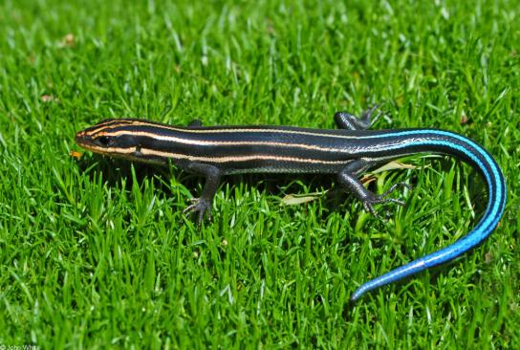
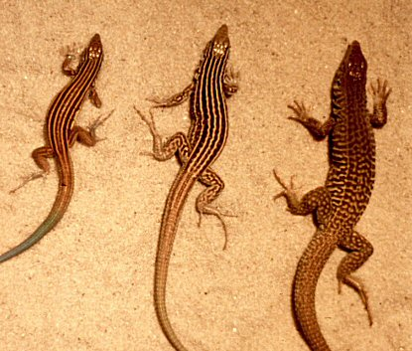
SCINCIDAE (“Skinks)
Lizard group chracterized by extremely fusiform body, virtualy no neck.
Known to be parthenogenetic, including the local species Cnemidopherus tigris (a local species at far right).
Southeastern 5-line skink Local whiptail skink, Cnemidopherus

Slide 14
Phylogenetic Relationships of Squamate Reptiles
Rhynchocephalia (including
the extant Sphenodon)
Gekkkota (Geckos)
Scincidae (Skinks)
Amphisbaenia (limbless lizards)
Iguania (Iguanid lizards)
Varanidae (Varanid lizards)
Mosasauridae
Serpentes (Snakes)
Anguimorpha

Slide 15
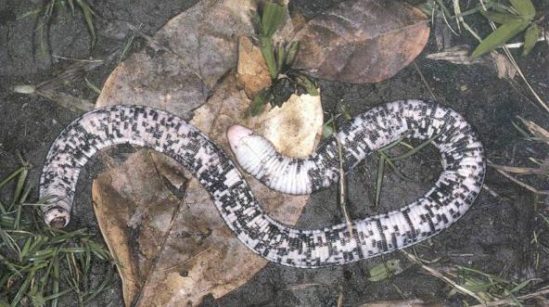
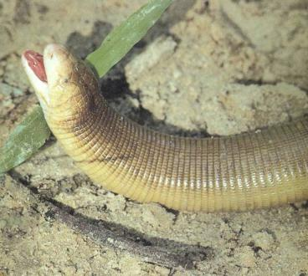
Amphisbaenia: Limbless Lizards
Distinct from snakes. They have much more robust skulls for lifestyles that are primarily fossorial and living in leaf-litter.
Limblessness has evolved numrous times within Lepidosauria, including the amphibaenians, Anguidae (also known as glass lizrards), Dibamidae, and Pygopodidae (limbless relatives of gekkos)

Slide 16
Phylogenetic Relationships of Squamate Reptiles
Rhynchocephalia (including
the extant Sphenodon)
Gekkkota (Geckos)
Scincidae (Skinks)
Amphisbaenia (limbless lizards)
Iguania (Iguanid lizards)
Varanidae (Varanid lizards)
Mosasauridae
Serpentes (Snakes)
Anguimorpha

Slide 17
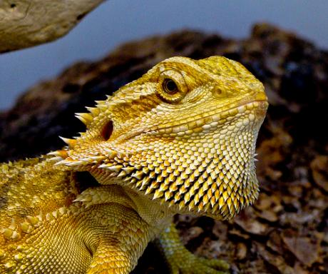
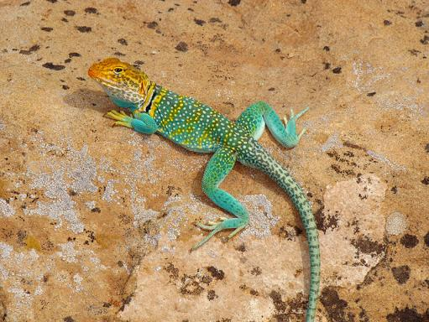
IGUANIDAE
Dominant group of extant new-world lizards
Relatively stubbier snouts than the varanids
Whereas varanids are generally carnivorous, and/or carrion eaters, iguanids are frequently herbivorous or omnivorous.

Slide 18
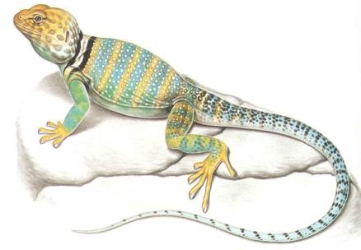
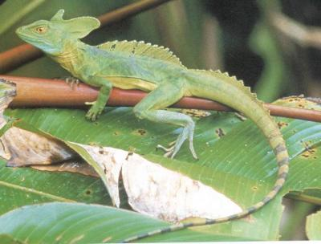
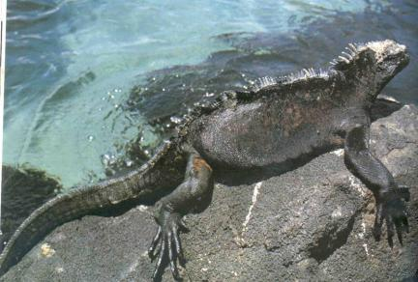
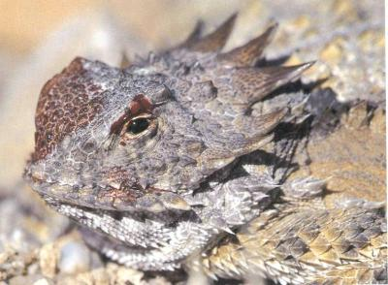
Basciliscus Crotaphytus (local, “collared lizard”)
Phyrnosoma - “Horny-toads” are not toads. Galapagos marine iguana

Slide 19
Phylogenetic Relationships of Squamate Reptiles
Rhynchocephalia (including
the extant Sphenodon)
Gekkkota (Geckos)
Scincidae (Skinks)
Amphisbaenia (limbless lizards)
Iguania (Iguanid lizards)
Varanidae (Varanid lizards)
Mosasauridae
Serpentes (Snakes)
Anguimorpha

Slide 20
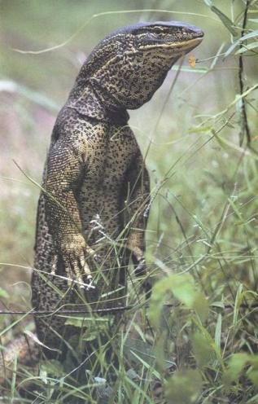
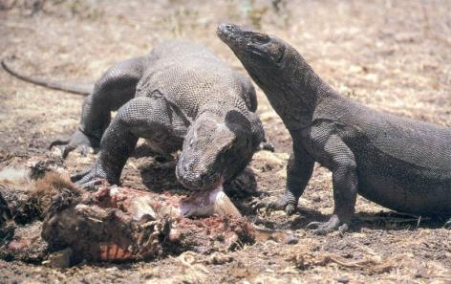
VARANIDAE
Dominant group of extant old-world lizards
Elongate snouts
Generally carnivorous, and/or carrion eaters
Group from which the extinct aquatic mosasaurs evolved.
Monitor lizard
Komodo dragon – largest living lizard

Slide 21
Phylogenetic Relationships of Squamate Reptiles
Rhynchocephalia (including
the extant Sphenodon)
Gekkkota (Geckos)
Scincidae (Skinks)
Amphisbaenia (limbless lizards)
Iguania (Iguanid lizards)
Varanidae (Varanid lizards)
Mosasauridae
Serpentes (Snakes)
Anguimorpha

Slide 22
SERPENTES (Snakes)
Limbless, though most primitive groups (boids and some others) retain vestigial hip elements.
Highly mobile (kinetic) skulls and jaws.
Lack moveable eyelids
Lack external auditory apparatus

Slide 23
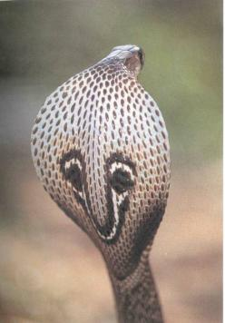
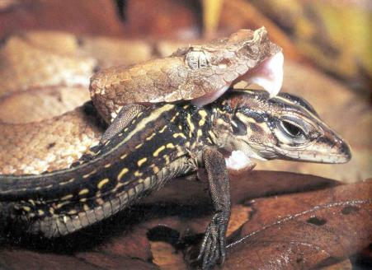
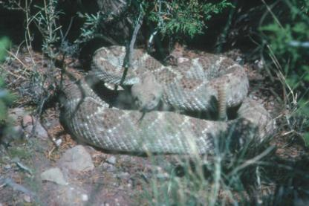
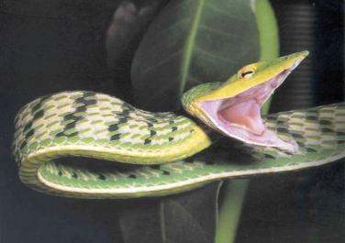
Cobra
Hog-nosed pit viper
Cobra
Long-nosed vine snake
Western Diamond-back Rattlesnake

Slide 24
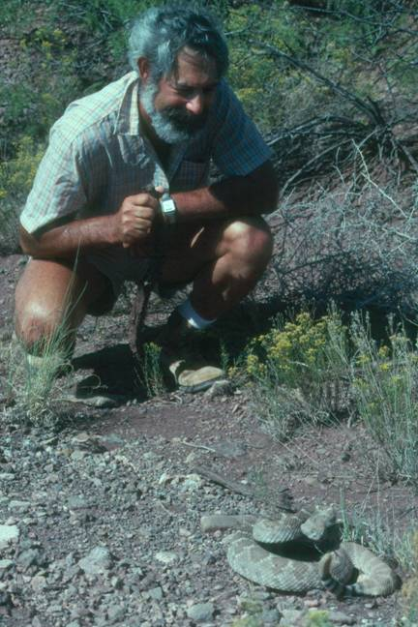

Slide 25
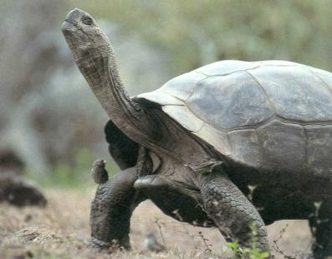
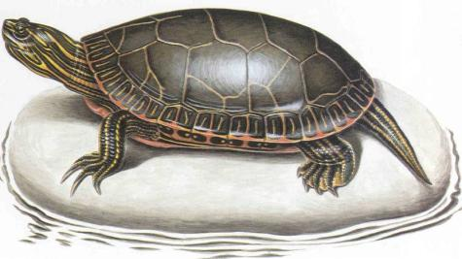
So…
…what the hell are turtles??
With their highly derived shell and plastron, they have been confusing, and placed with all sorts of groups: Their own; pariasauian reptiles, procolophonid reptiles, captorhinid reptiles, and even diapsids.
They are incredibly difficult to figure out as they are the only vertebrates with their ribs superficial to their limb girdles.

Slide 26
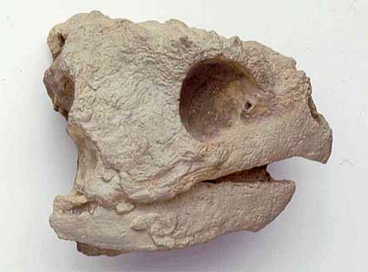
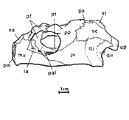
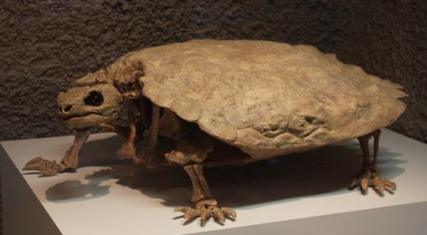
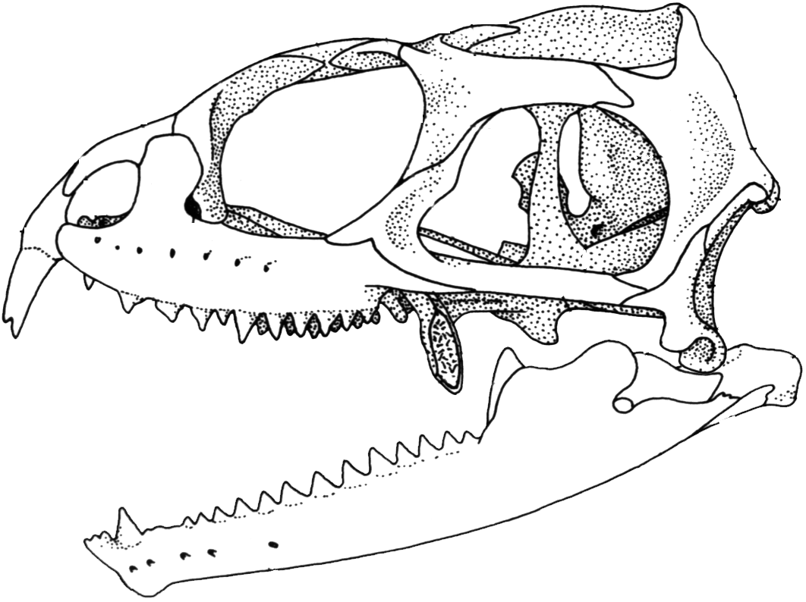
Skull of the primitive turtle Proganochyles. It is thought by some that the emarginations of the caudal end of the skull are equivalent to the partial margins of the old diapsid fenestrae, making them diapsids, or the sister-group to diapsids.
?
Sphenodon

