Slide 1
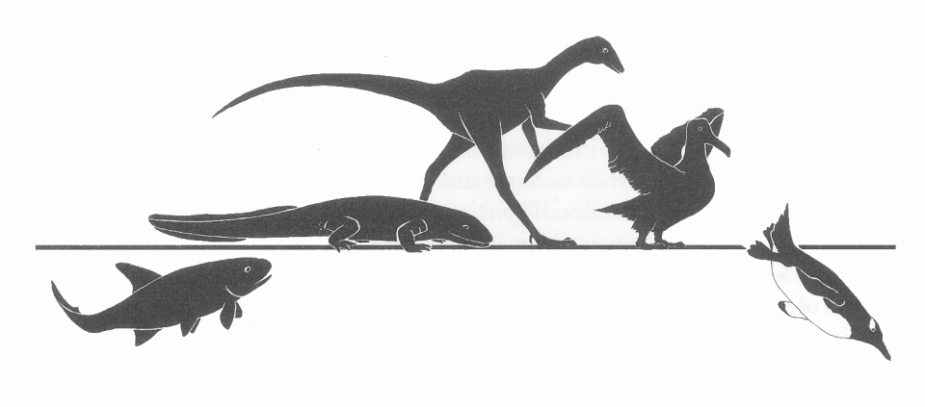
Stuart S. Sumida
Biology 342
Phylogeny of Basal Tetrapoda

Slide 2
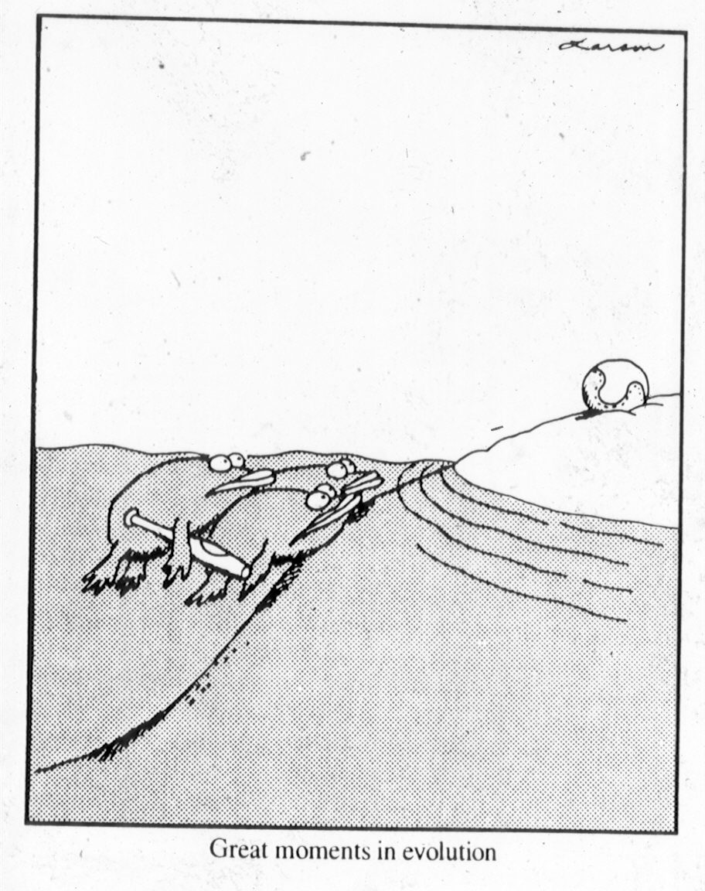

Slide 3
The group of bony fishes that gave rise to land-dwelling vertebrates and their descendants (Tetrapoda, or colloquially, “tetrapods”) was the lobe-finned fishes, or Sarcopterygii.
Sarcoptrygii includes coelacanths (which retain one living form, Latimeria), lungfish, and crossopterygians.
The transition from sarcopterygian fishes to stem tetrapods proceeded through a series of groups – not all of which are included here. There was no sharp and distinct transition, rather it was a continuum from very tetrapod-like fishes to very fish-like tetrapods.

Slide 4
SARCOPTERYGII – THE LOBE-FINNED FISHES
Includes
Actinista (including Coelacanths)
Dipnoi (lungfishes)
Crossopterygii
Crossopterygians include “tetrapods” – 4-legged land-dwelling vertebrates.

Slide 5
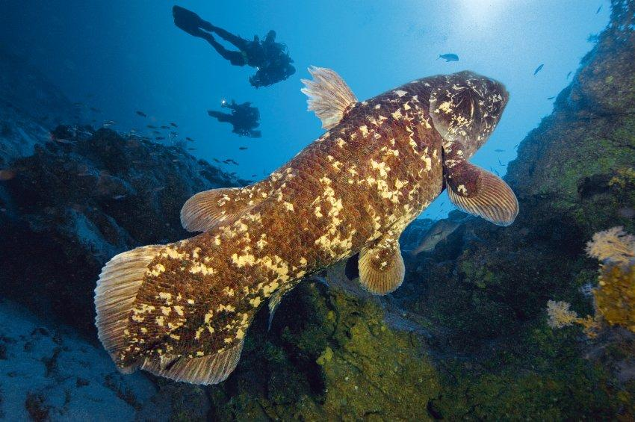
The Actinista date back to the Devonian. They have very well developed lobed-fins. There remains one livnig representative of the group, the coelacanth, Latimeria chalumnae.

Slide 6
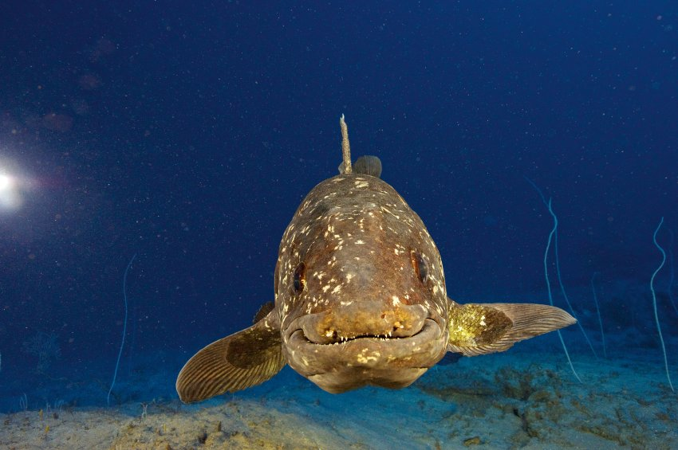

Slide 7
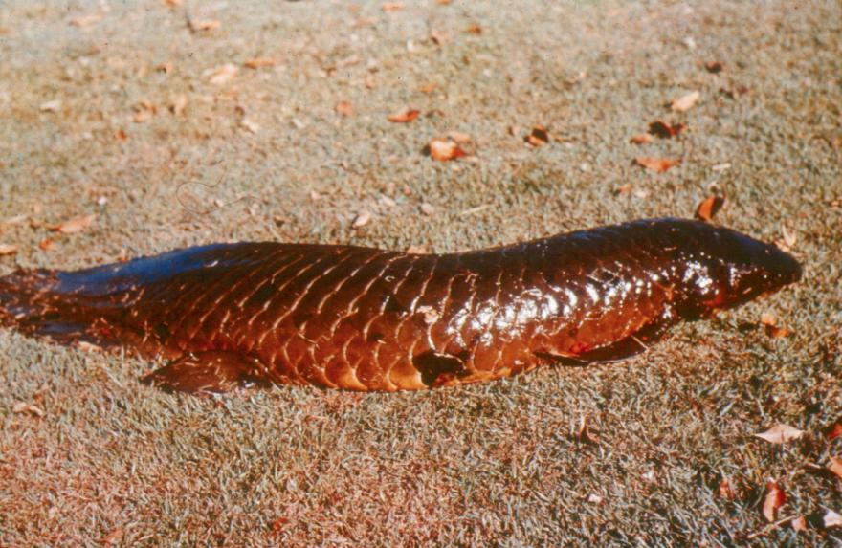
A lungfish

Slide 8
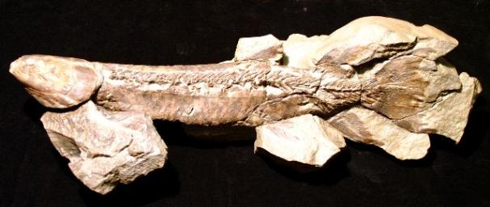
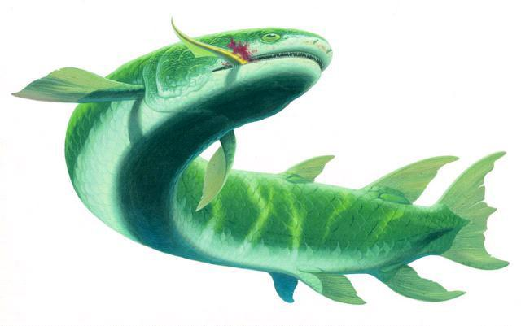
The Crossopterygii include numerous representatives, the best known of which include Eusthenopteron (pictured here) and Panderichthyes.

Slide 9
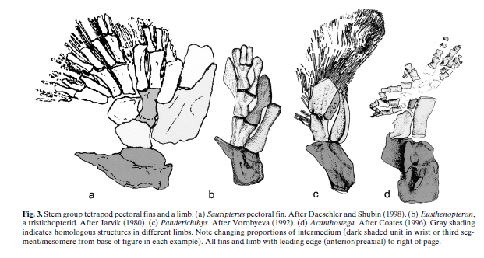

Slide 10
Panderichthyids were the most tetrapod-like of the sarcopterygian fishes.

Slide 11
Panderichthyes – note the lack of dorsal fine, but retention of tail fin.

Slide 13
Coelacanths
Lungfish
Rhizodontids
Eusthenopteron
Panderichthyes
Tiktaalik
Ventastega
Acanthostega
Ichthyostega
Tulerpeton
Whatcheeria
Pederpes
More advanced amphibians

Slide 14
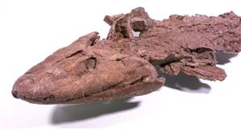
Tiktaalik roseae – a lobe-finned fish intermediate between typical sarcopterygians and basal tetrapods.
Mid to Late Devonian; 375 million years old.

Slide 15
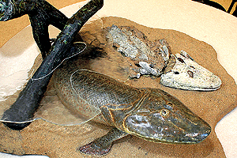

Slide 16
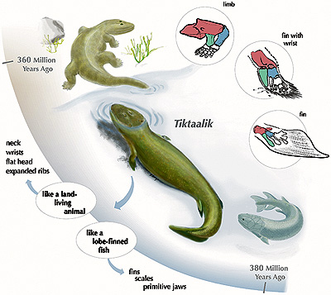

Slide 17
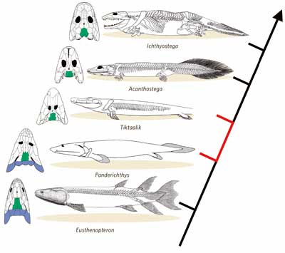
The back end of Tiktaalik’s skull is intermediate between fishes and tetrapods.

Slide 18
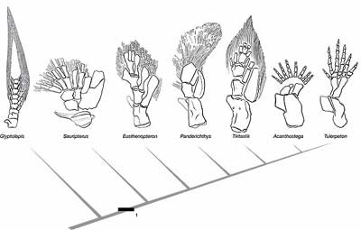
Tiktaalik is a fish with wrist bones, yet still retaining fin rays.

Slide 19
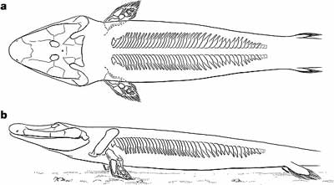
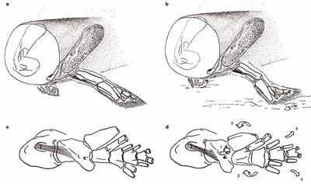
The posture of Tiktaalik’s fin/limb is intermediate between that of fishes an tetrapods.

Slide 20
Coelacanths
Lungfish
Rhizodontids
Eusthenopteron
Panderichthyes
Tiktaalik
Ventastega
Acanthostega
Ichthyostega
Tulerpeton
Whatcheeria
Pederpes
More advanced amphibians

Slide 21
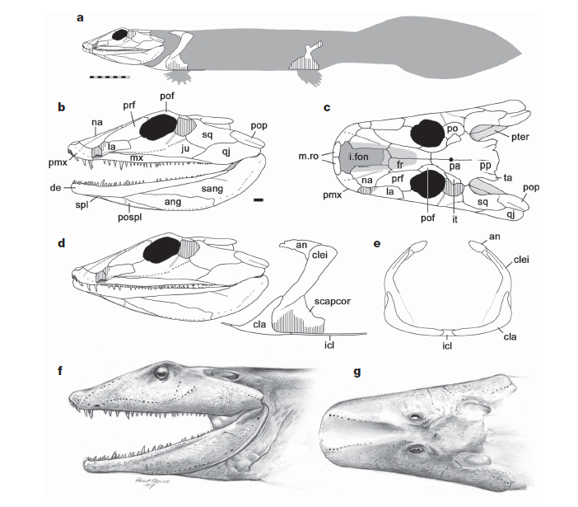
Reconstructions of the basal tetrapod Ventastega.

Slide 22
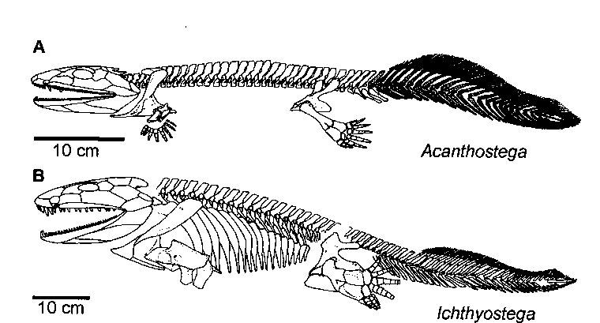
The Earliest Tetrapods (such as Ventastega and Ichthyostegalians) were Very “Fish-like”

Slide 23
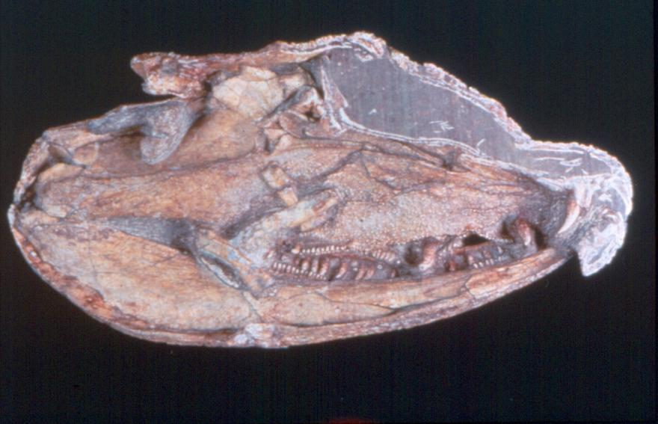
Acanthostega gunneri

Slide 24
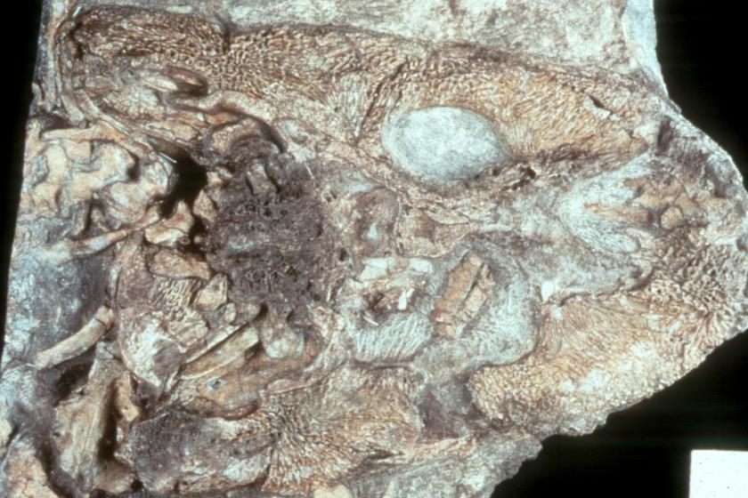
Acanthostega gunneri

Slide 25
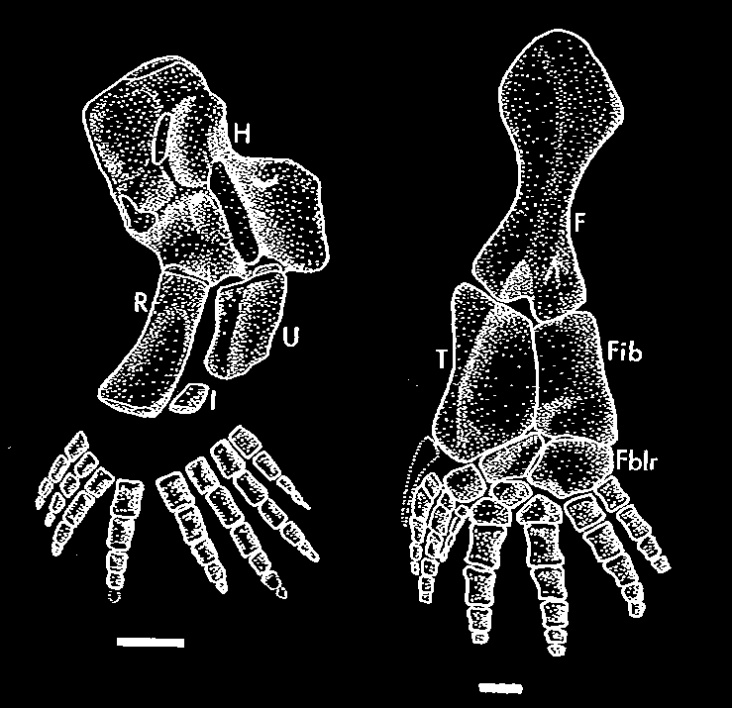
Fins or Limbs…? Yes, polydactylous fins/limbs.

Slide 26
Coelacanths
Lungfish
Rhizodontids
Eusthenopteron
Panderichthyes
Tiktaalik
Ventastega
Acanthostega
Ichthyostega
Tulerpeton
Whatcheeria
Pederpes
More advanced amphibians
Number of digits: ? ? 7/8 7 6 5 5 5

Slide 27
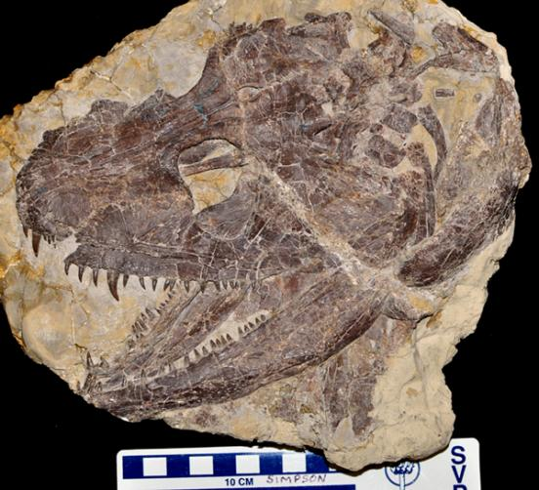
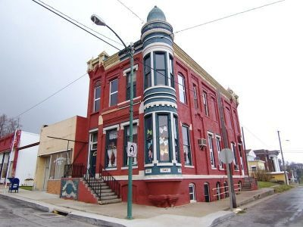
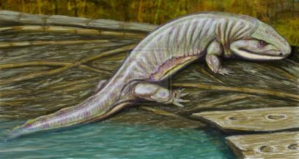
Skull of Whatcheeria deltae, a highly aquatic tetrapod found near the town of What Cheer, Iowa.

Slide 28
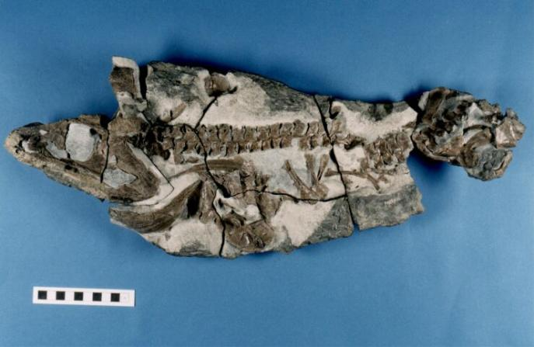
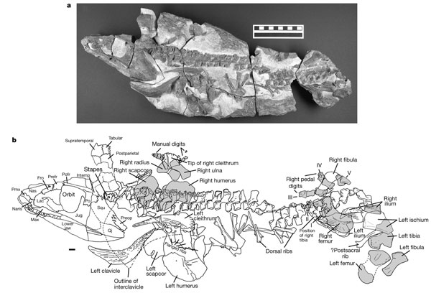
Pederpes, initially mistaken as a fish, but oops, it has hips and legs.

Slide 29
Other Sarcopterygians
Panderichthyids
Ichthyostegalia
Dissorophoids
Lissamphibia
Anthracosauria
Seymouriamorpha
Diadectomorpha
Amniota
Sarcopterygii
Tetrapoda

Slide 30
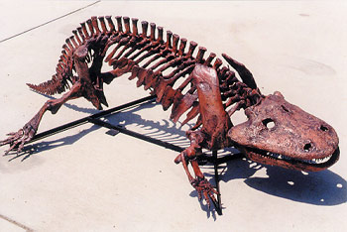

Slide 31
Living Amphibians:
All used to be included in a group called Lissamphibia
Lissamphibia was considered a natural group because all have similar teeth (pedicillate) and all have similar ear bones.
Lissamphibia included:
Gymnophiona (limbless amphibians)
Caudata (salamanders)
Anura (frogs and toads)

Slide 32
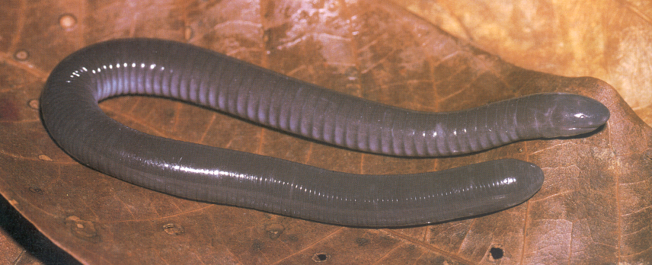
Gymnophiona (limbless amphibians)

Slide 33
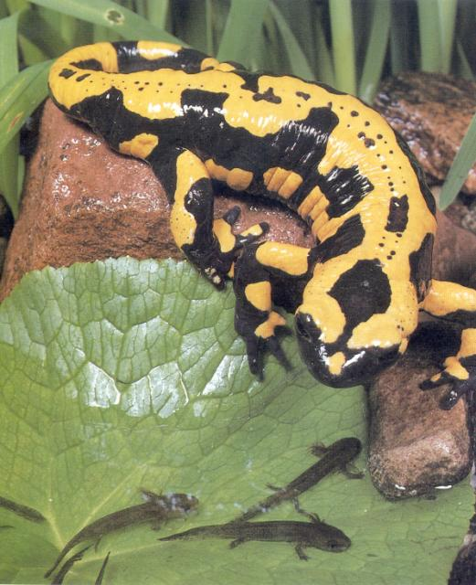
Caudata
(salamanders)

Slide 34
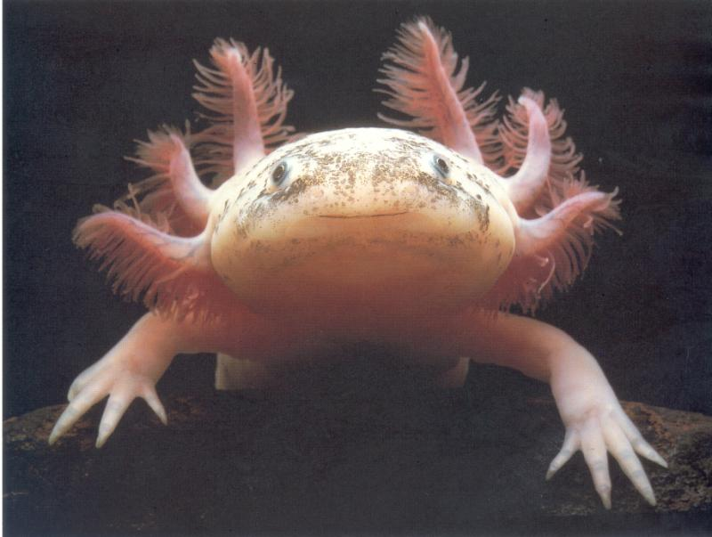
Caudata (salamanders)

Slide 35
NEW INFORMATION!!!
It turns out…
We’ve found some important new fossil material that has given us the opportunity to reassess the evolutionary relationships of “Lissamphibia”.
A new animal – now known as Gerobratrachus hottoni was discovered.
From the Early Permian, about 280 million years old, of present-day north-central Texas
Looks remarkably like a frog, but still has a longer body and a tail like a salamander.

Slide 36
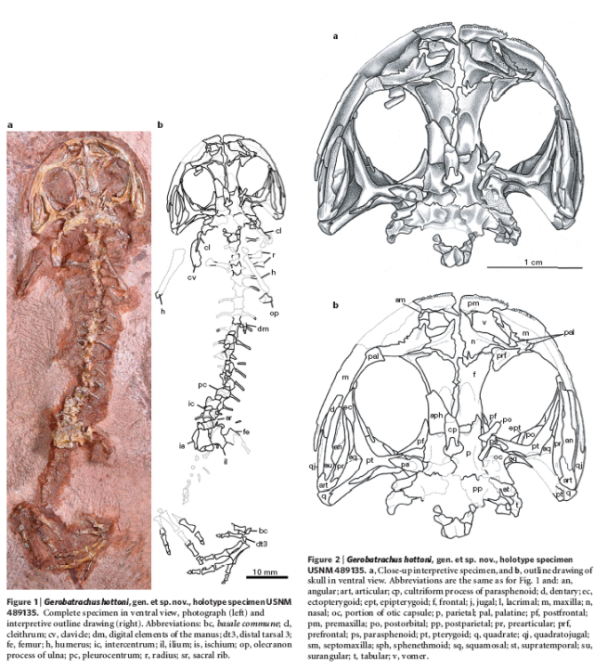
Gerobratrachus hottoni

Slide 37
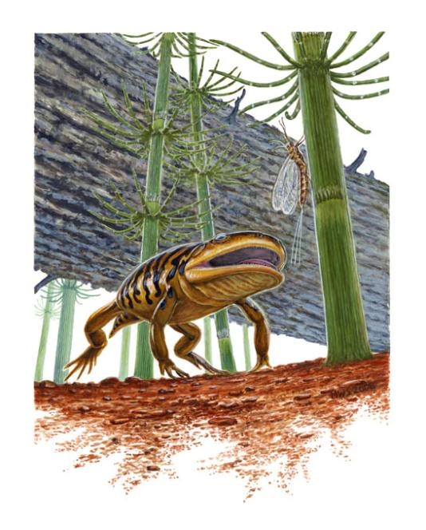

Slide 38
It turns out:
With the help of Gerobatrachus, we now know that frogs and salamanders are closely related, but gymnophionans are convergent in their dental features.
Frogs and salamanders ARE related to dissorophoid amphibians.
Whereas gymnophionans are probably related to a group called MICROSAURS.

Slide 39
Other Sarcopterygians
Panderichthyids
Ichthyostegalia
Dissorophoids
“Batrachia” (frogs &
salamanders)
Anthracosauria
Seymouriamorpha
Diadectomorpha
Amniota
Sarcopterygii
*
**
Tetrapoda
* = Microsauria
** = Gymnophiona

Slide 40
In other words…
“Lissamphibia” is not a true group; also known as “POLYPHYLETIC”

Slide 41
