Slide 1
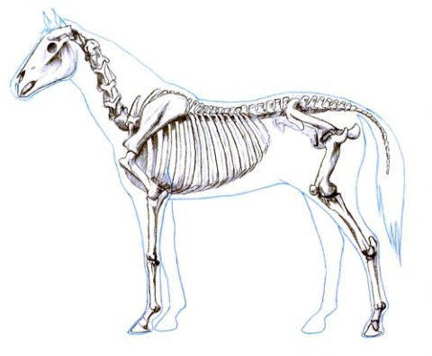
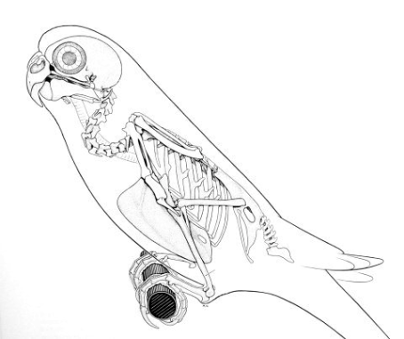
BIOLOGY 524
ADVANCED VERTEBRATE MORPHOLOGY
(OSTEOOGY)
STUART SUMIDA

Slide 2


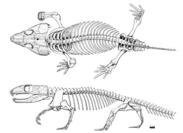

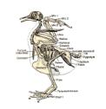



Slide 3
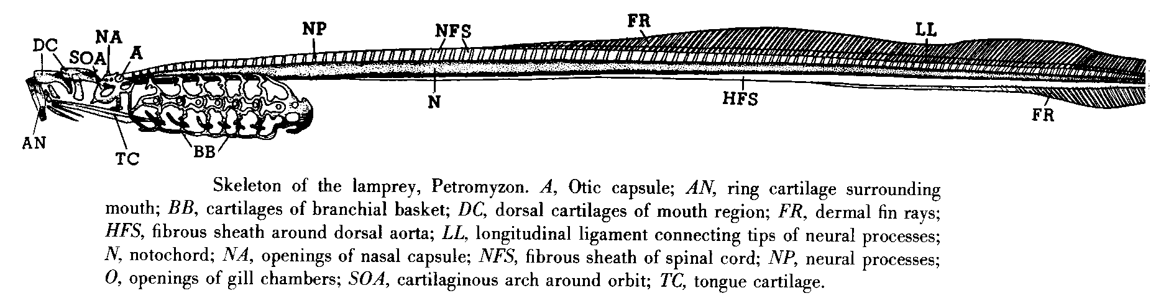
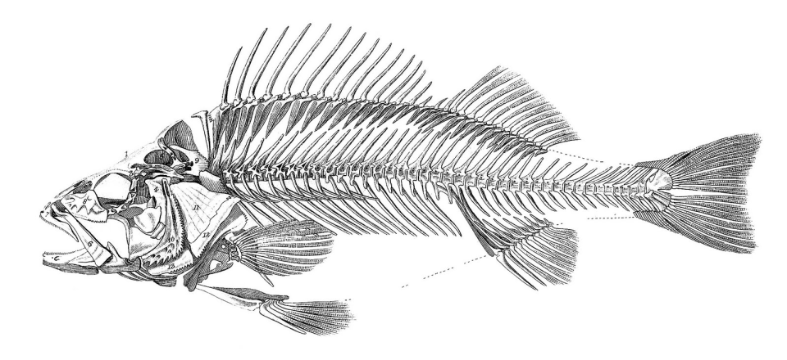
Petromyzon, lamprey – jawless fish: axial skeleton, gill skeleton, partially developed cranial skeleton
Perca, perch – gnathostome; cranial skeleton, axial skeleton, gill skeleton, appendicular skeleton.

Slide 4
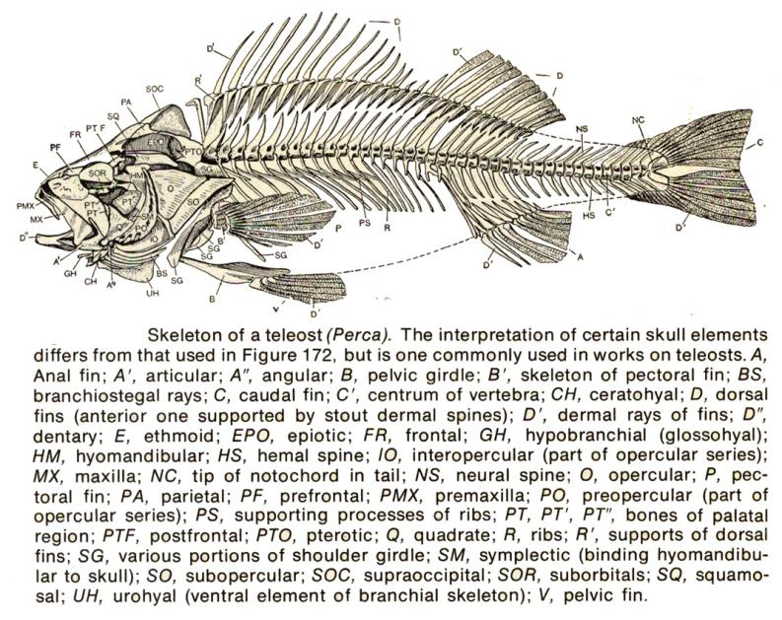

Slide 5
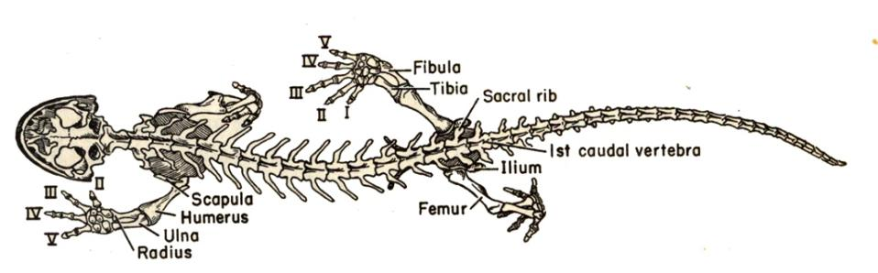

Slide 6
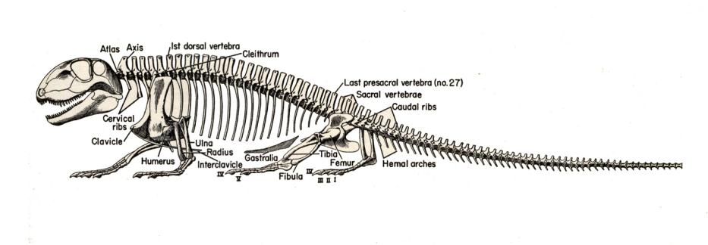

Slide 7
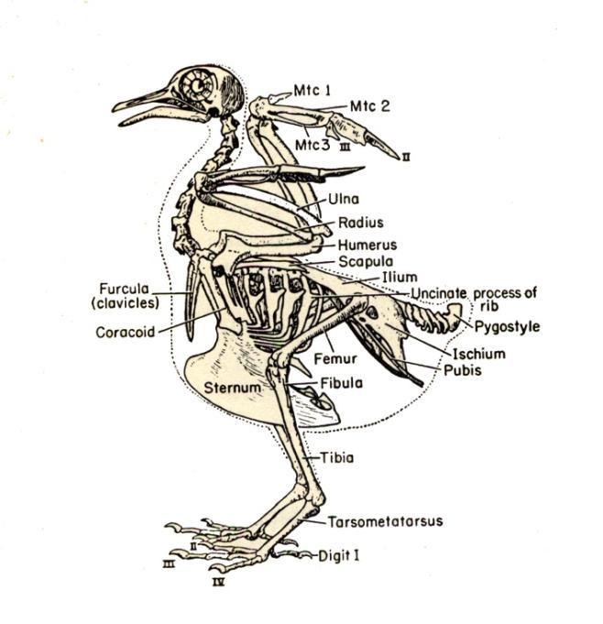

Slide 8
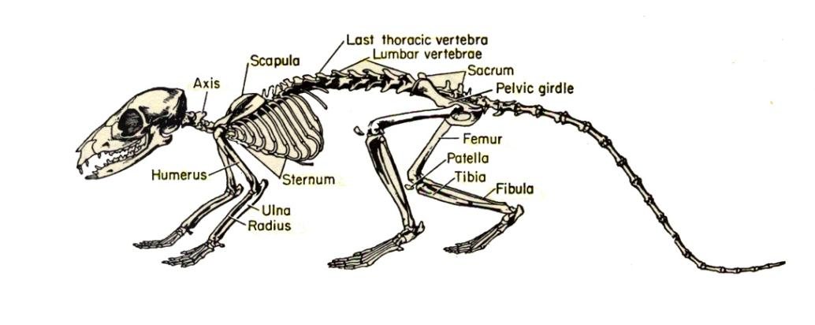

Slide 9


Slide 10


Slide 11
Axial skeleton
Skull, cranial skeleton
Pelvic Limb and Gridle
Pectoral Limb and Girdle

Slide 12
Drawing components parts of a skull:

Slide 13
ORIENTATION TO THE VERTEBRATE SKULL
BRAINCASE- preformed in cartilage. Derived from both mesoderm and nerual crest. Forms a cradle for the brain, and throgh which major nerves and blood vessels pass.
DERMAL SKULL COMPONENTS:
DERMAL SKULL ROOF - A shield of intramembranously derived bone derived entirely from neural crest, covers over the top and sides of the head to protect the brain dorso-laterally. Extends down to rim of upper jaw and bears the marginal row(s) of teeth. Has openings for major sense organs (nose, eye, parietal eye).
PALATAL COMPLEX – originally a plate or sheath of intramembranously derived bone derived entirely from neural crest, applied to the underside of the braincase to border he roof of the oral cavity. Parts of the mandibular components of the splnchnocranium (see below) come to be fused onto it.
SPLANCHONOCRANIUM – structures associated with visceral (throat) skeleton and gill slits/pouches. Includes structures of the jaw and hyoid apparatus which come to be incorporated into skull structure. All components are endochondral in formation, and derived from neural crest tissue.

Slide 14
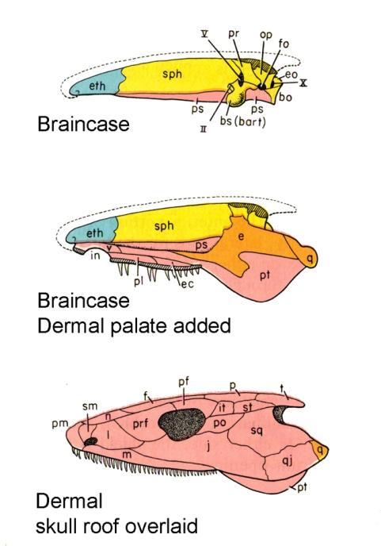
Braincase: internal cradle for the brain. Open from above.
Dermal palate (and some components of mandibular arch of splanchnocranium) added.
Dermal roof added in this view to see how it protects from above.

Slide 15
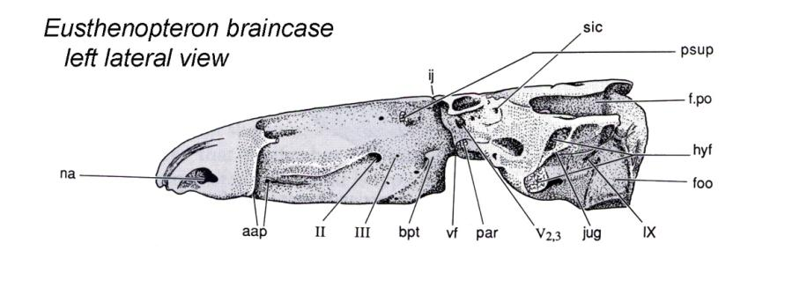

Slide 16
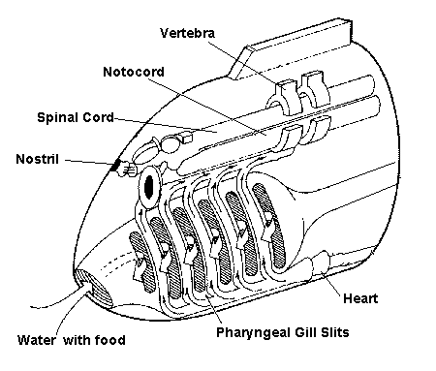

Slide 19
