Slide 1
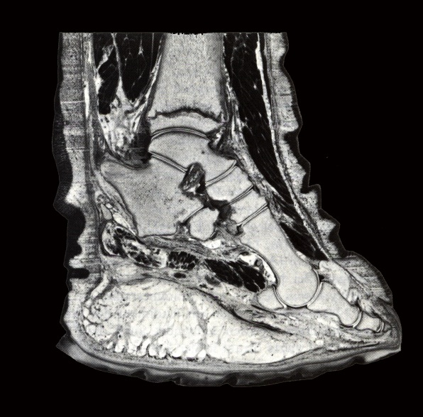
BIOLOGY 524
POSTCRANIAL SKELETON - V
CRUS AND PES
S. S. Sumida

Slide 2
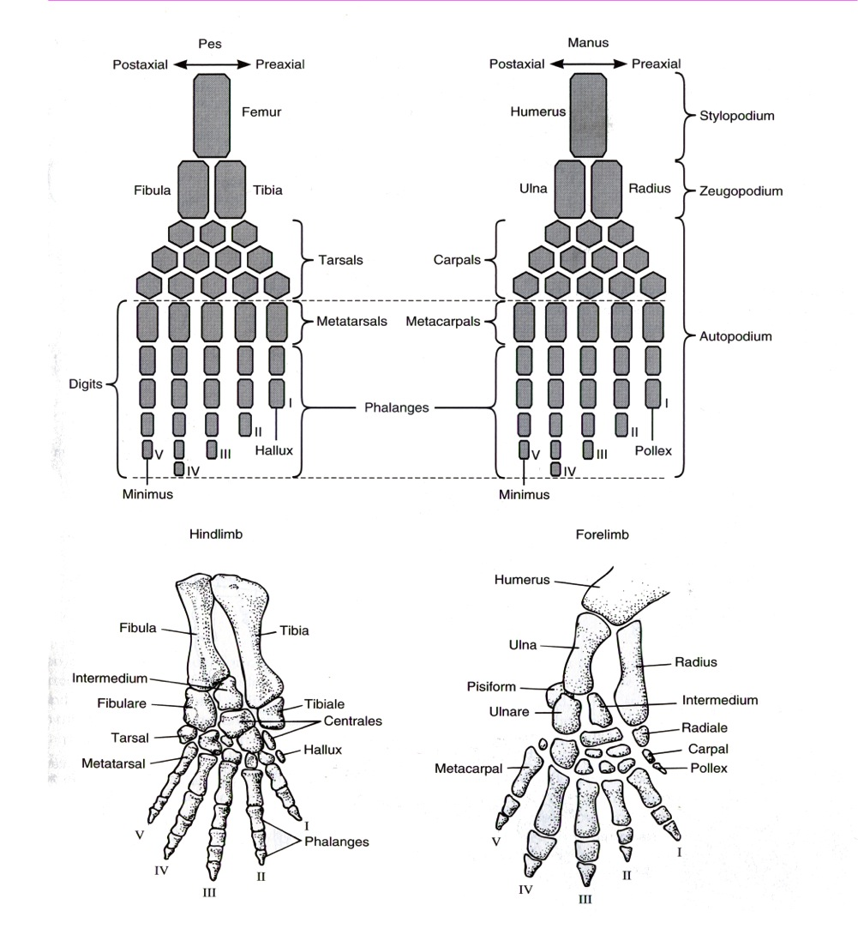

Slide 3
The basic tetrapod crus:
… is composed of two elements, distal to the femur, the TIBIA on the [PREAXIAL] side of the first digit (thumb), and the FIBULA on the [POSTAXIAL] side of the fifth digit.
The basic tetrapod pes:
Distal to the tibia is an element known as the TIBIALE; distal to the fibula is the FIBULARE. Between the tibiale and fibulare is an element known as the INTERMEDIUM.
In the transition to tetrapods, the PES (foot) consolidates into a more discrete series of structures:
Three elements make up the base of the foot: TIBIALE, INTERMEDIUM, and FIBULARE.
Up to four CENTRALIA (singular CENTRALE), numbered 1-4 make up the next row of the pes.
Five DISTAL TARSALS, numbered 1-5 make up the next row.
Each digit has a METATARSAL at its base.
The digits have a variable number of PHALANGEAL ELEMENTS. The PHALANGEAL FORMULA is the number of phalangeal elements in digits 1-5.

Slide 4
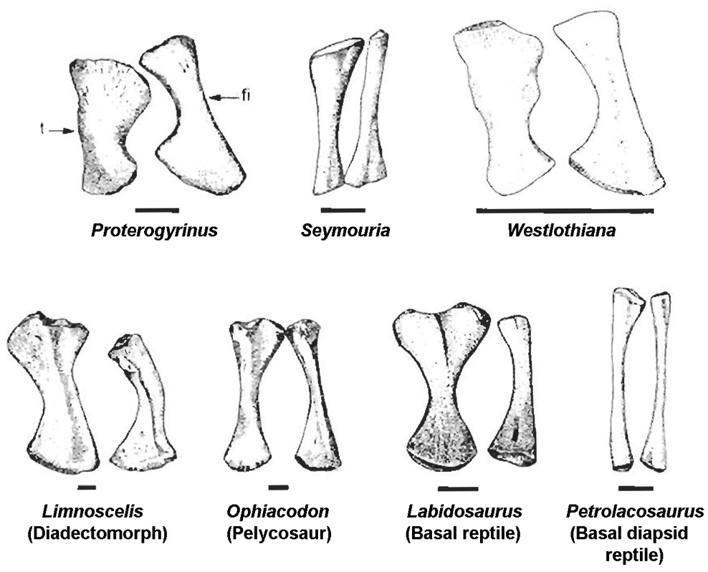
CRUS: AMPHIBIANS and BASAL AMNIOTES
For those with a homocentric perspective, the tibia is frequently assumed to be the larger of the crural elements. However, in basal tetrapods, the fibula is often very close to the tibia on absolute size. This makes it clear that both elements were of importance in both postural function and providing attachment for locomotor musculature.
The tibia and fibula of
anamniote tetrapods
(aka “amphibians”;
“non-amniotes”) often
have curved outlines on
the side of the elements
facing one another.
Elements frequently are
more flattened than
cylindrical.

Slide 5
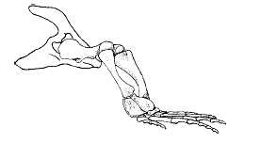
The articular surfaces of the proximal ends of the tibia and fibula were not set a perfect right angle to the long axis of the elements, leading Sumida (1997) and Holmes (1977) to speculate that the tibia and fibula did not sit exactly perpendicular to the substrate, but rather at an angle of 75-80 degrees.
Distally, the fibula articulates with the fibulare and intermedium, whereas the tibia articulates with the tibiale plus intermedium.

Slide 6
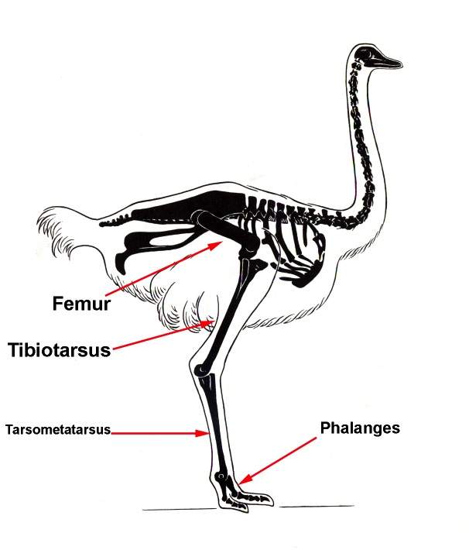
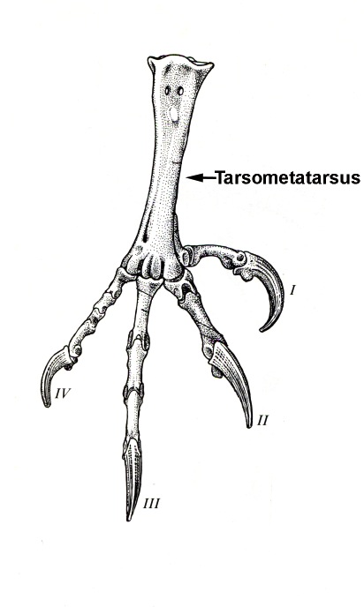
CRUS OF BIRDS
Birds have highly modified tarsal elements. Proximal components of the tarsus fuse with the distal end of the tibia to make the composite element the TIBIOTARSUS. Distal elements of the tarsus fuse with metatarsal elements generating the TARSOMETATARSUS. This leaves the “bird foot” as only the phalanges.

Slide 7
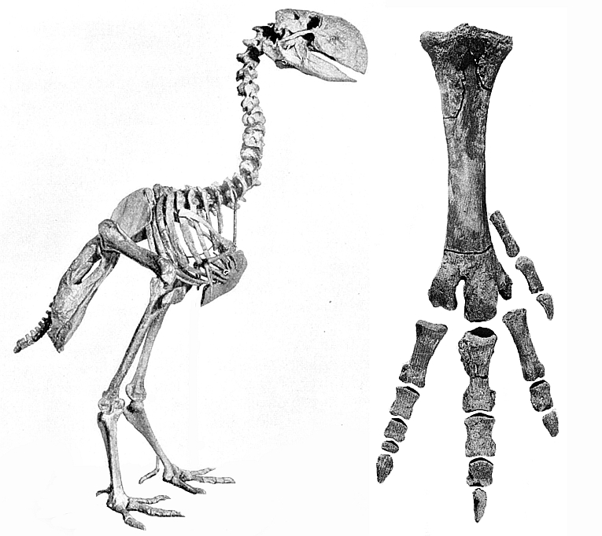

Slide 8
CRUS: MAMMALIA
Primitively mammals retain both the tibia and the fibula, though highly cursorial ungulates often fuse them, or lose the fibula.
The tibia in mammals is easy to identify, as it is essentially triangular in cross section, whereas the tibia is similar in shape to an elongate, flattened sword.
The tibia forms the articular surface of the knee joint, and the tibia, though primitively still present functions primarily only as a lateral brace and to provide additional surface area for muscular attachment and the insertion of the interosseous membrane.

Slide 9
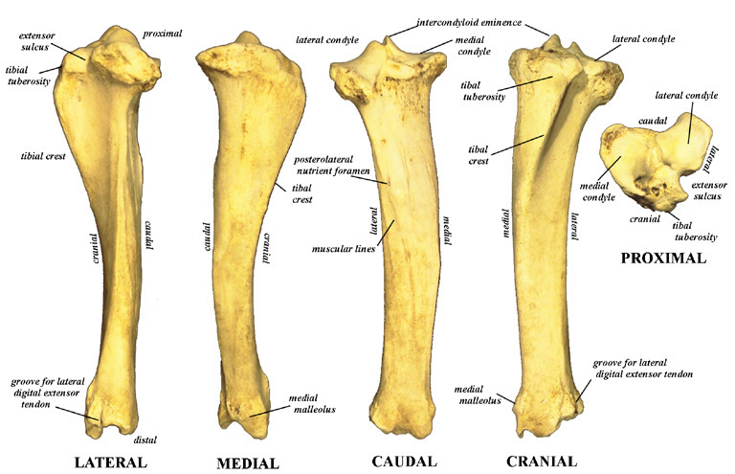

Slide 10
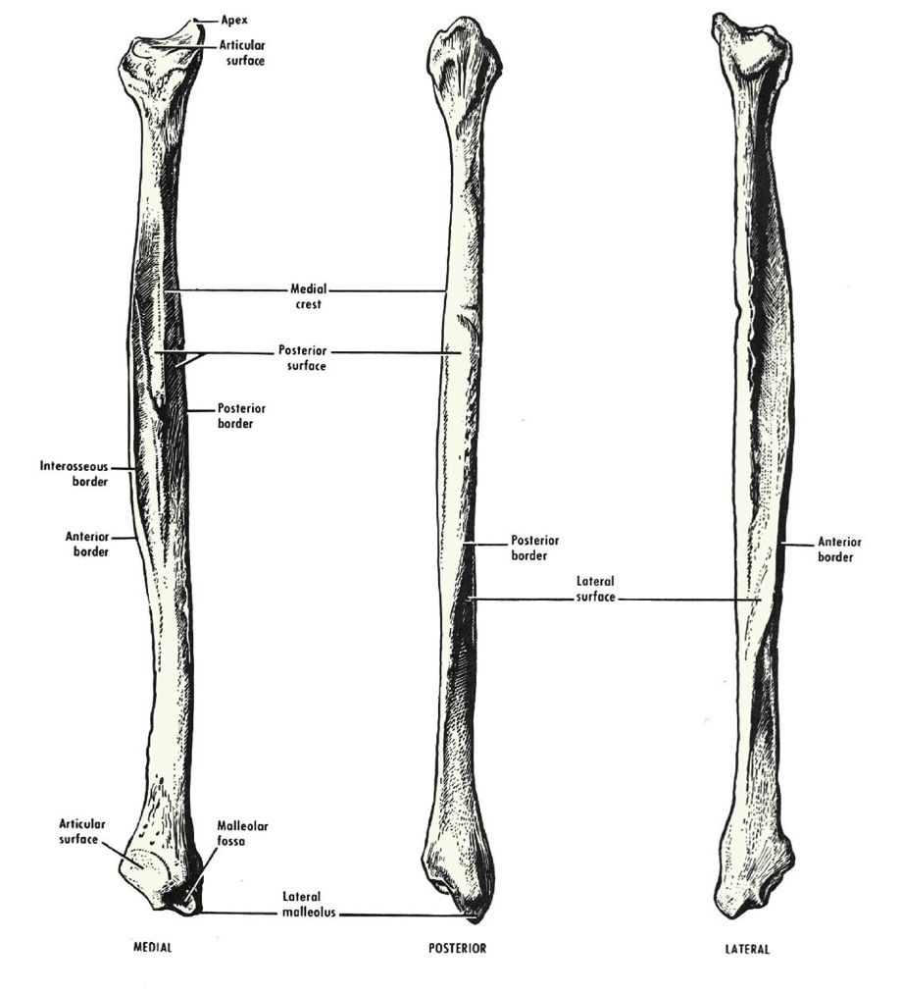

Slide 11
PES
The tetrapod PES is composed of the sole of the foot, or TARSUS which is a flexible mosaic of tarsal bones and five metatarsals; and the DIGITS, each with varying numbers of phalangeal elements.
Differing groups of tetrapods are often characterized by the number of phalangeal elements each as a PHALANGEAL FORMULA (for instance, that of humans is 2,3,3,3,3).

Slide 12
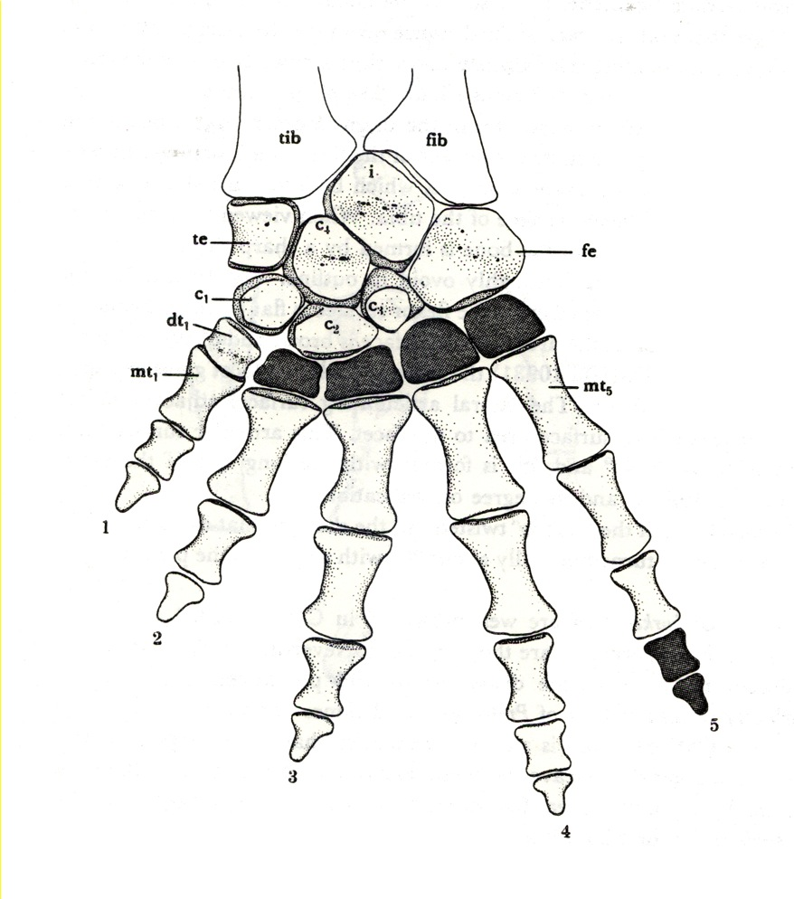
Pes: Basal Tetrapods
THREE PROXIMAL TARSALS
(from digit I /thumb side)
Tibiale
Intermedium
Fibulare
(As many as) FOUR MIDDLE TARSALS
Centrale 1
Centrale 2
Centrale 3
Centrale 4
FIVE DISTAL TARSALS
Distal Tarsal 1
Distal Tarsal 2
Distal Tarsal 3
Distal Tarsal 4
Distal Tarsal 5
The basal condition may be seen in the embolomere amphibian Greererpeton.

Slide 13
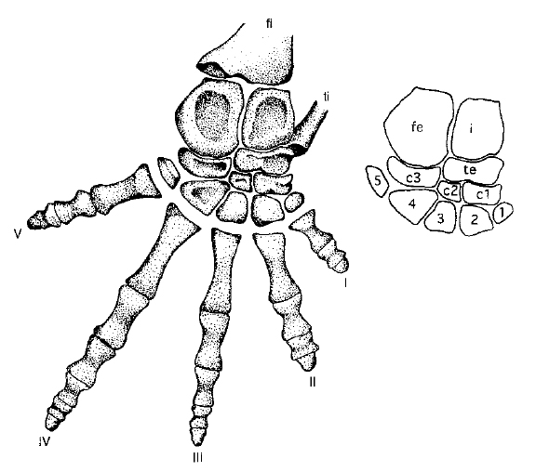
The condition in the seymouriamorph amphibian Seymouria is somewhat more advanced. The proximal and distal rows of tarsals remain, but the Centralia are reduced in number to three. Note that the tibale has moved to a position distal to the intermedium. It is still identifiable as the tibiale because of how the tibia comes in to articulate with it.

Slide 14
Pes: Basal Amniota
The story of the tarsus in amniotes is that of the formation of the ASTRAGALUS and CALCANEUM; as well as reduction of the Centralia.
The CALCANEUS is generally considered to be homologous to the fibulare.
Although there are alternative hypotheses, the most common one for the ASTRAGALUS that it is a fusion of the tibiale+intermedium+[probably] the 4th centrale.
The lone remaining amniote centrale is probably a fusion of Centralia 1-3.
All five DISTAL TARSALS remain.
The astragalus and calcaneum each possess a notch which when the two elements articulate create a central foramen for a perforating artery.

Slide 15
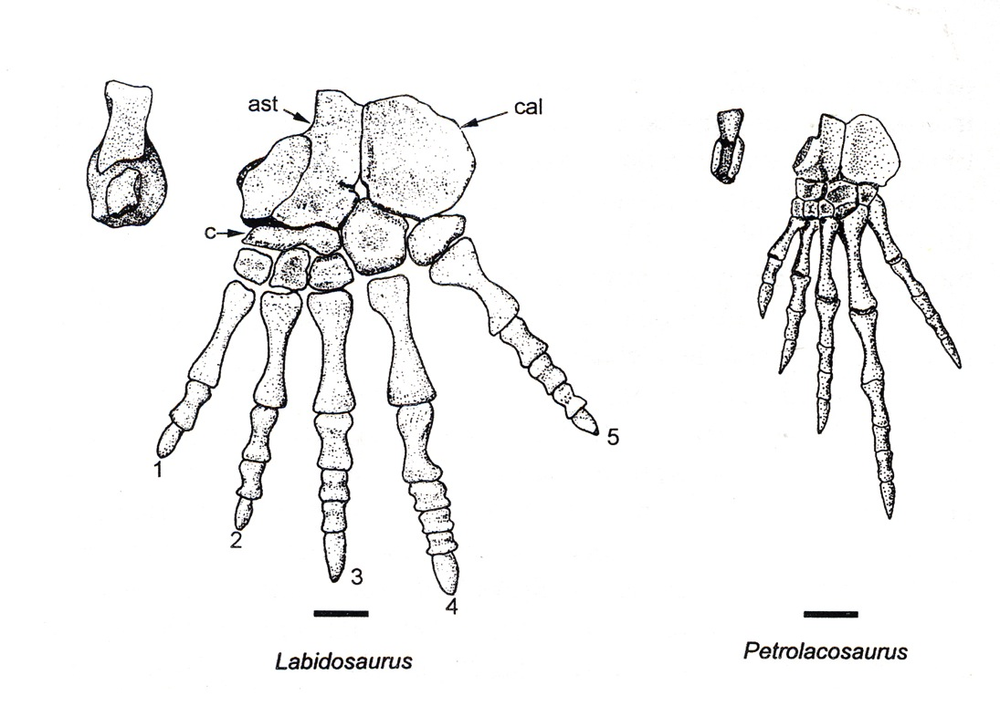
The astragalus is characterized by its “L-shaped” outline and large facet to accept the tibia.
The astragalus of diapsid reptiles has a “tongue-and-groove” slot so that it articulates tightly with the calcaneus. (Below right.)

Slide 16
The Transition from Amphibian to Amniote:
The Confusion of the Astragalus
Diadectomorpha, including the genus Diadectes, is currently regarded at the sistergroup to Amniota as traditionally defined. However for many years it was thought to have some problematic issues with that possible position, including what was thought to be an unusual tarsus.
In 1931, Romer and Byrne describd what appeard to be a very unusual set of tarsal bones in Diadectes wherein they were fused into a large, elongate structure.

Slide 17
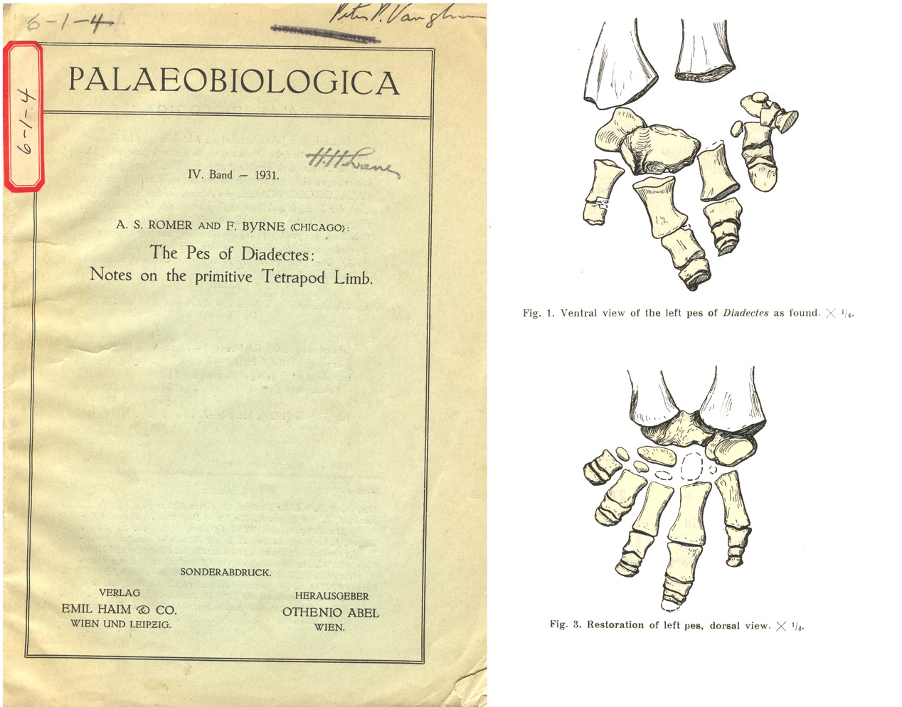

Slide 19
Then, in 2003, Berman and Henrici discovered juvenile diadectids in German and Utah. These slightly younger individuals showed the larger elements were late-life fusions of elements we already knew, namely the three proximal tarsals and the centrale.
Their work showed conclusively that diadectids have an astragalus composed of a tibale, intermedium and [proximal] centrale.
Thus, the condition of the tarsus in diadectids (and the larger group to which they belong, the Diadectomorpha) is more like amniotes than like non-amniote amphibians.

Slide 20
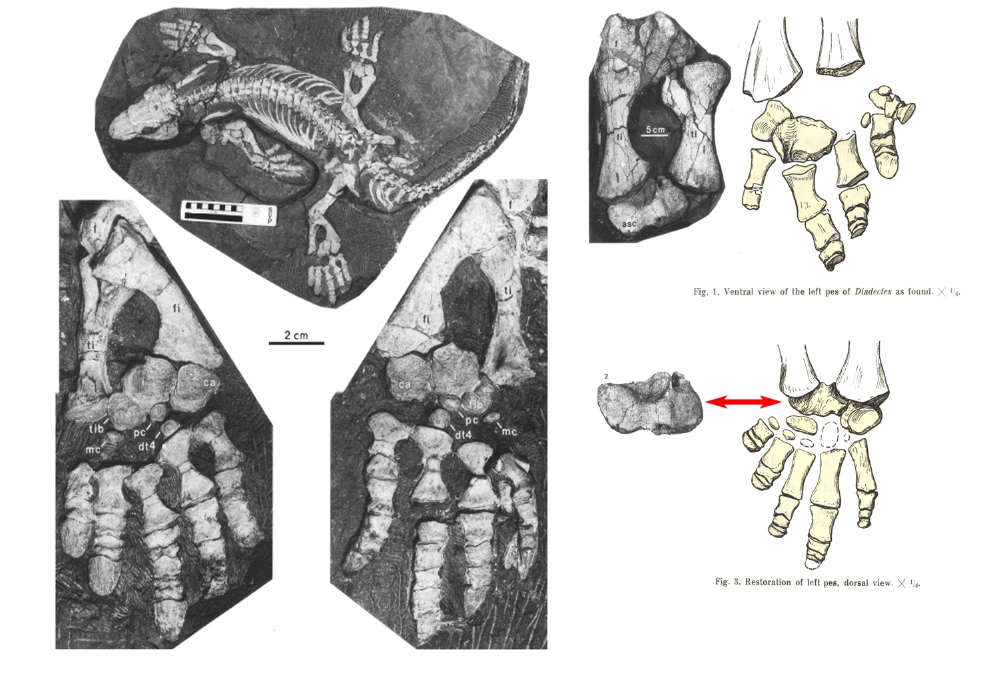

Slide 21
PES: MAMMALIA
TWO PROXIMAL TARSALS – ONLY ONE OF WHICH ARTICULATES WITH THE TIBIA.
The TALUS articulates with the tibia. This is logical, and the talus = astragalus.
The CALCANEUS remains is is set distal to the talus.
NAVICULAR
The only remnant of the centralia is the NAVICULAR, which is homologous to [a fusion] of centralia 1-3.
DISTAL ROW OF TARSALS
Distal tarsal 1 becomes CUNEIFORM 1.
Distal tarsal 2 becomes the CUNEIFORM 2.
Distal tarsal 3 becomes the CUNEIFORM 3.
Distal tarsal 4 becomes the CUBOID.
Distal tarsal 5 is lost.

Slide 22
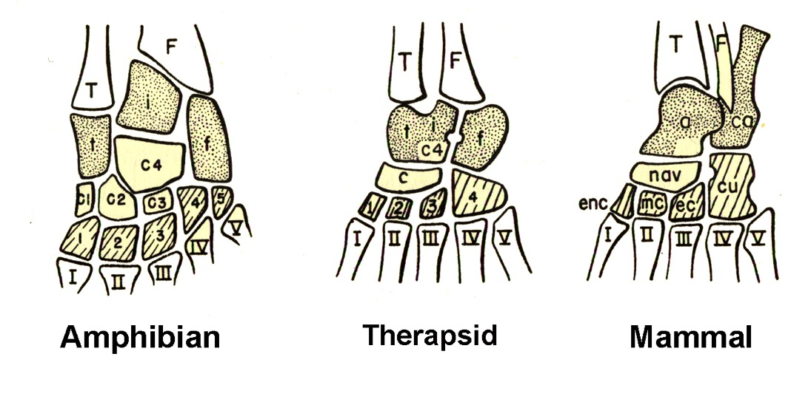
TWO PROXIMAL TARSALS – ONLY ONE OF WHICH ARTICULATES WITH THE TIBIA.
The TALUS articulates with the tibia. This is logical, and the talus = astragalus.
The CALCANEUS remains is is set distal to the talus.
NAVICULAR
The only remnant of the centralia is the NAVICULAR, which is homologous to [a fusion] of centralia 1-3.
DISTAL ROW OF TARSALS
Distal tarsal 1 becomes CUNEIFORM 1.
Distal tarsal 2 becomes the CUNEIFORM 2.
Distal tarsal 3 becomes the CUNEIFORM 3.
Distal tarsal 4 becomes the CUBOID.
Distal tarsal 5 is lost.

Slide 26
FOOT POSTURES
The primitive mammalian condition is to have the entire foot “flat” on the ground, from calcaneus to phalanges. This is known as the PLANTIGRADE condition. It generalized, though climbers tend to retain it as well.
A variety of highly CURSORIAL animal (fast runners) elongate elements of the hand and foot, elevating the tarsals and metatarsals, contacting only the digits. This conditions, common to canids, felids, and glires (rodents + lagomorphs (rabbits)) is known as DIGITIGRADE.
Also in the highly cursorial Perissodactyla (odd-toed ungulates), Artiodactyla (even-toed ungulates), is the condition wherein the the nail of the middle digit is the only element in contact with the ground. This is known as UNGULIGRADE.

Slide 27
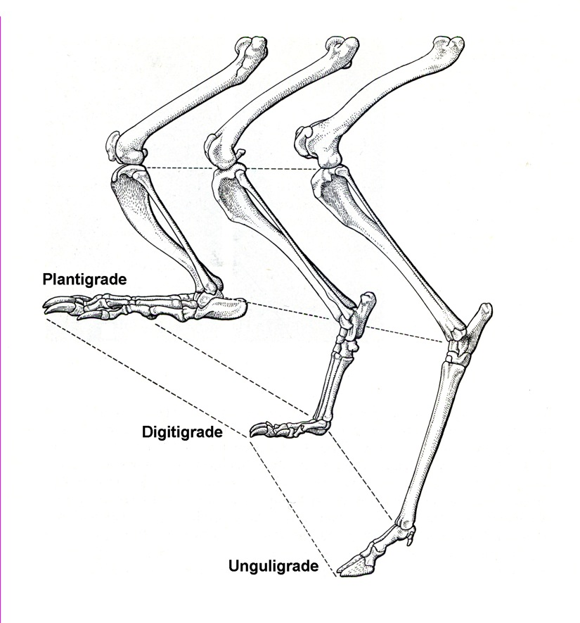
FOOT POSTURES
The primitive mammalian condition is to have the entire foot “flat” on the ground, from calcaneus to phalanges. This is known as the PLANTIGRADE condition. It generalized, though climbers tend to retain it as well.
A variety of highly CURSORIAL animal (fast runners) elongate elements of the hand and foot, elevating the tarsals and metatarsals, contacting only the digits. This conditions, common to canids, felids, and glires (rodents + lagomorphs (rabbits)) is known as DIGITIGRADE.
Also in the highly cursorial Perissodactyla (odd-toed ungulates), Artiodactyla (even-toed ungulates), is the condition wherein the the nail of the middle digit is the only element in contact with the ground. This is known as UNGULIGRADE.

Slide 28
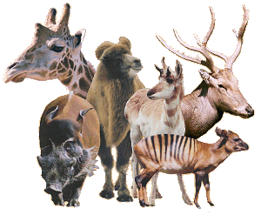

Slide 29
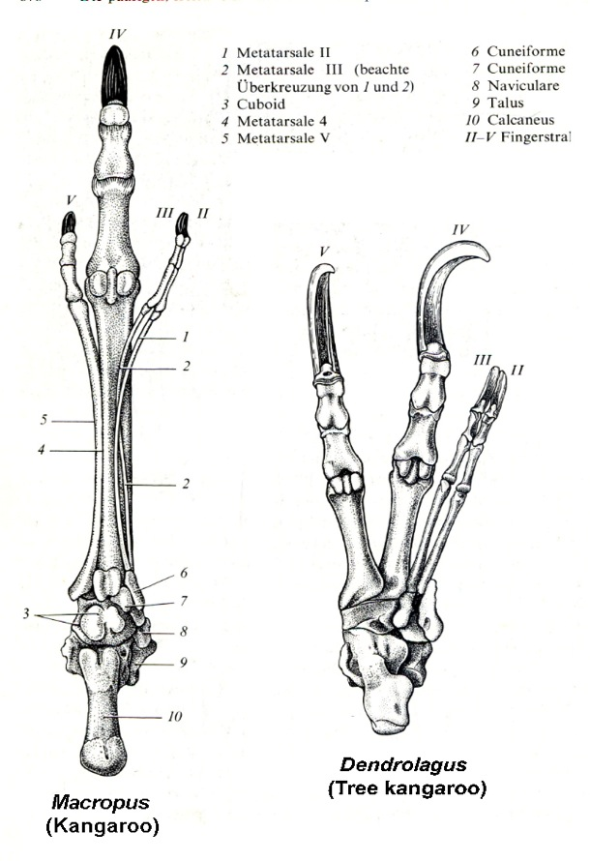
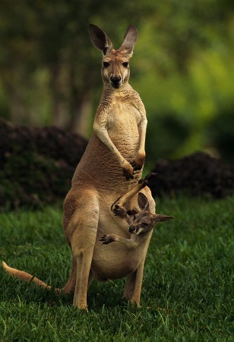
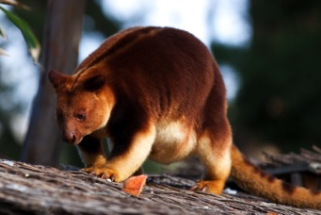
MACROPOD MARSUPIALS
Macropod marsupials (kangaroos and their relatives) are a particilar condition withing digitgrade mammals.
They have extremely elongate metatarsals.
And they have characteristically and unusually reduced digits 2 and 3 - reduced to thin elongate tendons.

Slide 30
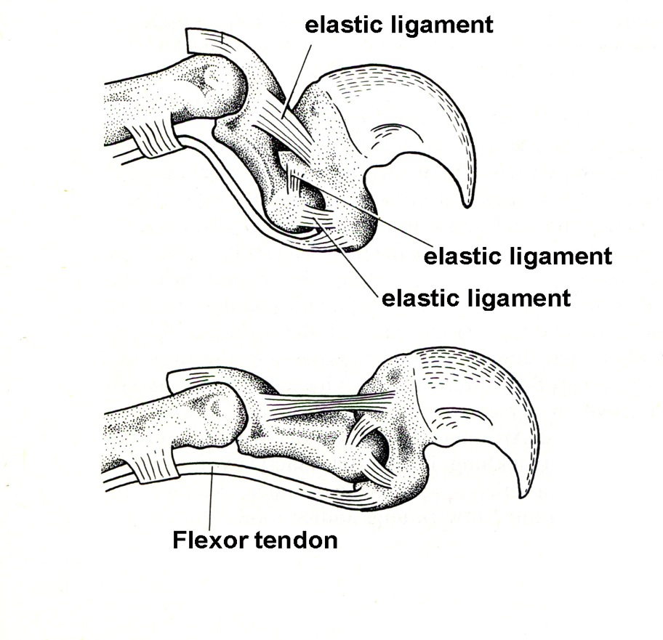
FELID CLAWS
Cats are actually specialized distal phalangeal elements which includes the claw. (De-clawing is the equivalent of cutting off the distal phalanx.)
Specialized flexor tendons, when shortened, pulls the proximal end of this distal phalanx proximally, which pulls the claw forward.
Relaxation of the flexor tendon retracts the claw.
Cheetahs are the exception. Their high speed running abilities preclude their having this system.

Slide 31
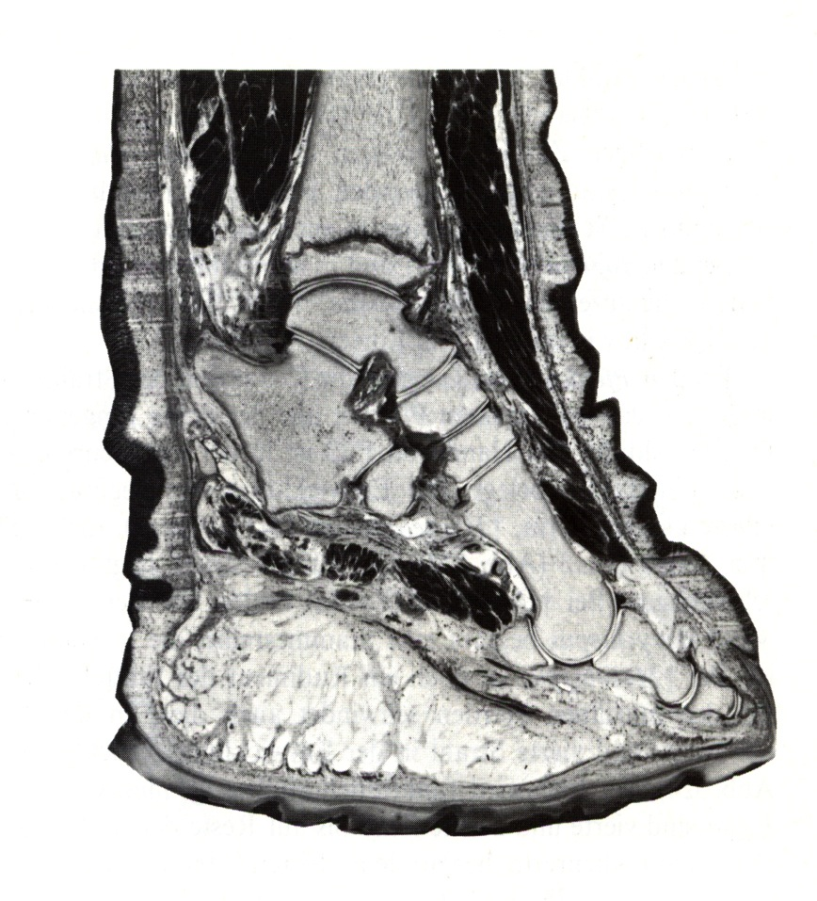
GRAVIPORTAL MAMMALS
The best known of graviportal mammals are elphants. They are animals so heavy their morphology is cominated by responses to gravity itself.
Limb orientation is columnar, and manual and pedal morphology has placed huge fat pads distal to digitigrade foot orientations.

