Slide 1
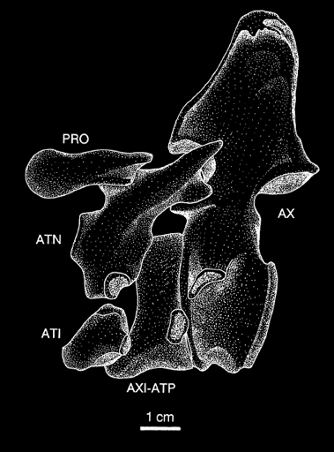
BIOLOGY 524
POSTCRANIAL SKELETON - I
AXIAL SKELETON
S. S. Sumida

Slide 2
INTRODUCTION
The axial skeleton is generally considered one of the hallmark features of vertebrates; it is after all, the namesake of the group. However, the idea that the group was defined by having vertebrae or a vertebral column turns out to be an oversimplification.

Slide 3
NOTOCHORD
In fact, the beginnings of the axial skeleton of vertebrates, both embryologically and phylogenetically is not about the vertebral column. Rather it is about the notochord. The notochord:
Derived from mesoderm
A trans-segmental structure immediately ventral to the dorsal hollow nerve cord.
A laterally flexible, but incompressible rod, that prevents telescoping of the body in primitive vertebrates, as well as embryos.
It does not become the vertebral column, but is replaced in varying degrees by structures of the sklerotome of the somite.

Slide 4
VERTEBRAL COLUMN AND ASSOCIATED STRUCTURES
We will track the following significant trends:
Eventual replacement of the notochord (in whole or in part) by vertebrae.
Reorganization of sklerotomal materials to facilitate terrestrial biomechanics.
Differing trajectories of emphasis on different structures depending on whether tetrapods remain aquatic or become more terrestrially adapted.
Development and consolidation of the atlas-axis complex.
In mammals and birds, the development of regionally specialized sections of the vertebral column.

Slide 5
AXIAL STRUCTURE IN PRIMITIVE VERTEBRATES
The subphylum Vertebrata is defined by the presence of ectodermal placodes and neural crest tissue and structures that develop from them.
The reason the “Vertebrata is not defined by vertebrae” is because the most basal of vertebrates do not in fact have a true vertebral column.

Slide 6
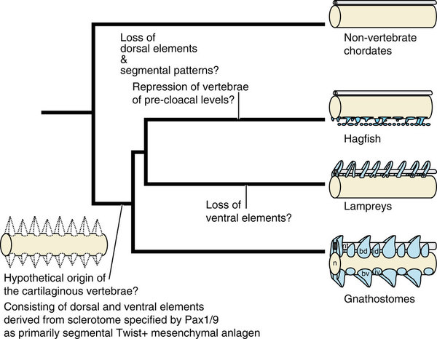
AXIAL STRUCTURE IN PRIMITIVE VERTEBRATES
Agnathans and even primitive gnathostomes do not have a fully ossified vertebral column. Fossil agnathans show little or no evidence of an ossified vertebral column. With such highly developed dermal armor, it may not have been necessary.
Living agnathans do not have much in the way of vertebral structures either.
Hagfish: small, poorly developed haemal arches.
Lampreys: small, poorly developed neural arches.

Slide 7
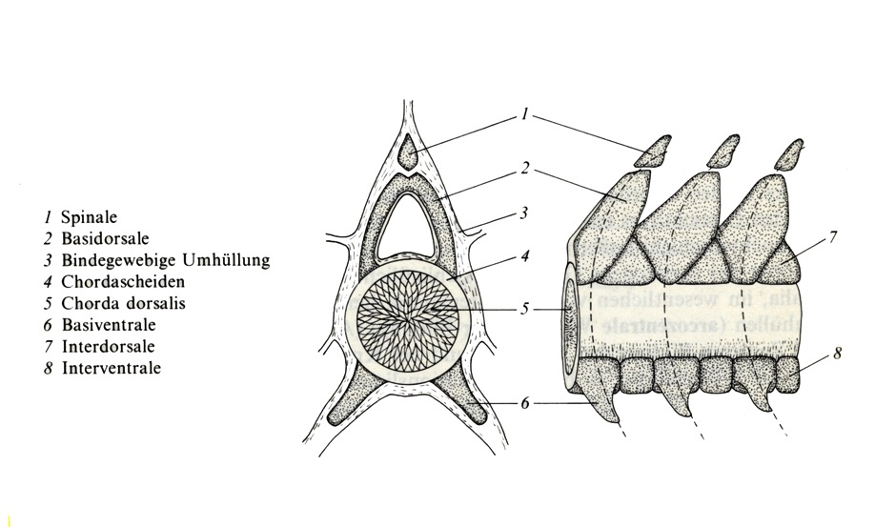
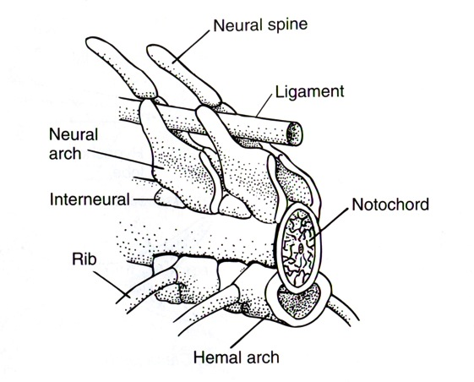
Even primitive living gnathostomes only have structures dorsally and ventrally, with the notochord remaining the majority of the mass of the axial skeleton.
Where dorsal structures rest on the top of the notochord, and ventral structures attach to the underside of the notochord, there are often supporting plugs of material that are dense, and occasionally even become calcified cartilage.

Slide 9
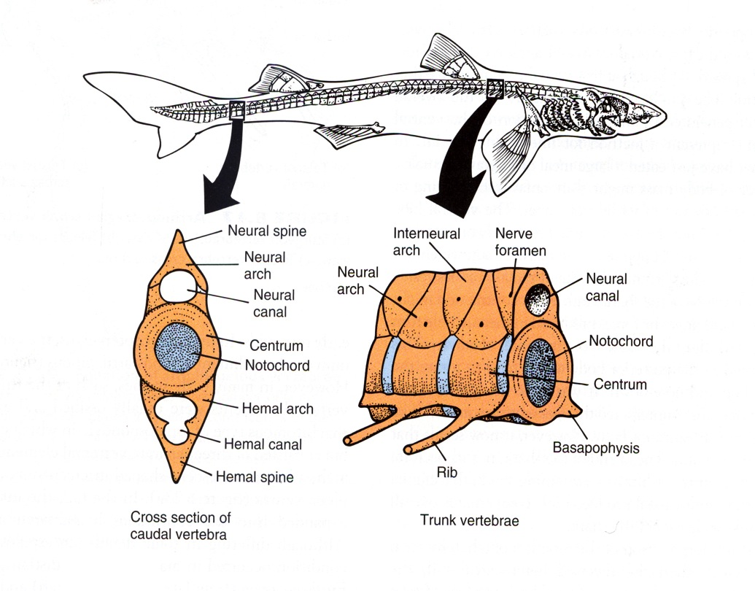
Sharks and their relatives have fully developed vertebral central, as well as neural arches. In the tail region, HAEMAL ARCHES combine to protect the caudal extension of the dorsal aorta.
In the trunk region, the neural arches are triangular in outline laterally. This would leave a series of triangular spaces between each neural arch. But in sharks these spaces are plugged by structures known as INTERCALARY PLACES, or interneural plates.
Vertebral central are NOTOCHORDAL, with the notochord persisting and running through the center of each centrum.

Slide 10
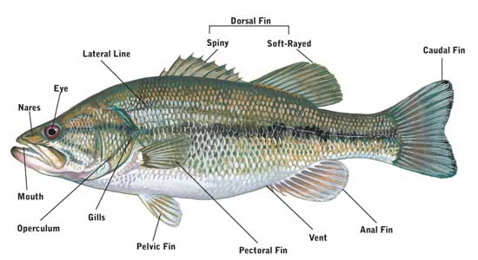
MEDIAN FINS OF FISHES
They are usually supported by midline extensions away from the vertebral column. UNPAIRED MEDAN FINS include:
One or more dorsal fins.
In salmonid fishes, the second of the dorsal fins is fleshy with no bony support, and called an ADIPOSE FIN.
An ANAL FIN, sometimes called a ventral fin.
The TAIL FIN.

Slide 11
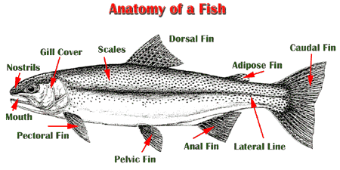
BASIC STRUCTURES OF A SALMONID FISH

Slide 12
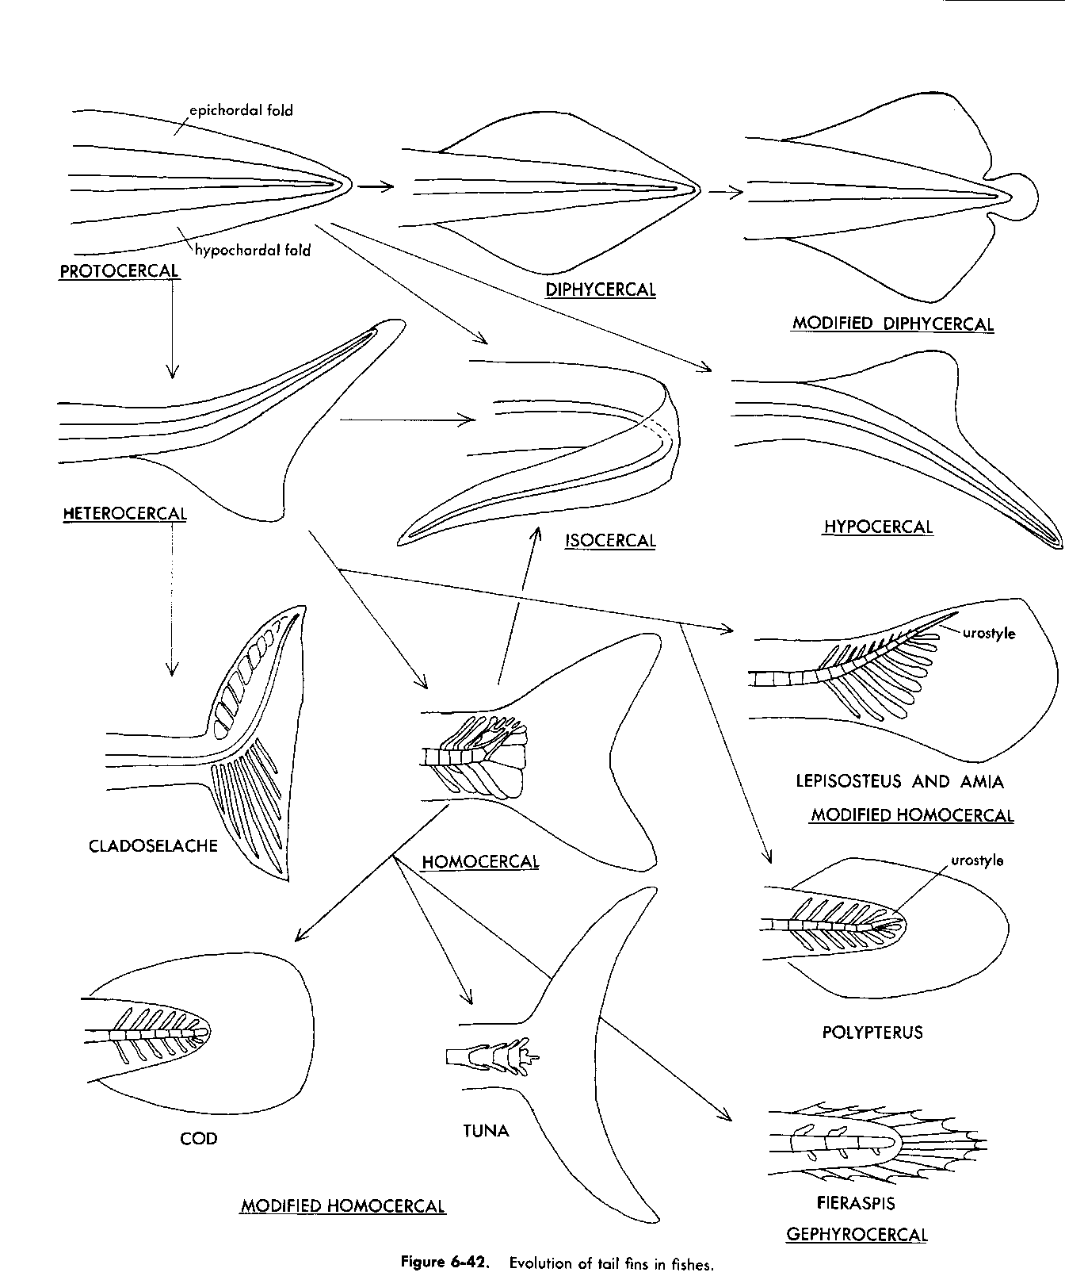
TAIL FIN STRUCTURE
HOMOCERCAL – tail that looks externally symmetrical, but may not be internally. (There are many ways to build a homocercal tail.)
HETEROCERCAL - tail in which longer lobe is dorsal, usually with vertebral column continuing into it.
HYPOCERCAL – tail in which longer lobe is ventral, usually with vertebral column continuing into it.

Slide 13
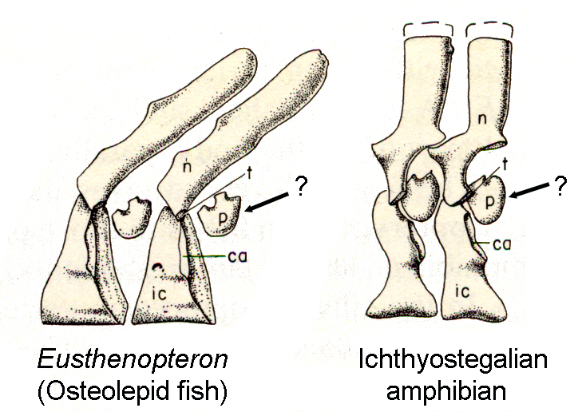
VERTEBRAL STRUCTURE FROM CROSSOPTERYGIAN
FISHES TO THE EARLIEST TETRAPODS
Vertebral centra of crossopterygians are wedge-shaped, and triangular in outline in lateral view. Small accessory structures sometimes called pleurocentra (singular = pleurocentrum) may actually be intercalary plates.
Neural arches become somewhat more erect.
And although the earliest tetrapods appear to have remained largely aquatic, they must have had to deal with gravity and the needs for support at least on occasion, as they do demonstrate the development of zygapophyses.
ZYGAPOPHYSES are structures for articulation between successive vertebral structures so that each vertebra rests partially on the vertebral immediately caudal to it. This helps resist ventral-ward collapse of the column in tetrapods.

Slide 14
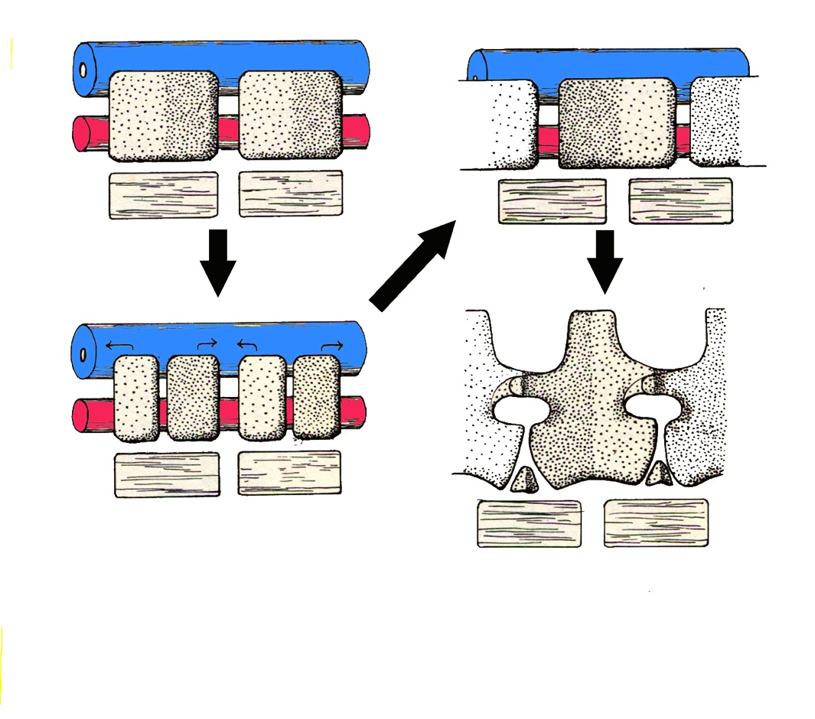
To understand the difference between the INTERCENTRUM and PLEUROCENTRUM, the early embryology of the vertebra must be understood.
To understand that, recall that the segmental somites are subdivided into dermatome, myotome, and sklerotome. Key here is the sklerotome that will give rise to vertebral structures, and the myotome which gives rise to the musculature that attaches to that skeletal structure.

Slide 15
The developing sklerotome (above) and myotome are initially in line with one another.
This is not an advantageous means of attachment if the muscle is to act across a joint.
Each sklerotome SPLITS into a cranial half and a caudal half, which then migrate away from one another.
This causes the cranial half of one sklerotome and the caudal half of that immediate forward of it to move toward one another.

Slide 16
When they touch the like tissues fuse, giving rise to a vertebral structure that is built from caudal and cranial halves of adjacent sklerotomes.
This results in myotomes/muscle blocks now spanning intervertebral joints, generating a condition more useful for stabilizing the vertebral column and RESISTING SAGGING DUE TO GRAVITY.
This reorganized vertebra type is a PLEUROCENTRUM.
A vertebra that doe not go through this reorganization is known as an INTERCENTRUM. Notably, even when much of the vertebra resegments, sometimes small parts of the original sklerotome does not. This is the intercentrum.

Slide 17
The original condition — i.e. the fish condition, the aquatic condition – is NOT to resegment. To remains as an intercentrum.
What we will see is that those lineages of tetrapods that come to be more and more terrestrially adapted will come to emphasize the pleurocentrum more and more. This will included the lineage leading to Amniota.
Conversely, some early tetrapod lineages never truly left the water, and some became obligate aquatic organisms. In other words, they continued to mostly swim. Those groups came to continue the emphasis on the intercentrum.
Below we can see two main lineages of basal tetrapods. One lineage, that leading from crossopterygian fishes has a small pleurocentrum for a bit but eventually it is abandoned and the intercentrum is the only component of the vertebral body. (In this case color-coded blue).
On the other hand, the lineage that lead toward more completely terrestrial amniotes emphasized the pleurocentrum, (In this case color-coded red.) and the intercentrum became smaller and smaller.

Slide 18
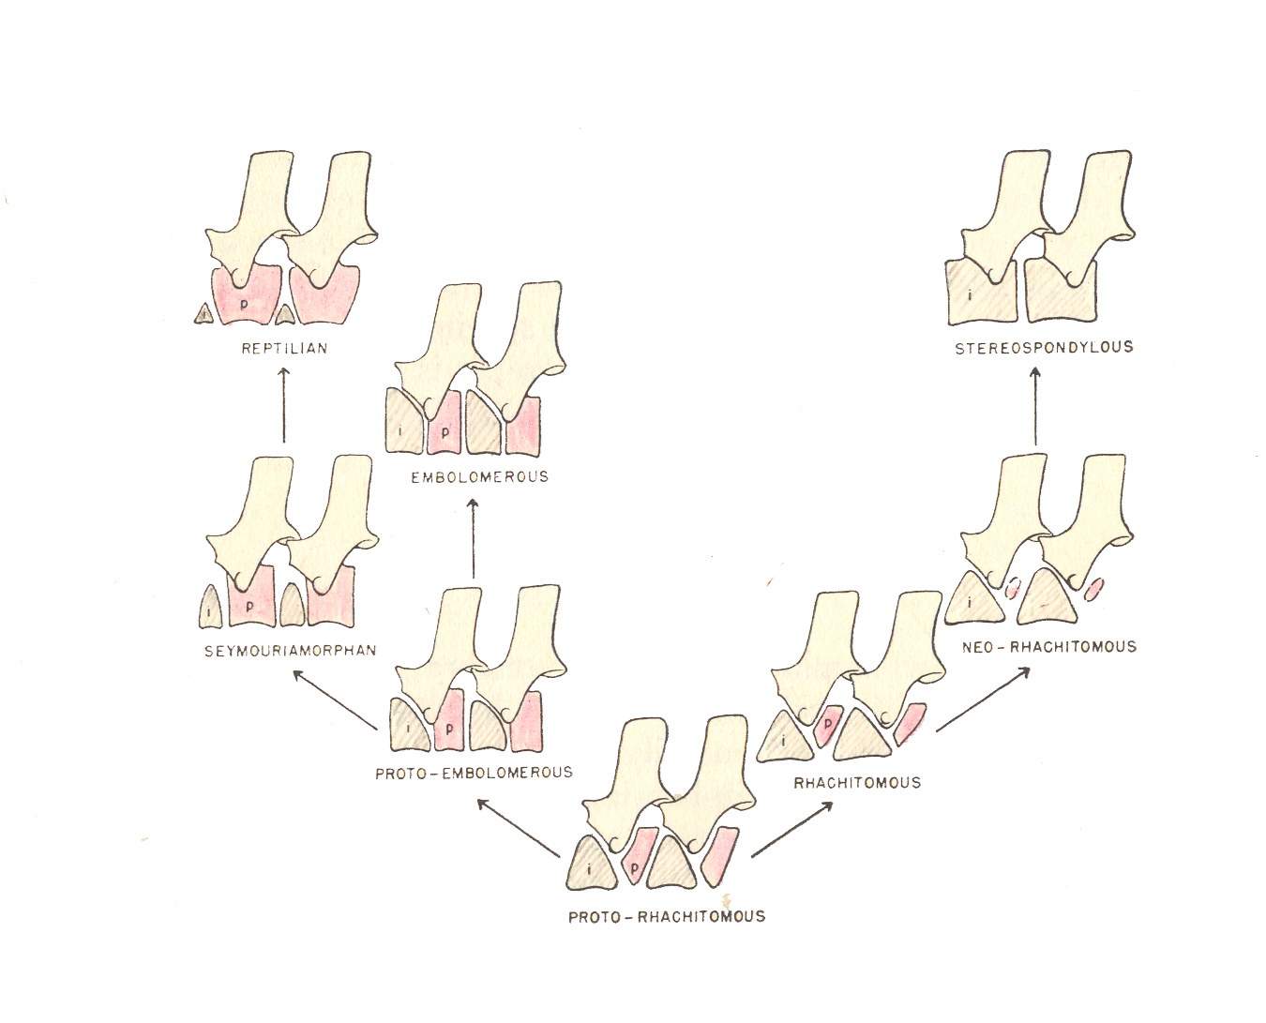

Slide 19
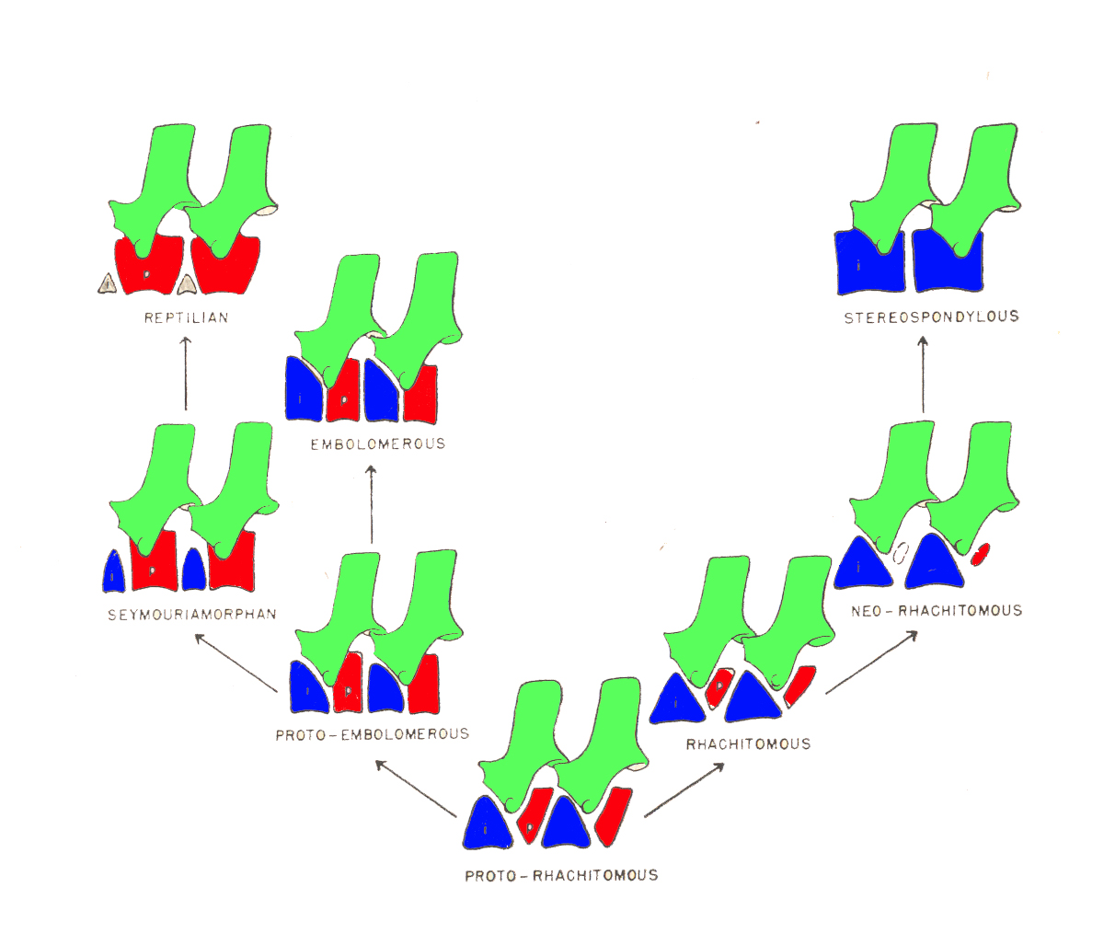

Slide 20
How can you tell an intercentrum from a pleurocentrum in a fossil with no development to watch? Note that from fishes on, the ribs articulate with the neural arch and the intercentrum.
The names of the large groups of Paleozoic tetrapods are generally given based on their vertebral structure:
The Rhachitomi have a “rachitomous” condition of alternating wedges intercentra and pleurocentra.
The “stereospondylous” condition of the Stereospondyli is that of a single cylincrical intercentrum and no pleurocentrum.
On the lineage leading to Amniota:
Embolomeri with the “embolomerous” condition have centra made of two distinct disc-like structures, one the interenrum, the other the pleurocentrum.
Seymouriamorpha have a dominant pleurocentrum and smaller intercentrum. The intercentrum must have been continued dorsally as cartilage, but the pleurocentrum is clearly becoming dominant.
Amniota has a large pleurocentrum, and only tiny intercentrum though it is present and does accept the costal articulation.

Slide 21
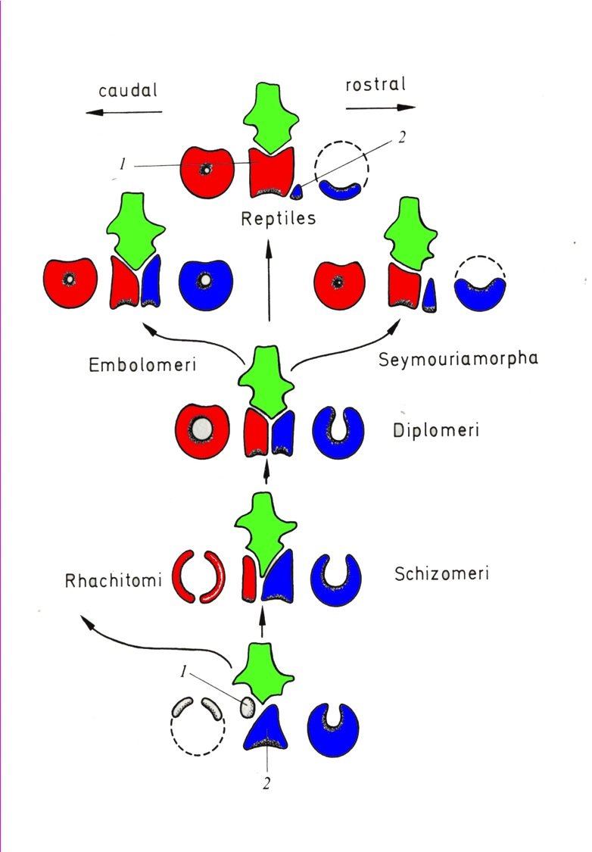
How can you tell an intercentrum from a pleurocentrum in a fossil with no development to watch? Note that from fishes on, the ribs articulate with the neural arch and the intercentrum.
The names of the large groups of Paleozoic tetrapods are generally given based on their vertebral structure:
The Rhachitomi have a “rachitomous” condition of alternating wedges intercentra and pleurocentra.
The “stereospondylous” condition of the Stereospondyli is that of a single cylincrical intercentrum and no pleurocentrum.

Slide 22
On the lineage leading to Amniota:
Embolomeri with the “embolomerous” condition have centra made of two distinct disc-like structures, one the interenrum, the other the pleurocentrum.
Seymouriamorpha have a dominant pleurocentrum and smaller intercentrum. The intercentrum must have been continued dorsally as cartilage, but the pleurocentrum is clearly becoming dominant.
Amniota has a large pleurocentrum, and only tiny intercentrum though it is present and does accept the costal articulation.

Slide 23
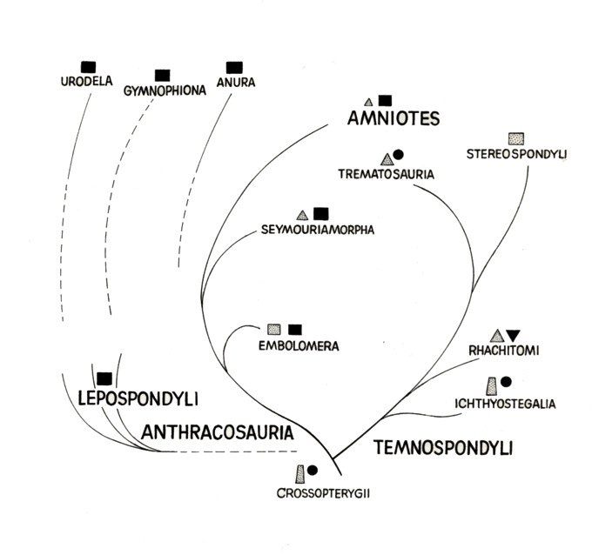

Slide 24
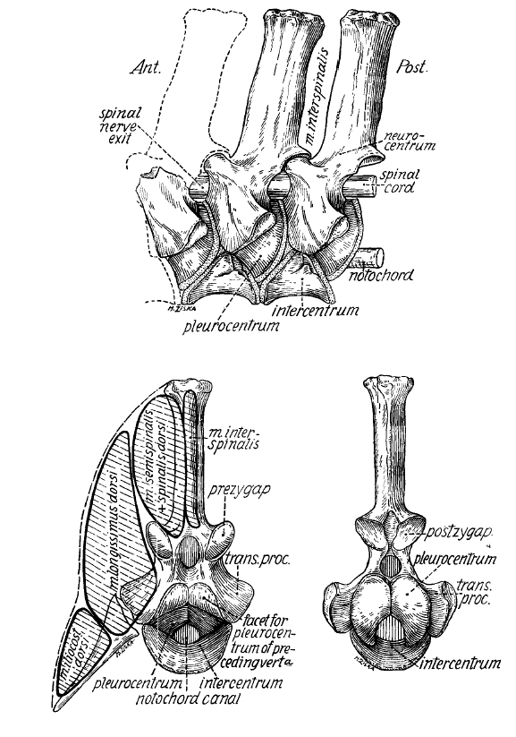

Slide 25
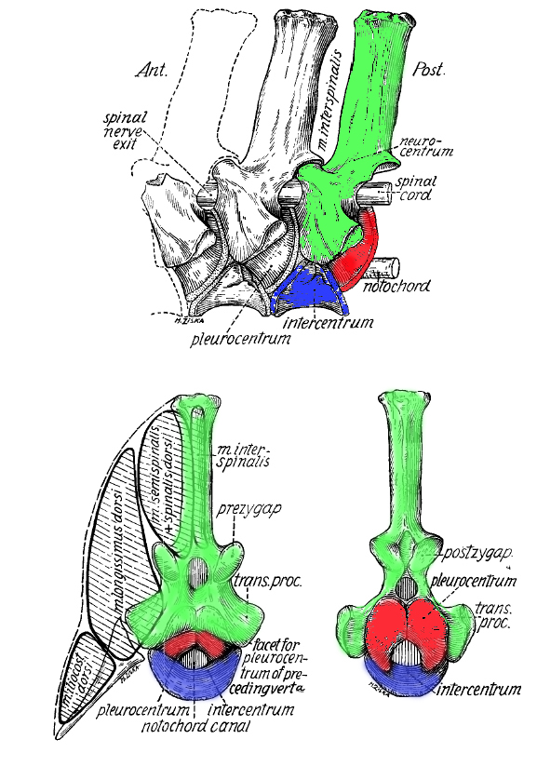

Slide 26
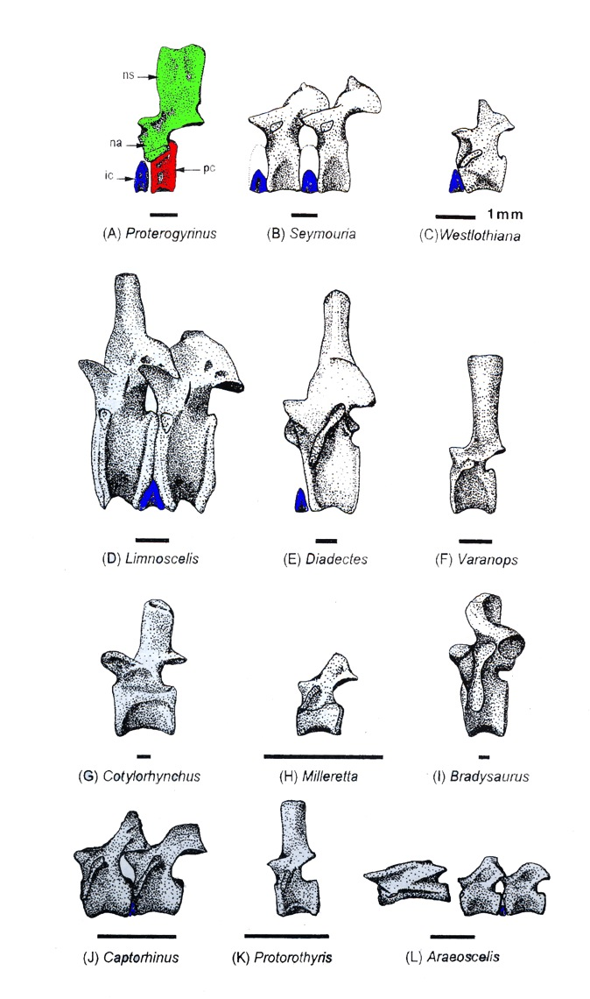
VERTEBRAL STRUCRTURE IN AMNIOTES
After the example of the very terrestrially adapted amphibians Protogyrinus, only the intercentra are color-coded for reference.
Note that in some cases two successive vertebrae are illustrated. This is because in many Late Paleozoic tetrapods, there was an alternation in structure of the neural spines between tall, cylindrical, robust spines, and those with low, narrow or non-existent spines.
This phenomenon was probably to give interspinous musculature a greater potential range of contraction.

Slide 27
VERTEBRAL STRUCRTURE IN AMNIOTES
Limnoscelis and Diadectes belong to a group known as DIADECTOMORPHA. They are very amniote-like, and may well have been amniotes for all we know
The remainder of taxa illustrated are either basal reptiles or basal synapsids.

Slide 28
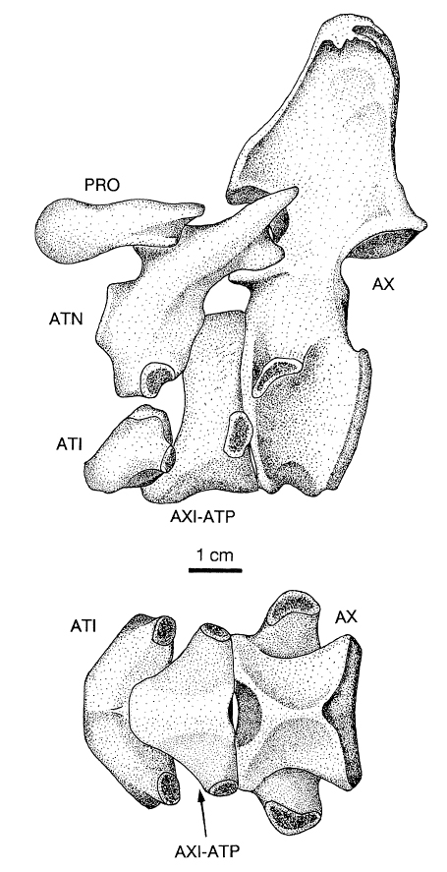
ATLAS-AXIS COMPLEX
Tetrapods also begin to develop specialized modifications of the first two vertebrae to facilitate support and movement of the large head.
Amniotes and those closely related to them show a particularly diagnostic condition. See the situation in the diadectomorph Diadectes here.
Atlantal intercentrum is an independent structure.
Right and left atlantal neural arches are independent structures, and do not fuse in the dorsal midline.
The axial intercentrum comes to underlie the atlantal pleurocentrum – excluding the axial pleurocenrum from ventral exposure on the underside of the vertebral column.
A small right and left proatlas provide articulation for the atlantal neural arches with the occipital region of the skull
The axis is very robust, as is the very large neural spine.

Slide 29
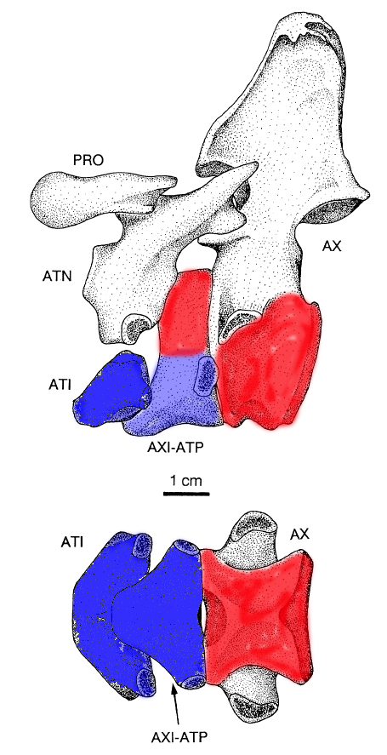
ATLAS-AXIS COMPLEX
Tetrapods also begin to develop specialized modifications of the first two vertebrae to facilitate support and movement of the large head.
Amniotes and those closely related to them show a particularly diagnostic condition. See the situation in the diadectomorph Diadectes here.
Atlantal intercentrum is an independent structure.
Right and left atlantal neural arches are independent structures, and do not fuse in the dorsal midline.
The axial intercentrum comes to underlie the atlantal pleurocentrum – excluding the axial pleurocenrum from ventral exposure on the underside of the vertebral column.
A small right and left proatlas provide articulation for the atlantal neural arches with the occipital region of the skull
The axis is very robust, as is the very large neural spine.

Slide 30
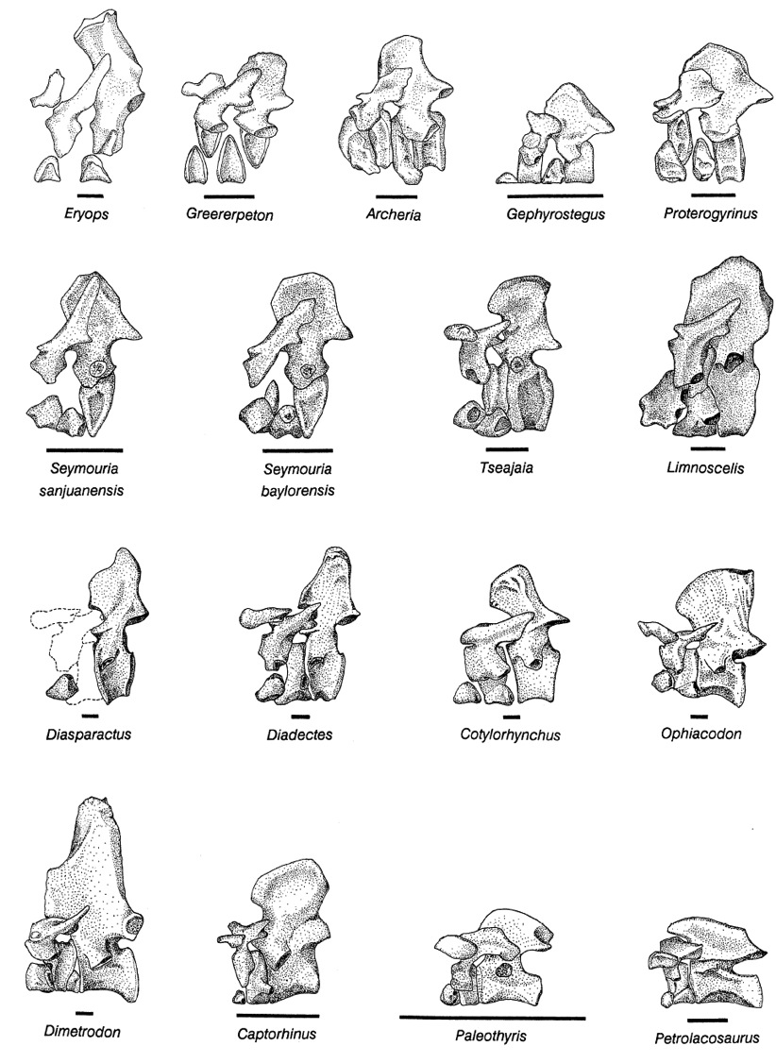

Slide 31
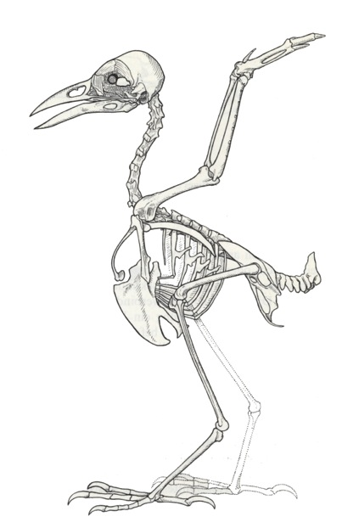
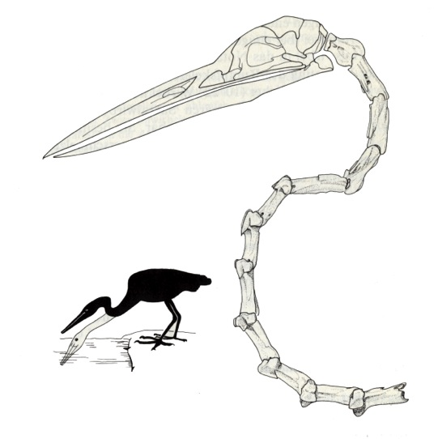
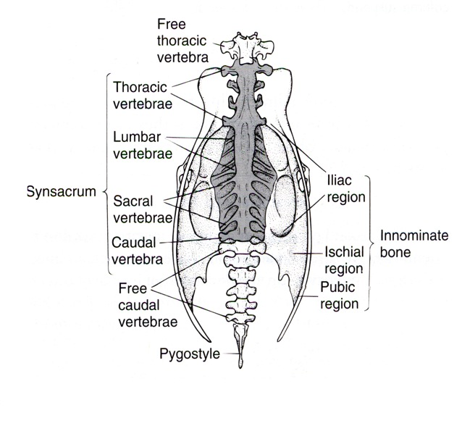
VERTEBRAL COLUMN IN BIRDS
As birds are descended from theropod dinosaurs they inherit an essentially reptilian condition. However, extant avian vertebral structures are part of the air-sac system and there are very light and thin walled.
Neck vertebrae in birds remain mobile; in fact highly mobile, in many cases with extreme curvature in neck vertebrae.
Birds usually fuse all but a couple trunk vertebrae to a stiff, median SYNSACRUM.

Slide 32
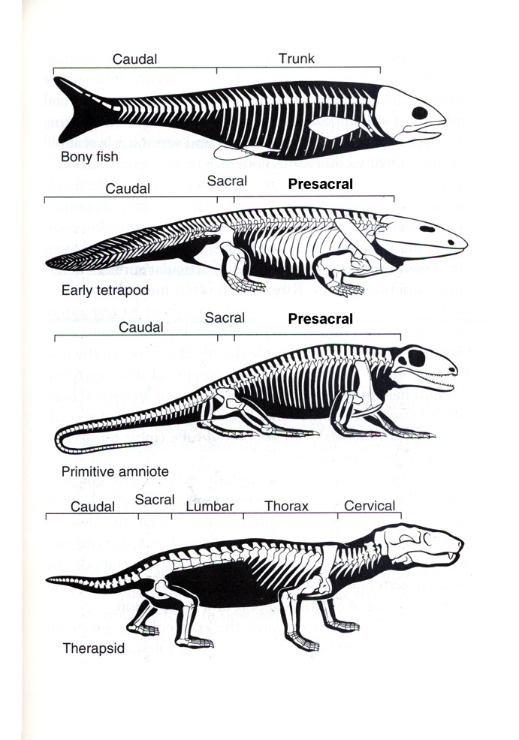
VERTEBRAL STRUCTURES IN MAMMALS
The hallmarks of mammals are the development of regional differention of the backbone into cervical, thoracic, lumbar, and sacral regions; as well as the loss or fusion of ribs, leaving the thoracics as the region with mobile ribs.
In general, the CERVICAL region, which includes the atlas-axis complex, are defined by the presence of the transverse foramen on either side.
THORACIC vertebrae retain mobile ribs.
Developing ribs fuse to the transverse processes of the LUMBAR region.
The SACRUM is the fusion of two or more segments to provide anchorage for the ilium of the pelvic limb.

Slide 33
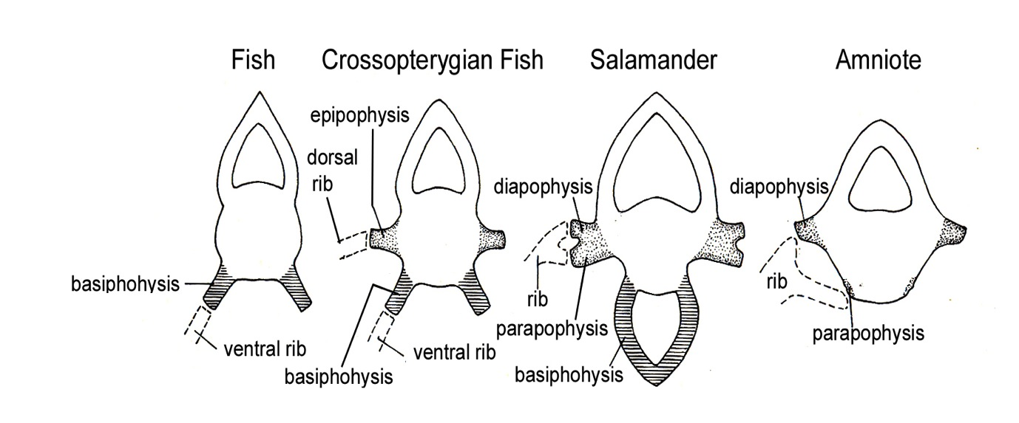
OTHER AXIAL STRUCRURES: RIBS
Agnathans do now show rib development, but otherwise, gnathostomes have a rib for every vertebral segment, including the atlas-axis complex in tetrapods.
As mentioned earlier, fishes have two distinct sets of ribs, DORSAL RIBS and VENTRAL RIBS – which articulate at the EPIPOPHYSES and BASIPOPHYSES respectively.
In tetrapods, ribs are generally double-headed, articulating with the DIAPOPHYSIS of the neural arch and the PARAPOPHYSIS of the intercentrum.

Slide 34
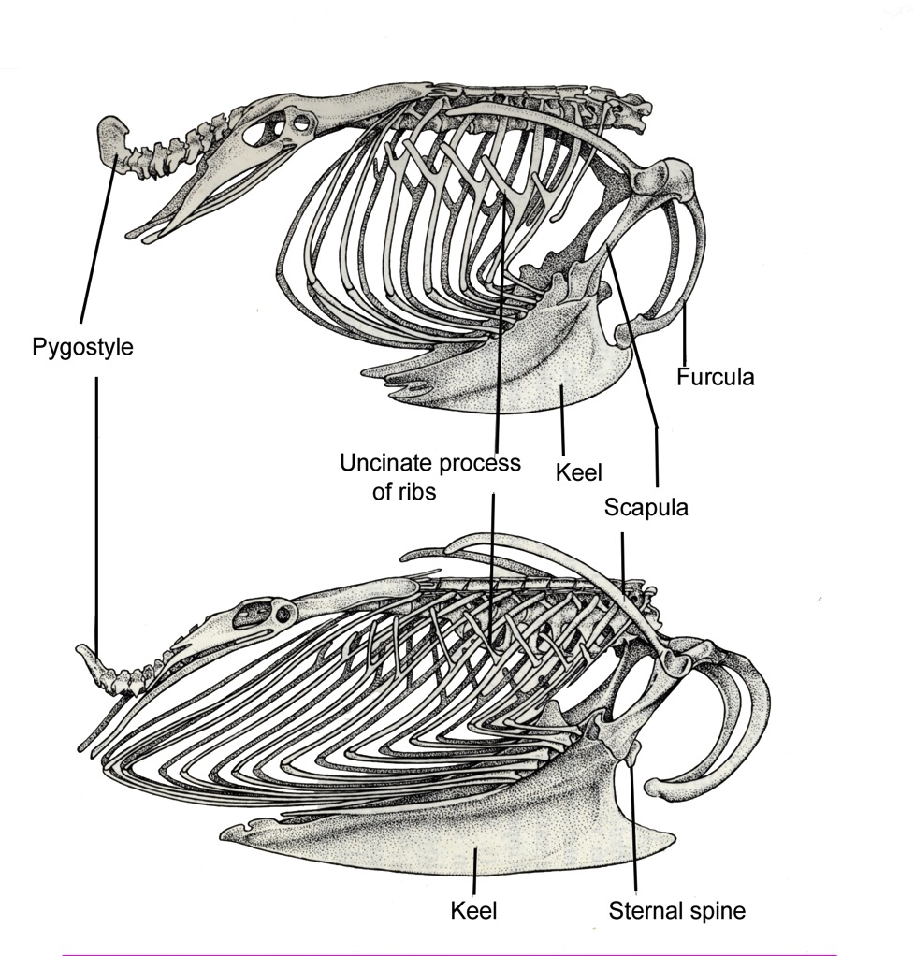
AVIAN RIBCAGE
NOTE almost complete enclosure of body in ribcage
Uncinate processes
PYGOSTYLE is modified end of vertebral column for insertion of highly mobile tail feathers.

Slide 35
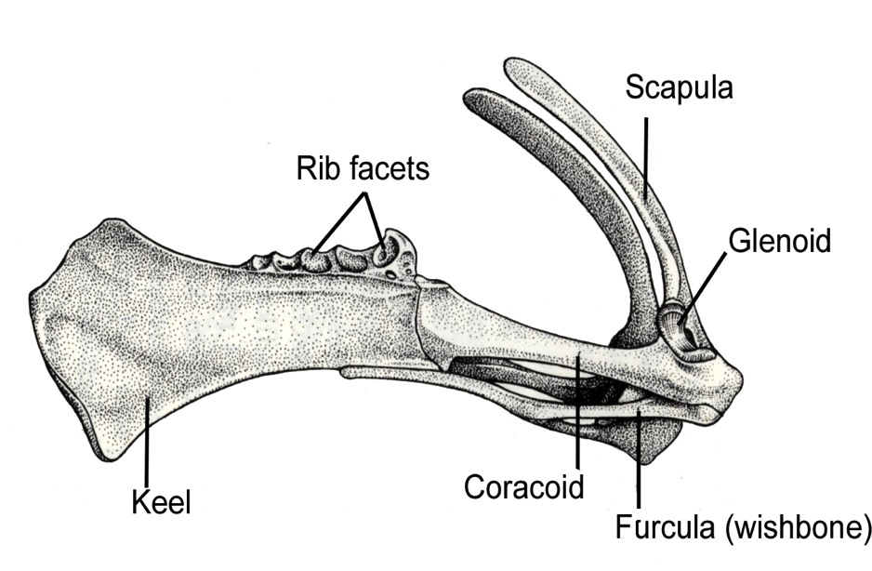
OTHER AXIAL STRUCTURES: STERNUM
In birds and mammals, the STERNUM provides a ventral articulation for the more cranial of the ribs.
AVES: In birds it is elaborated into the robust KEEL or KARINA. It has a deep ventral keel providing extensive surface area for the supracoracoideus (wing elevator muscle) and pectoralis (wing depressor muscle).

Slide 36
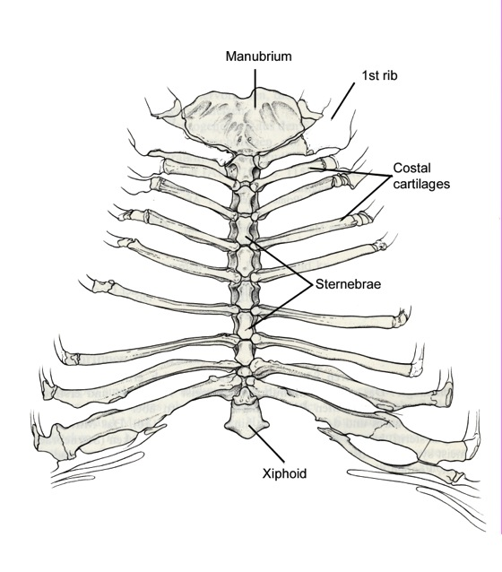
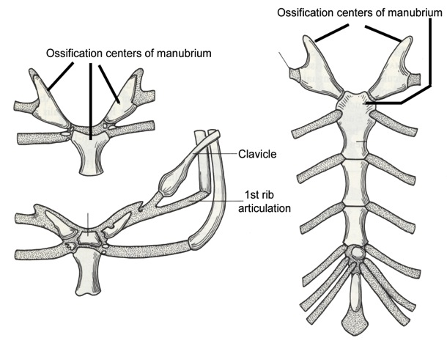
OTHER AXIAL STRUCTURES: STERNUM
In birds and mammals, the STERNUM provides a ventral articulation for the more cranial of the ribs.
MAMMALIA: The STERNUM in mammals is a segmental structure, derived originally from multiple STERNEBRAE.
Generally the mammalian sternum is subdivided into a MANUBRIUM cranially, BODY, and XIPHOID PROCESS most caudally.

