Slide 1
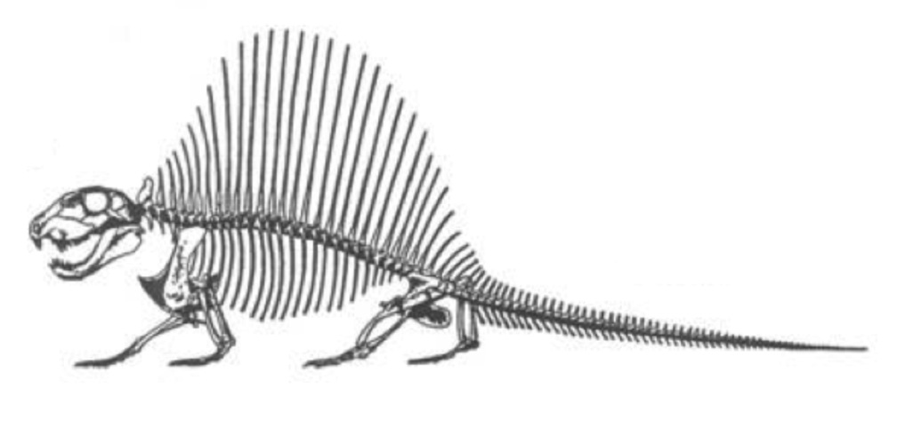
BIOLOGY 622 – FALL 2014
BASAL AMNIOTA - STRUCTURE AND PHYLOGENY
WEEK – 2
BASAL SYNASIDA
INTRODUCTION TO CASEASAURIA AND EUELYCOSAURIA
S. S. SUMIDA

Slide 2
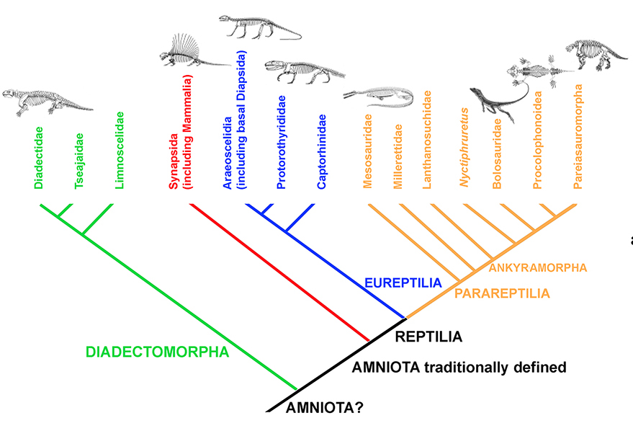
The Synapsida is one of the two great groups of the Amniota sensu stricto (the other being Reptilia).

Slide 3
Synapsida used to be mistakenly considered as derived from more “primitive” reptiles, and thus for nearly a century were commonly called “Pelycosaurs”, and inappropriately called the “mammal-like reptiles”.
We know now that Synapsida has been an independent amniote lineage since probably before Reptilia. And, whereas Synapsida is a proper monophyletic group of Amniota, “Pelycosauria” is technically not a proper taxonomic term, as it is best regarded as a ‘grade of organization’ within Synapsida:

Slide 4
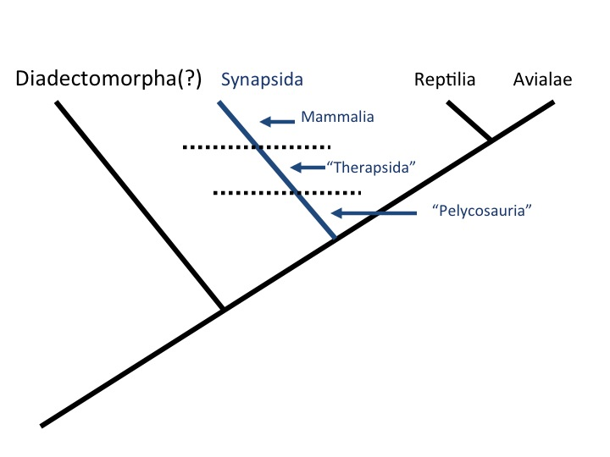

Slide 5
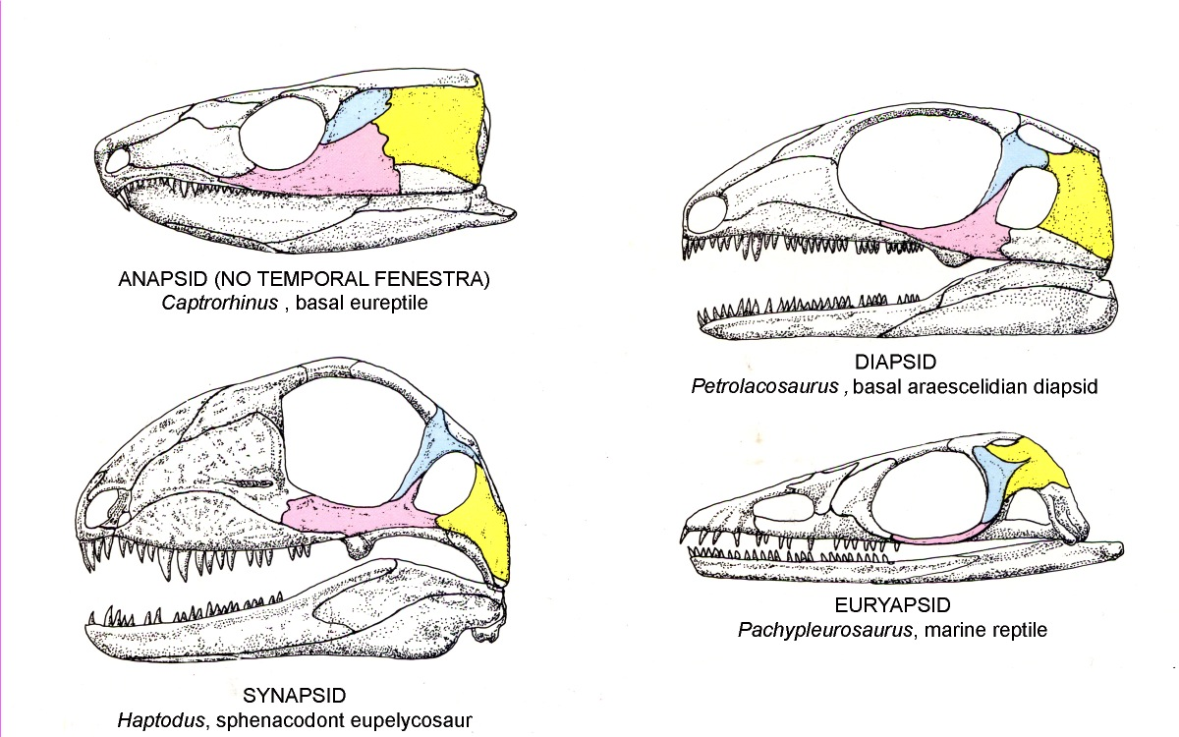
At the base of Synapsida, the most reliable defining feature has been, and remains, the presence of a lateral temporal fenestra bounded by the squamosal, jugal, and postorbital bones. There are other patterns of temporal fenestration in basal amniotes, as well as the primitive lack of temporal fenestration in many basal reptiles.

Slide 6
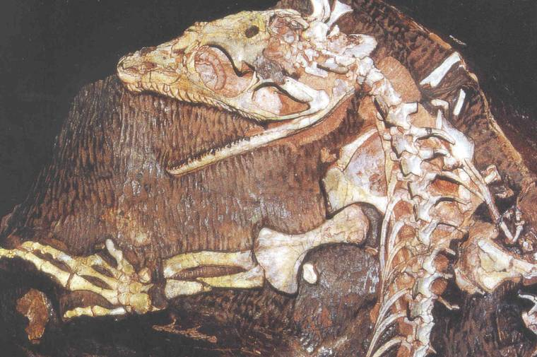
Basal Synapsida (“Pelycosauria”): A single opening on side of skull

Slide 7
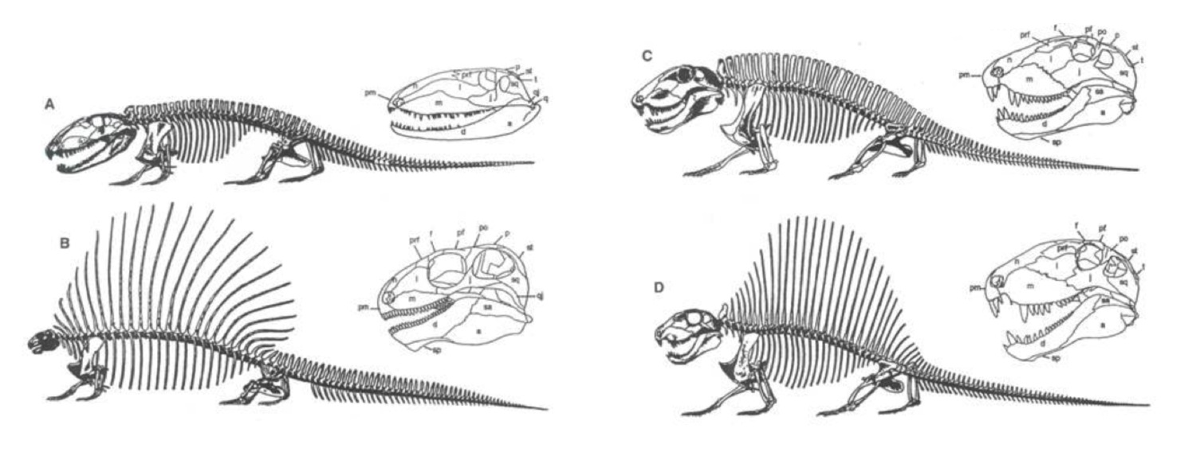
Notably, “pelycosaurs” include some of the most famous and iconic of non-dinosaurian fossils, including the famous sail-backed Dimetrodon.
At least one other family of synapsids has developed a sail (the Edaphosauridae), and there is quite a diversity of non-sailed pelycosaurian families as well, ranging from the mid-Carboniferous to the Early (and possibly middle) Permian.

Slide 8
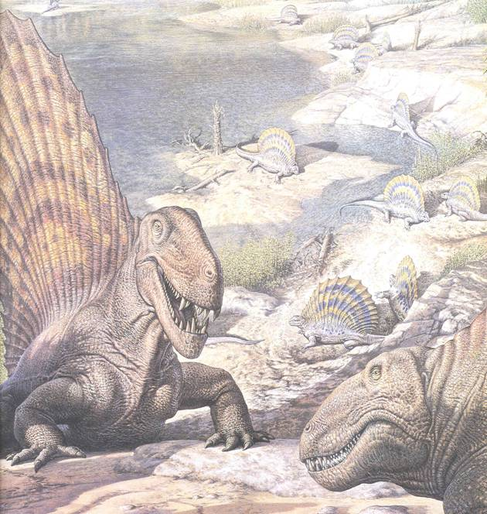

Slide 9
PELYCOSAURIA: HISTORICAL PERSPECTIVE
Through the middle of the last century, most of the landmark work on pelycosaurs was done by A. S. Romer (University of Chicago, then Harvard University), culminating in the landmark Review of the Pelycosauria by Alfred S. Romer and Lewellyn Price in 1940. This 526 page “paper” (Bulletin of the Geological Society of America) reviewed every family, genus, species, specimen, locality, and anatomical description of every pelycosaur specimen known at the time.

Slide 10
The anatomical descriptions and illustrations of Romer and Price (1940) remain as accurate and remarkable as ever.
Many of the phylogenetic relationships between families suggested by Romer and Price (1940) are now out of date, but their family designations have had remarkable durability.
Price did all of the illustrations, and Romer directed them. Additionally, he provided all of the text, analysis and phylogenetic interpretation.

Slide 11
In this image, taken from Romer and Price (1940) Romer designated the family Ophiacodontidae as the most primitive of pelycosaurs.
This was suggested due in part to their clearly semi-aquatic features, and at the time semi-aquatic was equated with “primitive”.
These features included a fish-trap style skull and jaws, and poorly ossified limb elements.

Slide 12
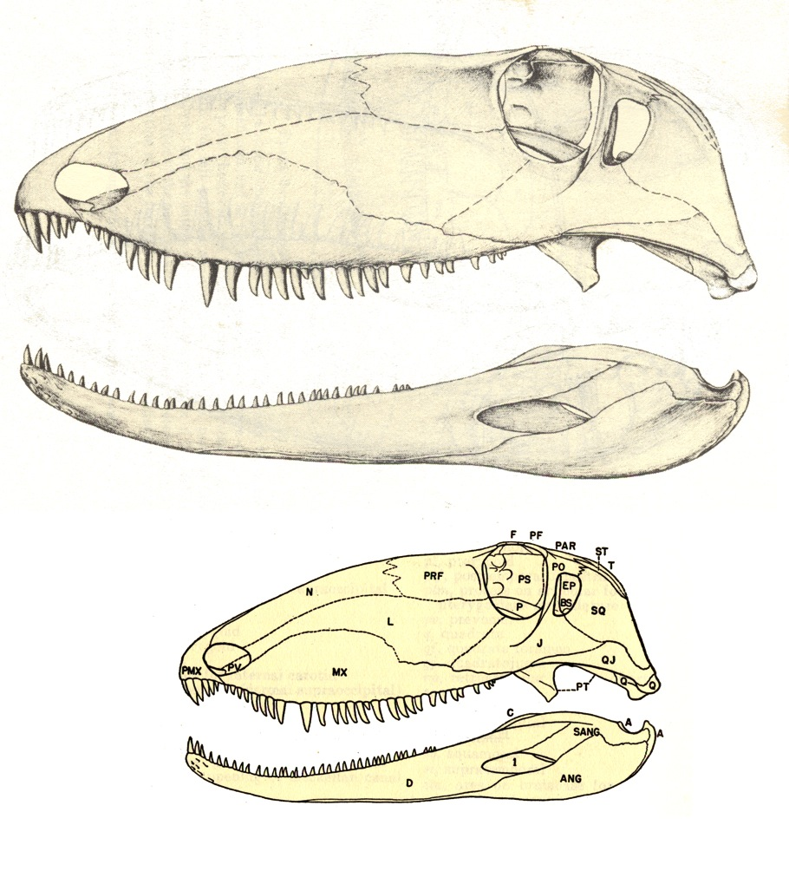

Slide 13
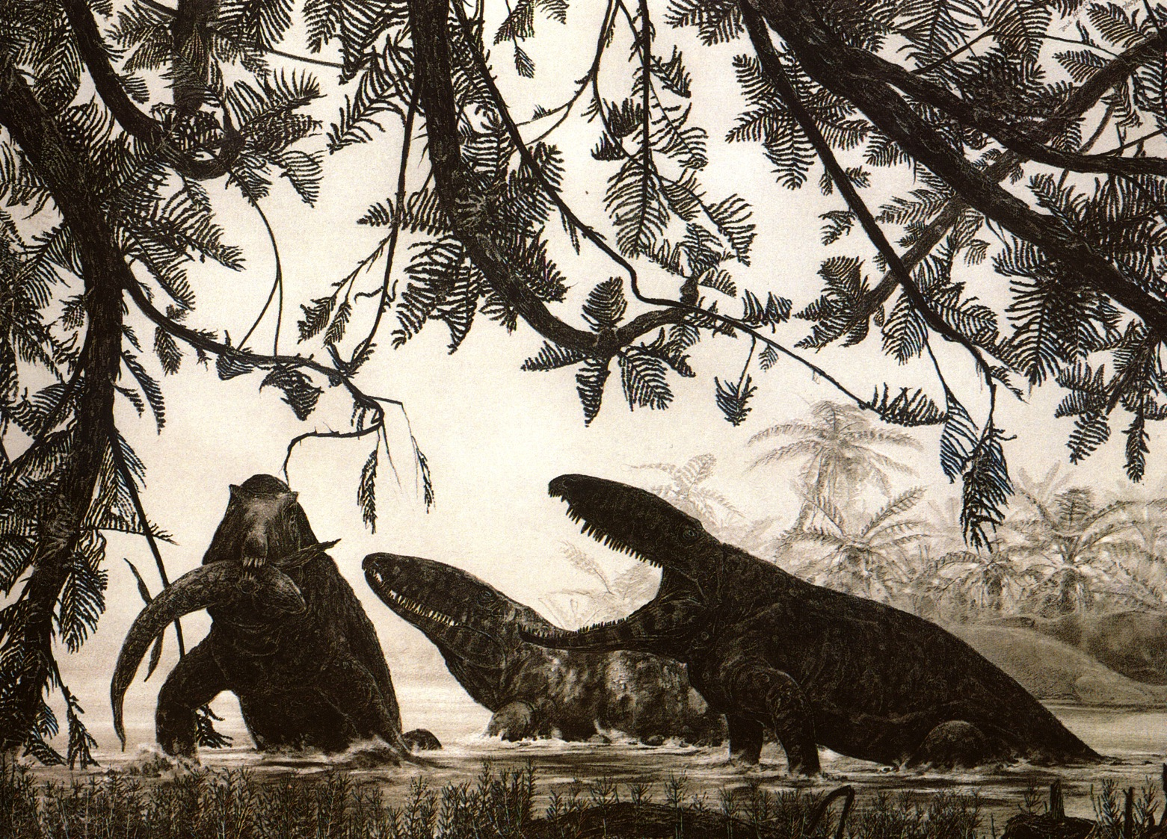

Slide 14
Other notable features included:
Romer’s placing the large, barrel-shaped herbivores Caseidae and Edaphosauridae close to one another. This is no longer considered accurate, but Lupeosaurus has since been subsumed into the Edaphosauridae, so he was close on that count.
Haptodontines are considered close to sphenacodontines, which is still considered to be the case.
Sphenocodontines are considered as the ancestral stock that gave rise to therapsid-grade synapsids, which is also still considered correct.

Slide 15
The first comprehensive phylogenetic analysis of pelycosaurs was provided by Robert Reisz in 1980.
Reisz (1980) essentially confirmed the validity of most of Romer’s pelycosaurian families, including the Eothyrdidiae, the Caseidae, the Varanopseidae, Edaphosauridae, and Sphenocondontidae.
However, the interrelationships have changed and been reassessed in some cases.

Slide 16
SYNAPSIDA: DEFINITION
(1) The presence of a lateral temporal fenestra on each side of the skull bounded by the squamosal, jugal, and postorbital remains the fundamental defining feature of Synapsida.
Other workers have suggested that to this may be added:
(2) The occipital region was broad and it faced posterodorsally. (Whereas in other early amniotes, the endochondral bones of the braincase formed a narrower surface, and it was more or less vertical.) See angle of blue line.
(3) The pubis had a long, ridged anterodorsal edge.

Slide 17
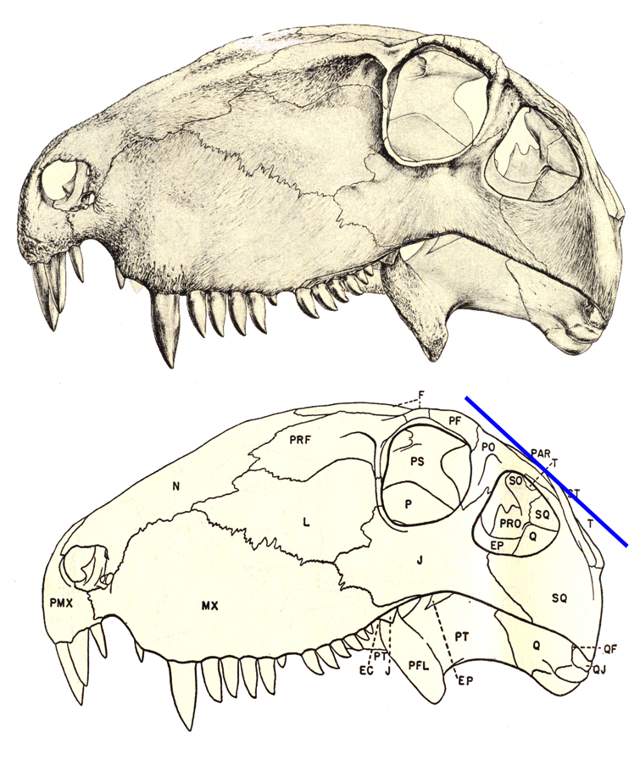
SYNAPSIDA: DEFINITION
The presence of a lateral temporal fenestra on each side of the skull bounded by the squamosal, jugal, and postorbital remains the fundamental defining feature of Synapsida.

Slide 18
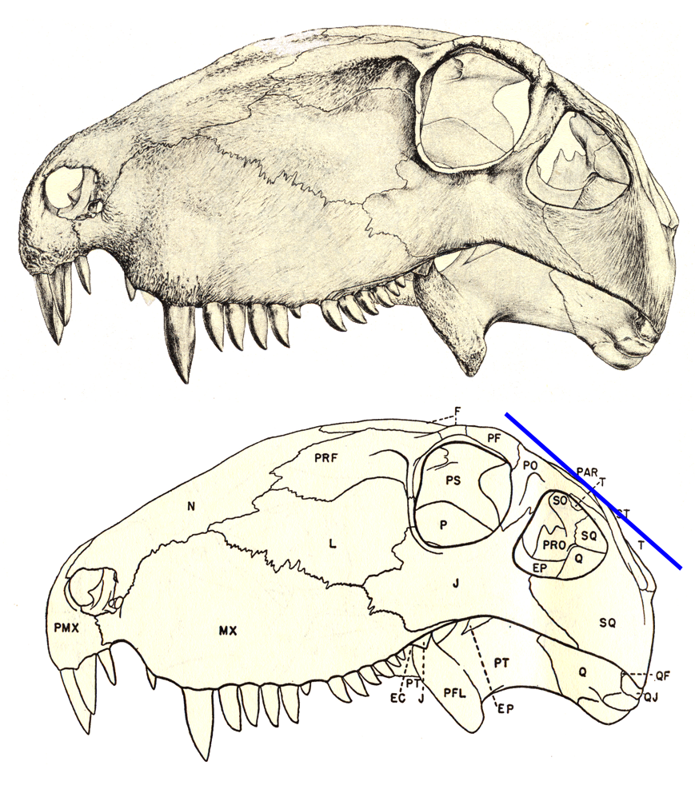
SYNAPSIDA: DEFINITION
(2) The occipital region was broad and it faced posterodorsally. (Whereas in other early amniotes, the endochondral bones of the braincase formed a narrower surface, and it was more or less vertical.) See angle of blue line.

Slide 19
SYNAPSIDA: DEFINITION
(3) The pubis had a long, ridged anterodorsal edge. Ar scales = 1 cm.)

Slide 20
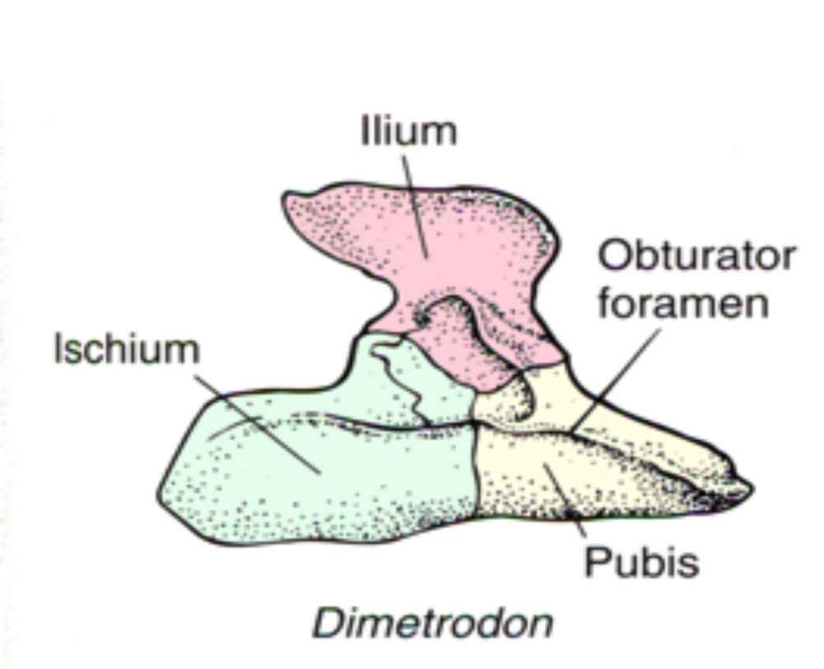

Slide 21
MODERN INTERPRETATIONS OF PHYLOGENETIC
RELATIONSHIPS OF BASAL SYNAPSIDS (I.E “PELYCOSAURS”)
The work of Reisz (1980, 1986), Reisz et al (1992), and Berman et al (1995) have confirmed the validity pelycosaurian families, and placed them in two distinct groups:
SYNAPSIDA
Caseasauria
Family Eothyrididae
Family Caseidae
Eupelycosauria
Family Varanopseidae
Family Ophiacodontidae
Haptodus
Palaeohatteria
Pantelosaurus
Cutleria
Family Edaphosauridae
Family Sphenacodontidae + Therpasida

Slide 22
Haptodus, Palaeohatteria, Pantelosaurus, and Cutleria are all genera that used to be placed in a distinct group known as the “Haptodontidae” or Haptodontinae”; but that has been shown to be a structural grade as opposed to a monophyletic family or subfamily.

Slide 23
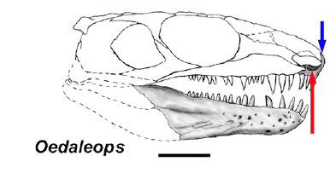
Caseasauria:
Those taxa bearing all basal synapsid synapomorphies with the following unique features: (1) An extremely long external naris with an external narial shelf; and (2) a pointed rostrum formed by the dorsal process of the premaxilla.

Slide 24
Eupelycosauria:
Those taxa bearing all basal synapsid synapomorphies with the following unique features: (1) A long, narrow supratemporal. (2) The frontal contributes to at least one third of the dorsal orbital margin.

Slide 25
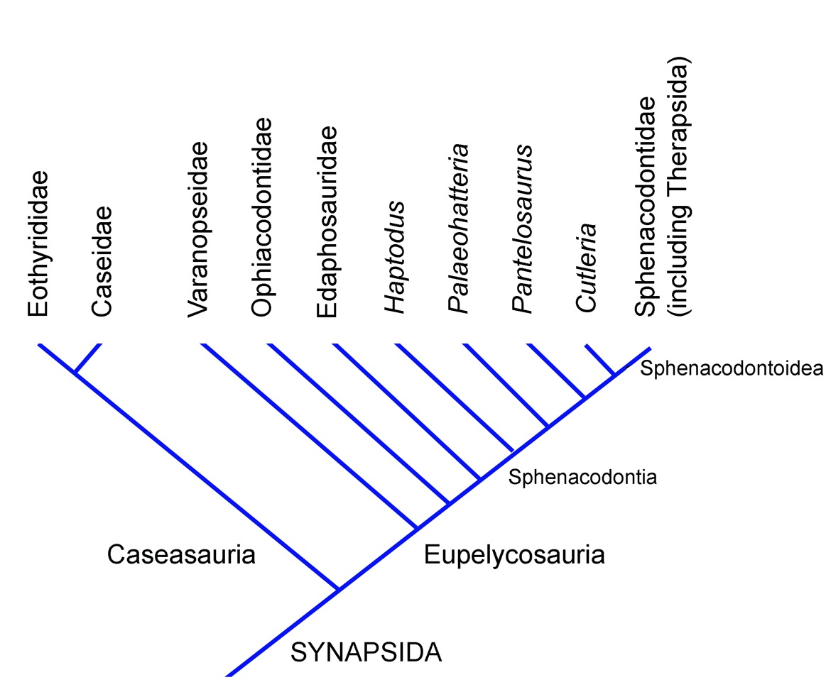
Features of each of these two major groups of basal synapsids will be reviewed subsequently. However, as an introduction, the following would be considered an up to date phylogeny of basal, pelycosaurian-grade synapsids:

Slide 26
The Caseasauria
Biology 622
Winter 2014
Jason Jung

Slide 27
Diversity of the Caseasauria
Two Families:
Eothrydidae (2 Genera)
Eothyris
Oedaleops
Caseidae (7 Genera)
Casea
Angelosaurus
Caseoides
Caseopsis
Cotylorhynchus
Ennatosaurus
Oromycter

Slide 28
Characters of the Eothrydidae
1. Maxillae are not part of the external narial floor.
2. Posterolateral process of the premaxilla is long.
3. Two sections of teeth found in the maxilla.
4. Very large caniniform teeth.
5. Jugals aren’t part of the cheek due to long anterior process of the Quadratojugal.
6. Jugals form the ventral side of the temporal fenestra via their posterior process.
7. Squamosals are broad and round in the posterior aspect, blurring the cheek and the occipital surface.
8. Lacrimals are narrow in the dorsoventral aspect and elongate.

Slide 29
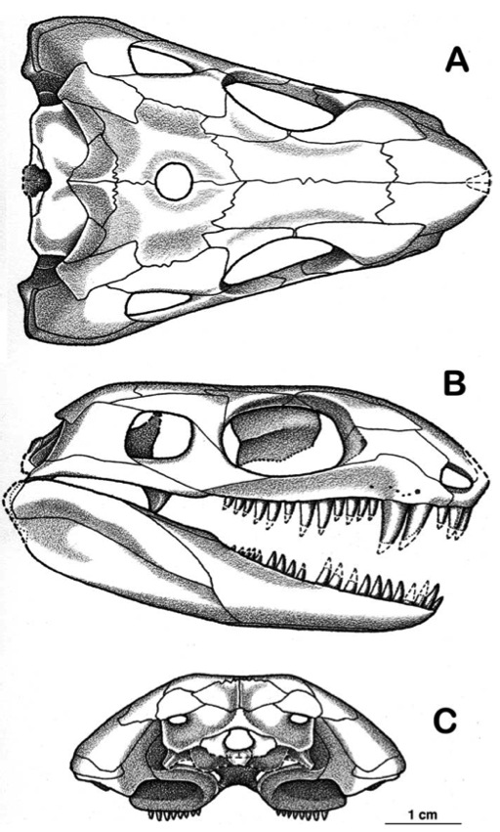
Eothyrididae: Eothyris
Time Period:
Early Permian
Location:
North Central Texas (Archer County)
Notes:

Slide 30
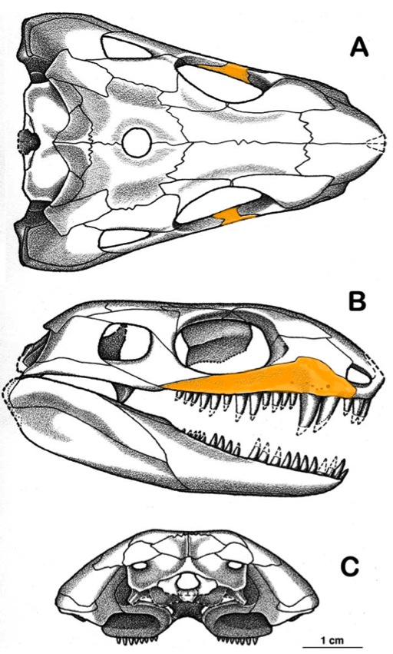
Eothyrididae: Eothyris
Time Period:
Early Permian
Location:
North Central Texas (Archer County)
Notes:
1. Maxilla is not part of the narial floor.

Slide 31
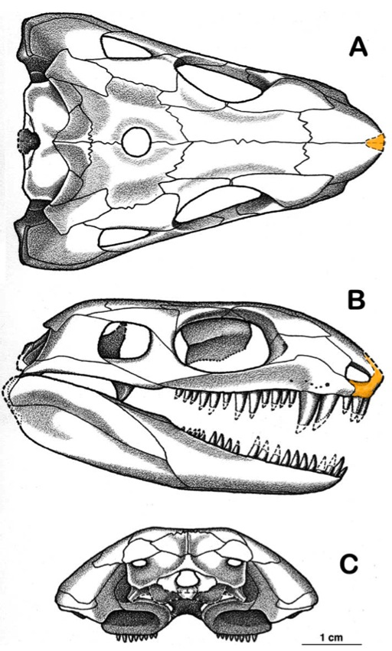
Eothyrididae: Eothyris
Time Period:
Early Permian
Location:
North Central Texas (Archer County)
Notes:
2. Posterolateral process of the premaxilla is long.

Slide 32
Eothyrididae: Eothyris
Time Period:
Early Permian
Location:
North Central Texas (Archer County)
Notes:
3. Two sections of teeth on the dentary
4. Very large caniniform teeth

Slide 33
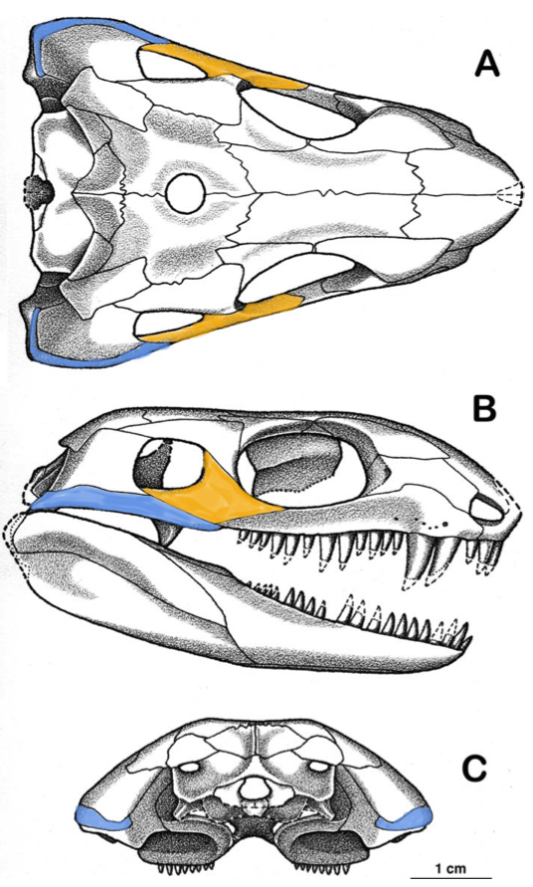
Eothyrididae: Eothyris
Time Period:
Early Permian
Location:
North Central Texas (Archer County)
Notes:
5. The Jugals aren’t part of the cheek due to the long anterior process of the Quadratojugals.

Slide 34
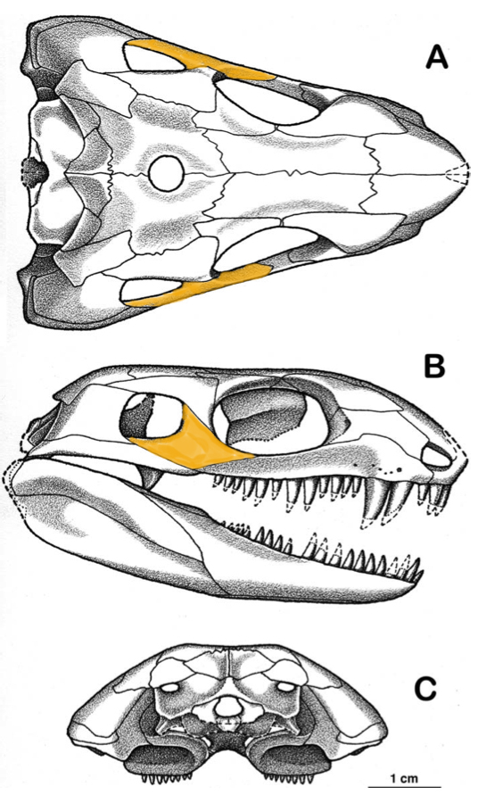
Eothyrididae: Eothyris
Time Period:
Early Permian
Location:
North Central Texas (Archer County)
Notes:
6. Jugals form the ventral side of the temporal fenestra through their posterior process.

Slide 35
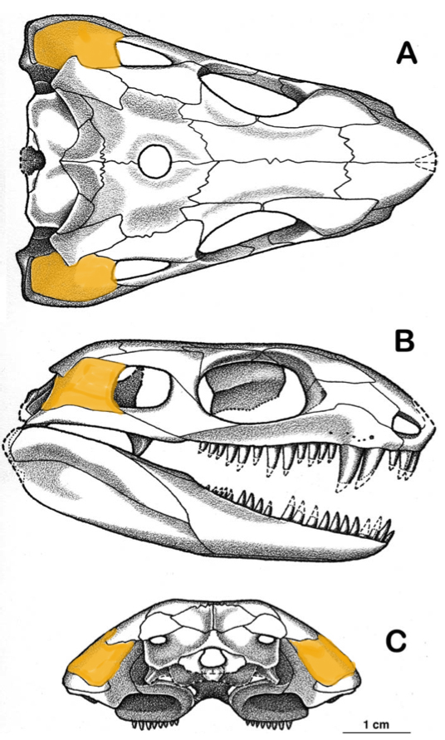
Eothyrididae: Eothyris
Time Period:
Early Permian
Location:
North Central Texas (Archer County)
Notes:
7. Squamosals are broad and round in the posterior aspect, blurring the cheek and the occipital surface.

Slide 36
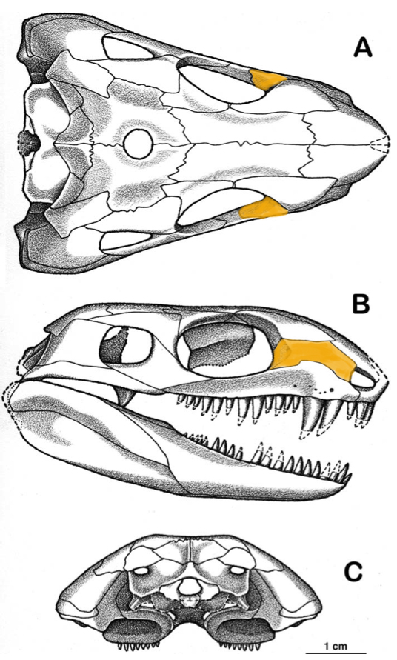
Eothyrididae: Eothyris
Time Period:
Early Permian
Location:
North Central Texas (Archer County)
Notes:
8. Lacrimals are narrow in the dorsoventral aspect and elongate

Slide 37
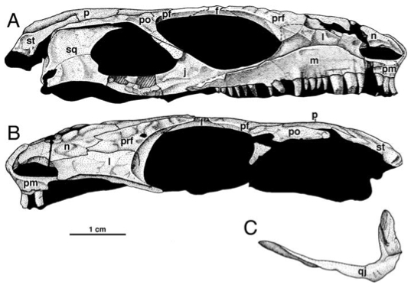
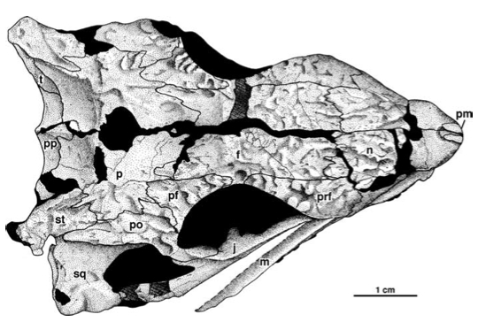
Eothyrididae: Oedaleops
Time Period:
Early Permian
Location:
Central Northern New Mexico (Rio Arriba County)
Notes:

Slide 38
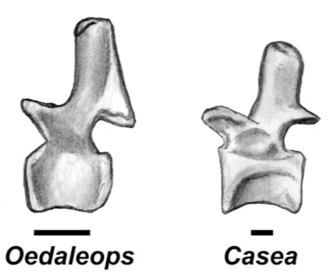
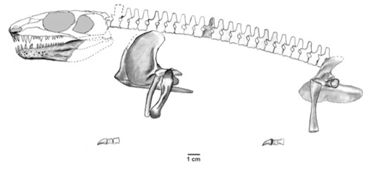
Eothyrididae: Oedaleops
Time Period:
Early Permian
Location:
Central Northern New Mexico (Rio Arriba County)
Notes:

Slide 39
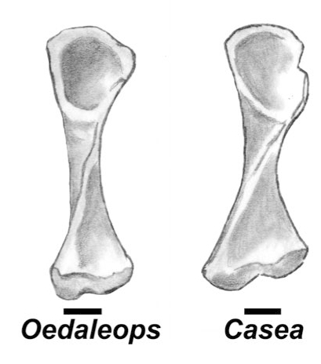
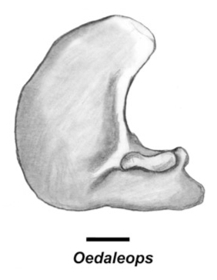
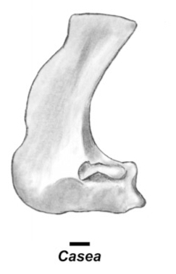
Eothyrididae: Oedaleops
Time Period:
Early Permian
Location:
Central Northern New Mexico (Rio Arriba County)
Notes:
Compare the femora and pectoral girdles of Oedaleops and Casea

Slide 40
Characters of the Caseidae
1. External naris is high and large.
2. Lacrimal contributes to emargination of the nares.
3. Lower jaw doesn’t taper anteriorly.
4. Phalangeal formula is reduced from basal condition:
From 2-3-4-4-3 to 2-2-2-3-2 in Caseidae
Basal: 2-3-4-5-3 (hand) 2-3-4-5-4 (foot)
5. Posterior marginal teeth have a longitudinal cusp row.
6. The first premaxillary tooth is the largest in the row

Slide 41
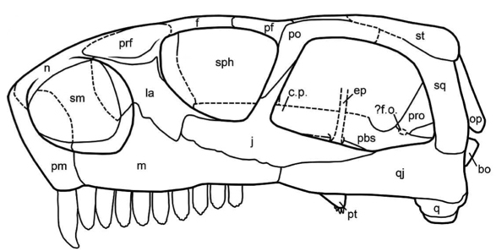
Characters of the Caseidae (Ennatosaurus):
1. External naris is high and large.

Slide 42
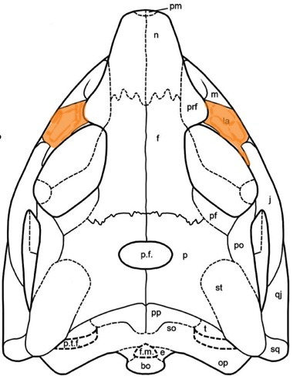
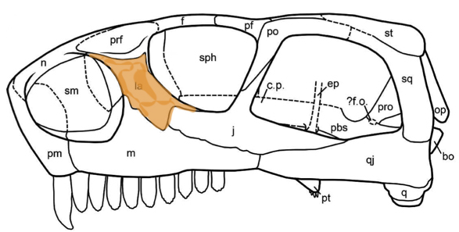
Characters of the Caseidae (Ennatosaurus):
2. Lacrimal contributes to emargination of the nares.

Slide 43
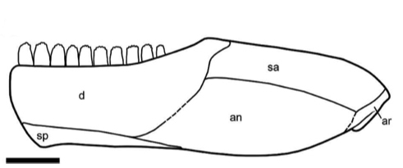
Characters of the Caseidae (Ennatosaurus):
3. Lower jaw doesn’t taper anteriorly.

Slide 44
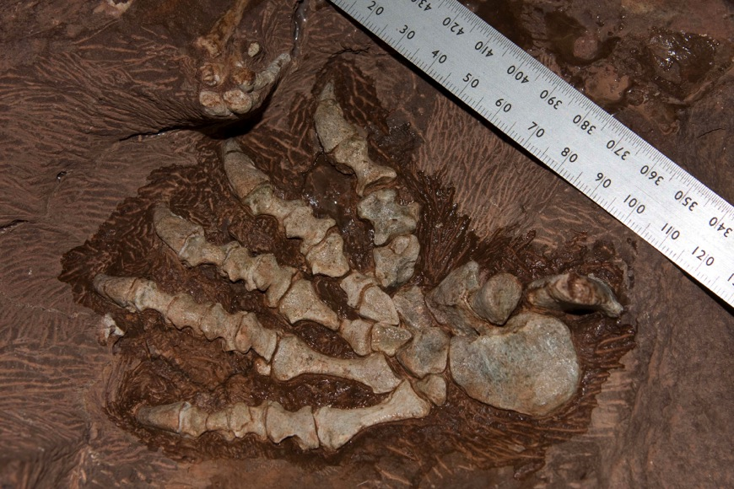
Caseidae: [unnamed specimen]
Time Period:
Early Permian
Location:
Central Germany
(Bromacker Quarry)
Notes:
The Pes of the specimen:

Slide 45
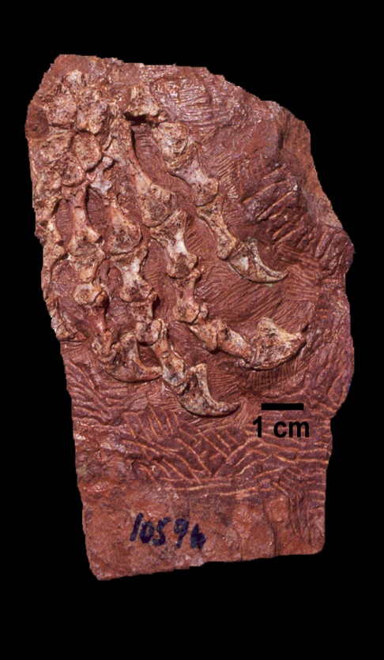
Caseidae: [unnamed specimen]
Time Period:
Early Permian
Location:
Central Germany
(Bromacker Quarry)
Notes:
The manus is the most convincing character for assignment to the Caseidae
Inferior Tubercle

Slide 46
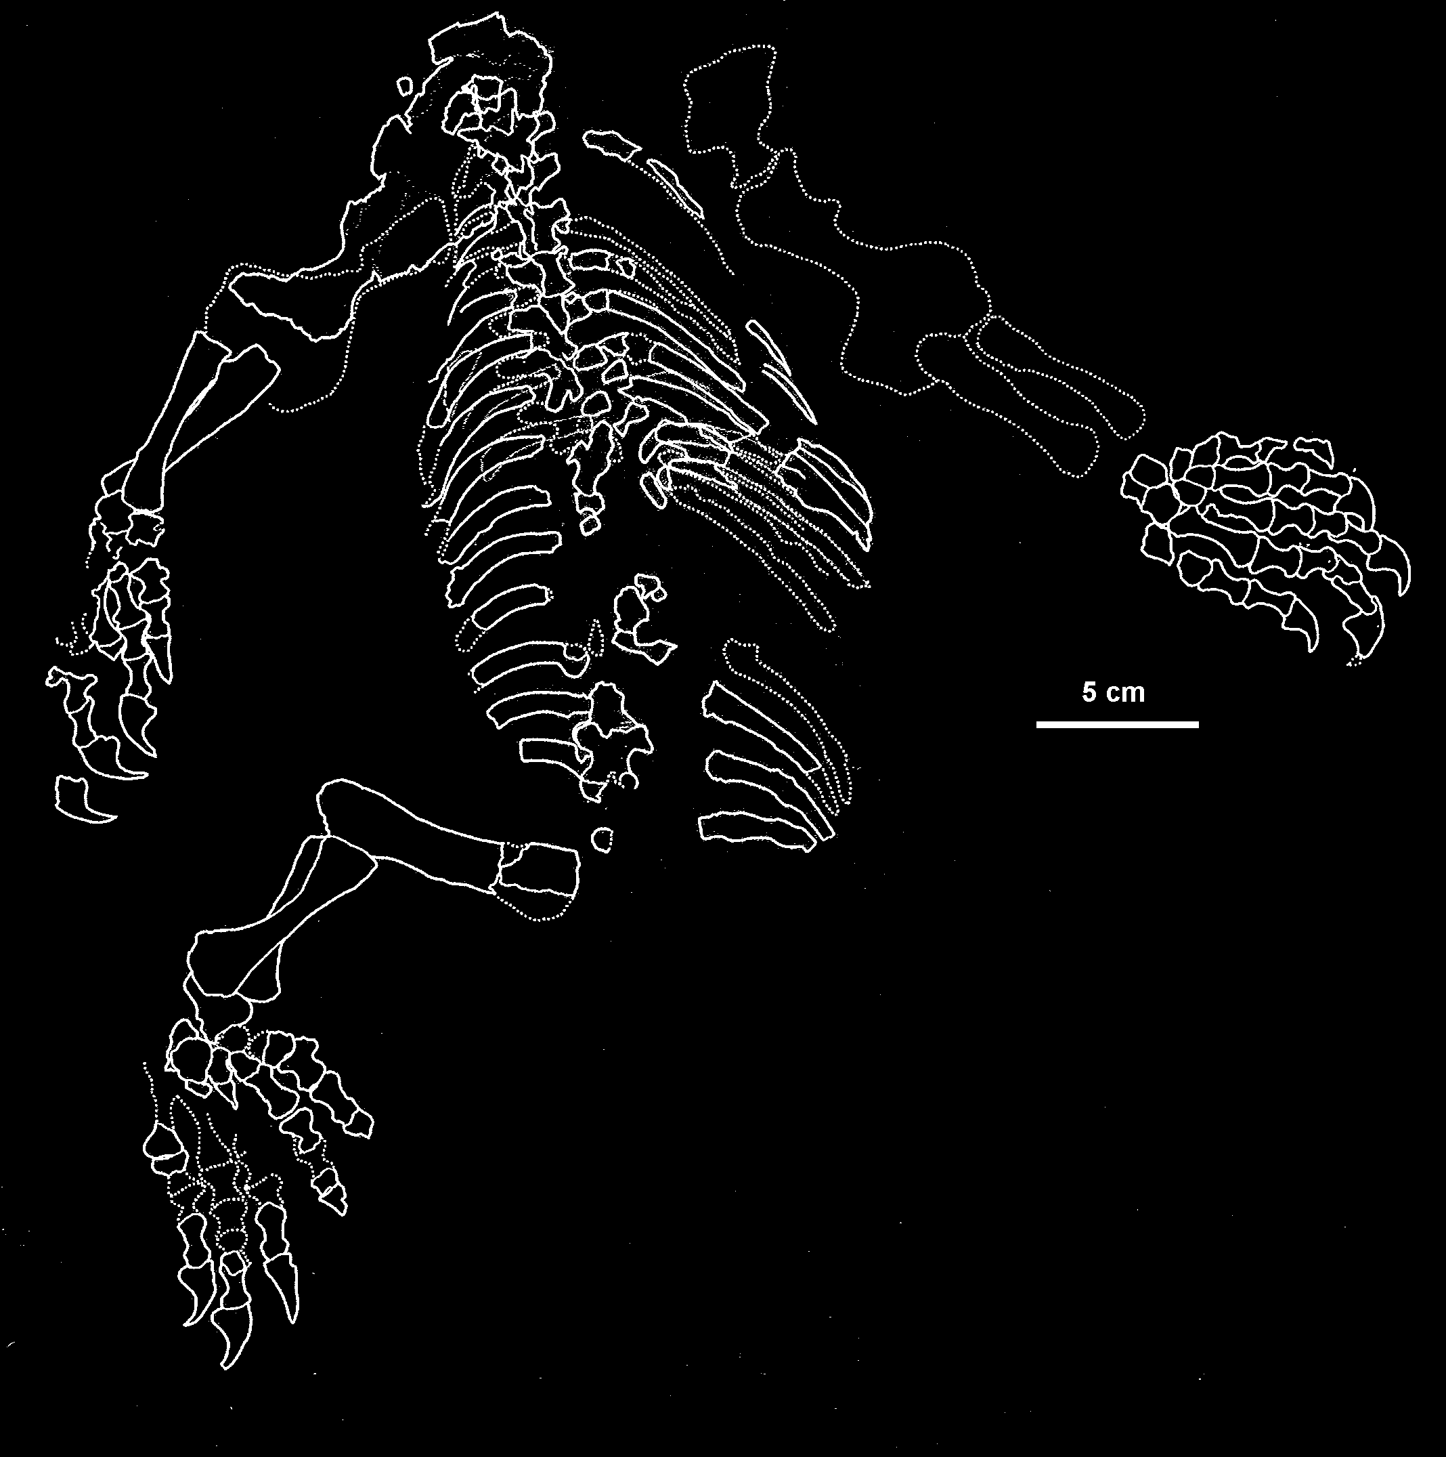
Caseidae: [unnamed specimen]
Time Period:
Early Permian
Location:
Central Germany
(Bromacker Quarry)
Notes:
Outline of the body

Slide 47
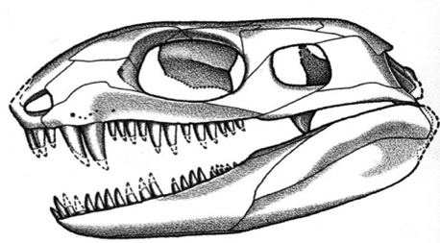
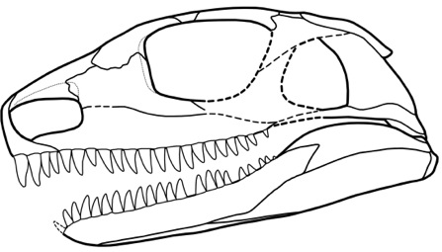
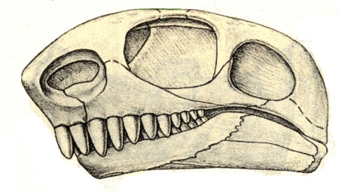
Caseidae: [unnamed specimen]
Notes:
Skull
Cf: Eothyris and Casea skulls
Eothyris
Bromacker Specimen
Casea

Slide 48
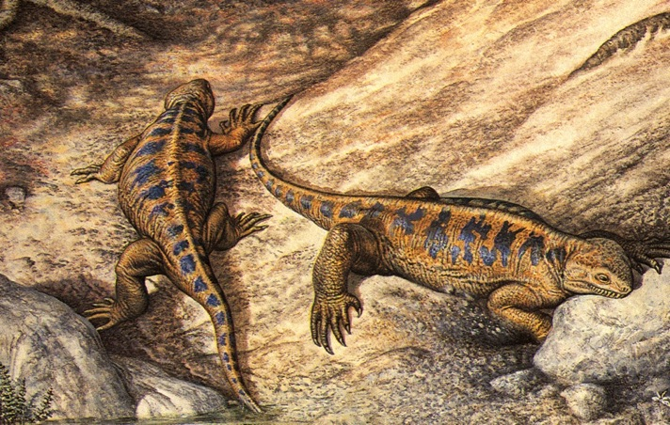
Caseidae: Casea
Time Period:
Early Permian
Location:
North Central Texas (Baylor County)
Notes:

Slide 49
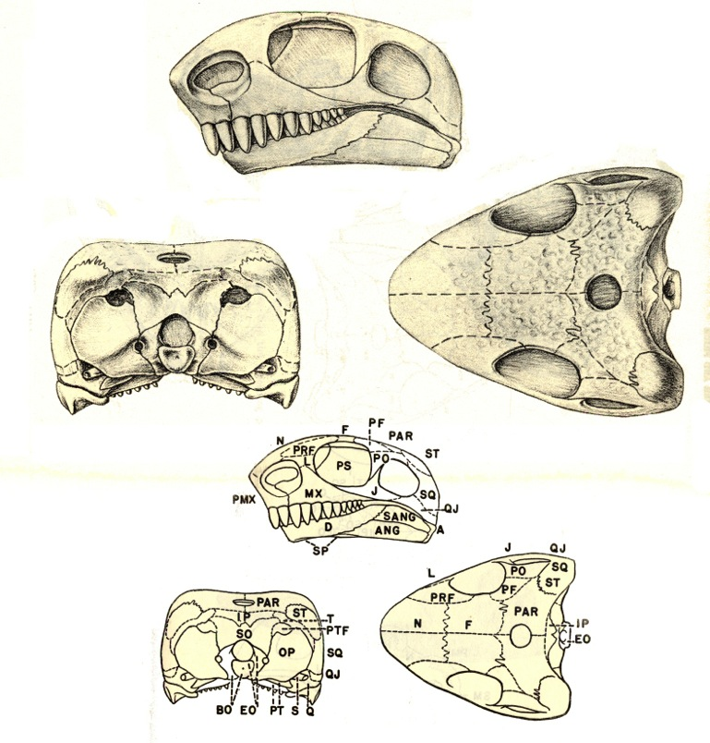
Caseidae: Casea
Time Period:
Early Permian
Location:
North Central Texas (Baylor County)
Notes:

Slide 50
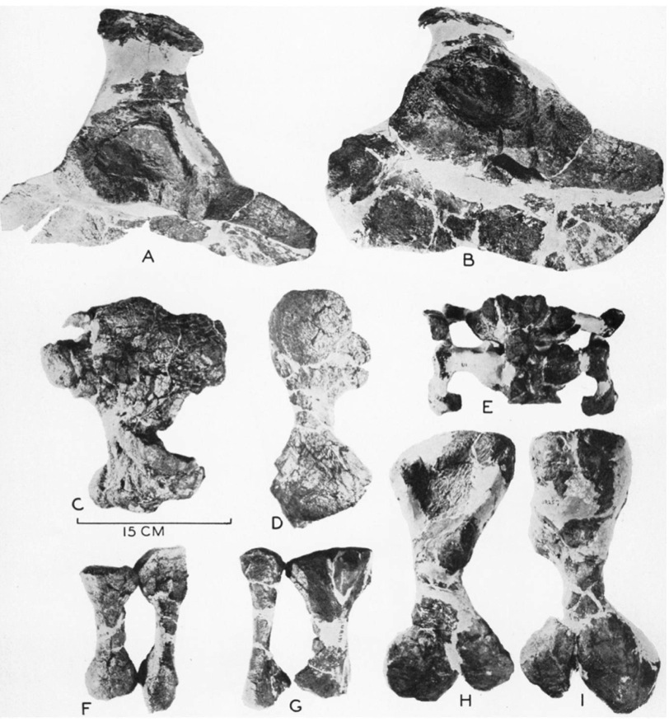
Caseidae: Angelosaurus
Time Period:
Early Permian
Location:
North Central Texas
Notes:
Known only from post-cranial skeleton
A & B: Pelvic Girdle
C: Dorsal Humerus
D: Dorsal Femur
E: Dorsal Sacrum
F: Radius and Ulna
G: Tibia and Fibula
H &I: Femur

Slide 51
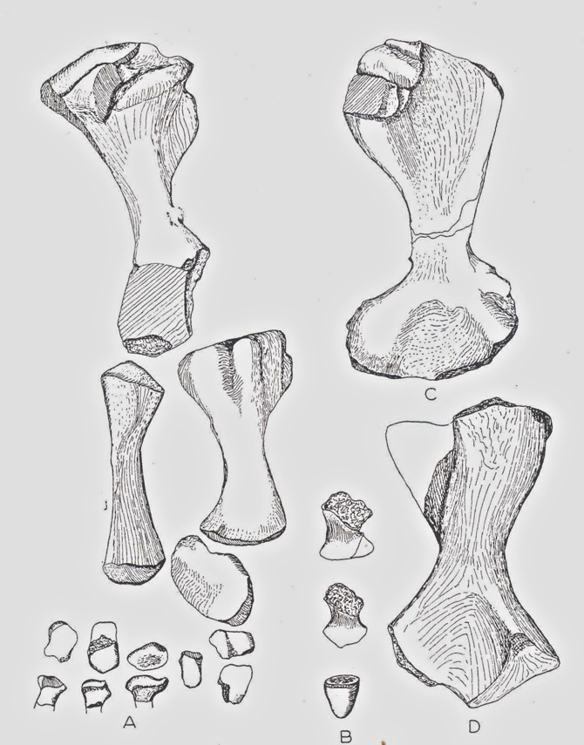
Caseidae: Caseoides
Time Period:
Middle Permian
Location:
Central Texas (San Angelo)
Features:
Known only from fragments
A: Right foot
B: Phalanges
C: Dorsal Right Humerus
D: Dorsal Left Femur

Slide 52
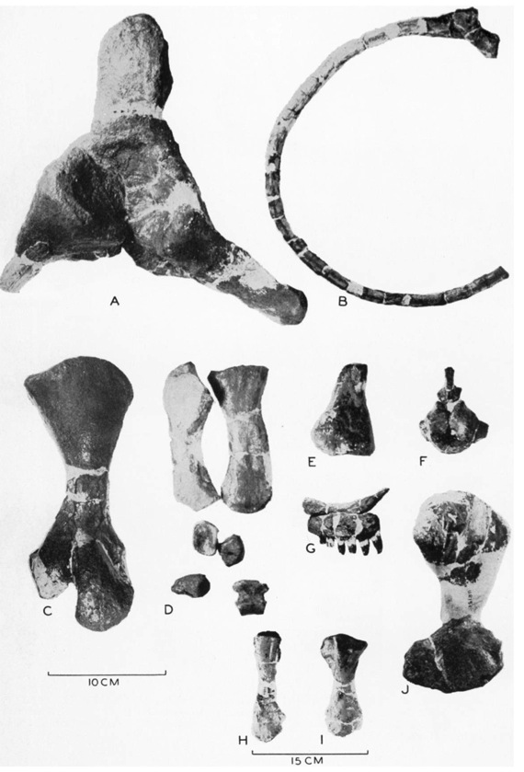
Caseidae: Caseopsis
Time Period:
Early Permian
Location:
North Central Texas
Notes:
Known from fragments
A: Right Pelvis
B: Dorsal Rib
C: Dorsal Femur
D: Radius, Ulna, Foot
E: Tibia fragment
F: Post. Lumbar Vertebra
G: Maxilla and Teeth
H & I: Tibia and Fibula

Slide 53
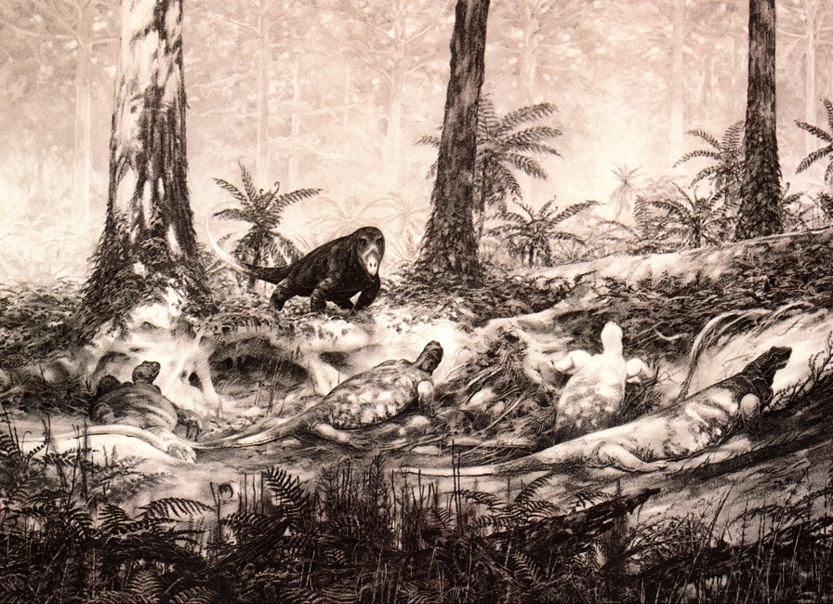
Caseidae: Cotylorhynchus
Time Period:
Early Permian
Location:
North Central Texas
Central Oklahoma
Central NW OK
Notes:
Very large bodies
Very small skulls

Slide 54
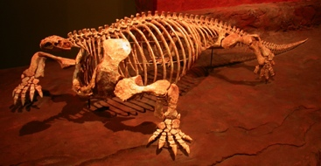
Caseidae: Cotylorhynchus
Time Period:
Early Permian
Location:
North Central Texas
Central Oklahoma
Central NW OK
Notes:
Very large bodies
Very small skulls

Slide 55
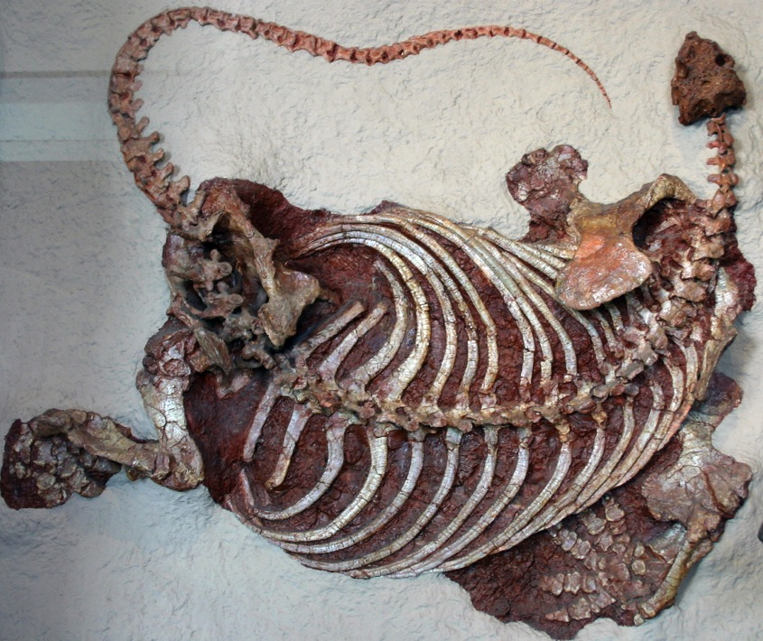
Caseidae: Cotylorhynchus
Time Period:
Early Permian
Location:
North Central Texas
Central Oklahoma
Central NW OK
Notes:
Very large bodies
Very small skulls

Slide 56
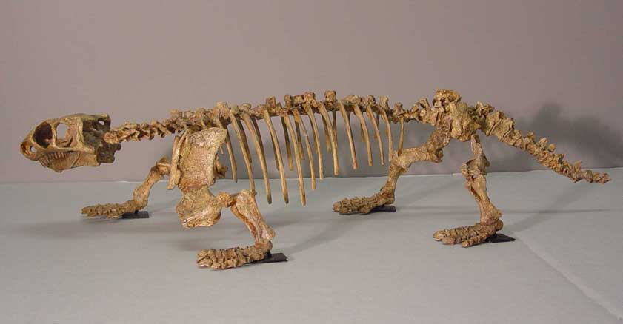
Caseidae: Ennatosaurus
Time Period:
Middle Permian
Location:
Pinega, Russia
Notes:

Slide 57
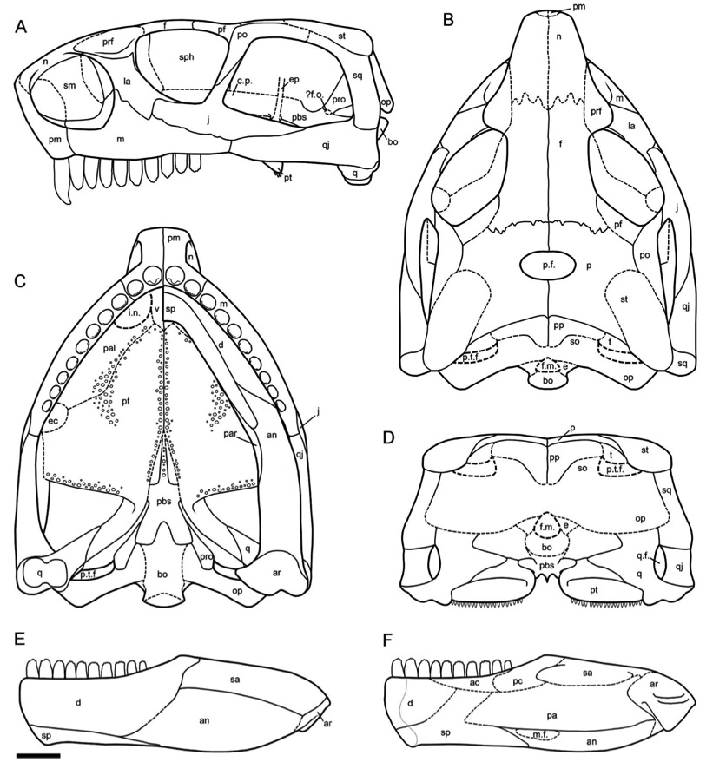
Caseidae: Ennatosaurus
Time Period:
Middle Permian
Location:
Pinega, Russia
Notes:

Slide 58
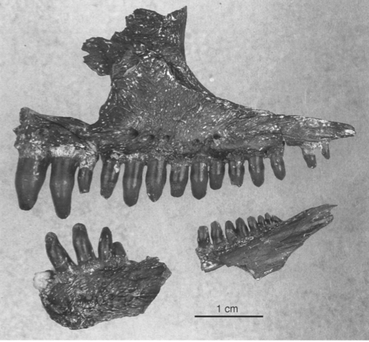
Caseidae: Oromycter
Time Period:
Early Permian
Location:
Fort Sill, Oklahoma
Notes:
Known from skeletal fragments
Originally described in 2005

Slide 59
Palaeo-biogeographic Distribution of Caseasauria
Oedaleops
Caseiodes,
Ennatosaurus
Eothyris
Angelosaurus,
Casea,
Caseopsis,
Cotylorhynchus,
Oromycter,

Slide 60
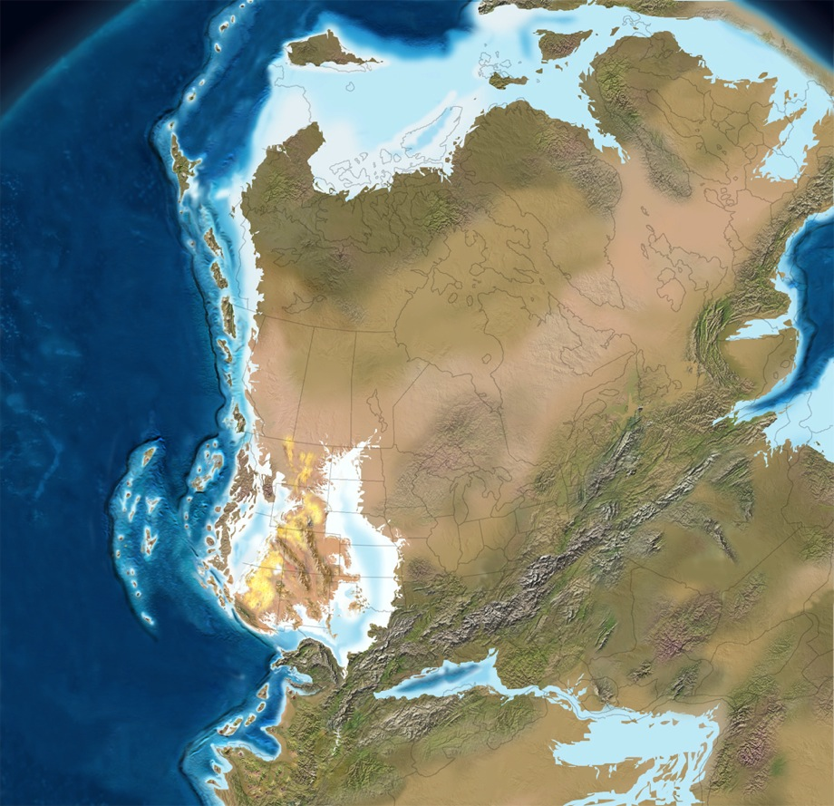
The Early Permian
•
Caseidae
•
•
•
•
•
Eothrydidae

Slide 61
The Middle Permian
•
Caseidae
•

