Slide 1
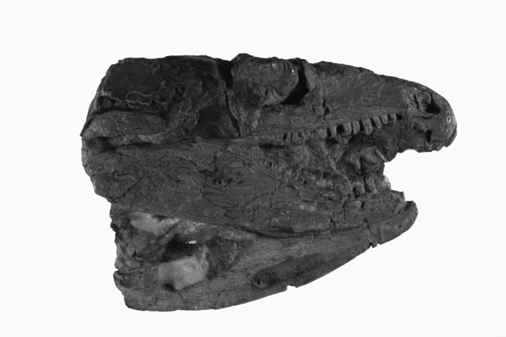
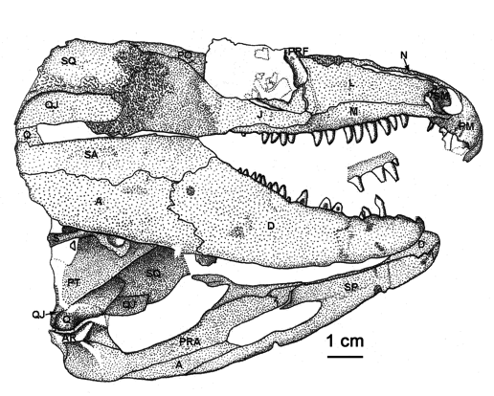
BIOLOGY 622 – FALL 2014
BASAL AMNIOTA - STRUCTURE AND PHYLOGENY
WEEK – 4
REPTILIA
Eureptilia
S. S. SUMIDA

Slide 2
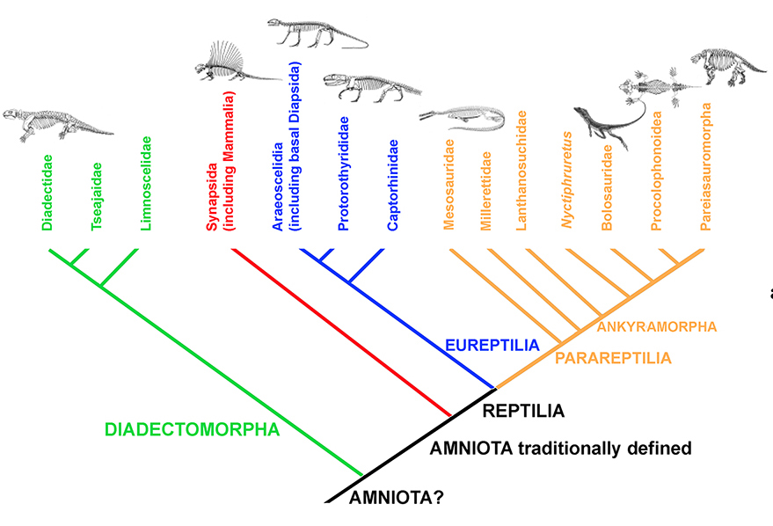

Slide 3
Reptilia was originally erected as a class by Laurenti in 1768 to accept all tetrapods that were neither birds nor mammals.
Owen (1854, 1859) therefore included amphibians in the group.
Haekel (1866) recognized the reproductive similarity of Reptiles, birds, and mammals – amniotes, and thus removed extant amphibians from the Reptilia.

Slide 4
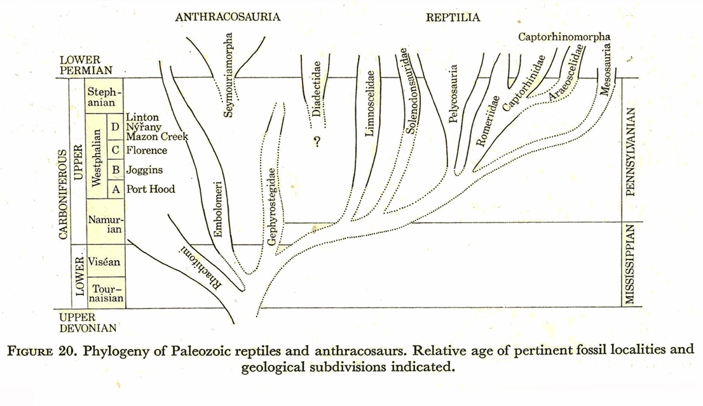
One of the better known of vertebrate paleont0logists to have worked on the problem of the origin of reptiles was Robert Carroll. Most of his initial work was done outside of the cladistics paradigm, and became something of a self-fulfilling prophecy of animals being more and more primitive as ancestors.
In the late 1960s Carroll’s work nonetheless held sway, and to his credit, he did have a number of the proper groups in play:

Slide 5
Early workers had no problem with a paraphyletic Reptilia, and so basal synapsids (“pelycosaurs”) were included as well. But this essentially became a “search for ancestors” as opposed to a search for origins, so those ancestors went farther and farther back, and became less and less reptilian.
More recent workers have:
Began to employ the rules of cladistics / phylogenetic systematics wherein groups are determined by unique features, and the interrelationships of groups determined by shared, derived features.
Recognized the fundamental distinction between Synapsida, and other amniotes, began to recognize that a group distinct from Synapsida needed recognition. This group included living and extinct taxa traditionally considered reptiles.
But, just because the cladograms (i.e phylogenetic trees) are the product of newly rigorous methodology, it doesn’t mean every hypothesis of relationships has been identical.

Slide 6
Early workers had no problem with a paraphyletic Reptilia, and so basal synapsids (“pelycosaurs”) were included as well.
More recent workers, recognizing the fundamental distinction between Synapsida, and other amniotes, began to recognize that a group distinct from Synapsida needed recognition. This group included living and extinct taxa traditionally considered reptiles.

Slide 7
More recent workers, recognizing the fundamental distinction between Synapsida, and other amniotes, began to recognize that a group distinct from Synapsida needed recognition. This group included living and extinct taxa traditionally considered reptiles.
In one case, all non-synapsid amniotes have been referred to as reptiles, and in others as “Sauropsids”.

Slide 8
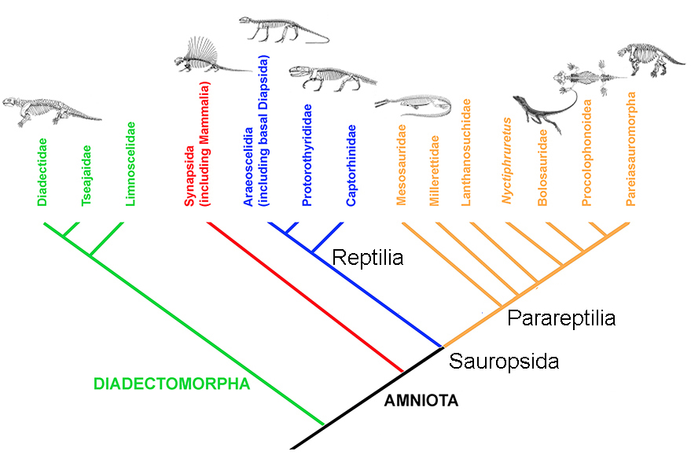

Slide 9
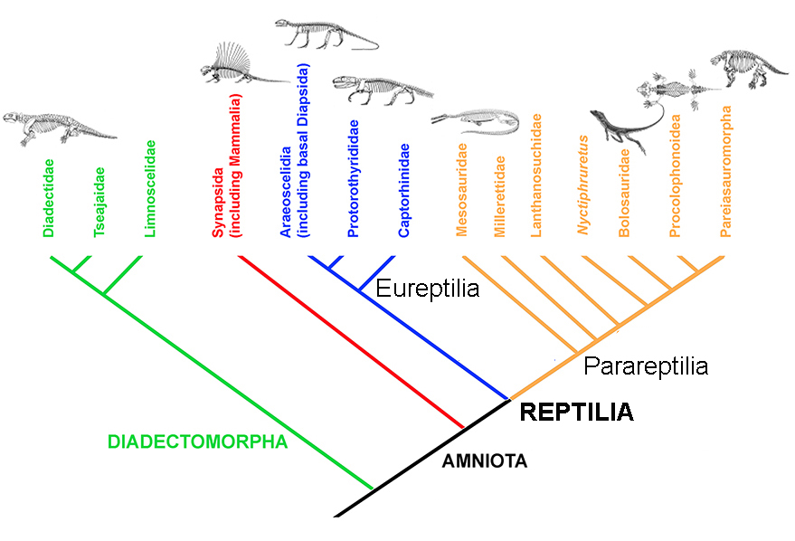

Slide 10
Most workers have recognized that extant reptiles, including crocodilomorphs, squamates, and turtles must be included in a grouping that would be considered reptilian.
The frequently contentious placement of turtles over the years resulted in some impressive phylogenetic gymnastics as they were considered to be related to any number of different groups.
These have included diadectomorphs, pareiasaurs, procolophonids, and even diapsids.

Slide 11
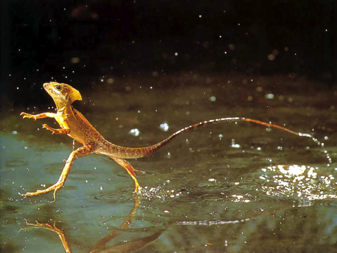
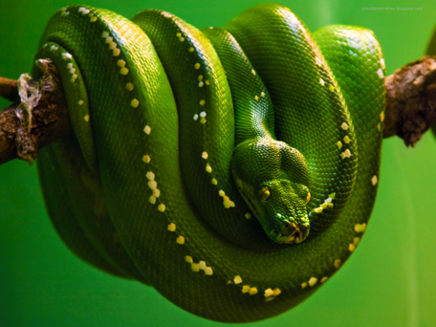
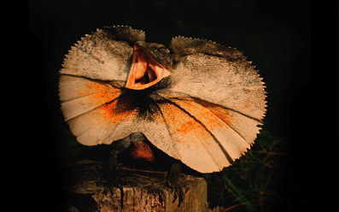
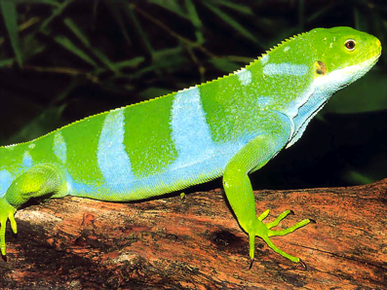
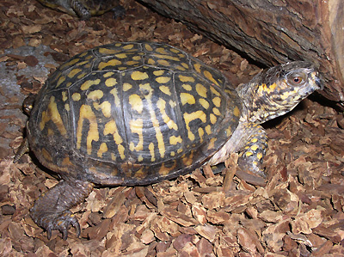
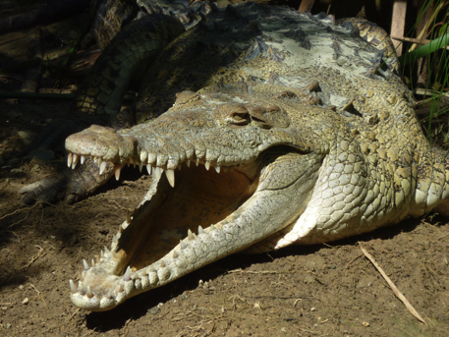
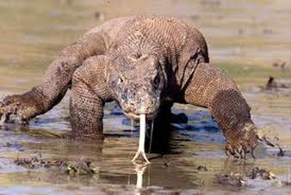
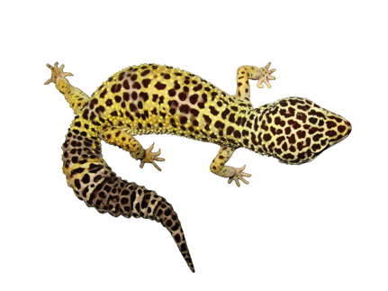
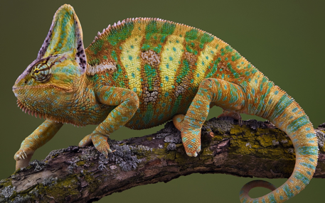

Slide 12
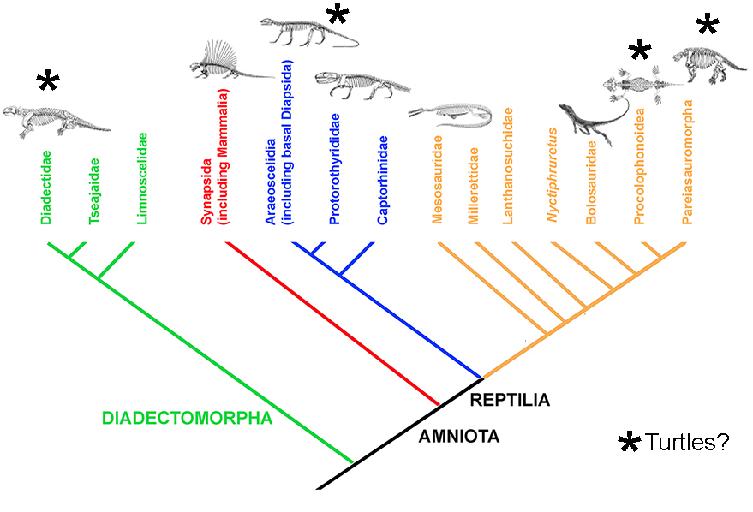

Slide 13
The taxonomic scheme we have adopted for this course includes both traditionally defined “true” reptiles and parareptiles as members of the Reptilia. For our purposes Reptilia is dived into two great groups, the Eureptilia (or “true reptiles”), and the Parareptilia.
REPTILIA
Eureptilia
(Family) Captorhinidae
Romeriida
“Protorothyrididae”
Araeoscelidia (including Diapsida)
Parareptilia
Mesosauria
Milleritidae
Lanthanosuchidae
Nyctiphruretus
Bolosauridae
Procolophonoidea
Pareiasauromorpha

Slide 14
CHARACTERISTICS OF REPTILIA AND EUREPTILIA
Previously, anatomical features used to “define” reptiles used to be simply those we used to define amniotes in general. However, with the recognition that Synasida and Reptilia represent distinct lineages of Amniota, we must now come up with a new set of synapomorphies to define Reptilia as a subset of Amniota.
The family Captorhinidae is amongst the basal-most of all reptilian clades, so it is logical to choose a member of this family to demonstrate features of both Reptilia as well as Eureptilia. The very well-known genus Captorhinus will be a model. (We will return to it in the review of diversity and distribution of this important family.)
Captorhinus was a small to moderate sized reptile, approximately the size of the local southern Californian “chuckwalla” (Sauromalus obesus).

Slide 15
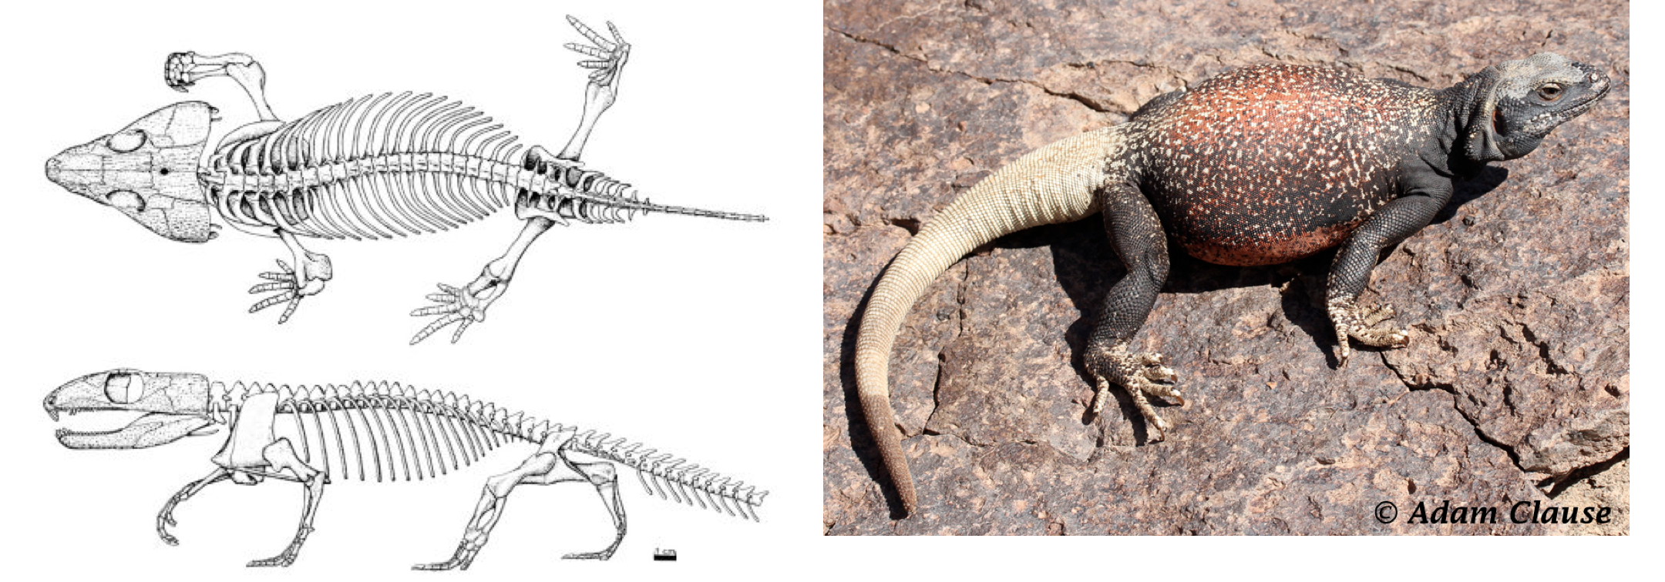

Slide 16
REPTILIA
Reptiles and parareptiles together comprise the complete Reptilia. These two groups offer a moderately high degree of diversity in body sizes and shapes; thus the features that characterize the group tend to be size-independent characters.
It has been suggested that the following features are synapomorphies of Reptilia:
Presence of a single coronoid. (Synapsids and diadectomorphs have two coronoid elements. )
Supinator process parallel to humeral shaft and separated from it by a groove.
Presence of a single pedal centrale. (Two centralia were present in the tarsus (ankle) of synapsids and diadectomorphs.)
Tabular small. (The tabular is missing in captorhinids.)
Suborbital foramen present. The suborbital foramen is a small hole near the lateral edge of the palate, between the pterygoid, palatine, and ectopterygoid (or jugal, when the ectopterygoid is absent).
Supraoccipital anterior crista present. (The supraoccipital of reptiles has a paired anterior parasagittal flange called an anterior crista.)
Supraoccipital plate narrow.

Slide 17
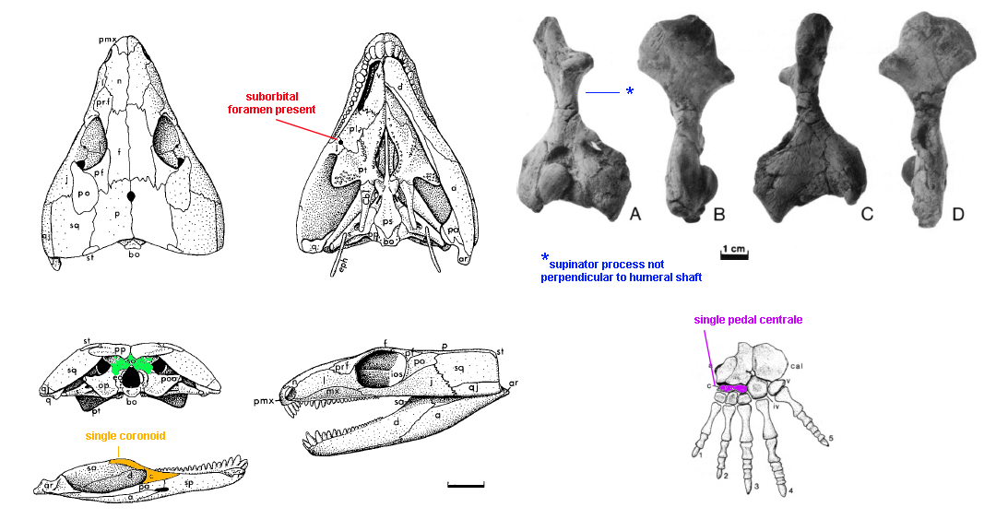
The skull is from Captorhinus (Heaton, 1979).
The photos of humeri are from Labidosaurus , a larger member of the family (Sumida, 1989).
The illustration of the foot is also from Labidosaurus (Sumida, 1989).

Slide 18
EUREPTILIA
Whereas the taxon Reptilia is characterized by cranial characters exclusively, Eureptilia is characterized by a mixture of cranial and postcranial features. These include:
Supratemporal small. (The supratemporal is large in most other groups of amniotes.)
Supratemporal does not contact the postorbital.
Caniniform maxillary tooth present. (Most other early amniotes have a relatively homodont dentition and no anterior maxillary tooth is much larger than the other teeth.)
Quadrate anterior process short. (The anterior process of the quadrate extends anteriorly along more than 55% of the quadrate ramus of the pterygoid in most other amniotes.)
Ventrolateral constriction of vertebral centra. (Vertebral central are “hourglass” shaped.)
Narrow blade of the ilium. See below on this page.

Slide 19
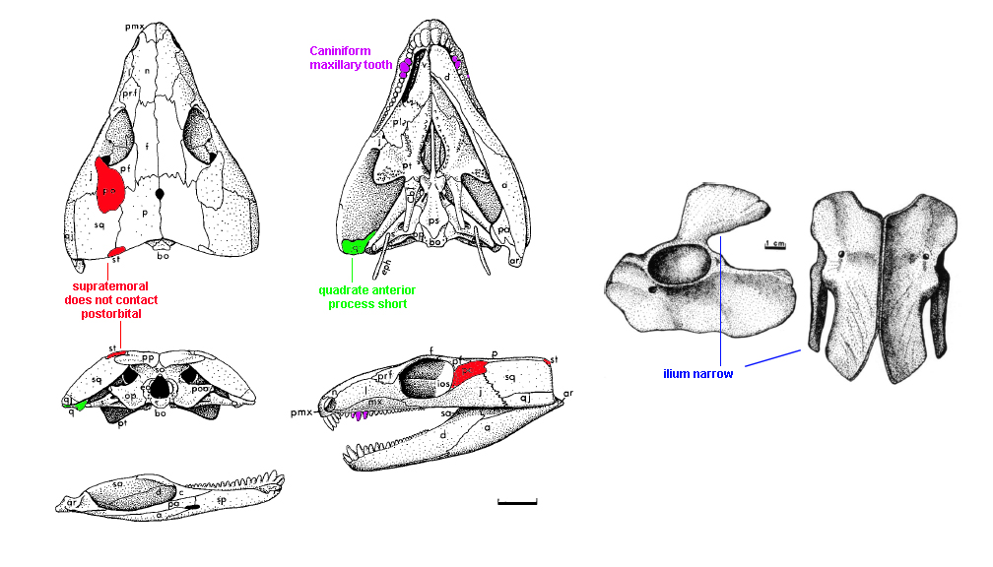

Slide 20
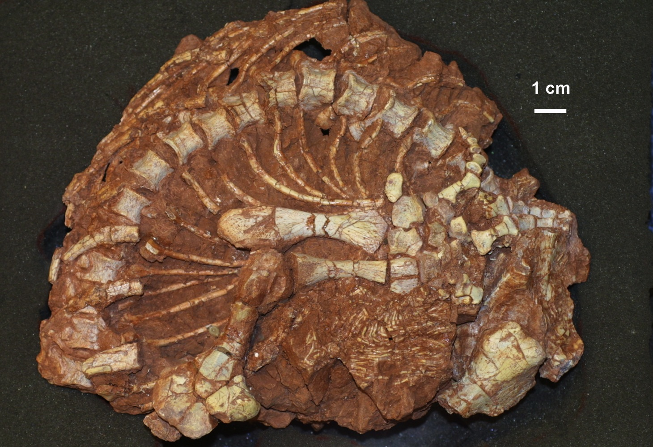
Hourglass-shaped centra

Slide 21
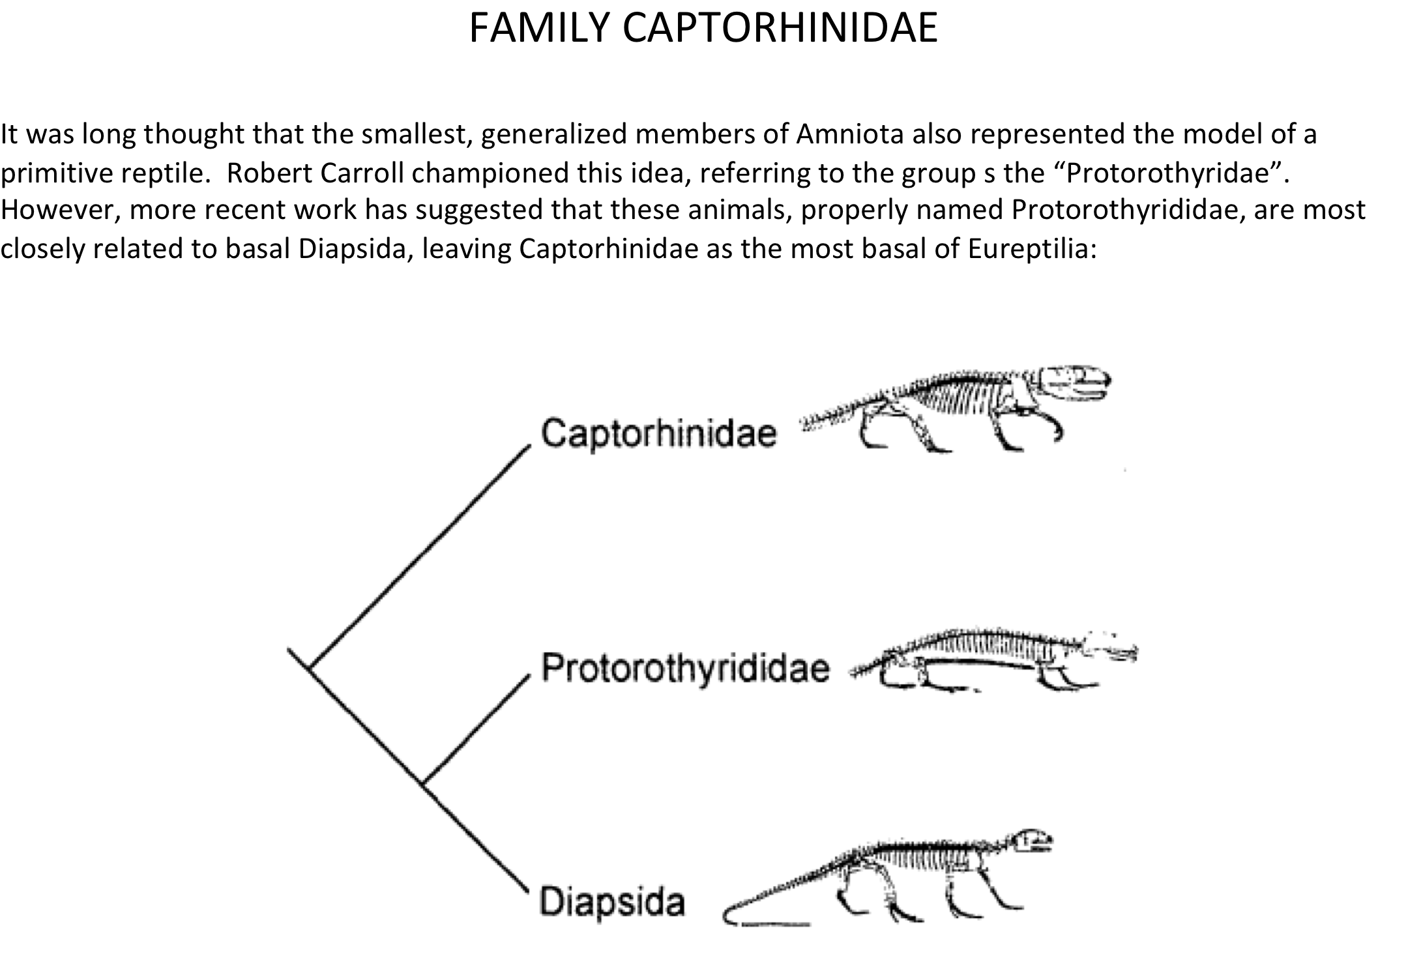

Slide 22
The reptilian family Captorhinidae was long characterized as a generalized group that was very conservative in nature. However recent discoveries have indicated that it is in fact a globally distributed family with a wide temporal distribution – from Late Pennsylvanian to Late Permian.
Morphologically, the features unique to, and defining of, the Captorhinidae are the following [somewhat esoteric] skeletal features:
a well developed suture between lacrimal and jugal
the pineal foramen is place relatively far forward between the parietals
absence of posterolateral frontal processes
the jugal extends anteriorly/rostrally beyond the anterior orbital margin

Slide 23
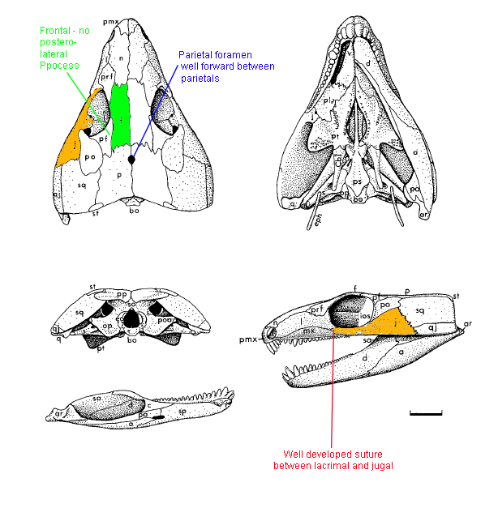

Slide 24
The basal eureptilian family Captorhinidae was long characterized as a fairly conservative, generalized family that didn’t change much through time. The one exception to this has been the development of multiple tooth rows in some members of the family. It is a feature for which the family is perhaps best known, however because it is not present in all members, it can’t be a defining feature of the family.
Initial work on this feature by well know workers such as Everett Olson and Armand de Ricqlés proposed that captorhinids with single maxillary and dentary tooth rows were more primitive (and usually smaller), whereas multiple tooth rows tended to be fond in later (i.e. younger, more recent), larger, more advanced taxa.
Examples of a captorhinid with single maxillary and dentary tooth rows may be seen in the examples of Captorhinus that are being used to illustrate the features of Reptilia, Eureptilia, and Captorhinidae.

Slide 25
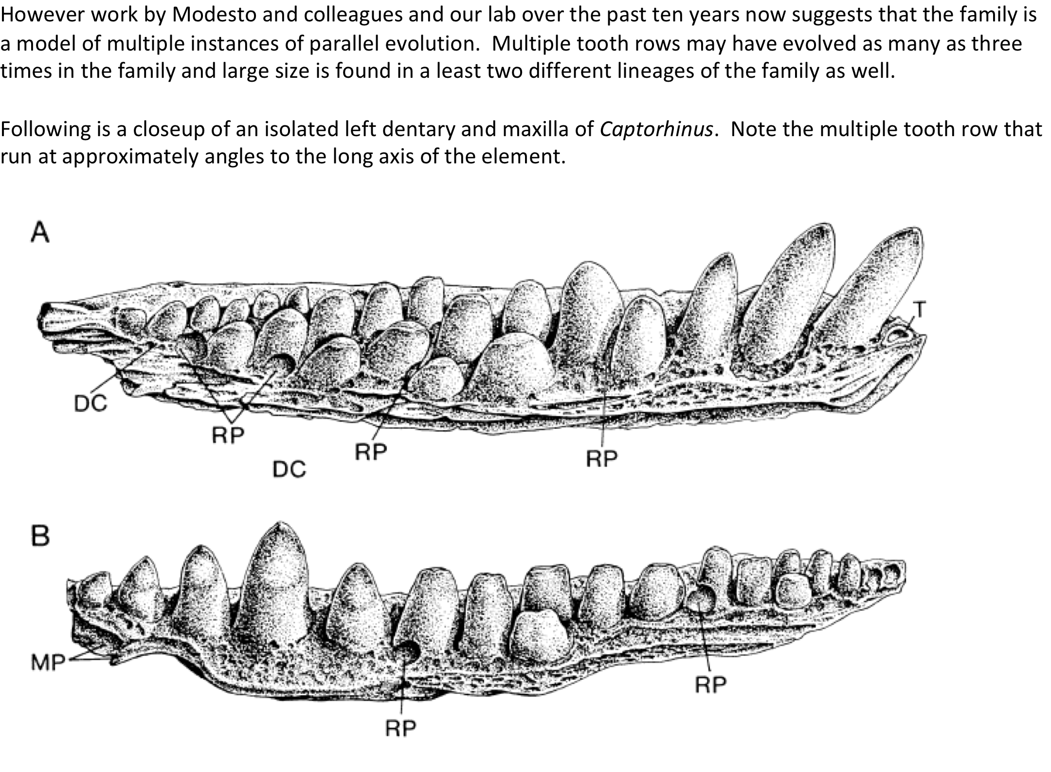

Slide 26
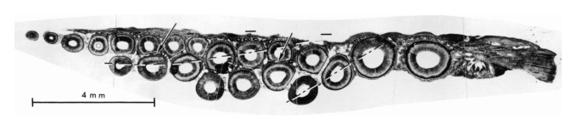
A histological section of a Captorhinus jaw, demonstrating clearly the lines of teeth knows as Zahnreihen.
Zahnreihen is a German-derived word that refers to the theory that throughout the life of animals that have constantly replacing teeth:
Impulses pass along the jaws from front-to-back at regular invervals, stimulating the development of teeth at each successive tooth locus.
Bolt and DeMar (1975) and Ricqles and Bolt hypothesized that there were multiple in the jaws of reptiles like Captorhinus.

Slide 27
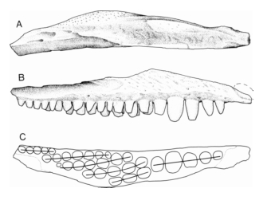
In this illustration, you can see them interpreting as many as five to six waves or Zahnreihen.

Slide 28
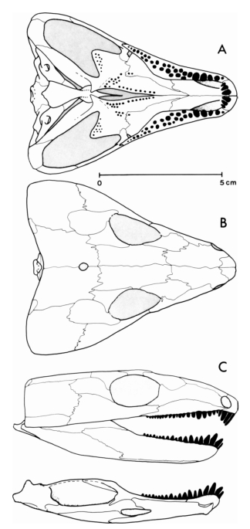

Slide 29
Captorhinid Subfamily
MORADISAURINAE
Much larger, more derived members of the family have been united into the subfamily Moradisaurinae.
Moradisaurinae is defined as larger captorhinid reptiles with multiple rows of maxillary and dentary teeth with the rows arranged in parallel with one another. Some taxa have as many as seven rows of teeth on each side.
Following are illustrations of the moradisaurine captorhinid Labidosaurikos from the Early Permian of Oklahoma to demonstrate the pattern of parallel tooth rows.

Slide 30
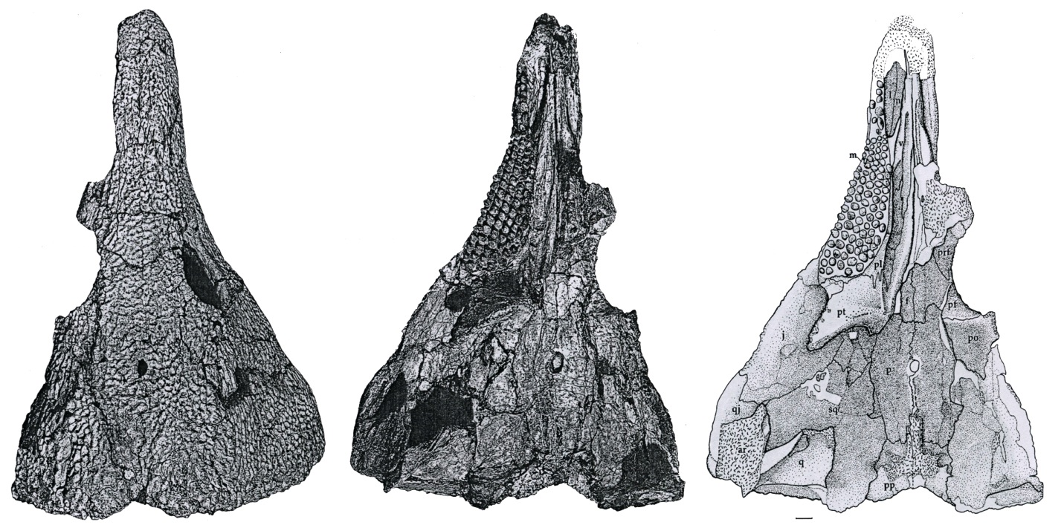

Slide 31
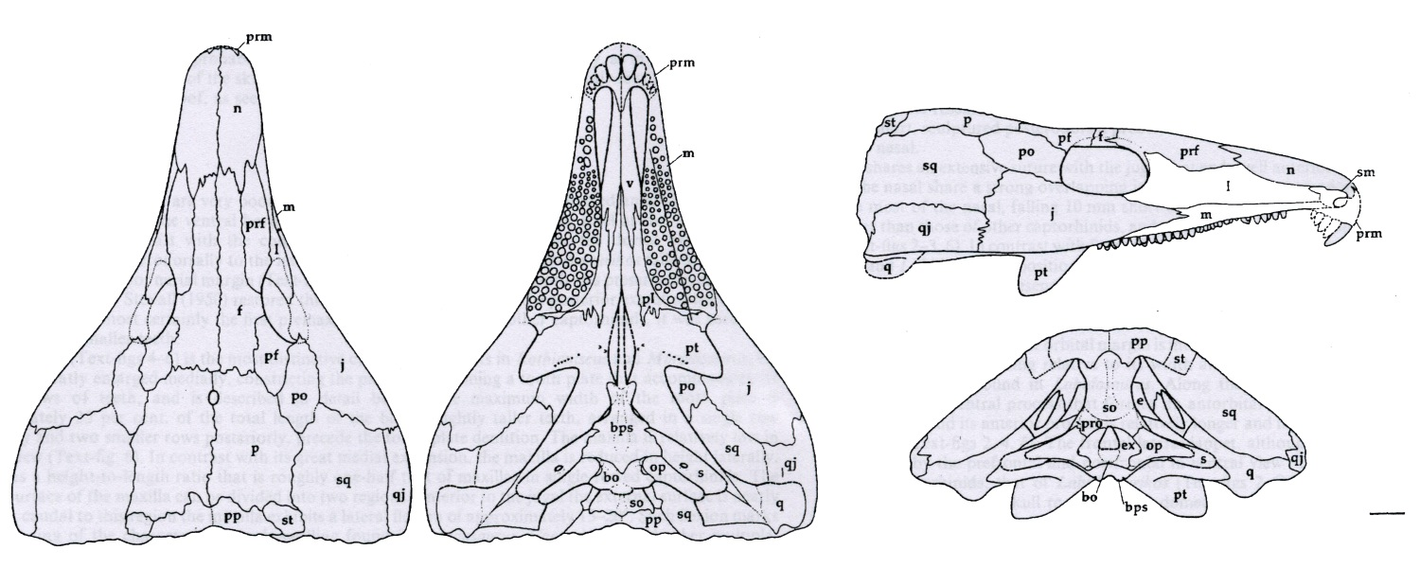

Slide 32
CAPTORHINIDAE
Kathleen Devlin
BIOL 622
Winter 2014

Slide 33
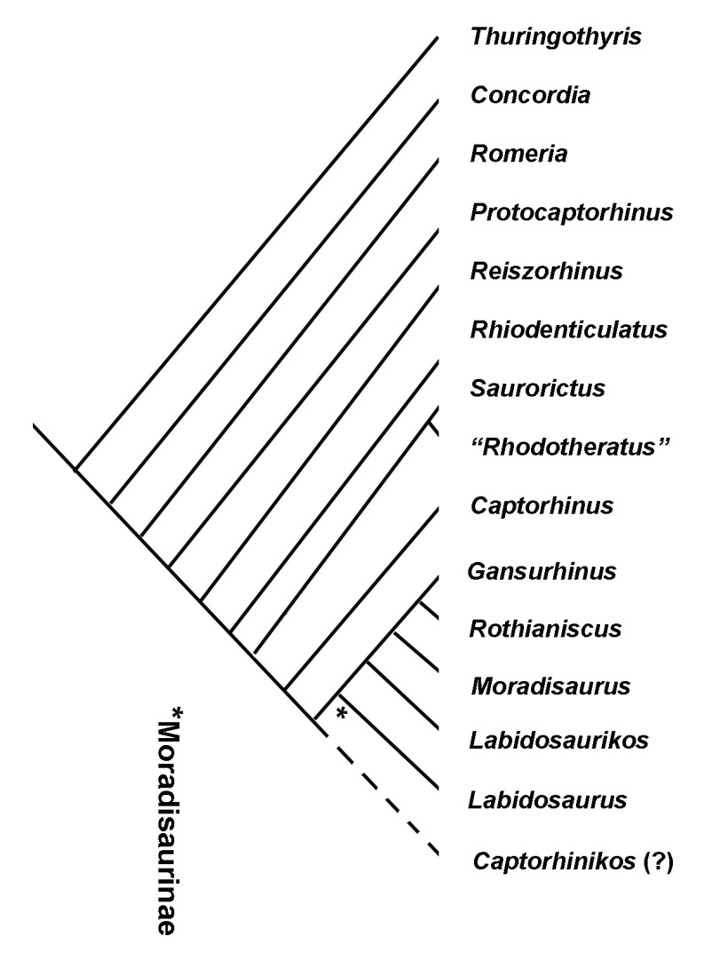
Monophyletic Family - Captorhinidae
*

Slide 34
Captorhinidae – Why Are They Important?
Very basal amniotes - Captorhinus aguti well studied
Represent the first reptilian diversification and geographic dispersal in terrestrial vertebrate evolution (Reisz 1997)
Evolutionary trend from faunivorous, to omniverous and herbivorous feeding habits within the clade (Reisz 2011)
Oldest known herbivorous reptiles
Generalized morphology
Highly terrestrial in nature
Unspecialized
Lack of geographic barriers allowed dispersal
Temporal range of more than 50 million years

Slide 35
What do Captorhinidae Look Like?
Start out very small
Earliest began with single row of teeth on maxilla and dentary
During early Permian we see an increase in size
Several taxa evolved multiple tooth rows on maxilla and mandible (evolved possibly 3 times) and indicate herbivorous diet
Animals with “heart shaped” skulls
All skulls pitted or have elongate groves – protects against spreading of micro-fractures
“Swollen” neural arches

Slide 36
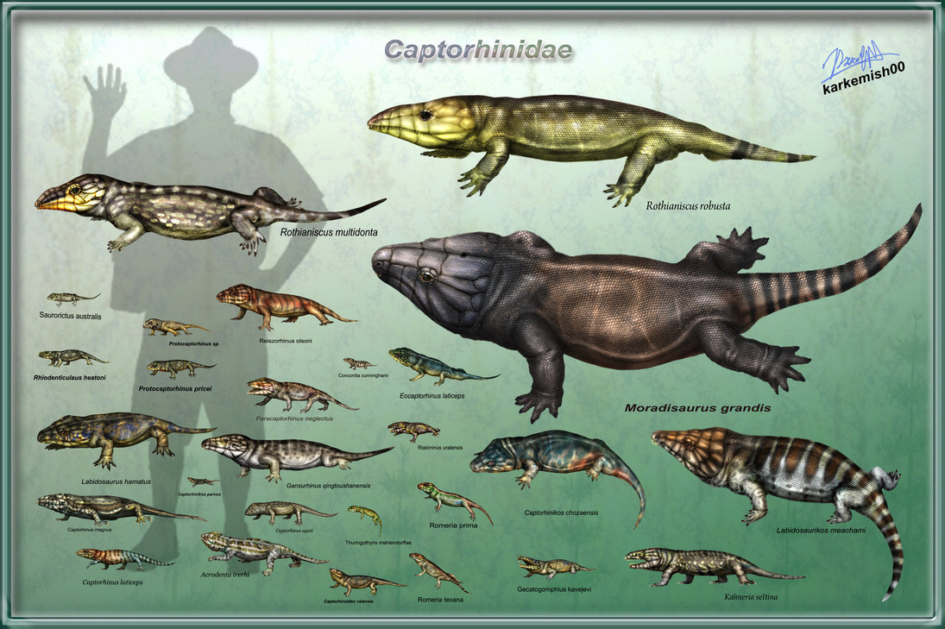

Slide 37
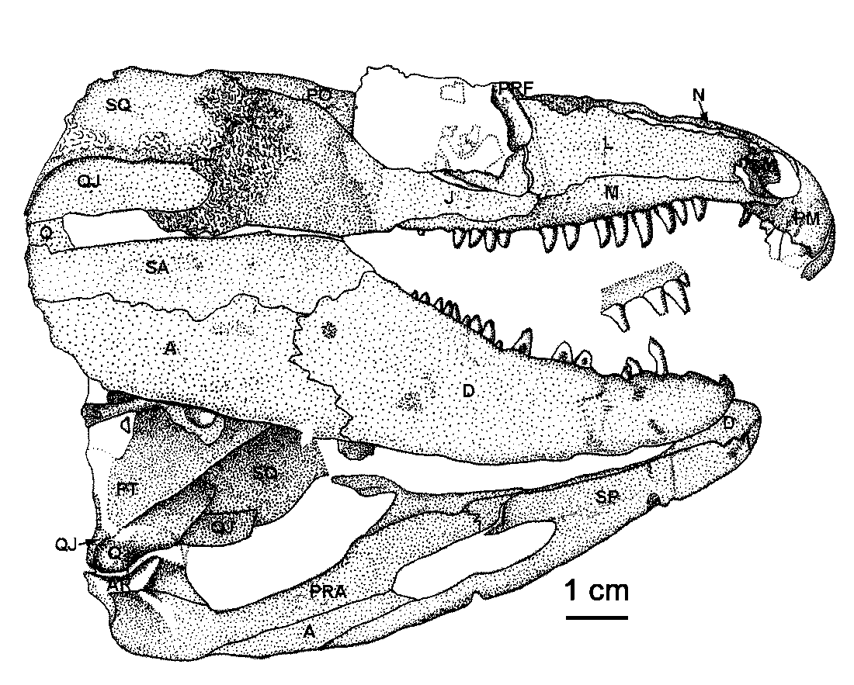

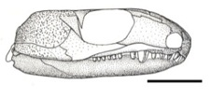
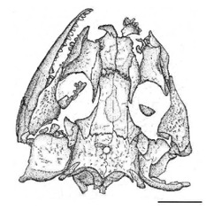
Relatively large Captorhinid reptile. (All bar scales = 1 cm.)
Saurorictus
Rhiodenticulatus
Concordia
Reiszorhinus

Slide 38
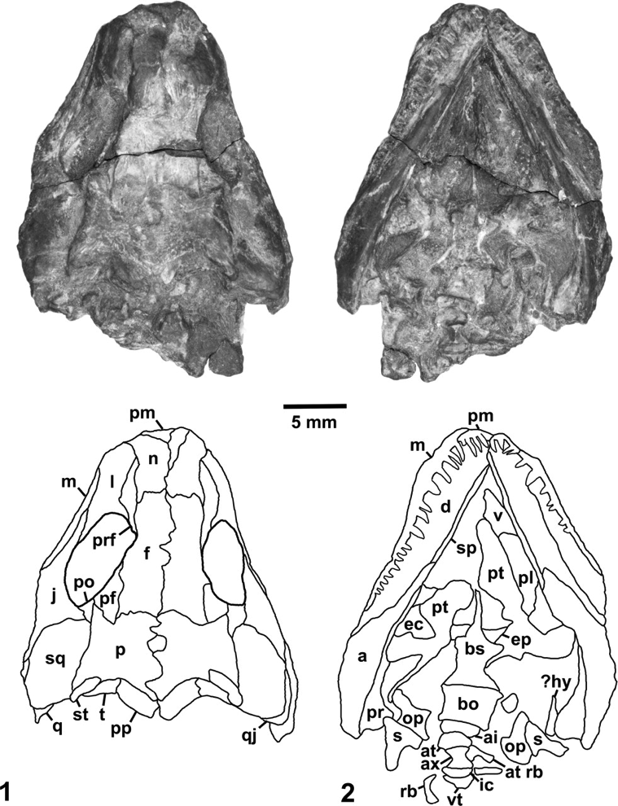
Thuringothyris
Lower Permian
Germany
Most primitive
Small
Single tooth row
Probably insectivorous

Slide 39
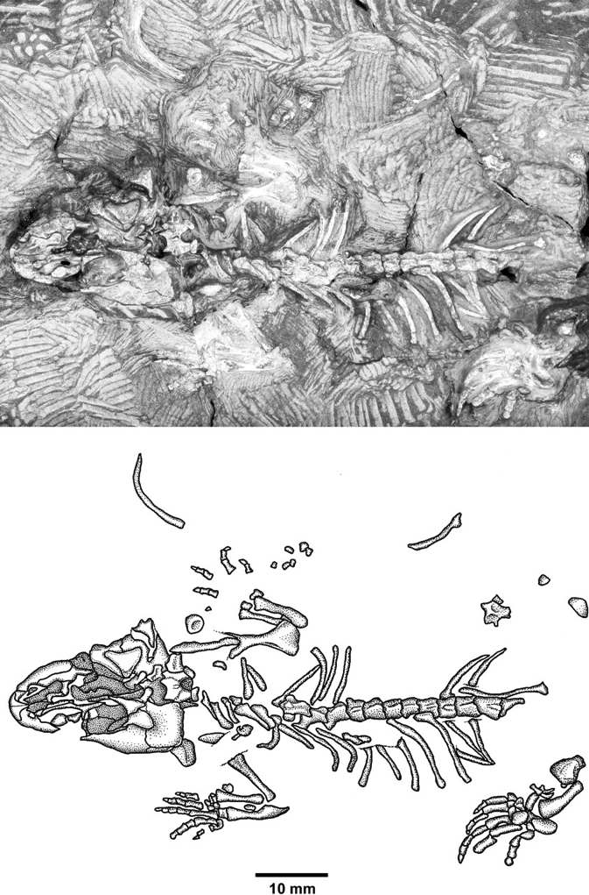
Thuringothyris mahlendorffae

Slide 40

Concordia
Late Pennsylvanian
Kansas
Small
Single tooth row
Probably insectiverous

Slide 41
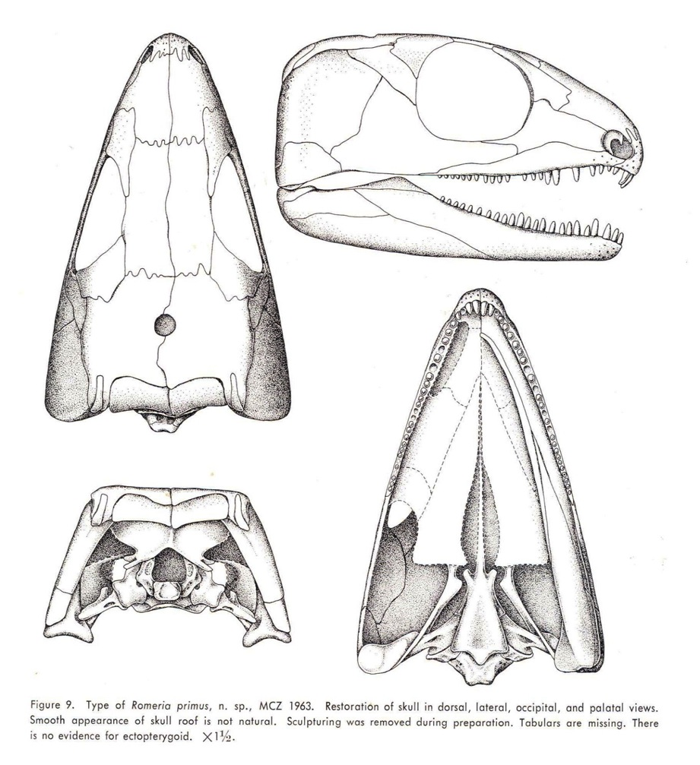
Romeria
Lower Permian
Texas
Small
Single tooth row
Pitting on skull
scraped off during
Preparation
Probably insectivorous

Slide 42
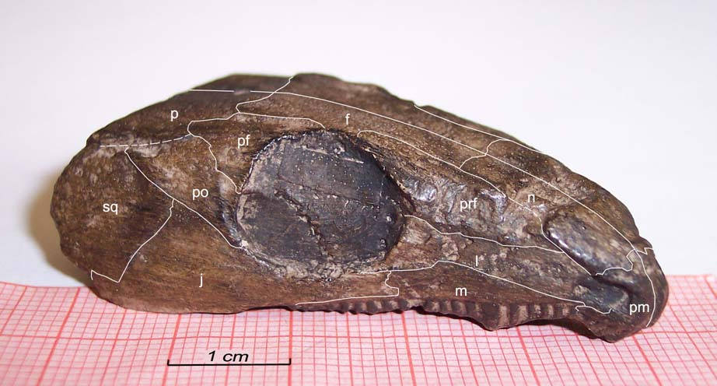
Romeria

Slide 43
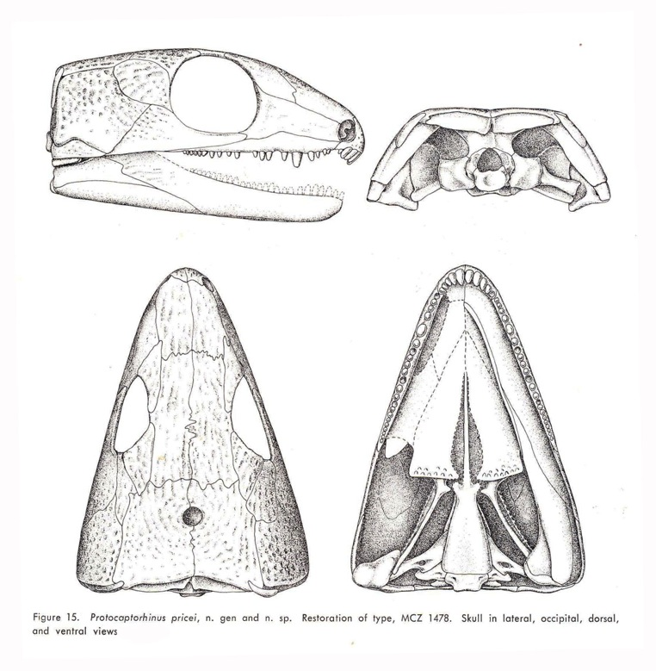
Protocaptorhinus
Lower/Middle Permian
Oklahoma
India
Zimbabwe
Small
Single tooth row
Probably insectivorous

Slide 44

Reiszorhinus
Lower Permian
Texas
Moderate size
Single tooth row
Most recurved teeth of all specimen
Probably ate bugs and small vertebrates

Slide 45
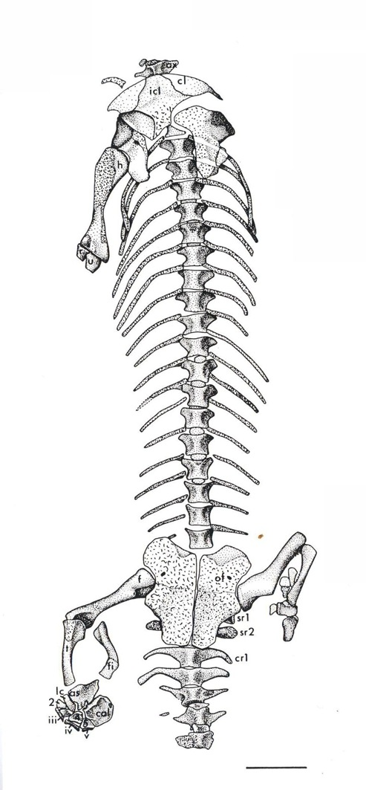
Rhiodenticulatus
Lower Permian
New Mexico
Small
Single tooth row
Probably insectivorous

Slide 46
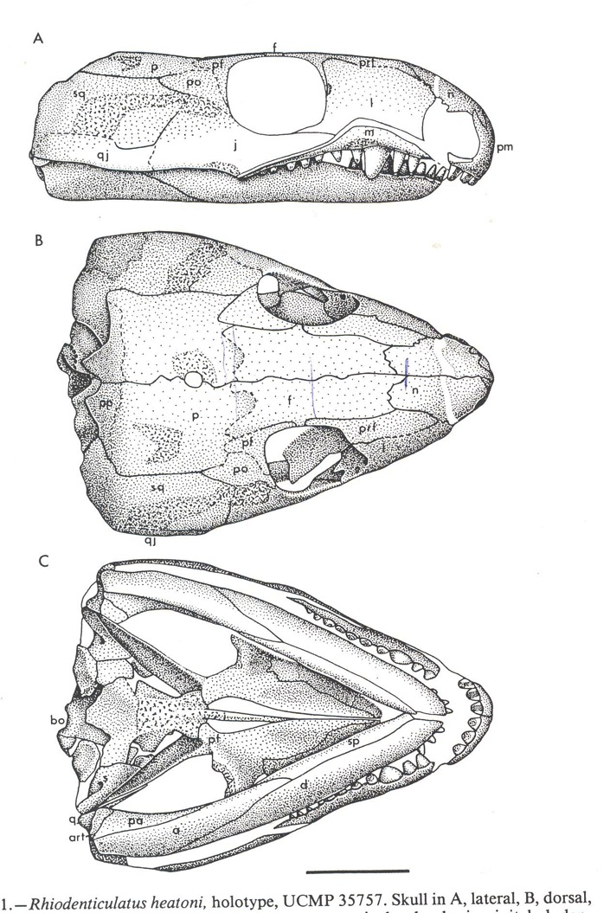
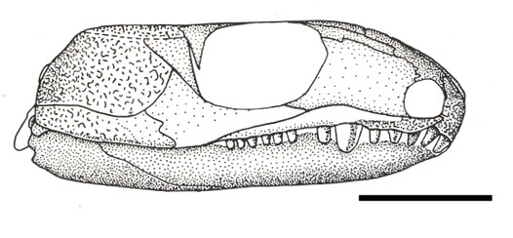
Rhiodenticulatus

Slide 47
Saurorictus
Upper Permian
South Africa
Small
Single tooth row
Probably insectivorous

Slide 48
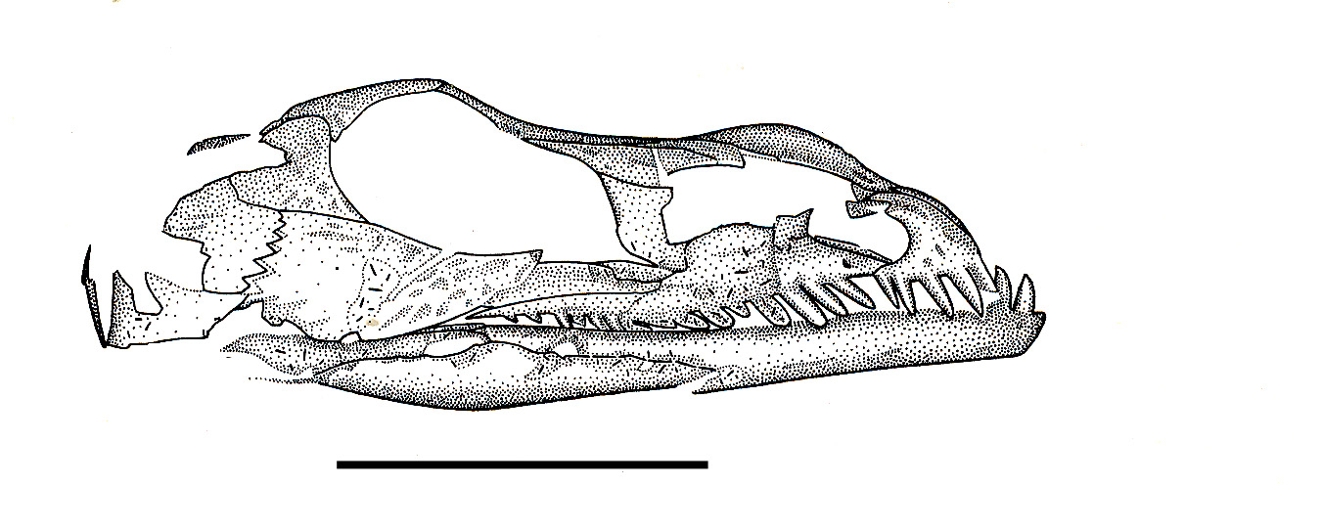
Saurorictus

Slide 49
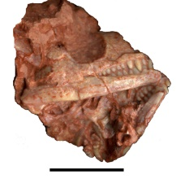
“Rhodotheratus”
Early Permian
Oklahoma
Small
Multiple tooth rows – 3 at most – (3rd time it evolved) – parallel rows
Probably insectivorous
Gavin Albright – thesis specimen

Slide 50
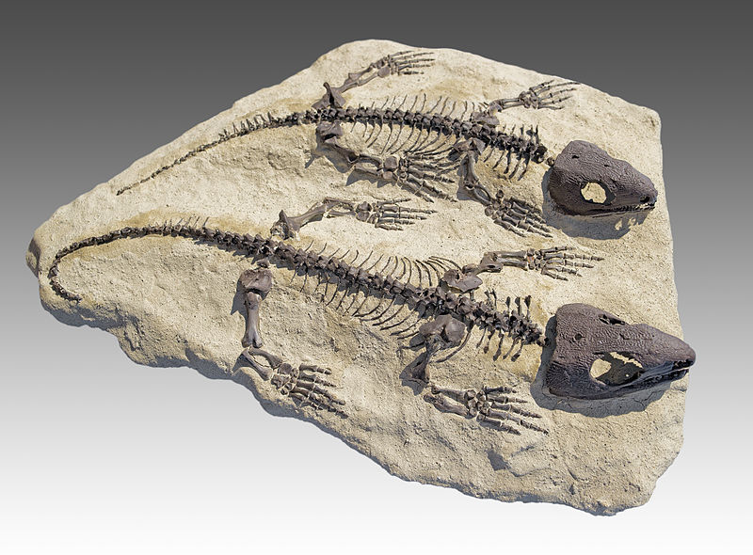
Captorhinus
Lower Permian
Oklahoma
Texas
New Mexcio
Small
Single or multi
Curved rows
True heart shaped
skull
Probably insectivorous
Captorhinus aguti

Slide 51
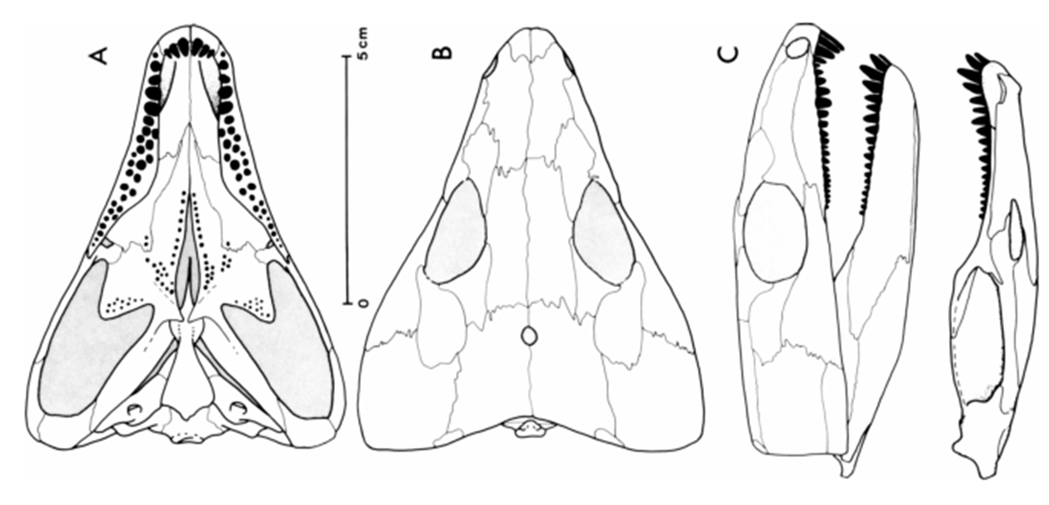
Captorhinus
Captorhinus aguti

Slide 52
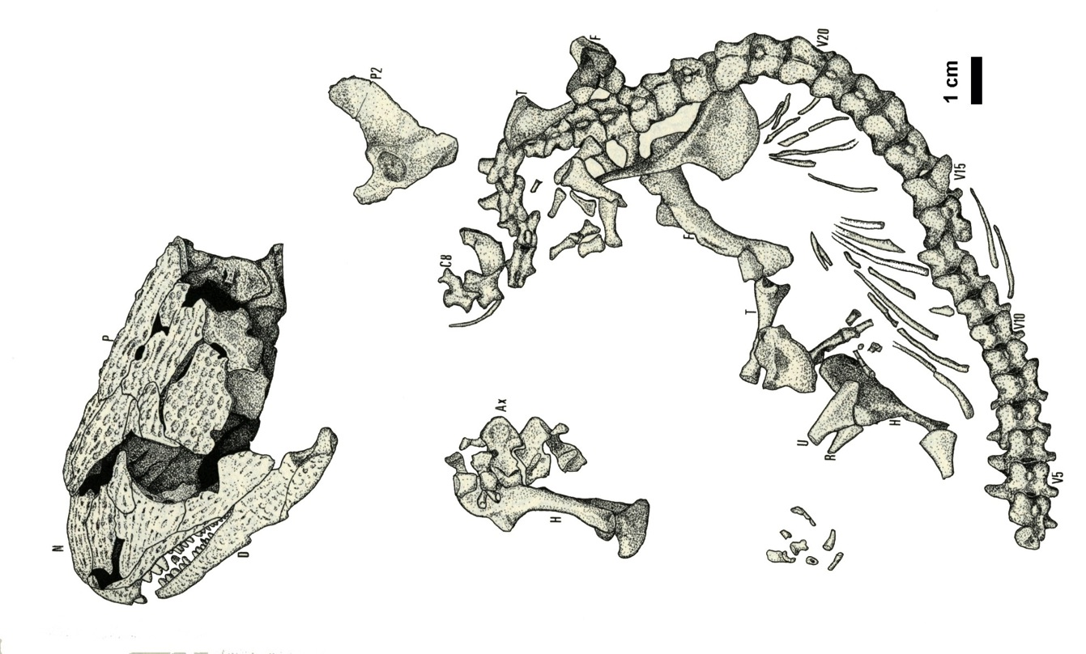
Captorhinus
Captorhinus aguti

Slide 53
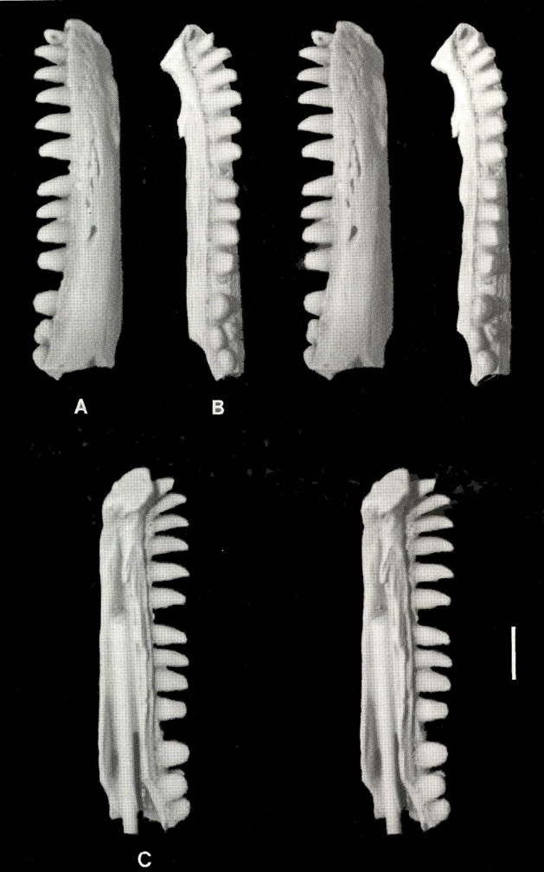
*Baeotherates
Lower Permian
Oklahoma
Small
Single tooth row
Fragmentary fossil record that includes only the right dentary
Almost certainly a captorhinid based on tooth shape
Probably insectivorous
* = Fragmentary remains

Slide 54
Captorhinikos (?)
Lower Permian
Oklahoma
Moderate
Multi tooth rows - 4 or more
Everette Olson erected the genus C. valensis, C. parvus and C. chozaensis
Name is out there
Of three species named by Olsen - two have been re-described and one renamed – third unsure

Slide 55
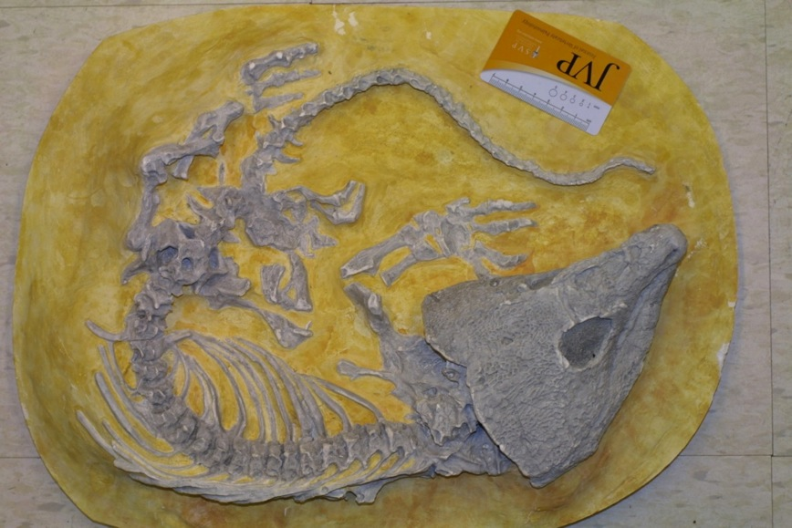
Labidosaurus
Lower Permian
Texas
Large
Single tooth row
Probably omnivorous
Probably added plants
to its diet

Slide 56
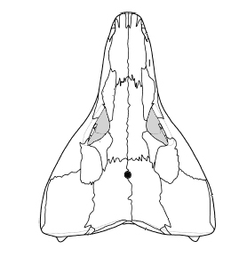
Labidosaurus
Transitional taxon between faunivorous basal reptiles and the herbivorous moradisaurines
Largest known single tooth row captorhinid

Slide 57
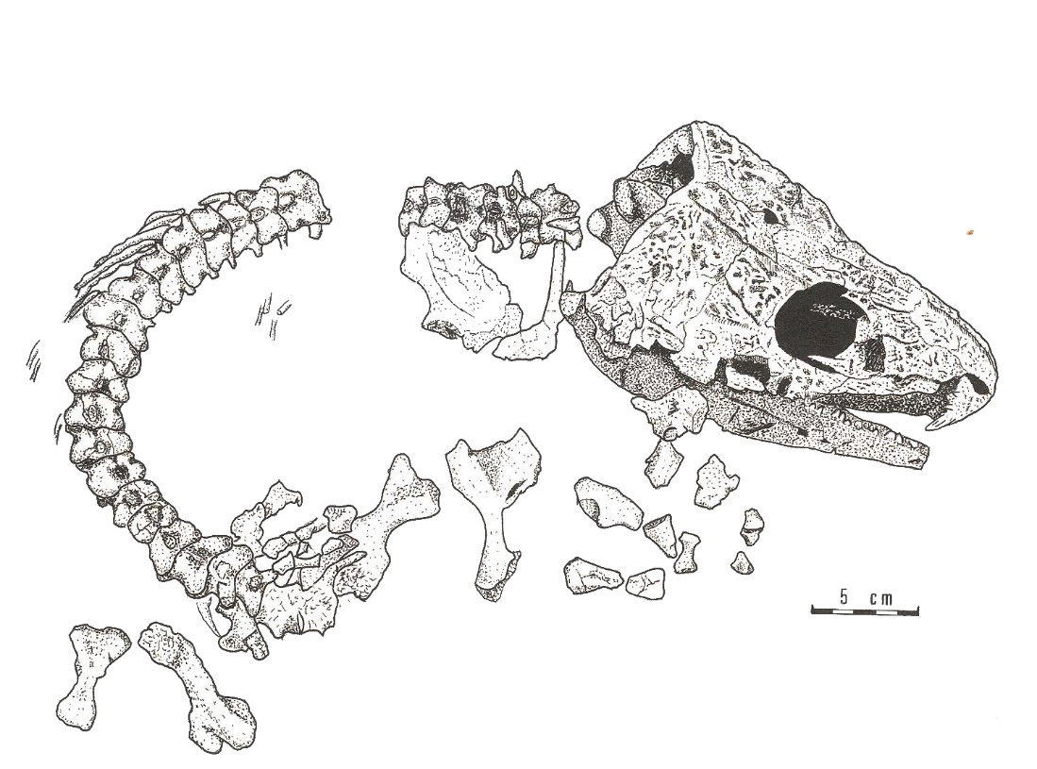
Labidosaurus

Slide 58

Labidosaurus

Slide 59

Labidosaurus

Slide 60


Labidosaurus

Slide 61

Labidosaurus

Slide 62
Sub-Family Moradisaurinae
Labidosaurikos
Moradisaurus
Rothianiscus
Gansurhinus
Acrodonta
Gecatogomphius
Kahneria
Becoming larger
All have multiple tooth rows
Plants added to diet
Possible some exclusively herbivorous

Slide 63
Labidosaurikos
Lower Permian
Oklahoma
Large
Multiple tooth rows (Up to 7) – parallel
Classic heart shaped head
Last multiple tooth row animal was small
Size and tooth rows independent features
Omnivorous to herbivorous
Interpretations from muscle fibers of adductor mandibulae and unique skull shapes suggest herbivory

Slide 64

Labidosaurikos

Slide 65

Labidosaurikos

Slide 66
Moradisaurus
Upper Permian
Niger
Animal for which sub-family is named
Very Largest of the large
Multiple tooth rows – (more than 9) – parallel
Herbivorous
Lower jaw suggest fore-and-aft translation

Slide 67


Moradisaurus

Slide 68

Moradisaurus

Slide 69

Moradisaurus

Slide 70

Moradisaurus

Slide 71

Moradisaurus

Slide 72
Rothianiscus
“Middle” Permian
Oklahoma
2nd largest of group – still very large
Multiple tooth rows (4 or 5)- parallel
Herbivorous

Slide 73


Rothianiscus
Rothianiscus – Dorsal View
Rothianiscus – Ventral View

Slide 74

Gansurhinus
Middle Permian
China
Medium-sized
Long diastema between single anterior teeth and multiple tooth rowed region
Multiple tooth rows (5) -parallel (Reisz 2011)
Pegged
Omnivorous to herbivorous

Slide 75

*Acrodonta
Middle/Late Permian
Morocco
Moderate
Multi tooth rows
Parallel
Omnivorous to herbivorous
* = Fragmentary
remains

Slide 76

*Kahneria and *Gecatogomphius
Kahneria
“Middle” Permian
Oklahoma
Moderate
Multi tooth row
Parallel
Gecatogomphius
Middle Permian
Russia
Moderate
Multi tooth row
Parallel

Slide 77
PALEO-BIOGEOGRAPHIC DISTRIBUTION OF CAPTORHINIDAE

Slide 78
Gansurhinus
Saurorictus
Moradisaurus
Gansurhinus (also upper)
Rothianiscus, Protocaptorhinus
Labidosaurikos
Rhodotheratus Reiszorhinus
Rhiodenticulatus
Captorhinus, Protocaptorhinus (also middle) , Labidosaurus
Romeria,Thuringothyris
Concordia

Slide 79

Late Pennsylvanian
Concordia in Kansas

Slide 80
Lower Permian
Thuringothyris
Romeria
Protocaptorhinus (Also Middle Permian)
Reiszorhinus
Rhiodenticulatus
Rhodotheratus
Captorhinus
Labidosaurikos
Labidosaurus
Captrohinikos

Slide 81
Middle Permian
Protocaptorhinus
Gansurhinus (upper also)
Rothianiscus

Slide 82
Upper Permian
Moradisaurus
Saurorictus
Gansurhinus

Slide 83

Red = Lower Permian
Green = Middle Permian
Yellow = Upper Permian

Slide 84
Ghost Lineages
Family | Subfamily | Genus (19) | Period | Location
Captorhinidae
 |  | Thuringothyris | Lower Permian | Germany
 |  | Concordia | Late Pennsylvanian | Kansas
 |  | Romeria | Lower Permian | Texas
 |  | Baeotherates* | Lower Permian | Oklahoma
 |  | Protocaptorhinus | Lower Permian | Texas
 |  | (possibly Protocaptorhinus) | Middle Permian | Zimbabwe
 |  | (possibly Protocaptorhinus) | Middle Permian | India
 |  | Reiszorhinus | Lower Permian | Texas
 |  | Rhiodenticulatus | Lower Permian | New Mexico
 |  | Saurorictus | Upper Premian | South Africa
 |  | “Rhodotheratus” | Lower Permian | Oklahoma
 |  | Captorhinus | Lower Permian | Texas, Oklahoma, New Mexico
 |  | Captorhinikos(?) | Lower Permian | Oklahoma
 |  | Labidosaurus | Lower Permian | Texas
 | Moradisaurinae | Labidosaurikos | Lower Permian | Oklahoma
 |  | Moradisaurus | Upper Permian | Niger
 |  | Rothianiscus | “Middle” Permian | Oklahoma
 |  | Gansurhinus | Middle-Upper Permian | China
 |  | Acrodenta* | Middle-Late(?) Permian | Morocco
 |  | Gecatogomphius* | Middle Permian | Republic of Tatarstan, Russia
 |  | Kahneria* | “Middle” Permian | Oklahoma
 |  | * = fragmentary remains

Slide 85
Ghost Lineages
Extend back in time
Humans and chimpanzees
Must have a common ancestor
No fossil record for the ancestor
No fossil chimpanzee ever found
Extend Forward in time
Coelacanths - Lazarus taxon – lobe finned fishes related to lung fishes & primitive tetrapods
Devonian to Cretaceous
None for past 80my
1938 coast of Africa
Recently Indonesia
Obviously still living but nothing in fossil record

