Slide 1
BIOLOGY 622 – FALL 2014
BASAL AMNIOTA - STRUCTURE AND PHYLOGENY
WEEK – 5
EUREPTILIA – “PROTOROTHYRIDIDAE AND ARAEOSCELIDIA
S. S. SUMIDA

Slide 2
Eureptilia is a huge group, including numerous extinct groups, and all sorts of extant taxa including extant diapsids – lizards and snakes, turtles (which are probably highly derived diapsids) the remaining extant archosauromorphs – the crocodilians and the birds (derived from saurischian therapod dinosaurs).
The group that was “displaced” by the Captorhinidae as the most primitive of reptilians has a somewhat complicated history.

Slide 3
Recall that Carroll (1969) designated the family Romeriidae as the group from which all other amniotes arose. The group was named for genus Romeria, originally named by Lewellyn Price with two species – Romeria texana and R. pricei (both from the Lower Permian of Texas).
Heaton (1979) removed Romeria from Romeriidae, suggesting they were better placed in the Captorhinidae.
This left Romeriidae without its namesake, so the name reverted to Protorothyrididae. (Carroll persisted in calling this group the “Protorothyridae”.)

Slide 4
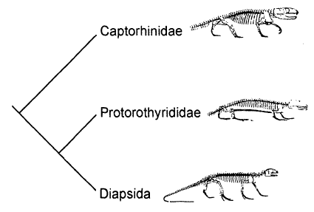
Here, Heaton and Reisz (1986) used only Captorhinus to represent Captorhinidae, Protorothyris to represent Protorothyrididae, and Petrolacosaurus to represent basal Diapsida.

Slide 5
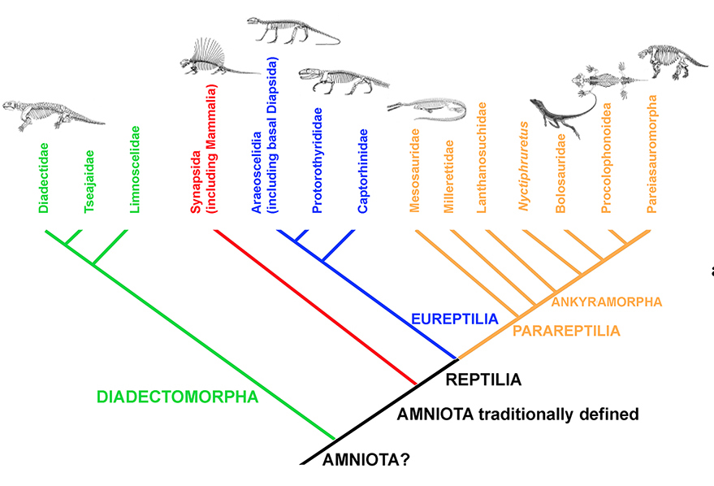

Slide 6
Made sense for the more gracile protorothyridids and araeoscelidians to be more closely related to one another than to the Captorhinidae.
However, when Muller and Riesz (2008) assessed all genera of protorothyridids they came up with a much messier scenario:
Captorhinidae maintained their monophyly.
Araeoscelidia, from which basal diapsids are derived, also maintained its monophyly.
However, Araeoscelidia was nestled within a group of Protorothyrididae, effectively rendering Protorothyrididae paraphyletic.

Slide 7
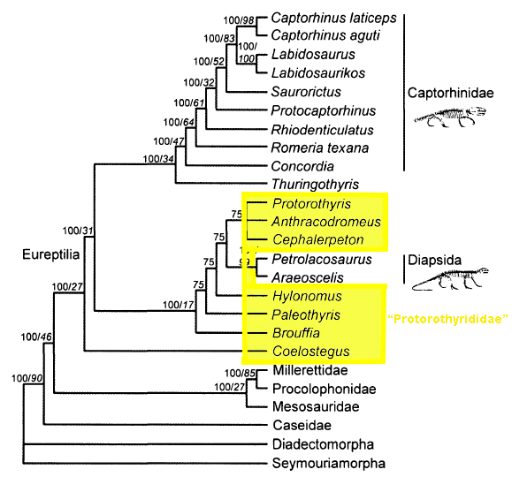

Slide 8
Thus their 2008 conclusions did not invalidate the grouping of taxa that included araeoscelidians and “protorothyridids” exclusive of captorhinids.
This is a grouping referred to by some as Romeriida. That term will be used here for convenience even if the protorothyridids should probably now be considered paraphyletic.

Slide 9
FEATURES OF THE ROMERIIDA – “PROTOROTHYRIDIDAE” + ARAEOSCELIDIA
These two groups are much more gracile than the Captorhinidae or the robust sister taxon to Amniota – Diadectomorpha. Most of the features uniting these groups are reflective of this:
Anterior pleurocentra keeled ventrally. The anterior pleurocentra of other amniotes is rounded ventrally.
Carpus and tarsus long and slender.
Metapodials overlapping. (The proximal heads of the metapodials of other amniotes barely contact each other whereas the metapodials of "protorothyridids" and diapsids are expanded proximally and overlap the metapodial lateral to them.)

Slide 10
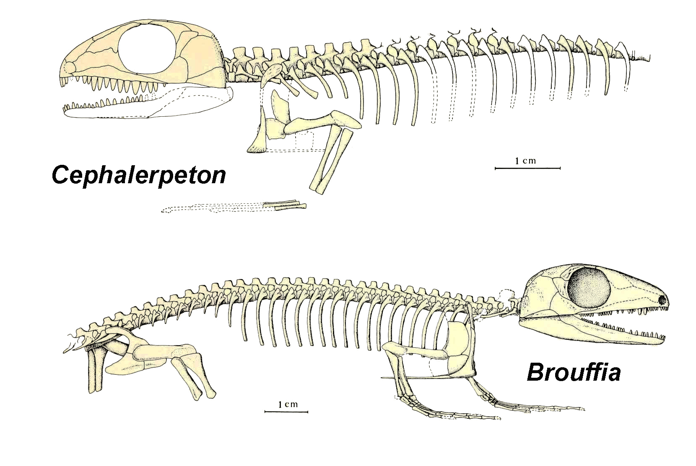

Slide 11
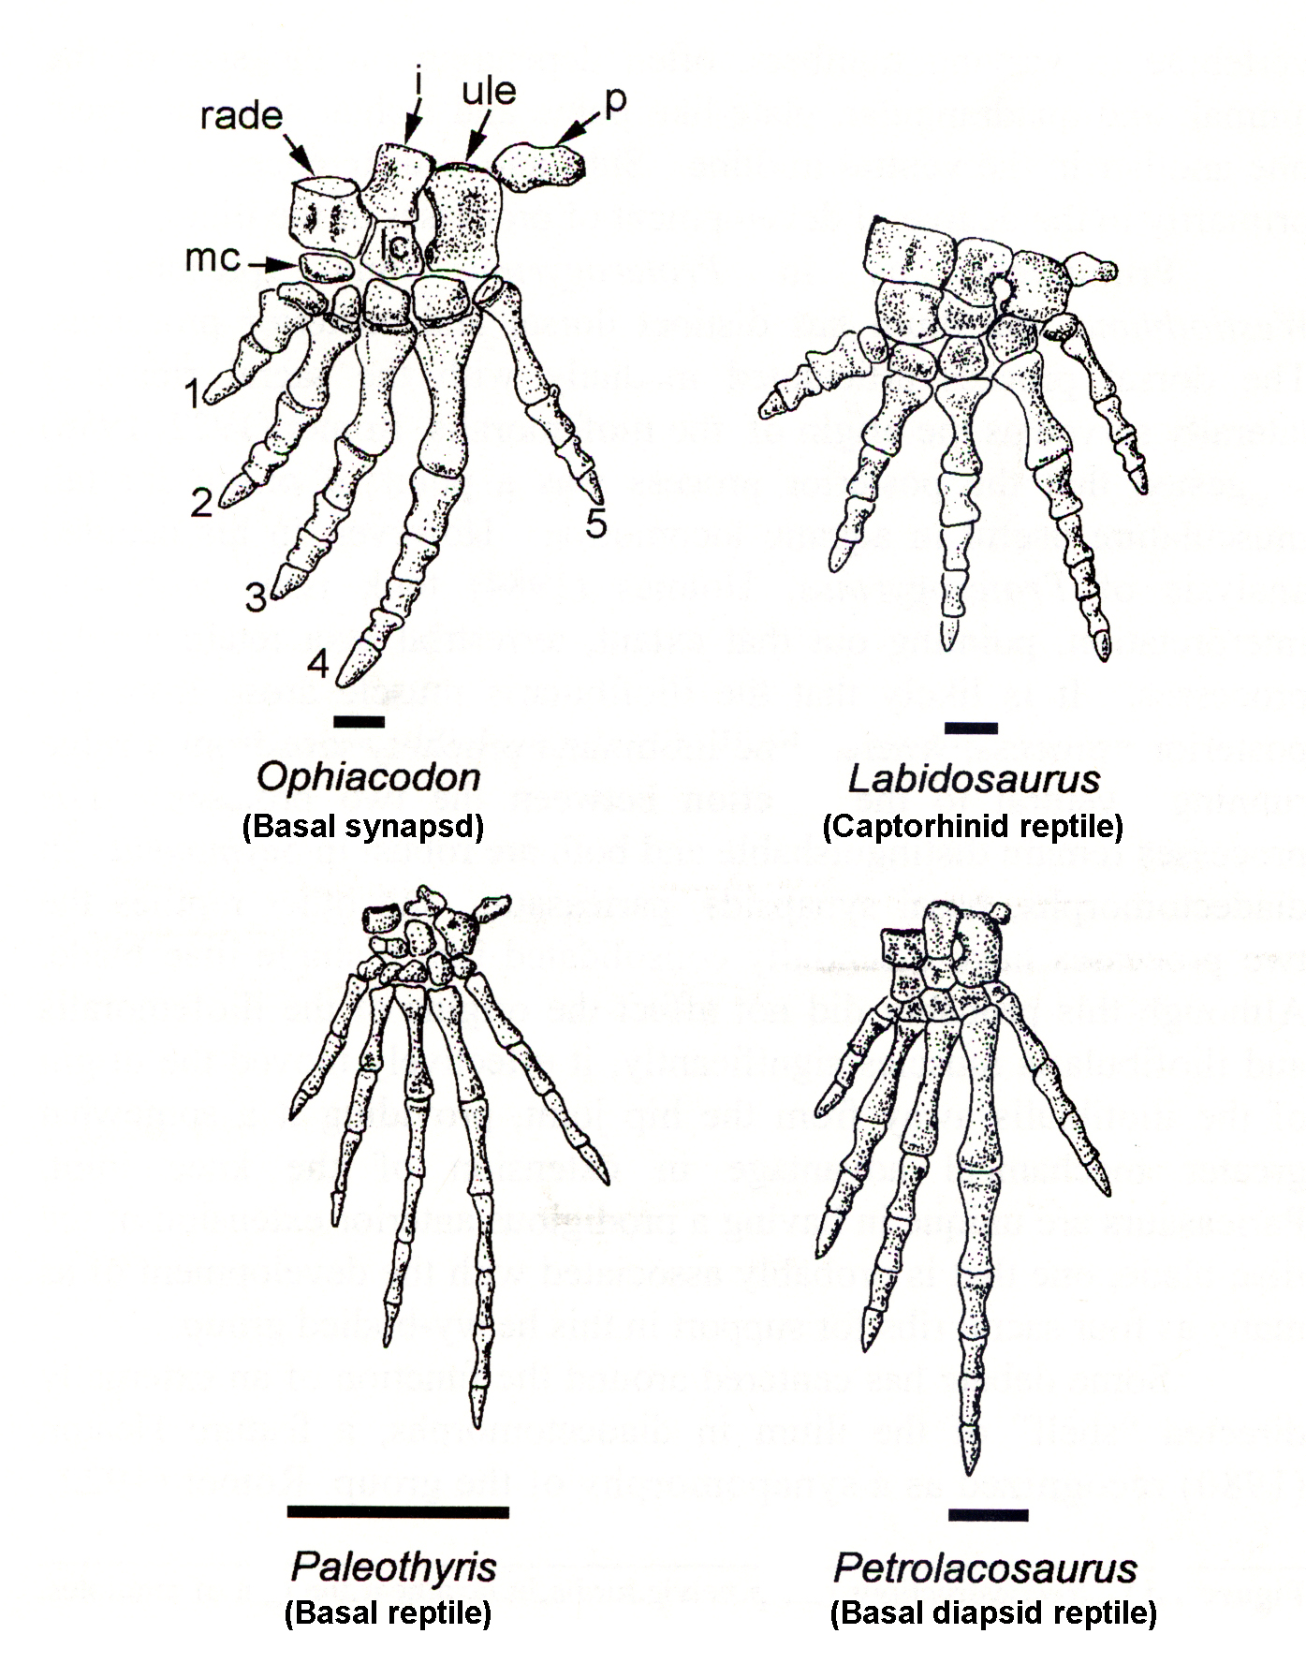

Slide 12
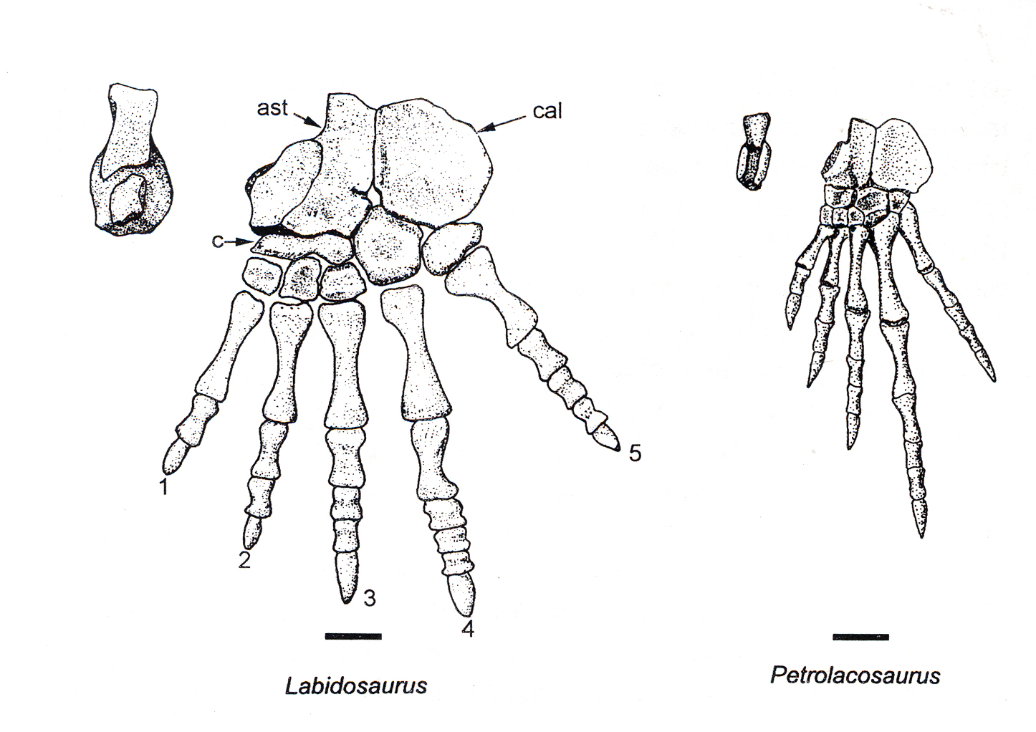

Slide 13
ARAEOSCELIDIA
The taxonomic history of the genus Araeoscelis is somewhat tortured.
Although it has always been considered an important Early Permian genus, it has been variously placed because of its unusual temporal fenestra morphology.
The skull has a single temporal fenestra. However, it is not homologous to that of synapsids.
It is a single fenestra, not double like a typical diapsid. It is similar to the upper fenestra of the paired fenestrae of diapsids.
This caused some workers to place it in its own group called the “Euryapsida”.

Slide 14
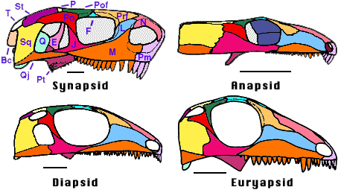

Slide 16
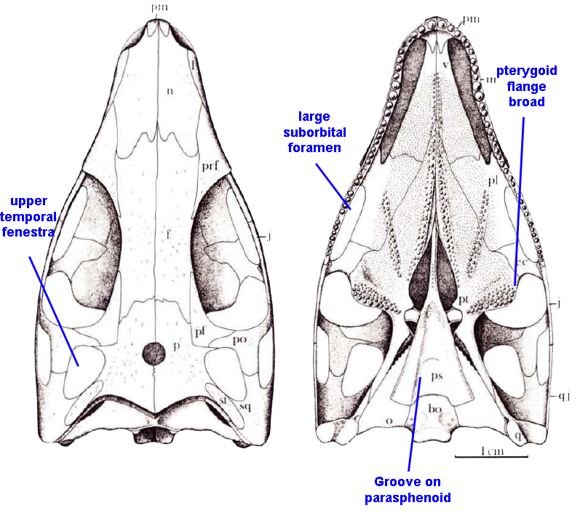
ARAEOSCELIDIA
Defining Features

Slide 17
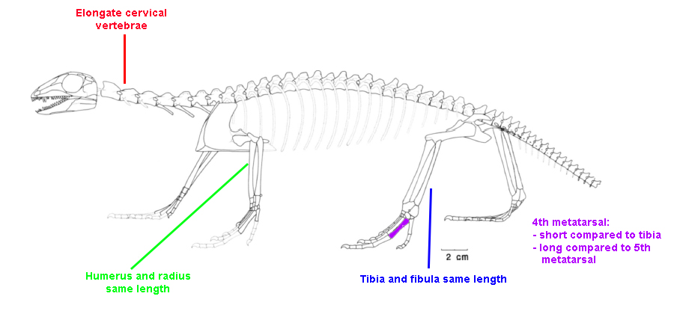
ARAEOSCELIDIA
Defining Features

Slide 18
Muller and Reisz (2006) also included the following features:
the presence of swollen dorsal neural arches
the presence of alternation in dorsal neural spine height
While this is flattering (because I was the one who documented it), it can’t really be used to define the group because it is also characteristic of captorhinid reptiles. In fact the condition is rather common.

Slide 19
