Slide 1
BIOLOGY 622 – FALL 2014
BASAL AMNIOTA - STRUCTURE AND PHYLOGENY
WEEK – 7
INTRODUCTON TO PARAREPTILIA
MESOSAURIA, MILLERETTIDAE and
ANKYRAMORPHA: (including) LANTHANOSUCHIDAE
S. S. SUMIDA

Slide 2
WHY THE TERM PARAREPTILIA?
As we have said, Eureptilia is a huge group, including numerous extinct groups, and all sorts of extant taxa including extant diapsids – lizards and snakes, turtles (which are probably highly derived diapsids) the remaining extant archosauromorphs – the crocodilians and the birds (derived from saurischian therapod dinosaurs).
The key here is that it includes extant members of Reptilia.

Slide 3
Essentially, within the Reptilia, the Eureptilia have included those reptilian taxa that are extant today.
Parareptilia has functioned to include reptilian grade amniotes, but reptilian grade amniotes that somehow are not closely related to extant (living, surviving) reptiles (including birds).
This has meant that the phylogenetic position of the extant turtles has had a lot to do with parareptilian systematics.

Slide 4
In recent years the [somewhat confident] resolution of the position of turtles as highly modified diapsids has removed some of the obstacles to a clearer understanding of parareptiles. This has been further facilitated by:
A host of new, in many cases younger, workers in he field, who have somwhat fearlessly taken on this problem. Among them Modesto, Müller, Tsuji, Cisneros joining and influencing many of the researchers that have become familiar thus far.
New fossil discoveries, or the redescription of important taxa in key parareptilian groups.
Inclusion of certain groups in the Parareptilia for the first time (for example, Bolosauridae), which has lent some stability to the group.

Slide 5
HISTORY OF PARAREPTILIA
In 1947, Olson completed his landmark attempt to clarify and clean up the Diadectidae.
He was, for the time, considered moderately successful: sinking many confusing, invalid taxa; coming up with a more reliable definition of the group; clarifying certain features that are anatomically characteristic of the group (particularly the temporo-occipital region and the middle ear); and recognizing that even if diadectids were not amniotes themselves, they were certainly highly terrestrial, and very close relatives of anmniotes.
Recognizing the highly terrestrial nature of diadectids, Olson (1947) suspected some potential relationship of other robust Permian amniotes, including procolophonids and pareiasaurs. Olson was also one of the first to suggest the role of turtles in this mess.

Slide 6
Over the last half of the previous century, the position of turtles seemed to bounce around a number of groups we now place in the Parareptilia. However recently, they appear to be settling in to Diapsida as members with highly modified or lost lower temporal arcades.
This in turn has allowed Müller, Tsuji, and some others to begin to attack the Parareptilia as a whole. Linda Tsuji began working on key members of Parareptilia, and in 2006, she and Johannes Müller published a key summary of the group and attempted to establish a clear definition and set of synapomorphies for it.

Slide 7
Six unequivocal features of Parareptilia:
absence of a lacrimal-narial contact
absence of a true caniniform region (this one is a bit dodgy – many parareptilians have caniniform regions, but none with a single largest canine.)
shortened postorbital region
single median embayment of the posterior margin of the skull roof
absence of a subtemporal process of the jugal
absence of a supraglenoid foramen
They also suggested Parareptilia was possibly characterized by some other somewhat less reliable characters including:
solid prefrontal-palatine contact
dorsally expanded quadratojugal
large foramen on the maxilla just below the naris (called the anterior maxillary foramen)
jaw articulation at the level of or slightly posterior to the occiput

Slide 8
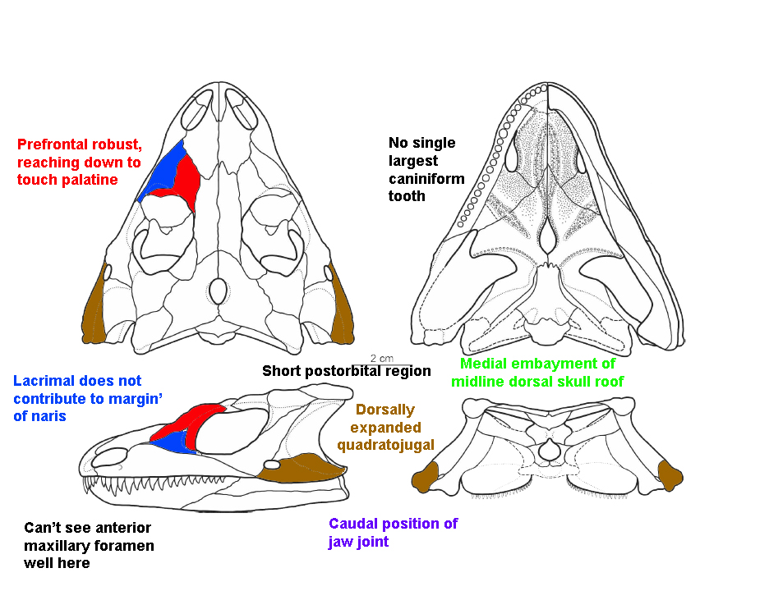
We will illustrate some of the cranial features with Macroleter, Middle Permian of Russia.

Slide 9
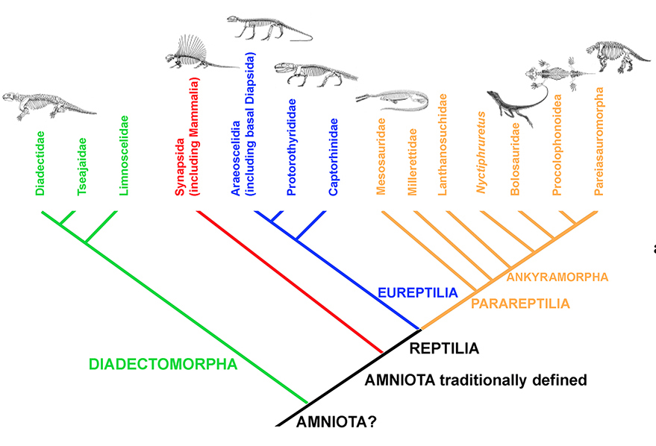

Slide 10
THE MESOSAURIA
The mesosaurs are simultaneously some of the enigmatic and most easily recognizable of all amniote groups. They are instantly recognizable by their aquatic adaptations, which include a fusiform body, reduced limbs, and “fish-trap” like jaws with needle like teeth.
Their aquatic adaptations have made it difficult to compare them easily with other amniotes, so difficult that they have occasionally be pulled out of both Parareptilia and Eureptilia to stand as their own, unique and odd group.
However, the analyses mentioned above appear to confidently place them in Parareptilia, albeit at the base of the group.
The group is known from the Lower Permian of both South America and Africa, and they were amongst the earliest of fossil data supporting the close association of those two continents in early recognition of plate tectonic research.
Because of their aquatic nature, they often express as spectacularly preserved fossils, and he has been able to reconstruct both the skull and postcranium with confidence.

Slide 11
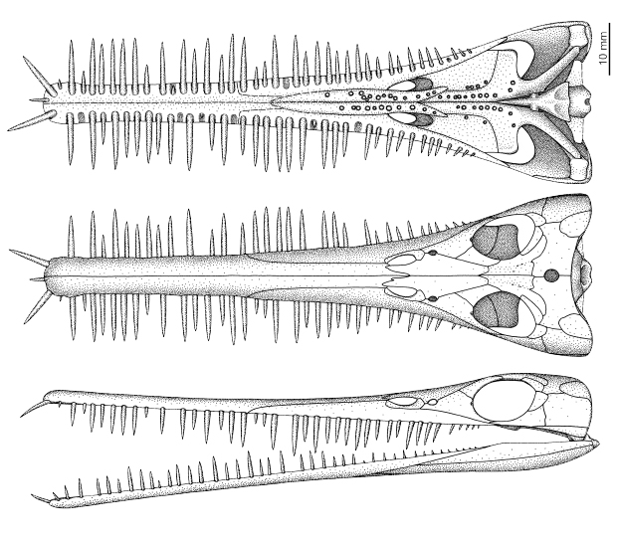

Slide 13
MILLERETTIDAE
The millerettids are nowhere near as unique or distinct as the mesosaurs, looking at first glance like small, lizard-like reptiles, but having the skull and dental proportions characteristic of parareptiles.
Cisneros has reviewed them recently, and has noted that various members of the group have been allied with any number of parareptilian groups, and even araeoscelidian diapsids.
They are primarily known from Middle and Late Permian sediments of South Africa.

Slide 14
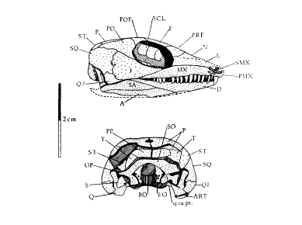
MILLERETTIDAE
Maxilla and quadratojugal are separate
Postorbital is fully visible/exposed in lateral view
No posterior extension of the orbit (i.e. the orbit is rounded or oval in outline)
No fangs on the vomer
Interpterygoid vacuity is long, at least 30% the length of the skull
Posttemporal fenestra measures less than half the width of the foramen magnum (in others it can be quite large)
Frequently have a lateral temporal fenestra that is not necessarily homologous (independently derived) with that of synapsids, or the lower fenestra of diapsids

Slide 15
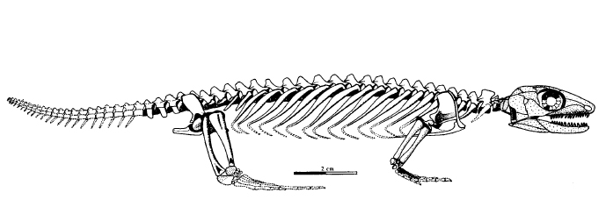
Milleretta

Slide 16
ANKYRAMORPHA
The remaining parareptilians, including Lanthanosuchidae, Bolosauridae, Procolophonoidia, and Pareiasauromorpha.
“Ankyra” is Greek for anchor, and the name derives from members having an anchor-shaped” interclavicle.
deBraga and Reisz (1996) reassessed, and in doing so, confirmed the monophyly of the Parareptilia. There are numerous features that deBraga and Reisz suggested are diagnostic of the Ankyramorpha. Only some of them here, as certain of them aren’t terribly useful when considering all of the Reptilia.

Slide 18
ANKYRAMORPHA
dorsal process of premaxilla narrow
anterodorsal process of maxilla high and extending to the dorsal limit of the external naris
posterior process of postorbital nearly as wide as long
dermal sculpturing on skull in the form of large tuberosities and pits
base of quadrate ramus of pterygoid deeply excavated posteriorly
ectopterygoid, if present, contributing to outer-most border of transverse flange
cultriform shorter than the body of the parasphenoid
paroccipital process antero-posteriorly expanded
quadrate condyle short and nearly flat antero-posteriorly
surangular short and not extending anteriorly beyond the coronoid eminence
prearticular short, terminating before coronoid eminence
trunk neural arches swollen but with narrow, high zygapophyseal buttresses
interclavicle with distinctive anchor shape (T-shaped); and anterior edge of transverse bar of interclavicle with deep groove for attachment of clavicles.

Slide 19
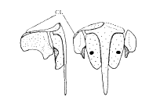
Below: the pectoral girdle of Milleretta to demonstrate the “anchor” shape of the interclavicle:
LEFT LATERAL VENTRAL

Slide 20
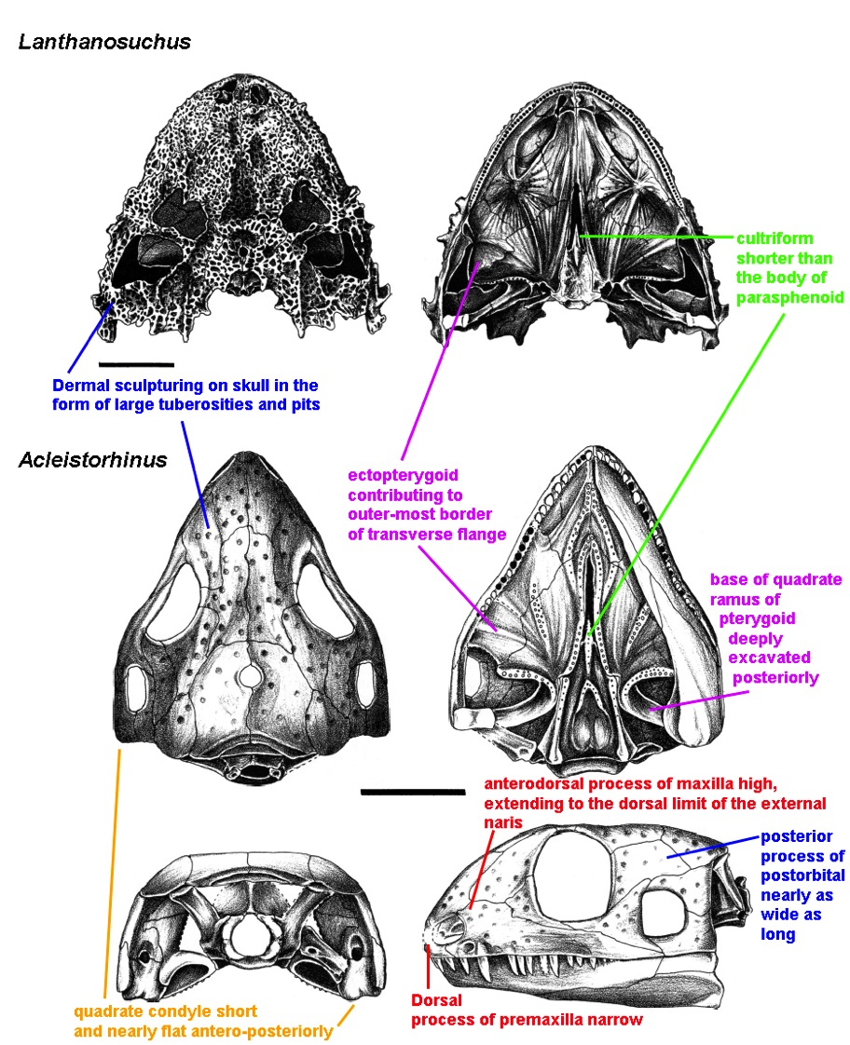

Slide 21
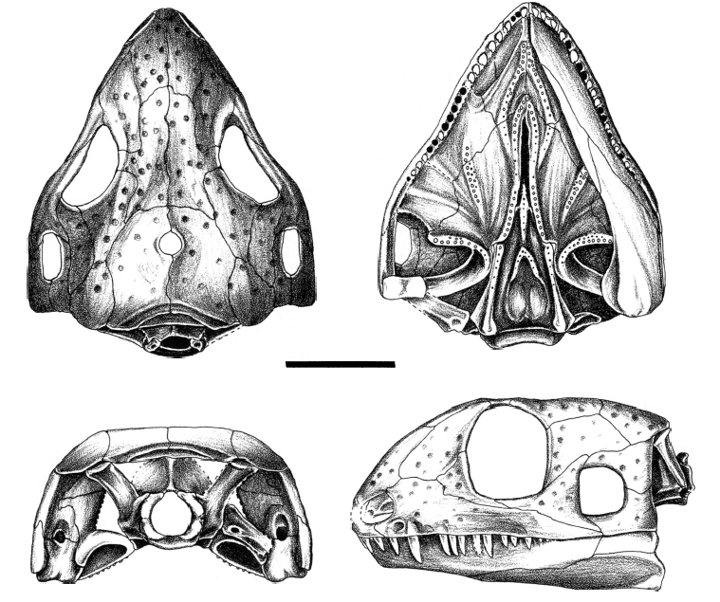
ANKYRAMORPHA – Acleistorhinus
Acleistorhinus is a Lower Permian form from Oklahoma, originally studied by Elenor Daly, restudied by deBraga and Reisz (1996). They identified it as a parareptile, an as such it is the oldest known member of the group.

Slide 22
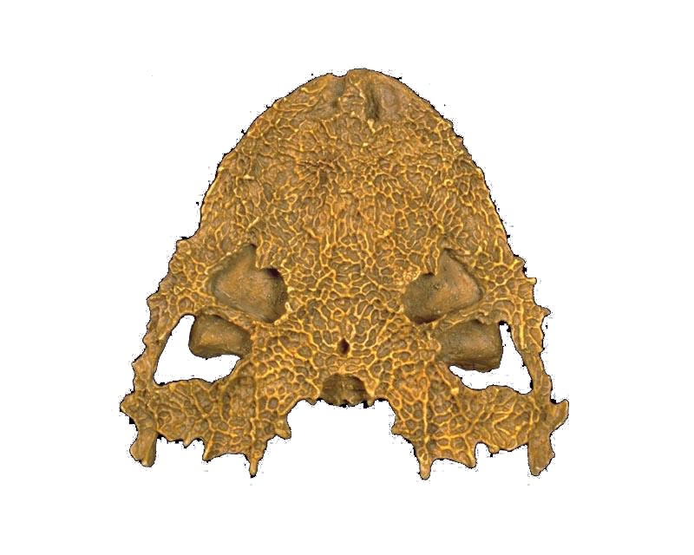
ANKYRAMORPHA – Lanthanosuchidae
Lanthanosuchans are an enigmatic Upper Permian group from Republic of Tatarstan, western Russia.
They are characterized by strongly ornamented skulls, Lanthanosuchus described by Efremov (1946) has been described as the mot perfectly preserved Paleozoic skull ever found.

Slide 23
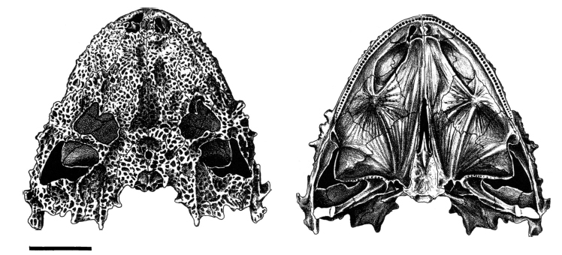
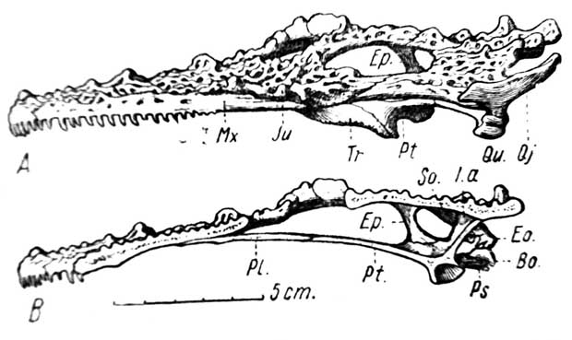

Slide 24
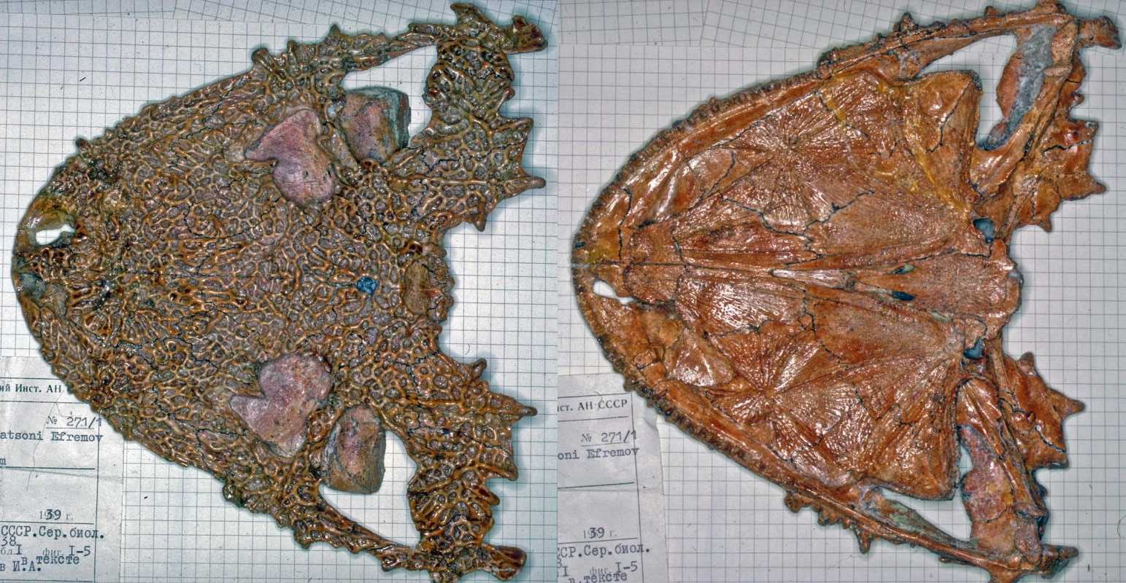

Slide 25
