Slide 1
Biology 323
Human Anatomy for Biology Majors
Lecture 1
Dr. Stuart S. Sumida
Humans as Vertebrates
Early Development of Humans

Slide 2
Humans as Vertebrates
Phylum – Chordata
Dorsal hollow nerve cord
Notochord
Pharyngeal (Gill) Pouches
Postanal Tail
Endostyle or Thyroid gland
Segmented Body Musculature
Neural crest tissue as the defining vertebrate feature.

Slide 3
Notochord
Slender, fibrous, longitudinal rod
Embryologically derived from mesoderm
Dorsal to the coelom
Ventral to the central nervous system
Provides stiffness for the animal
Bends laterally, resists cranio-caudal compression
Primitive function replaced by vertebral column

Slide 4
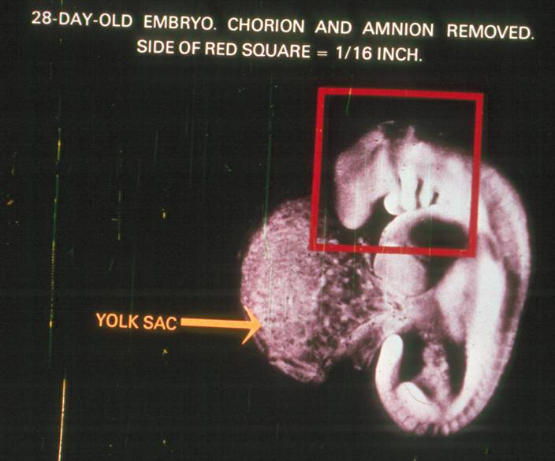
Pharyngeal (Gill) Pouches

Slide 5
Endostyle or Thyroid Gland
Endostyle
a ciliated groove in the floor of the mouth
Present in early chordates
Thyroid Gland
Present in more advanced chordates

Slide 6
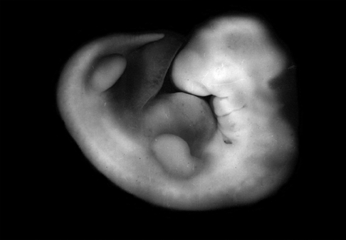
Post-anal Tail
A tail extending beyond the anus
Primarily for swimming in lower chordates

Slide 7
Segmented Body Musculature
Blocks of muscle
Arranged along the length of the body
You will see this clearly when you do your dissections.

Slide 8
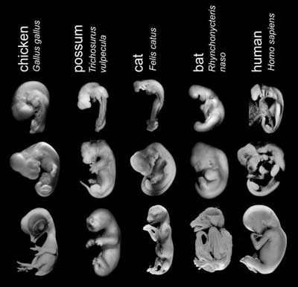

Slide 9
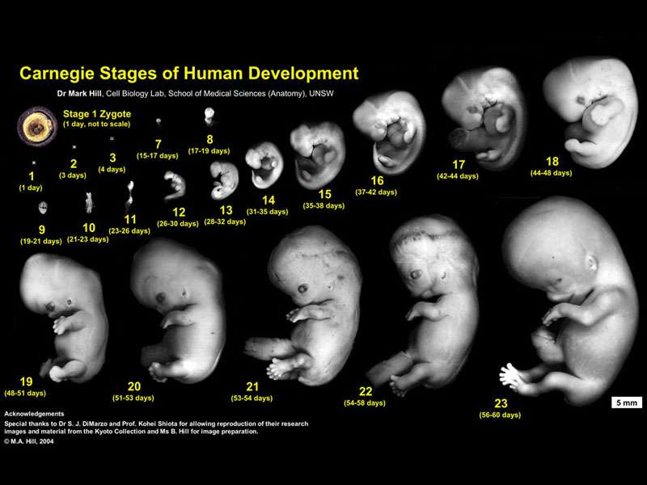

Slide 10
Humans are:
Animals – can’t make our own food, mobile
Chordates
Vertebrates – “backboned” animals
Tetrapods – vertebrates with four terrestrial limbs
Amniotes – we reproduce and survive away from water
Mammals – hair, mammary glands
Primates – opposable hallux, flat nails
Great Apes – no visible tail

Slide 11
Cells and Tissues
Cell structure
Cell association patterns
Epithelial pattern
Mesenchymal pattern
Tissues
Epithelial tissue - functions of exchange and functions of certain sensory reception.
Connective tissue
Muscle & nervous tissue

Slide 12
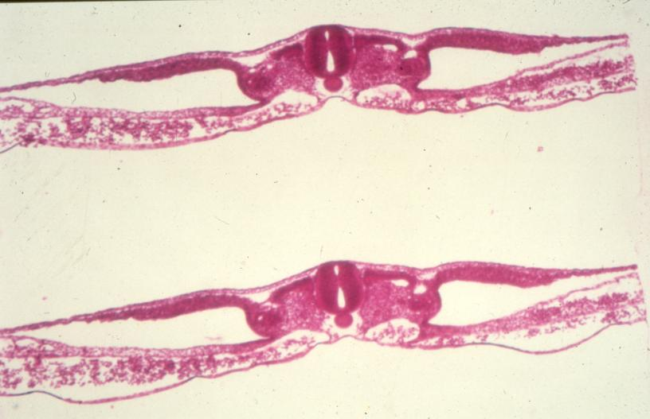
Epithelial tissue
Mesenchymal Tissue

Slide 13
Relative Directional Terms
Anterior/Ventral vs. Posterior/Dorsal
Cranial/Cephalic vs. Caudal
Superior vs. Inferior
Medial vs. Lateral
Proximal vs. Distal
Superficial vs. Deep
Bipedal and Orthograde
Note: You will not be tested on these terms. It will be assumed they are part of you vocabulary.

Slide 14
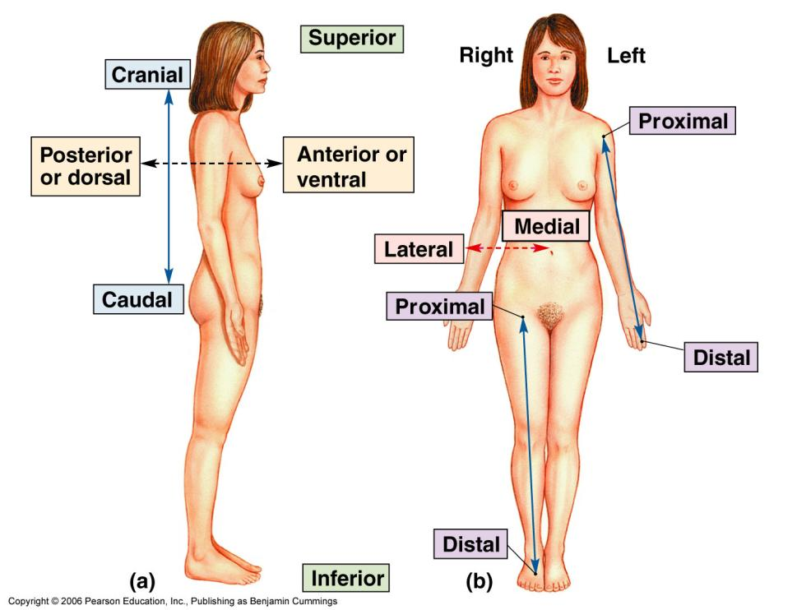
Note: You will not be tested on these terms. It will be assumed they are part of you vocabulary.

Slide 15
Anatomical Sections
Transverse plane: Transverse/Cross section
Frontal plane: Frontal section
Sagittal plane: Sagittal section
Median sagittal section: Down the mid-line
Parasagittal section: Off the mid-line
Note: You will not be tested on these terms. It will be assumed they are part of you vocabulary.

Slide 16
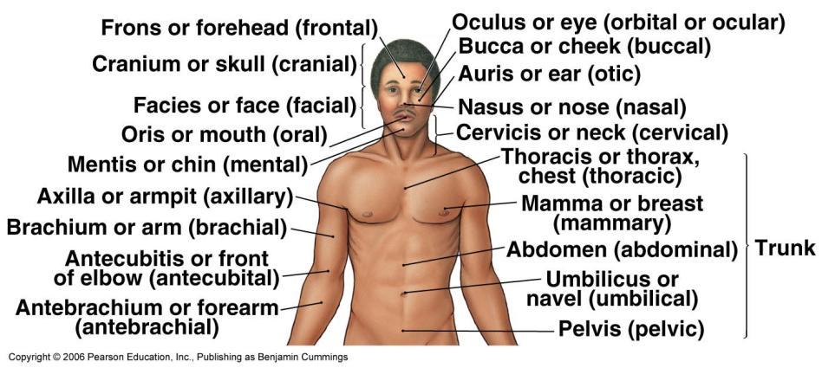
Word Roots
Note: You will not be tested on these terms. It will be assumed they are part of you vocabulary.

Slide 17
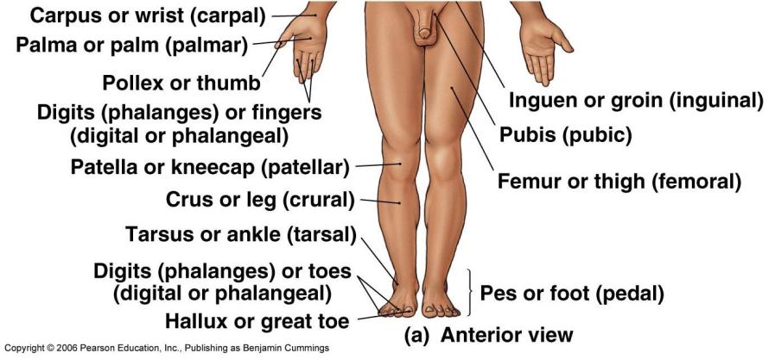
More Word Roots
Note: You will not be tested on these terms. It will be assumed they are part of you vocabulary.

Slide 18
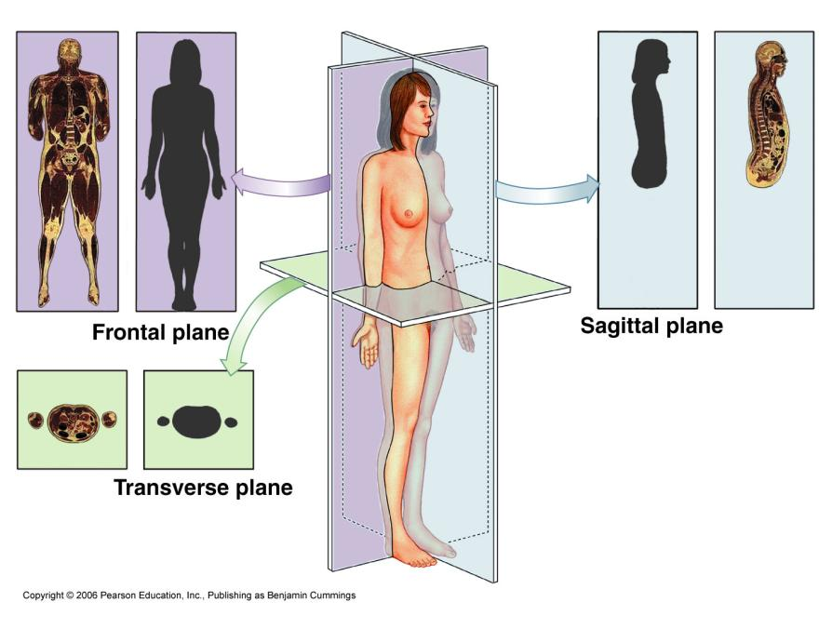
Anatomical Planes
Note: You will not be tested on these terms. It will be assumed they are part of you vocabulary.

Slide 19
Historical and Developmental Perspectives
Ontogeny
Early embryological development
Cross-section of the body
Chordate features – dorsal hollow nerve cord, notochord, gut tube, certain blood vessels, muscle blocks, and coelom.

Slide 20
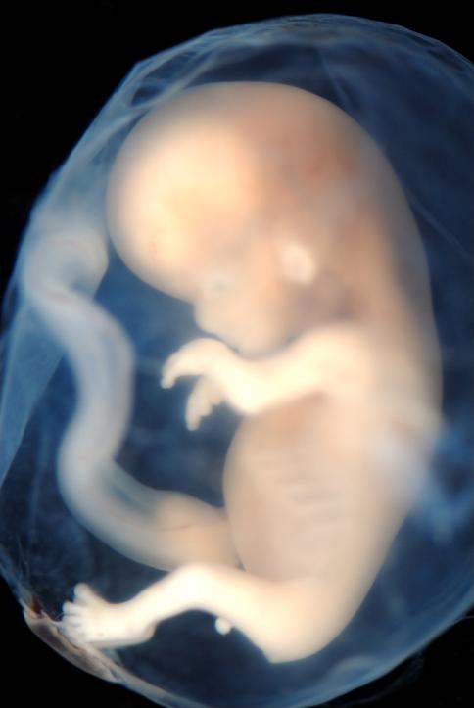
Early Development of Humans

Slide 21
Early Development of the Humans
The egg
macrolecithal versus microlicethal (know the difference)

Slide 22
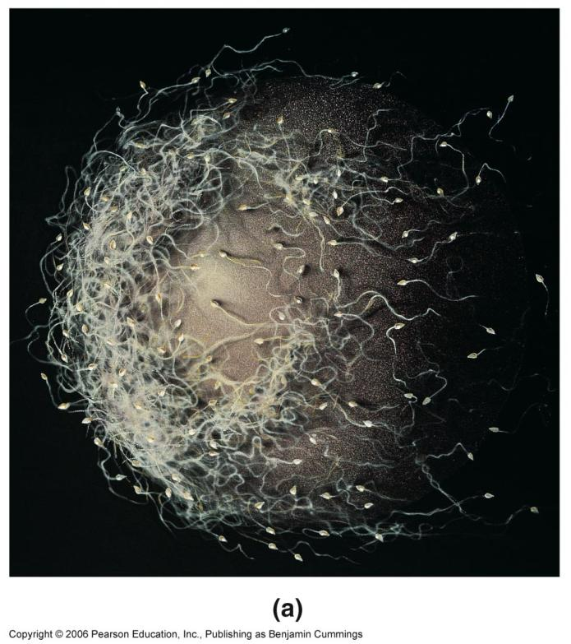

Slide 23
Early stages
Zygote
Morula
Blastocyst - inner cell mass, trophoblast
Amniotic cavity
Bilaminar embryo
Notochord - first discrete structure

Slide 24
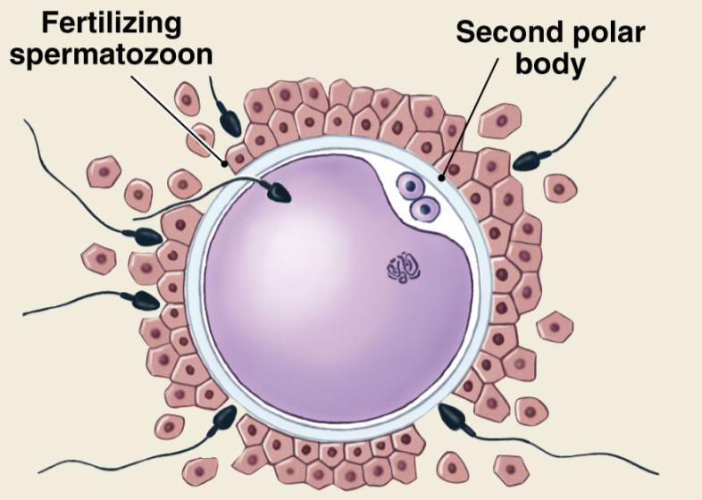
1 Sperm Wins

Slide 25
Fertilization and Oocyte Activation
Fusion of oocyte and sperm (2,000:1 volume ratio)
Oocyte: provides DNA, organelles, nourishment
Sperm: provides little more than DNA
Zona reaction prevents fertilization by multiple sperm
23 chromosomes from oocyte & sperm makes 46 total
Fertilized egg is called a zygote, oocyte metabolic activity increases, and cleavage begins

Slide 26
General Timetable for Gestation
First Trimester
Early cell divisions, establishment of germ layers (“germinate”), beginning of organogenesis
Second Trimester
Organogenesis completes
Third Trimester
Fetal growth, organ systems functional

Slide 27
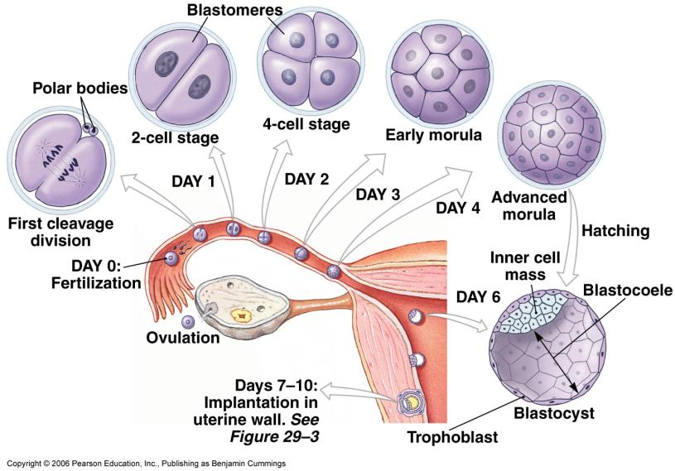
Cleavage: Zygote to Blastocyst

Slide 28
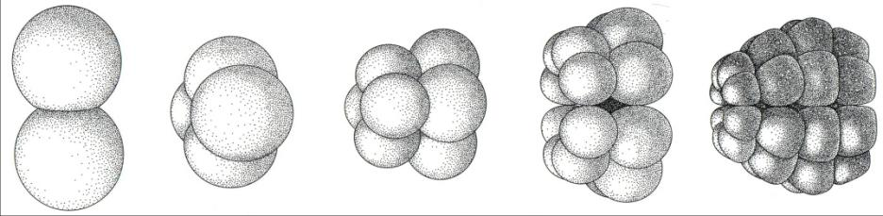
Holoblastic Cleavage
Rapid mitotic division begins
Cells gets progressively smaller
Zygote does not get larger (yet)
Morula: solid mass of cells (~32 cells)
~30 hours
4 days

Slide 29
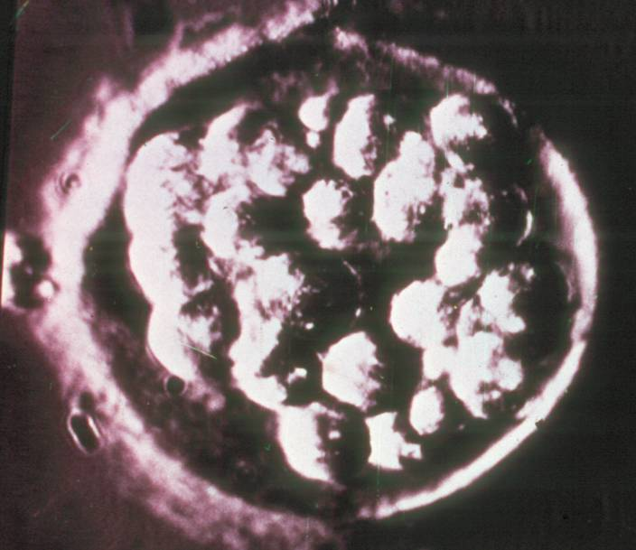
Morula

Slide 30
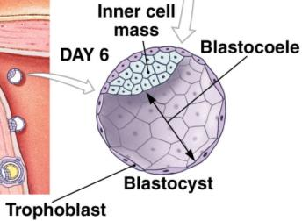
Blastocyst Formation
Cleavage continues at the morula stage
A hollow forms - Blastocoele
Cells amass as one end of the Blastocyst - Inner Cell Mass
Also called Embryoblast

Slide 31
Blastocyst Formation
Inner Cell Mass (Embryoblast)
Forms Embryo
Outer Cell Mass (Trophoblast)
Forms extra-embryonic tissues
Primarily placenta

Slide 32
Implantation
Coincident with blastulation, the zona pellucida is shed (hatching)
Hatching exposes the bare trophoblast cells to the uterine wall
The uterine wall is prepared for implantation each month under hormonal control
Trophoblast begins to thicken as it begins to implant

Slide 33
Implantation
Two layers form from the trophoblast
Cytotrophoblast - cellular layer closest to the inner cell mass (embryoblast)
Syncytiotrophoblast - cell walls break down on the side near the uterine wall and invade the uterine tissue
By day 10, the blastocyst is completely embedded

Slide 34
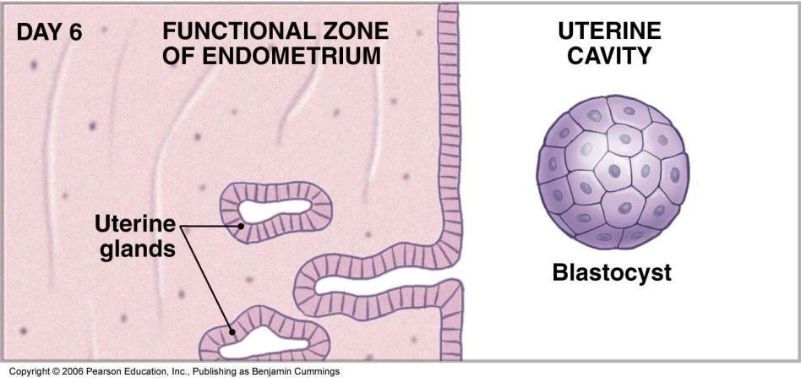

Slide 35
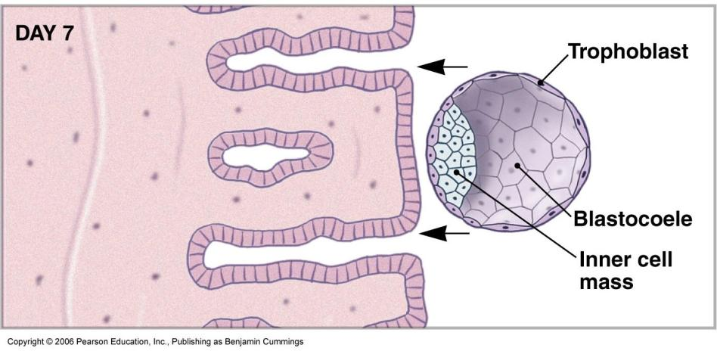

Slide 36
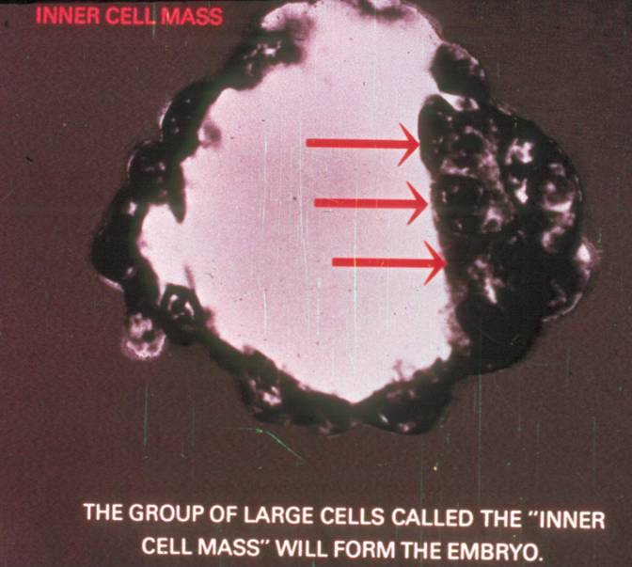

Slide 37
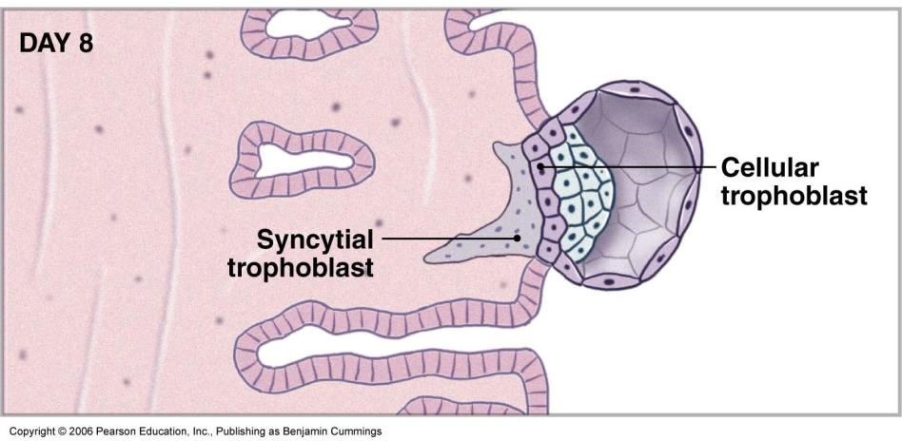

Slide 38
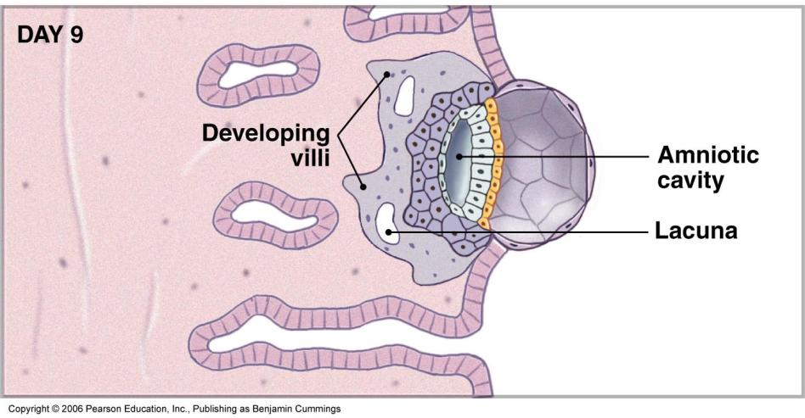

Slide 39
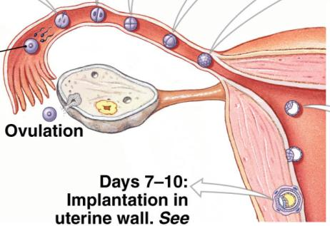
Normal and Ectopic Implantation
Normal: the endometrium of the uterus
Ectopic:
Uterine (Fallopian) tube
Cervix
Abdominal cavity
Ovary

Slide 40
Amniotic Cavity

Slide 41
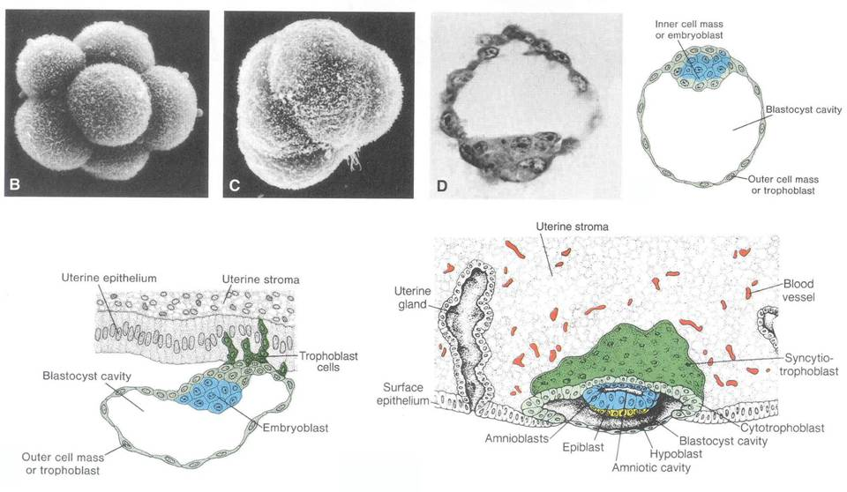

Slide 42
Amniotic Cavity Formation
Inner Cell Mass (ICM) pulls away from the Trophoblast forming a hollow Amniotic Cavity
ICM forms a flat disc with two layers - Bilaminar germ disc
Epiblast - dorsal, exposed to amniotic cavity
Hypoblast - ventral, facing the yoke sac

Slide 43
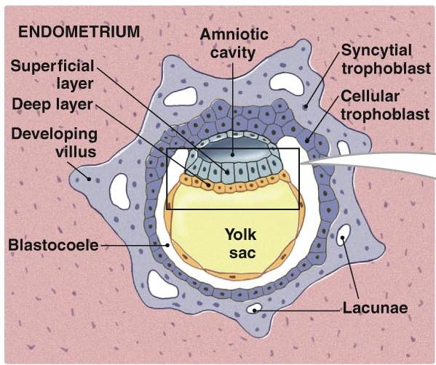
Bilaminar Germ Disc
Epiblast
Hypoblast

Slide 44
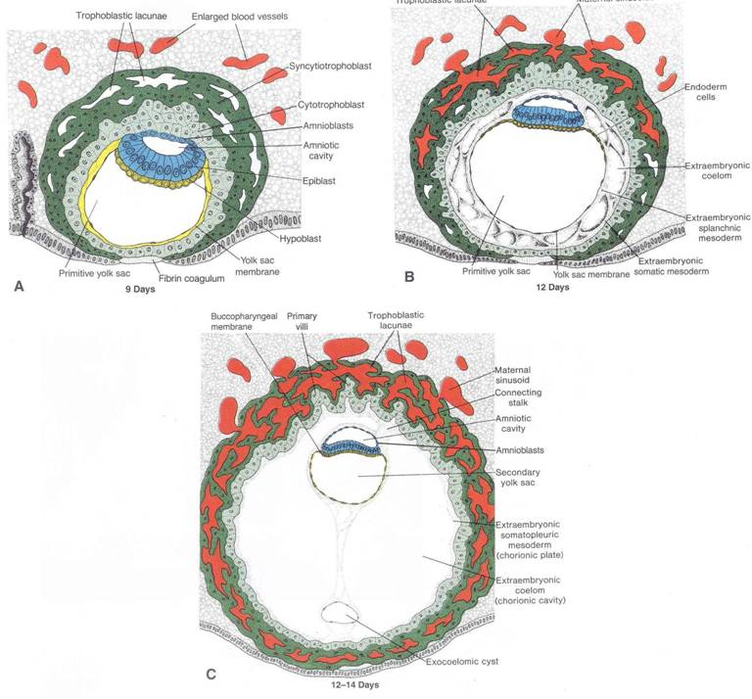

Slide 45
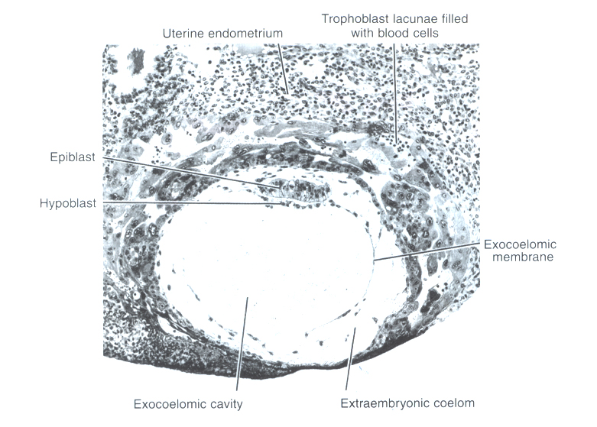

Slide 46
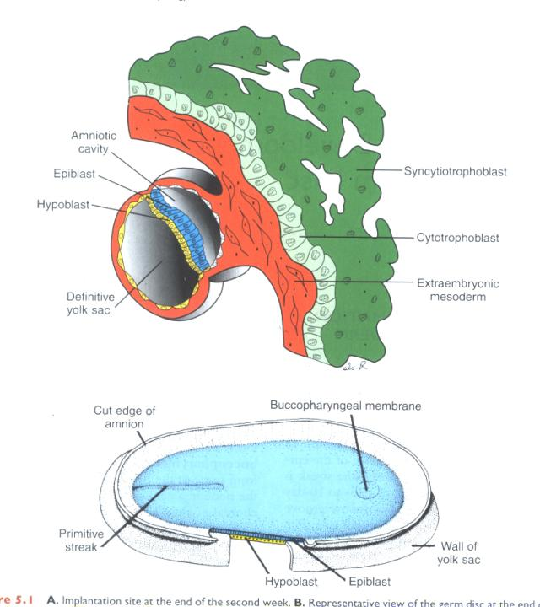

Slide 47

Anatomical Axes Defined
Dorsal
Left
Caudal
Cranial
Right
Ventral

Slide 48
Germ layers
Ectoderm
Mesoderm
Endoderm

Slide 49
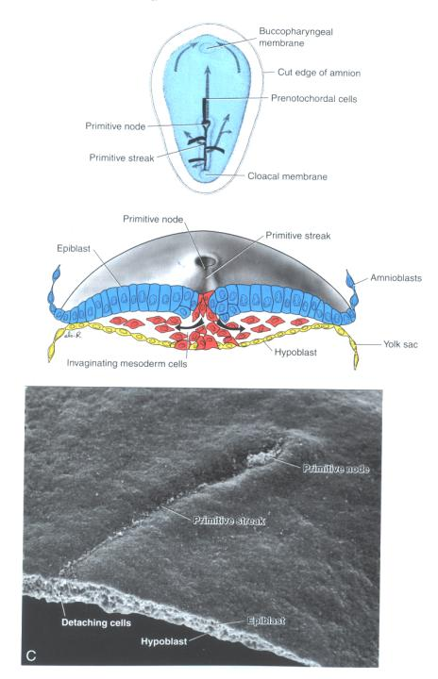

Slide 50
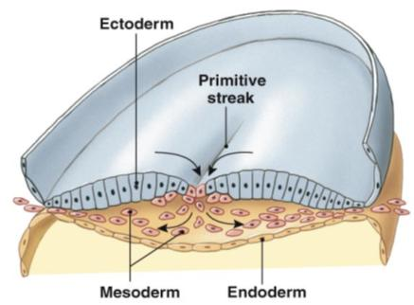
Gastrulation: Formation of Three Embryonic Layers
Epiblast cells begin to migrate medially toward the primitive streak
Then they move ventrally toward the hypoblast. The intermediate layer becomes Mesoderm.
This invagination progresses caudal to cranial
Textbook
Depiction

Slide 51
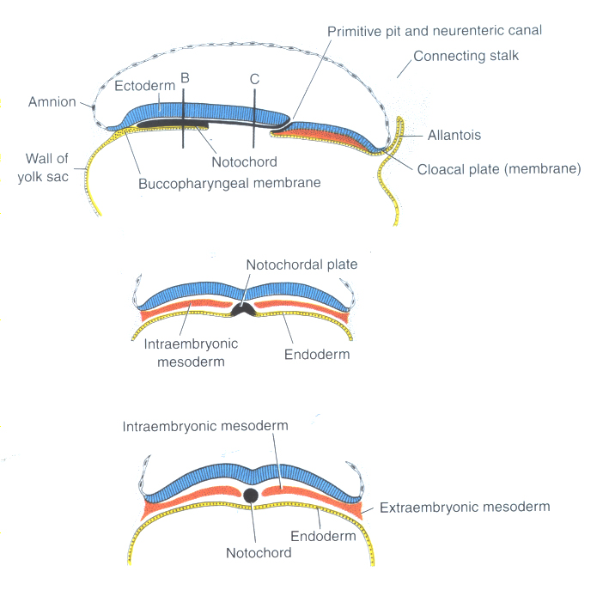

Slide 52
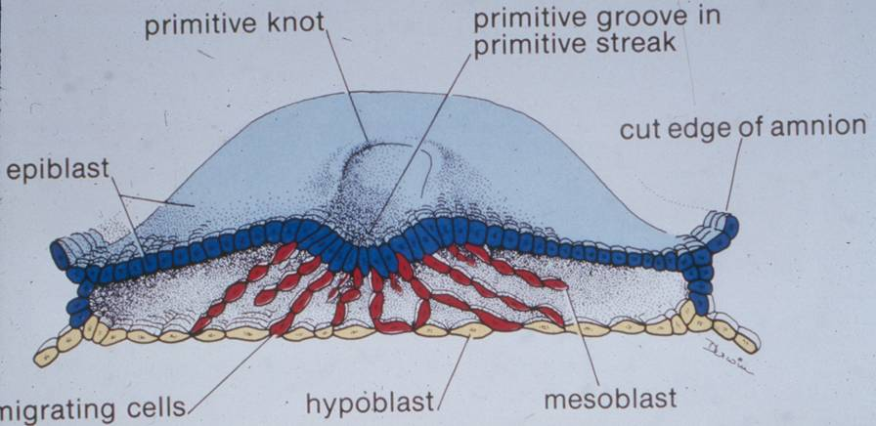

Slide 54
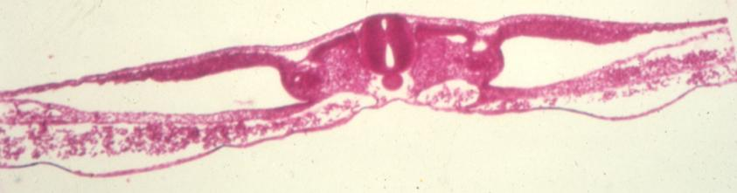
Formation of the Notochord
As mesodermal formation moves cranially, a dense aggregation of cells forms
This will form the notochord

Slide 55
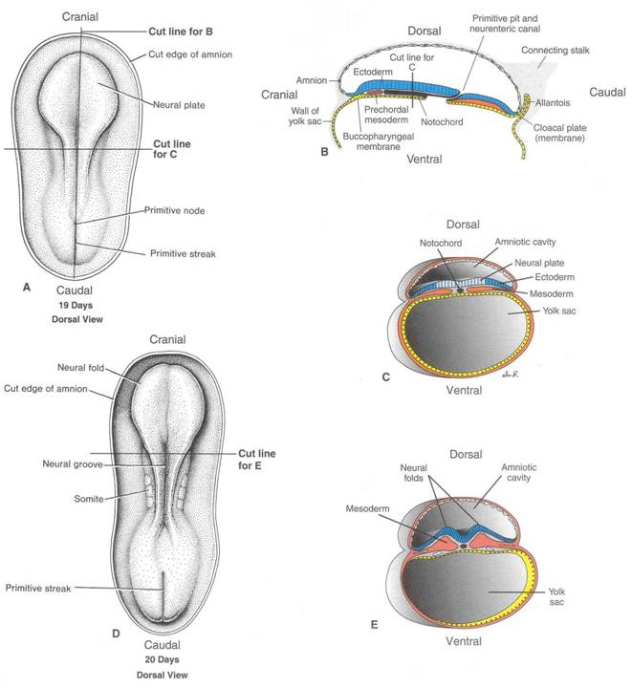

Slide 56
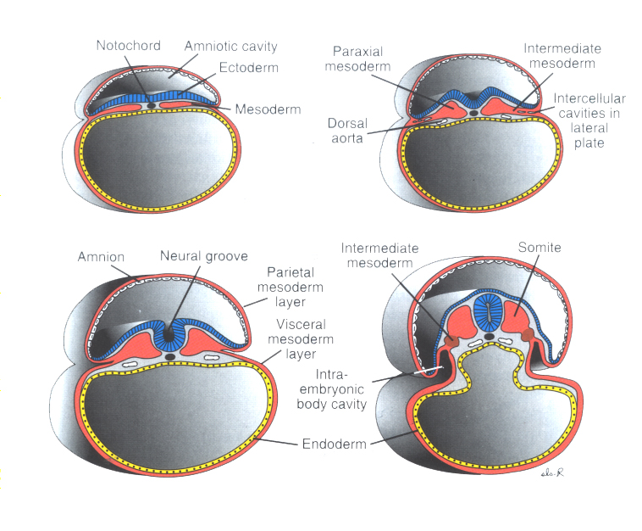

Slide 57
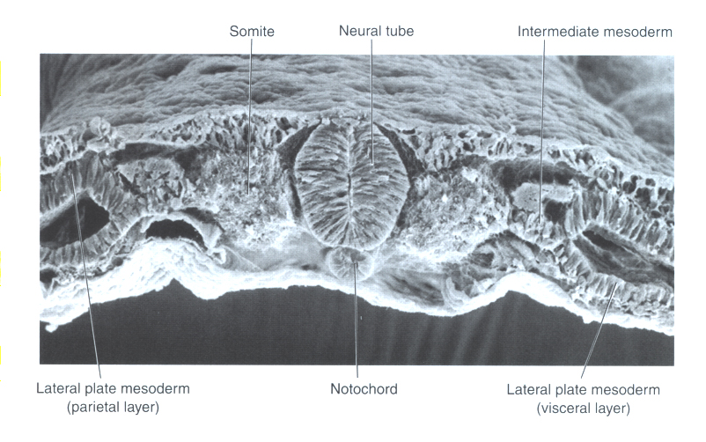

Slide 58
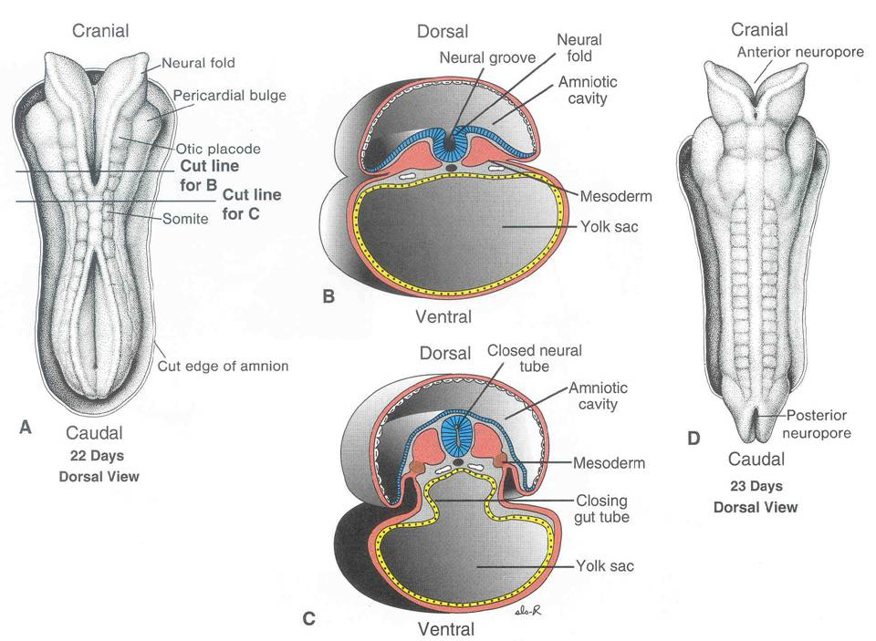

Slide 59
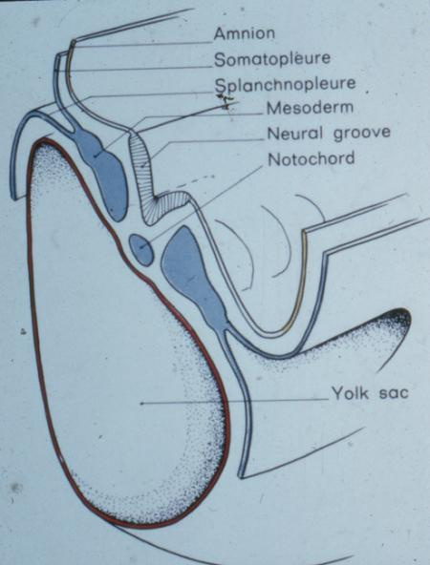
Concurrent events:
Neural folds to Neural Groove

Slide 60
Mesodermal structures
Paraxial mesoderm
Lateral mesoderm
Intermediate mesoderm
Somites
Segmental structures - how many in the head, neck, thorax, abdomen, pelvis, and in what remains of the tail. What is the total number of of segments in the body?

Slide 61
Early Development Continued:
Dorsal hollow nerve tube
Neural crest
Further differentiation of the mesoderm

Slide 62
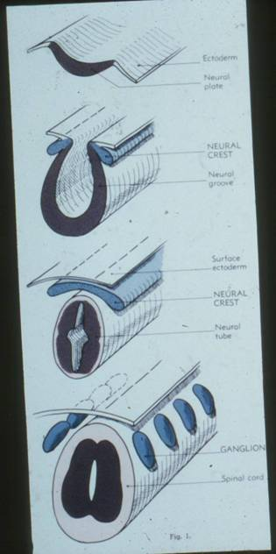
Neural Crest Development

Slide 63
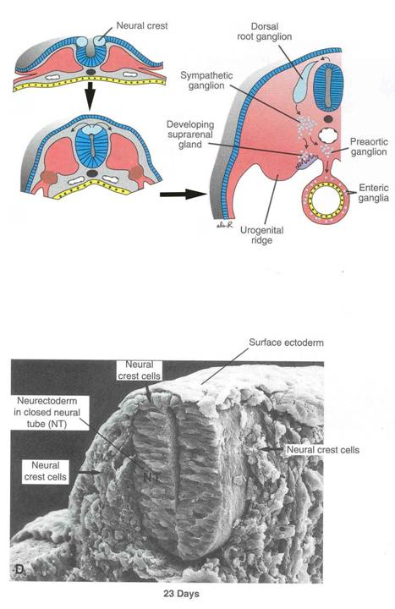

Slide 64
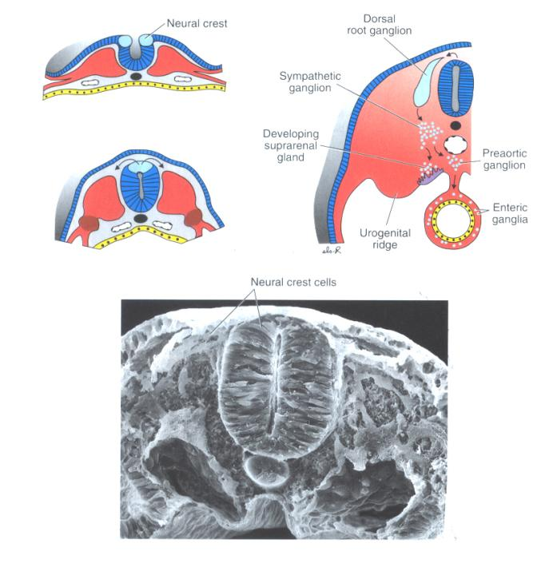

Slide 65
Structures Visible in the Basic Cross-Section of the Body (Embryo or Adult!)
Coelom
Somatopleure
Splanchnopleure
Parietal Peritoneum
Visceral Peritoneum
Dorsal mesentery
Ventral mesentery

Slide 66
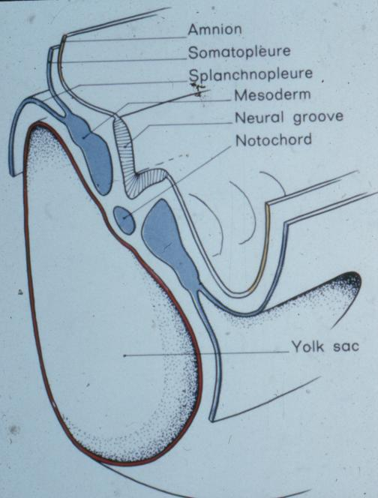

Slide 67
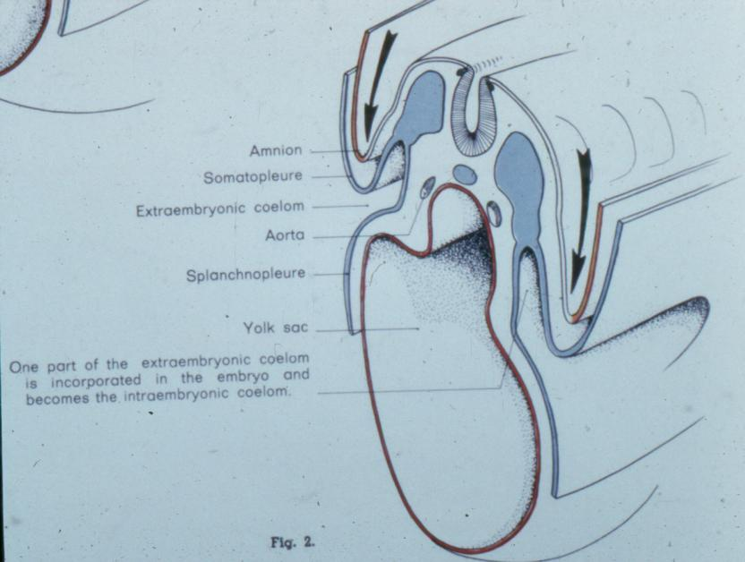

Slide 68
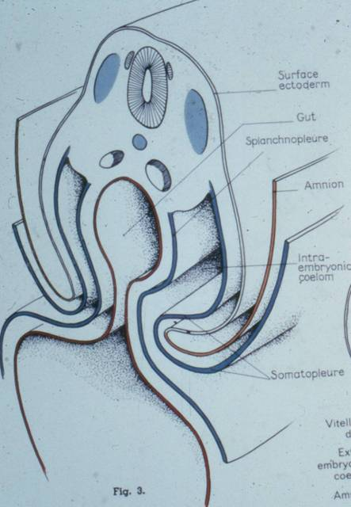

Slide 69
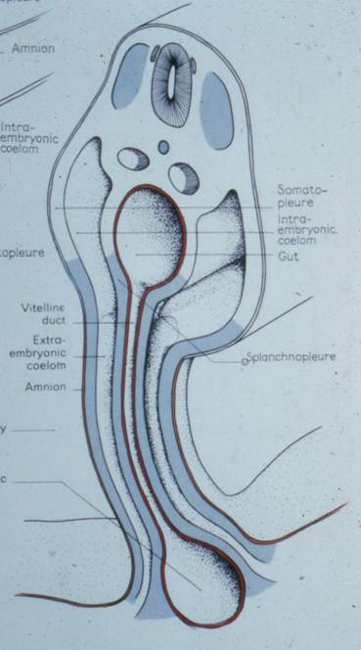

Slide 70
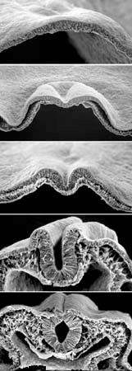
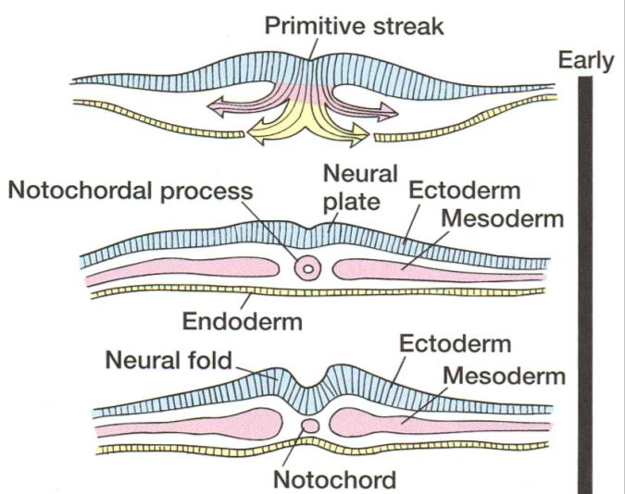

Slide 71
Ectoderm (pt. 1)
Epidermal Ectoderm
Epidermis - skin, hair follicles & hair, nails
Anterior mouth
Terminal GI system
Neural Plate Ectoderm
Central Nervous System - brain & spinal cord

Slide 72
Ectoderm (pt. 2)
Neural Crest Ectoderm
Peripheral nervous system - nerves outside CNS
Ganglia of nervous system (cranial, spinal, autonomic)
Dentine of teeth
Head skeleton
Pigment cells
Covering of the brain (meninges)

Slide 73
Mesoderm
Three divisions:
Epimere
Mesomere
Hypomere
Don’t confuse epimere with epiblast

Slide 74
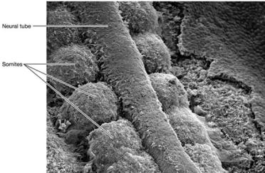
Mesoderm: Epimere
Epimere forms Somites (balls of tissue):
Dermatome - Dermis of skin
Myotome - Axial, limb, and body wall musculature
Sclerotome - Vertebral column & ribs

Slide 75
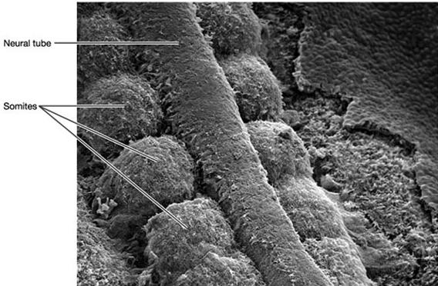

Slide 76
Mesoderm: Mesomere
Also called Intermediate Mesoderm
Forms urogenital system:
Kidneys and urogenital ducts

Slide 77
Mesoderm: Hypomere
Somatic (body) - Somatic Lateral Plate Mesoderm
Limb skeletons
Splanchnic (gut) - Splanchnic Lateral Plate Mesoderm
Heart, blood vessels
Smooth muscle of the digestive system

Slide 78
Endoderm
Divisions of the digestive tube
Mouth & pharynx
Abdominal Foregut: Stomach, liver, pancreas, beginning of small intestine.
Abdominal Midgut: most of small intestine, beginning of large intestine.
Abdominal Hindgut: Terminal intestines, urinary bladder

Slide 79
Trans-segmental structures versus
Segmental structures

Slide 80
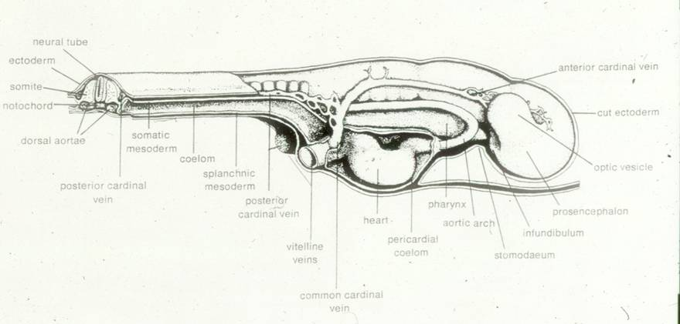

Slide 81
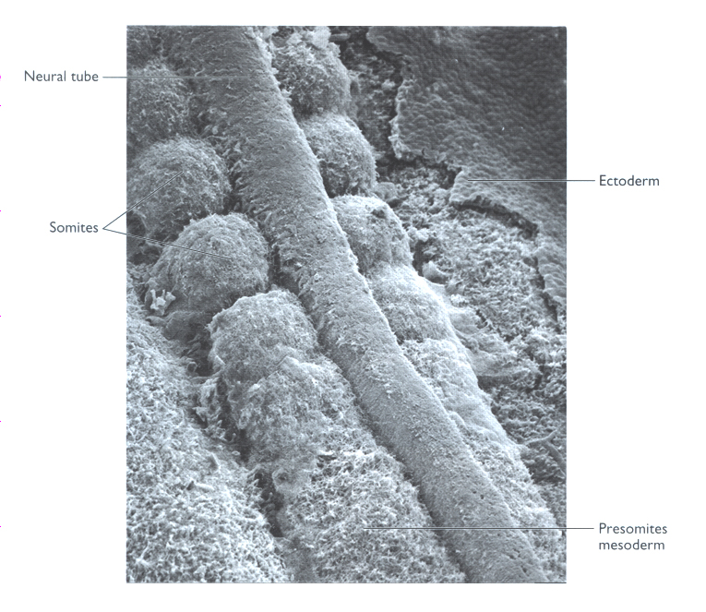

Slide 82
A few words about Segmentation
Humans are segmented animals
Vertebrae, ribs, body wall musculature
Segmentation is most obvious in Mesoderm derivatives
Somites → Dermatome, Myotome, Sclerotome

Slide 83

Segmented Dermatome

Slide 84

Segmented Sclerotome

Slide 85

Segmented Myotome

Slide 86
Gill slits / Gill pouches

Slide 87
Further endodermal development:
Lateral folds
Oropharyngeal membrane
Embryonic foregut
Embryonic hindgut

Slide 88


Slide 89


Slide 90


Slide 91


Slide 92

Outer tube vs. Inner tube
Somatic vs. Visceral
Soma
Viscera
Coelom
Gut

Slide 94
Dorsal
Ventral

Slide 95


Slide 96
Dorsal
Ventral

Slide 97


Slide 98
Dorsal
Ventral

Slide 99


Slide 100
Dorsal
Ventral

Slide 101


Slide 102
Ventral
Dorsal

