Slide 1
Biology 323
Human Anatomy for Biology Majors
Lecture 12
Dr. Stuart S. Sumida
Respiratory System: Development, Structure, Mechanics

Slide 2
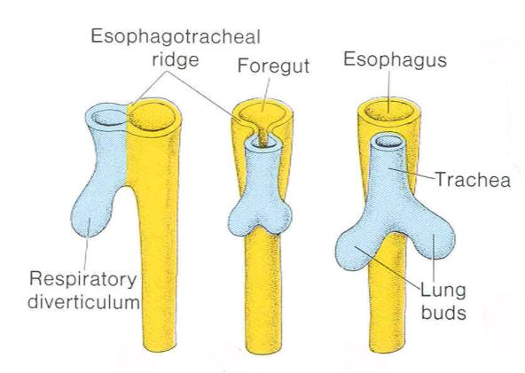
Trachea is a tubular outgrowth of the embryonic gut.
Begins as a bud in pharynx floor.
Each fork is called a primary bronchus.

Slide 3
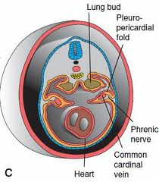
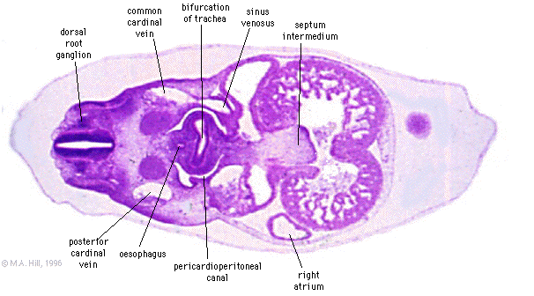

Slide 4
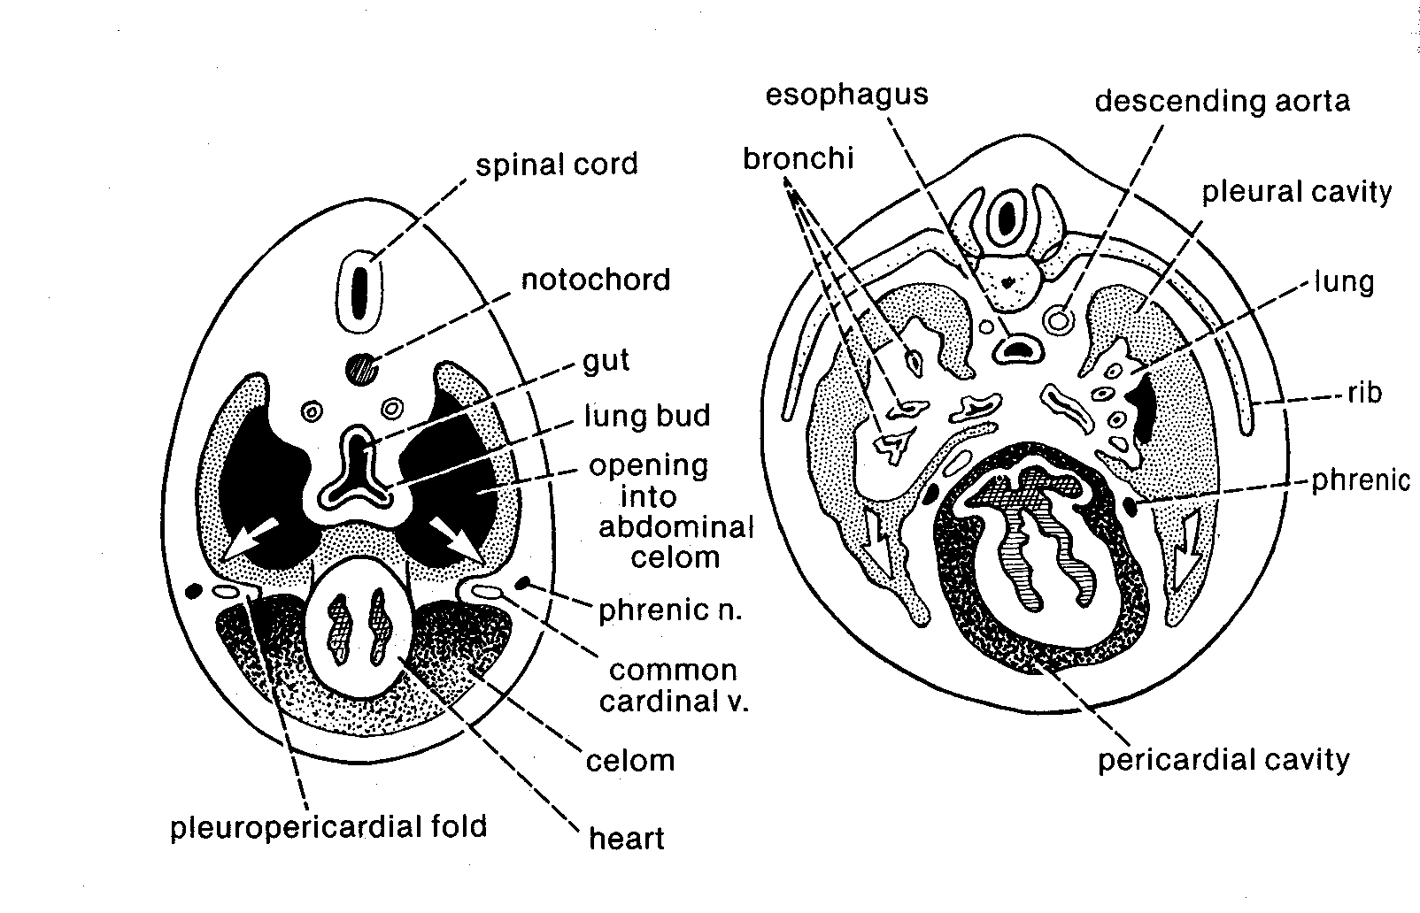

Slide 5
GERM LAYER DERIVATIONS
As outgrowths of pharynx, lung lining is derived from endoderm.
Cartilagenous support of bronchi is derived from visceral arch skeleton. Therefore, from NEURAL CREST.

Slide 6
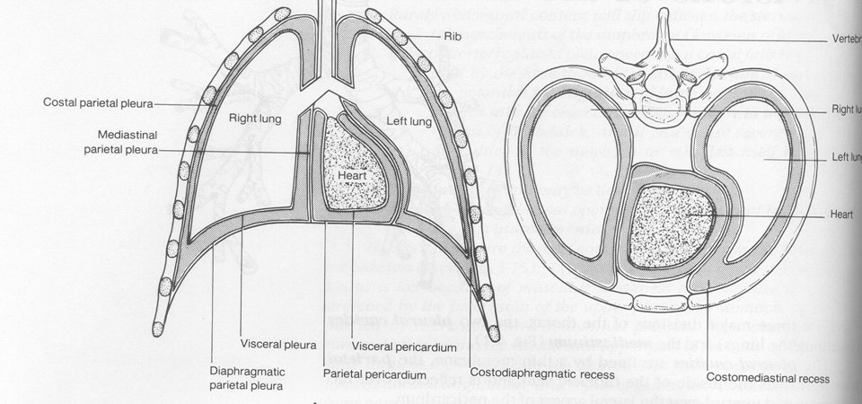

Slide 7
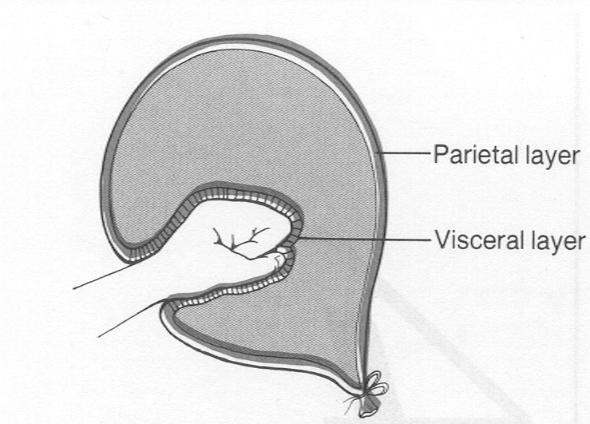

Slide 8
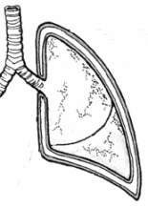

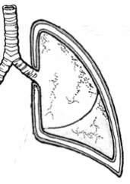

Parietal pleura lines the structures which surround the pleural sacs.
Each part of the parietal pleura is named for its association
costal
- lies against ribs
diaphragmatic
- lies against diaphragm.
mediastinal
- lies against mediastinum
cervical
- lies against root of neck

Slide 9
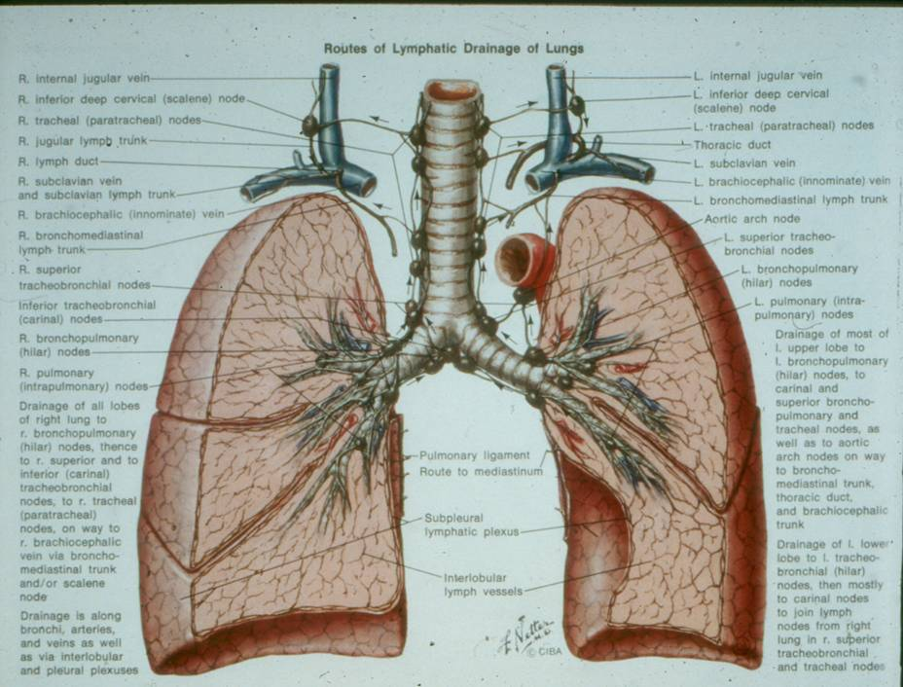

Slide 10
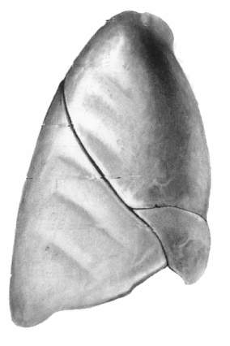
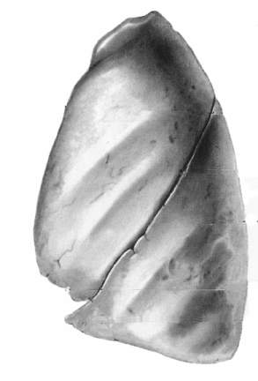
Each lung has rounded (blunt) posterior and sharp anterior margins
Each lung has a base and apex.
right lung
apex
left lung
anterior margins
posterior margin
posterior margin
base

Slide 11
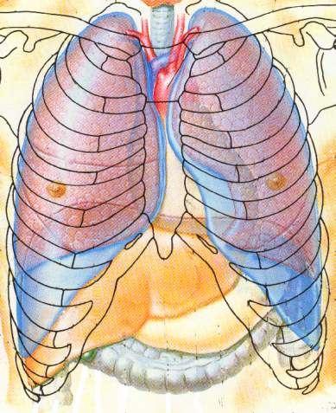
The oblique fissure crosses the 5th interspace and ends at 6th costochondral junction
Note positions of clavicles and ribs relative to lungs.

Slide 12
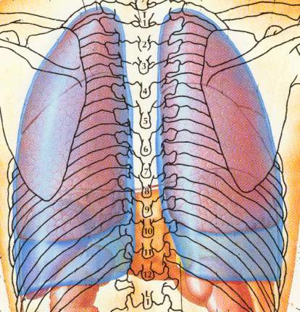
The horizontal fissure begins posterolaterally at the oblique fissure and passes deep to the 5th rib.
Note positions of scapulae and costal recess relative to lungs.

Slide 13
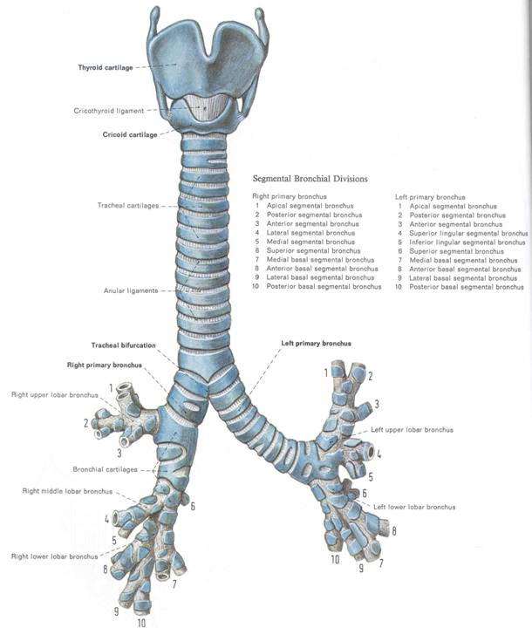

Slide 14
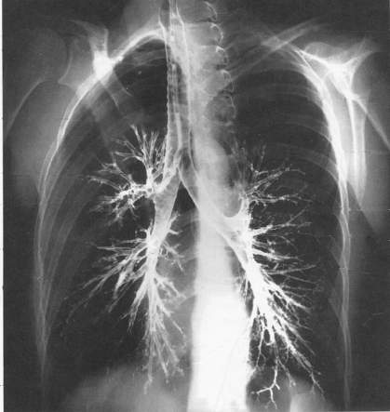
The bronchial tree can be visualized on x-ray by allowing a constrast medium to spread along the bronchial walls

Slide 15
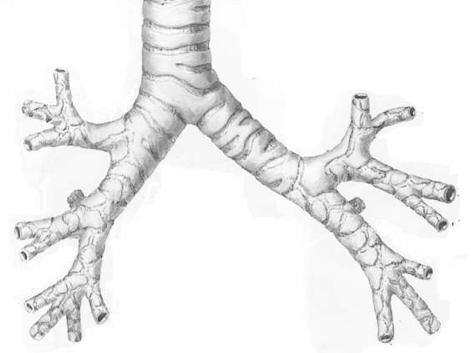
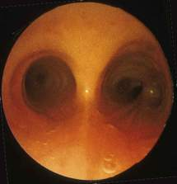
The trachea bifurcates into main bronchi at about the level of T4
A midline upward-projecting cartilage (carina) is a good endoscopic landmark
carina

Slide 16
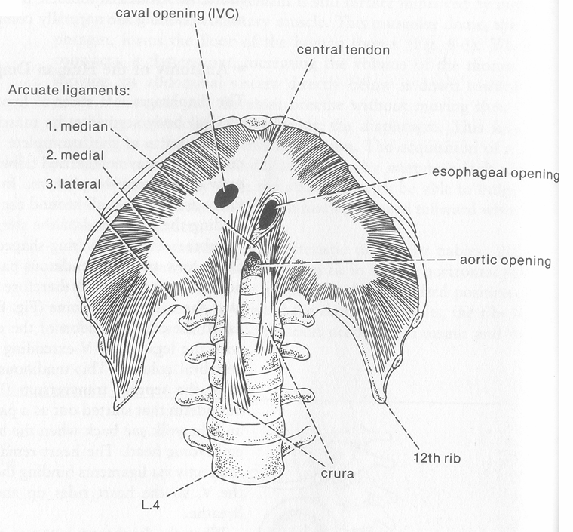

Slide 17
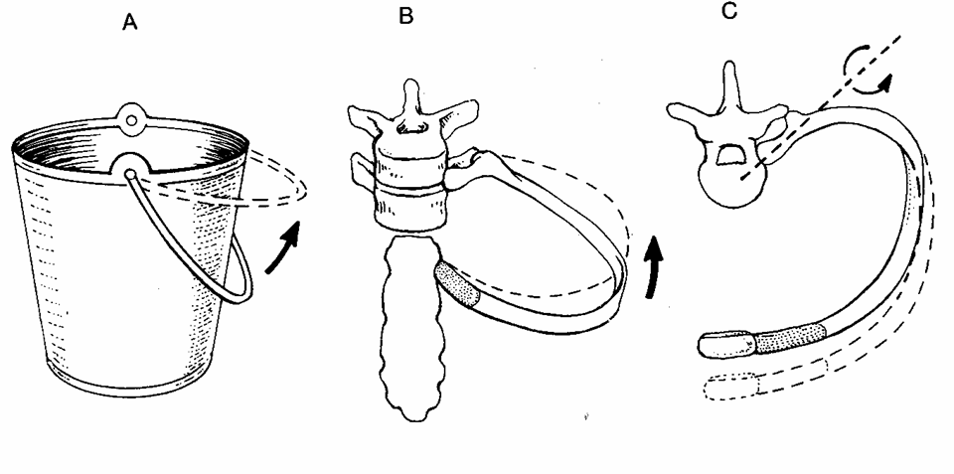

Slide 18
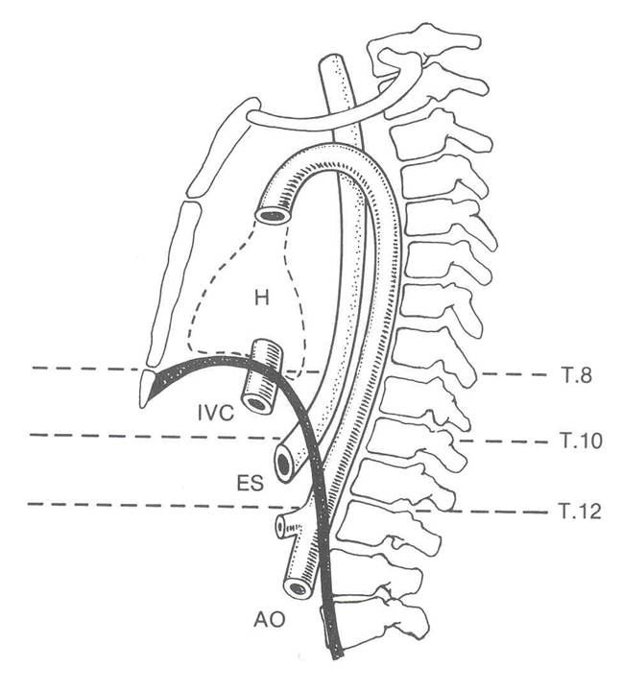

Slide 19
INNERVATION OF THE LUNG:
Sympathetic: from sympathetic levels T1-6 with synapse between preganglionic and postganglionic neurons in paravertebral ganglia T2-5; dilation of bronchi and blood vessels.
Parasympathetic: Vagus Nerve (X); constriction of bronchi and blood vessels.

Slide 20
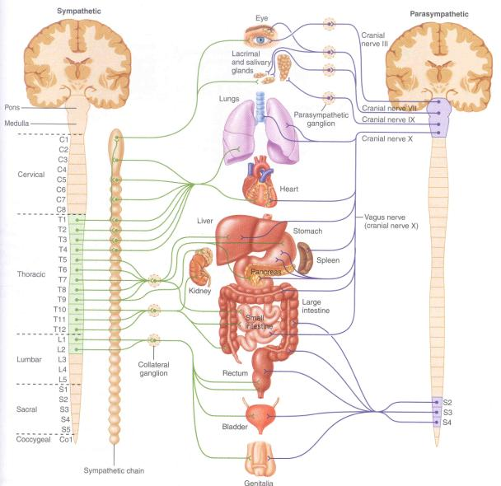
AUTONOMIC FIBER PLACEMENT:
Sympathetic – “Thoracolumbar” (T1-L2)
Parasympathetic = “Cranio-sacral” (Cnn III, VII, IX, X; S2-4

Slide 21
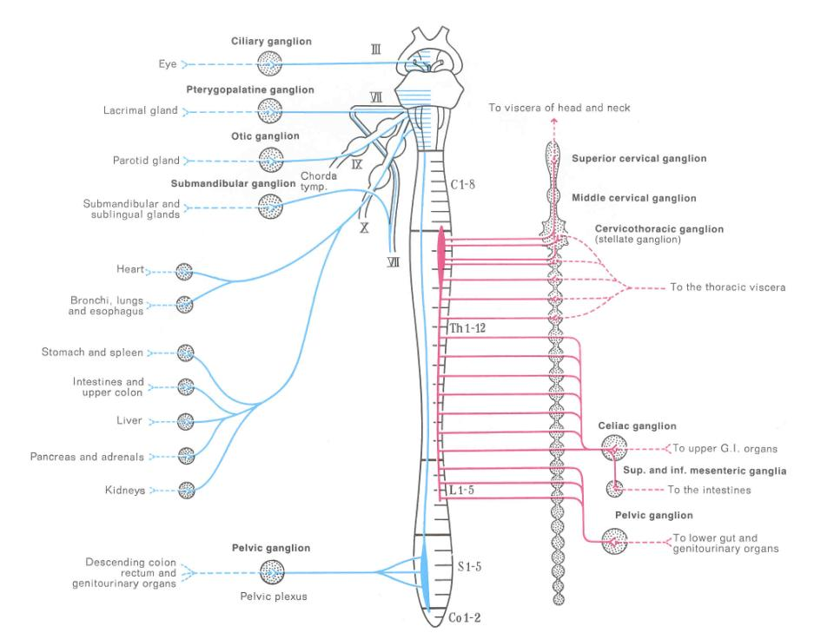

Slide 22
