Slide 1
Biology 323
Human Anatomy for Biology Majors
Lecture 13
Dr. Stuart S. Sumida
Gut Tube: Development, Structure, Function

Slide 2
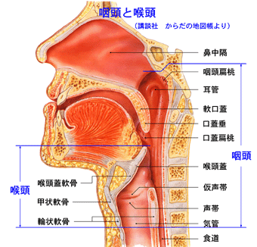

Slide 3
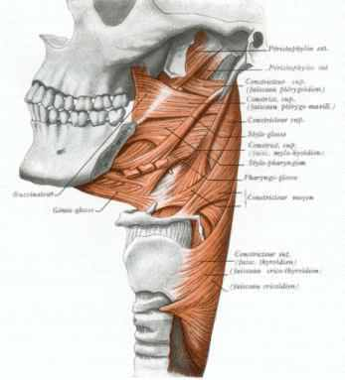

Slide 4
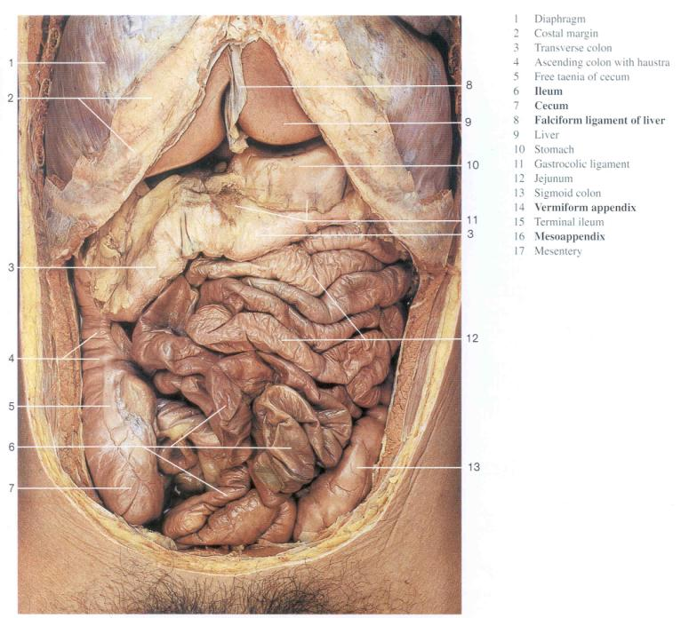

Slide 5
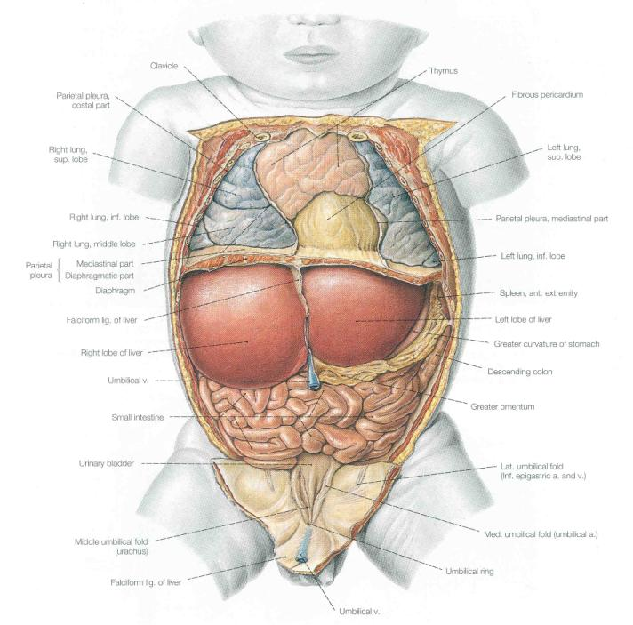

Slide 6
1. Implications of Gut Development
Foregut Development
Midgut Development
Hindgut Development
2. Circulation – Part I

Slide 7
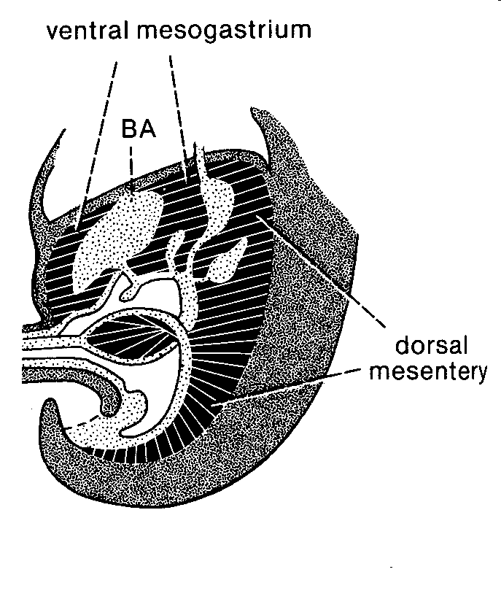
Dorsal vs. Ventral Mesentery Components

Slide 8
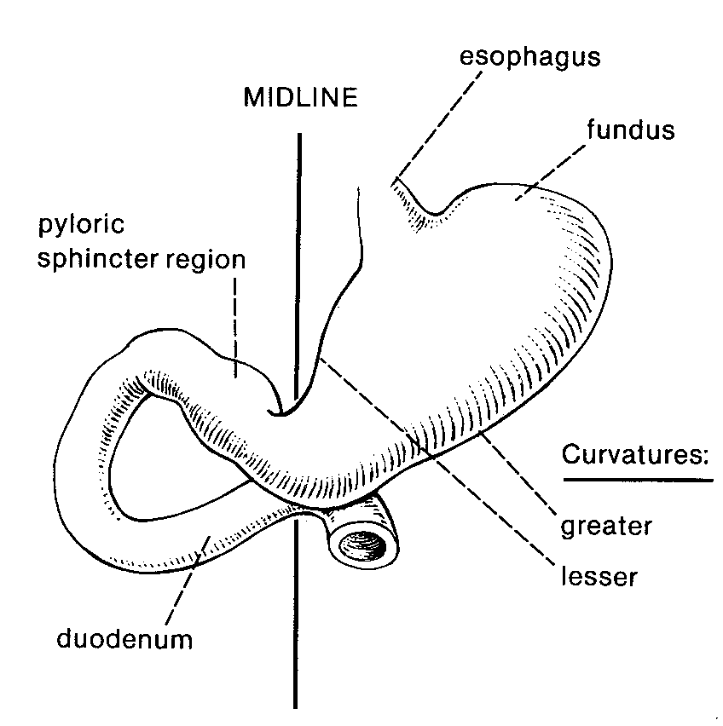

Slide 9
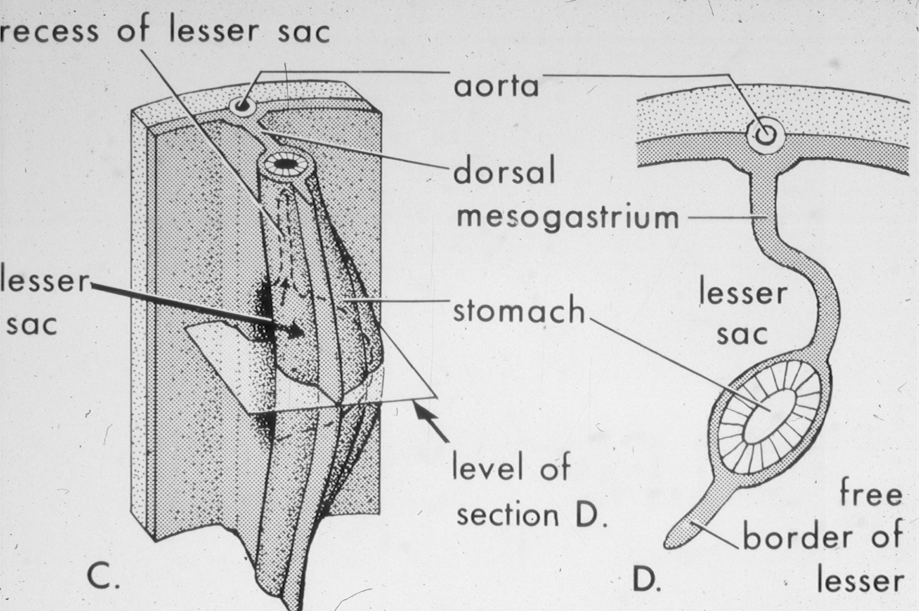
Early Development of the Stomach

Slide 10
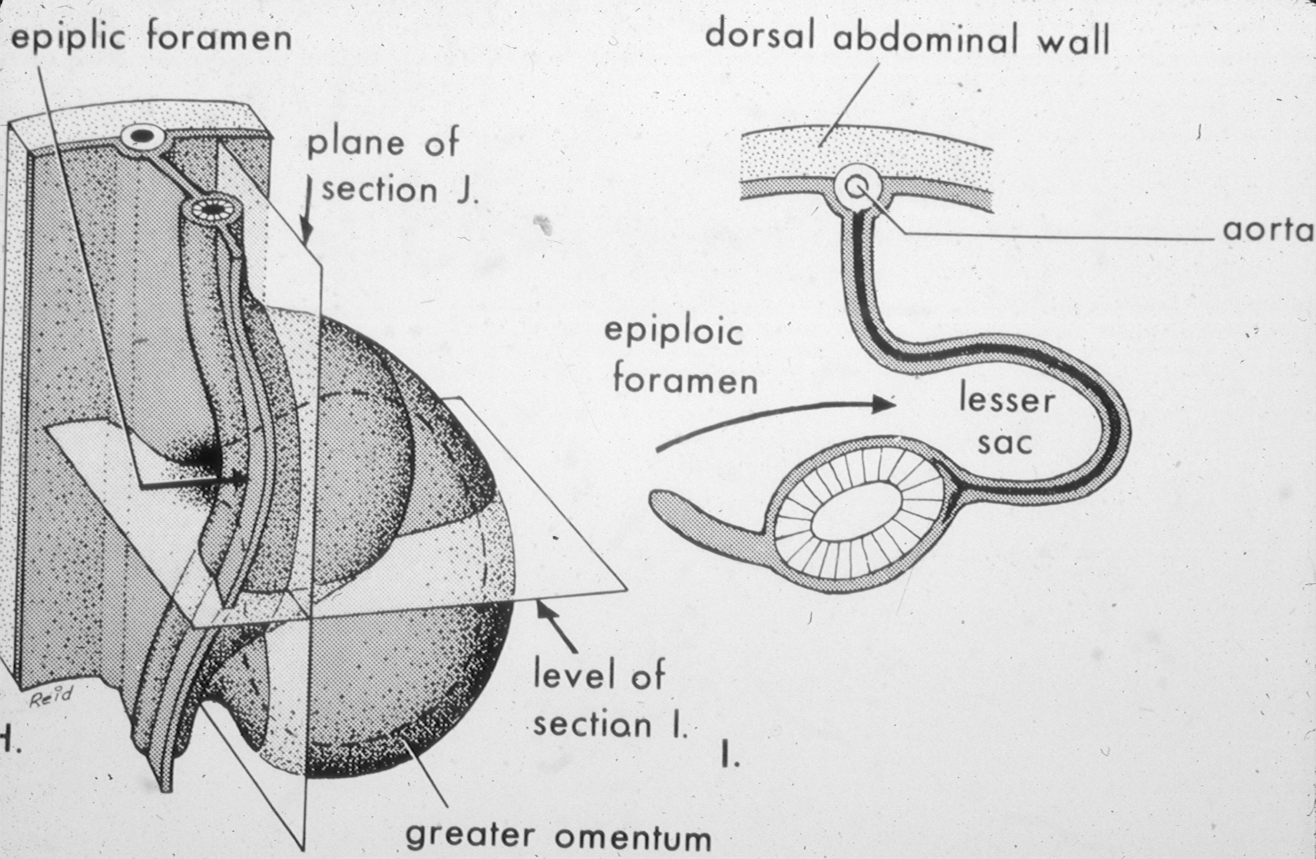
Continued Development of the Stomach

Slide 11
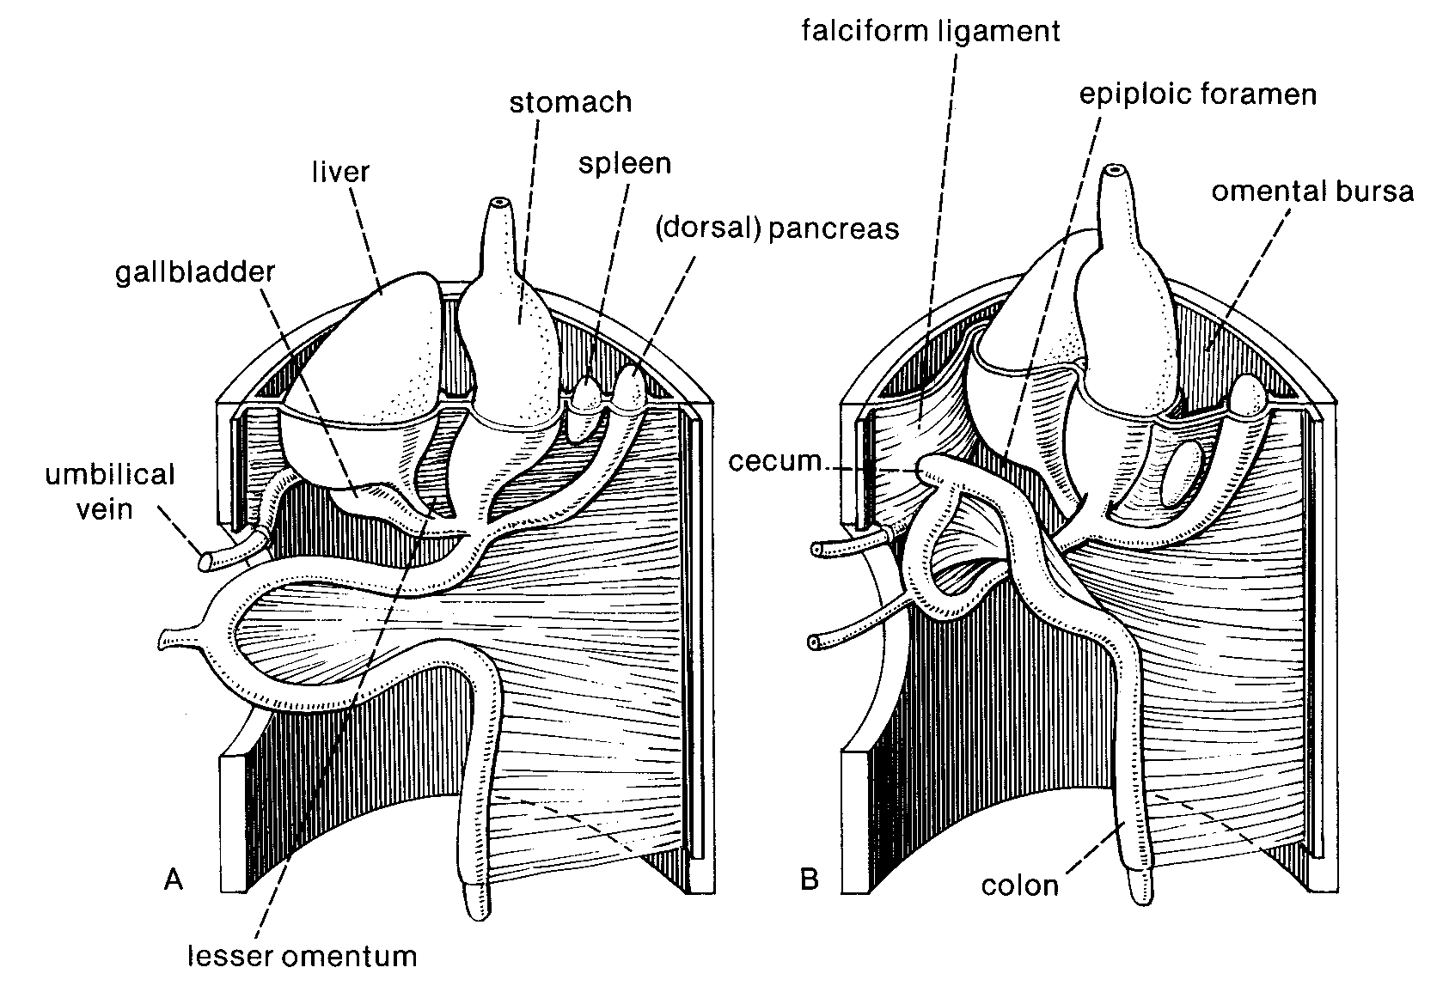
Rotation of the Foregut

Slide 12
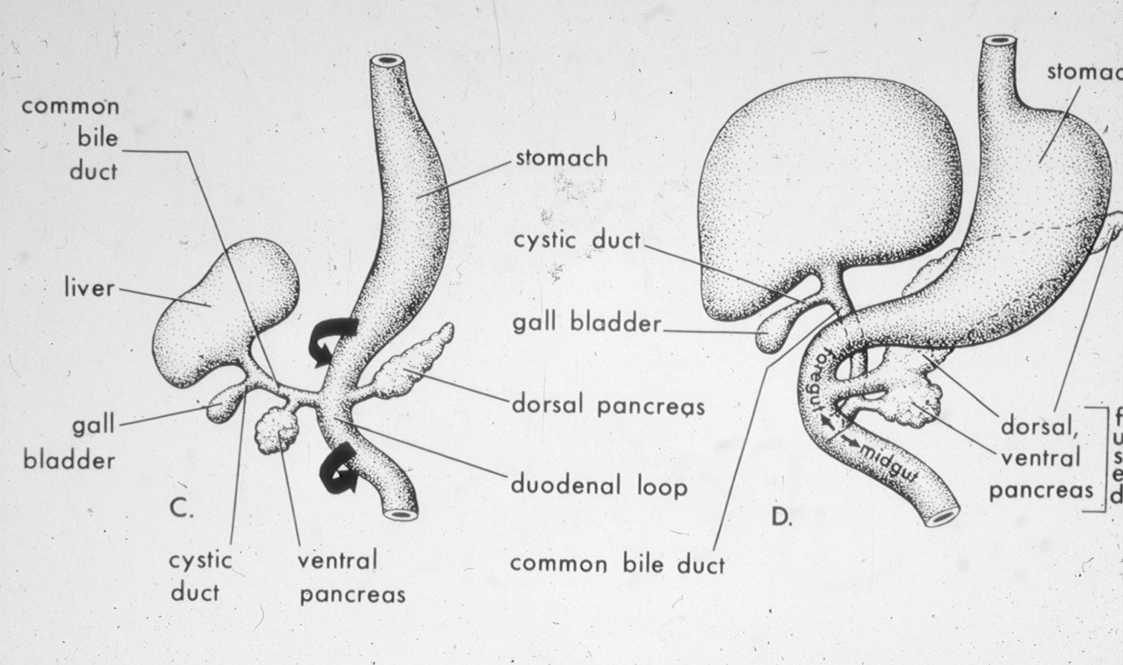
Development of diverticula of the foregut

Slide 13
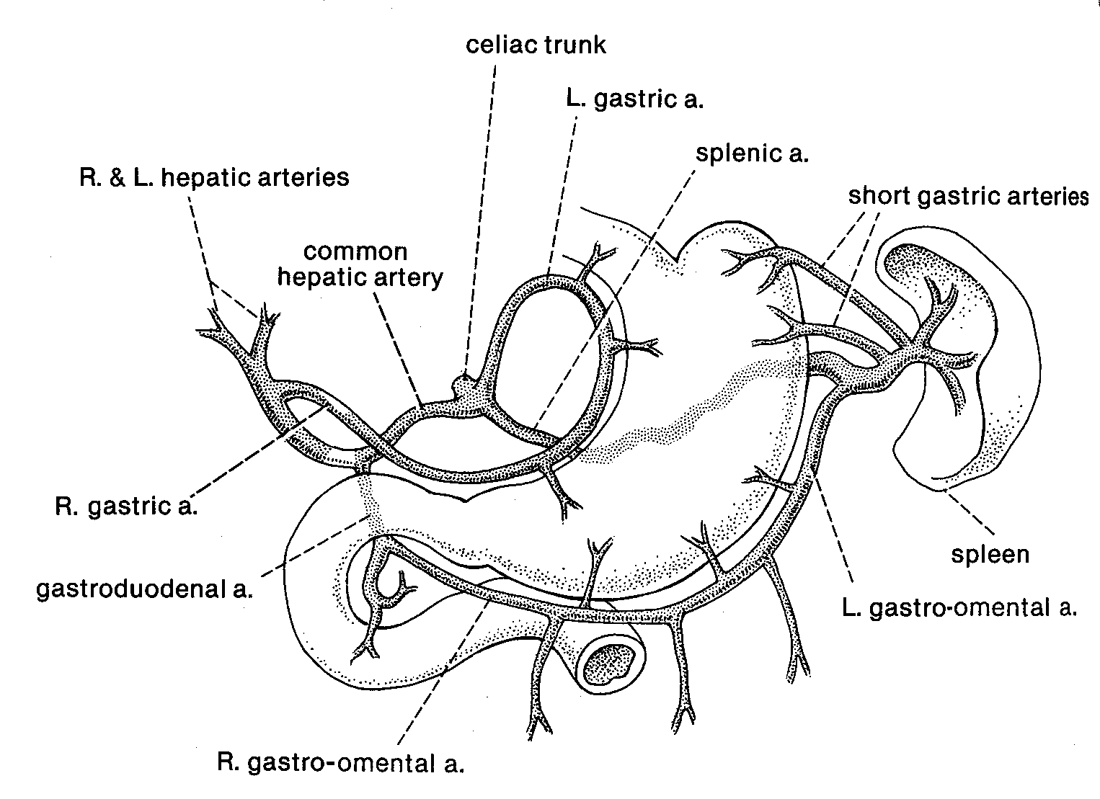

Slide 14
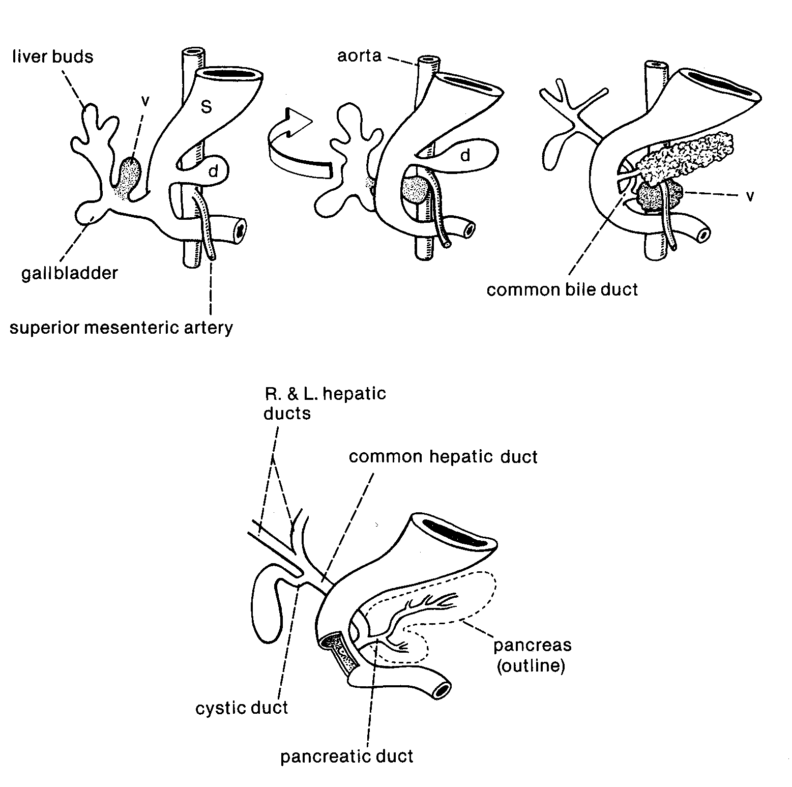
Pancreas
Development

Slide 15
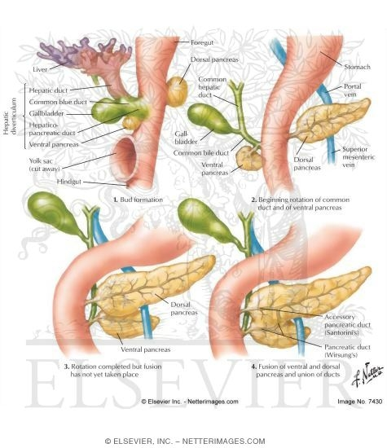
Development of Diverticula of Foregut
Hepatic Diverticulum
Pancreas originally two separate lobes (ventral part of hepatic diverticulum, dorsal independent.
Rotation brings dorsal (tail) and ventral components of pancreas together.

Slide 16
Development of Diverticula of Foregut
Hepatic Diverticulum
Pancreas originally two separate lobes (ventral part of hepatic diverticulum, dorsal independent.
Rotation brings dorsal (tail) and ventral components of pancreas together.

Slide 17
Development of Diverticula of Foregut
Hepatic Diverticulum
Pancreas originally two separate lobes (ventral part of hepatic diverticulum, dorsal independent.
Rotation brings dorsal (tail) and ventral components of pancreas together.

Slide 18
Development of Diverticula of Foregut
Hepatic Diverticulum
Pancreas originally two separate lobes (ventral part of hepatic diverticulum, dorsal independent.
Rotation brings dorsal (tail) and ventral components of pancreas together.

Slide 19
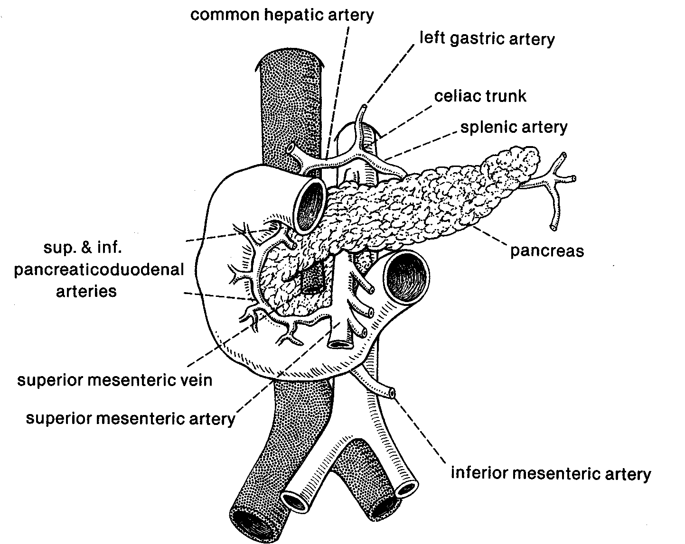

Slide 21
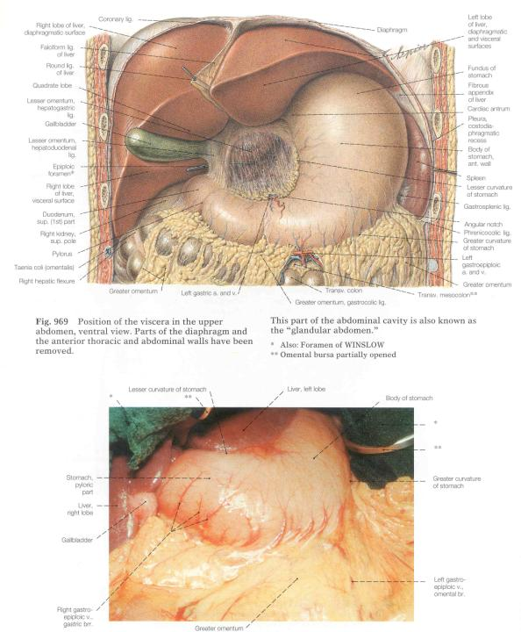

Slide 22
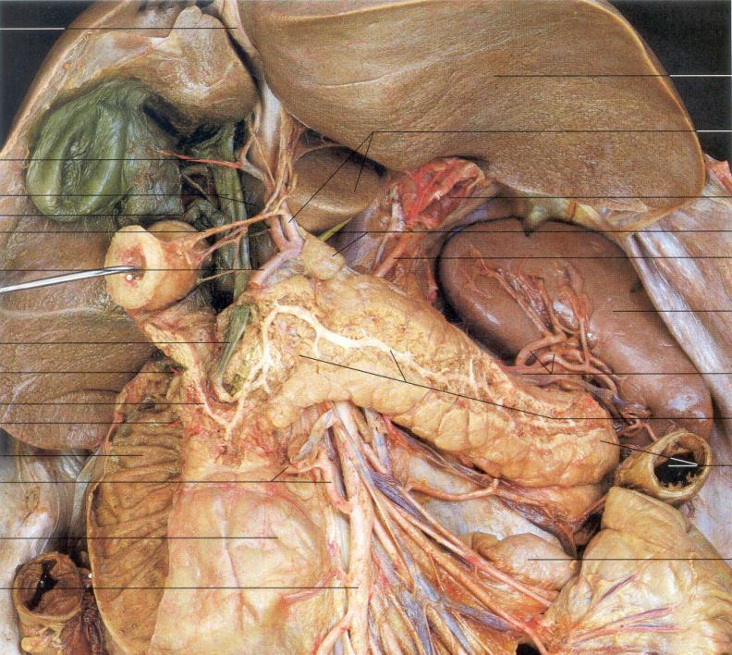
Hepatic
Portal Vein
Bile Duct

Slide 23
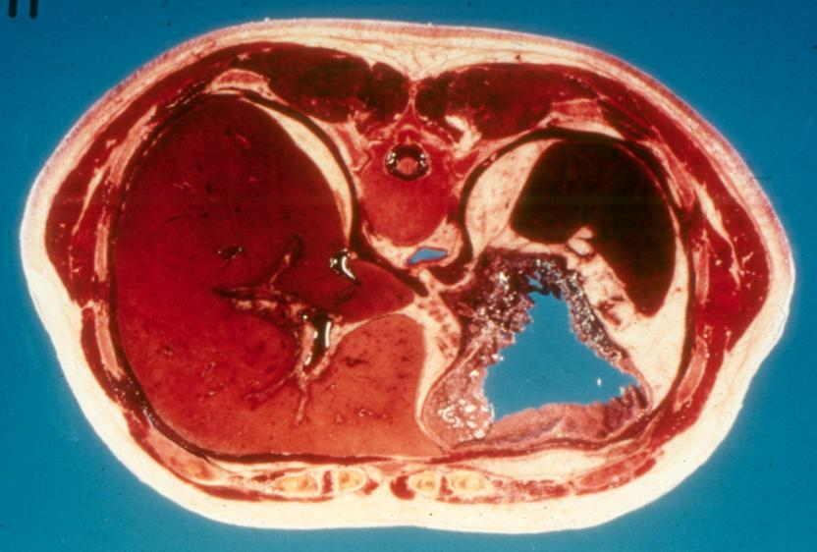
Liver Stomach

Slide 24
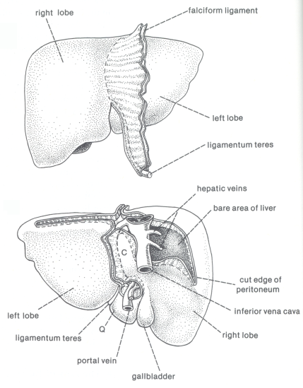
Liver:
Dorsal
View
Ventral
View
Ligamentum teres
(= old ductus venosus)

Slide 25
Foregut - Neurovascular Service:
Unpaired Branch of Abdominal Aorta: Celiac Artery
Unpaired Tributary of Hepatic Portal Vein: Splenic Vein
Sympathetic Nerve: Greater Splanchnic Nerve
Sympathetic Nerve Segmental Levels: T5-9
Sympathetic Ganglion: Celiac Ganglion
Parasympathetic Nerve: Vagus Nerve (CN – X)

Slide 26
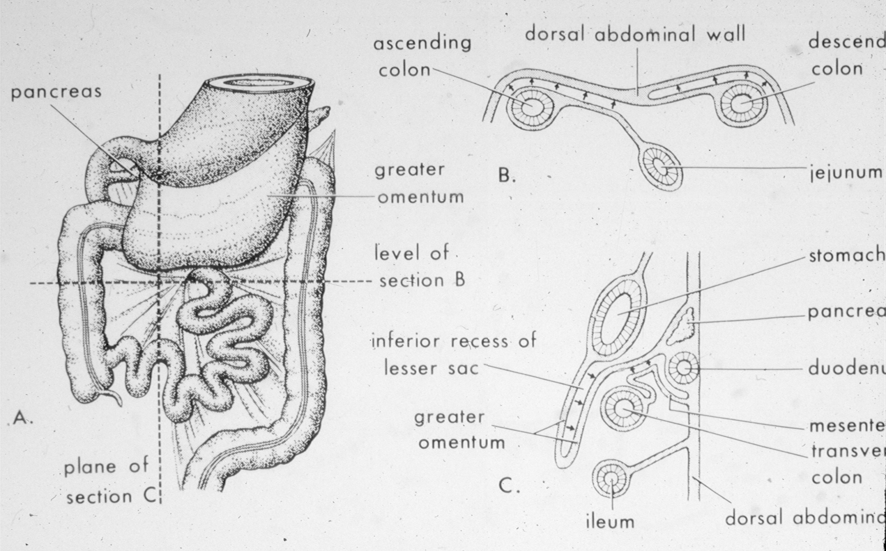

Slide 27
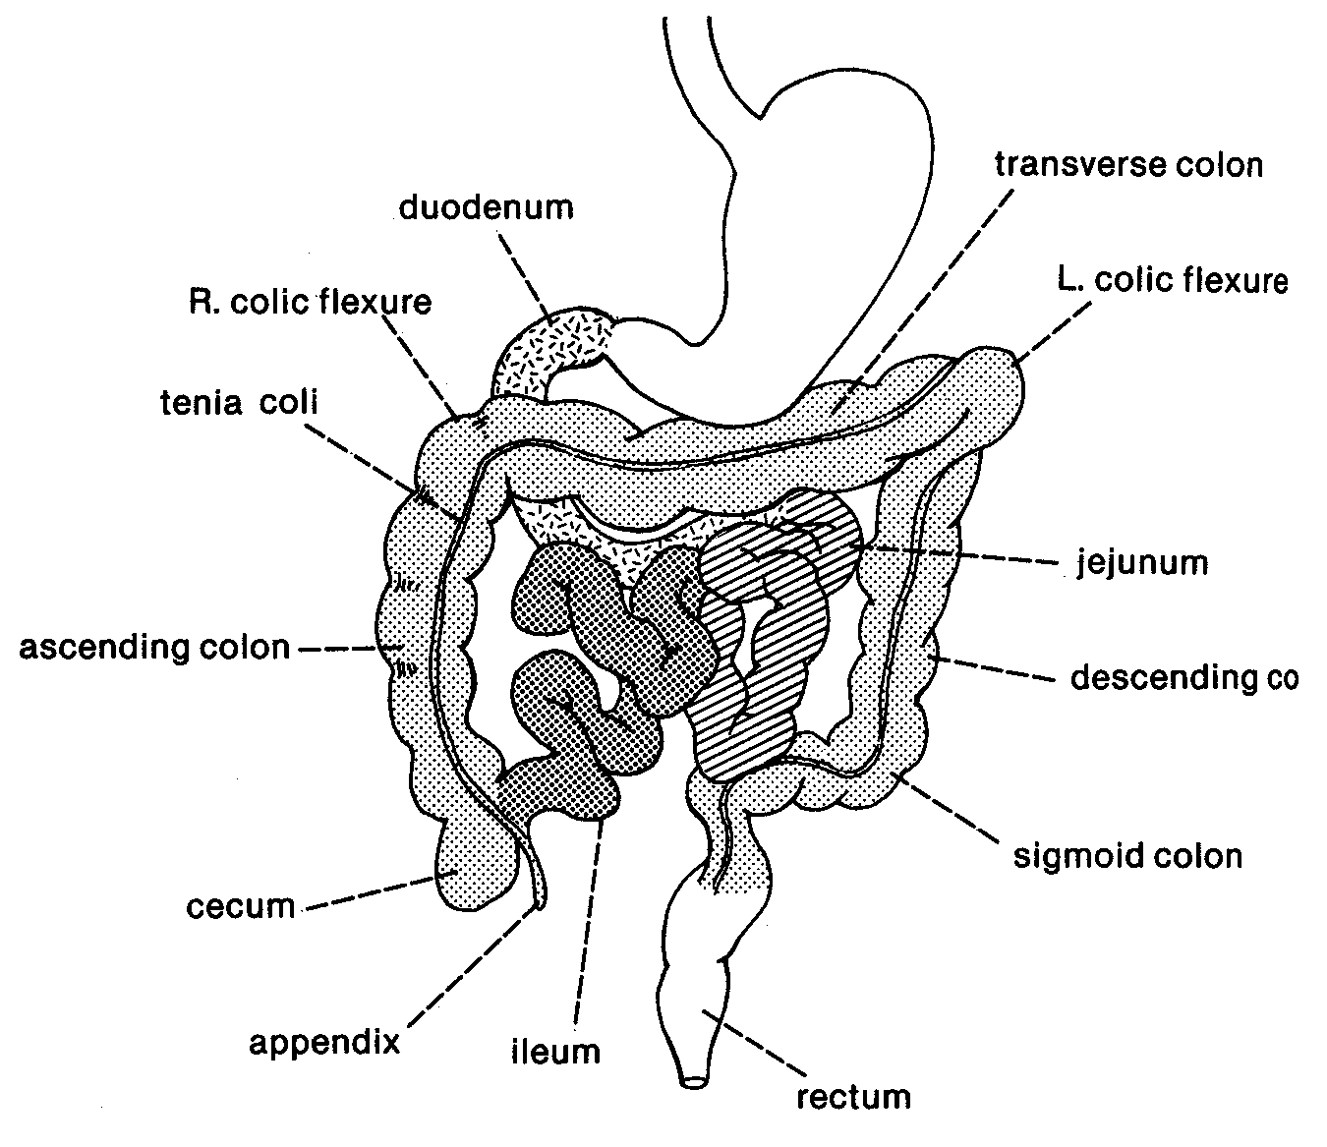

Slide 29
1. Implications of Gut Development
Foregut Development
Midgut Development
Hindgut Development
2. Circulation – Part I

Slide 30
Dorsal vs. Ventral Mesentery Components

Slide 31
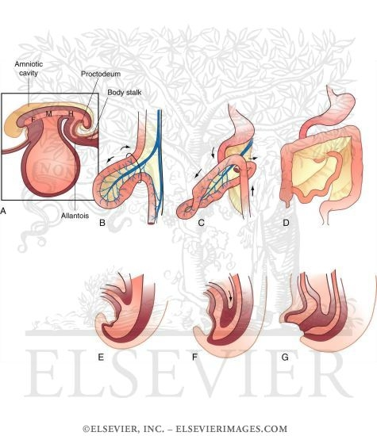

Slide 32
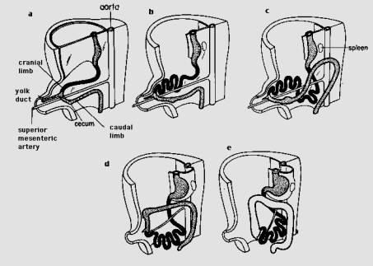
“Repackaging” of the Midgut

Slide 33
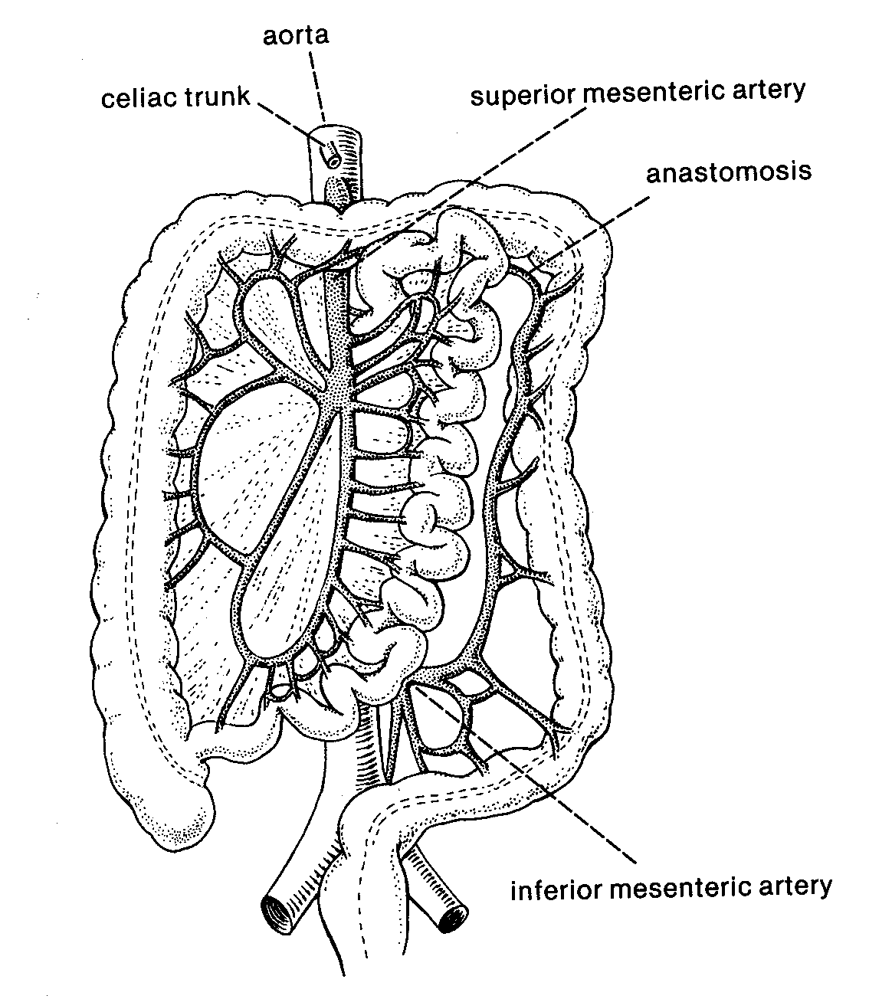

Slide 35
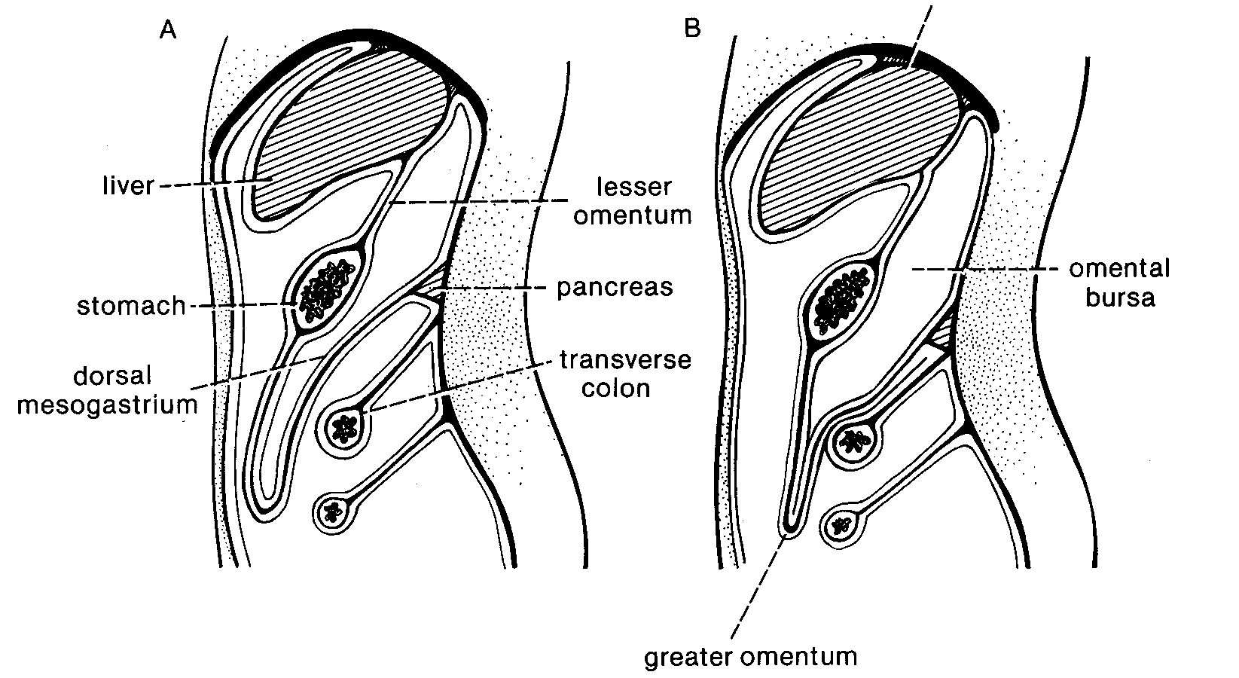

Slide 36
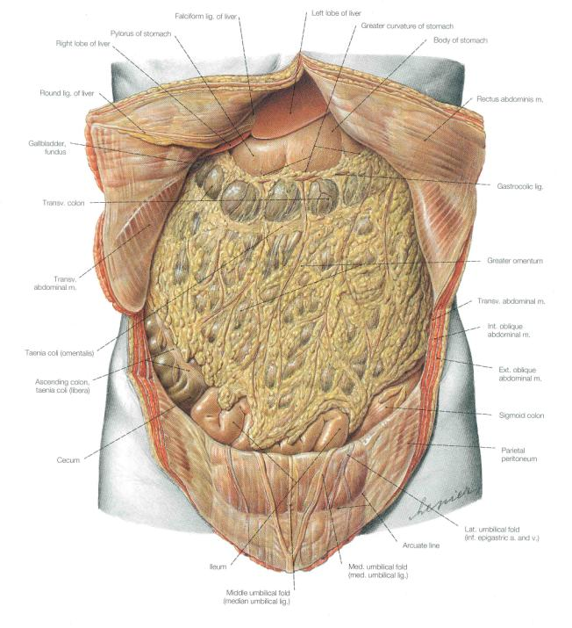

Slide 37
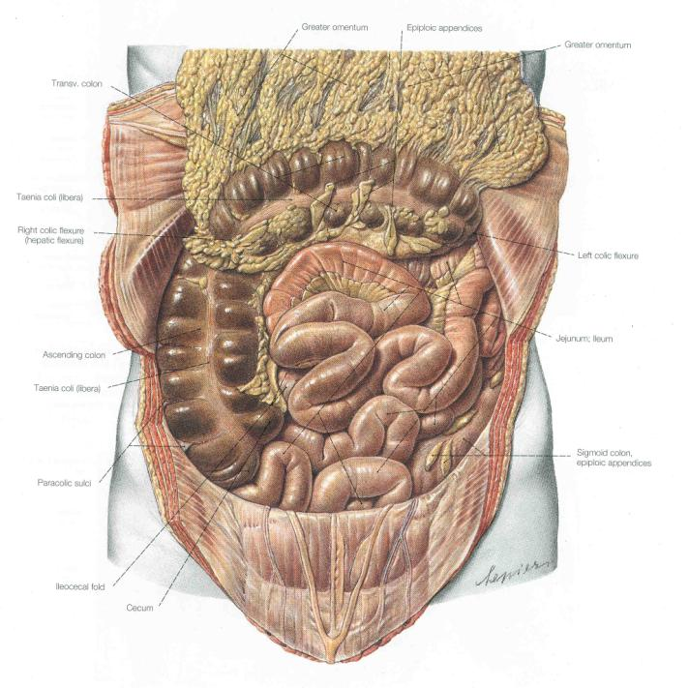

Slide 38
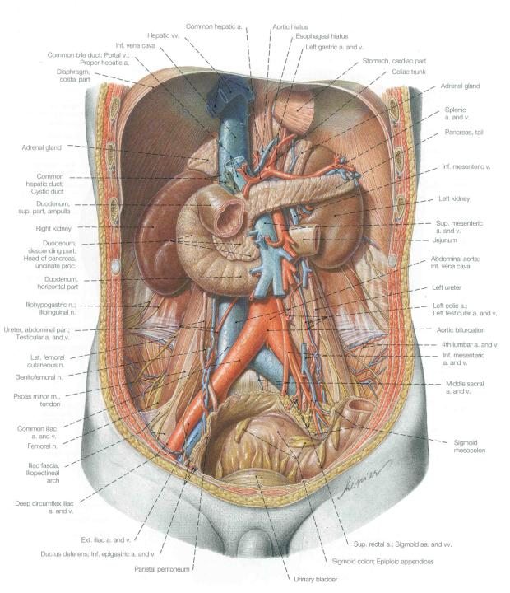
Retroperitoneal
components of
abdominal cavity

Slide 39
Midgut - Neurovascular Service:
Unpaired Branch of Abdominal Aorta: Superior Mesenteric Artery
Unpaired Tributary of Hepatic Portal Vein: Superior Mesenteric Vein
Sympathetic Nerve: Lesser Splanchnic Nerve
Sympathetic Nerve Segmental Levels: T10-11
Sympathetic Ganglion: Superior Mesenteric Ganglion
Parasympathetic Nerve: Vagus Nerve (CN – X)

Slide 40
1. Implications of Gut Development
Foregut Development
Midgut Development
Hindgut Development
2. Circulation – Part I

Slide 42
Review of Retroperitoneal
components of
abdominal cavity

Slide 43
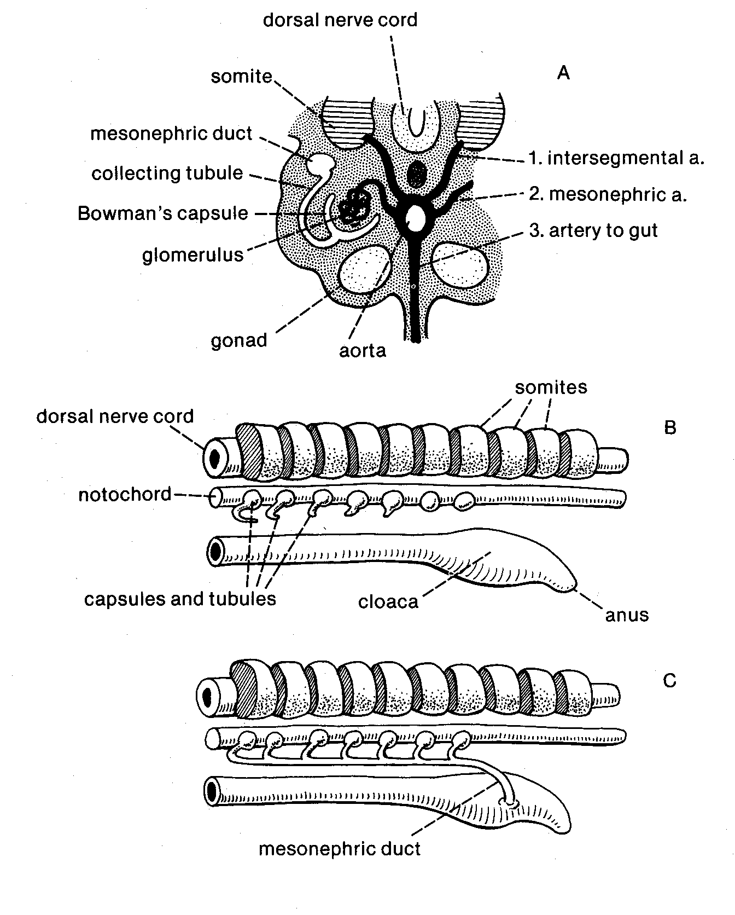

Slide 44
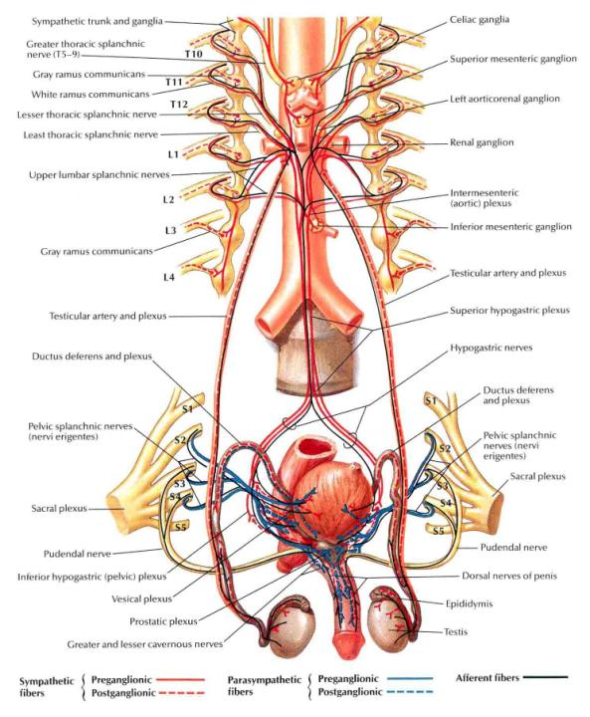
Innervation of Bladder
Sympathetic: predominantly L1-2 via hypogastric plexus
Parasympathetic:
S2-4 (as you would expect of a hindgut derivative).

Slide 45
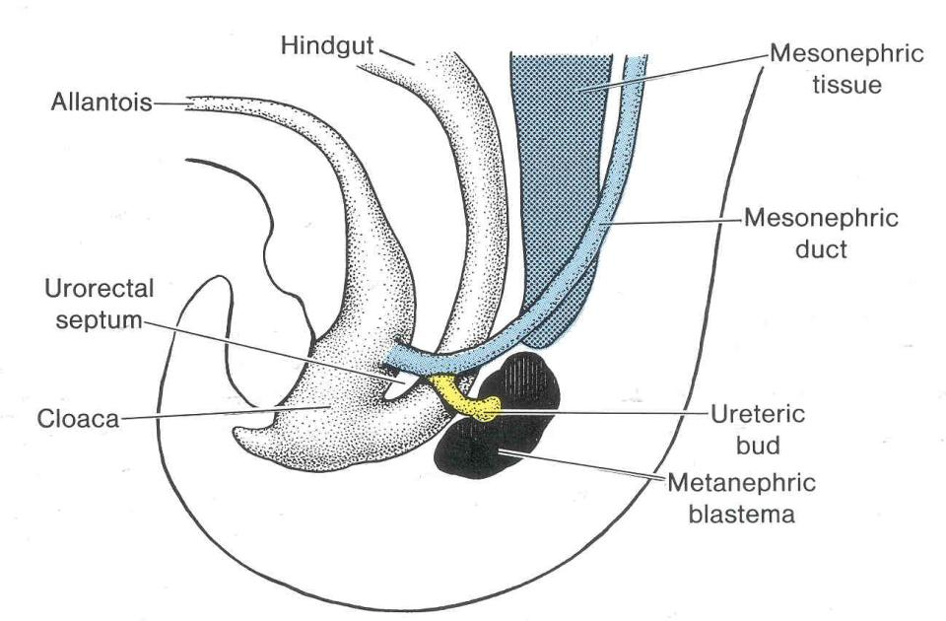
Developing

Slide 46
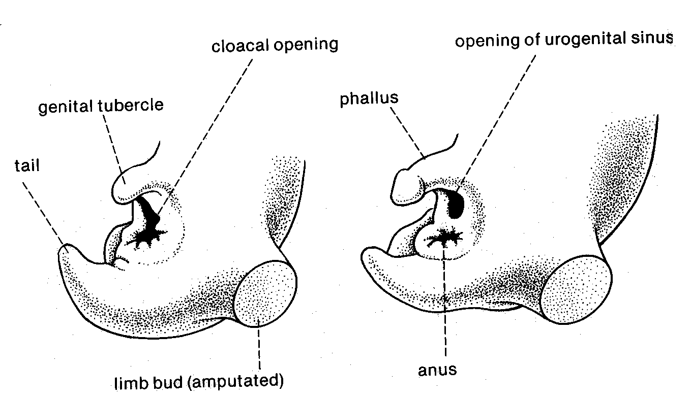

Slide 47
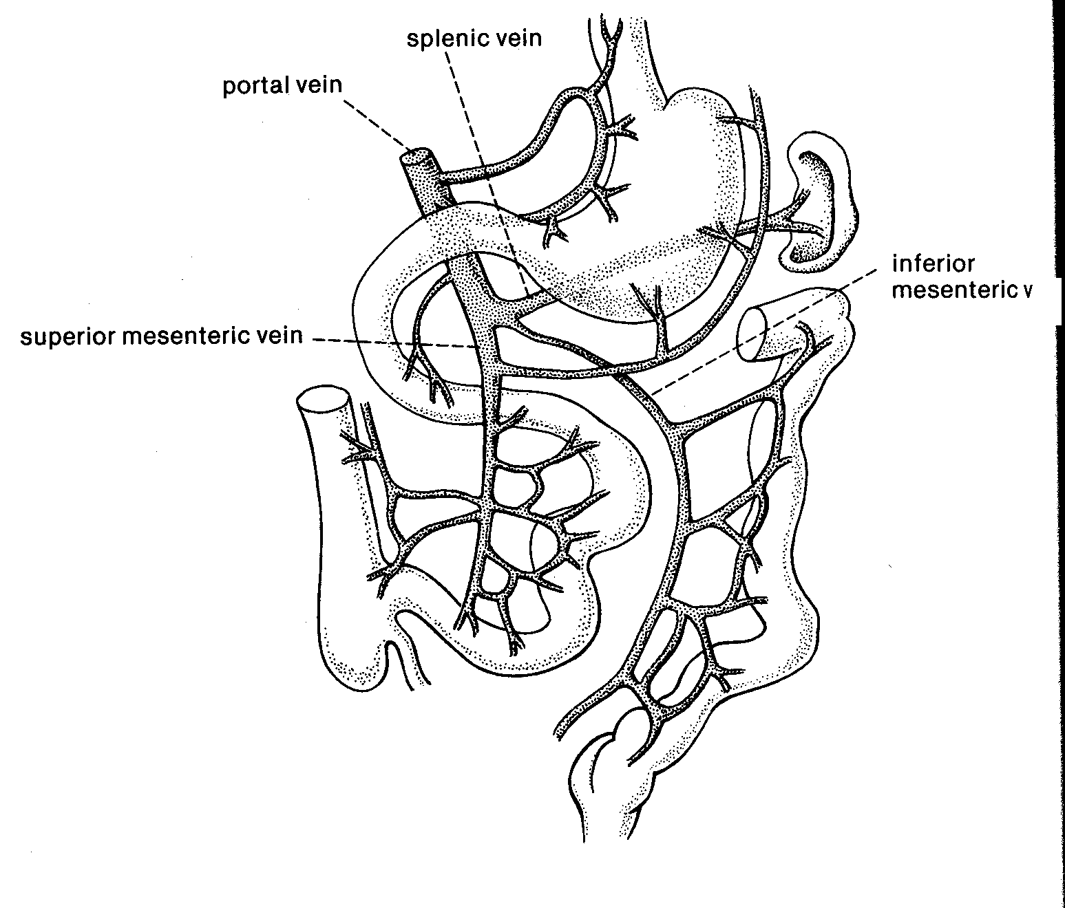
Hepatic Portal Vein and Its
Tributaries

Slide 48
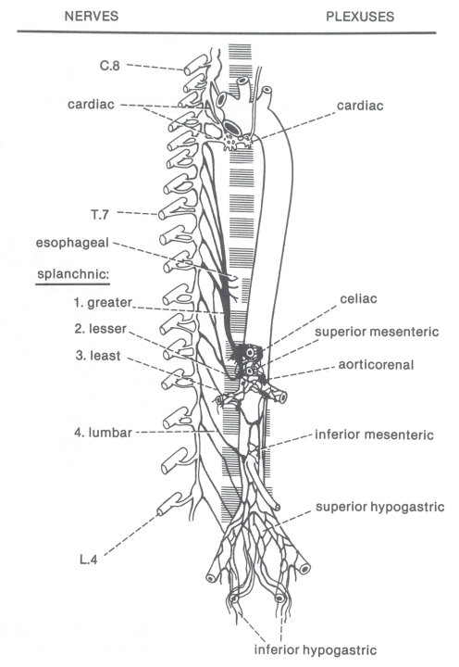
Sympathetic Supply of the Abdominal Gut

Slide 49
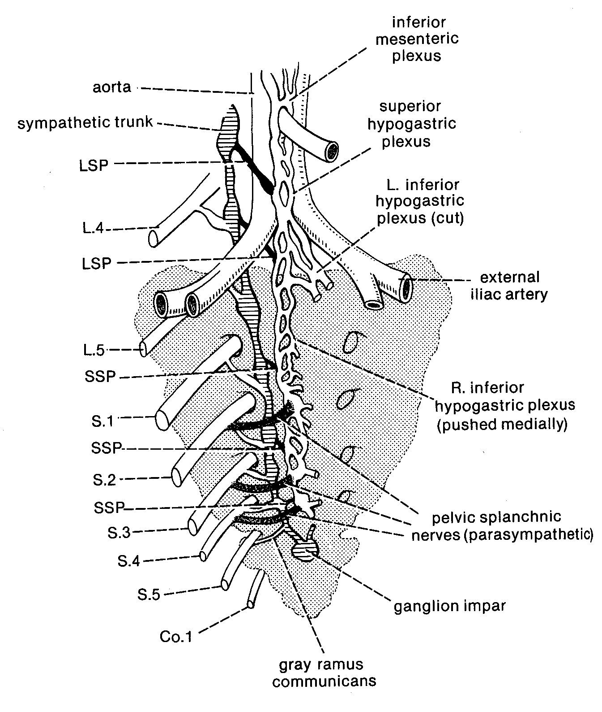
Parasympathetic Supply to the Hindgut: S2-4)

Slide 50
Hindgut - Neurovascular Service:
Unpaired Branch of Abdominal Aorta: Inferior Mesenteric Artery
Unpaired Tributary of Hepatic Portal Vein: Inferior Mesenteric Vein
Sympathetic Nerve: Least Splanchnic Nerve + Lumbar splanchnics
Sympathetic Nerve Segmental Levels: T12, L1(2)
Sympathetic Ganglion: Superior Mesenteric Ganglion
Parasympathetic Nerve: Pelvic Outflow, S2-4

Slide 51
Foregut, Midgut, & Hindgut
Summary
Embryonic Gut | Boundaries | Sympathetic nerve | Levels
Foregut | Through first ½ of duodenum | Greater Splanchnic | T5-9
Midgut | 2nd ½ of duodenum through left colic flexure | Lesser Splanchnic | T10-11
Hindgut | Left colic flexure to anus | Least Splanchnic + Lumbar splanchnics | T12, L1(2)

Slide 52
Summary Continued…..
Embryonic gut | Preaortic ganglia | Arteries of Abdominal aorta | Hepatic portal vein | Parasymp. innervation
Foregut | Celiac ganglion | Celiac artery | Splenic vein | Vagus Nerve (X)
Midgut | Superior mesenteric ganglion | Superior mesenteric artery | Superior mesenteric vein | Vagus Nerve (X)
Hindgut | Inferior mesenteric ganglion | Inferior mesenteric artery | Inferior mesenteric vein | Sacral Outflow (S1-S4)

