Slide 1
Biology 323
Human Anatomy for Biology Majors
Lecture 15
Dr. Stuart Sumida
Development and Structure, of the Reproductive System

Slide 2
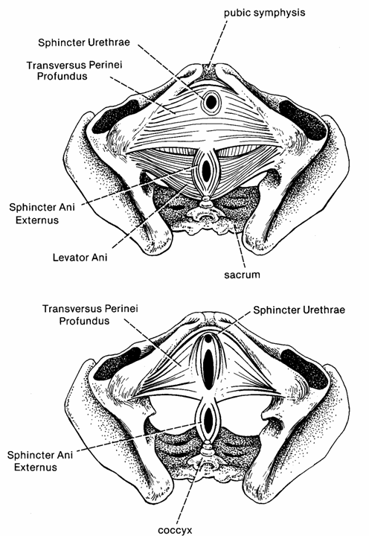

Slide 3
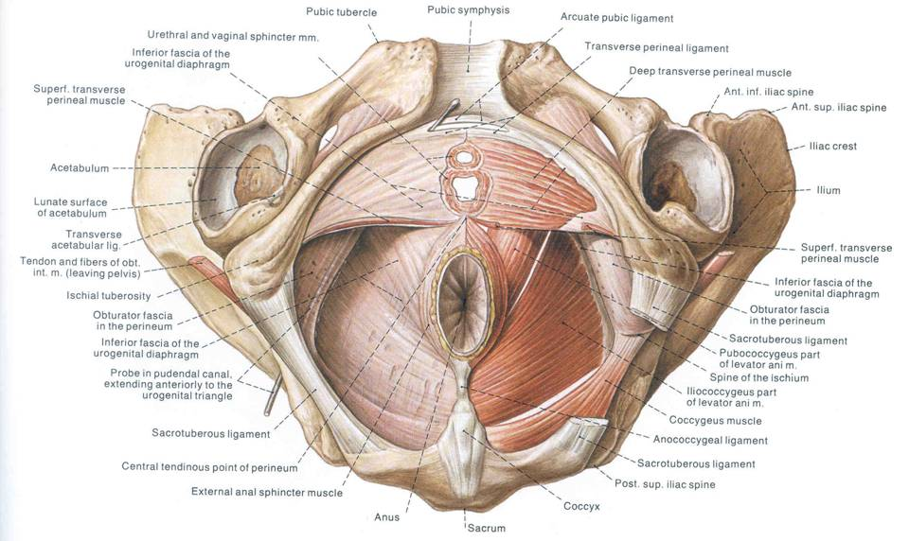

Slide 4
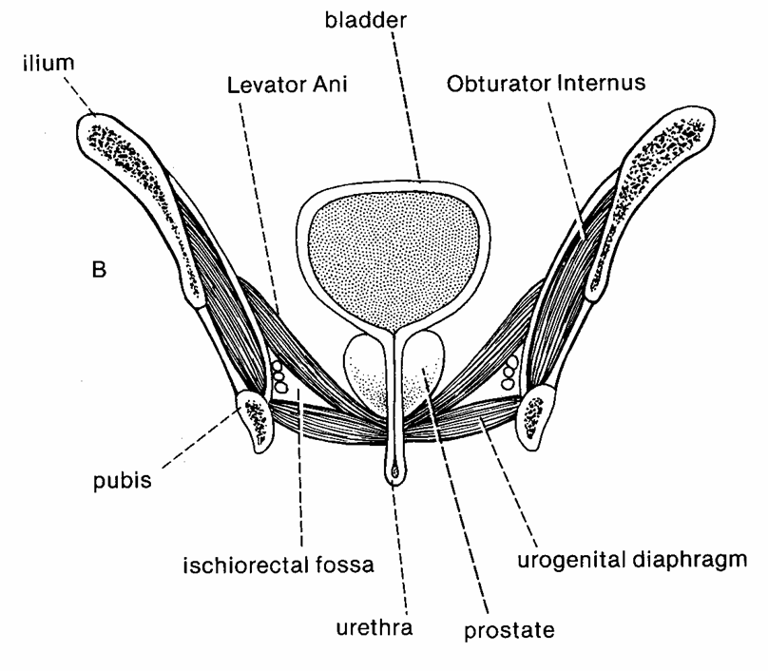

Slide 5
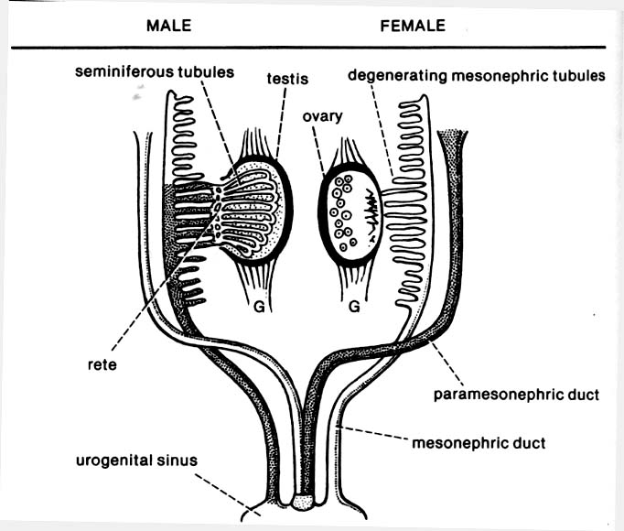
Development of urogenital organs/RELATIONSHIP TO ADULT MORPHOLOGY
“Males”
Former kidney duct become ductus deferns, epididymous, retains connection to bladder
X
X
X
X
X
X
X
X
“Females”
New tubes fuse at midline to become uterine tubes, uterus, superior 2/3 vagina

Slide 6
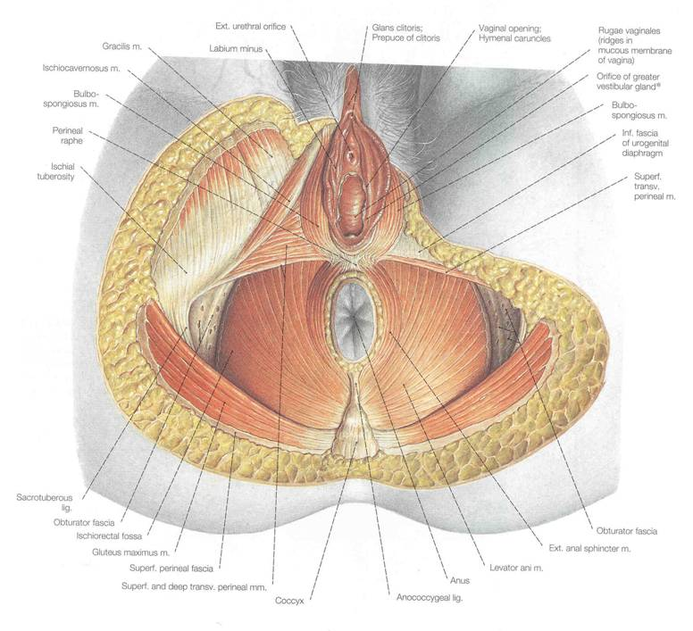
Ischiocavernosus
Bulbospongiosus

Slide 7
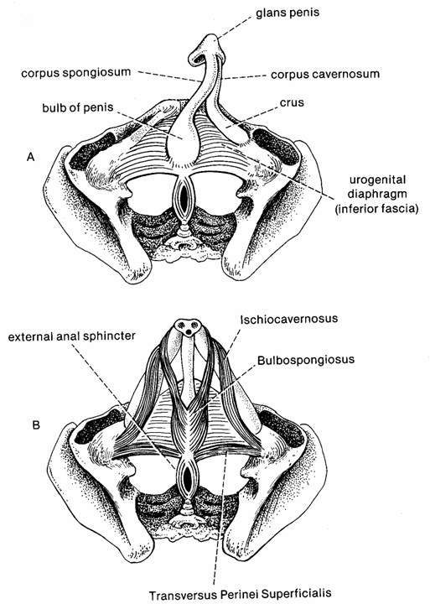

Slide 8
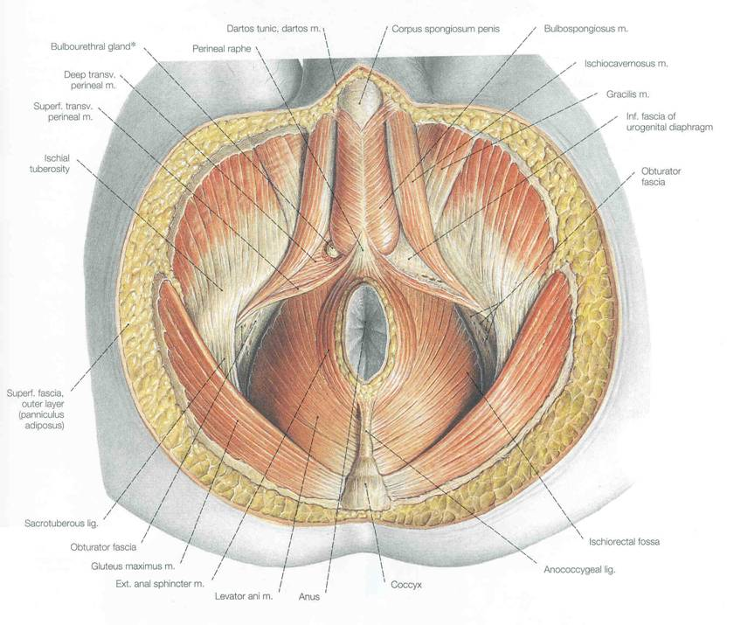
Ischiocavernosus
Bulbospongiosus

Slide 9
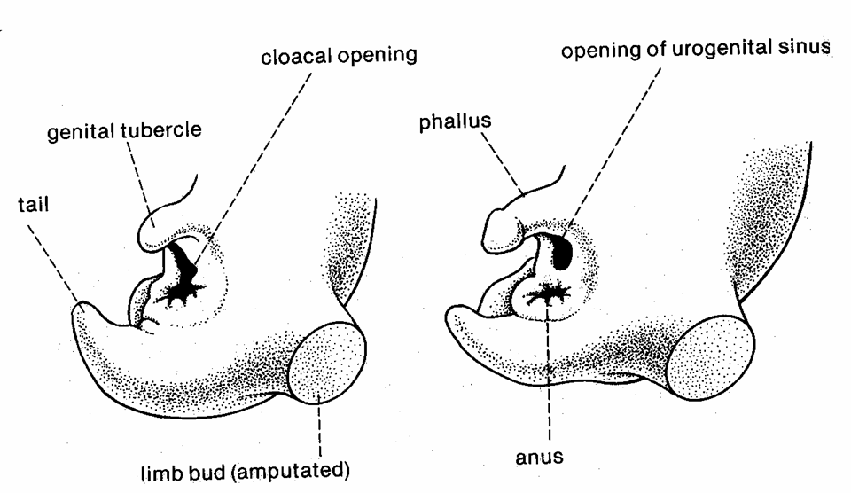

Slide 10

(RETURN TO) DIVISION OF THE CLOACA
Recall how the urogenital diaphragm subdivided the cloaca in a rectum and a bladder.
Recall also how it subdivide the cloacal opening to split off the urogenital opening from the anus.
The urogenital opening is the more ventral of the two.

Slide 11
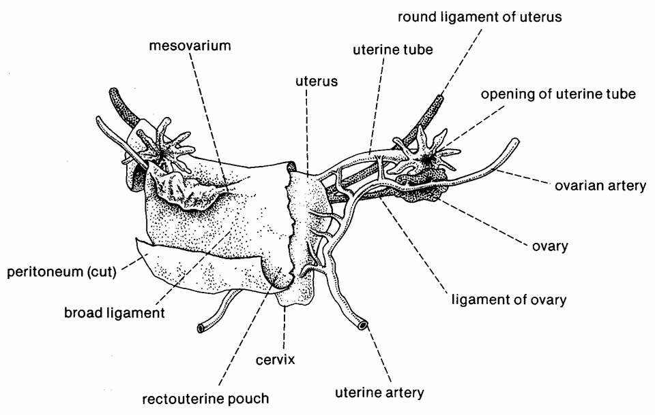

Slide 12
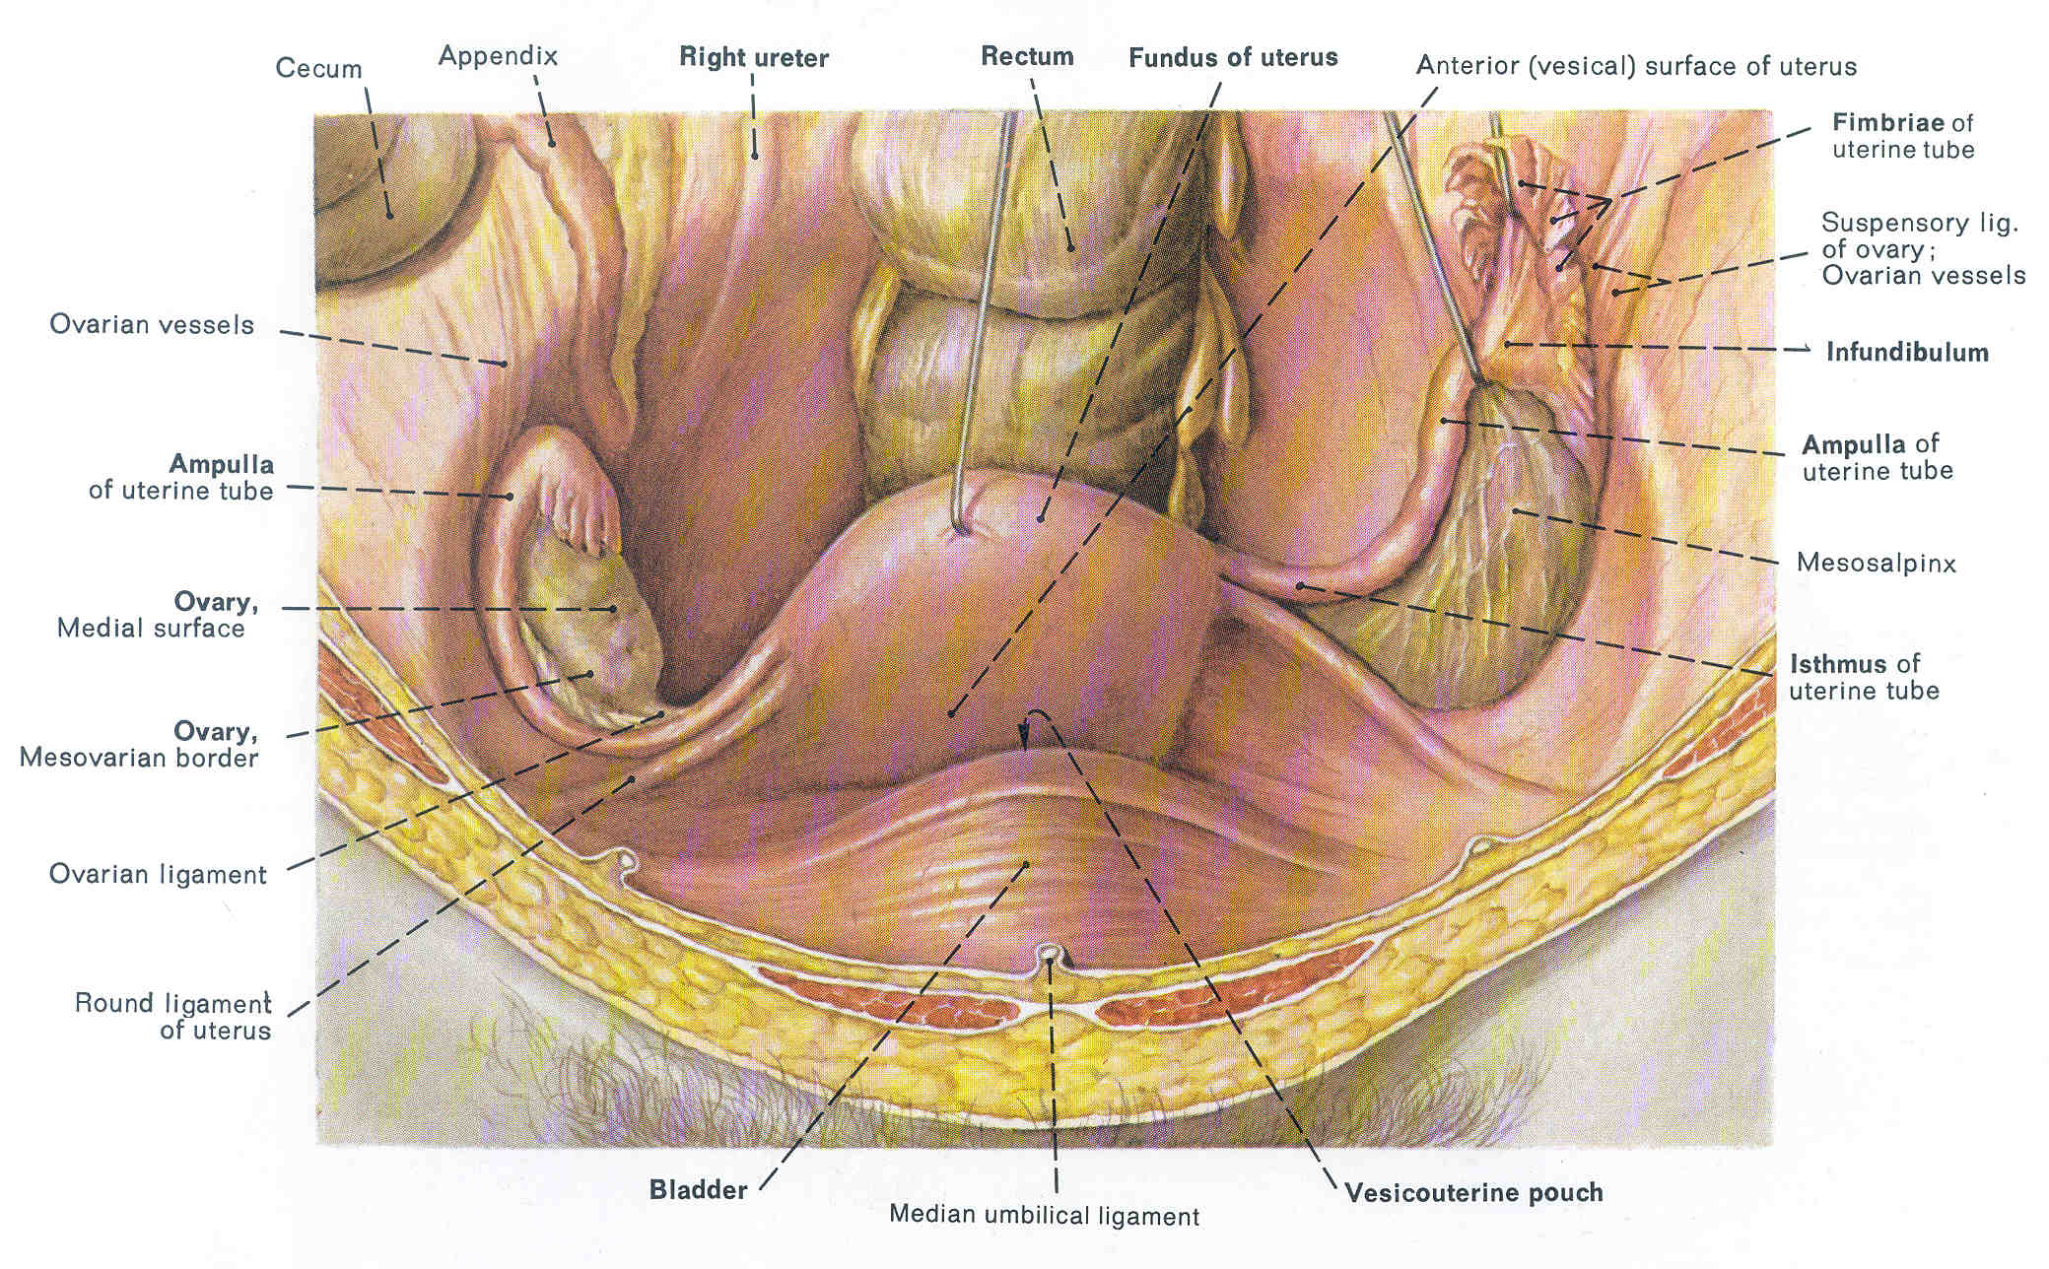

Slide 13
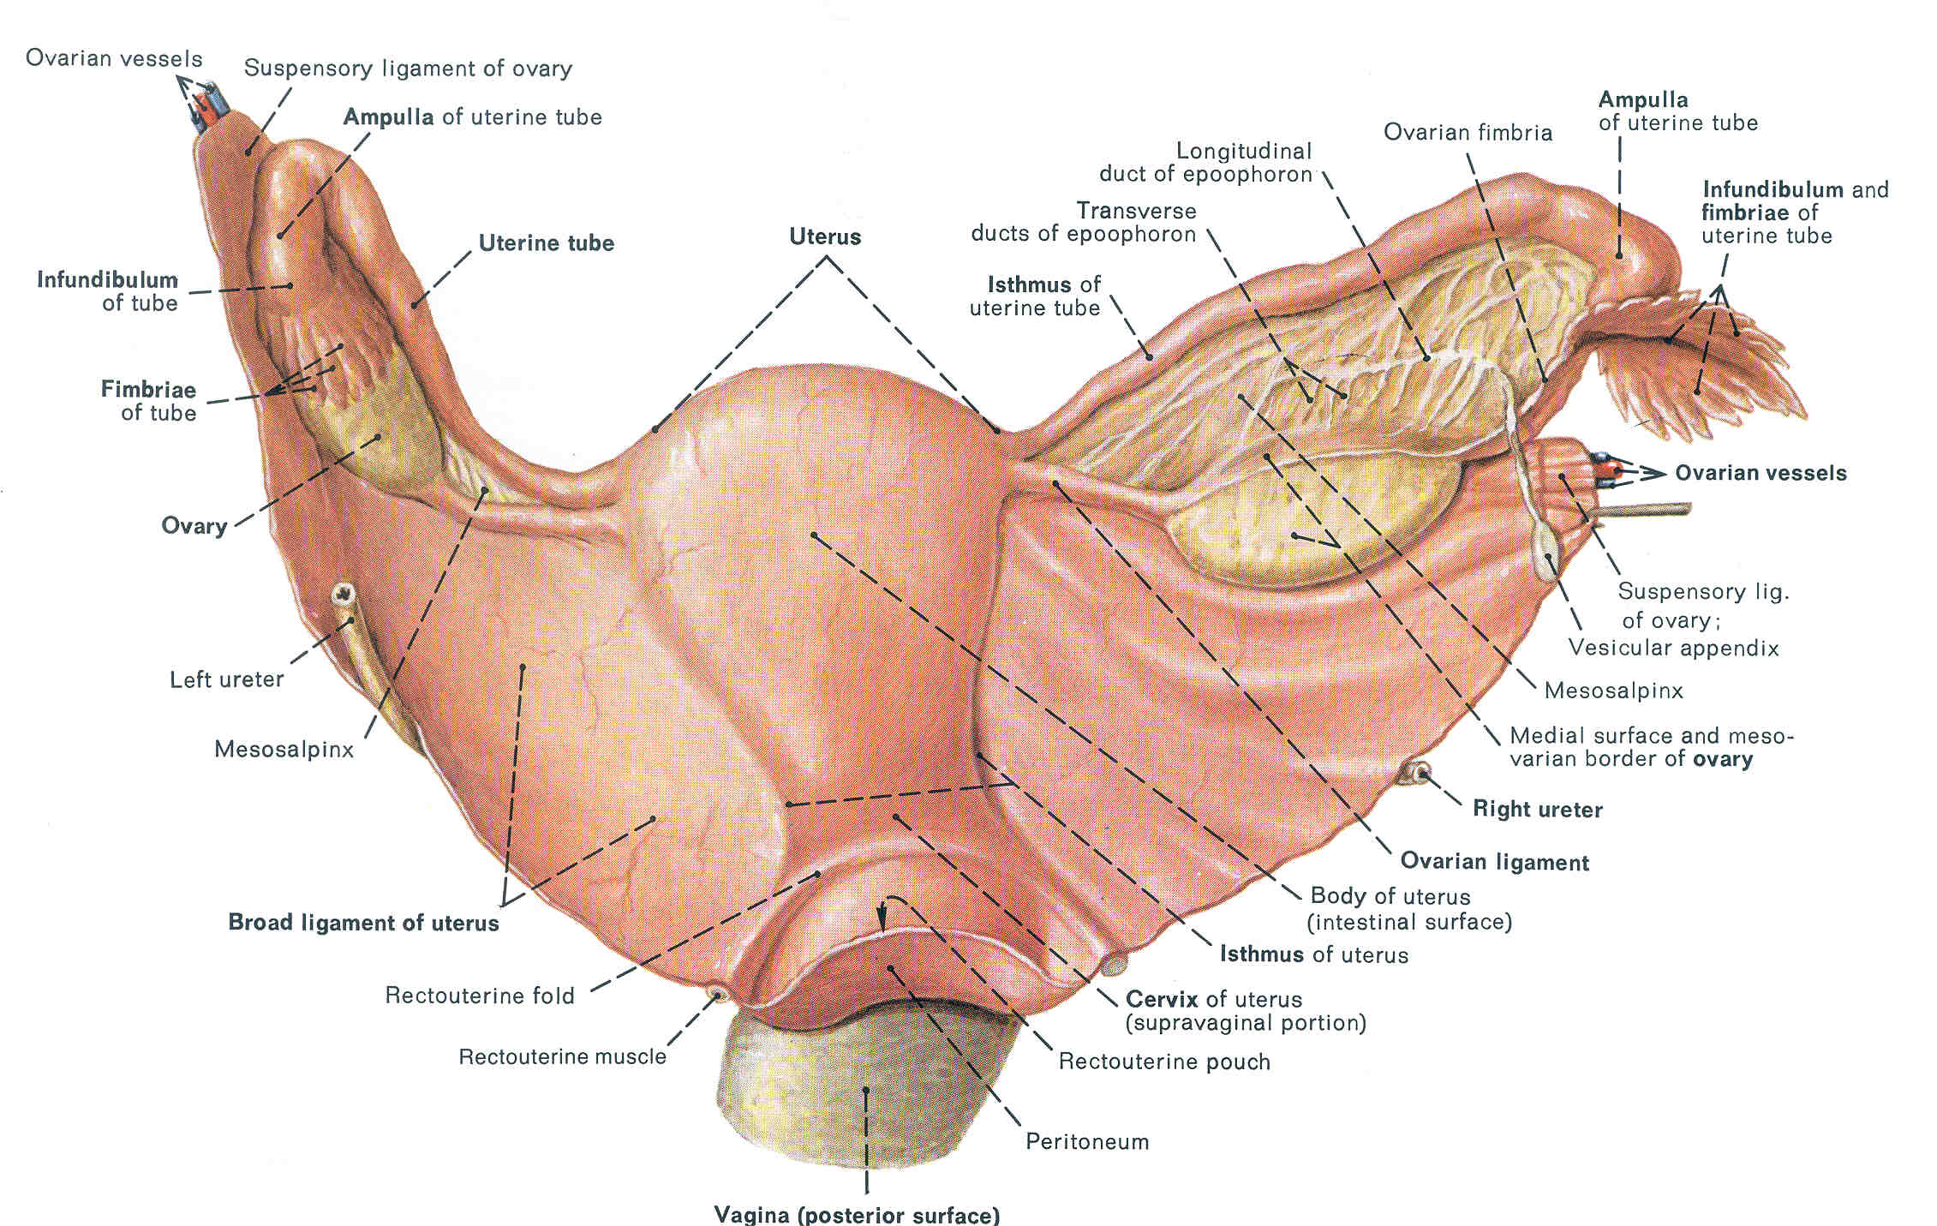

Slide 14
OVARIAN LIGAMENTS
Ovaries attached by broad ligament to uterus, with two named subdivisions
Between uterus and ovary, inferior to ovarian ligament is the mesovarium
Between ovarian ligament & uterine tube is mesosalpinx
Broad ligament is double fold of peritoneum

Slide 15
Note that there is no direct connection between ovary and uterine tube.
Ovulation releases oocyte by rupture into peritoneal cavity
Fimbriae of uterine tube guide oocyte into uterine tube
Fertilization occurs immediately after ovulation, high in uterine tube at or near fimbriae.

Slide 17
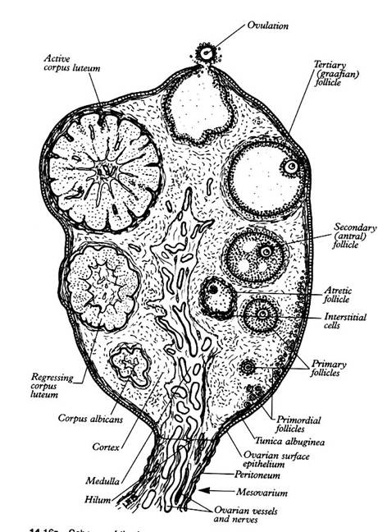
Understand relations & functions/SUBPERITONEAL PELVIC VISCERA /Ovaries
Paired structures lateral to uterus close to lateral pelvic wall, in ovarian fossa
Almond-shaped, approx. 6cm3, but volume varies
Contain primary ovarian follicles
Lymphatic drainage via lumbo-aortic and pelvic lymph nodes.
Ovary dual-purpose:
Oocyte development and release (cortex)
Endocrine gland (cortex and medulla)

Slide 18
“DESCENT” OF THE OVARY
The ovary also descends, following a gubernaculum, but it does not exit into an extra-abdominal position like the testes.
It ends its descent just below rim of bony pelvic girdle.
The ovary’s gubernaculum persists in the adult as a pair of fibrous cords that RUN THROUGH A VESTIGAL INGUINAL CANAL, and insert into the LABIA MAJORA.

Slide 19
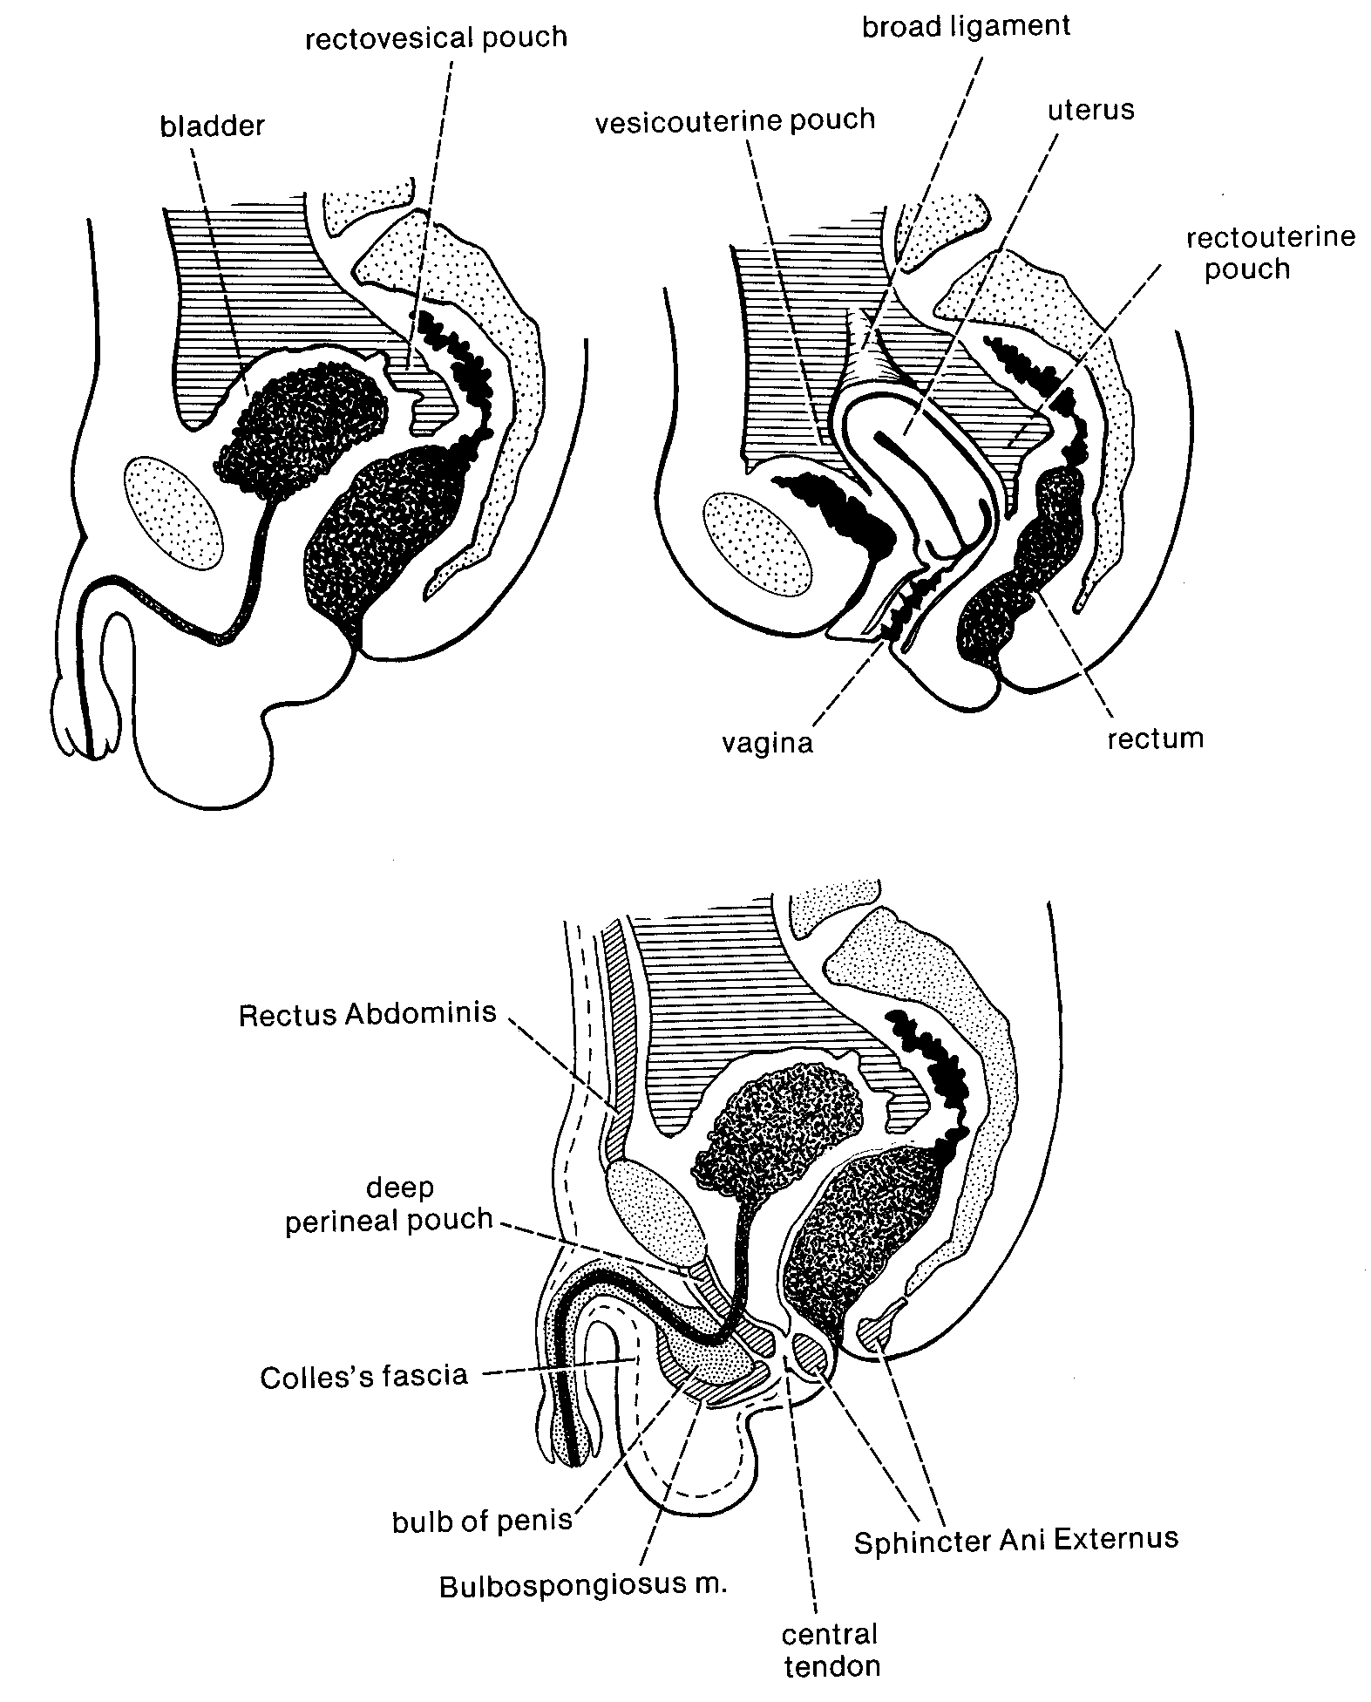

Slide 20
Development of urogenital organs/ RELATIONSHIP TO ADULT MORPHOLOGY
Note thin wall of rectouterine pouch and posterio-superior portion of vagina

Slide 21
FEMALES:
Important “pouches” – regions of perineal coelom – of females:
VESICOUTERINE POUCH
RECTOUTERINE POUCH

Slide 22
MALES: Only ONE Important “pouch” –
RECTOVESICLE POUCH

Slide 23
UTERUS AND VAGINA
Recall the formation of the uterus from the midline fusion of the paramesonephric ducts (fallopian tubes).
The space left for the opening ventral to the rectum is the UROGENITAL SINUS.
A midline outpocketing of the urogenital sinus grows dorsally toward uterus and forms a tubular VAGINA.
The vagina opens at its dorsal end into the uterus and at its ventral end into the urethral part of the urogenital sinus.

Slide 24
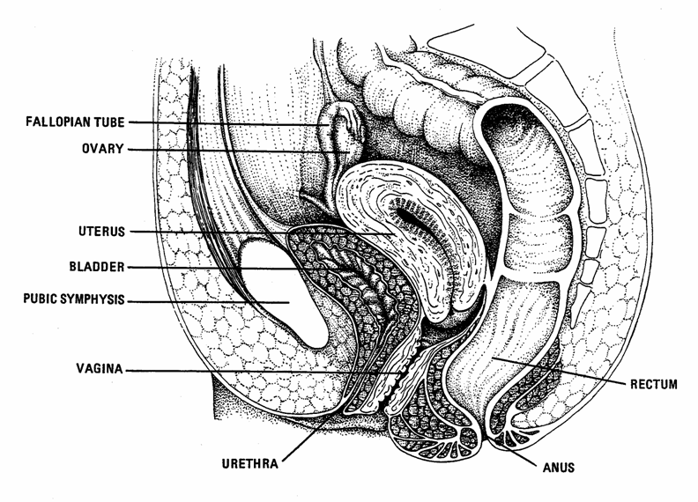
In Females: THREE OPENINGS of the old cloaca: (1) urethra, (2) vagina, and (3) anus.

Slide 25
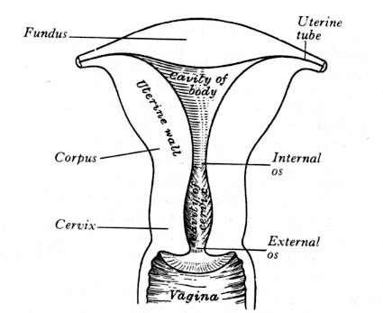
Uterus
Hollow, thick-walled muscular organ between bladder and rectum
Paired-shaped in nullipara, flattened A-P
Long axis almost at right angles to vagina
Superior hypogastric plexus for PAIN and sympathetic nn.
Composed of:
Body (corpus)
Fundus superior to uterine tubes
Cervix (inferiorly) with internal and external os; cervix normally blocked by mucus plug except around ovulation

Slide 26
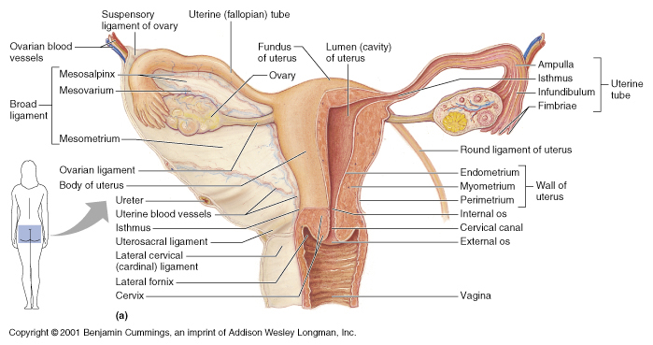
Fibro-muscular tube, length varies somewhat but 7.5 – 9 cm on average
Vaginal part of cervix at anterior-superior end of vagina
No mucus glands! Lubrication from vascular weeping.
Upper portion from paramesonephric ducts, lower from external invagination

Slide 27
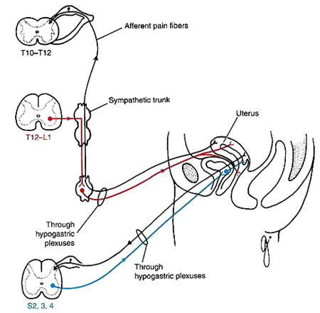
Uterus Autonomics:
Sympathetic: T12-L1 via sympathetic trunk and [synapse in] hypogastric plexus
Parasympathetic: S2-4 via hypogastric plexus.
Lower vagina – pudendal nerve provides somatic motor and sensory,

Slide 28
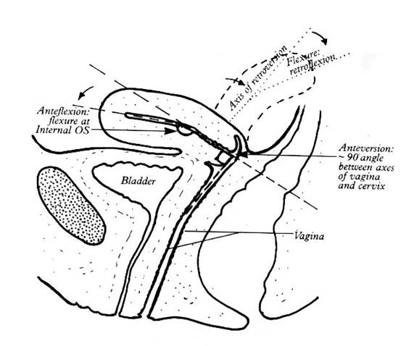
Understanding relations & functions/SUBPERITONEAL PELVIC VISCERA /Uterus & vagina
Fibro-muscular tube, length varies somewhat but 7.5 – 9cm on average
Vaginal part of cervix at anterior-superior end of vagina
No mucus glands! Lubrication from vascular weeping.
Upper portion from paramesonepthic ducts, lower from external invagination
Upper vagina - autonomic from vaginal plexus (sympathetic) & pelvic splanchnic nerves (parasympathetic)
Lower vagina – pudendal nerve (somatic motor and sensory)

Slide 29
DESCENT OF THE TESTES:
Recall from the previous lecture that the male testes descend from their initially intraperitoneal position, through the body wall, into a pouch protruding from the body wall called the SCROTUM.
Everything gets drug along in this descent: ductus deferens, nerves, blood vessels.
All of these together form a connection (“leash”) of testicular connections called the SPERMATIC CORD.

Slide 30
RETROPERITONEAL POSITION OF THE TESTES
The serial homolog of the coelom and its peritoneal boundaries together are called the TUNICA VAGINALIS.
(Another way of saying this is that each testis is surrounded by its own little coelomic sac.
Remember, each testis started out retroperitoneal on the dorsal side of the body wall with the coelom ventral to it.
Appropriately, tunica vaginalis is wrapped around only part of each testis – the ventral side, leaving it retroperitoneal even in the scrotal sac.

Slide 31
WHY DESCEND???
Preserve male fertility – sperm must be kept a bit cooler than standard mammalian body temperature. Otherwise they degenerate and lose motility.
Recall from the previous lecture:
As a transitory stage of kidney degenerates, a ligament called the GUBERNACULUM descends on each side of abdomen from inferior pole of gonad.
Gubernaculum passes obliquely through developing anterior abdominal wall at site of future inguinal canal and attaches at internal surface of labioscrotal swelling (future position of scrotum in males or labium majorum in females).
Gubernaculum is thought to guide descent of testes into scrotum, and ultimately anchors testis to scrotal wall.

Slide 32
ENTRANCE INTO THE SCROTUM
Spermatic cord passes through opening to the scrotal pouch to reach the testis on each side.
If it were a wide open hole, loops of the intestine could slip out there – with resulting damage to gut tube (constriction or strangulation) – a “HERNIATION” or HERNIA.
This danger is guarded against by the opening being a very narrow slit – the INGUINAL CANAL.

Slide 33
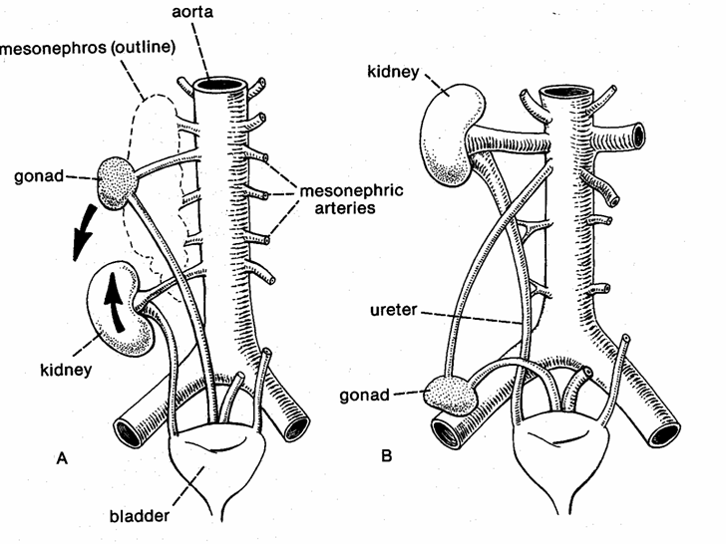
POSITION OF THE TUBES
The testes “descend” and place the spermatic cord in a position just ventral (“in front of”) the ureter!!

Slide 34
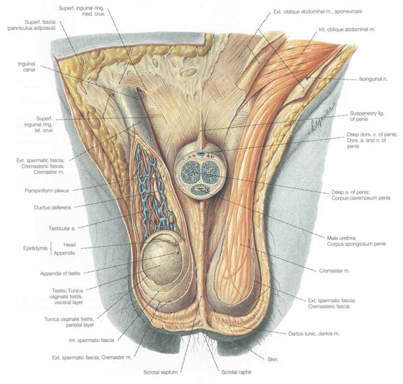
ENTRANCE INTO THE SCROTUM
Spermatic cord passes through opening to the scrotal pouch to reach the testis on each side.
If it were a wide open hole, loops of the intestine could slip out there – with resulting damage to gut tube (constriction or strangulation) – a “HERNIATION” or HERNIA.
This danger is guarded against by the opening being a very narrow slit – the INGUINAL CANAL.

Slide 35
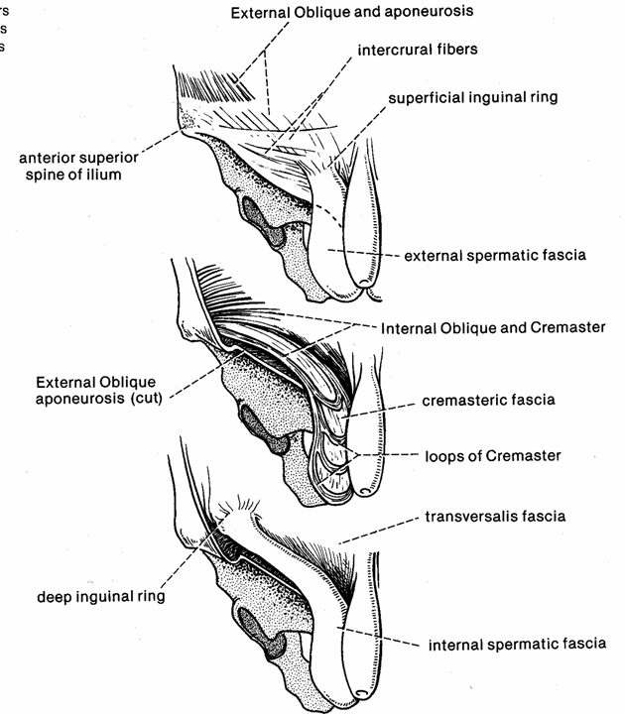
Body Wall
Derivatives

Slide 36
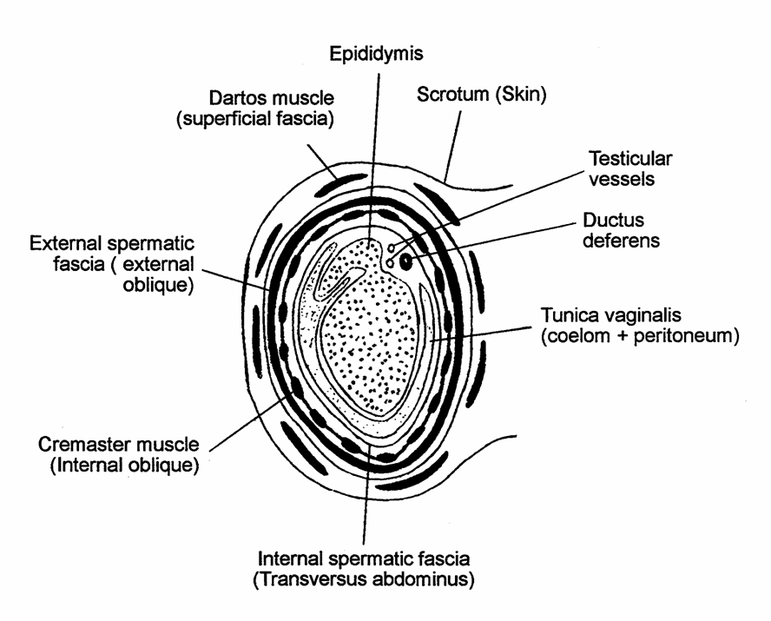

Slide 37
SERIAL HOMOLOGS OF SCROTAL STRUCTURES
As testes push through body wall, they carry with them all layers and a bit of coelomic space. The equivalents are:
Skin: SCROTAL SAC
Superficial fascia: DARTOS MUSCLE
External oblique: EXTERNAL SPERMATIC FASCIA
Internal oblique: CREMASTER MUSCLE
Transversus abdominus: INTERNAL SPERMATIC FASCIA
Coelom + peritoneum: TUNICA VAGINALIS

Slide 38
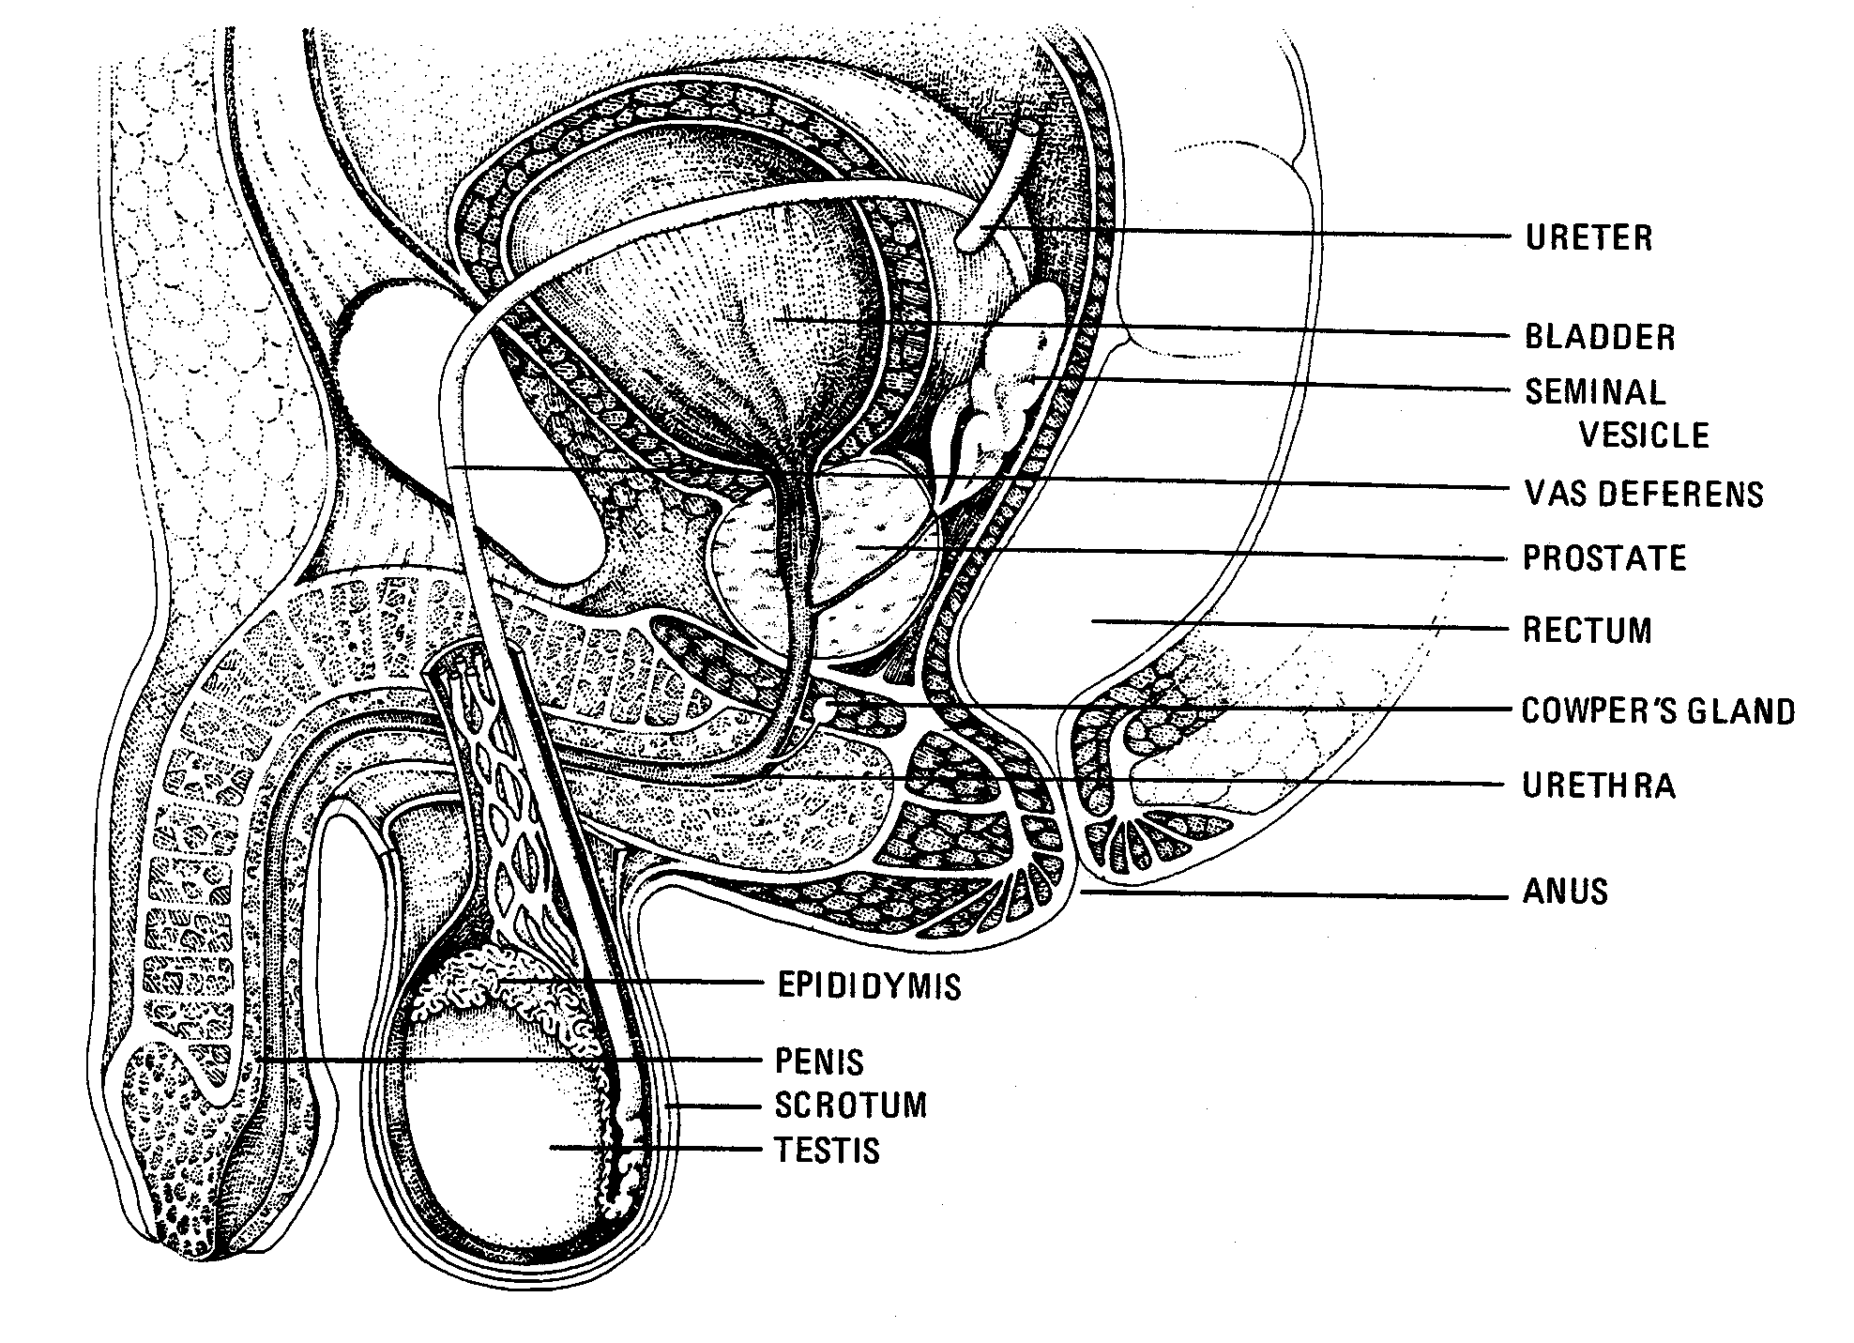
Notice how the spermatic cord loops ventral to (“in front of”) the attachment of the ureter of the bladder.

Slide 39
Sperm are stored at the distal end of the old mesonephric duct...at the distal end of the ductus deferens.
This distal end bit that attaches to the testis is called the EPIDIDYMIS.

Slide 40
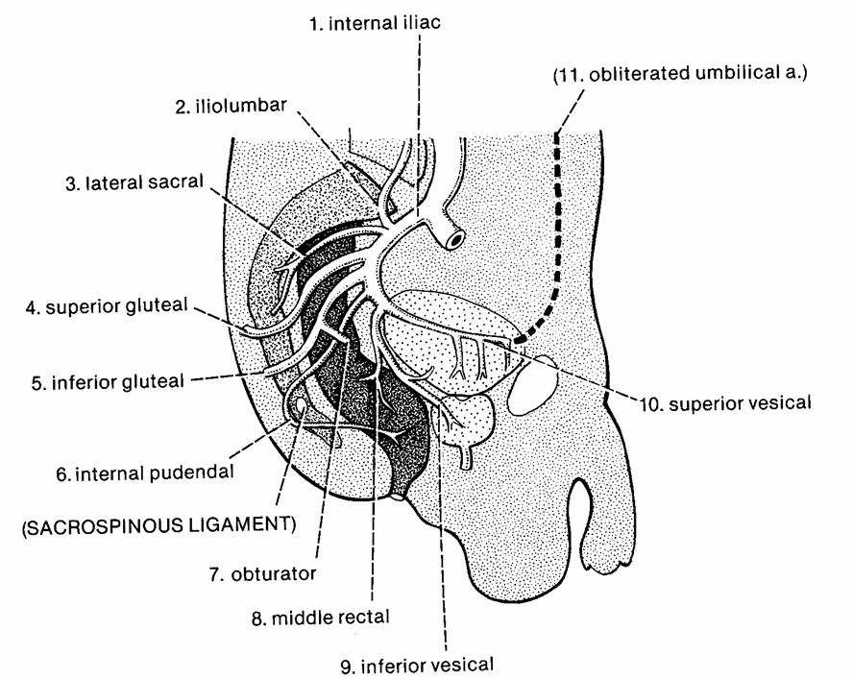

Slide 41
ERECTILE TISSUE
Just above (cranial to) cloacal opening in human embryo is a small bump called the GENITAL TUBERCLE.
It forms from tissue of the cloacal rim.
It elongates and comes to hang over opening.
Specialized erectile tissue develops from mesoderm in the tubercle as well as rim of urogenital opening.
The specialized erectile tissues form as two masses on each side of the midline (total of four-4):
Closer to midline: right and left BULB.
More laterally: right and left CRUS (plural – curura).

Slide 42
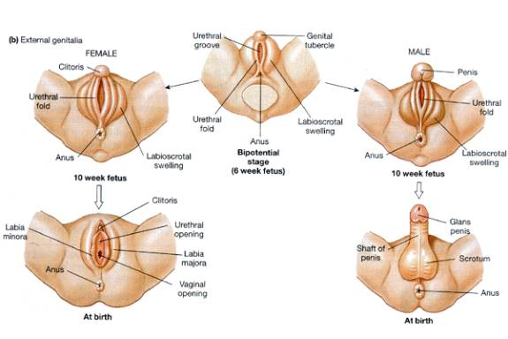
ERECTILE TISSUE
Just above (cranial to) cloacal opening in human embryo is a small bump called the GENITAL TUBERCLE.
It forms from tissue of the cloacal rim.
It elongates and comes to hang over opening.
Specialized erectile tissue develops from mesoderm in the tubercle as well as rim of urogenital opening.
The specialized erectile tissues form as two masses on each side of the midline (total of four-4):
Closer to midline: right and left BULB.
More laterally: right and left CRUS (plural – curura).

Slide 43
(RETURN TO) DIVISION OF THE CLOACA
Recall how the urogenital diaphragm subdivided the cloaca in a rectum and a bladder.
Recall also how it subdivide the cloacal opening to split off the urogenital opening from the anus.
The urogenital opening is the more ventral of the two.

Slide 44
ERECTILE TISSUE IN THE MALE
Males have three columns of erectile tissue.
Right and left bulbs fuse in the midline to form the CORPORA SPONGIOSUM – surrounds the urethra.
Urethra emerges out of tip of enlarged genital tubercle – the GLANS OF THE PENIS.
At its tip is the bulbous dilation that is the GLANS OF THE PENIS.
Right and left crura remain independent and form the paired CORPORA CAVERNOSA.
Right and left sides are bound to one another by TUNICA ALBUGINEA.

Slide 45
ERECTILE TISSUE IN THE MALE
Males have three columns of erectile tissue.
Right and left bulbs fuse in the midline to form the CORPORA SPONGIOSUM – surrounds the urethra.
Urethra emerges out of tip of enlarged genital tubercle – the GLANS OF THE PENIS.
At its tip is the bulbous dilation that is the GLANS OF THE PENIS.
Right and left crura remain independent and form the paired CORPORA CAVERNOSA.
Right and left sides are bound to one another by TUNICA ALBUGINEA.

Slide 46
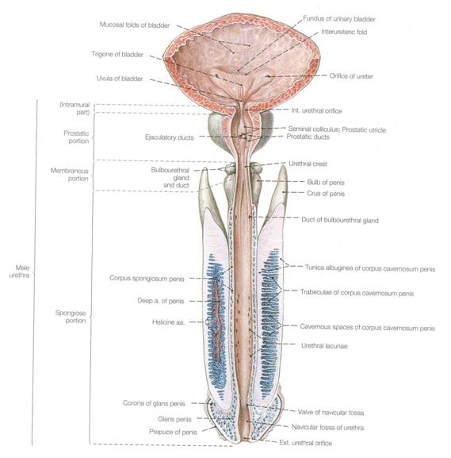
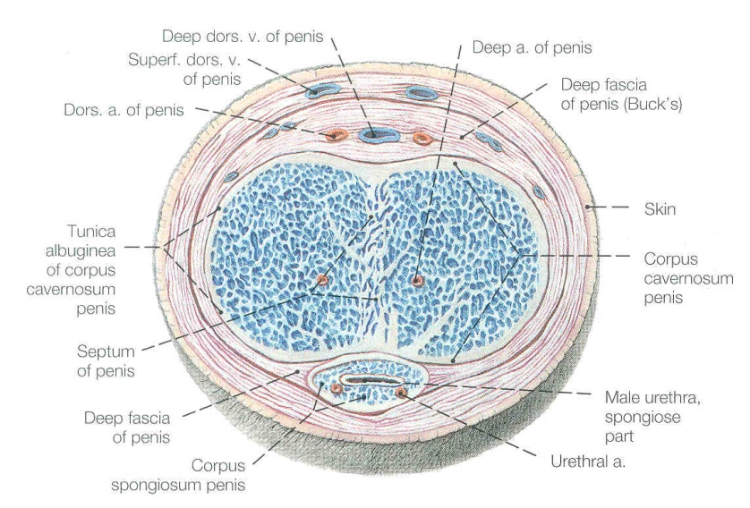

Slide 47


Slide 48
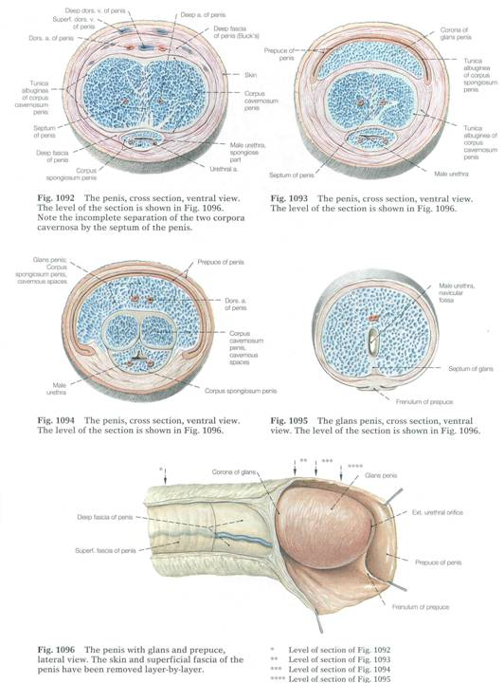

Slide 49
ERECTILE TISSUE IN THE FEMALE
Erectile tissue is present, but bulbs do not fuse in midline and do not enlarge as much.
They form separate masses of erectile tissue on either side of the vginal opening - the BULBS OF THE VESTIBULE, which become the LABIA MINORA (singular, MINORUM)
As a result, the female urethra cannot be enclosed in the midline (as in the corpora spongiosa of the male)
The tip end if the midline columns is the CLITORIS. (Similarly sensitive to glans of male.) Right and left crura form (much smaller) corpora cavernosa of clitoris.

Slide 50
ERECTILE TISSUE IN THE FEMALE
Erectile tissue is present, but bulbs do not fuse in midline and do not enlarge as much.
They form separate masses of erectile tissue on either side of the vaginal opening - the BULBS OF THE VESTIBULE, which become the LABIA MINORA (singular, MINORUM)
As a result, the female urethra cannot be enclosed in the midline (as in the corpora spongiosa of the male)
The tip end if the midline columns is the CLITORIS. (Similarly sensitive to glans of male.) Right and left crura form (much smaller) corpora cavernosa of clitoris.

Slide 51
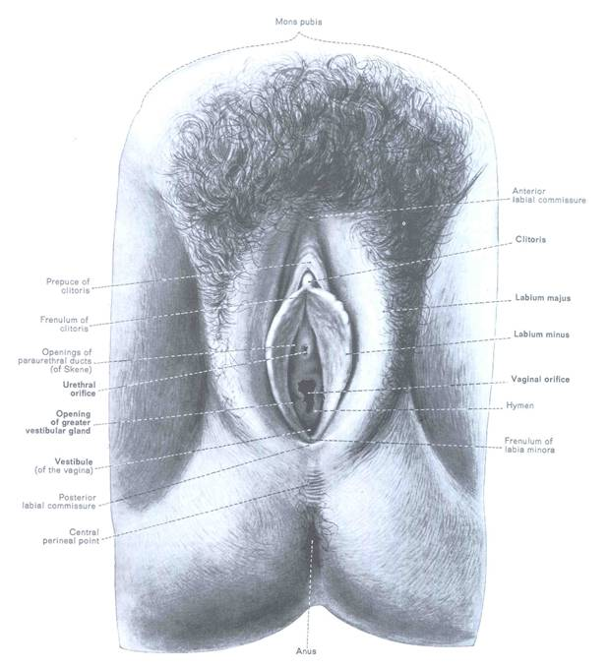
Clitoris
Labia majorum
Labia minorum

Slide 52
GLANDS OF INNER WALL OF UROGENITAL SINUS
Several glands develop s outpocketings of the inner wall of the urogenital sinus. (Most are better developed in males.)
PROSTATE GLAND – at upper end of urethra in the male. Encircles urethral neck.
SEMINAL VESICLES – outpocketing of ejaculatory duct.
BULBOURETHRAL GLANDS – in postpelvic body wall (of uncertain function)
GREATER VESTIBULAR GLANDS – (in females) secrete mucous fluids that serve as lubricants during copulation.

Slide 53
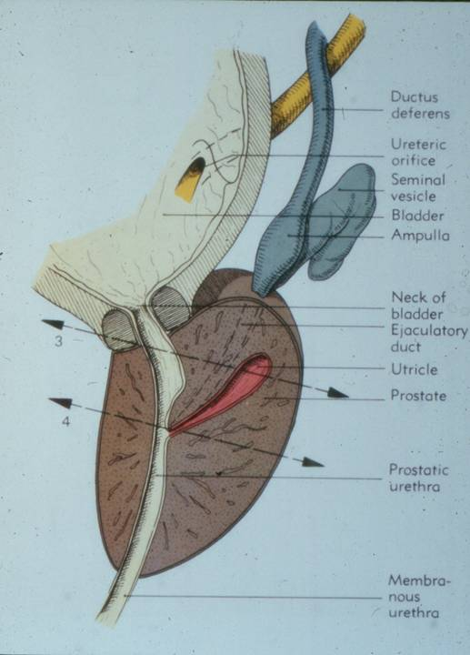
Ductus deferens
Seminal vesicle
Prostate gland
Urethra

Slide 54
MUSCULATURE OF PERINEAL REGION
In both sexes, the mass of erectile tissue is overlain by a thin mass of specialized hypaxial musculature.
This is often referred to as the specialized FOURTH layer of hypaxial musculature in the perineal region.
ICHIOCAVERNOSUS MUSCLE – arises from ischium behind crus of penis or clitoris. Wraps behind to insert on either side on tunica albuginea.
BULBOSPONGIOSUS MUSCLE – arises from central tendon (median raphe’) of the urogenital diaphragm and inserts into the tunica albuginea (males) or fascia of clitoris (females).

Slide 55
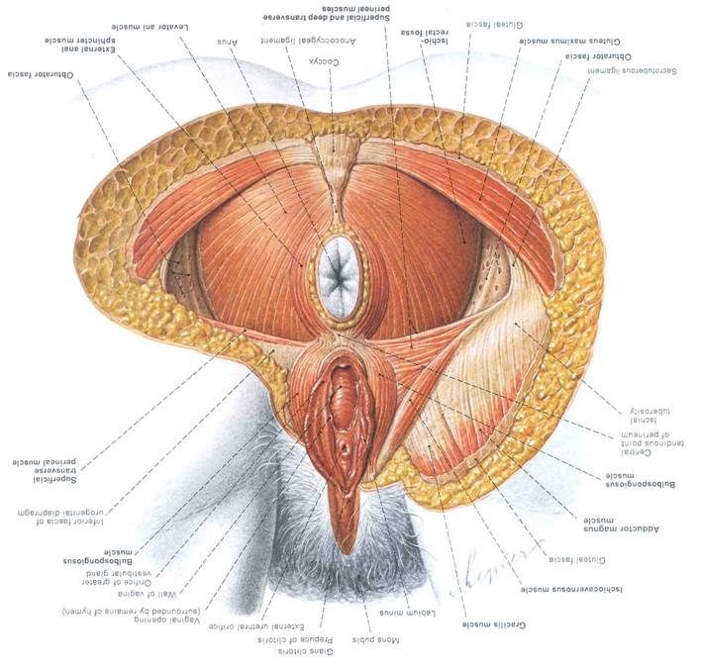
central tendon
ICHIOCAVERNOSUS MUSCLE
BULBOSPONGIOSUS MUSCLE

Slide 56
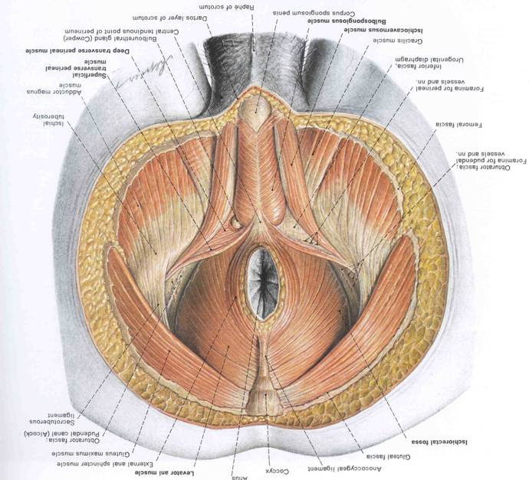
central tendon
BULBOSPONGIOSUS MUSCLE
ICHIOCAVERNOSUS MUSCLE

Slide 57
MUSCULATURE OF PERINEAL REGION
ICHIOCAVERNOSUS MUSCLE
BULBOSPONGIOSUS MUSCLE
The function of these muscles is debated.
Some (mostly male researchers) insist that their position overlying erectile tissue aids in the erection of the male.
(Uh, OK, so then why to females have them?) IF that’s the case, then erection ought to be a voluntary, controllable function for males.
More likely: they have a sphincter-like function to:
squeeze out last few drops of semen in males.
have sphincter-like function around vaginal opening in females.

