Slide 1
Biology 323
Human Anatomy for Biology Majors
Lecture 16
Dr. Stuart S. Sumida
Overview of Structure of the Adult Skull

Slide 2
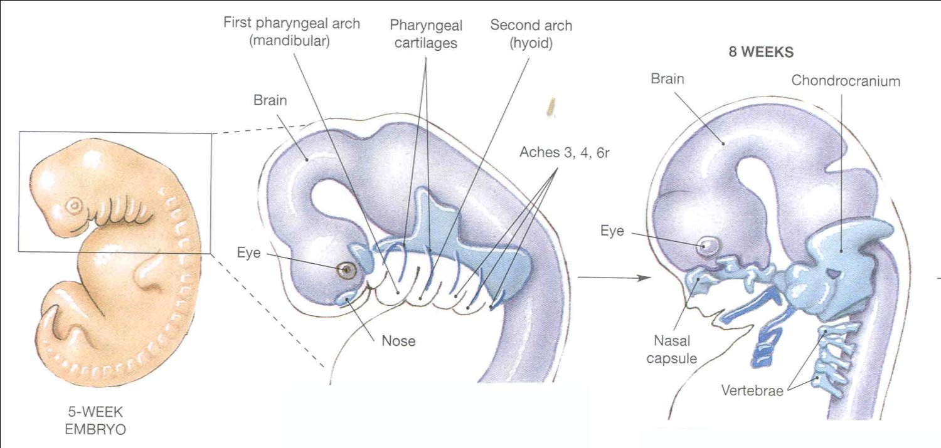

Slide 3
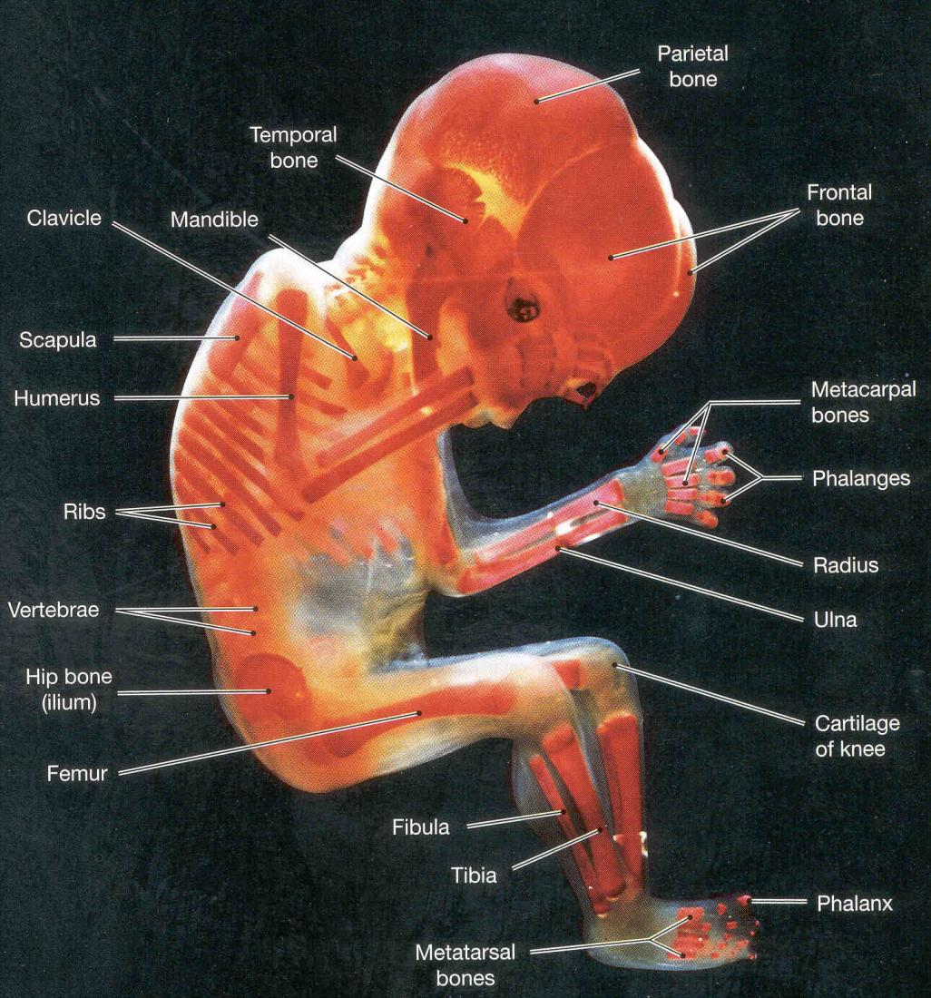

Slide 4
The developing skull has three component origins:
Condrocranium (base of skull / braincase)
Dermatocranium (flat bones of skull)
Splanchnocranium (bones derived from gill arch elements)

Slide 5
Mode of Germ Layer
Formation Origin
Condrocranium Endochondral Mesoderm
Dermatocranium Dermal Neural Crest
Splanchnocranium Endochondral Neural Crest

Slide 6
CHONDROCRANIUM: Bones of the base of the skull.
Most major cranial nerves escape the skull through these.
Endochondral
Mostly Mesodermal
Include: ethmoid, sphenoid (part), occipital (part) right and left temporal (parts).

Slide 7
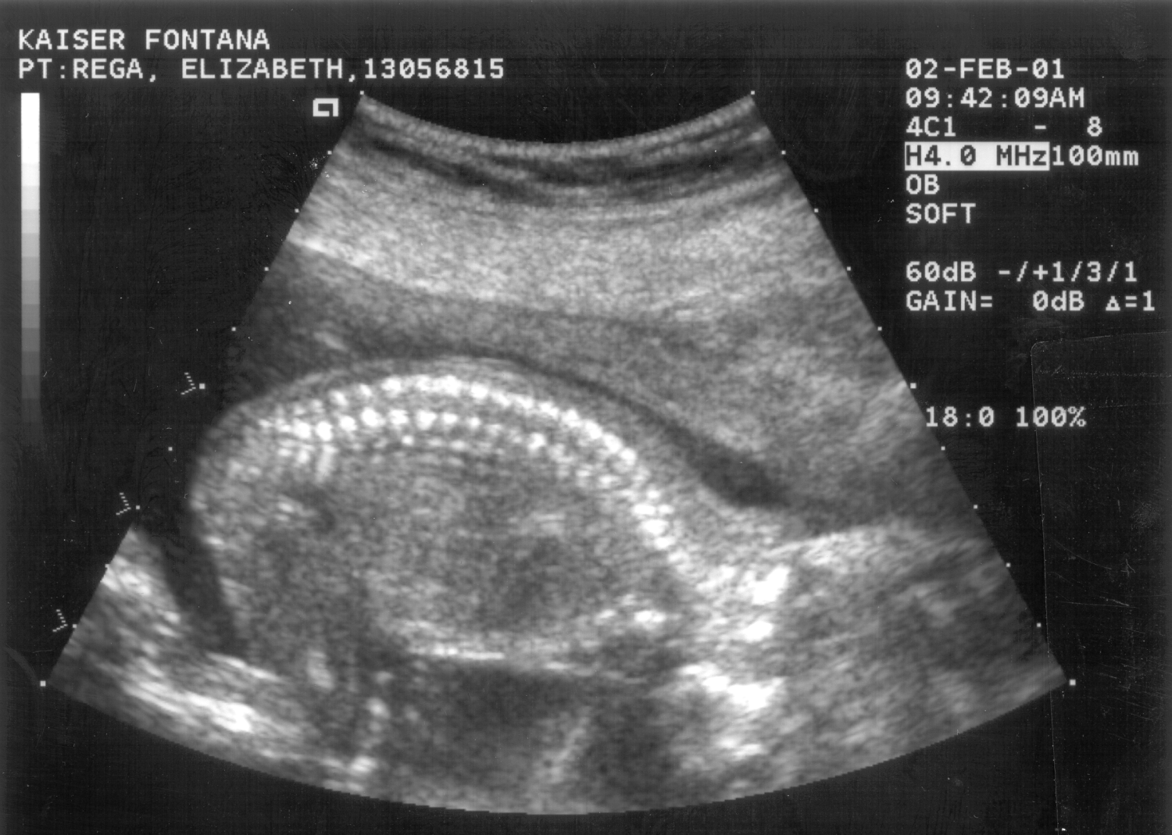

Slide 8

orbit II/
Ethmoid
Sphenoid
Petrous temporal
Basioccipital

Slide 9
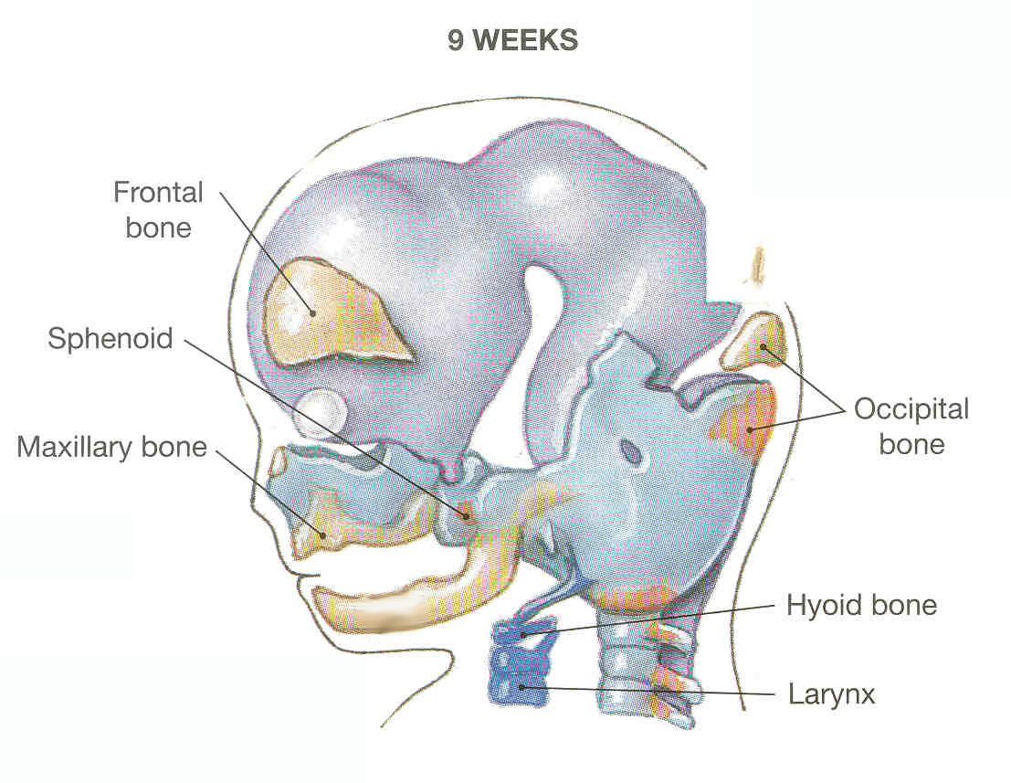

Slide 10
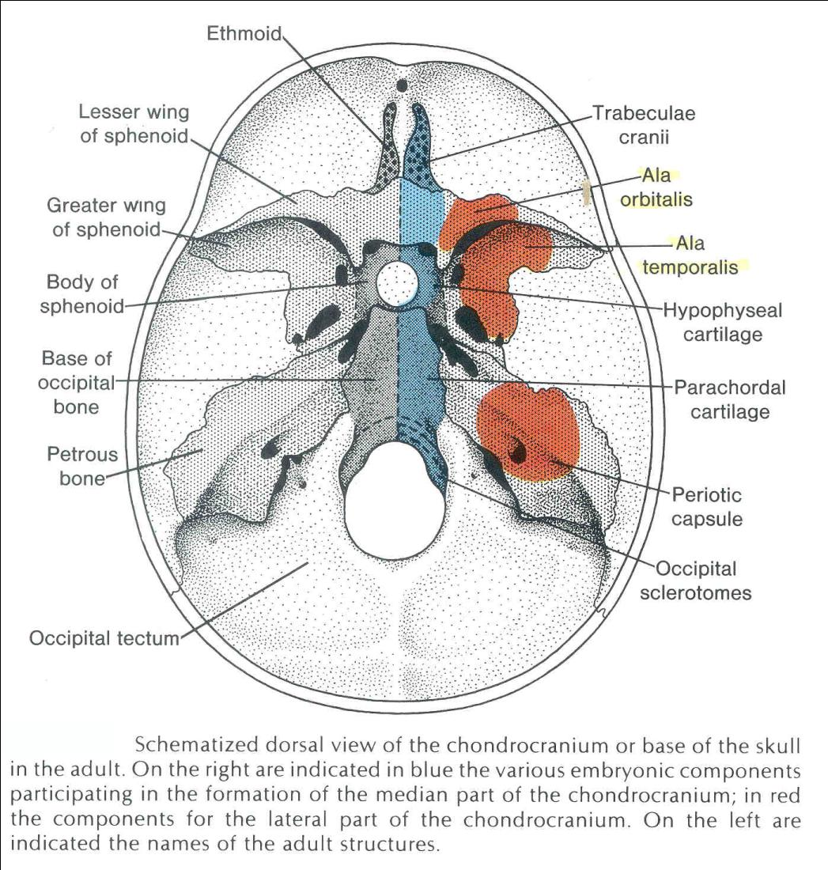

Slide 11
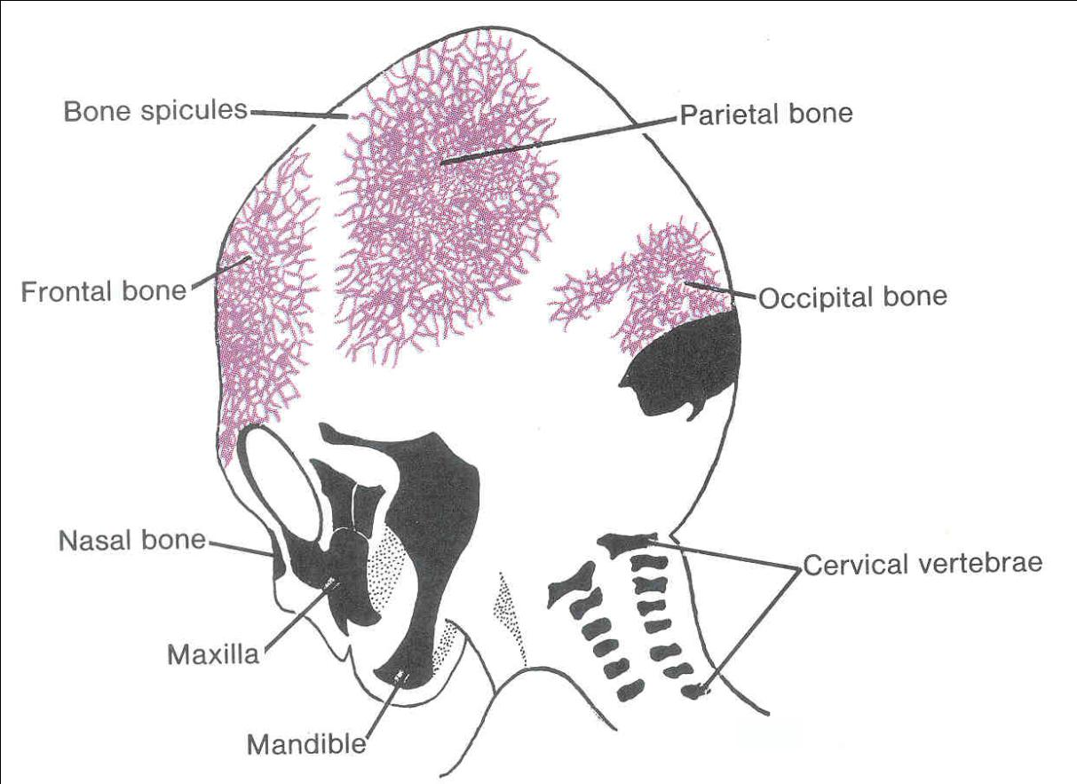
Flat bones of skull: DERMATOCRANIUM
(These and others.)

Slide 12
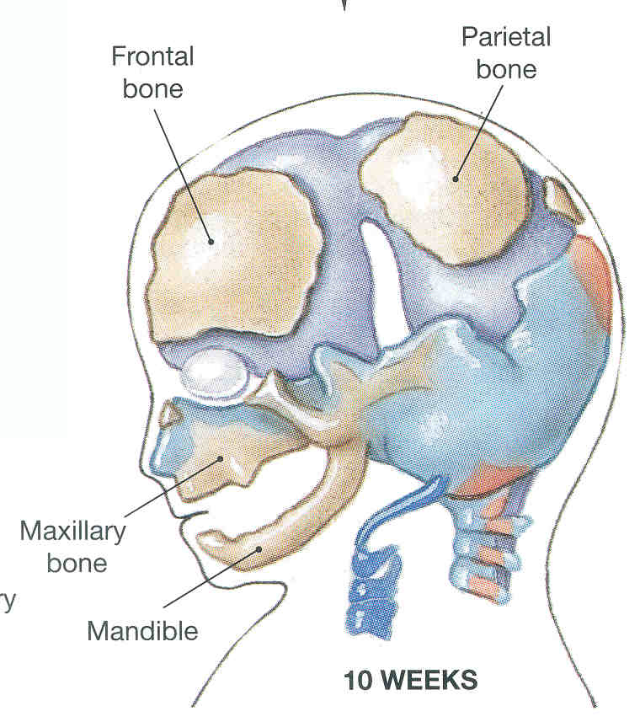

Slide 13
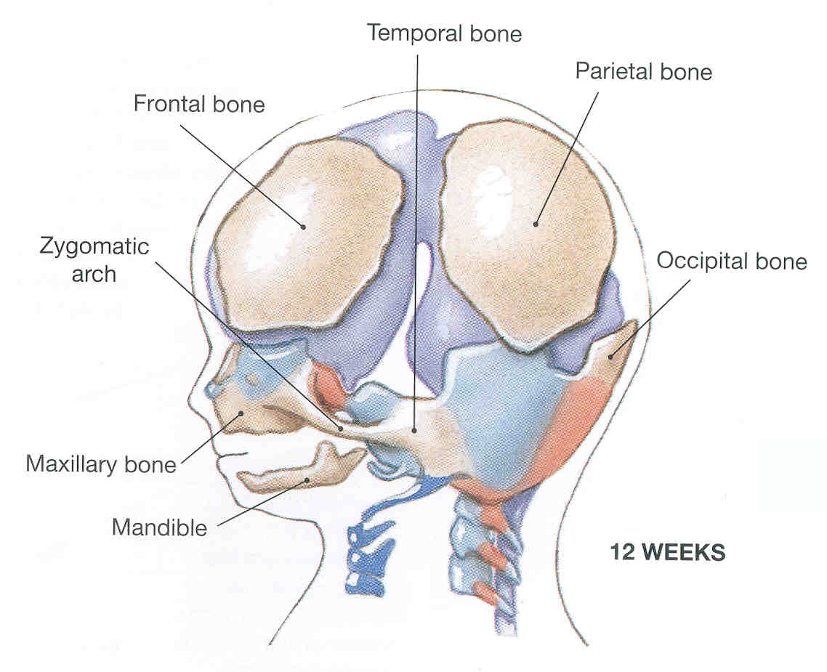

Slide 14
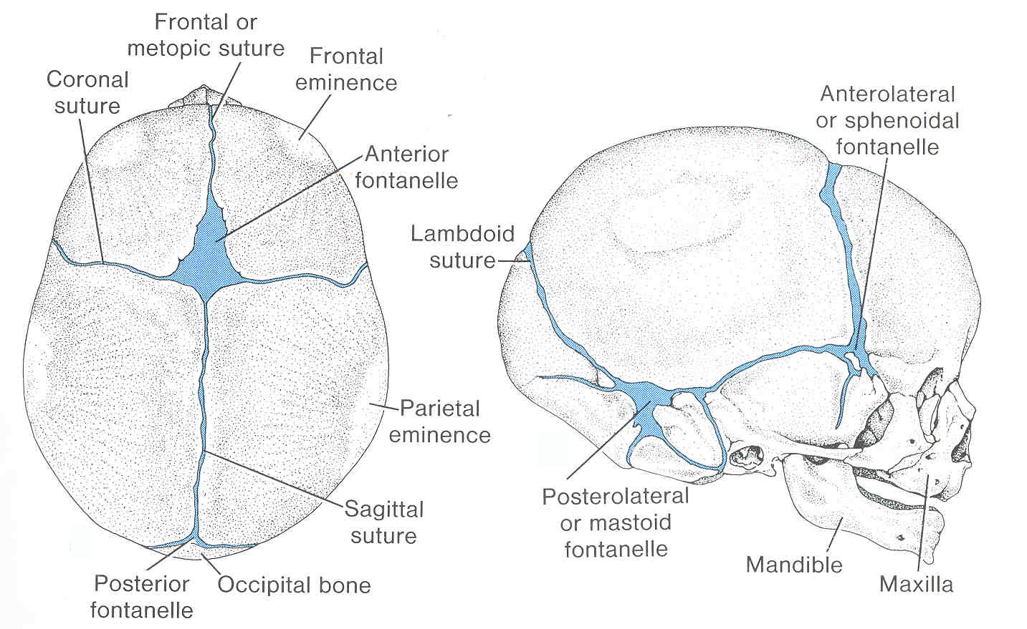

Slide 15
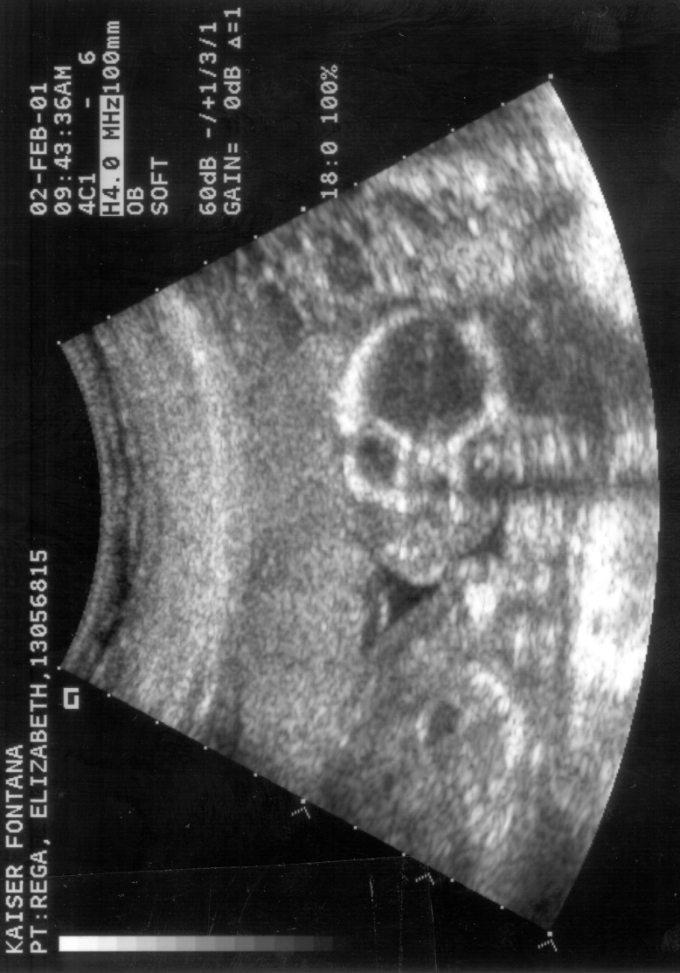

Slide 16
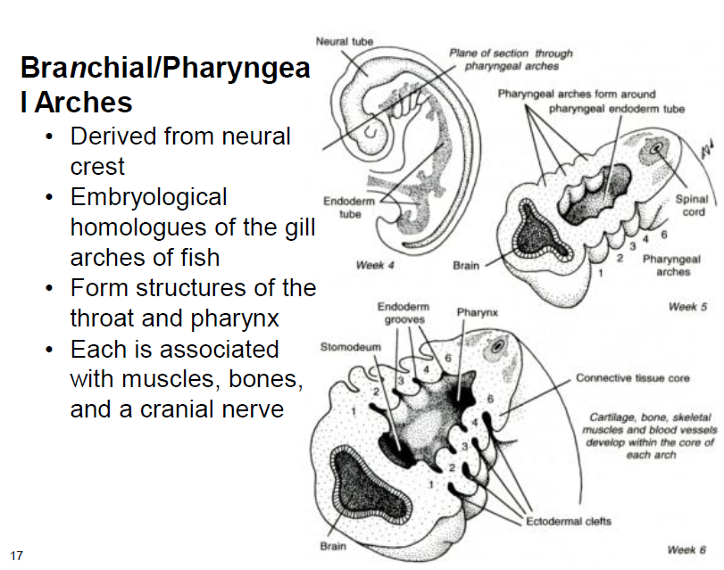

Slide 17
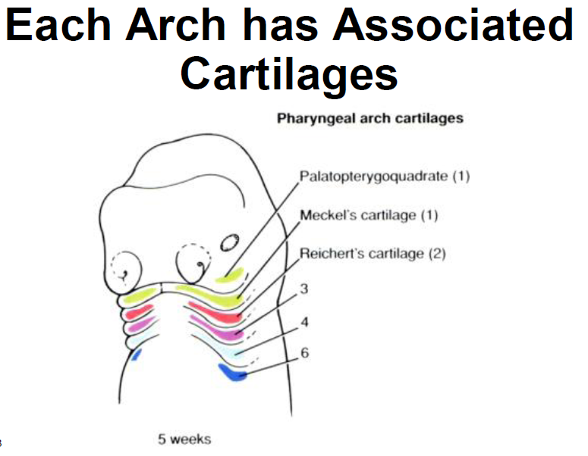

Slide 18
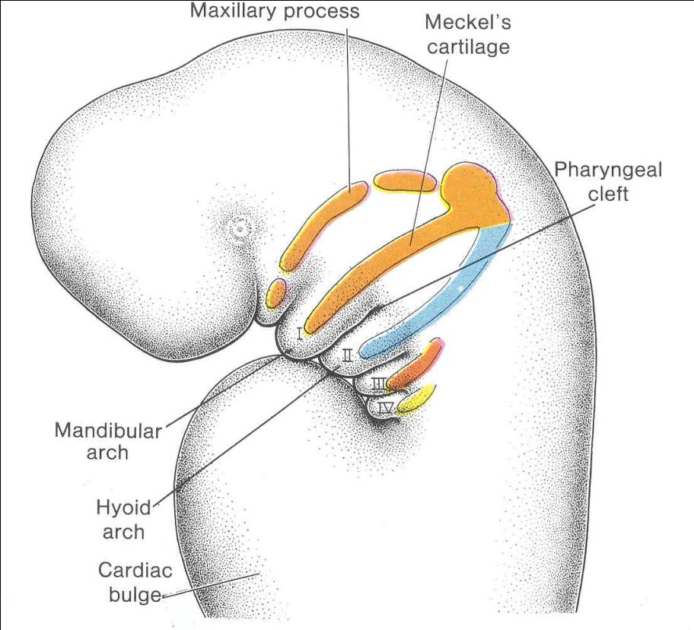
Gill Pouch Bones: become SPLANCHNOCRANIUM

Slide 19
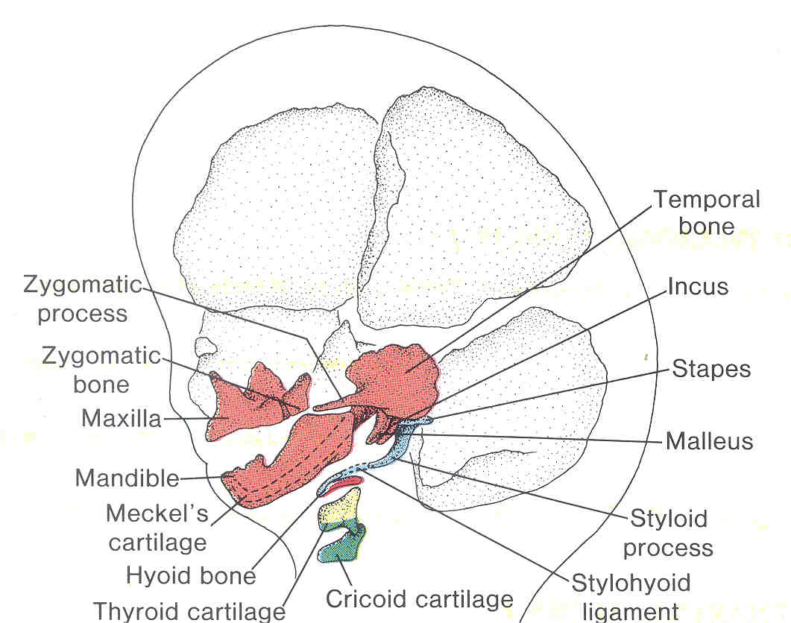

Slide 20
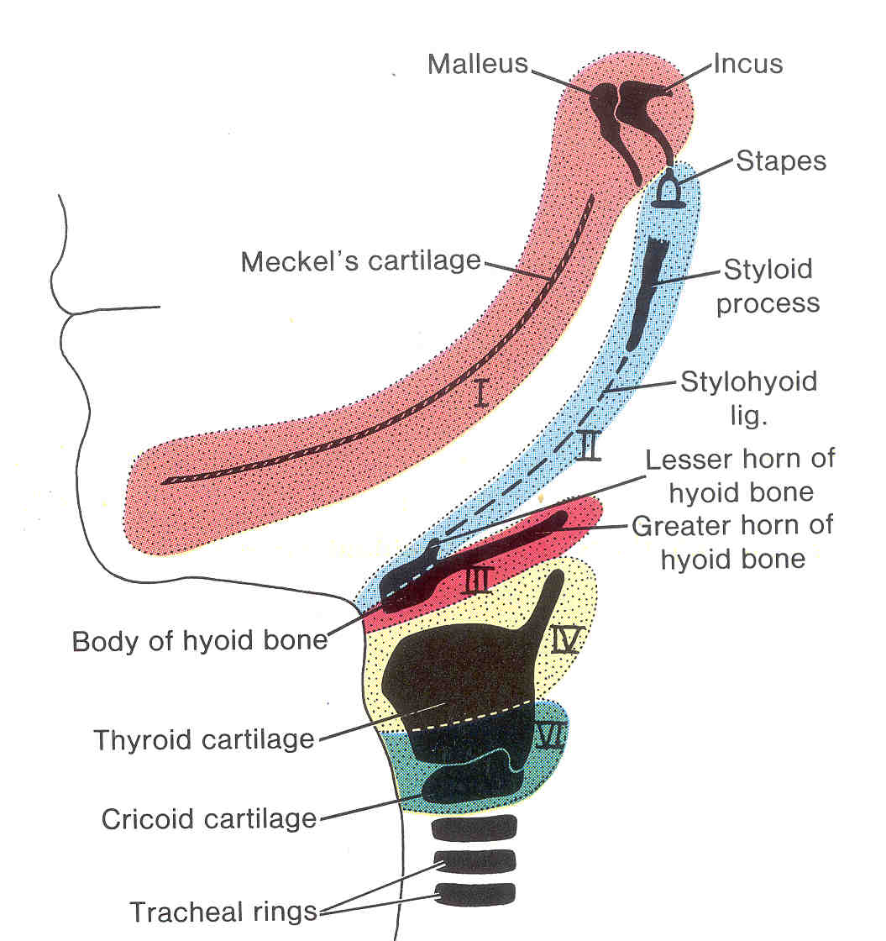

Slide 21
This lecture will revolve around the early embryology of the vertebrate skull. One of the landmark achievments in this was the summary of that topic – based initially the developing embryonic shark head – by Edwin S. Goodrich. Thus it has come to be known as the “Goodrich Diagram”.

Slide 22
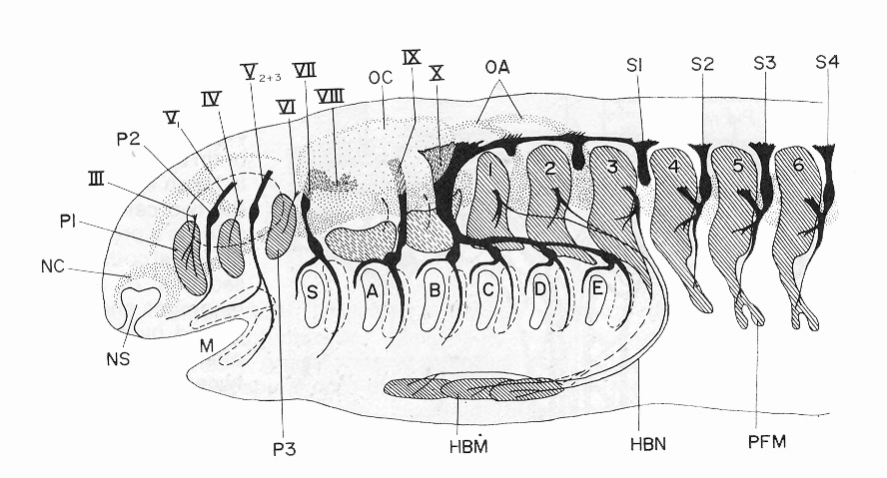
From Studies on the structure and development of vertebrates by Edwin S. Goodrich, 1958.

Slide 23
If you’re working with the PowerPoint files, save space in your notes to draw here.

Slide 24
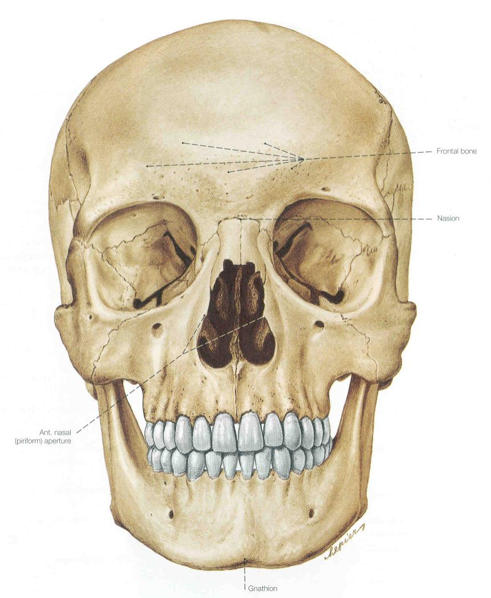

Slide 25
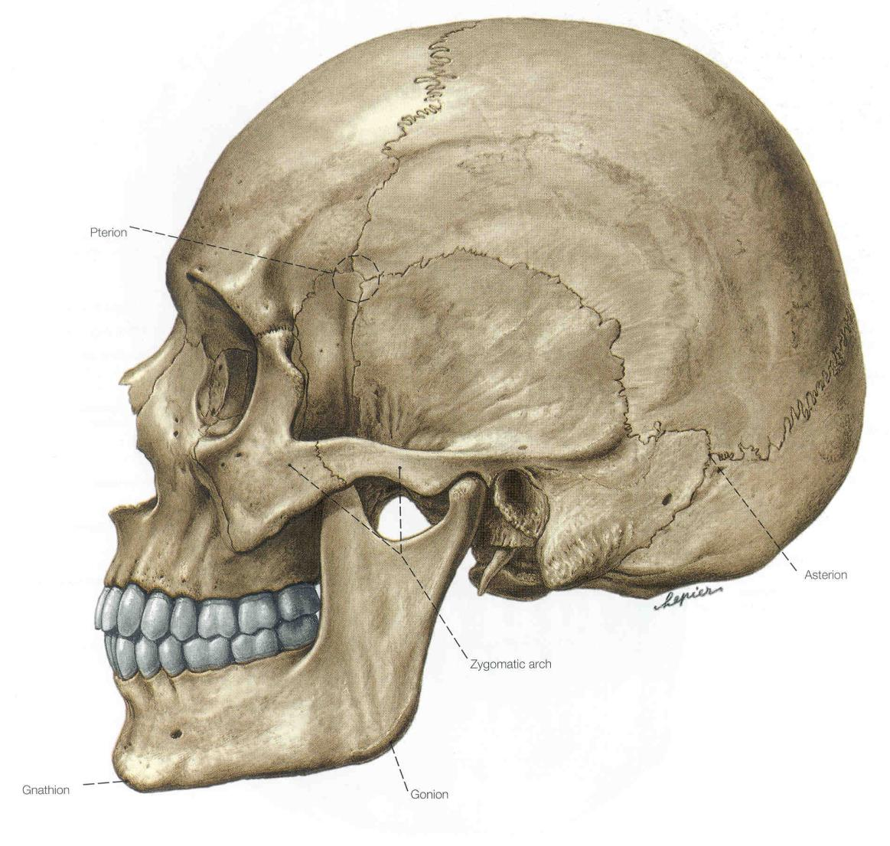

Slide 26
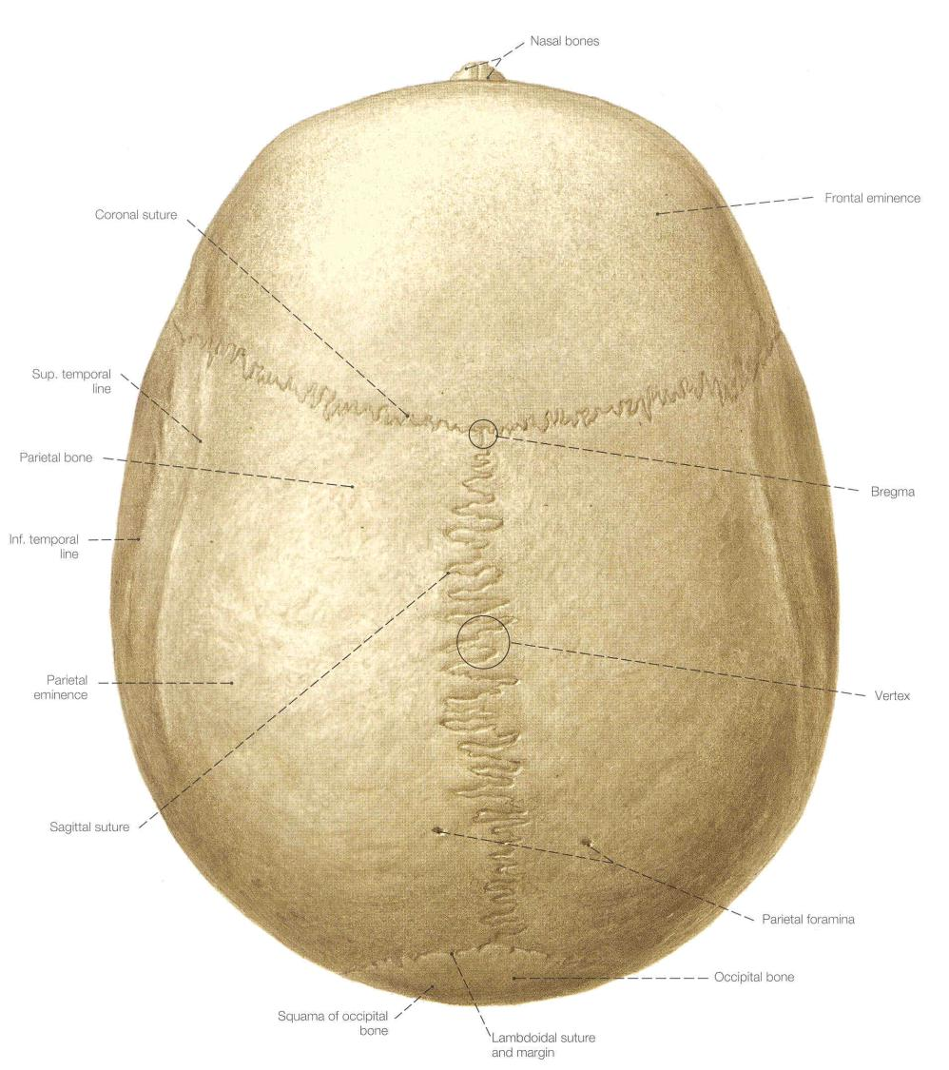

Slide 27
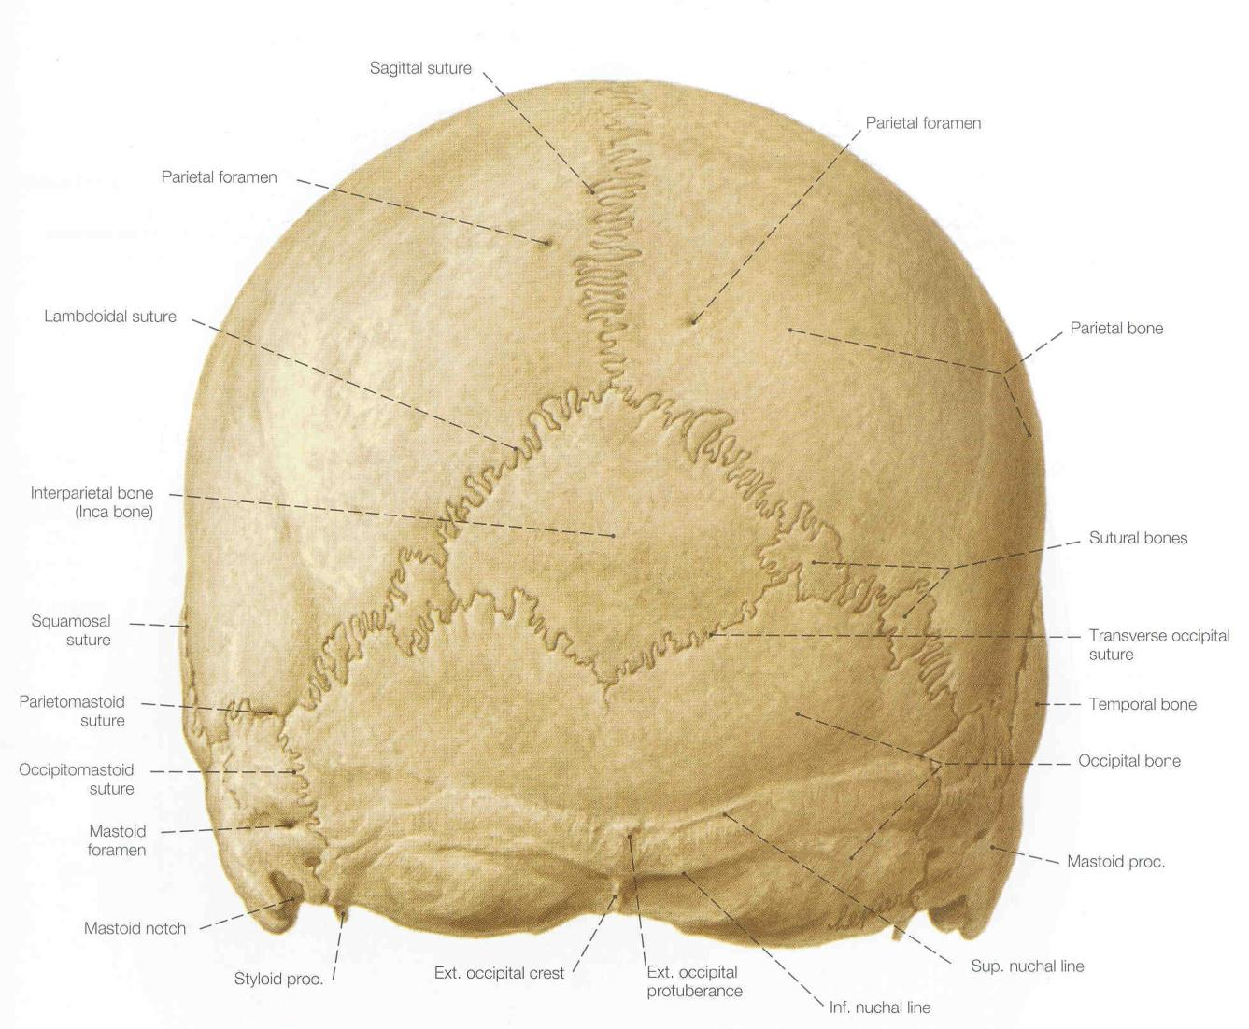

Slide 28
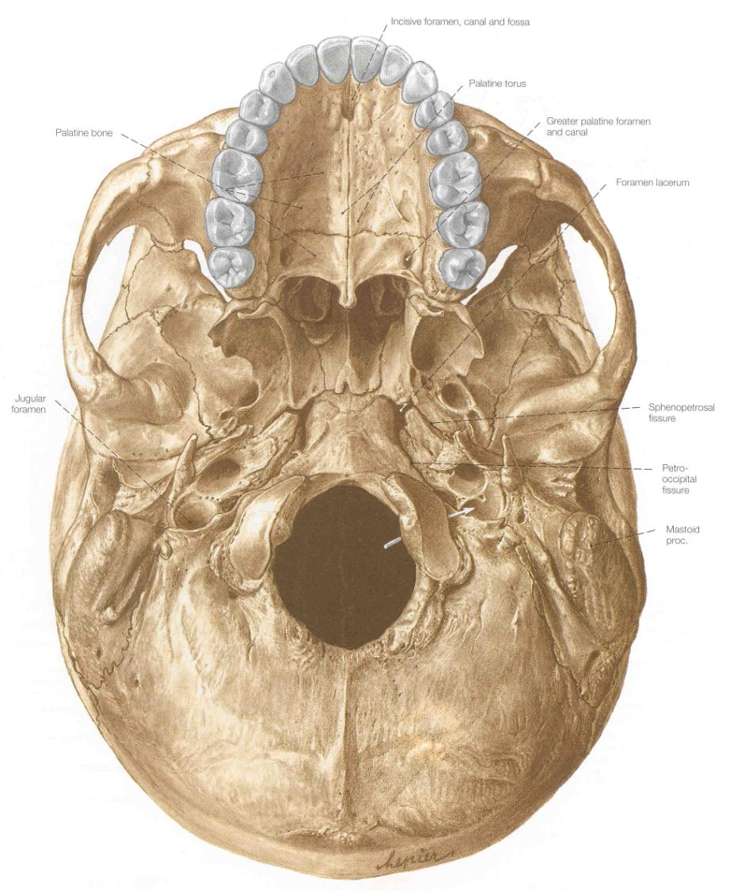

Slide 29
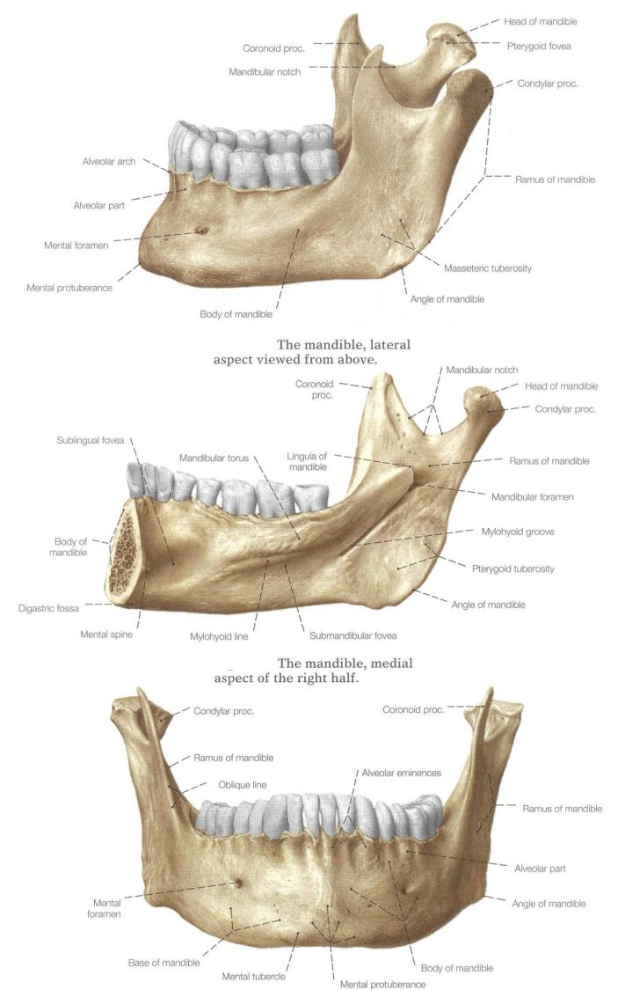
Mandible
(Lower Jaw)

Slide 30
Skull – Anterior View

Slide 32
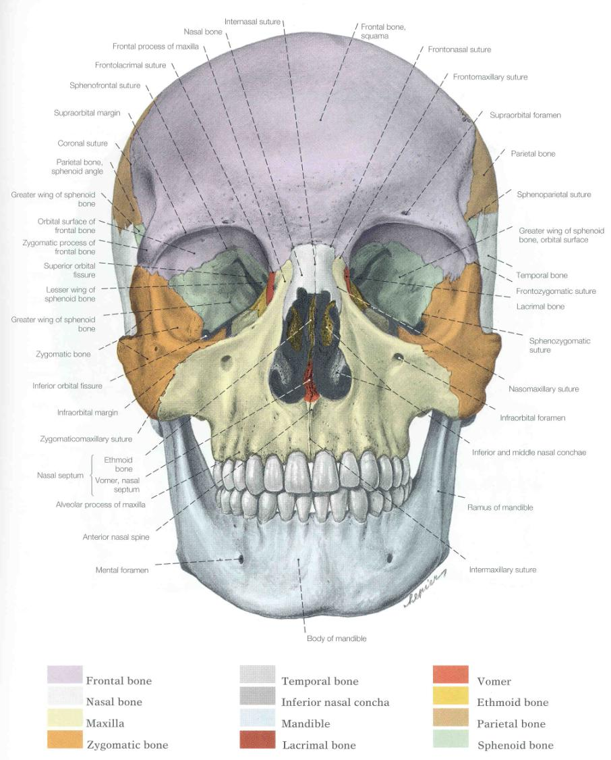

Slide 33
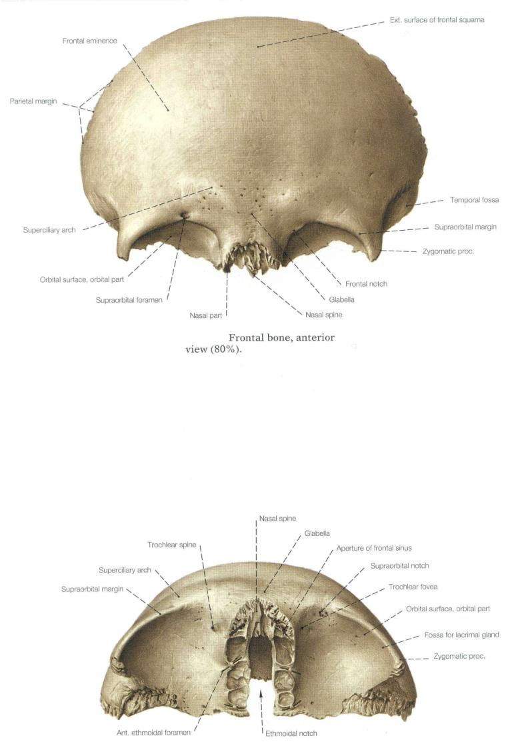
Anterior
Inferior
Frontal

Slide 34
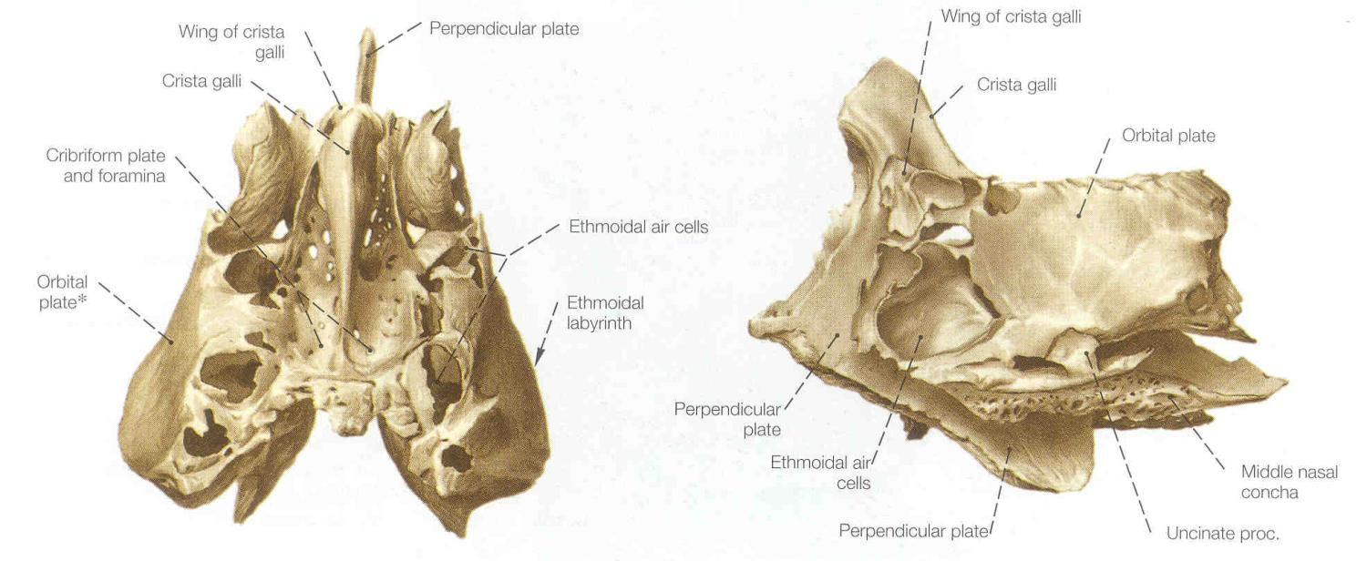
Ethmoid
superior
lateral

Slide 35
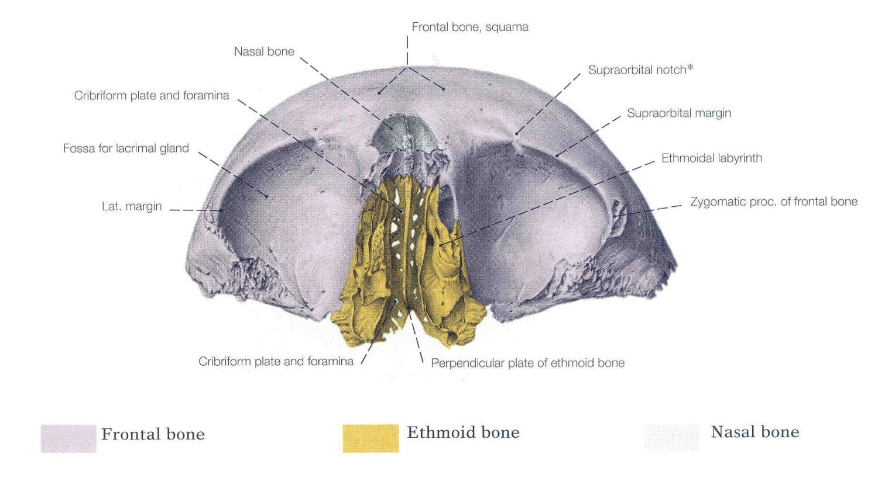

Slide 36
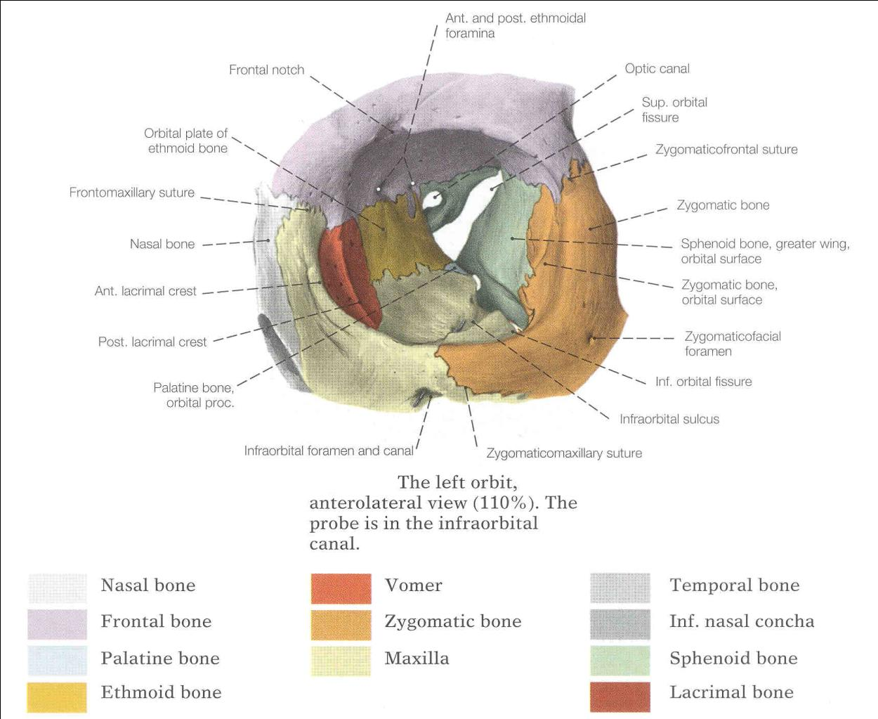
Bones of the Orbit

Slide 37
Skull – Lateral View

Slide 39
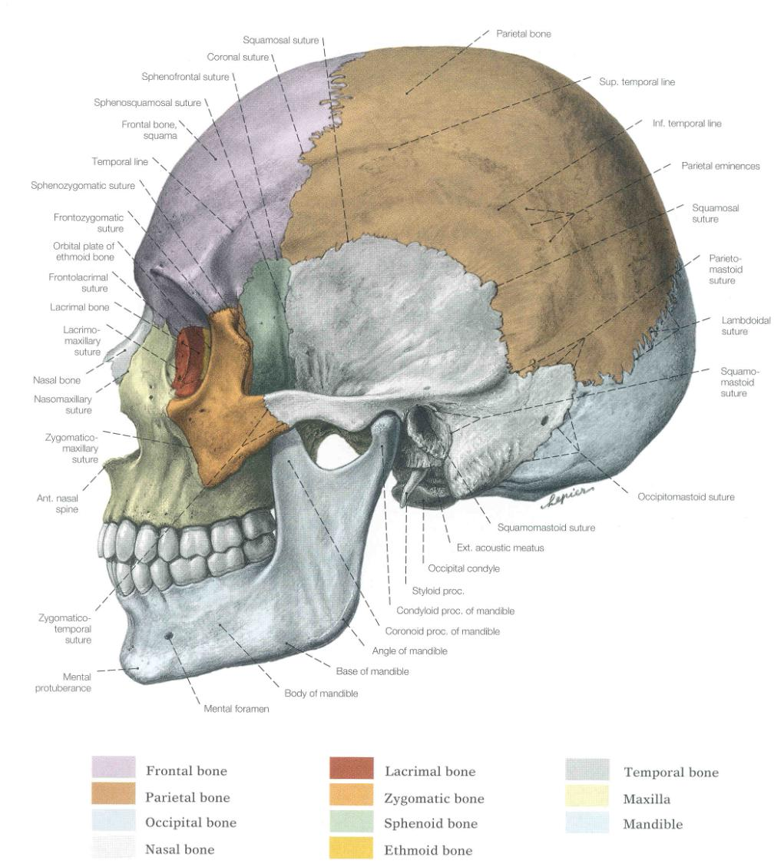

Slide 40
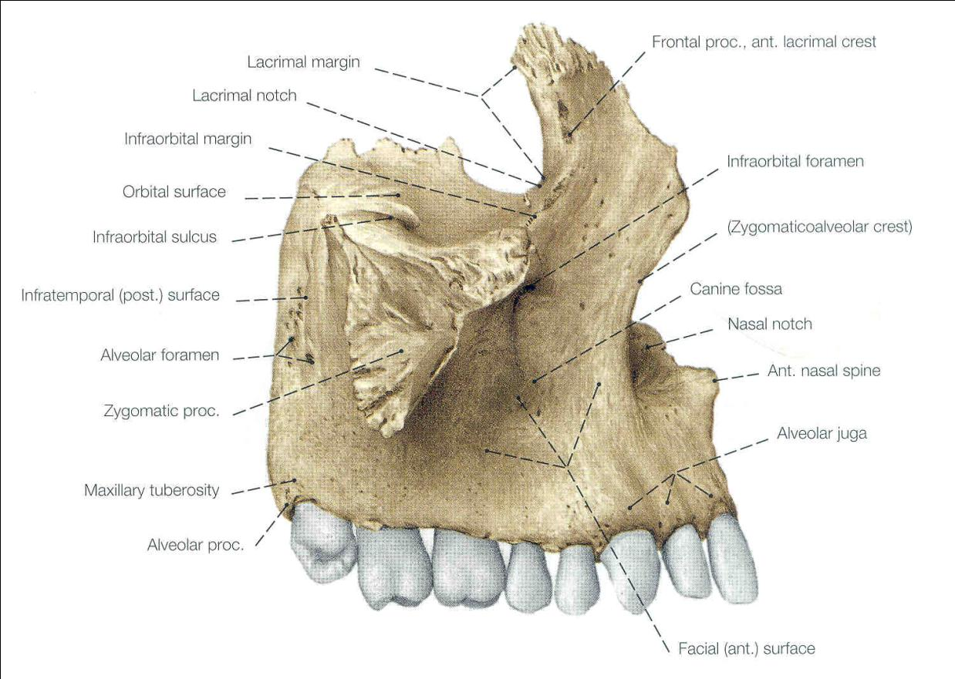
Maxilla: Lateral View

Slide 41
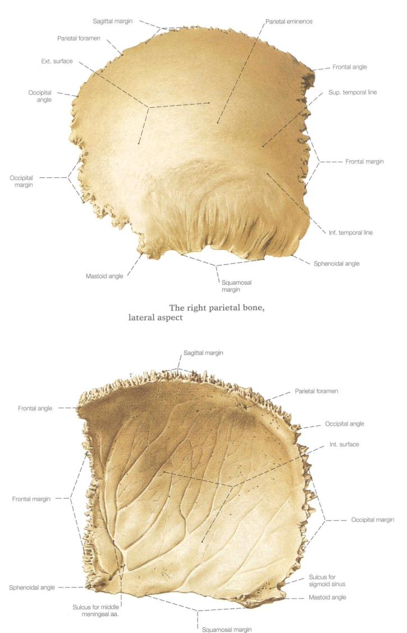
External
Internal
Parietal

Slide 42
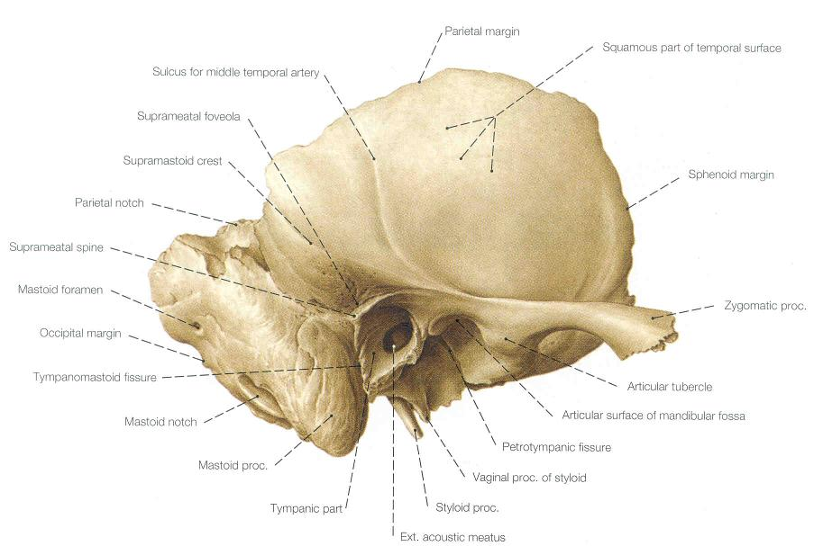
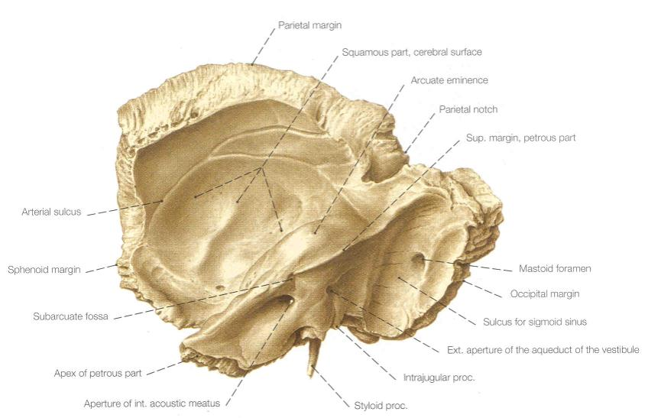
Temporal
Internal
External

Slide 43
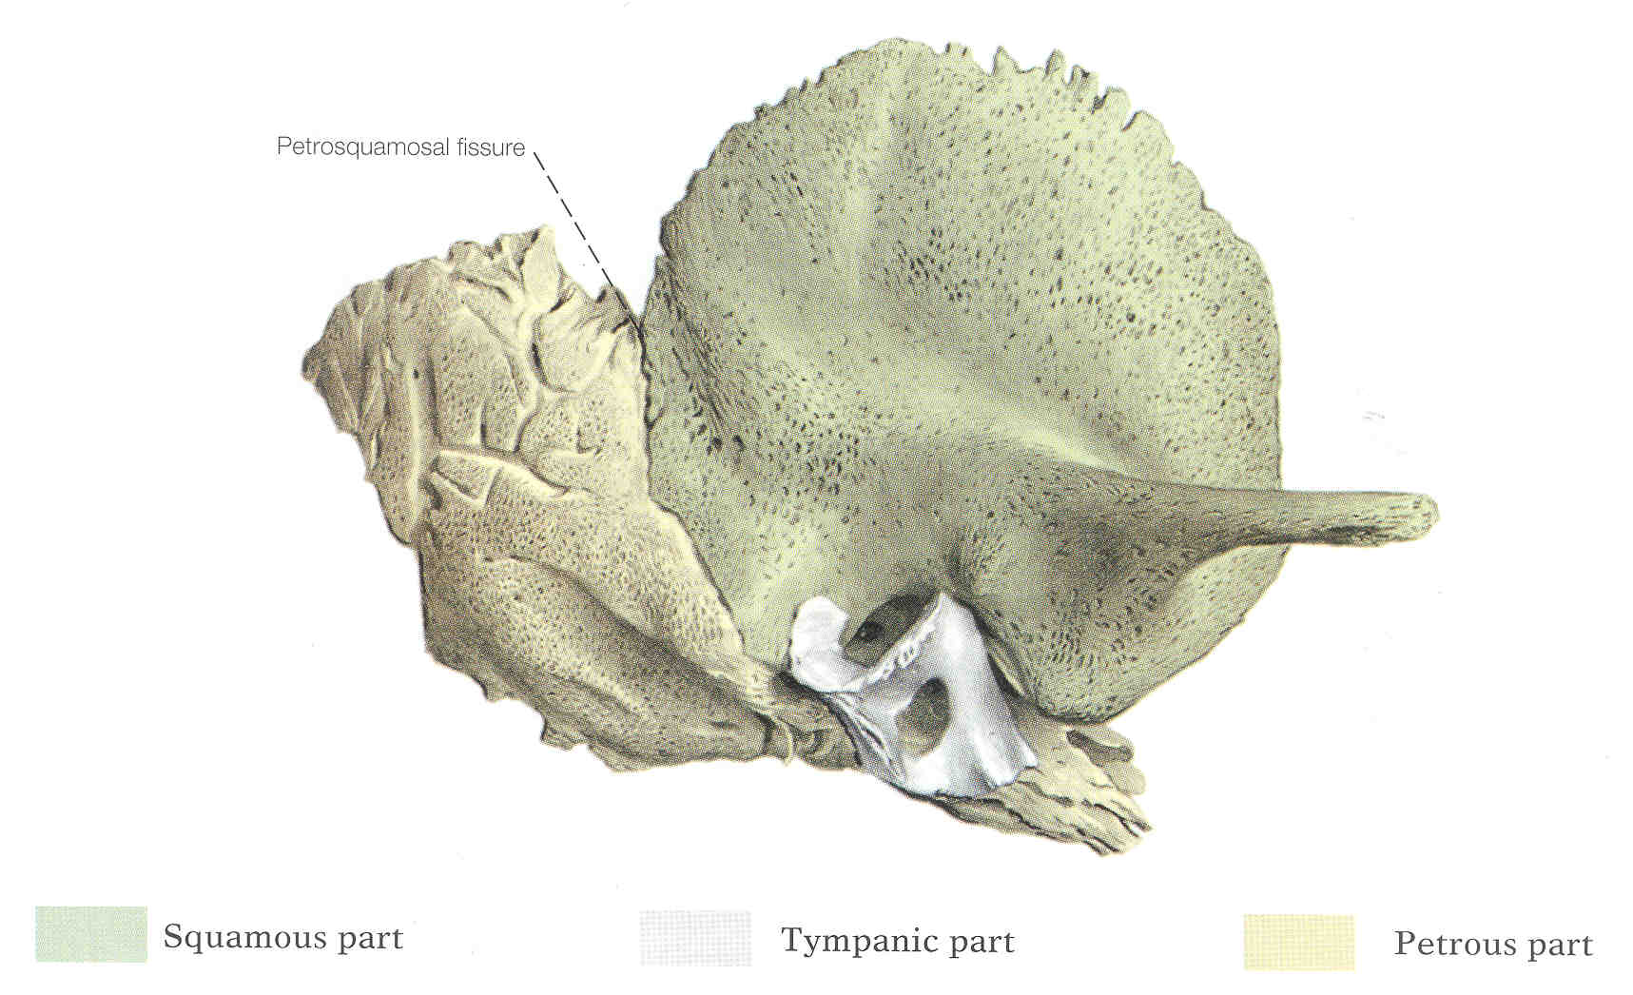
Neonatal Temporal Bone

Slide 44
Skull – Superior View

Slide 46
Skull – Posterior View

Slide 48
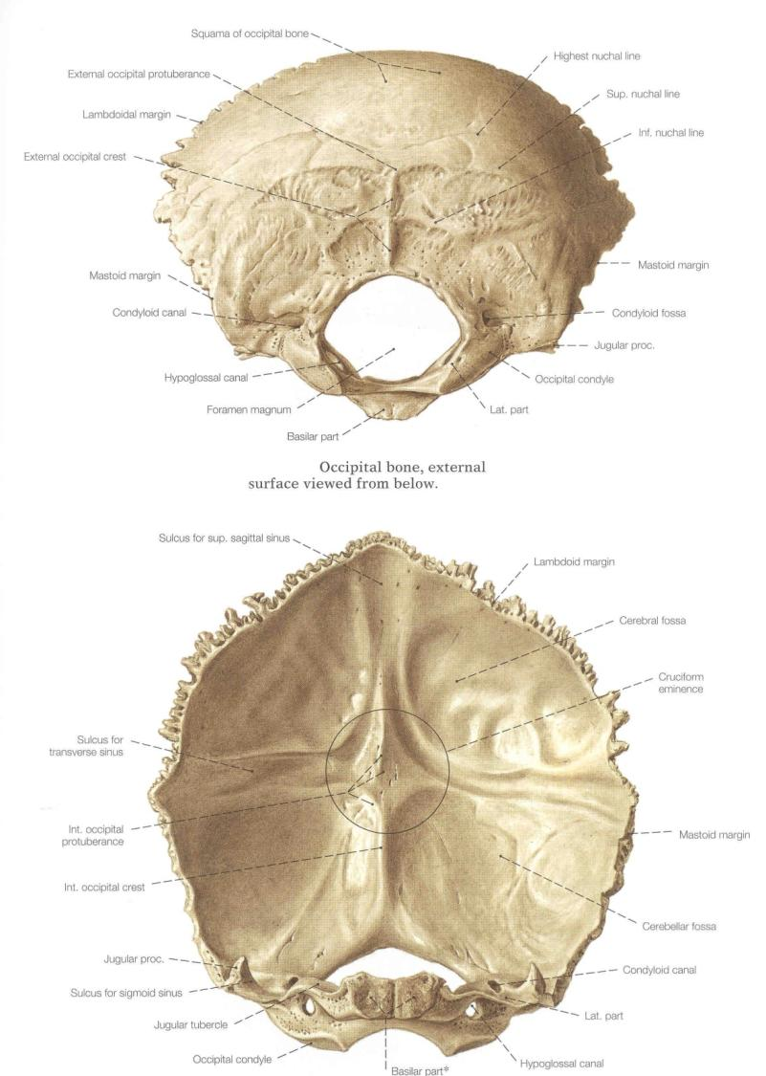
Inferior
Internal
Occipital

Slide 49
Skull – Inferior View

Slide 51
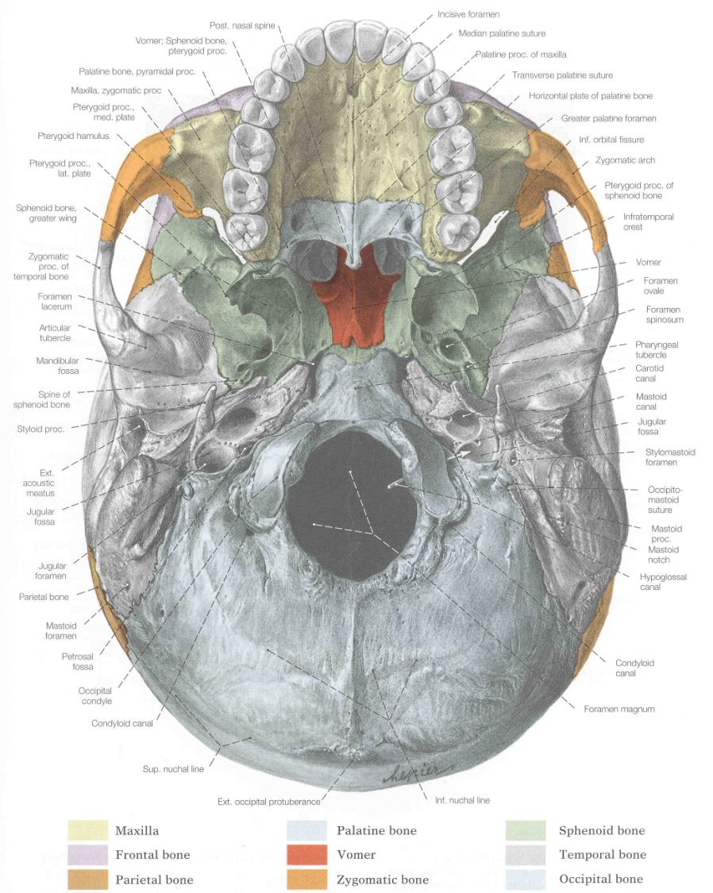

Slide 52
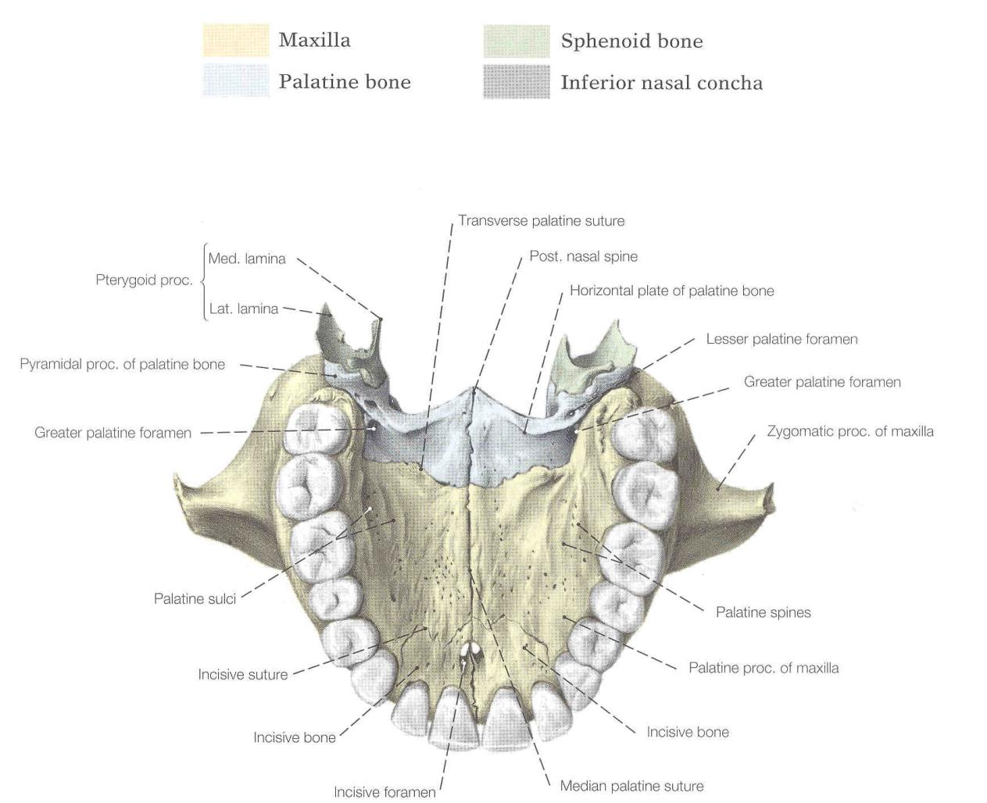
Hard Palate

Slide 53
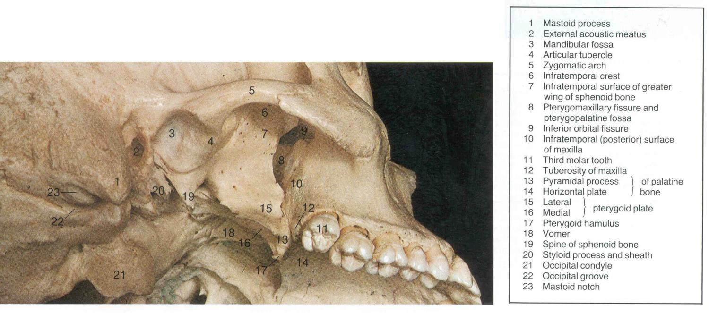
Infratemporal Region

Slide 54
Skull – Internal View

Slide 55
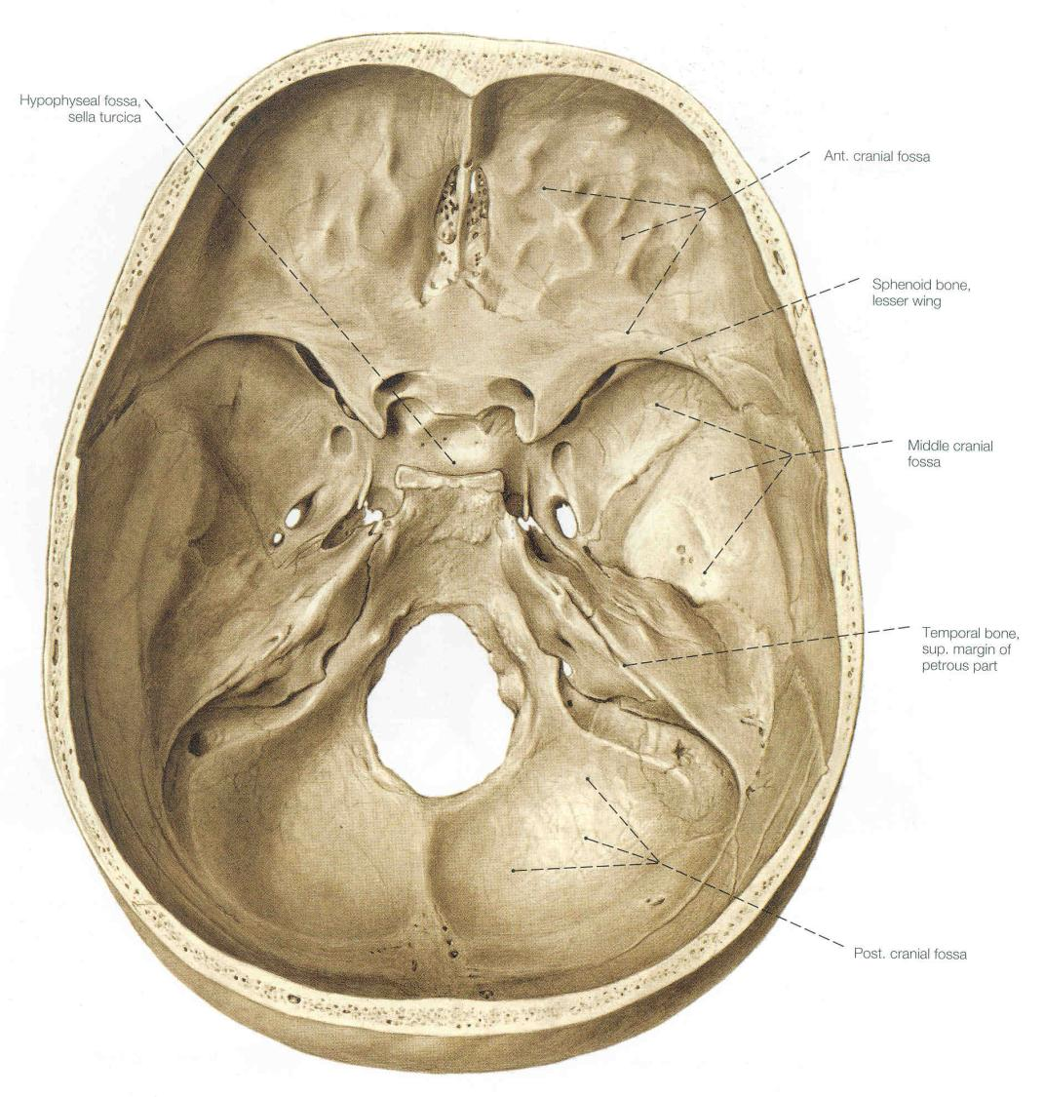

Slide 56
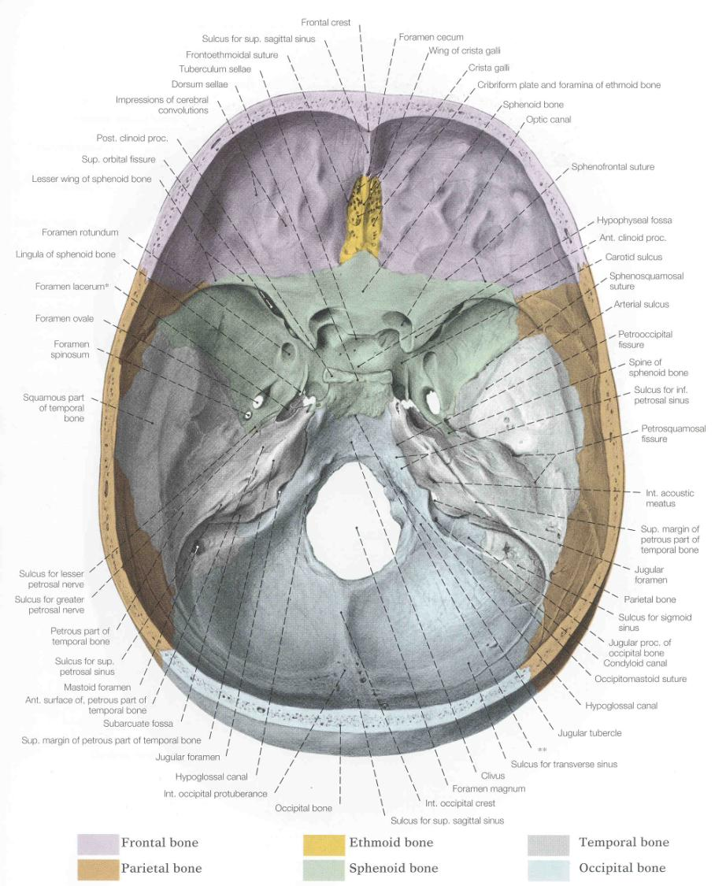

Slide 57
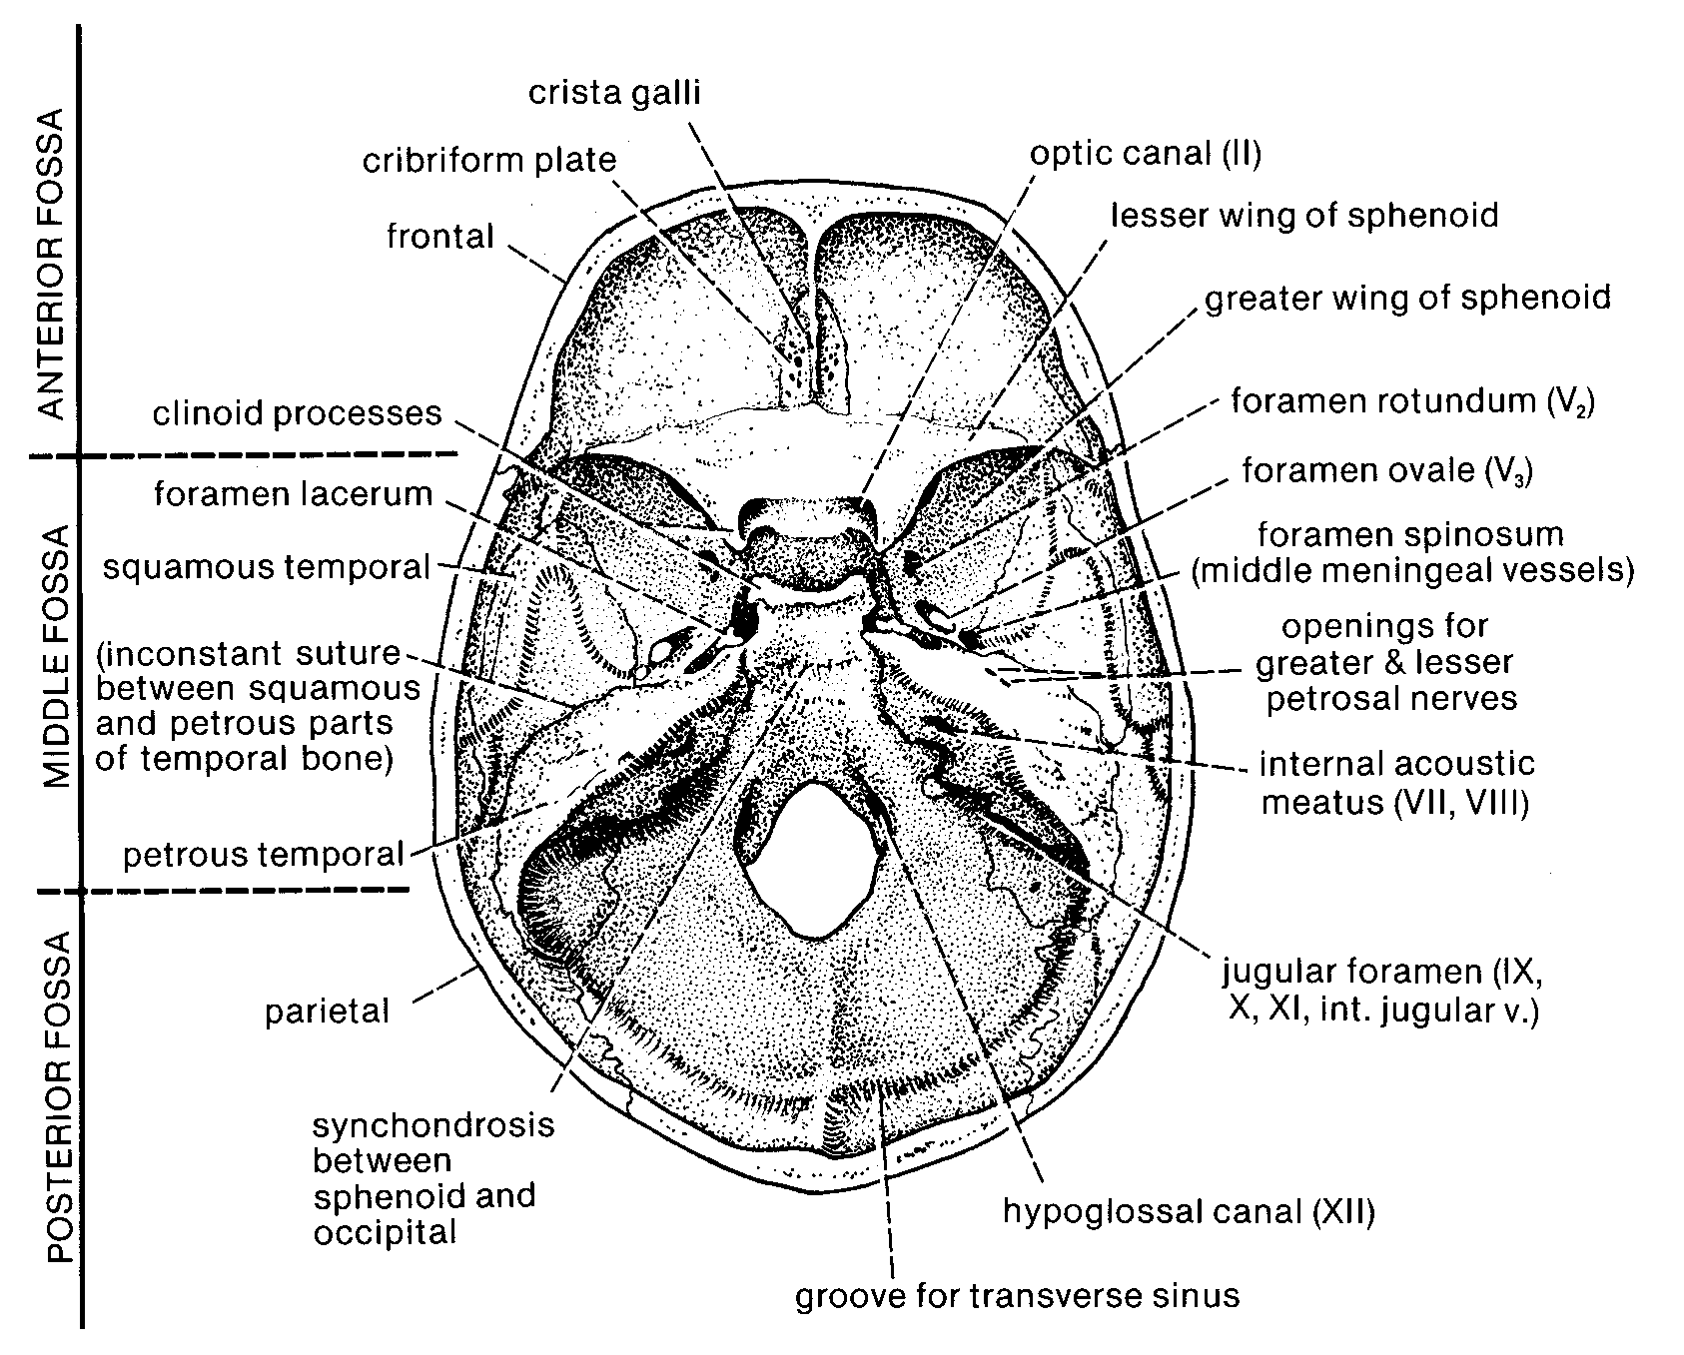

Slide 58
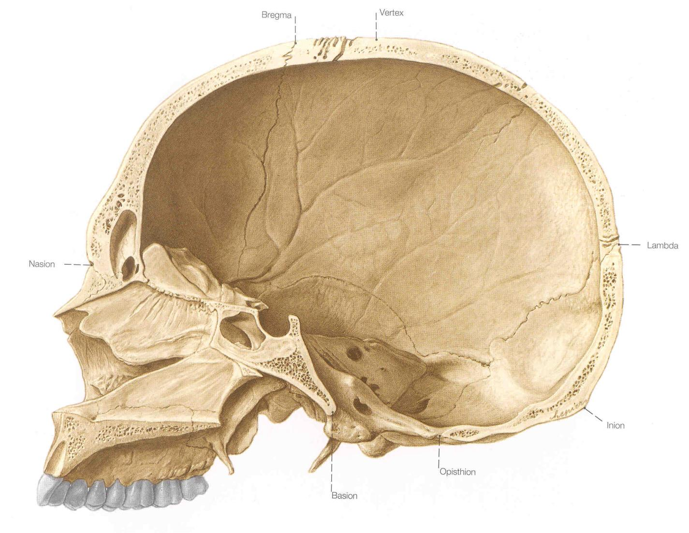

Slide 59
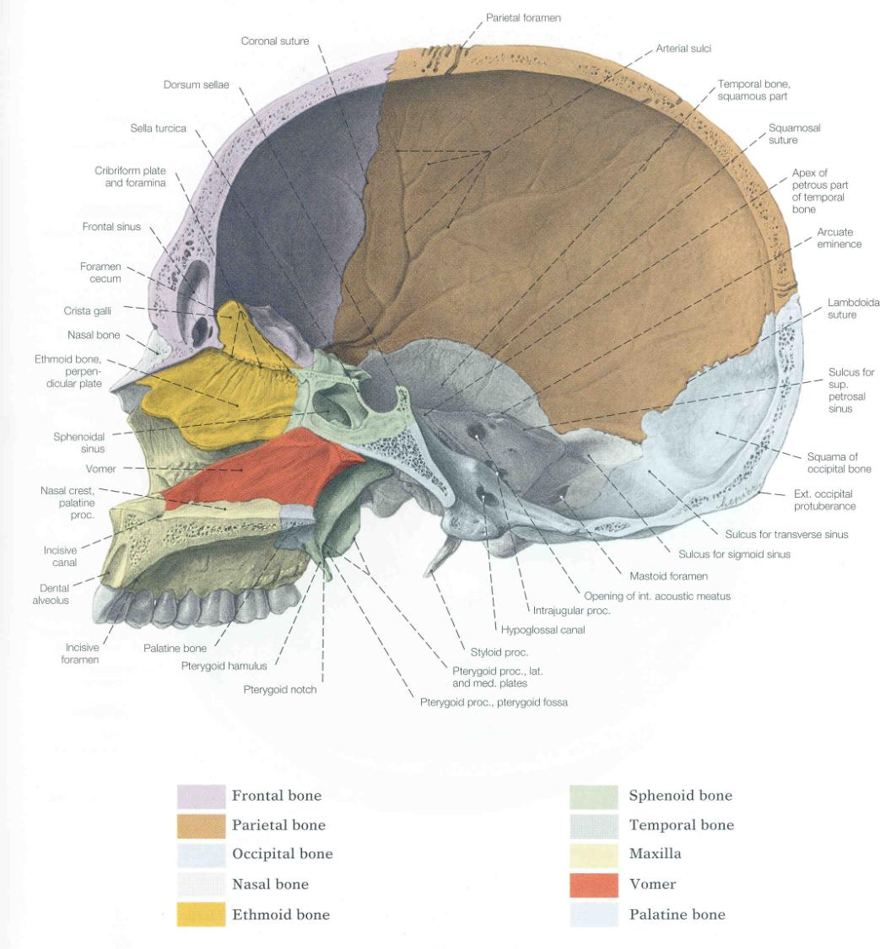

Slide 60
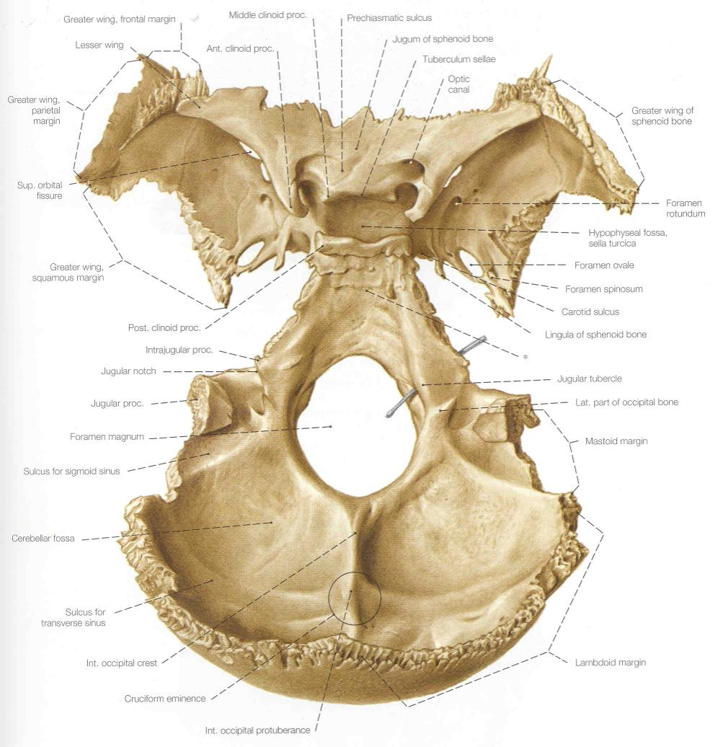
Sphenoid
Occipital

Slide 61
Major Ligaments Near Jaw Joint

Slide 62
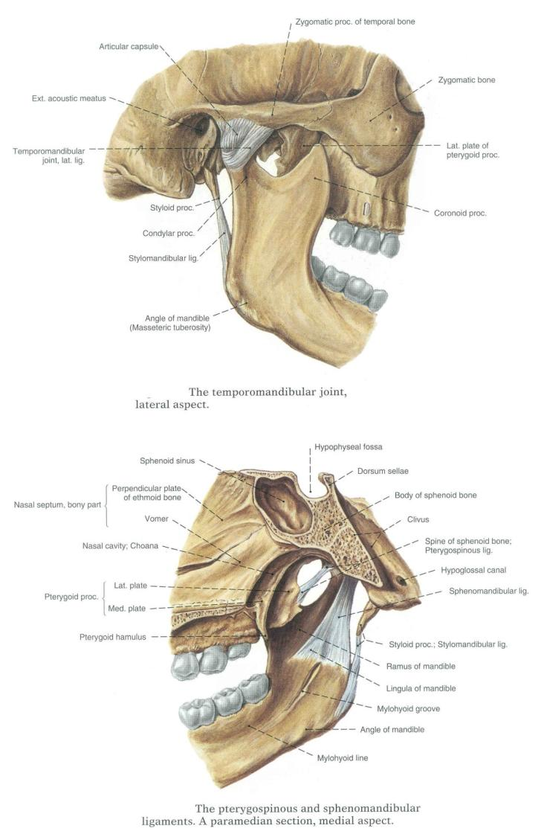
Major Ligaments Near Jaw Joint:
Stylomandibular
Sphenomandibular

Slide 63
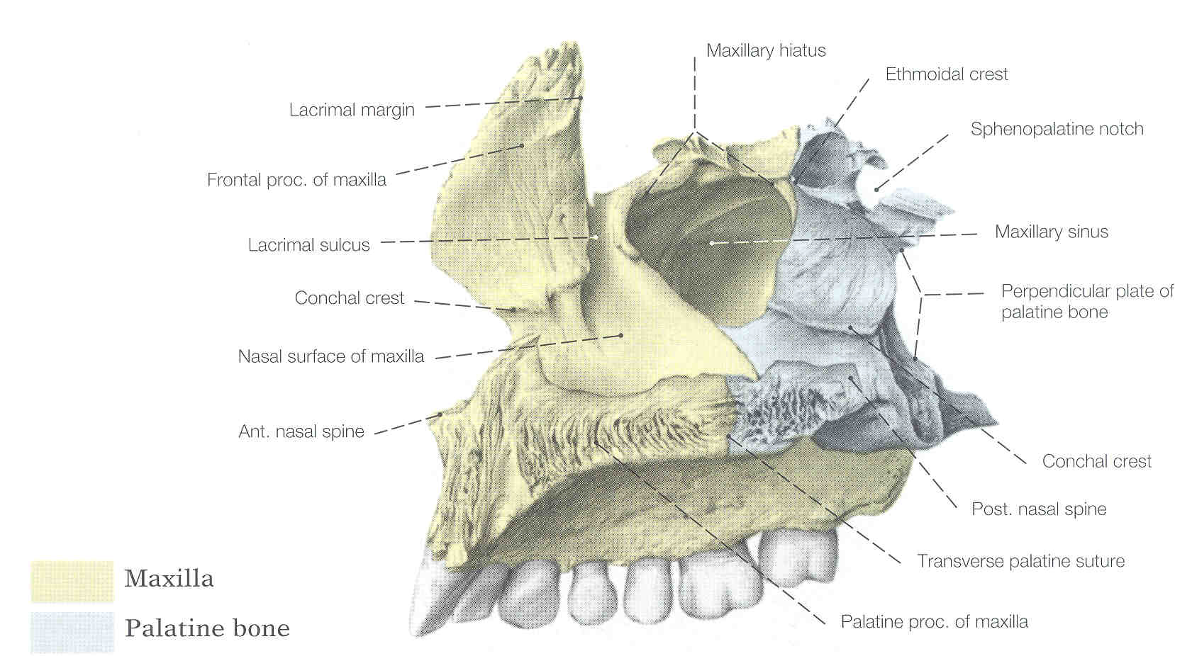

Slide 64
Bones of the Basicranium
Ethmoid
Sphenoid
Temporal
Occipital

Slide 65
Ethmoid
superior
lateral

Slide 66
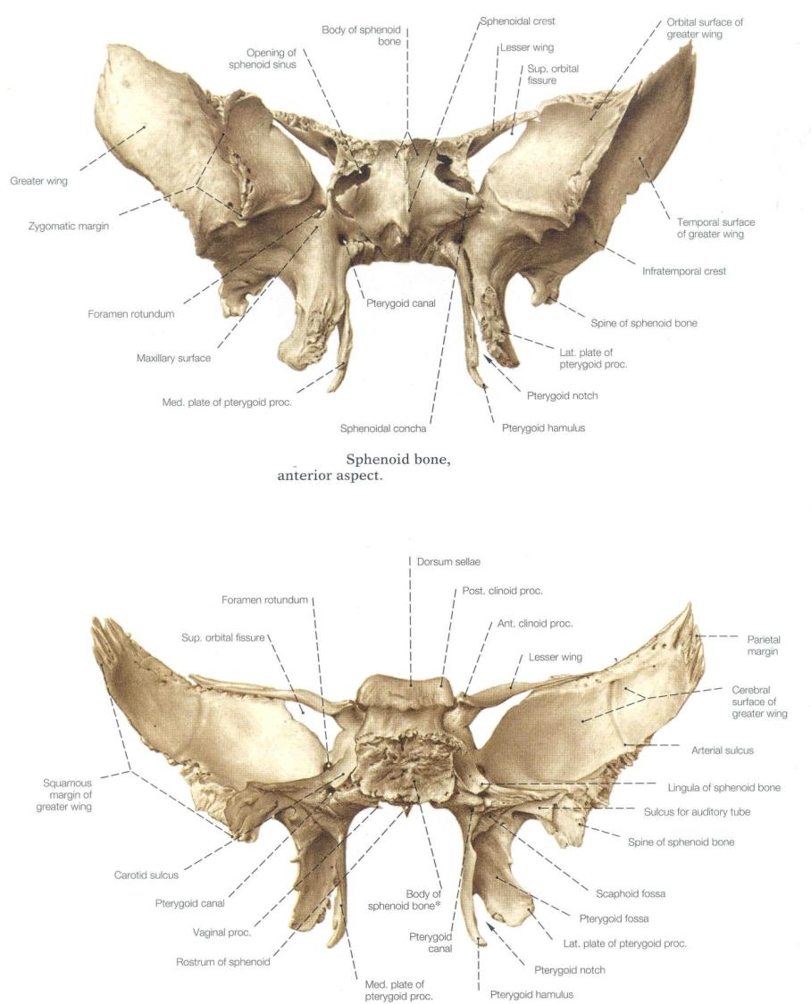
Anterior
Posterior
Sphenoid

Slide 67
Temporal
Internal
External

Slide 68
Neonatal Temporal Bone

Slide 69
Sphenoid
Occipital

Slide 71
Dermal Roofing Bones
Nasals
Frontal
Parietals

Slide 73
Anterior
Inferior
Frontal

Slide 75
External
Internal
Parietal

Slide 76
Dermal Facial Bones
Maxilla
Zygomatic
Lacrimal

Slide 78
Maxilla: Lateral View

Slide 80
Bones of the Orbit

Slide 81
Dermal Palatal Bones
Maxilla
Palatine
Vomer

Slide 82
Hard Palate

Slide 84
Bones of Splanchnopleure
Sphenoid Greater Wing
Temporal Styloid Process
Middle Ear Ossicles

Slide 85
Anterior
Posterior
Sphenoid

Slide 86
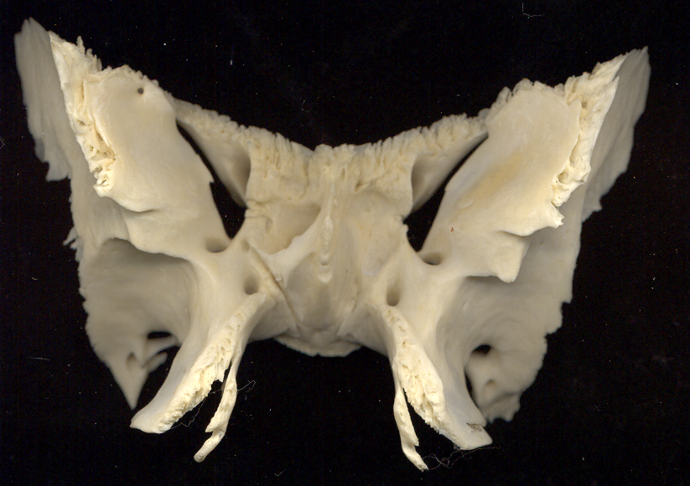
Sphenoid/ anterior view of orbital surface and foramina with associated cranial nerves indicated
II
V1
III
Opth. a.
IV
VI
Opthalmic v.
V2
Nerve of pterygoid canal ALSO CALLED VIDIAN NERVE (VII parasympathetics + sympathetics)
V3

Slide 87
Neonatal Temporal Bone

Slide 88
Middle Ear Ossicles
Malleus
Incus
Stapes

Slide 89
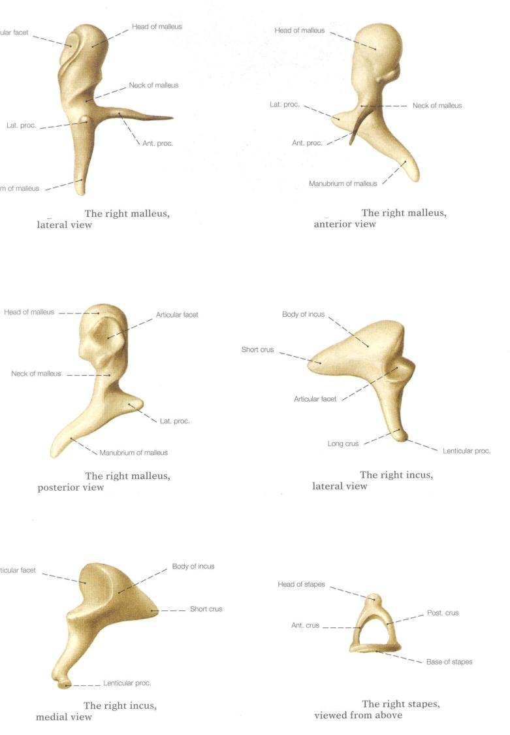

Slide 90
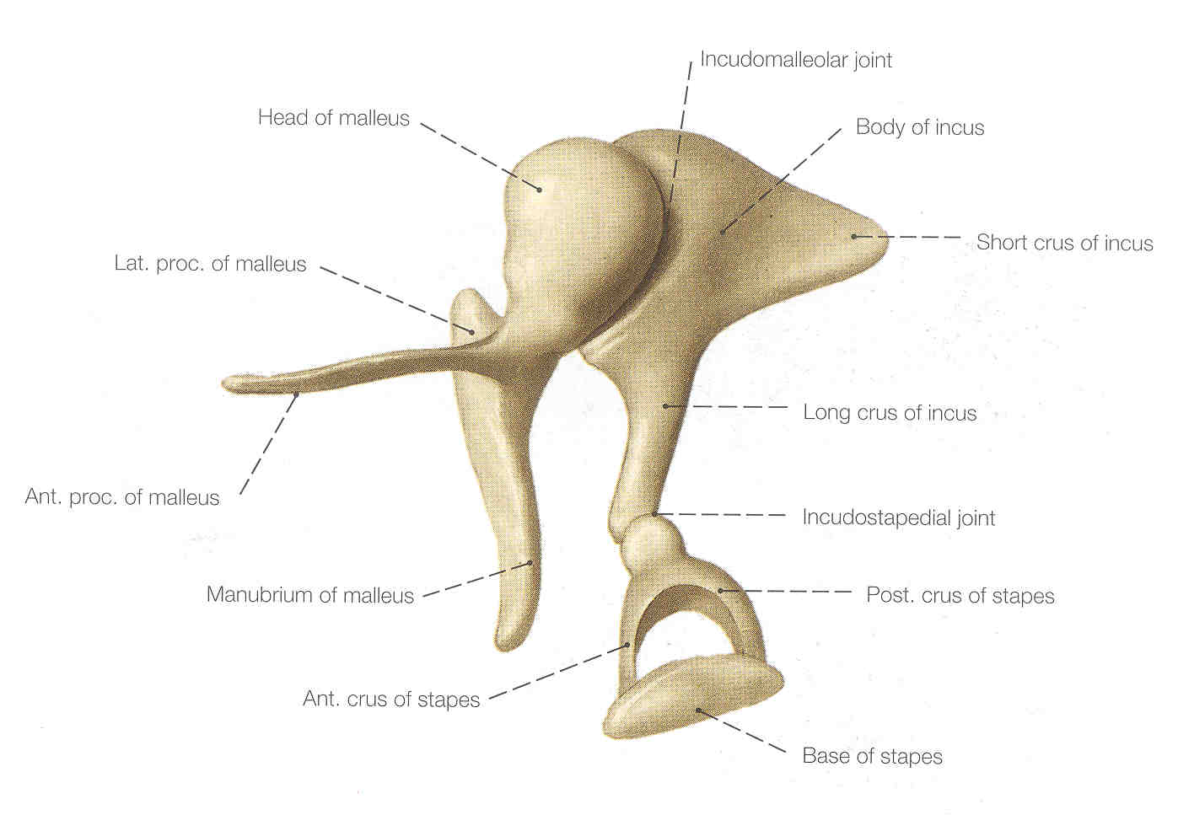

Slide 91
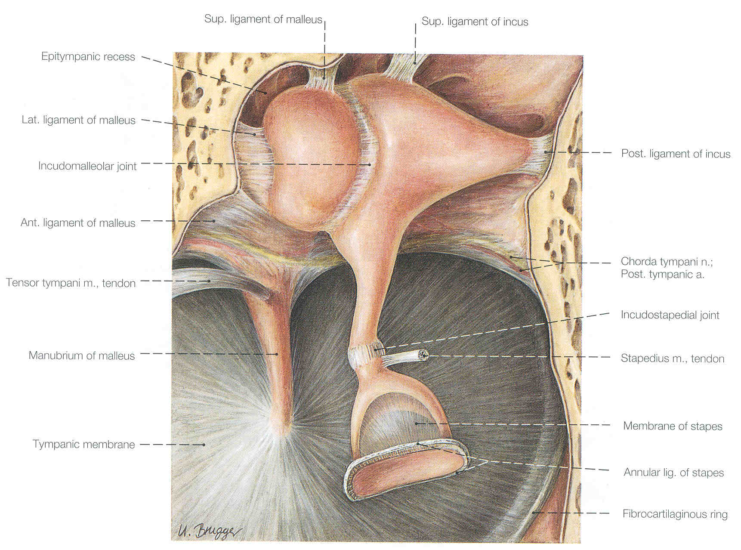

Slide 92


Slide 93


Slide 94


Slide 95


