Slide 1
Biology 323
Human Anatomy for Biology Majors
Lecture 17
Dr. Stuart S. Sumida
Cranial Nerves and Soft Tissues of the Skull

Slide 2
Start with
BRAIN STUFF…

Slide 3
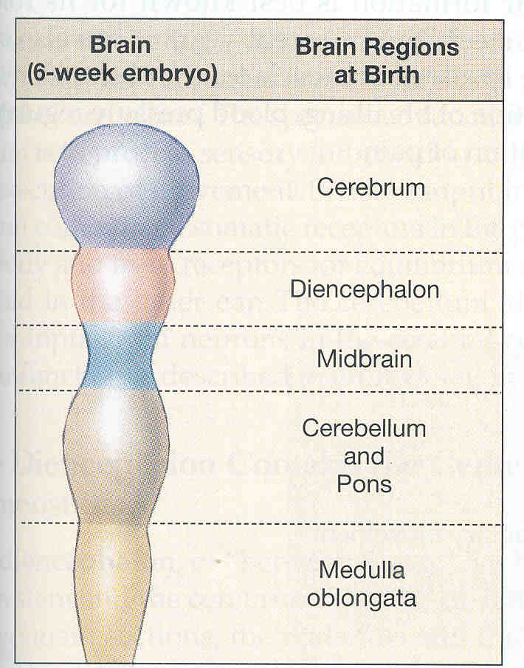
FOREBRAIN
MIDBRAIN
HINDBRAIN

Slide 4
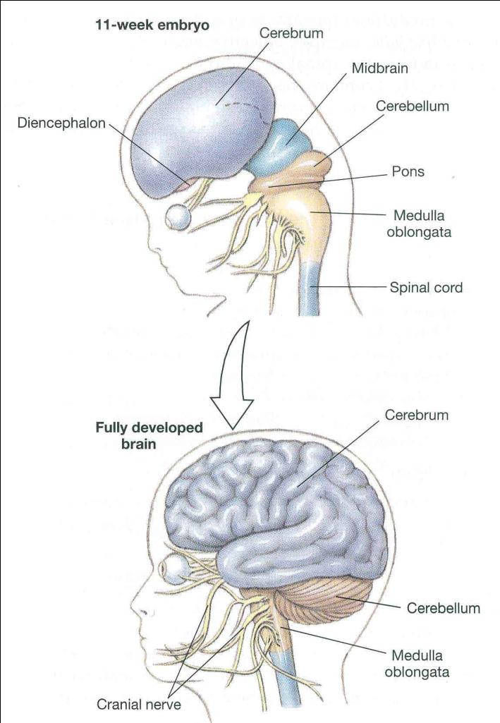

Slide 5
Forebrain:
Cerebrum – Perception, movement of somatopleure,
sensoro-motor integration, emotion, memory, learning.
Diencephalon – Homeostasis, behavioral drives in
hypothalamus; sensory relay and modification in thalamus;
melatonin secretion in pineal gland.
Midbrain (Mesencephalon)
Control of eye movement.
Hindbrain
Cerebellum and Pons – control of movement,
proprioreceptive input; relays visual and auditory reflexes in
pons.
Medulla Oblongata – Involuntry functions: blood pressure,
sleep, breathing, vomiting.

Slide 6
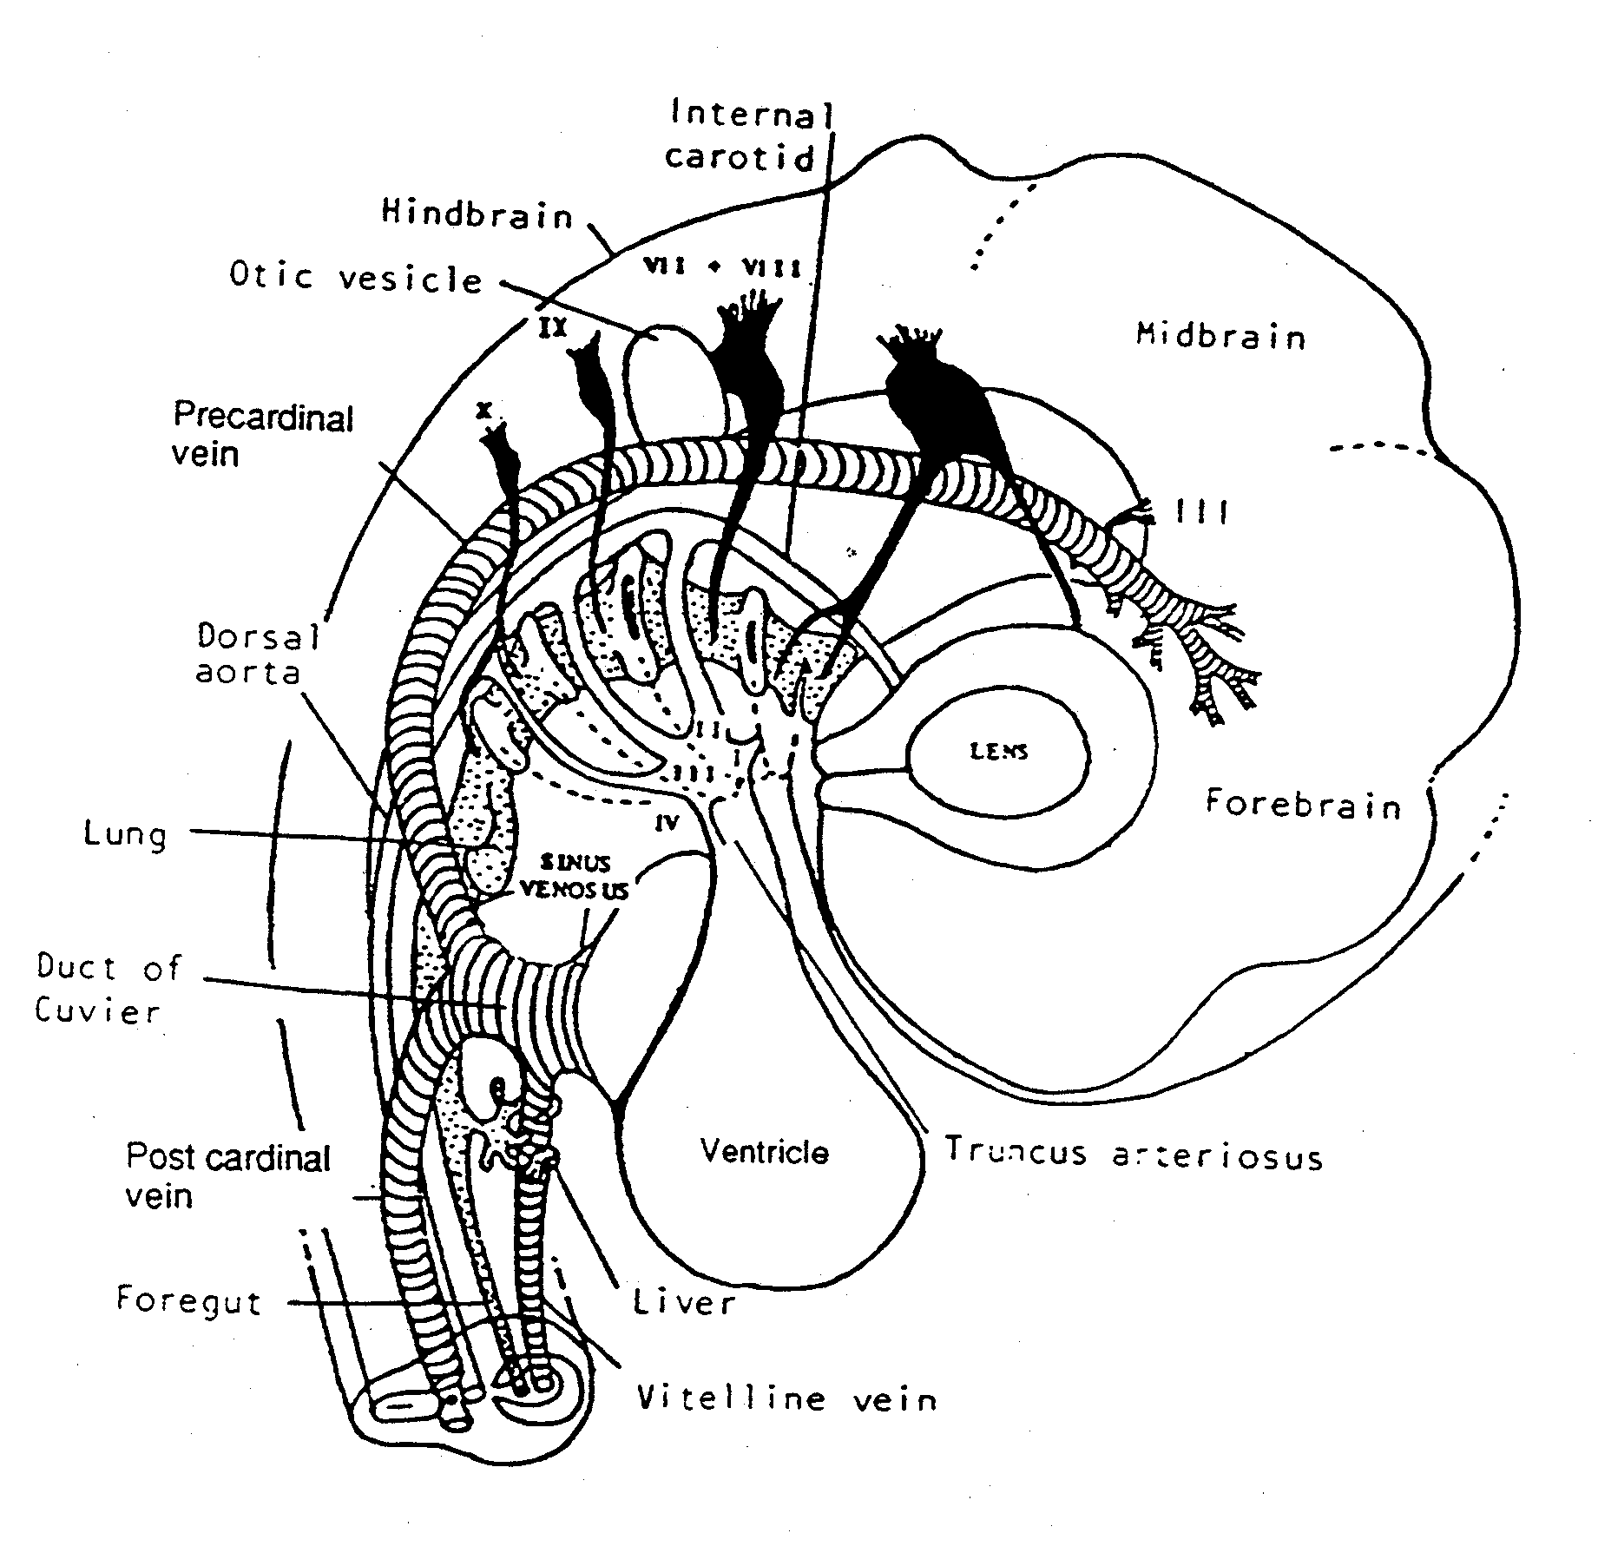
See in Part 3 of your Laboratory Protocols....

Slide 7
Development
Special Sense organs = nose, eyes and ears, begin as small outcrops of ectoderm called placodes

Slide 8
Development
Placode 1 = nose
Placode 2 = eye
Placode 3 = ear

Slide 9
Development
In the nose, the ectoderm become nerve cells that send their fibres through the cribriform plate of the ethmoid, back to the brain
This is Cranial Nerve I = the Olfactory Nerve

Slide 10
Development
The second placode becomes the lens of the eye.
It sinks below the surface of the skin, and an outgrowth of the brain wraps around it.
The outgrowth is the retina, and the stalk connecting it is Cranial Nerve II = The Optic Nerve

Slide 11
Eye starts out as photosensitive lobe of brain underlying surface of skin.
Lobe eventually becomes two-layered cup = retina.
Connected to brain by “stalk” that is the OPITC NERVE (cranial nerve II).
Lens from ectodermal placode.
Marginal cells of retina become specialized as MUSCLE CELLS that regulate opening of pupil:
Sphinctor pupillae (parasympathetically regulated)
Dilator pupillae (sympathetically regulated)

Slide 12
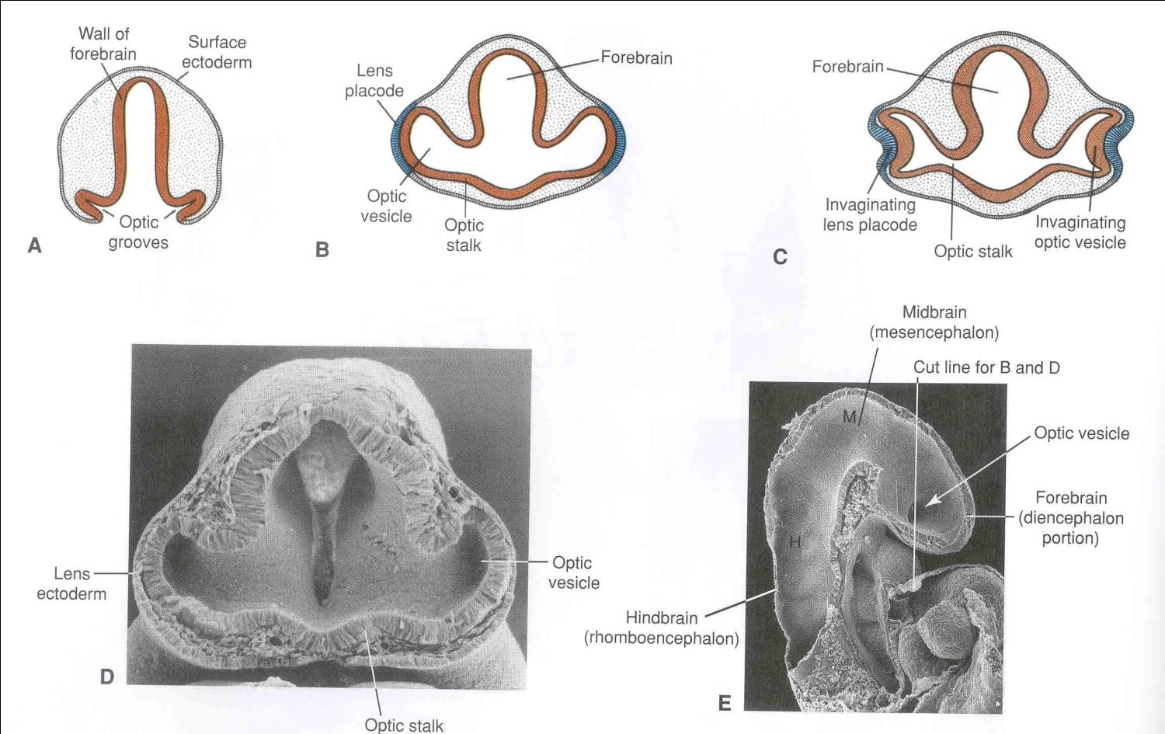

Slide 13
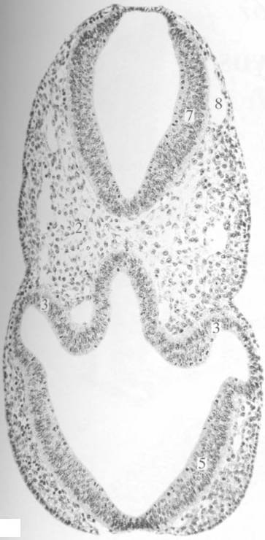

Slide 14
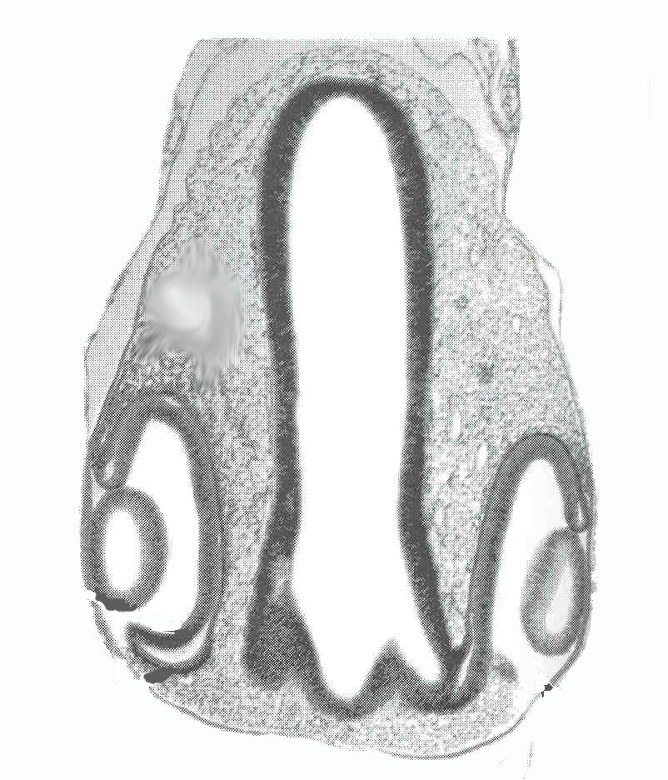
Developing
Retina
Developing
Lens

Slide 15
Development
The Inner ear starts out as a lens, but turns into a fluid filled sac
Receptor organs of hearing and balance.
Cranial Nerve VIII = Auditory or Vestibulocochlear Nerve

Slide 16
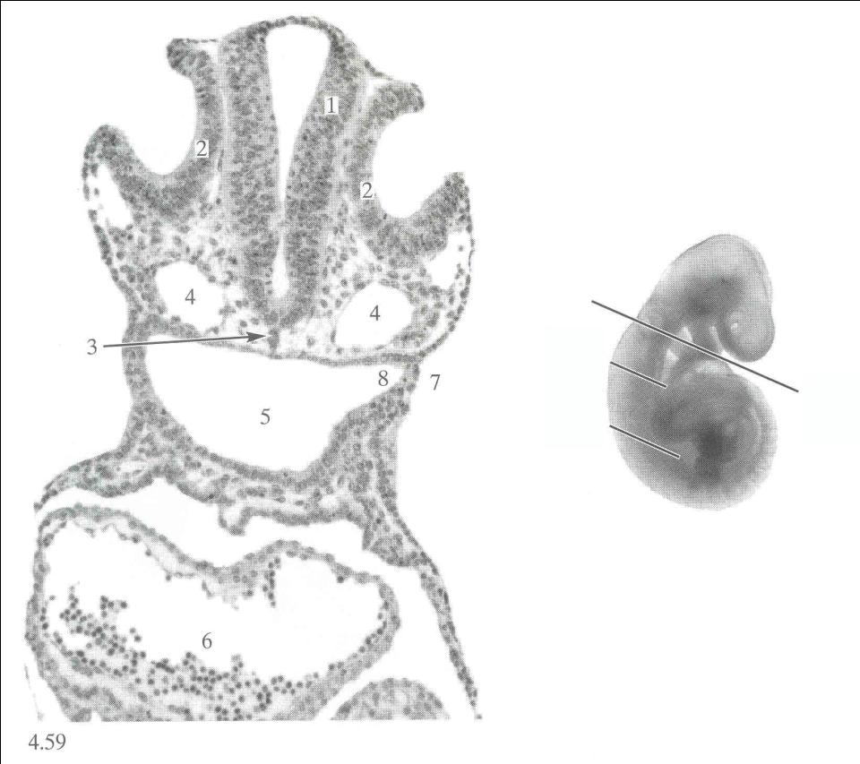
Cranial Nerve VIII
Vestibulocochlear Nerve
(Evolutionary branch of VII)
Otic Vesicle

Slide 17
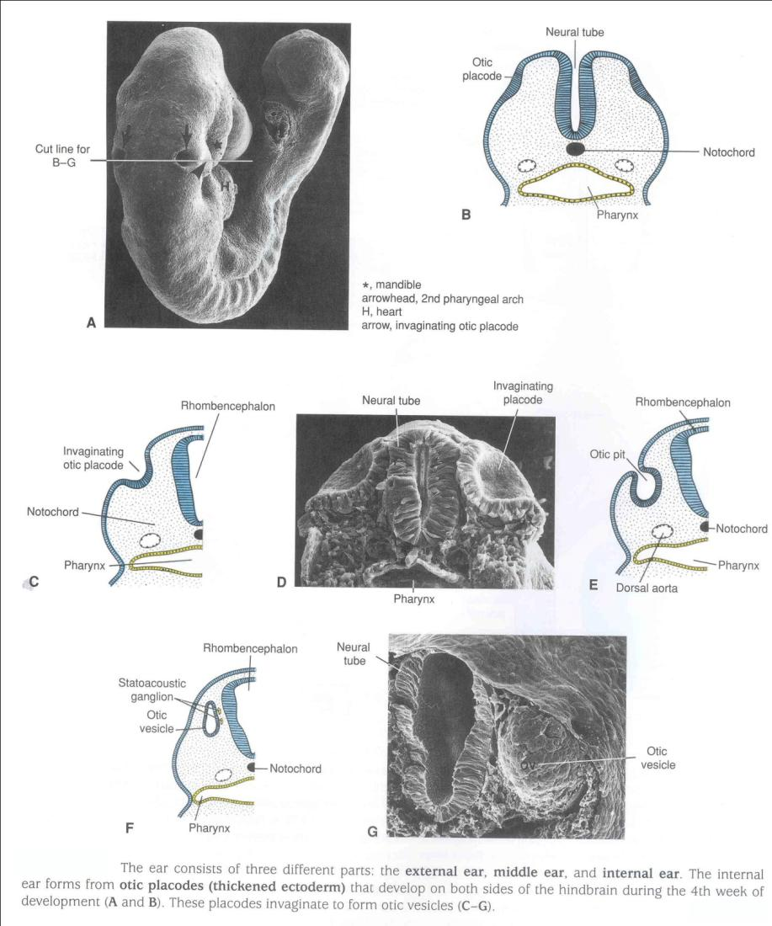
Early Development of the Ear

Slide 18
Ventral Root Cranial Nerves
Somite Associated

Slide 19
Development
Head somites can be divided into 2 sets. Pre-otic and post-otic

Slide 20
Development
The sklerotomes of the post otic somites form the floor of the brain case

Slide 21
Development
….and their myotomes develop into muscles of the tongue

Slide 22
Development
The myotomes of the pre-otic somites form the muscles that move the eyeballs.

Slide 23
Development
Each is supplied by a different cranial nerve:

Slide 24
Development
Cranial Nerve III =
Occulomotor Nerve

Slide 25
Development
Cranial Nerve IV =
Trochlear Nerve

Slide 26
Development
Cranial Nerve VI = Abducens Nerve

Slide 27
EYEBALL MOVING MUSCLES:
Rectus Muscles
Superior rectus - III
Inferior rectus - III
Lateral rectus - VI
Medial rectus - III
Oblique muscles
Superior oblique - IV
Inferior oblique - III
Lavator palpebrae superioris - III

Slide 28
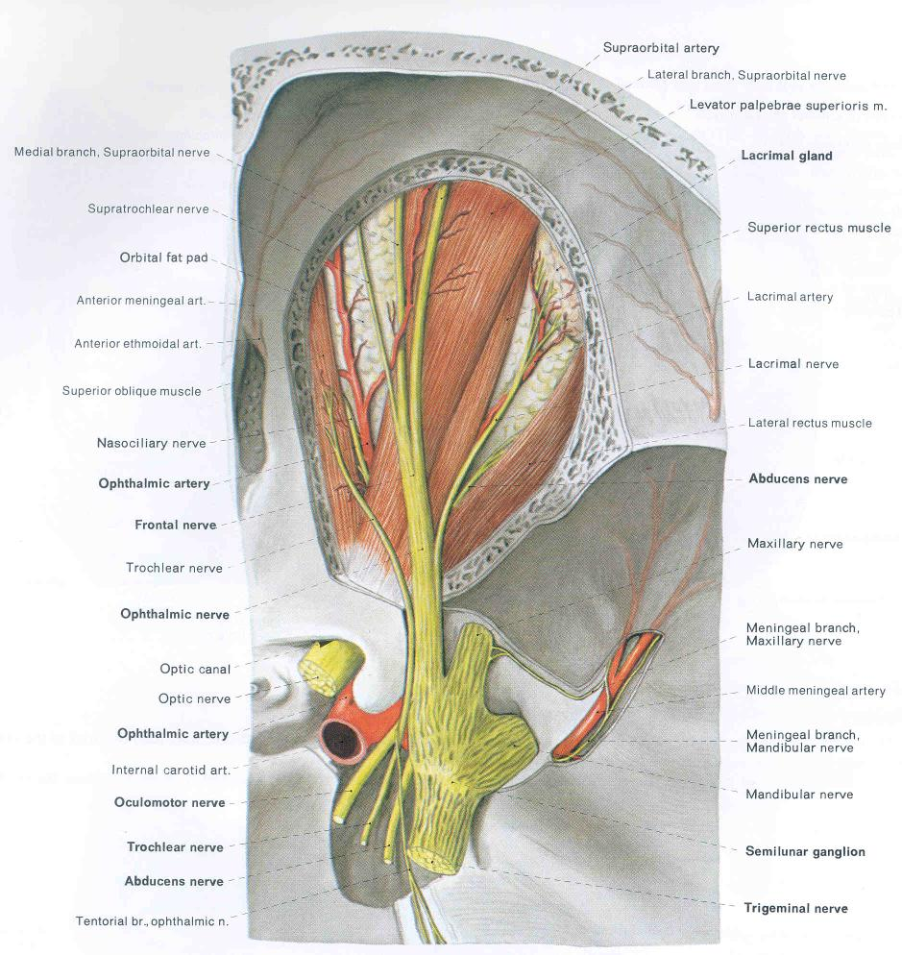

Slide 29
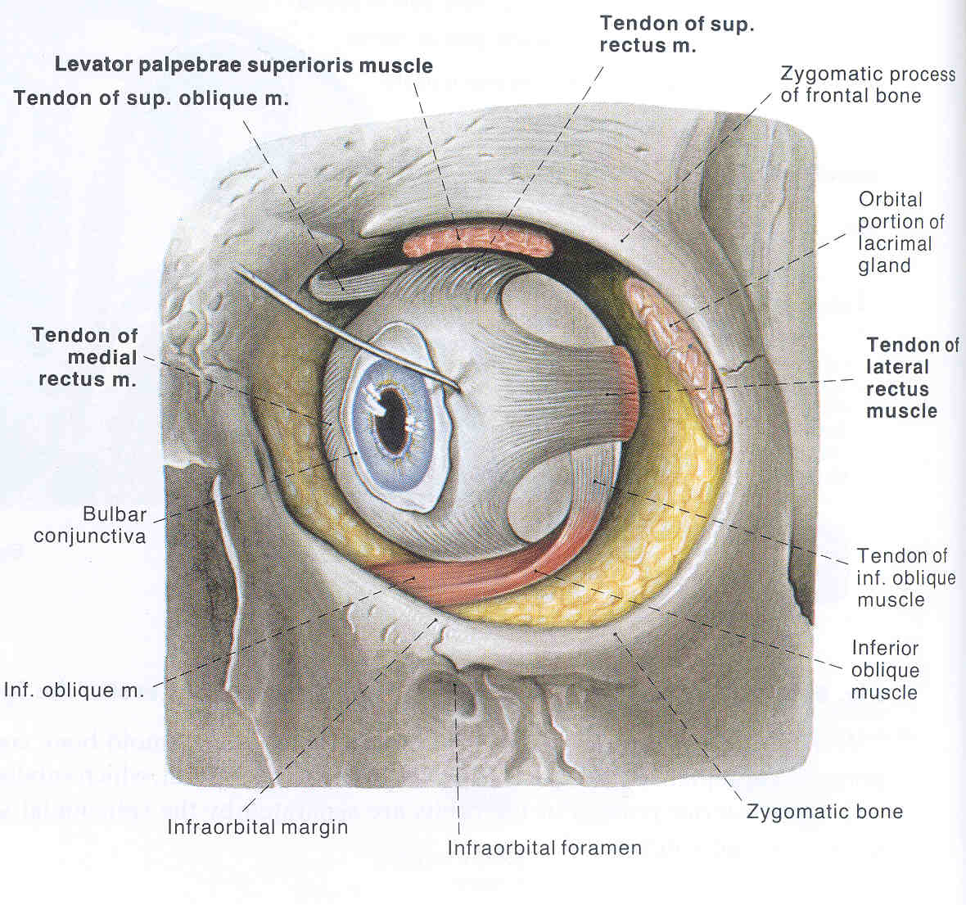

Slide 30
Dorsal Root Cranial Nerves
Gill Pouch Associated

Slide 31
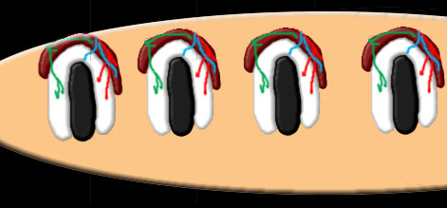
Development
Gill Arch Derivatives

Slide 32
Development
Mandibular arch

Slide 33
Cranial Nerve V: The Trigeminal Nerve (3 branches) V1 Opthalmic ,
V2 Maxillary,
V3 Mandibular

Slide 34
Development
Hyoid arch

Slide 35
Cranial Nerve VII:
Facial nerve

Slide 36
Development
Next arch

Slide 37
Cranial nerve IX:
Glossopharyngeal Nerve

Slide 38
Development
Remaining arches

Slide 39
Cranial nerve X:
The Vagus Nerve

Slide 40
The Cranial Nerves
Summary of Cranial Nerves

Slide 41
Is there a “#0” nerve?
The Nervus Terminalis (Nerve Zero) has been suggested as a primitive vertebrate structure serving the vomeraonasal organ.

Slide 42
Special Sensory Nerves

Slide 43
I

Slide 44
Cranial Nerve I
The Olfactory Nerve
Sensory
Smell
Cribriform plate of ethmoid

Slide 46
II

Slide 47
Cranial Nerve II
The Optic Nerve
Sensory
Vision
Optic foramen

Slide 48
Ventral Root Cranial Nerves

Slide 49
III

Slide 50
Cranial Nerve III
The Occulomotor Nerve
Mainly motor
Eye Movement
Superior orbital fissure

Slide 51
Cranial Nerve III
The Occulomotor Nerve
Mainly motor
Eye Movement
Superior orbital fissure

Slide 52
Detail on Occulomotor (III) Function:
Motor to all extra-ocular muscles except lateral rectus and superior oblique.
Parasympathetic innervation to sphincter pupillae and ciliaris muscles (synapse in ciliary ganglion).
Sympathetic innervation to sphincter pupillae and ciliaris muscles. Fibers originate in upper thoracic levels, synapse in cervical ganglia, get to orbit via associated arteries.

Slide 53
IV

Slide 54
Cranial Nerve IV
The Trochlear Nerve
Mainly motor
Superior oblique
Superior orbital fissure

Slide 55
Cranial Nerve IV
Superior oblique

Slide 56
VI

Slide 57
Cranial Nerve VI
The Abducens Nerve
Mainly motor
Lateral rectus
Superior orbital fissure

Slide 58
Cranial Nerve VI
Lateral rectus

Slide 59
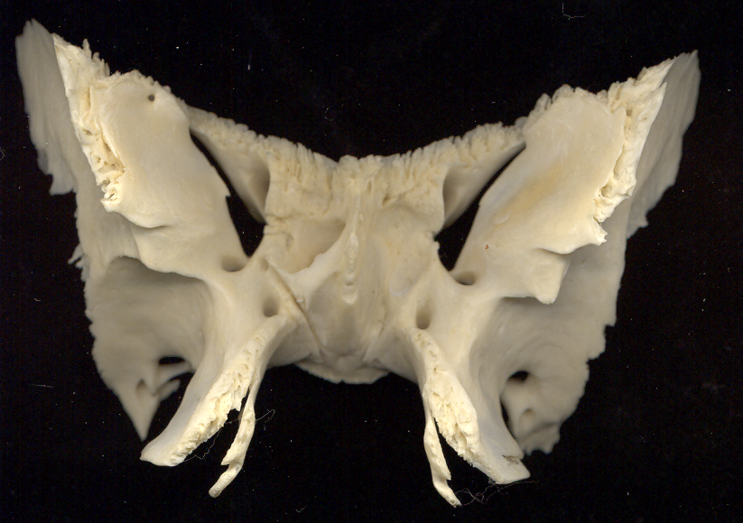
Sphenoid/ anterior view of orbital surface and foramina with associated cranial nerves indicated
II
V1
III
Opth. a.
IV
VI
Opthalmic v.
V2
Nerve of pterygoid canal ALSO CALLED VIDIAN NERVE (VII parasympathetics + sympathetics)
V3

Slide 60
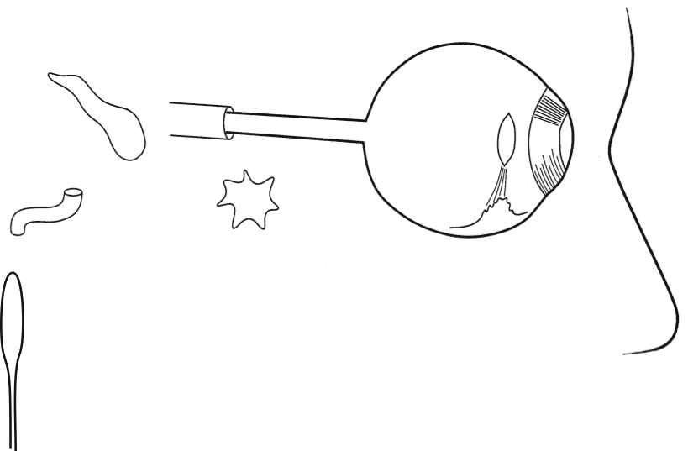
Pathways of the Oculomotor Nerve (CN III)
Sensory
Parasympathetic
Somatic Motor
Sympathetic
Superior rectus
Inferior rectus
Medial rectus
Inferior oblique
Skin around eyes
and forehead
Superior Orbital
Fissure
Superior oblique
V1
Pupillary
dilator
Lateral rectus
III
Eye
IV
Pupillary
constrictor
VI
Ciliary
muscle
(Accommodation
Reflex)
Carotid
canal
Ciliary
ganglion
Superior
Cervical
Ganglion
of
Sympathetic
Chain
Sympathetic Targets:
Pupillary dilator
Smooth muscle of blood vessels
Smooth muscle of eyelid
Sweat glands
Nose

Slide 61
XII

Slide 62
Cranial Nerve XII
The Hypoglossal Nerve
Mainly Motor
Tongue
Hypoglossal Canal

Slide 63
Dorsal Root Cranial Nerves

Slide 64
V

Slide 65
Cranial Nerve V
The Trigeminal Nerve
Both
V₁= ophthalmic
V₂ = maxillary
V₃ = mandibular

Slide 66
Cranial Nerve V₁
Ophthalmic division
Sensory
Superior orbital fissure

Slide 67
Cranial Nerve V₁
Ophthalmic division
Sensory
Superior orbital fissure

Slide 68
Detail on Ophthalmic (V-1) Function:
Almost wholly sensory: eyeball, lacrimal gland, conjunctiva, part of nasal mucosa, from brow ridge superiorly.
Carrys a bit of sympathetic fibers for dilator pupillae. From upper thoracic levels, synapsing in in upper cervical ganglion. Reaches via branches of internal carotid artery.

Slide 69
Cranial Nerve V₂
Maxillary division
Sensory
Foramen rotundum

Slide 70
Cranial Nerve V₂
Maxillary division
Sensory
Foramen rotundum

Slide 71
Cranial Nerve V₃
Mandibular division
Both
Foramen ovale

Slide 72
Cranial Nerve V₃
Mandibular division
Both
Foramen ovale
Sensory Component

Slide 73
Detail on Mandibular (V-3) Function:
Sensory to lower jaw region, including teeth.
Motor nerve to muscles of the mandibular arch: masseter, temporalis, anterior and posterior pterygoids, mylohyoid, tensor tympani, anterior digastric, and tensor veli palatini.
The auriculotemporal branch contains secretomotor fibers to the parotid gland via the parotid branches.

Slide 74
Cranial Nerve V

Slide 75
VII

Slide 76
Cranial Nerve VII
The Facial Nerve
Both
Motor and sensory

Slide 77
Cranial Nerve VII
The Facial Nerve
Both motor and sensory
Muscles of facial expression
Parasympathetic:
Lacrimal ducts, taste, salivary glands

Slide 78
Cranial Nerve VII
The Facial Nerve
VII_{a} Temporal VII_{b} Zygomatic VII_{c} Buccal VII_{d} Mandibular VII_{e} Cervical

Slide 79
Cranial Nerve VII
Enter skull via internal auditory meatus

Slide 80
Cranial Nerve VII
Exit skull via stylomastoid foramen

Slide 81
Cranial Nerve VII
a Temporal
b Zygomatic
c Buccal
d Mandibular
e Cervical

Slide 82
Detail on Facial (VII) Function:
Motor to muscles of the hyoid arch: posterior digastric, mm. of facial expression.
Sends parasympathetic fibers via greater petrosal branch and pterygopalatine ganglion to lacrimal gland (secretomotor fibers).
It may also supply parasympathetic innervation to palatine, pharyngeal, and nasal glands.

Slide 83
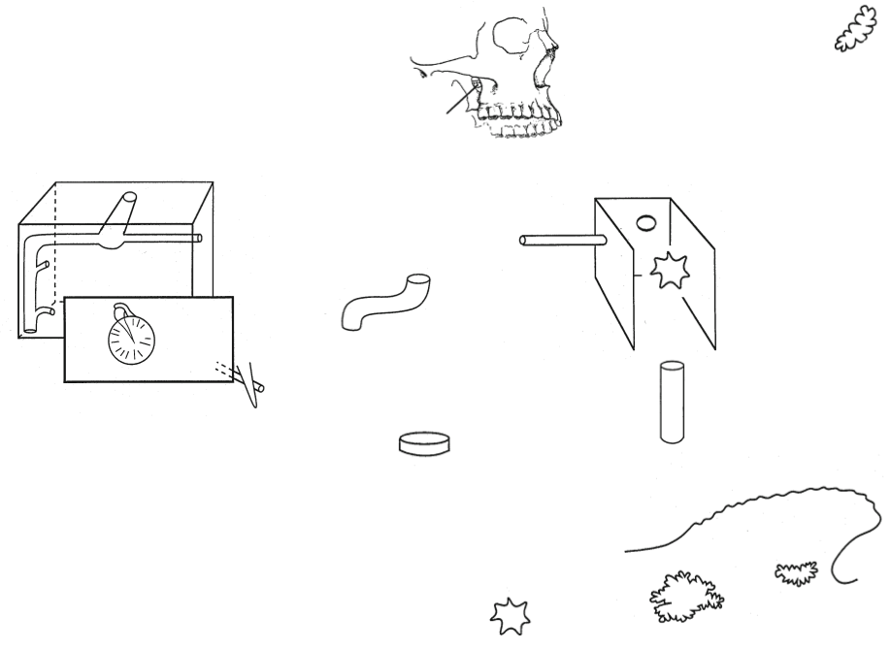
Pathways of the Facial Nerve (CN VII)
Lacrimal
Gland
Pterygopalatine
Fossa
VII
Internal
Auditory
Meatus
Petrous
part of
Temporal
Bone
Nasal
cavity
Pterygopalatine
ganglion
Carotid
canal
Eardrum
Front teeth &
Gums
V3
Palatine
canals
Styloid
process
Foramen
ovale
Back teeth &
Palate
Branchial Motor
to Muscles of
Facial Expression
(Arch 2)
Tongue
Taste
Parasympathetic
Sensory
Sympathetic
Submandibular
ganglion
Sublingual
gland
Branchial Motor
Submandibular
gland

Slide 84
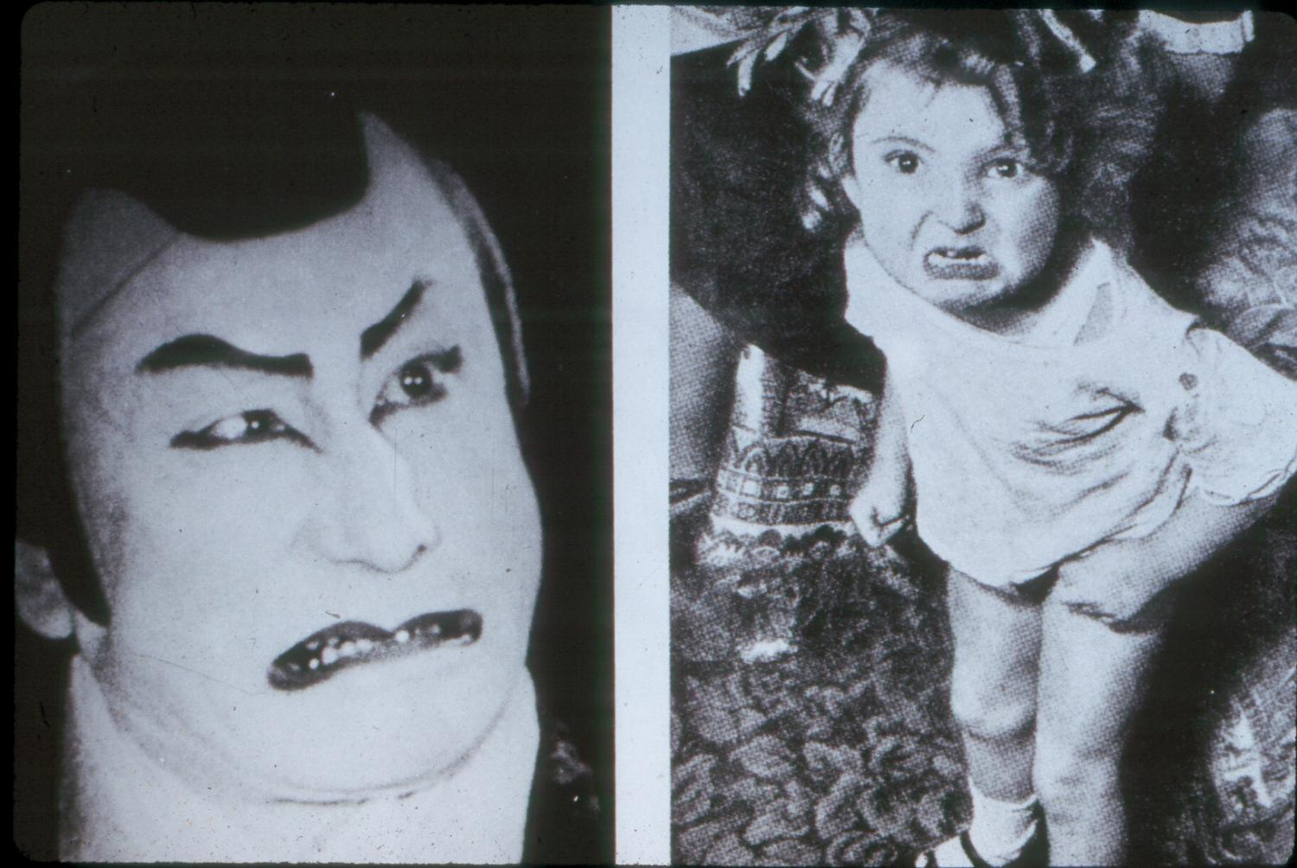

Slide 85
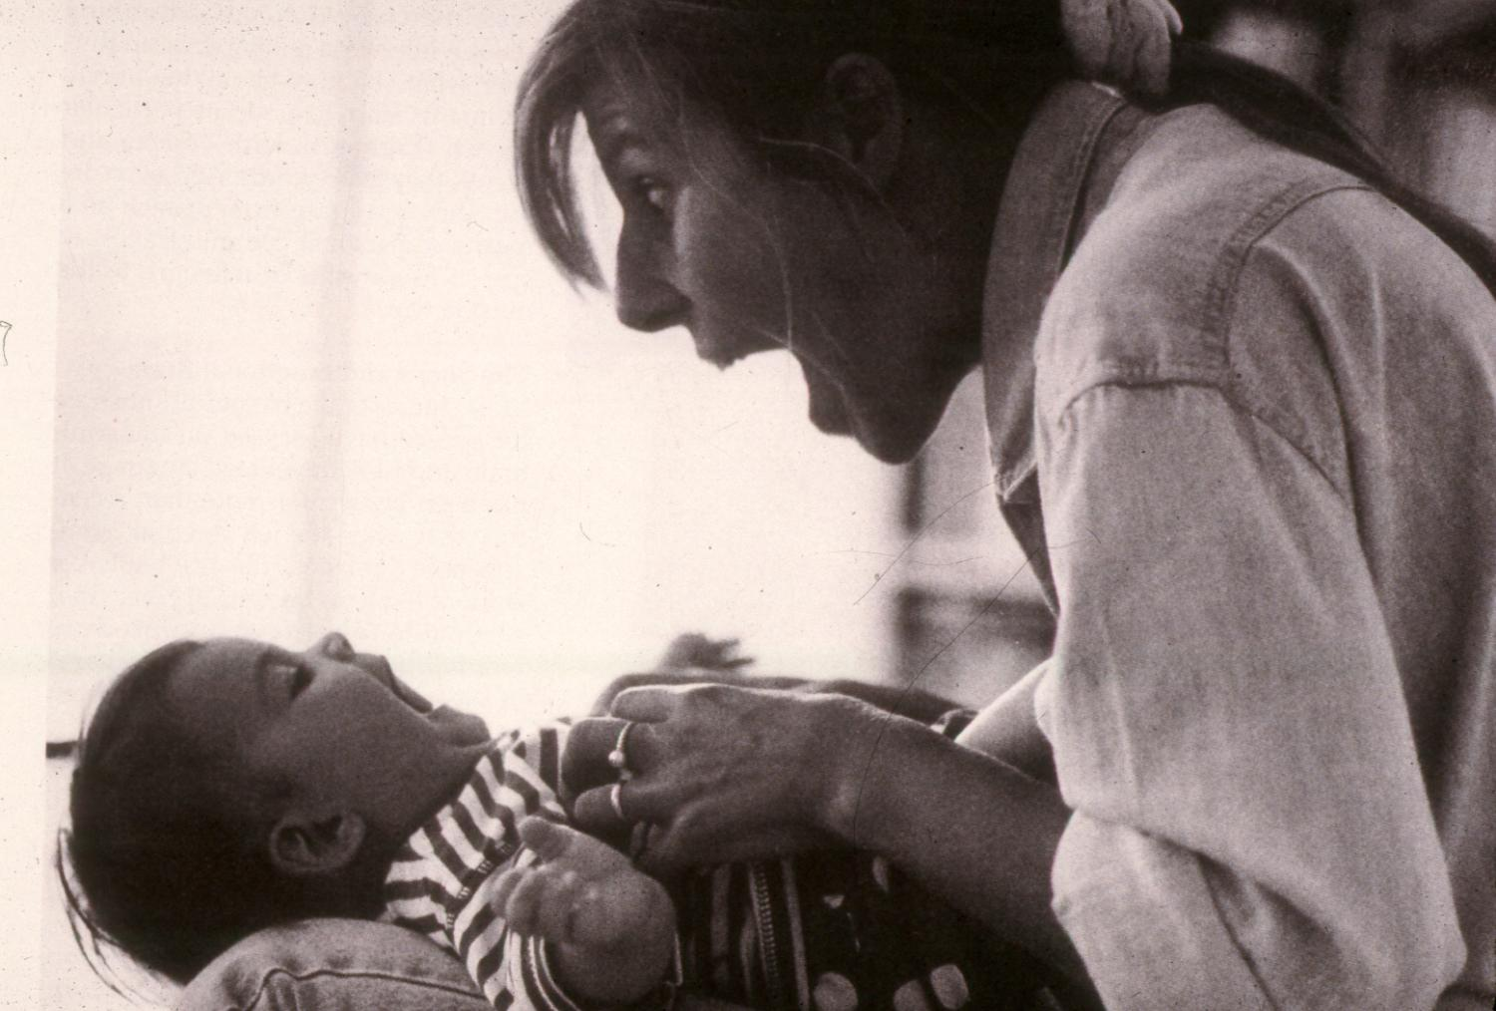

Slide 86
VIII
An Evolutionary Branch of VII

Slide 87
Cranial Nerve VIII
Vestibulocochlear Nerve
Sensory
Hearing
Internal Auditory Meatus

Slide 88
IX

Slide 89
Cranial Nerve IX
The Glossopharyngeal Nerve
Both
Pharynx, posterior tongue
Jugular foramen

Slide 90
Cranial Nerve IX
The Glossopharyngeal Nerve
Both
Pharynx, posterior tongue
Jugular foramen

Slide 91
Detail on Glossopharyngeal (IX) Function:
Motor to stylopharyngeus muscle.
Parasympathetic secretomotor fibers to parotid gland.
Sensory to pharynx, tonsils, and posterior 1/3 of tongue.
Taste fibers for posterior 1/3 of tongue.

Slide 92
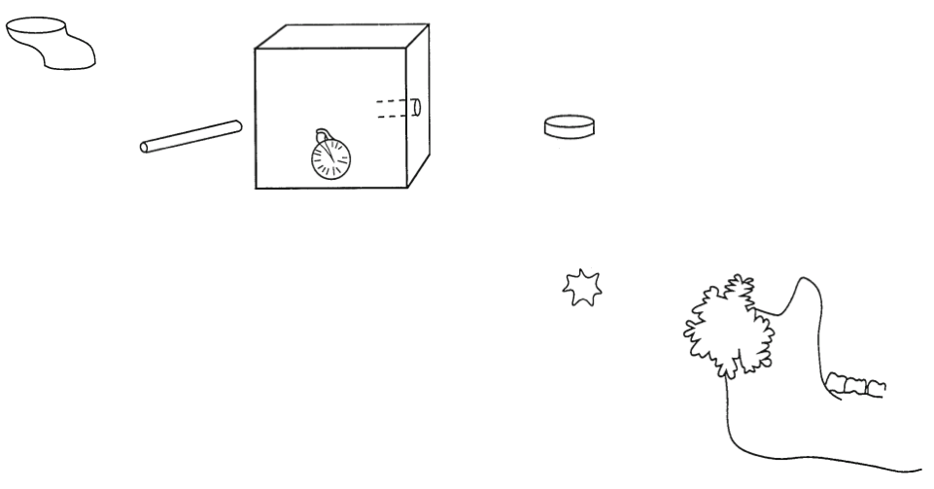
Pathways of the Glossopharyngeal Nerve (CN IX)
Sensory
Parasympathetic
Branchial Motor
Taste
Auriculotemporal
nerve
(skin near ear)
IX
Petrous part of
temporal bone
Jugular
foramen
Cranial
cavity
V3
Foramen
ovale
Eardrum
Otic
ganglion
Stylopharyngeus
muscle
(Arch 3)
Posterior 1/3
of Tongue
Parotid
gland
Carotid body (CO2)
Carotid sinus (pressure)
Posterior 1/3
of Tongue
Mandible

Slide 93
X

Slide 94
Cranial Nerve X
The Vagus Nerve
Both
Throat to end of midgut
Jugular foramen

Slide 95
Cranial Nerve X
The Vagus Nerve
Both
Throat to end of midgut
Jugular foramen

Slide 96
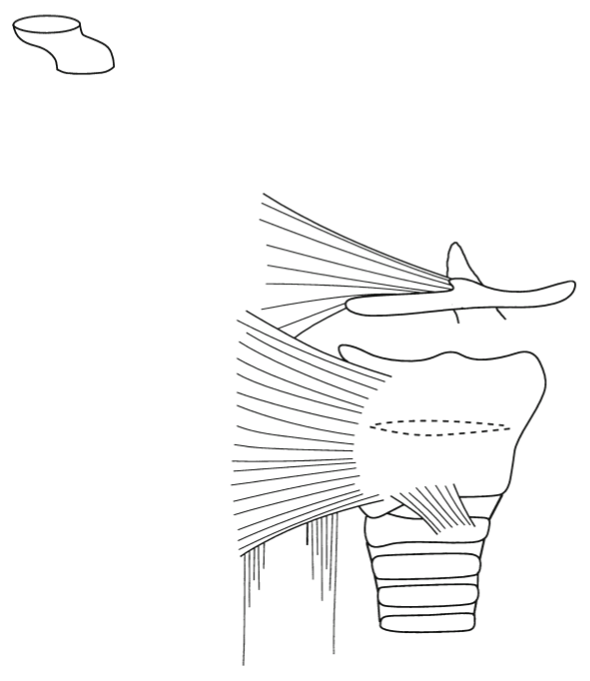
X
Pathways of the Vagus Nerve (CN X)
Jugular
foramen
Sensory
Parasympathetic
Branchial Motor
Taste
Posterior
pharynx
Superior
laryngeal
nerve
Hyoid bone
Epiglottis(?)
Pharyngeal
Constrictor
Muscles
Laryngeal
Muscles
Thyroid cartilage
(Laryngeal cartilage)
Cricoid
cartilage
Recurrent
laryngeal
nerve
Thorax &
Abdomen
Esophagus

Slide 97
XI
An Evolutionary Branch of X

Slide 98
Cranial Nerve XI
The Accessory Nerve
Mainly Motor
larynx, pharynx, trapezius and sternocleidomastoid
Foramen Magnum

Slide 99
Review of Branchial Arches
Mandibular Arch (#1)
Trigeminal nerve (CN V); Muscles of mastication; Chewing
Hyoid Arch (#2)
Facial nerve (CN VII); Muscles of facial expression
First “Regular Visceral Arch (#3)
Glossopharyngeal nerve (CN IX); Tongue & anterior pharynx; Swallowing
Remaining Arches (#s 4 & 6)
Vagus nerve (CN X); Posterior pharynx & larynx; Swallowing & talking

Slide 100
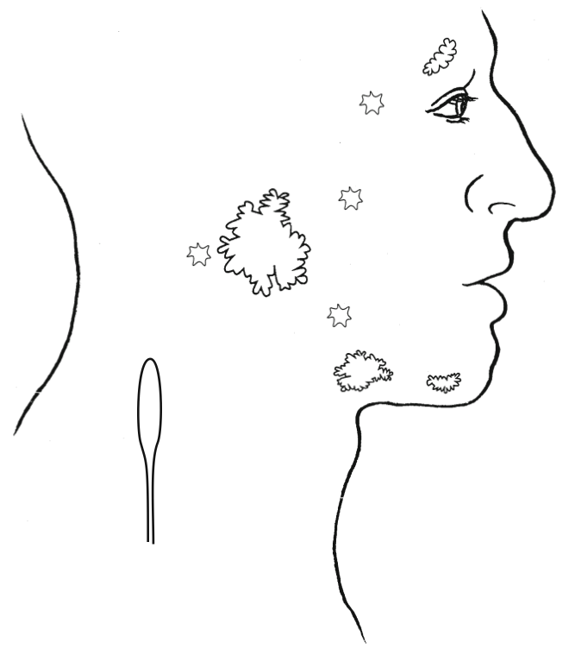
Parasympathetic
III
Lacrimal
Gland
Sympathetic
VII
Intra-ocular
Muscles
IX
Nasal
Cavity
X
Overview of
Autonomic
Targets
Oral Cavity
Parotid
Gland
Pharynx
Sublingual
Glands
Superior
Cervical
Ganglion
of
Sympathetic
Chain
Submandibular
Glands
Larynx
Preganglionic Neurons
Postganglionic Neurons
Esophagus
Viscera

Slide 101
Cranial nerve | Exits braincase | Path through skull | Sensory or Motor | Targets | Autonomics
I OLFACTORY | Cribraform plate ethmoid | Into nasal cavity | SPECIAL SENSORY | NASAL EPITHELIUM | X
II OPTIC | Optic canal of SPHENOID | Into orbit | SPECIAL SENSORY tract of brain | Retina | X
III OCCULOMOTOR | Superior orbital fissure of SPHENOID | Into superior orbit | MOTOR | EYE MUSCLES except below | via SHORT CILARY NN. (synapse in CILIARY GANGLION) [actions opposed by LONG CILIARY NN. (sympathetic)]
IV TROCHLEAR | Superior orbital fissure of SPHENOID | Into superior orbit | MOTOR | SUPERIOR OBLIQUE M. | X
VII ABDUCENS | Superior orbital fissure of SPHENOID | Into superior orbit | MOTOR | LATERAL RECTUS M. | X
XII HYPOGLOSSAL | Hypoglossal canal | Into tongue | MOTOR | INTRINSIC TONGUE MM. | X

Slide 102
 | Exits braincase | Path through skull | Sensory or Motor | Targets | Autonomics
TRIGEMINAL V1 Opthalmic (“DRG”= semilunar ganglion) | Superior orbital fissure of SPHENOID | Into superior orbit | SENSORY | Supraorbital, supratrochlear nn. to forehead Lacrimal nerve to lateral eyelids and conjunctiva Nasociliary nerve -sensory branches through ciliary ganglion to eyeball -posterior ethmoidal nerve& anterior ethmoidal nerve (and external nasal nerve for nose tip) -Infratrochlear nerve to medial conjunctiva and medial eyelids | (Short cilliary carries III parasympathetics) (Long ciliary nerves – sensory to eyeball + sympathetic from carotid plexus to dilate pupil of eye, if not in short ciliarys ) (Lacrimal n carries terminal hitchhiking VII parasympathetics to lacrimal gland)
V2 maxillary (“DRG”= semilunar ganglion) | Foramen rotundum of SPHENOID | Into pterygopalatine fossa; distributes to nasal epitheliam and into infraorbital groove, canal and out onto face via foramen | SENSORY | Infraorbital n. – face above mouth Nasopalatine n. - mucosa Greater/lesser palatine nn.—roof of mouth Zygomaticotemporal n. skin of temple and overlying cheekbone; carries VII parasympathetics Superor alveloar nn. – upper teeth of temple and overlying cheekbone; carries VII parasympathetics Superor alveloar nn. – upper teeth | (V II to lacrimal gland via zygomaticotemporal n. ; to nasal mucosa via nasopalatine n.)
V3 Mandibular (“DRG”= semilunar ganglion) | Foramen ovale of SPHENOID | into infratemporal fossa | BOTH | Sensory: -Inferior alvelolar n. LOWER JAW + teeth, -Buccal n. MOUTH INTERIOR -Lingual n. touch ant. 2/3 tongue Motor: -mm. of mastication & tensor veli palatine m. -n. to mylohyoid: ant belly of digastrics and mylohyoid m. | (VII parasympathetics from chorda tympani travel via LingualCranial nerve n.)

Slide 103
Cranial nerve | Exits braincase | Path through skull | Sensory or Motor | Targets | Autonomics
VII + VIII FACIAL VESTIBULO-COCCHLEAR | Internal acoustic meatus of PETROUS TEMPORAL | Through FACIAL CANAL Exits: Stylomastoid foramen to face mm. Greater petrosal groove (GPN) on ant. petrous temporal in middle cranial fossa, traversing lateral foramen lacerum Petrotympanic fissure (chorda tympani) | VII BOTH VIII SENSORY | Sensory: (“DRG”= geniculate ganglion for VII) to interior of ear canal & taste to ant. 2/3 tongue VIII for hearing cochlea and balance semicircular canals [“DRG” =vestibular & cochlear (spiral) ganglia] Motor to: -mm. of facial expression, including buccinator -stapedius m. -post belly of digastrics m. | Parasympathetics from nervus intermedius to 1.Submandibular/sublingual glands via chorda tympani (syn. in SUBMANDIBULAR GANGLION) 2. Lacrimal gland (greater petrosal n to nerve of pterygoid canal to (syn. in PTERGOPALATINE GANGLION) to infraorbital n(V2) to zygomaticofacial n (V2) to lacrimal n. (v1) ** note deep petrosal sympathetics merge w/greater petrosal @ pterygoid canal
IX GLOSSOPHARY-NGEAL | BETWEEN PETROUS TEMPORAL AND BASIOCCIPTIAL Neural portion of jugular foramen + tympanic canaliculus (for lesser petrosal n.) | Into pharynx (into infratemporal fossa for lesser pet. n.) | BOTH | Sensory to: (“DRG”= sup/inf. Glossopharyngeal ganglia) -carotid body (O2) -taste/touch post 1/3 tongue -ext. ear & inner tympanic mem. + middle ear mucosa, aud. tube - pharynx Motor to: -stylopharyngeus | Lesser petrosal nerve Tympanic canaliculus to tympanic plexus on middle ear promontory to groove lateral to greater petrosal groove. Out through foramen ovale; synapse in Otic ganglion). Travel with V3 auriculotemporal n. to Parotid gland.
X VAGUS | BETWEEN PETROUS TEMPORAL AND BASIOCCIPTIAL Neural portion of jugular foramen |  | BOTH | Sensory to: (“DRG”= sup/inf. vagal ganglia) -ex. Ear canal, ext. tympanic mem. (can cause vomiting) -larynx, pharynx, viscera trachea, stretch receptors in aortic arch walls, chemoreceptors in aortic bodies -taste post. medial tongue Motor to: mm. of pharynx and larynx -palatoglossus m. | Viscera up to left colic flexure; glands of pharynx and larynx
XI ACCESSORY | Jug. For. |  | MOTOR | trapezius and sternocleidomastoid mm. | X

Slide 104
I | Olfactory
II | Optic
III | Occulomotor
IV | Trochlear
V | Trigeminal
VI | Abducens
VII | Facial
VIII | Vestibulochochlar
IX | Glossopharyngeal
X | Vagus
XI | Accessory
XII | Hypoglossal

Slide 105
Motor, sensory, or both

Slide 106
I | O | Sensory
II | O | Sensory
III | O | Mainly motor
IV | T | Mainly motor
V | T | Both
VI | A | Mainly motor
VII | F | Both
VIII | A | Sensory
IX | G | Both
X | V | Both
XI | A | Mainly motor
XII | H | Mainly motor

Slide 107
Meninges (All from Neural Crest)
Outermost: Dura mater
Middle: Arachnoid mater
Deepest: Pia mater
Cerebrospinal fluid between Arachnoid and Pia mater

Slide 108
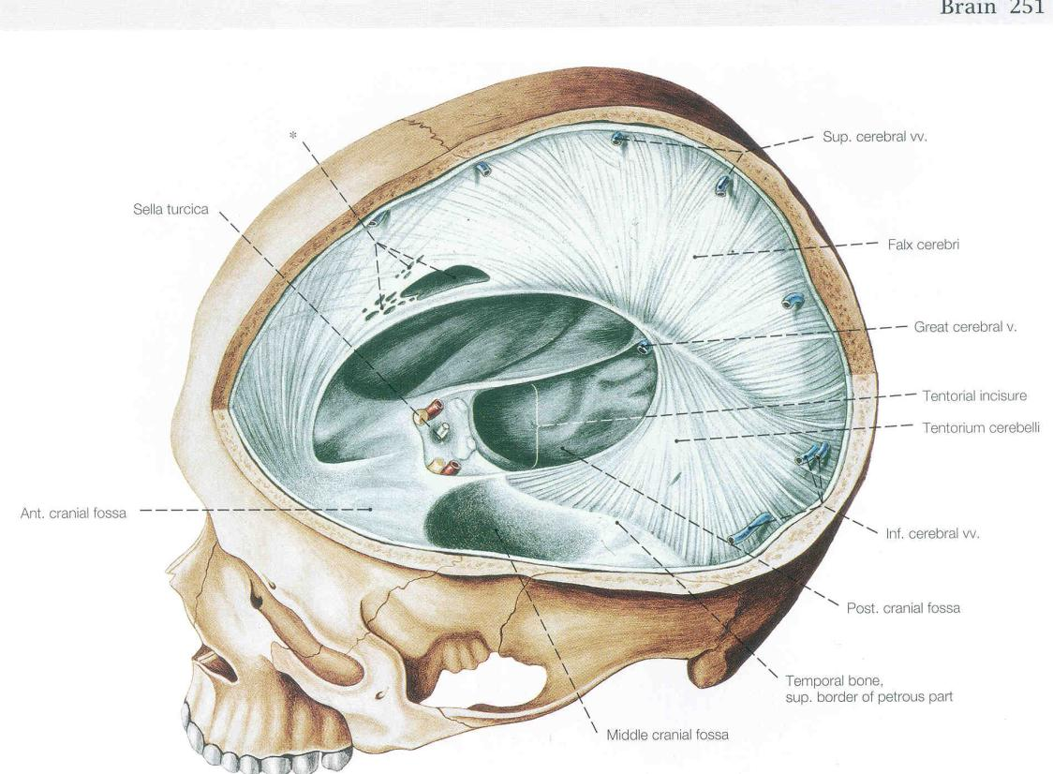
Meninges: Dura mater

Slide 109
Dural Reflections
Falx cerebri
Tentorium cerebelli

Slide 110
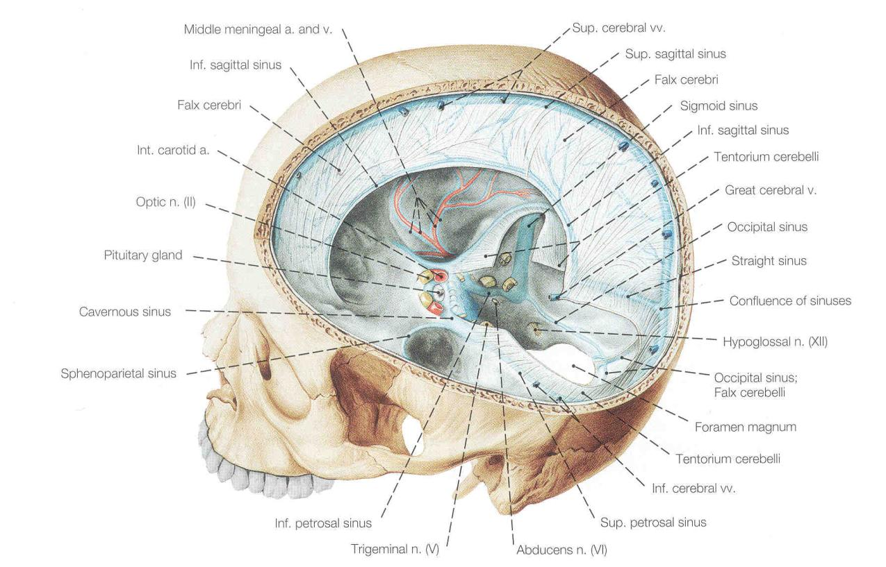
Vasculature: Venus Sinuses

Slide 111
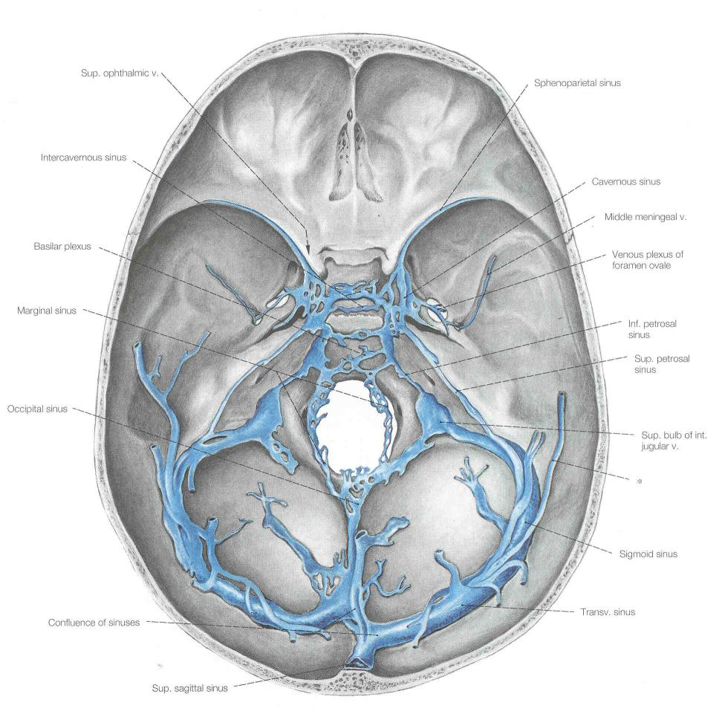
Vasculature: Venus Sinuses

Slide 112
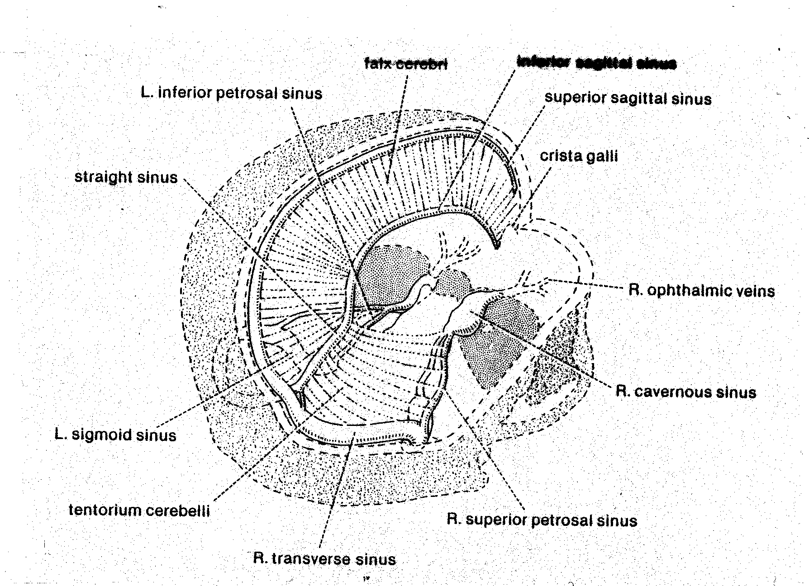
Vasculature: Venus Sinuses

Slide 113
VENOUS DRAINAGE OF THE SKULL:
SUPERIOR SAGITTAL SINUS to RIGHT/LEFT TRANSVERSE SINUS
INFERIOR SAGITTAL SINUS TO STRAIGHT SINUS
R/L TRANSVERSE SINUSES TO R/L SIGMOID SINUSES
R/L SIGMOID SINUSES TO SUPERIOR BULB OF R/L JUGULAR VEIN
ALSO TO JUGULAR: R/L MARGINAL SINUSES, R/L CAVERNOUS SINUSES, OCCIPITAL SINUS, R/L

Slide 114
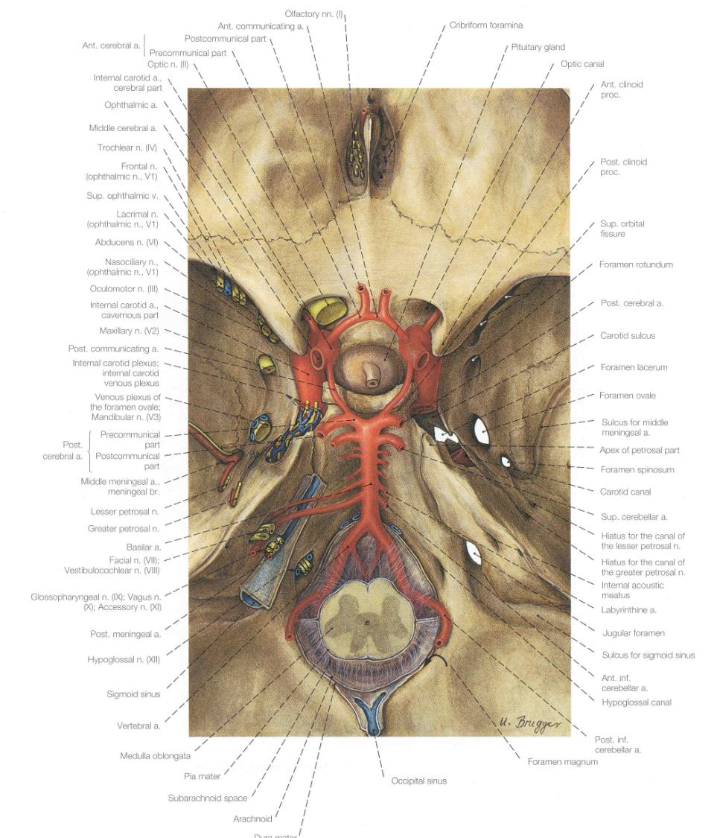
Vasculature:
Arterial Supply

Slide 115
ARTERIES LEADING TO CIRCULOSUS ARTERIOSUS CEREBRI
Right Carotid Artery
Left Carotid Artery
Basilar Artery (formed from right and left Vertebral Arteries)
Also, know branches off of it!

Slide 116
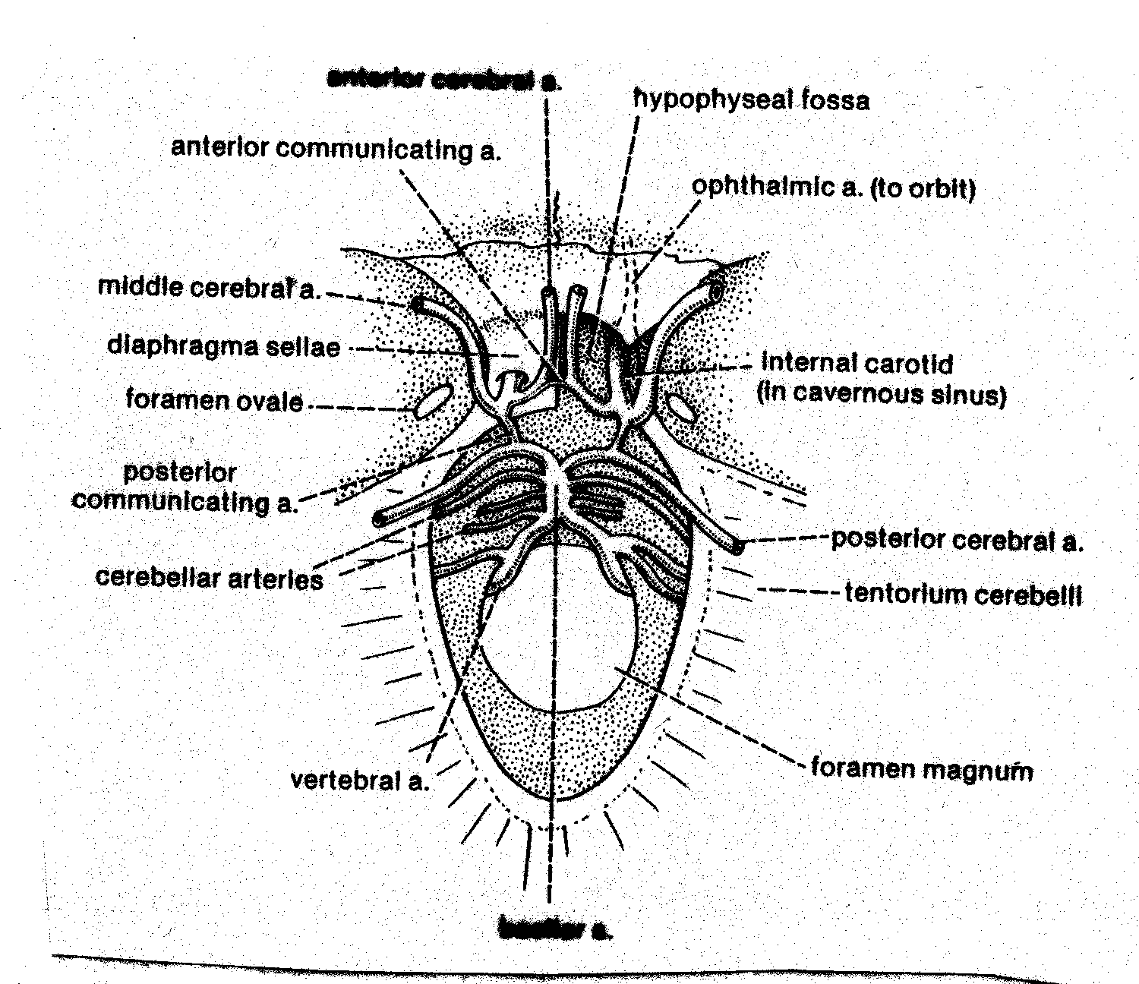
Vasculature: Arterial Supply

Slide 117
Other Muscle and Nerve Stuff…

Slide 118
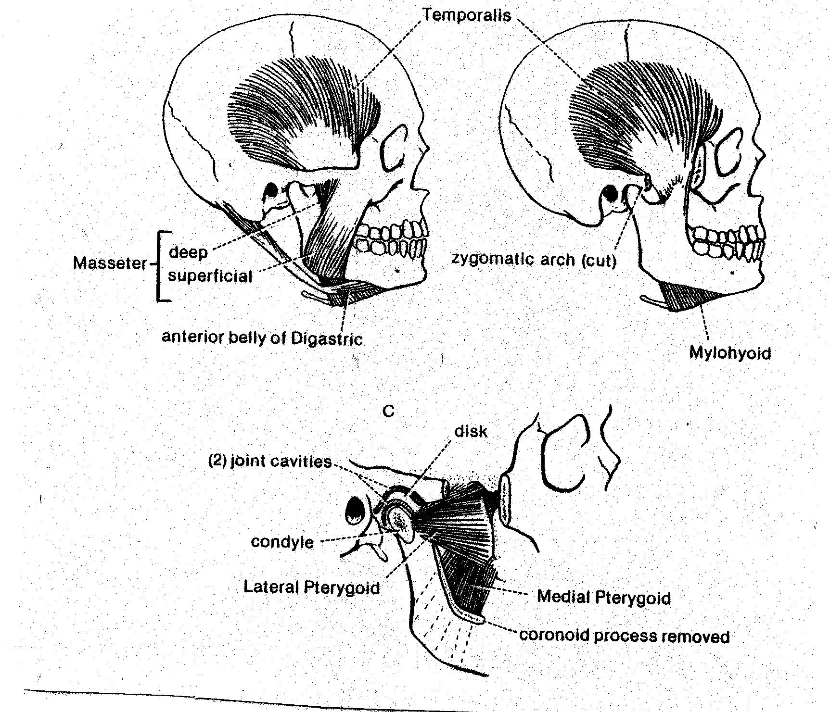
Jaw Moving Musculature:

Slide 119
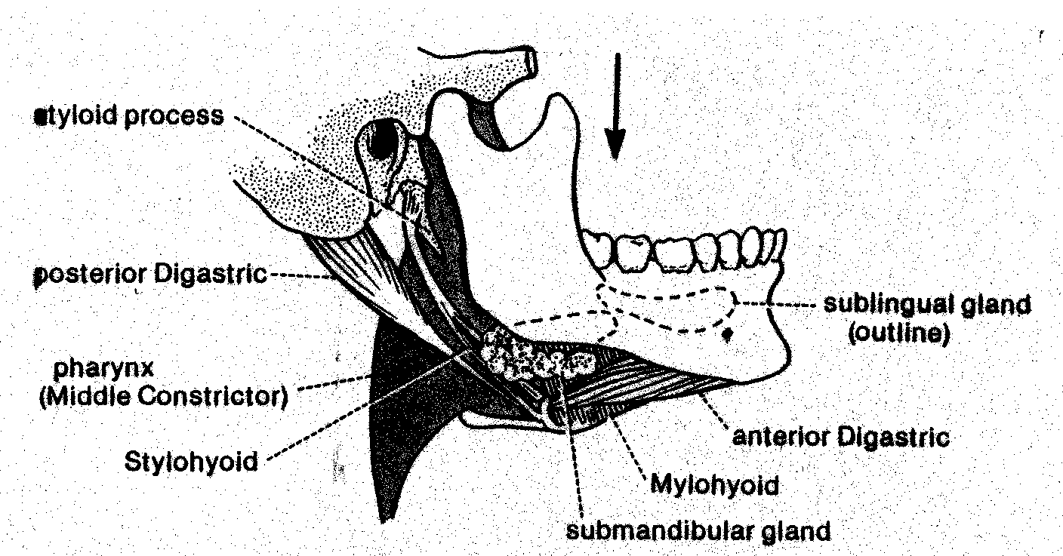
Jaw Opening Musculature: Diagastric Muscle
Anterior belly – innervated by Mandibular (V3) nerve
Posterior belly – innervated by Facial (VII) nerve

Slide 120
Major Muscles of the Mandibular Arch (innervated by V3):
Temporalis
Masseter
Medial Head of Pterygoid
Lateral Head of Pterygoid
Mylohyoid
Anterior Belly of Digastric
Tensor Tympani

Slide 121
“True” Muscles of mastication
All V3 innervation
Temporalis m.
Masseter m.
Medial pterygoid
Lateral pterygoid
upper head: to articular disc
lower head: to neck of mandibular condyle
ADDUCTORS – jaw closing/raising
“Accessory” Muscles of mastication
Vital for normal chewing, but not mandibular adductors/protractors
Buccinator VII
Digastric V3 & VII
Tongue XII

Slide 122
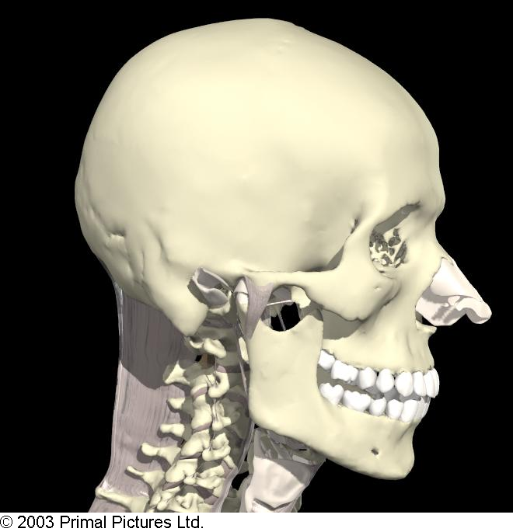
Temporal fossa/floor
Floor:
parietal
frontal
sq. temporal
SP

Slide 123
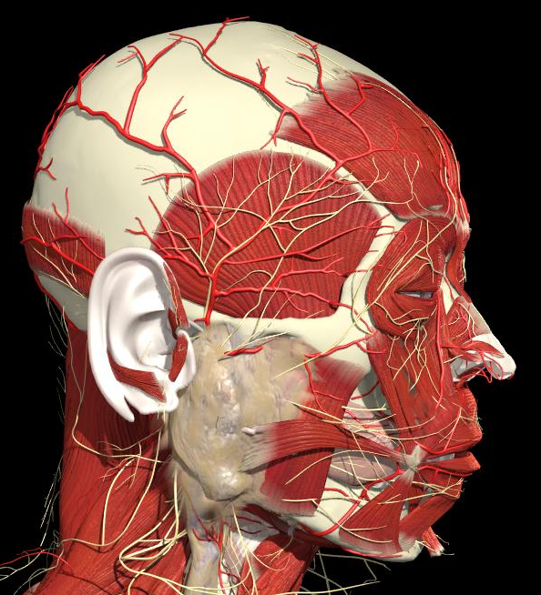
Temporal fossa/structures related to roof
Temporalis m.

Slide 124
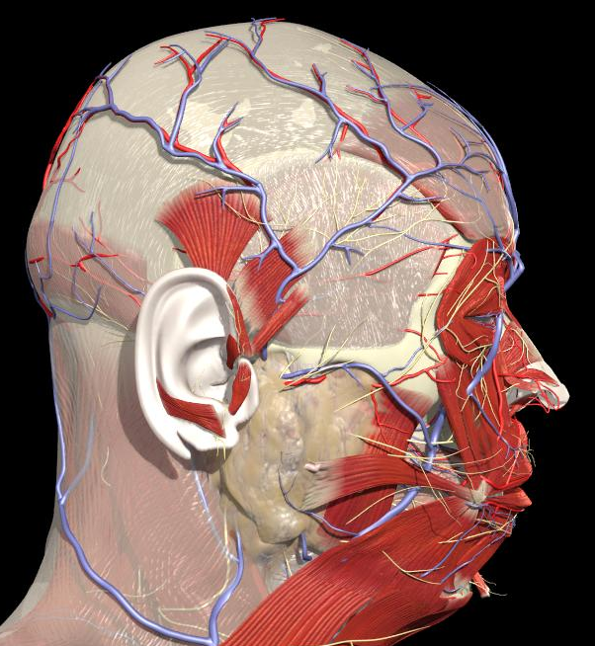
Temporal fossa roof/ temporal fascia

Slide 125
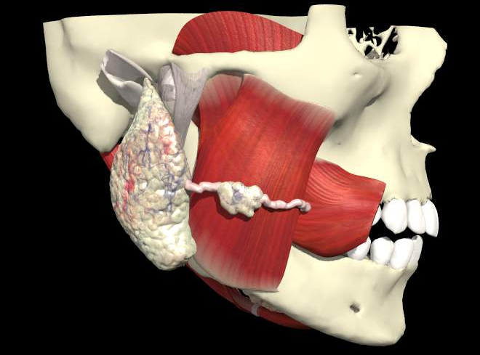
zygomatic
masseter
Three layers:
Superficial, middle and deep with slightly different fiber orientations; important in recruitment for chewing

Slide 126
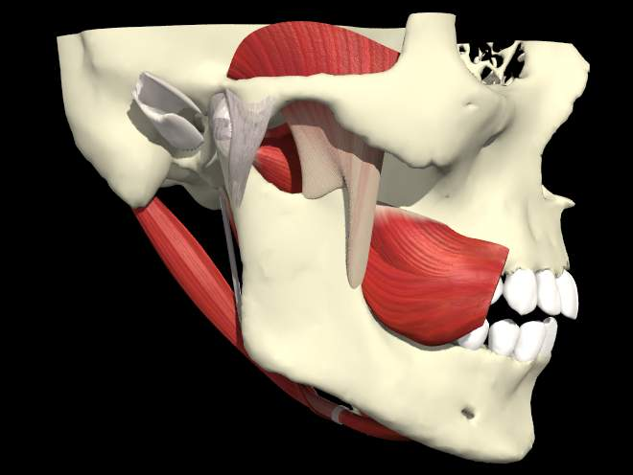
temporalis
Posterior belly of digastric
buccinator
Stylomandibular ligament

Slide 127
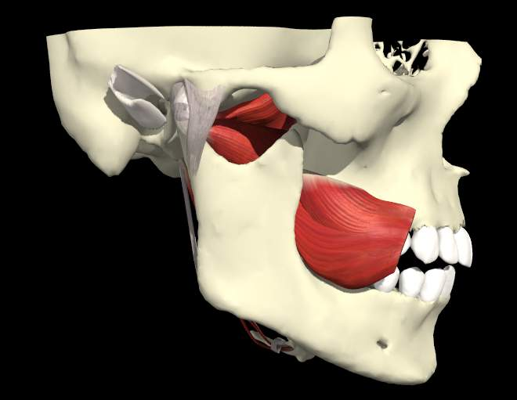
INFRATEMPORAL FOSSA
borders:
Lateral: ramus of mandible
Medial: lateral pterygoid plate
Roof: greater wing of sphenoid, adj. maxilla & palatine bones
Inferior: continuous with deep cervical fascia
Lateral pterygoid:
upper head
lower head
Line of action of lateral pterygoids is from anterior to posterior in horizontal plane. They PROTRACT or pull the mandible forward.

Slide 128
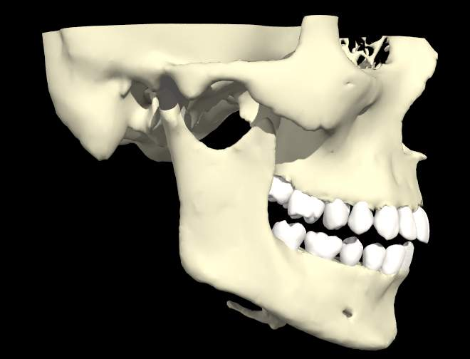
Mandibular fossa
Articular emminence
condyle
Coronoid process of mandible
neck
Mandibular notch
Mental foramen for V3 sensory branch

Slide 129
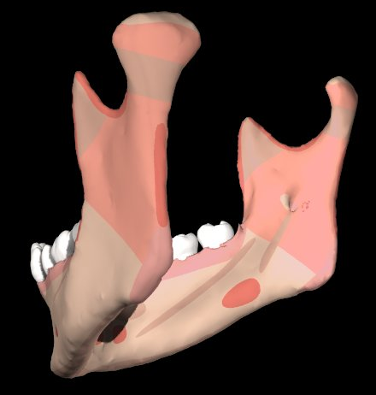
Injections to numb the lower teeth also numb chin and lower lip but not uppers
Mandibular foramen for inferior alveolar branch of V3, vv.
lingula
Mylohyoid groove for V3 branch to mylohyoid
Mylohyoid line for m. attachment

Slide 130
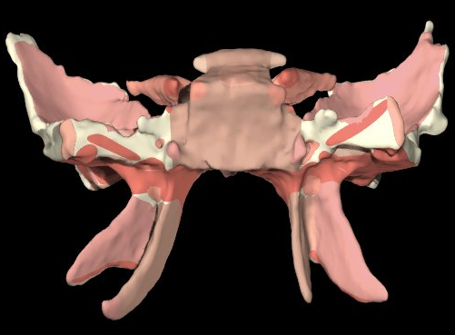
Sphenoid/Muscular origins
Lateral pterygoid upper head – to articular disc
Lateral pterygoid lower head to neck of mandibular condyle
Tensor veli palatini
Medial pterygoid
“Pterygoid” means “talon-like”

Slide 131
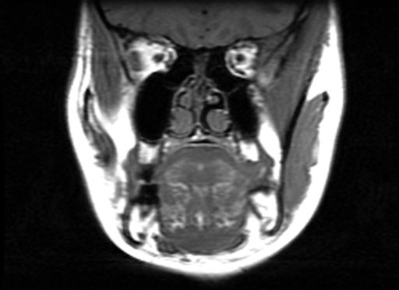
Temporalis m.
Masseter m.
MRI series 1 of 6 – coronal section, anterior to posterior

Slide 132
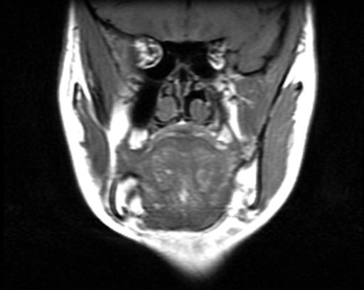
Lateral pterygoid
Upper head: to articular disc
Lower head: to neck of mandibular condyle
MRI series 2 of 6

Slide 133
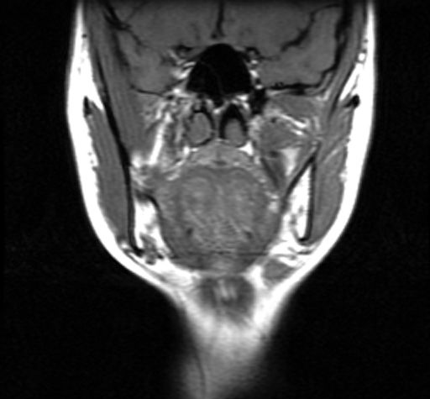
Medial pterygoid
MRI series 3 of 6

Slide 134
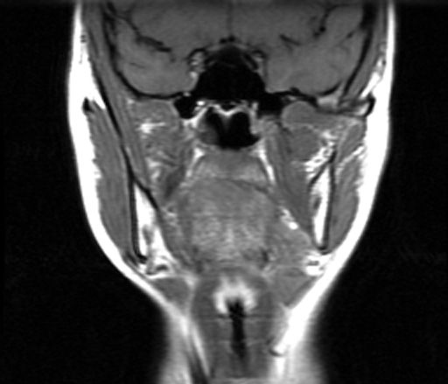
MRI series 4 of 6

Slide 135
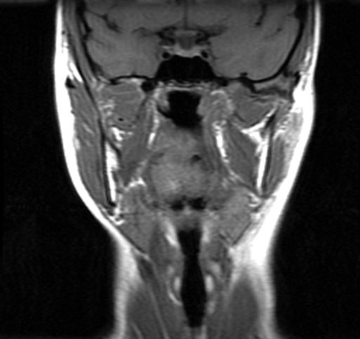
MRI series 5 of 6

Slide 136
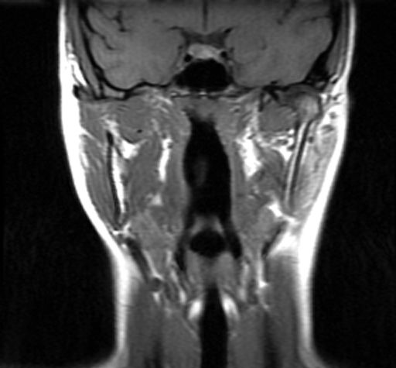
MRI series 6 of 6

Slide 137
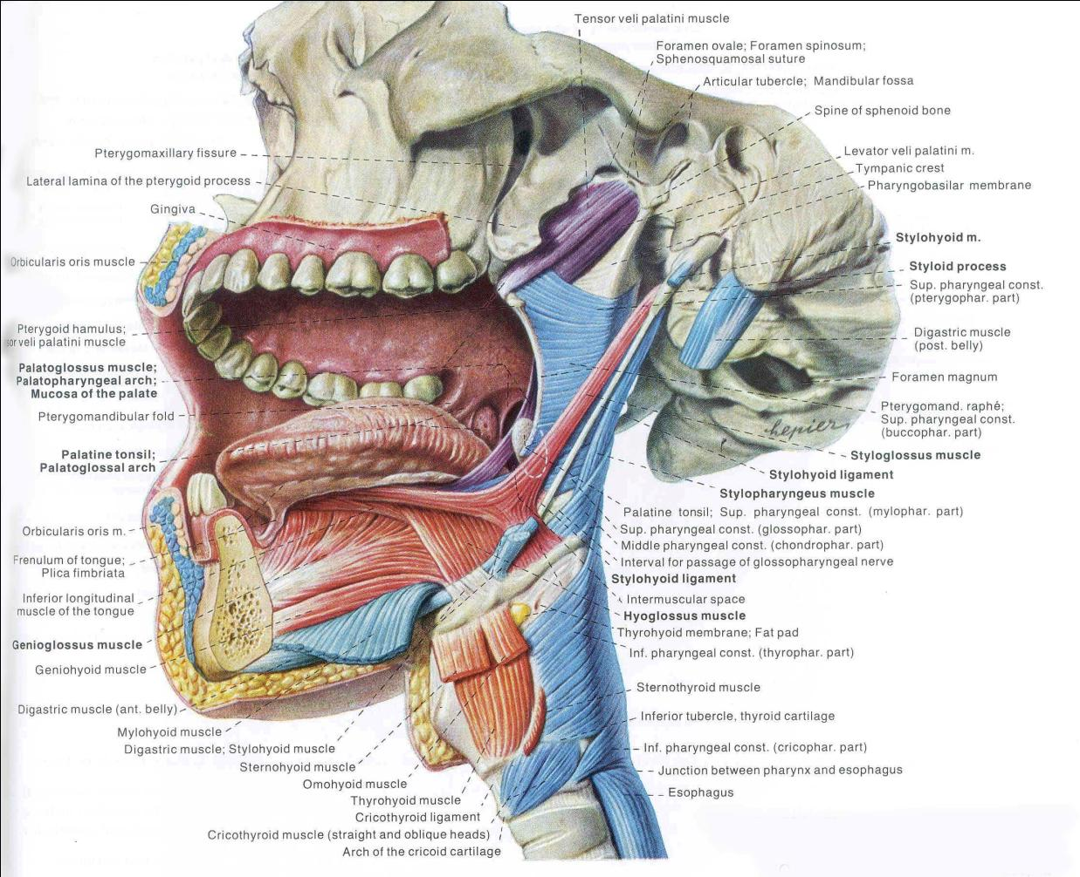
Stylohyoid, styloglossus, tongue muscles in general.

Slide 138
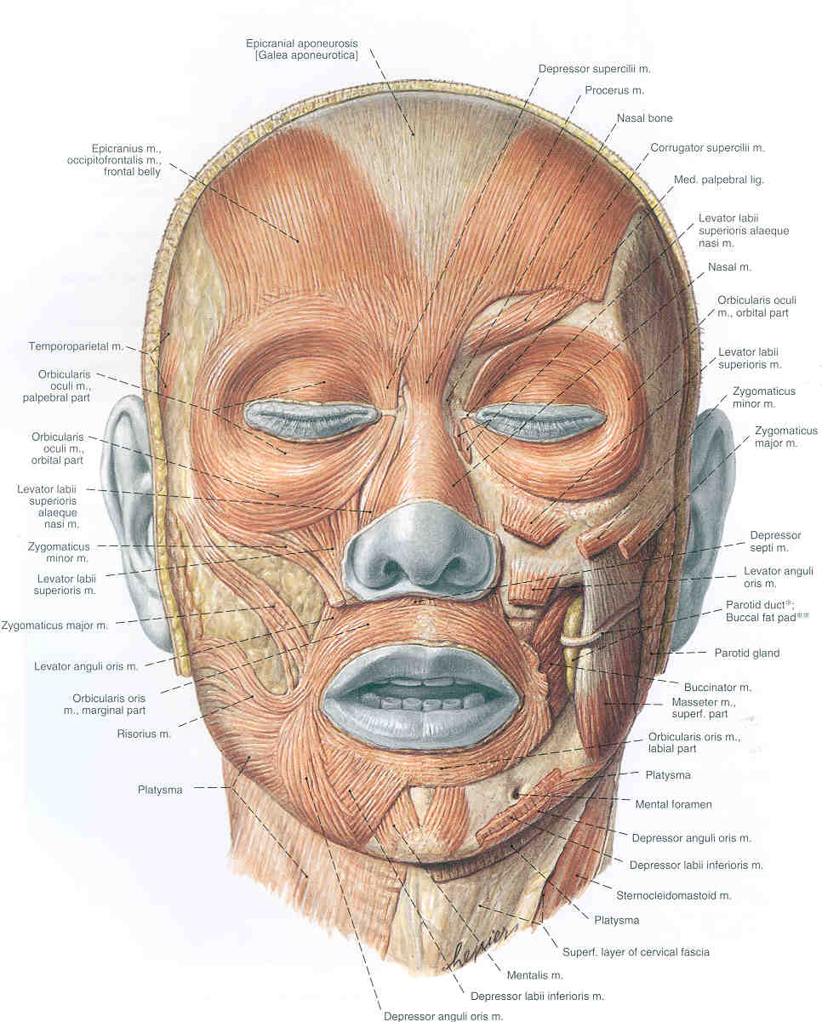
Superficial Facial Muscles (all innervated by VII)

Slide 139
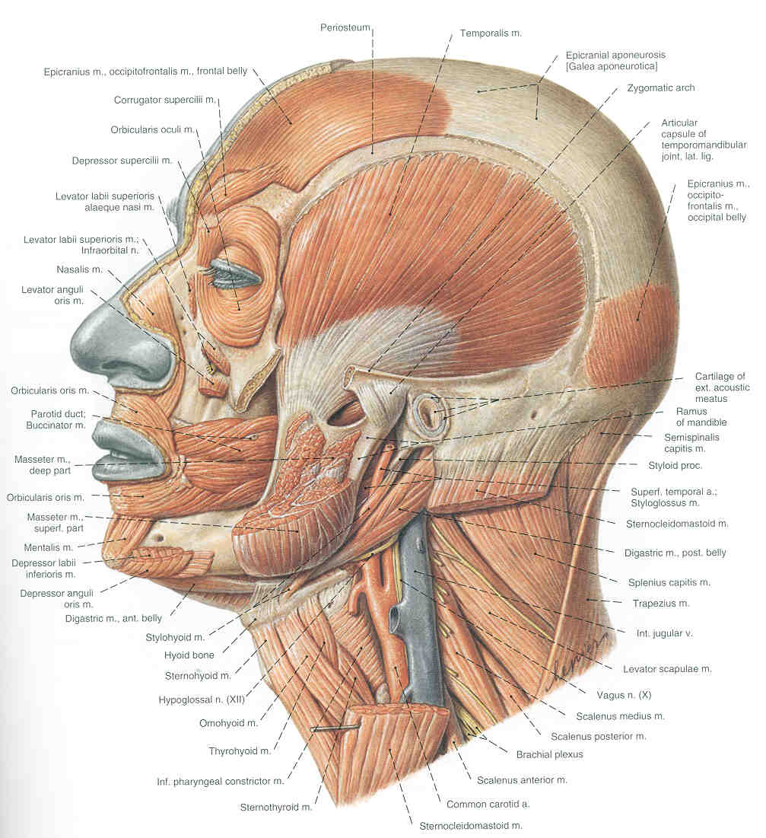
Some muscles of mastication (Innervated by V3)
Deeper Facial Muscles (All innervated by VII)

Slide 140
Major Muscles of the Hyoid Arch (innervated by VII):
Posterior Belly of Digastric
Facial Muscles (!!)
Stapedius
Stylohyoid

Slide 141
Facial Muscles You Have to Remember:
Obicularis Oris
Obicularis Occuli
Frontalis
Buccinator
Platysma
Zyogmaticus Major
Depressor Anguli Oris

Slide 142
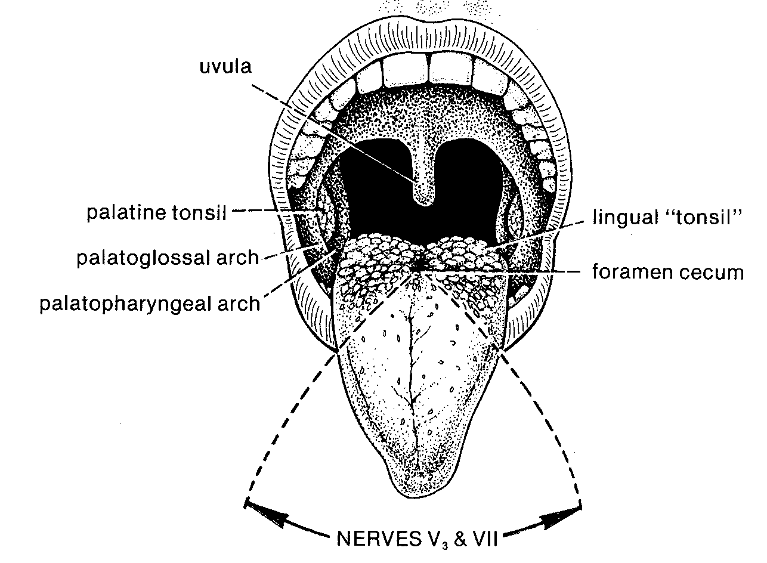
Tongue: Surface

Slide 143
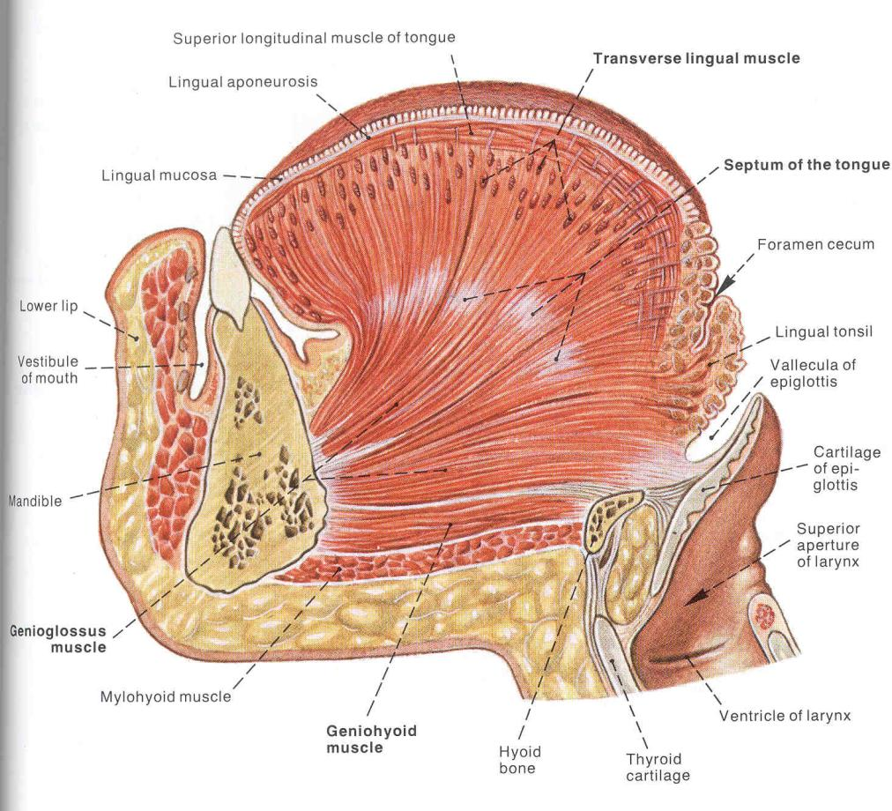
Extrinsic and Intrinsic Tongue Muscles

