Slide 1
Biology 323
Human Anatomy for Biology Majors
Lecture 4
Dr. Stuart S. Sumida
Appendicular Skeleton

Slide 2
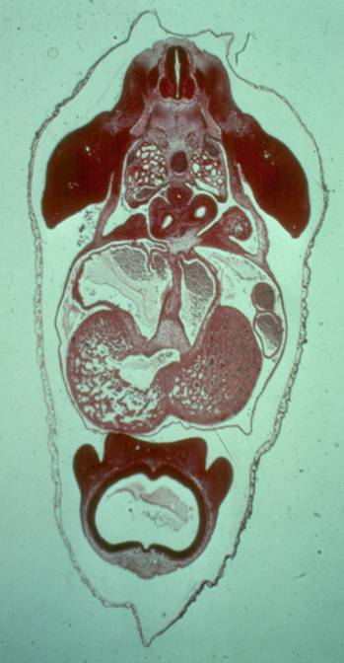

Slide 3
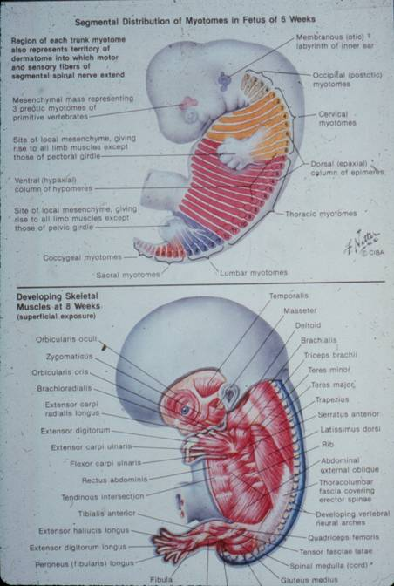

Slide 4
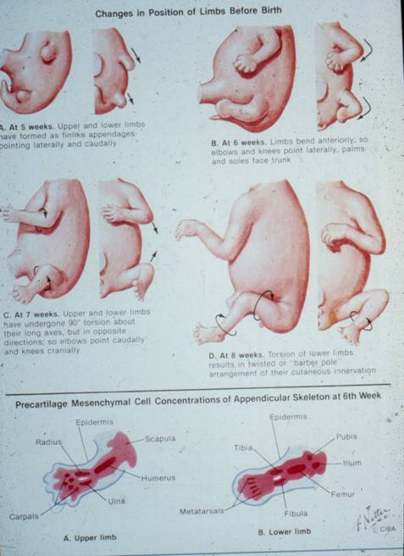

Slide 5
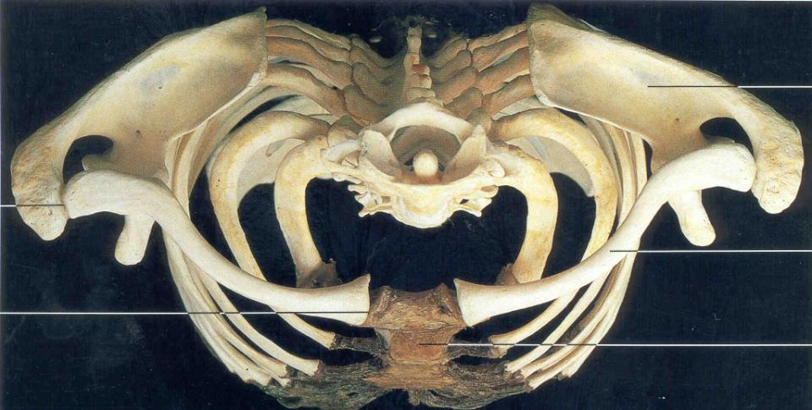

Slide 6
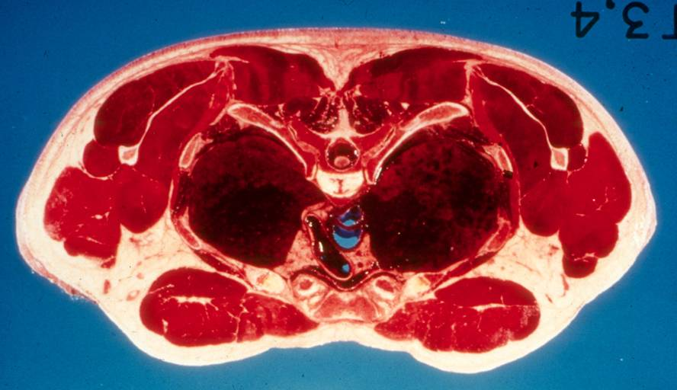

Slide 7
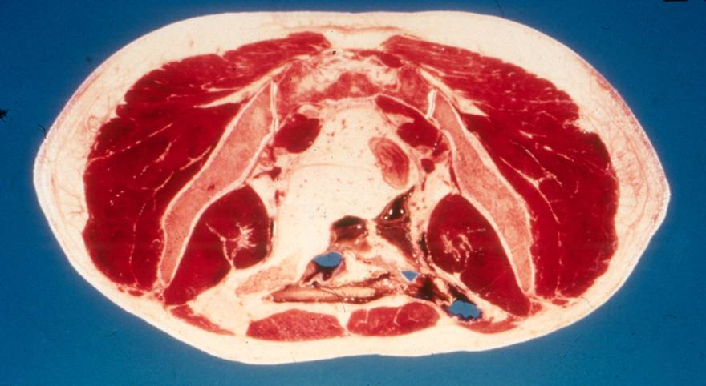

Slide 8
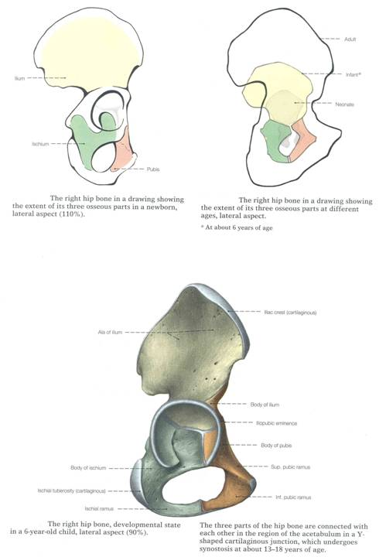

Slide 9
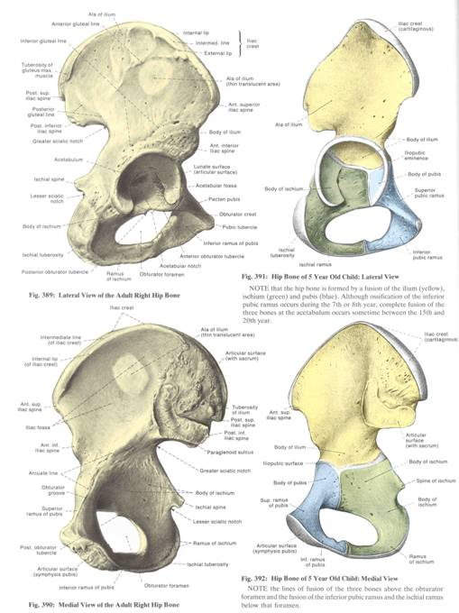

Slide 10
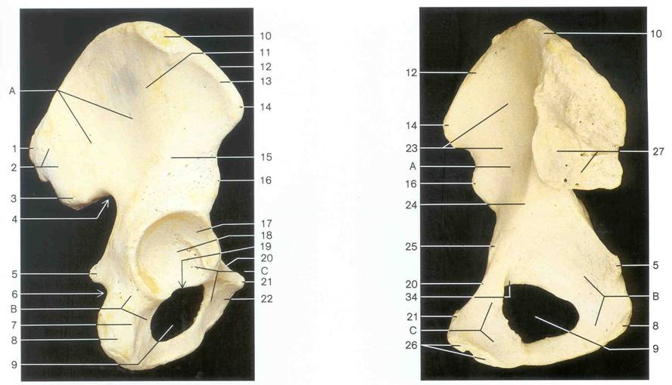

Slide 11
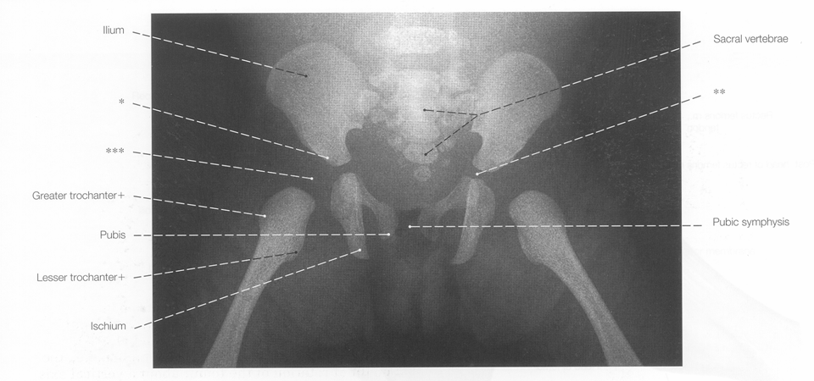

Slide 12
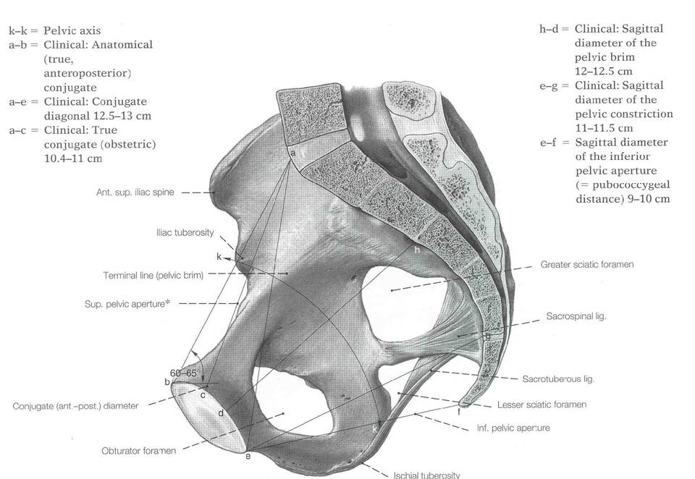

Slide 13
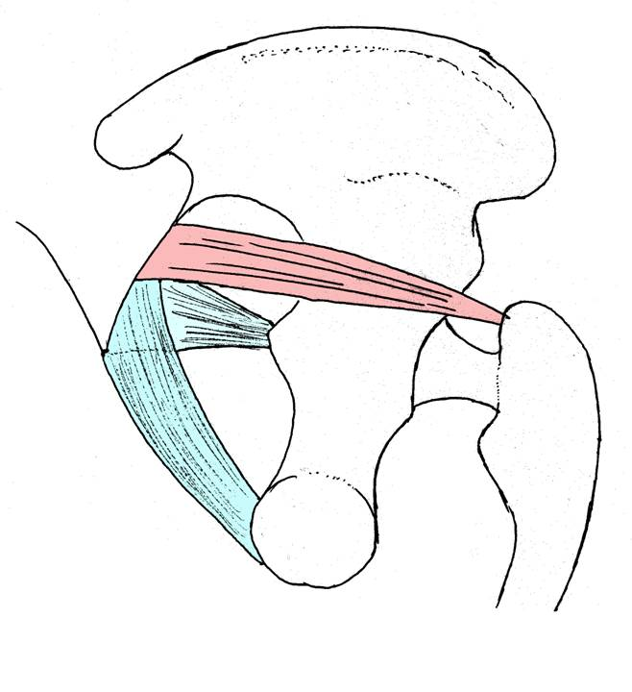

Slide 14
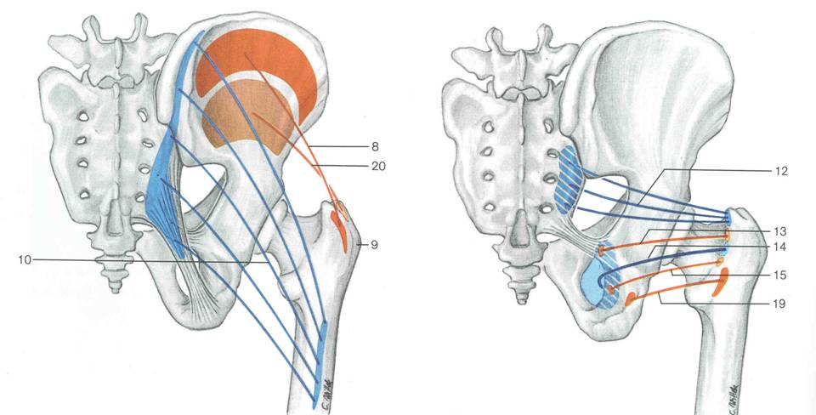

Slide 15
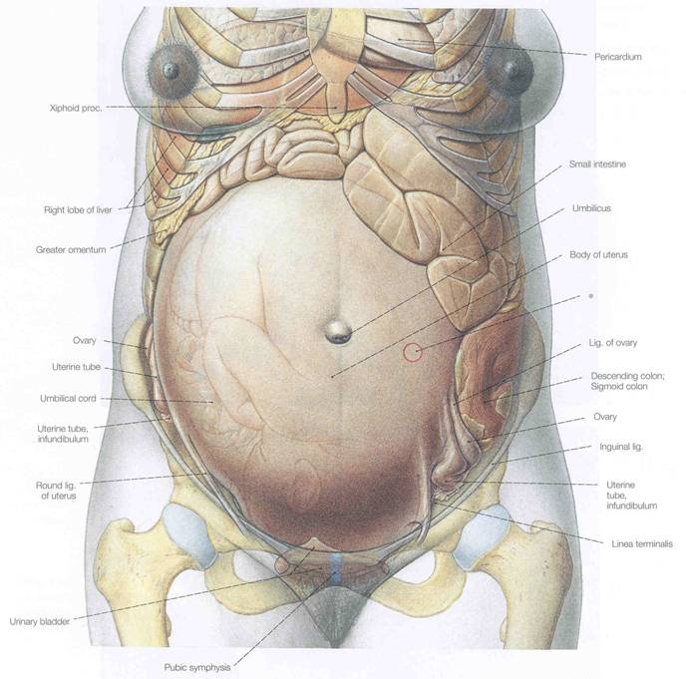

Slide 16
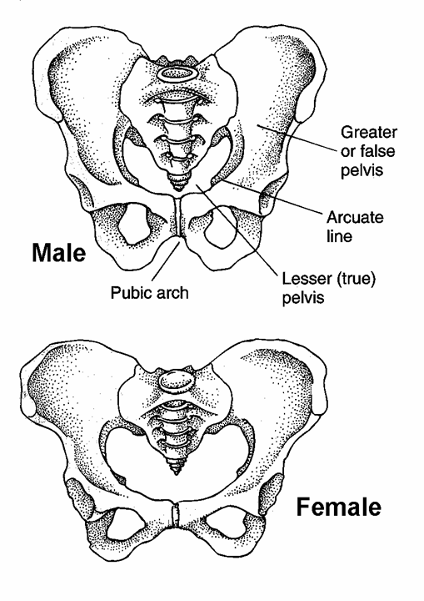

Slide 17
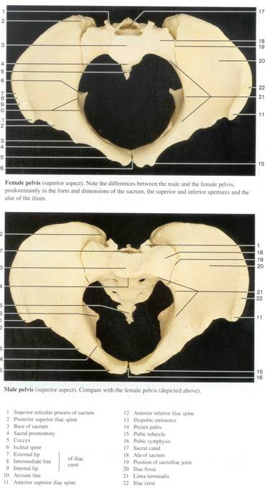
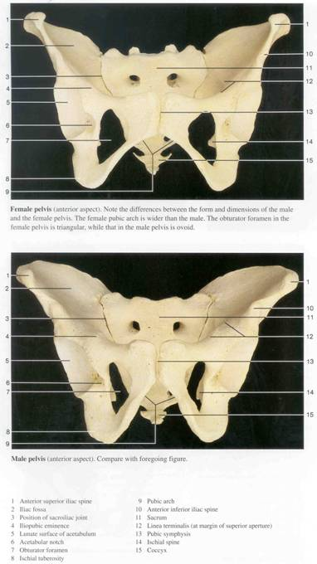
Female
Male

Slide 18
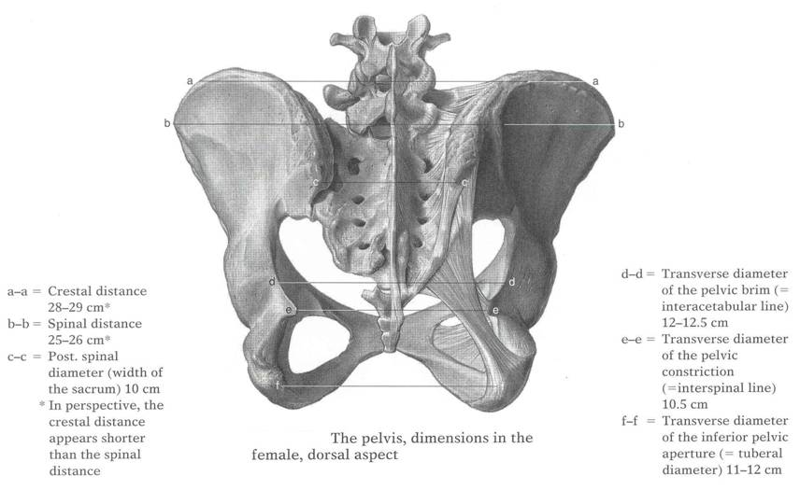
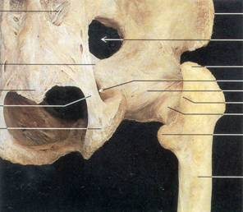

Slide 19
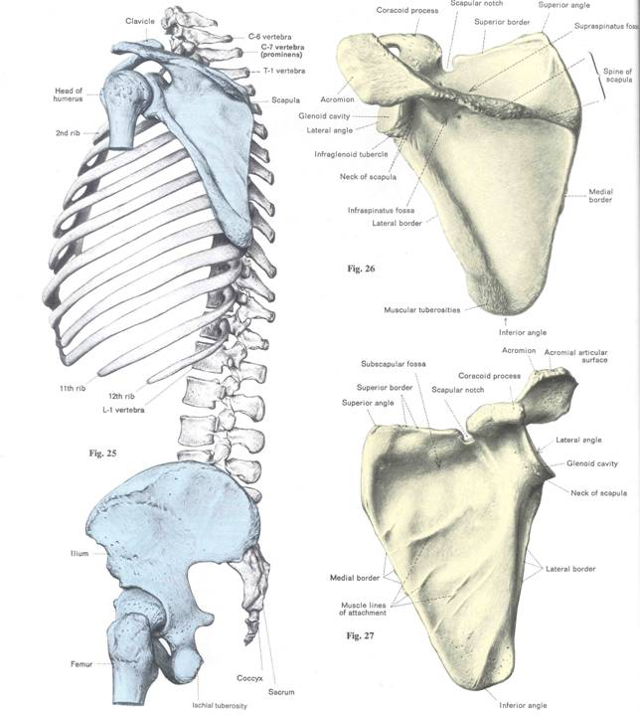

Slide 20
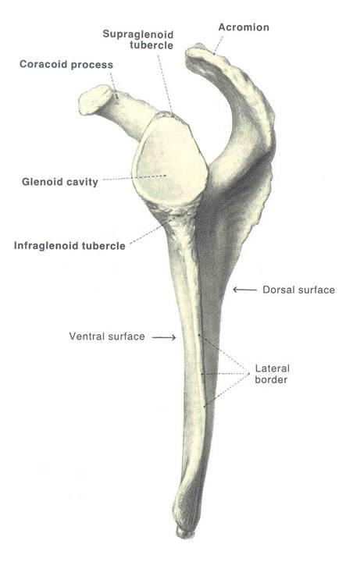

Slide 22
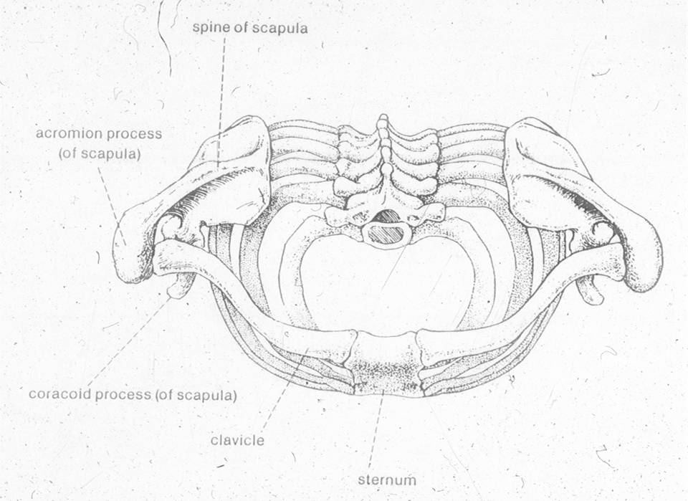

Slide 23
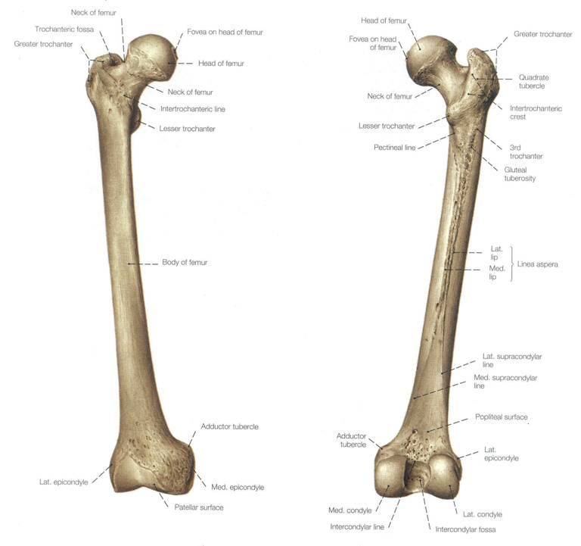

Slide 24
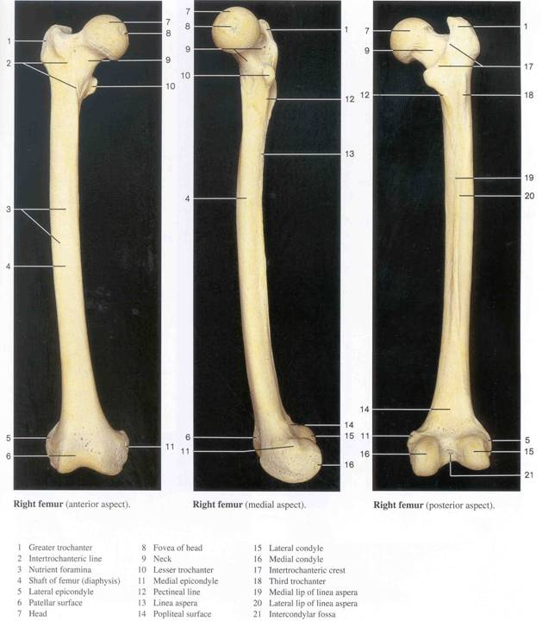

Slide 25
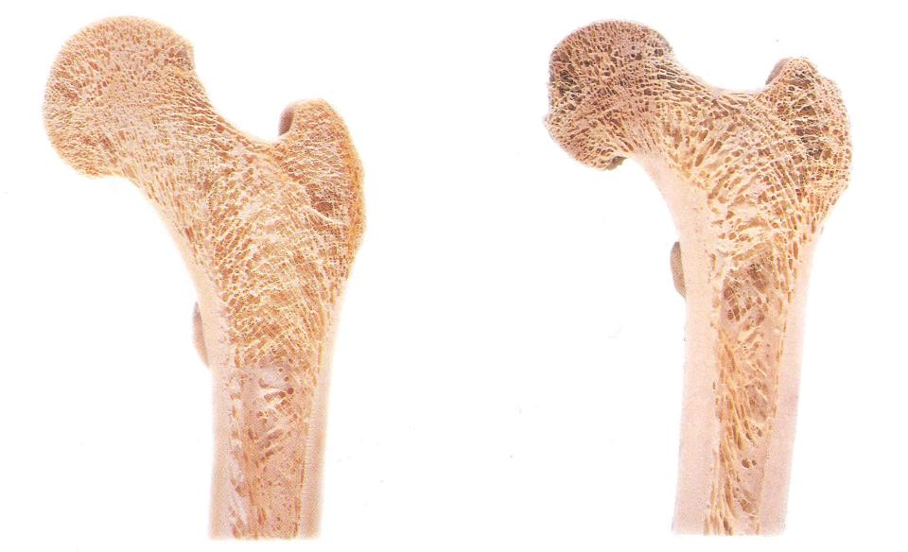
Normal
Osteoporotic
Notice buttress-like trabecular orientation of proximal femur for transfer of weight through head of the femur to cortical bone of femoral shaft

Slide 26
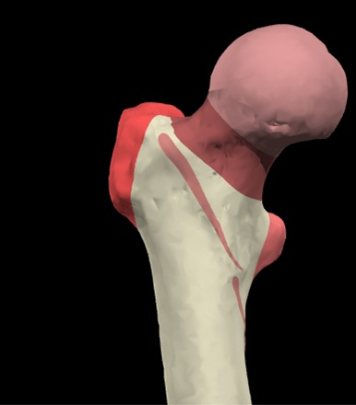
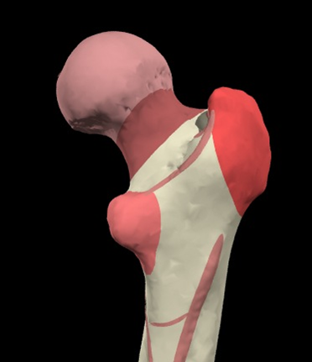
NECK
INTERTROCHANTERIC LINE
INTERTROCHANTERIC CREST
LESSER TROCHANTER
GREATER TROCHANTER
1
2
5
1
2
3
4

Slide 27
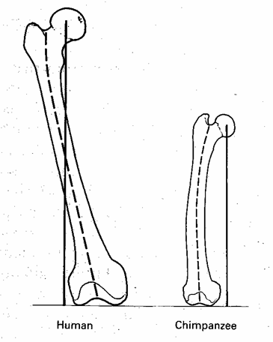
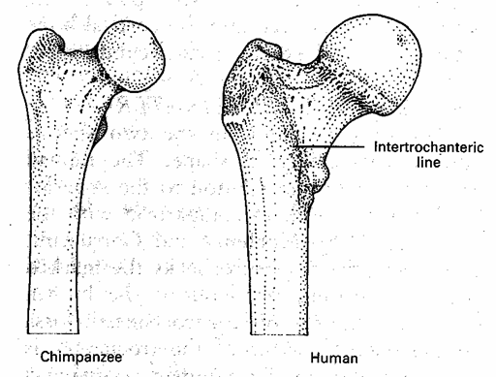

Slide 28
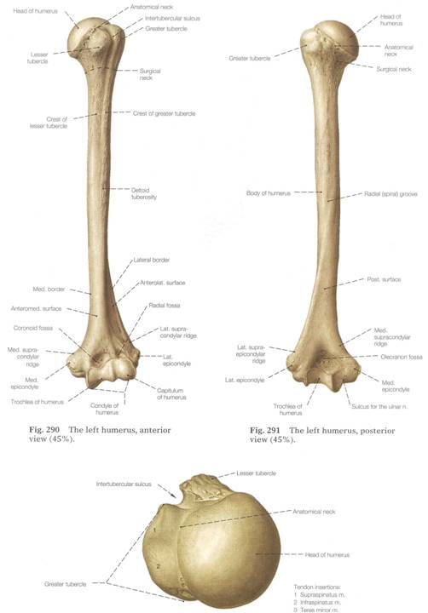

Slide 29
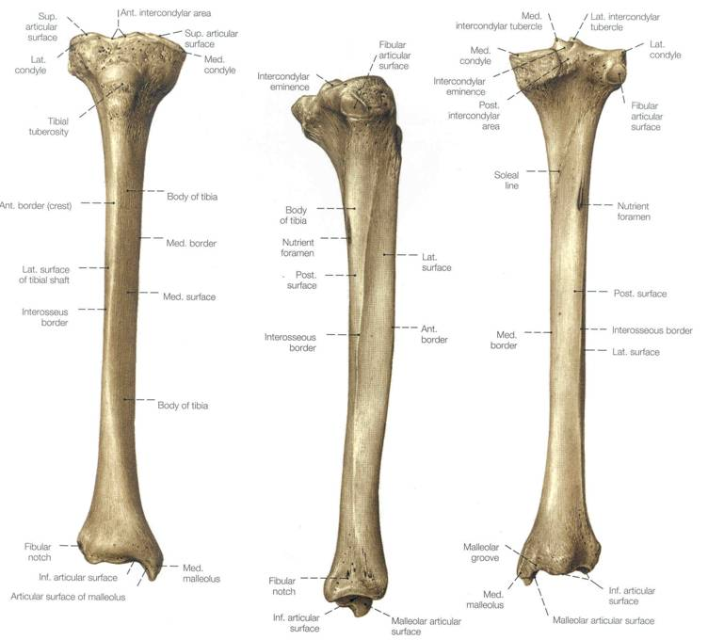

Slide 30
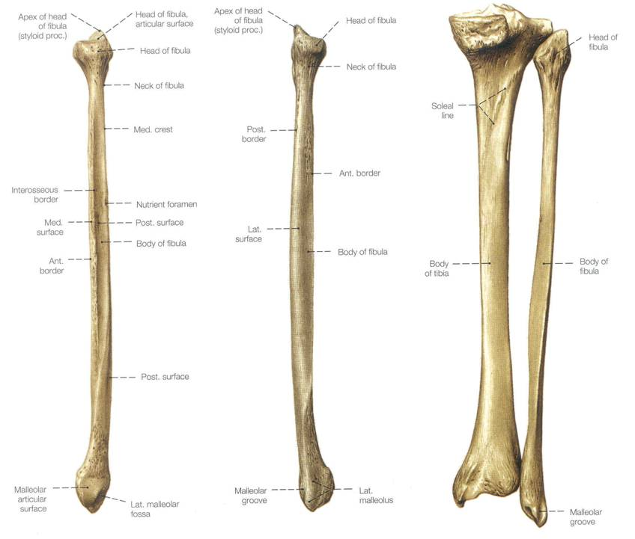

Slide 31
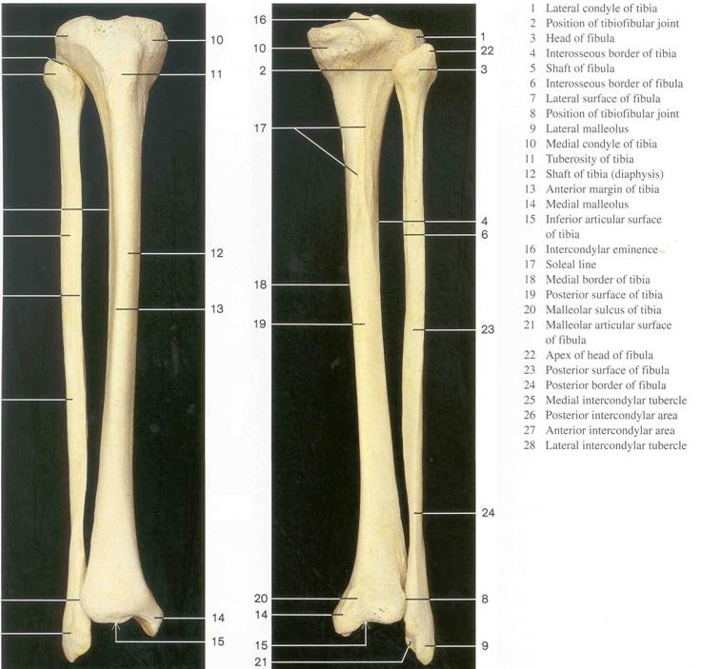

Slide 32
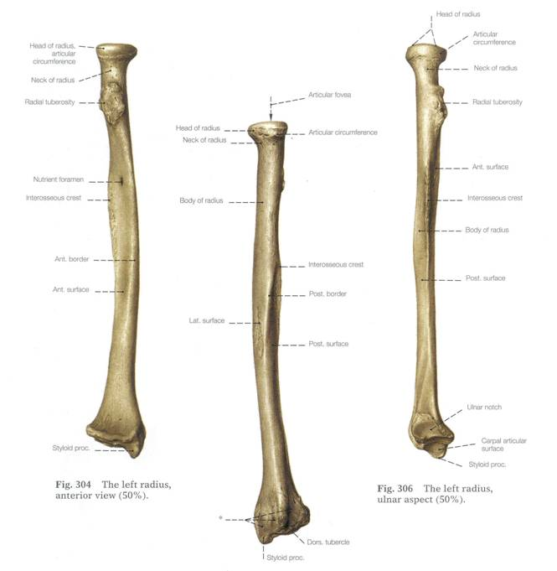

Slide 33
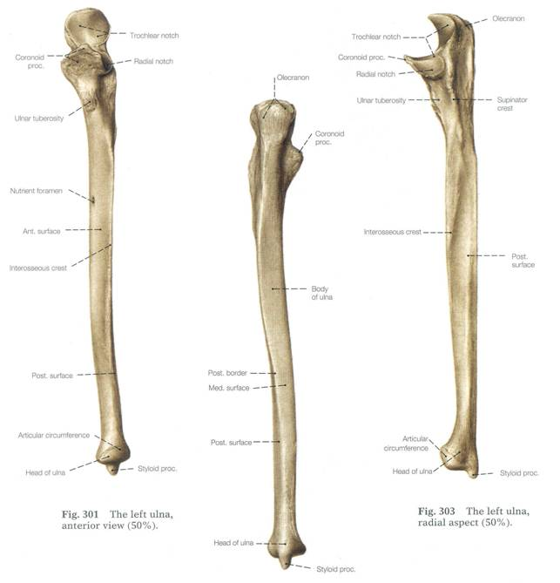

Slide 34
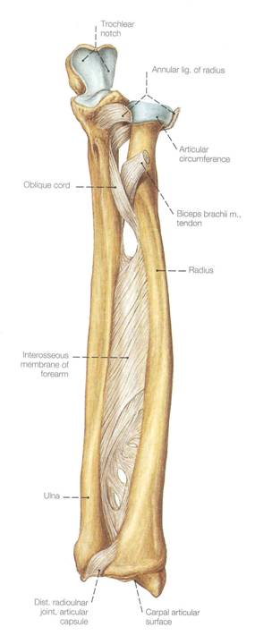

Slide 35
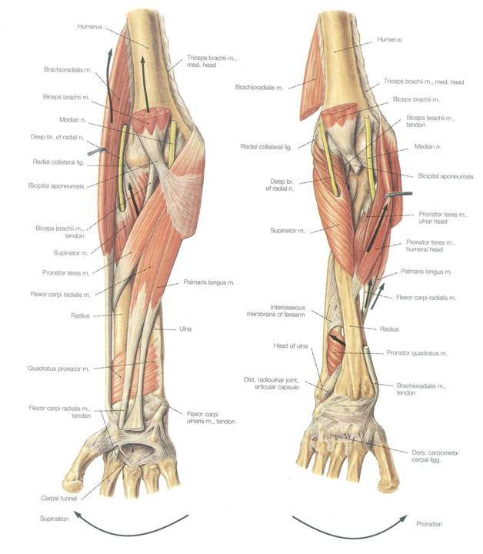

Slide 36
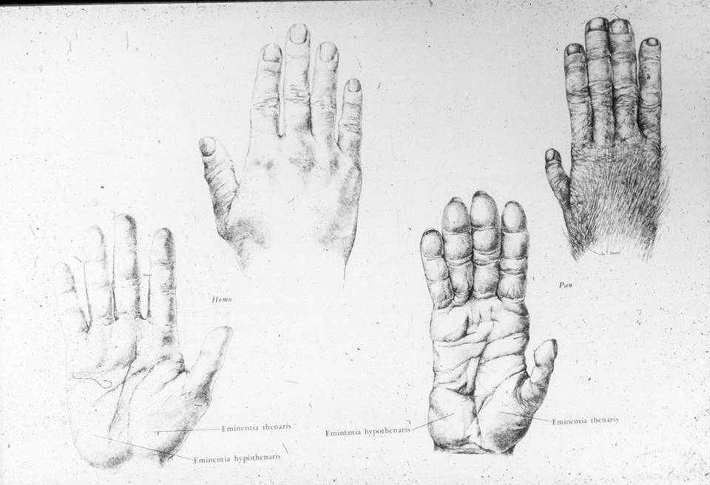

Slide 37
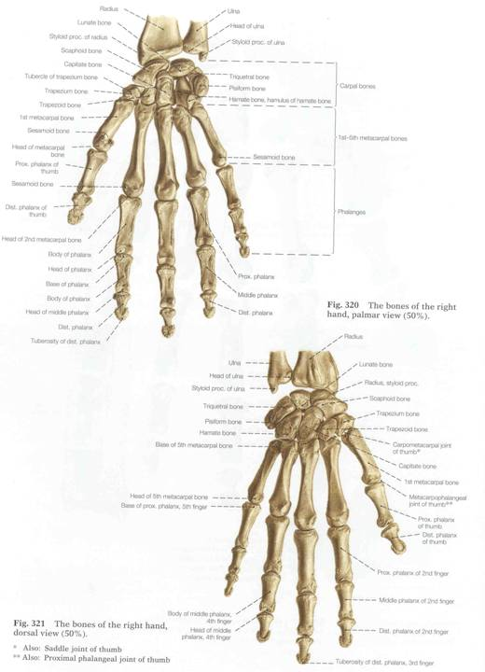

Slide 38
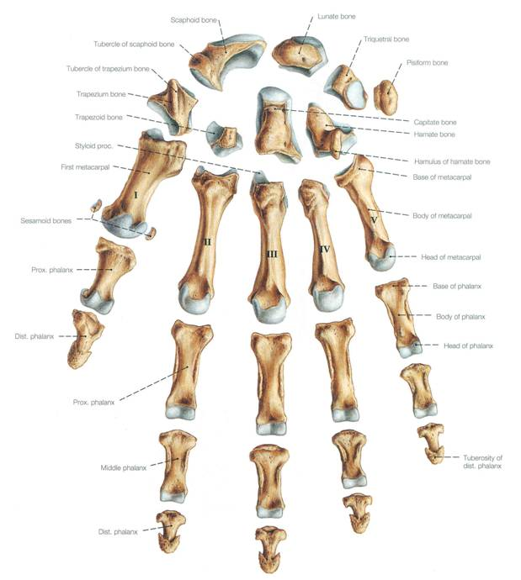

Slide 39
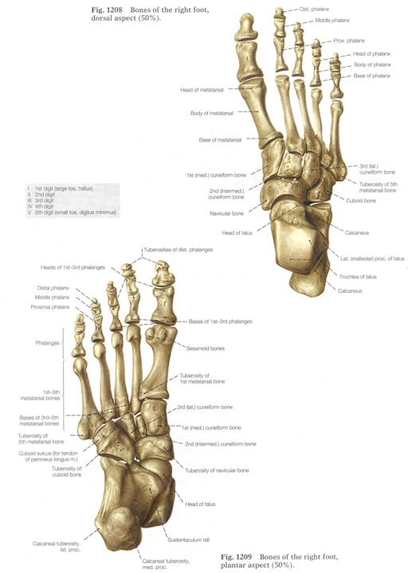

Slide 40
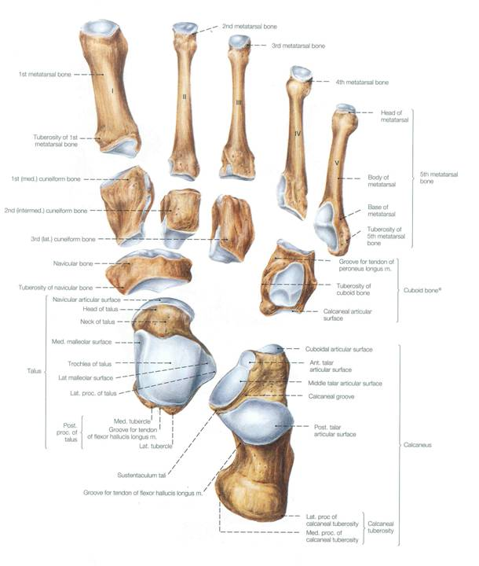

Slide 41
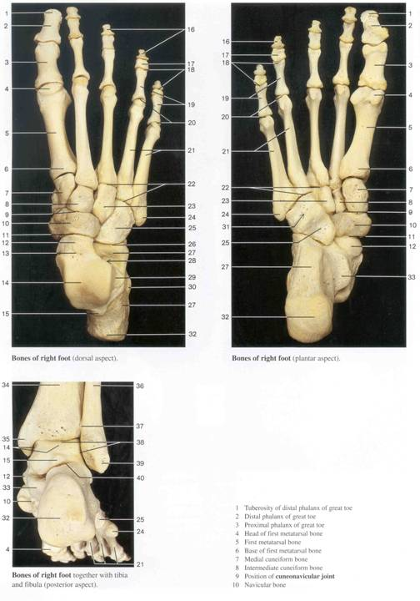

Slide 42
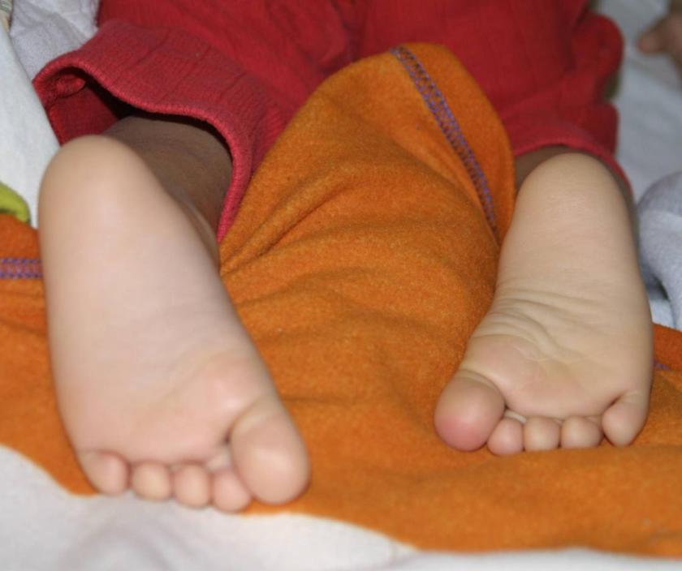
C
Nav
CU

Slide 43
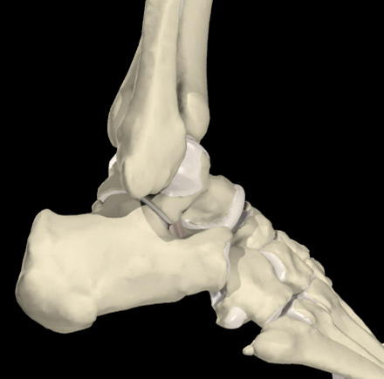
Anatomical Joints: Talo-crural Talo-calcaneal-Navicular joints
ANKLE lateral
tibia
fibula
Transverse tarsal
talus
NV
CUN
calcaneus
cuboid
5th metatarsal

Slide 44
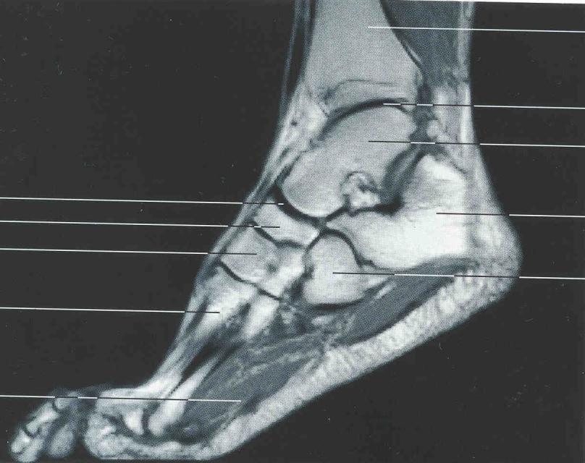
Objective 3: JOINTS and LIGAMENTS OF THE FOOT & ANKLE/ Parasagittal MRI
tibia
talus
navicular
calcaneus
cuboid
2nd metatarsal

Slide 45
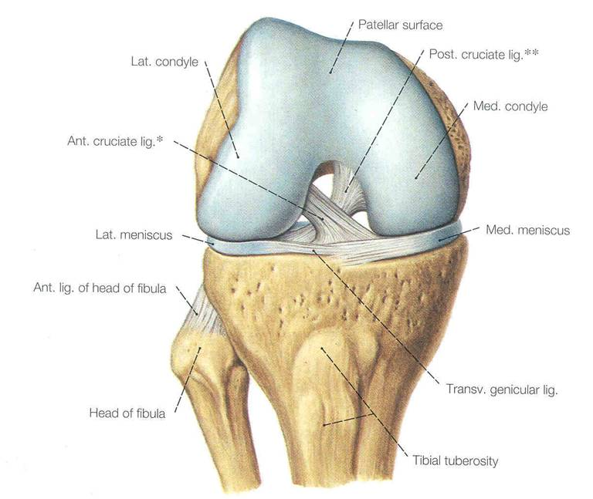

Slide 46
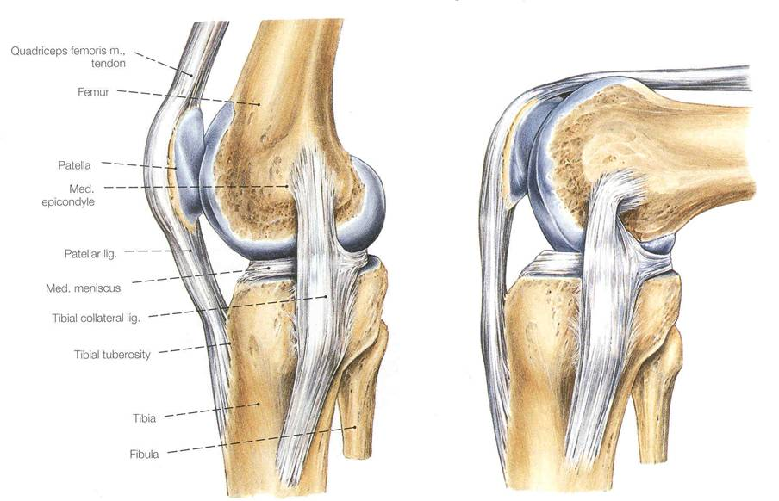

Slide 47
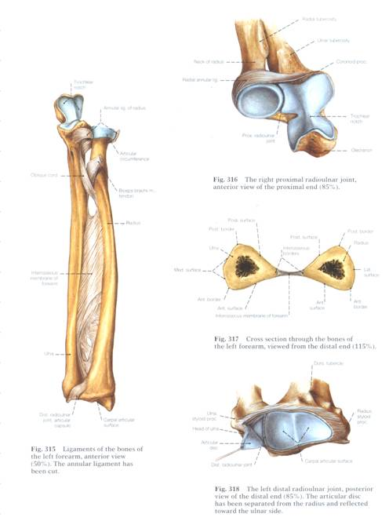
Note interosseus membrane

Slide 48
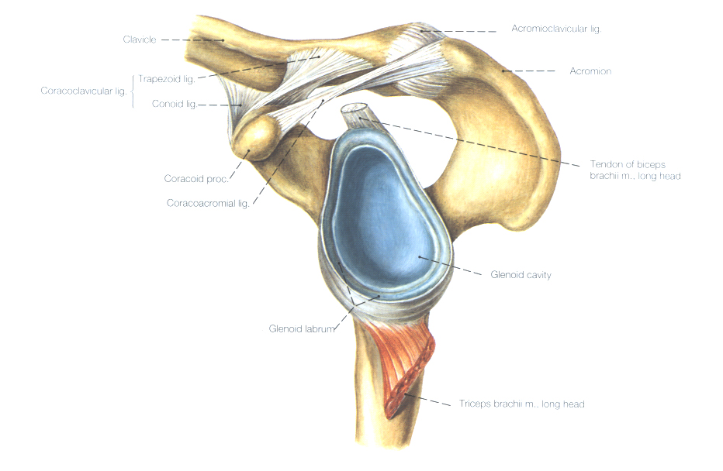
3
2B
2A
1
Major Ligaments
Coracoacromial lig.
Coracoclavicular lig.
2A. Conoid
2B. Trapezoid
3. Acromioclavicular lig.

Slide 49


Slide 50


Slide 51


Slide 52


Slide 53


ACETABULUM
INCOMPLETE RING OF BONE
LUNATE (ARTICULAR) CRESCENT
ACETABULAR FOSSA WITH INTRA-ARTICULAR FAT PAD
LABRUM – FIBROCARTILAGENOUS
TRANSVERSE ARTICULAR LIGAMENT (DEMARCATING FORAMEN FOR COMMUNICATION OF NERVES, VESSELS.
Ant. Obturator ARTERY/VEIN
Posterior Obturator ARTERY/VEIN source of acetabular vessels
1
3
2
4
5
6

Slide 54

LABRUM
ACETABULAR FOSSA WITH INTRA-ARTICULAR FAT PAD
TRANSVERSE ARTICULAR LIGAMENT
FEMORAL LIG.
FEMORAL LIGAMENT DOES NOT PREVENT DISLOCATION OF FEMURAL HEAD
POSTERIOR Obturator ARTERY/ VEIN supplies ligament of fovea capitus femoris

Slide 55

ILIOFEMORAL LIGAMENT
Attaches to intertrochanteric line of femur
PUBOFEMORAL LIGAMENT ATTACHMENT
to inferior neck

Slide 56

ISHIOFEMORAL LIGAMENT to superior posterior neck
ILIOFEMORAL LIGAMENT
Attaches to intertrochanteric line of femur

Slide 57


FEMORAL LIGAMENTS
PUBOFEMORAL
ISHIOFEMORAL
ILIOFEMORAL
2
3
1

Slide 58




FEMORAL LIGAMENTS
PUBOFEMORAL
ISHIOFEMORAL
ILIOFEMORAL
3
2
ANTERIOR VIEW
1

Slide 59

Note that the articulation of the femur at the tibia is not straight (180 degrees)
This angle is know as the VALGUS angle. Typically 170-175 degrees but …
It is more often greater in women because of the more widely-spaced acetabula.
Vertical
Valgus

Slide 60

Additional attachments
(patellar retinaculum)
Patellar ligament

Slide 61


Knee Joint/ ARCHITECTURE / Osseous features
Medial epicondyle
MEDIAL VIEW
POSTERIOR VIEW

Slide 62


Mensici – increase joint congruence
Collateral ligaments – increase lateral stability and promote knee locking
Lat coll Lig
LM
MM

Slide 63



Slide 64


POSTERIO-MEDIAL VIEW
TIBIAL COLLATERAL LIGAMENT
POSTERIOR CRUCIATE LIGAMENT
ANTERIOR CRUCIATE LIGAMENT
1
3
2

Slide 65

Structures to be identified in your bone boxes
Distal femur: lateral and medial condyles (articular and attachment surfaces), patellar surface, intercondylar fossa, epicondyles.
Fibula: head, shaft, lateral malleolus, interosseus membrane attachment
Tibia: condyles, intercondylar notch, patellar (tibial) tuberosity, medial malleolus, facet for fibular head, fibular notch, attachment of soleus muscle, interosseus membrane attachment;
Patella
Posterior view

Slide 66
3 FUNCTIONAL JOINTS in foot
Functional joint = unit of movement
TALOCRURAL
SUBTALAR (incl. Talo-calcaneal of TCN)
TRANSVERSE TARSAL (incl. Talo-navicular of TCN)

Slide 67
Medial: medial collateral ligament (MCL); very strong, trauma by means of avulsion rather than material failure.
“deltoid ligament” superficial
posterior tibio-talar
tibiocalcaneal
tibionavicular.
deep ligaments
anterior talotibial ligament
posterior talotibial ligament
Lateral: lateral collateral ligament (LCL)
anterior talofibular ligament
posterior talofibular ligament -- resists ANTERIOR displacement, allows fibular rotation
calcaneofibular ligament – resist posterior displacement
Anterior:
anterior tibiofibular ligament
Posterior:
posterior tibiofibular ligament
inferior transverse tibio-fibular ligament.
Superior:
interosseous membrane & ligament

Slide 68



MEDIAL COLLATERAL LIGAMENT (MCL)
MEDIAL VIEW
DELTOID LIGAMENT
TIBIONAVICULAR PART
TIBIOCALCANEAL PART
POSTERIOR TIBIO-TALAR PART
ANTERIOR TIBIO-TALAR PART
4
1
3
2

Slide 69



Slide 70
The Skeleton, Nutrition, Sex, and Growth
SEX NUTRITION
Good Poor
Male Continued Growth, Reduced Growth
Greater Height SHORTER than normal height
Female Energy to Delayed onset of
Reproduction & reproductive ability;
Supporting Fat Continued bone Reserves growth; TALLER

