Slide 1
Biology 323
Human Anatomy for Biology Majors
Lecture 5
Dr. Stuart S. Sumida
Nervous System

Slide 2
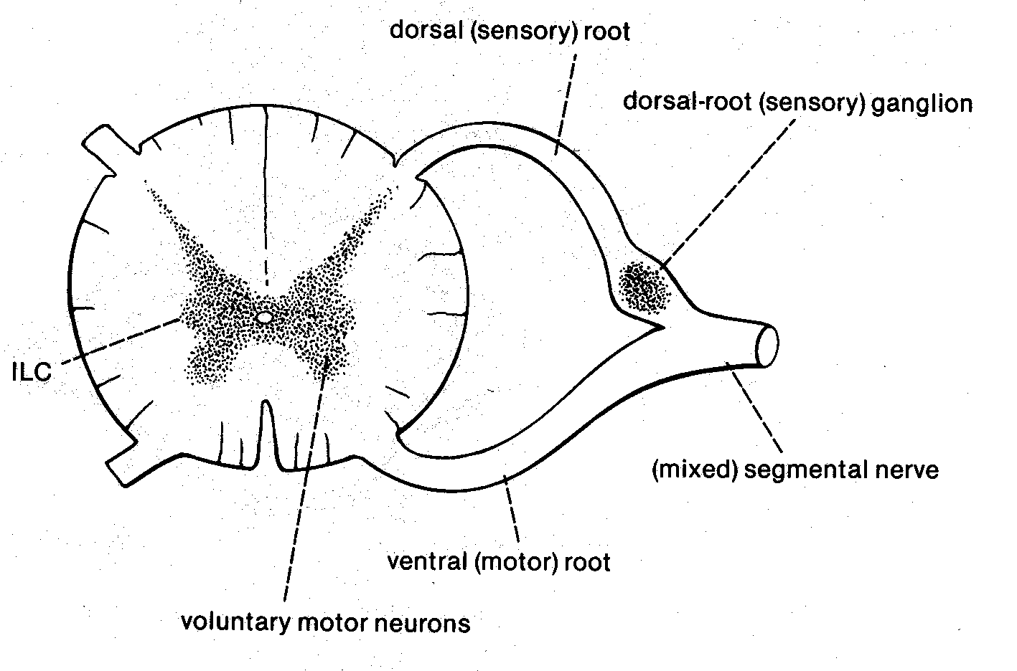

Slide 3
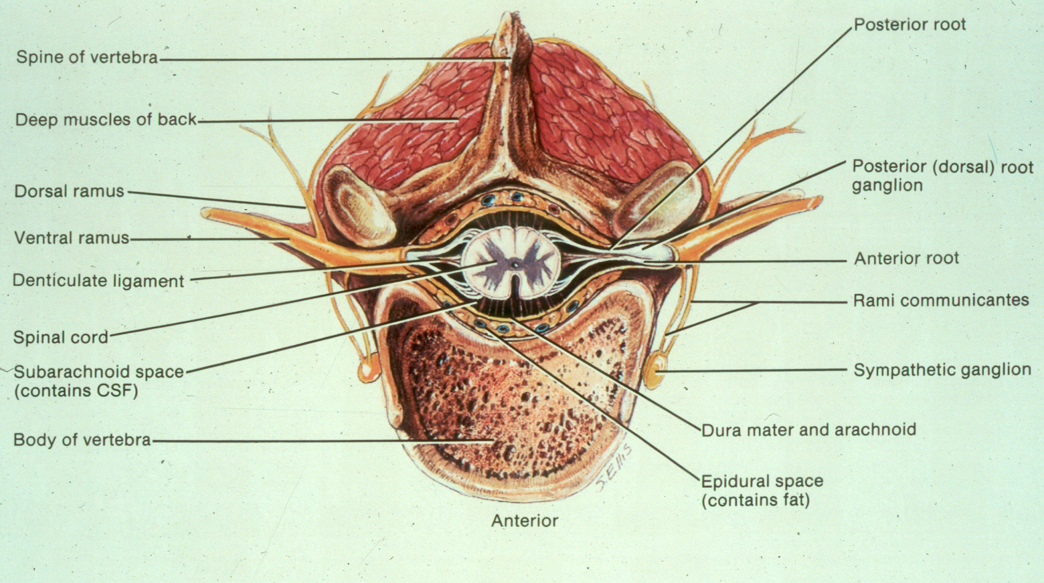

Slide 4
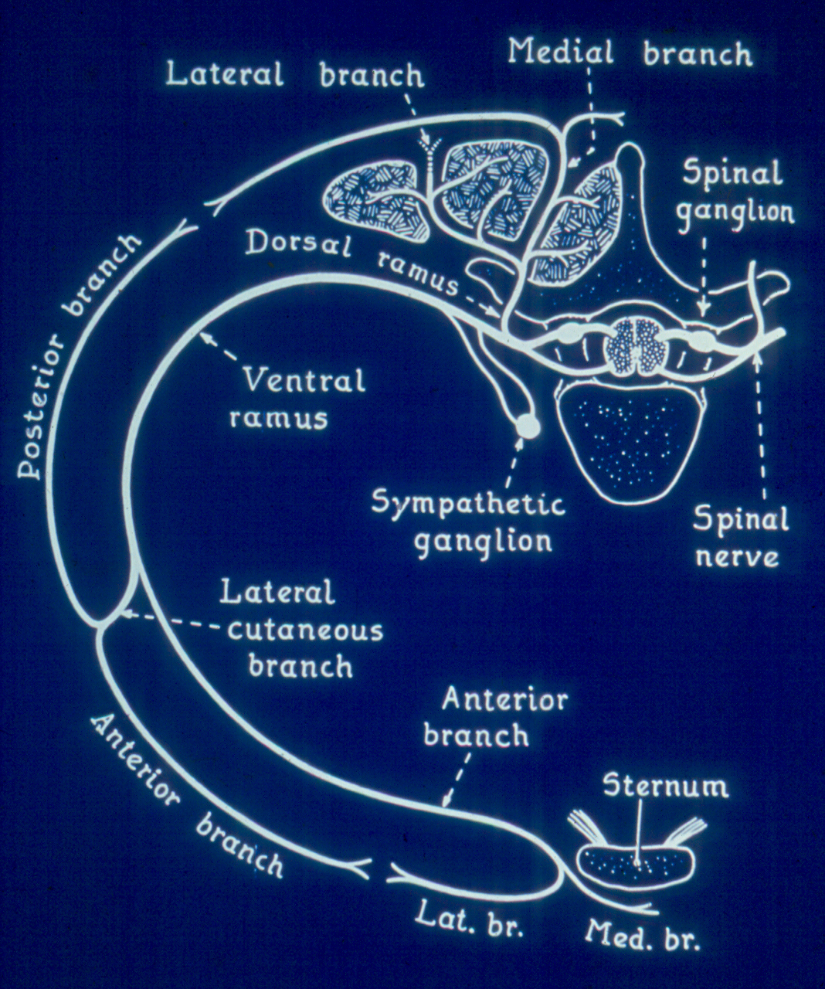

Slide 5
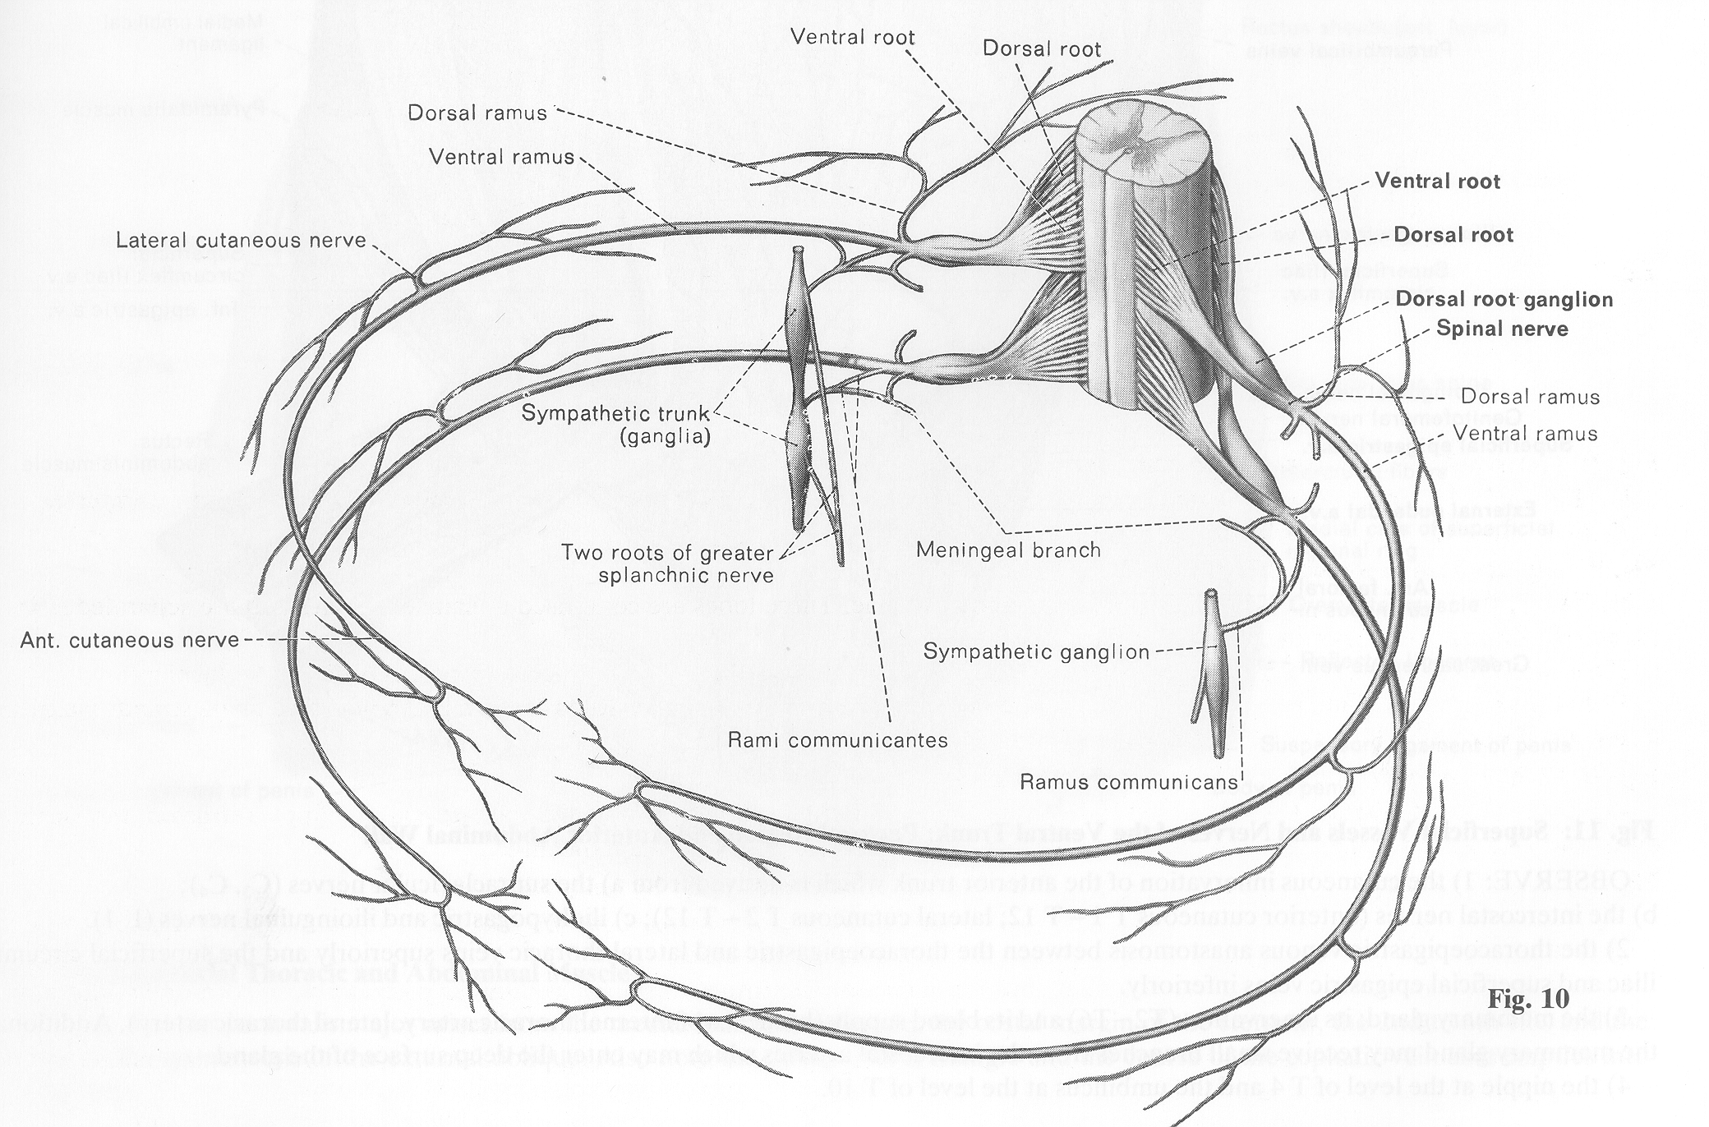

Slide 6
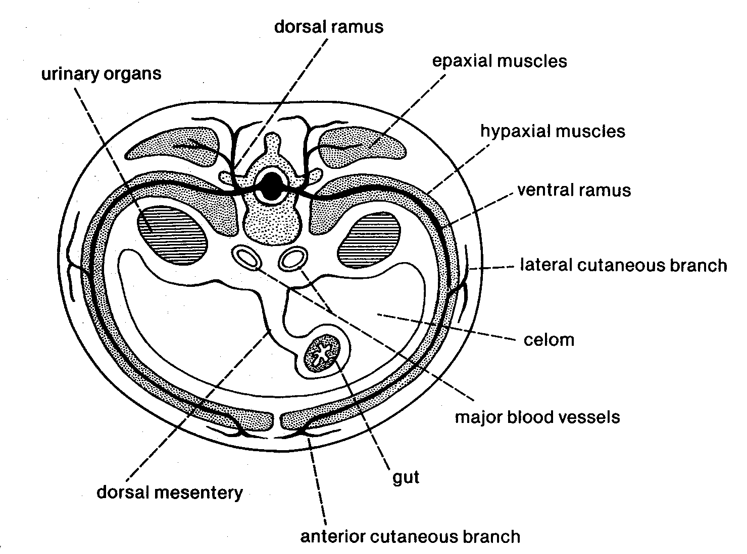

Slide 7
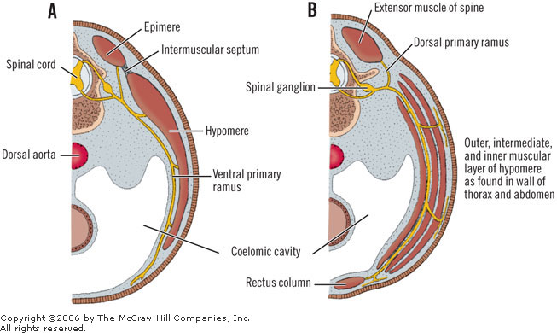
Returning to the basic cross-section: You should now be able to add a segmental nerve to your basic cross section.

Slide 8
You have to be able to draw a standard segmental nerve.

Slide 9
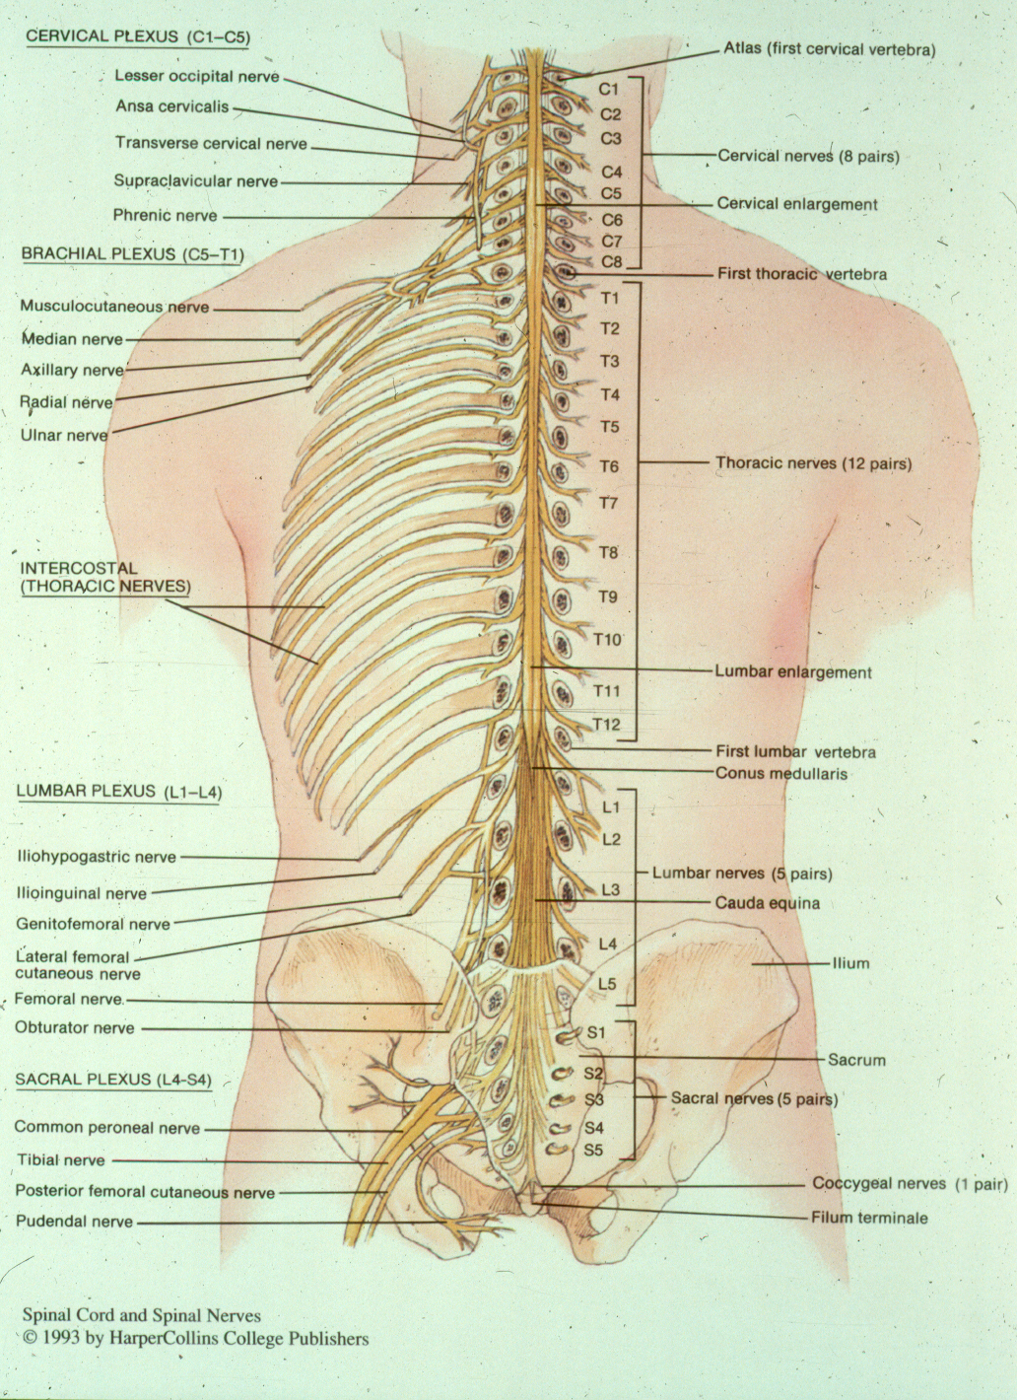

Slide 10
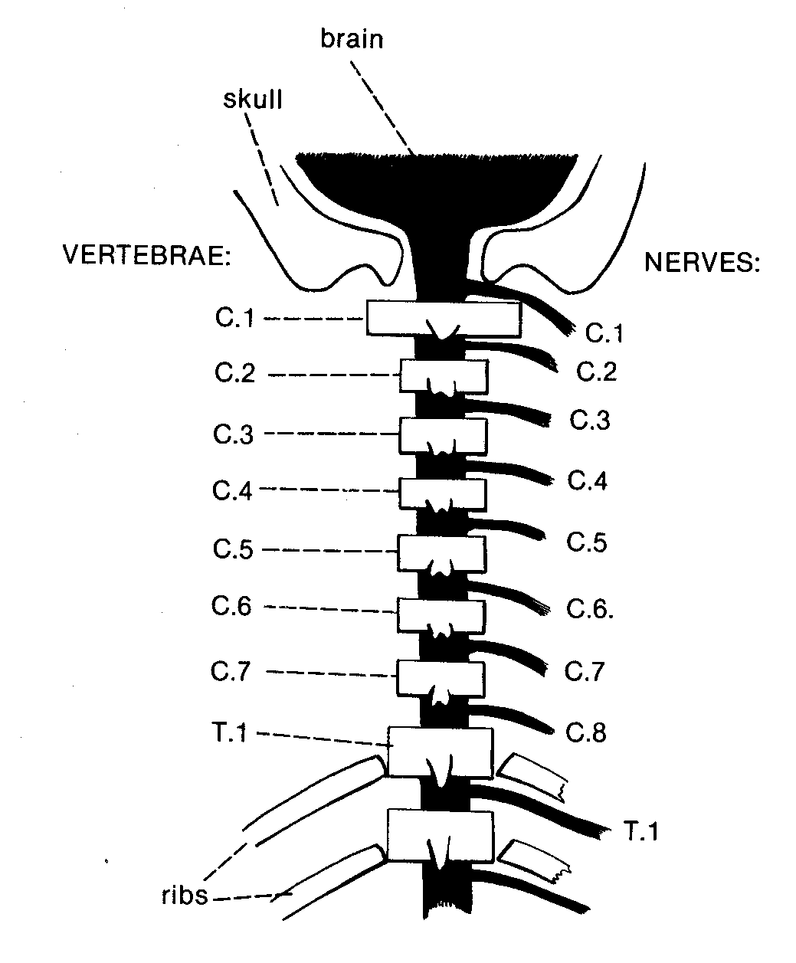
Note the difference between how we number vertebrae and NERVES.

Slide 11
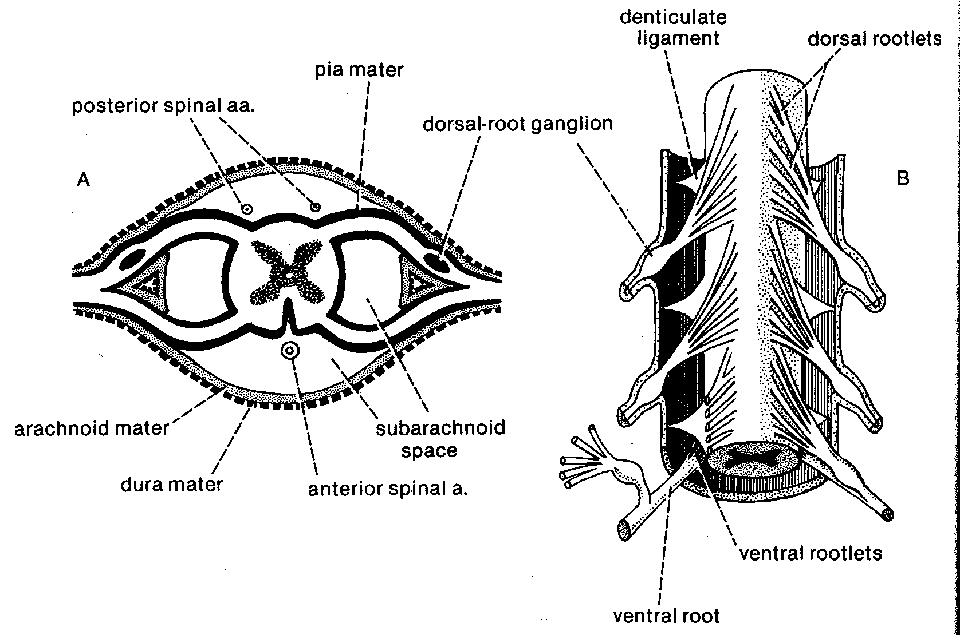

Slide 12
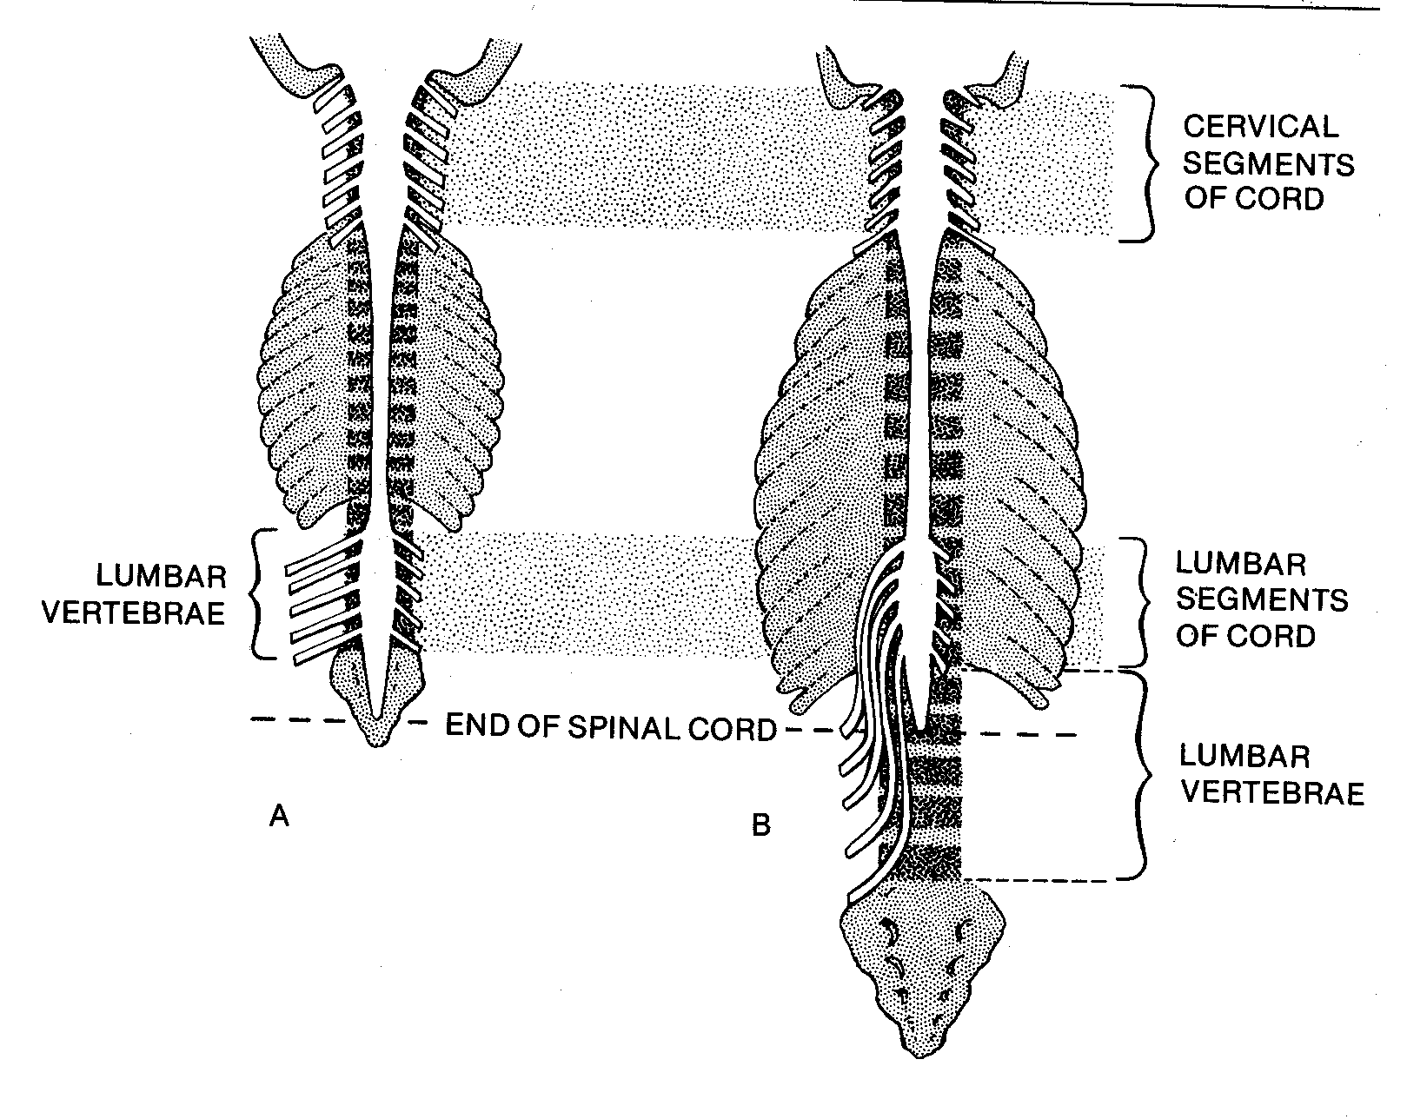

Slide 13
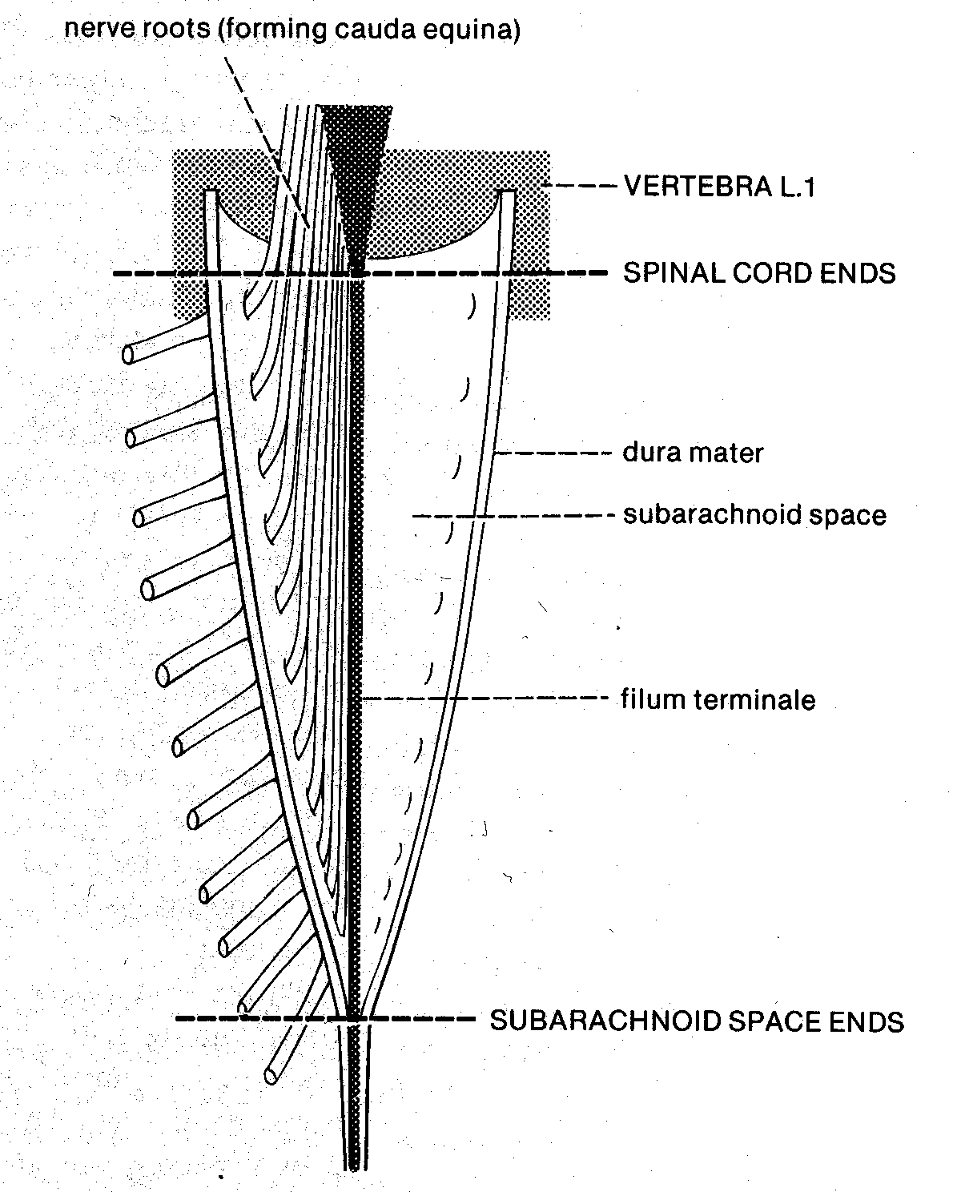

Slide 14
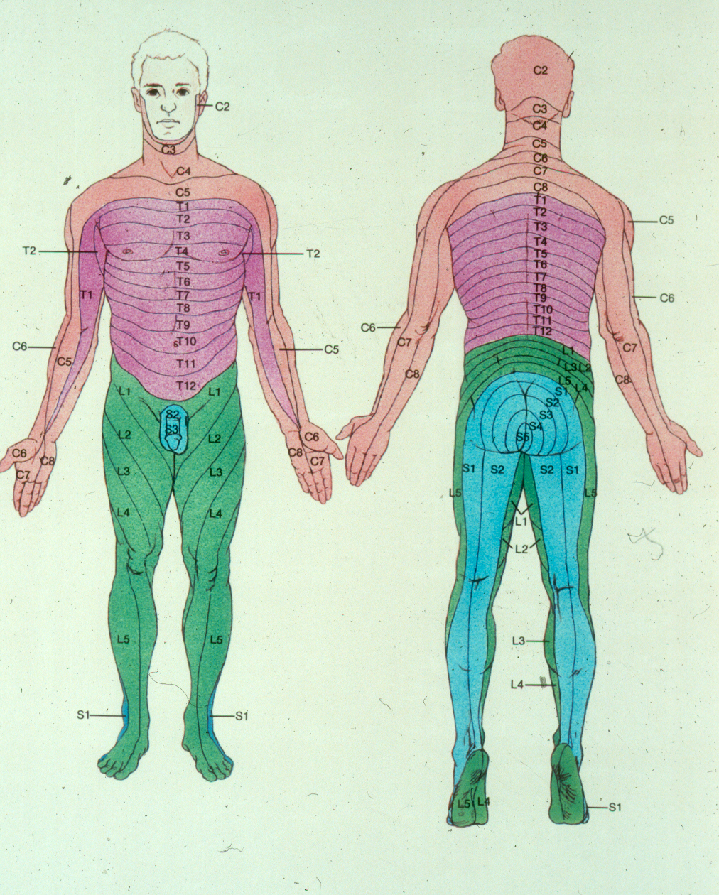

Slide 15
So...what the heck are these messes?!

Slide 16
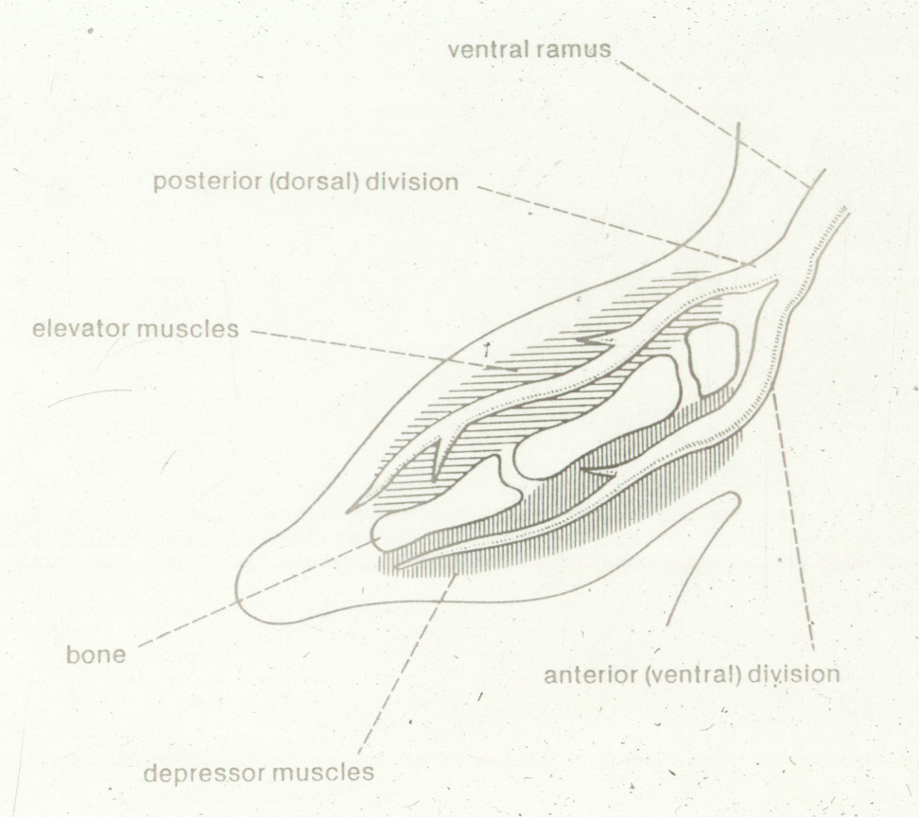

Slide 17
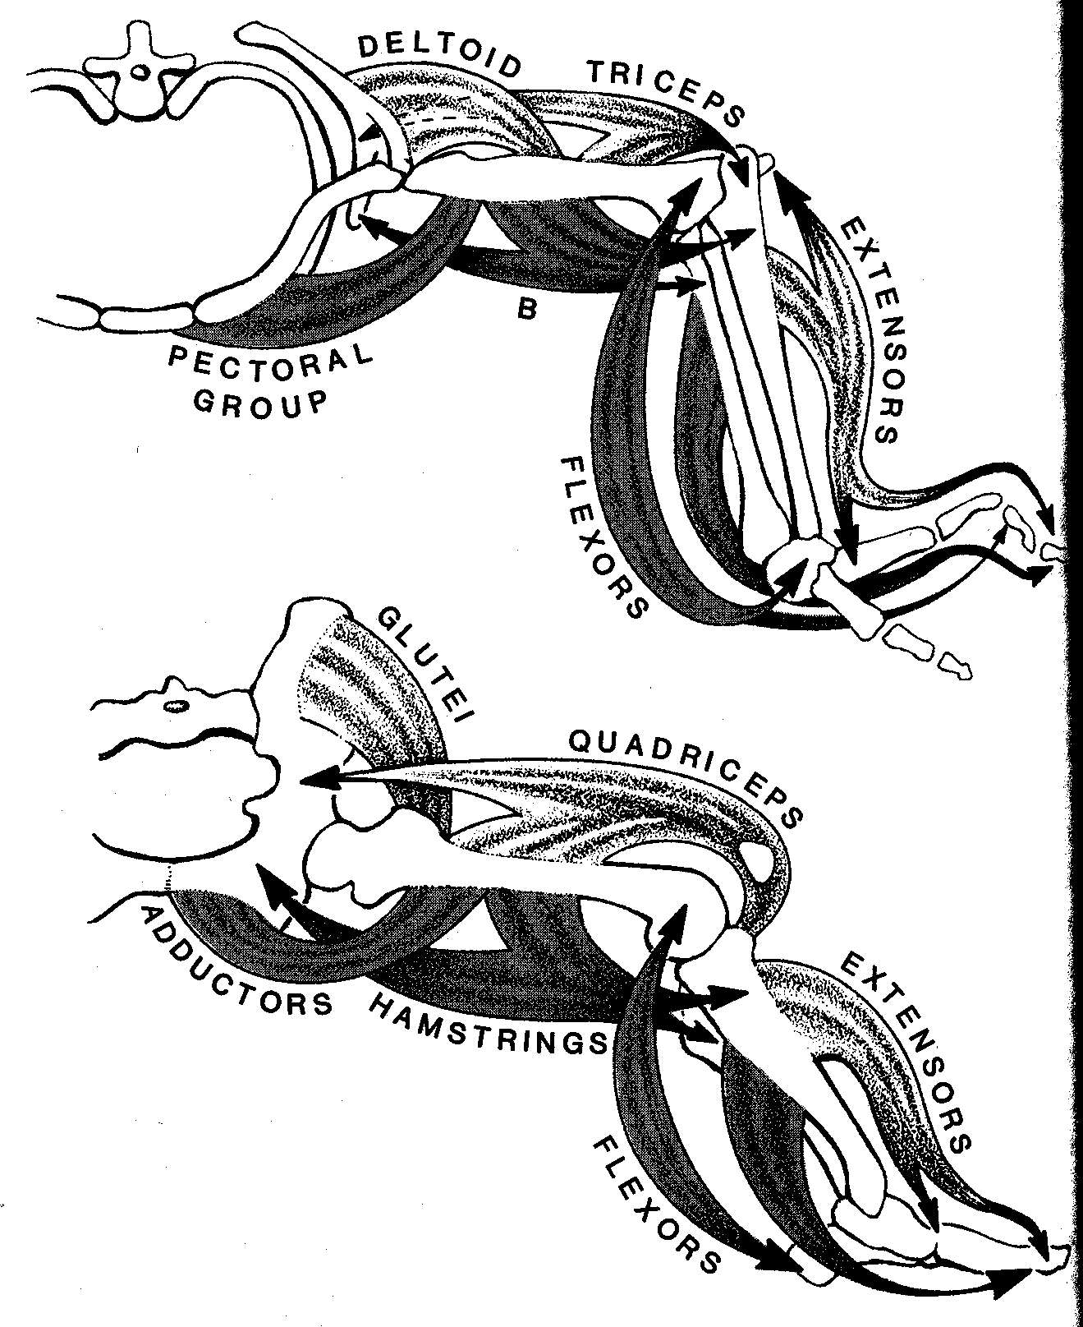

Slide 18
THE PLEXUS:
A complex interconnection of adjacent segmental nerves.
In this case, the ventral rami of adjacent spinal nerves are sorted and recombined so that fibers of a particular peripheral nerve contain elements from a number of segments.
This allows a single segment to exert a greater influence than it could otherwise.

Slide 19
Remember, limbs are multisegmental. How many?

Slide 20
Remember, limbs are multisegmental. How many? 6
So, there should be components of six nerve segments serving each limb.

Slide 21
DORSAL DIVISIONS serve embryologically DORSAL muscles (extensors, elevators).
VENTRAL DIVISIONS serve embryologically VENTRAL muscles (flexors, depressors).

Slide 22
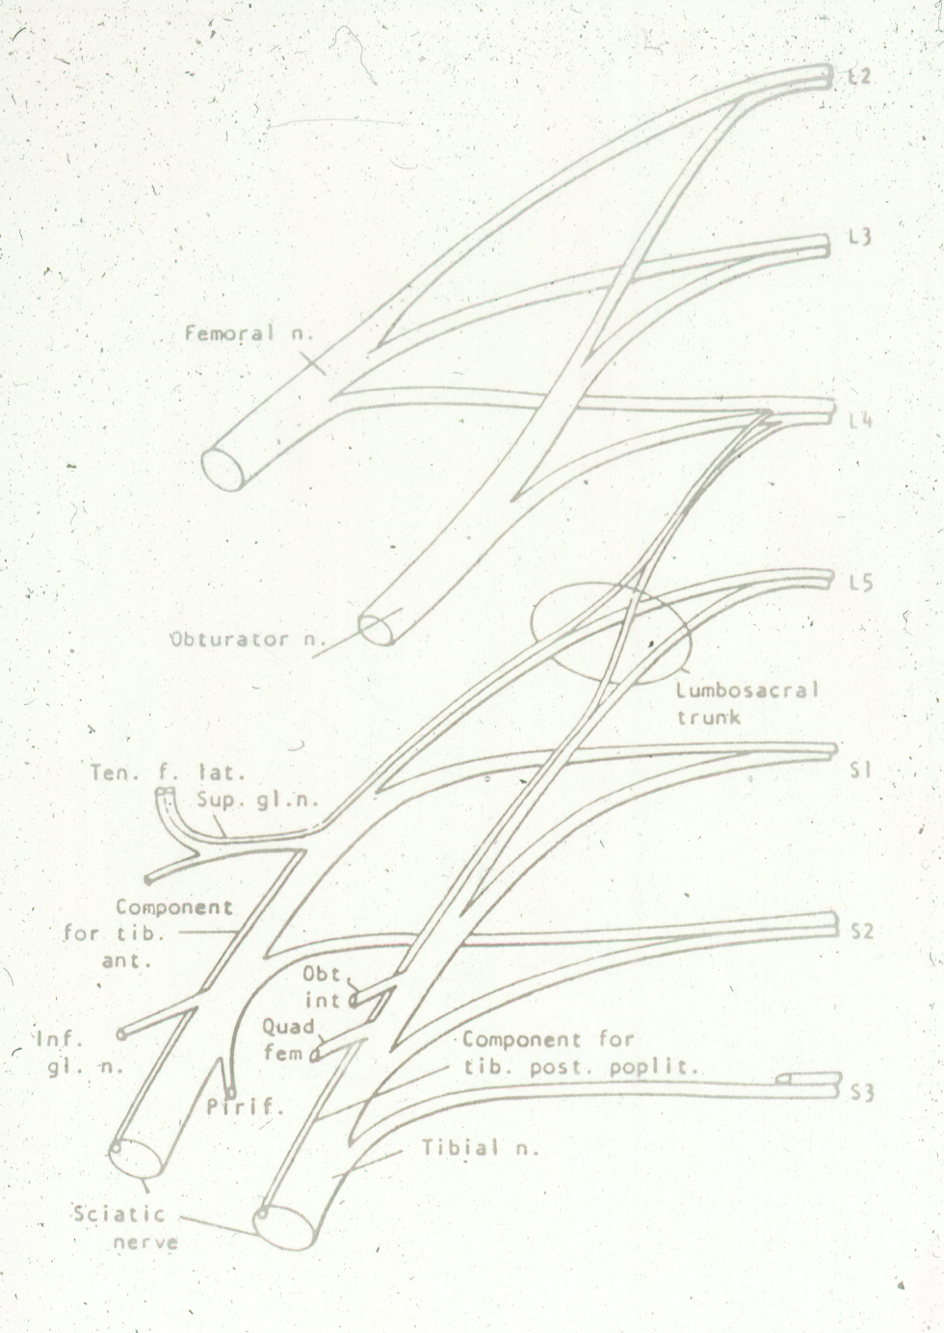
THE LUMBO-SACRAL
PLEXUS
(Not as horrifying as you might think...)

Slide 23
Let’s draw the lumbosacral plexus...

Slide 24
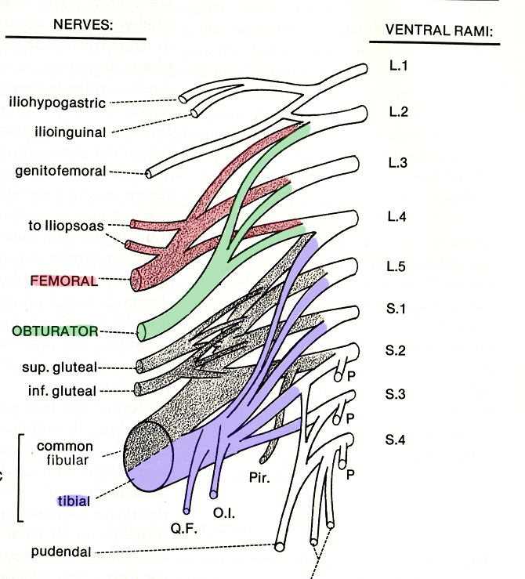

Slide 25
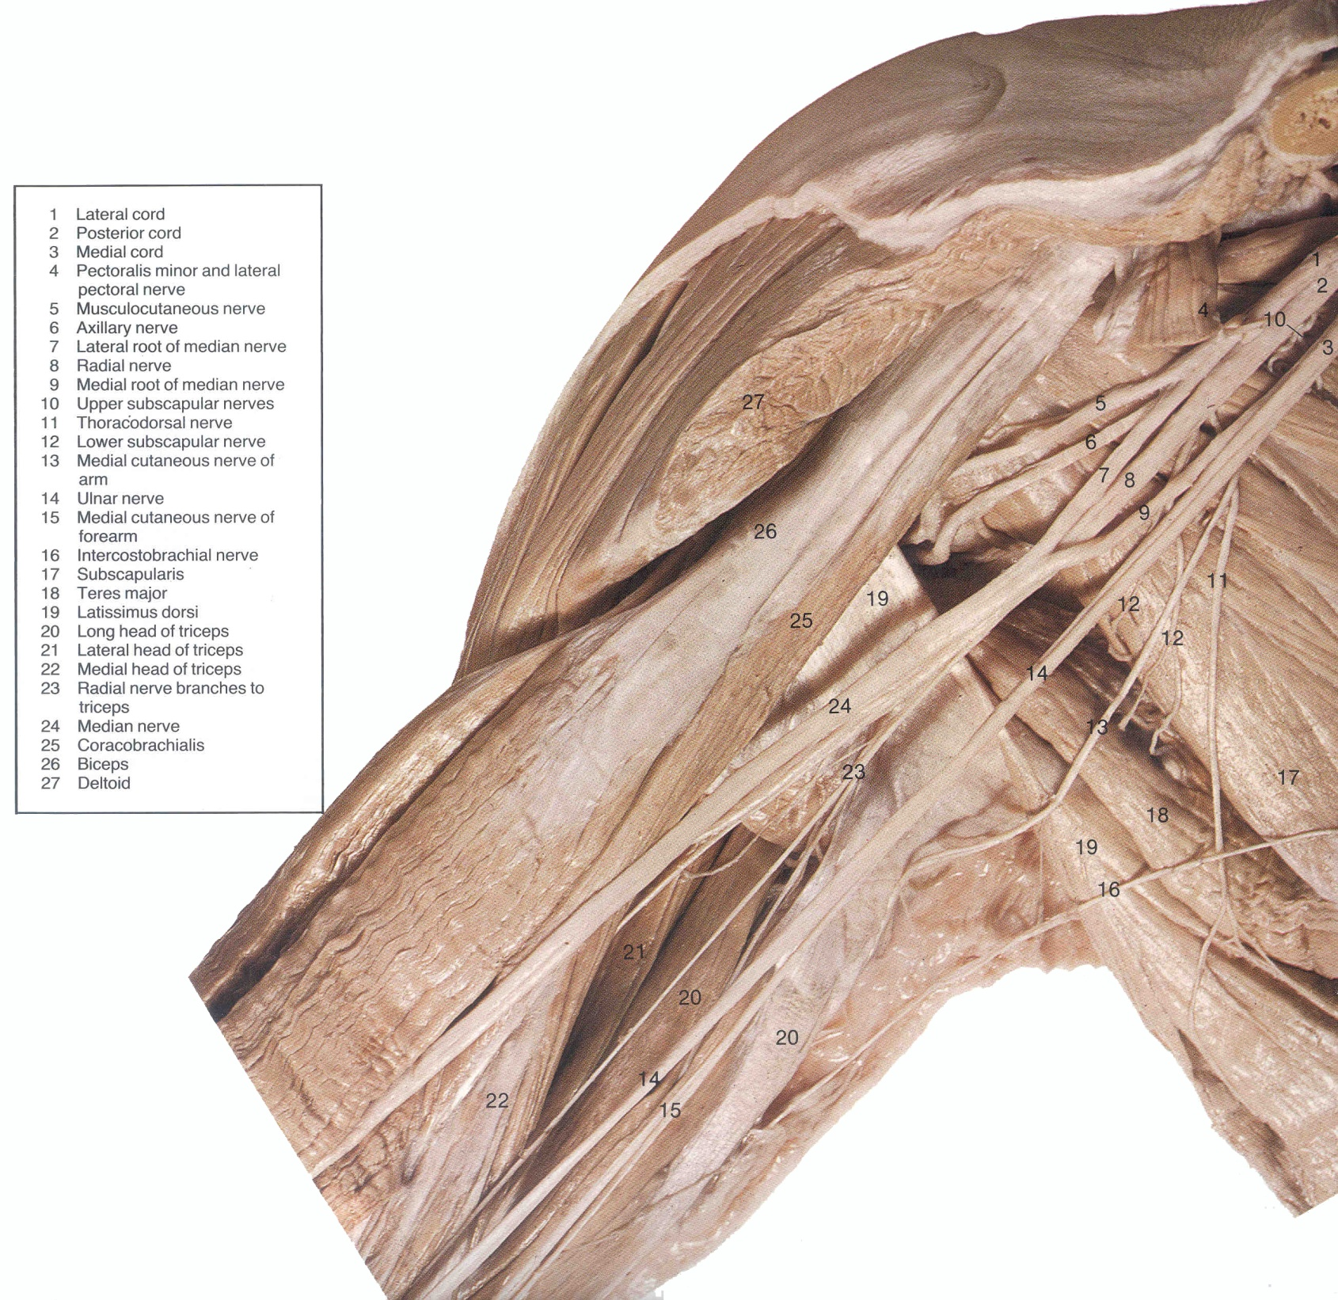
THE BRACHIAL PLEXUS
(About as horrifying as it looks...

Slide 26
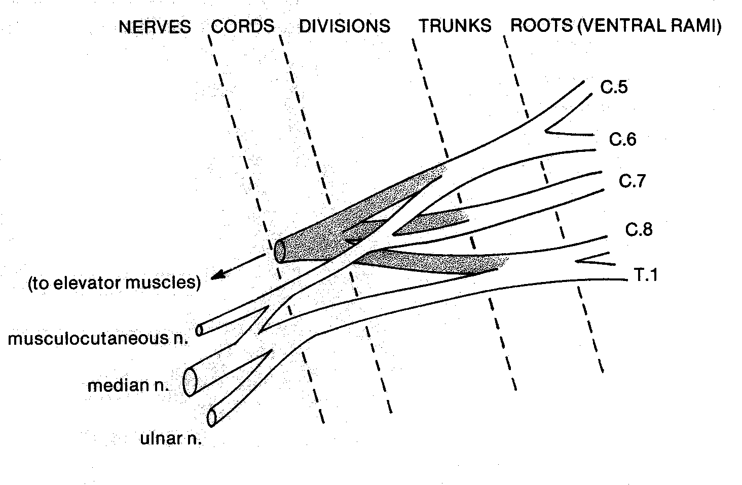

Slide 27
BREAKING DOWN THE BRACHIAL PLEXUS
5/6 SEGMENTAL 3 TRUNKS 6 DIVISIONS 3 CORDS 5 TERMINAL
ROOTS NERVES
C4
C5 Superior
C6
C7 Middle
C8
Inferior
T1
All dorsal divisions unite to give POSTERIOR CORD.
LATERAL & MEDIAL CORDS are ventral divisions
AXILLARY N.
RADIAL N.
MUSCULOCU-
TANEOUS N.
MEDIAL N.
ULNAR N.
Each of the 3 trunks divides into its component dorsal and ventral divisions (recall dorsal and ventral mm.)

Slide 28
MEDIAN
The ventral (serving flexors) divisions form a letter “M”, with the median nerve in the middle of the “M”.

Slide 29
THE BRACHIAL PLEXUS
(About as horrifying as it looks...

Slide 30
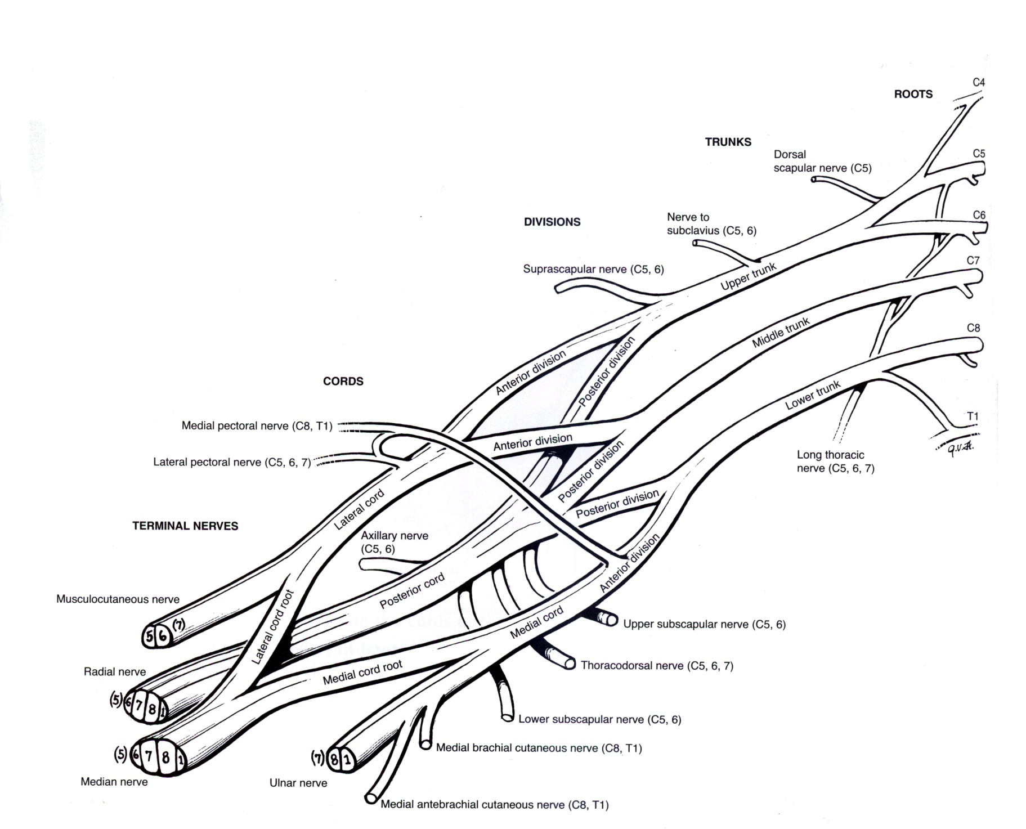
Anterior = Ventral
Posterior = Dorsal

Slide 31
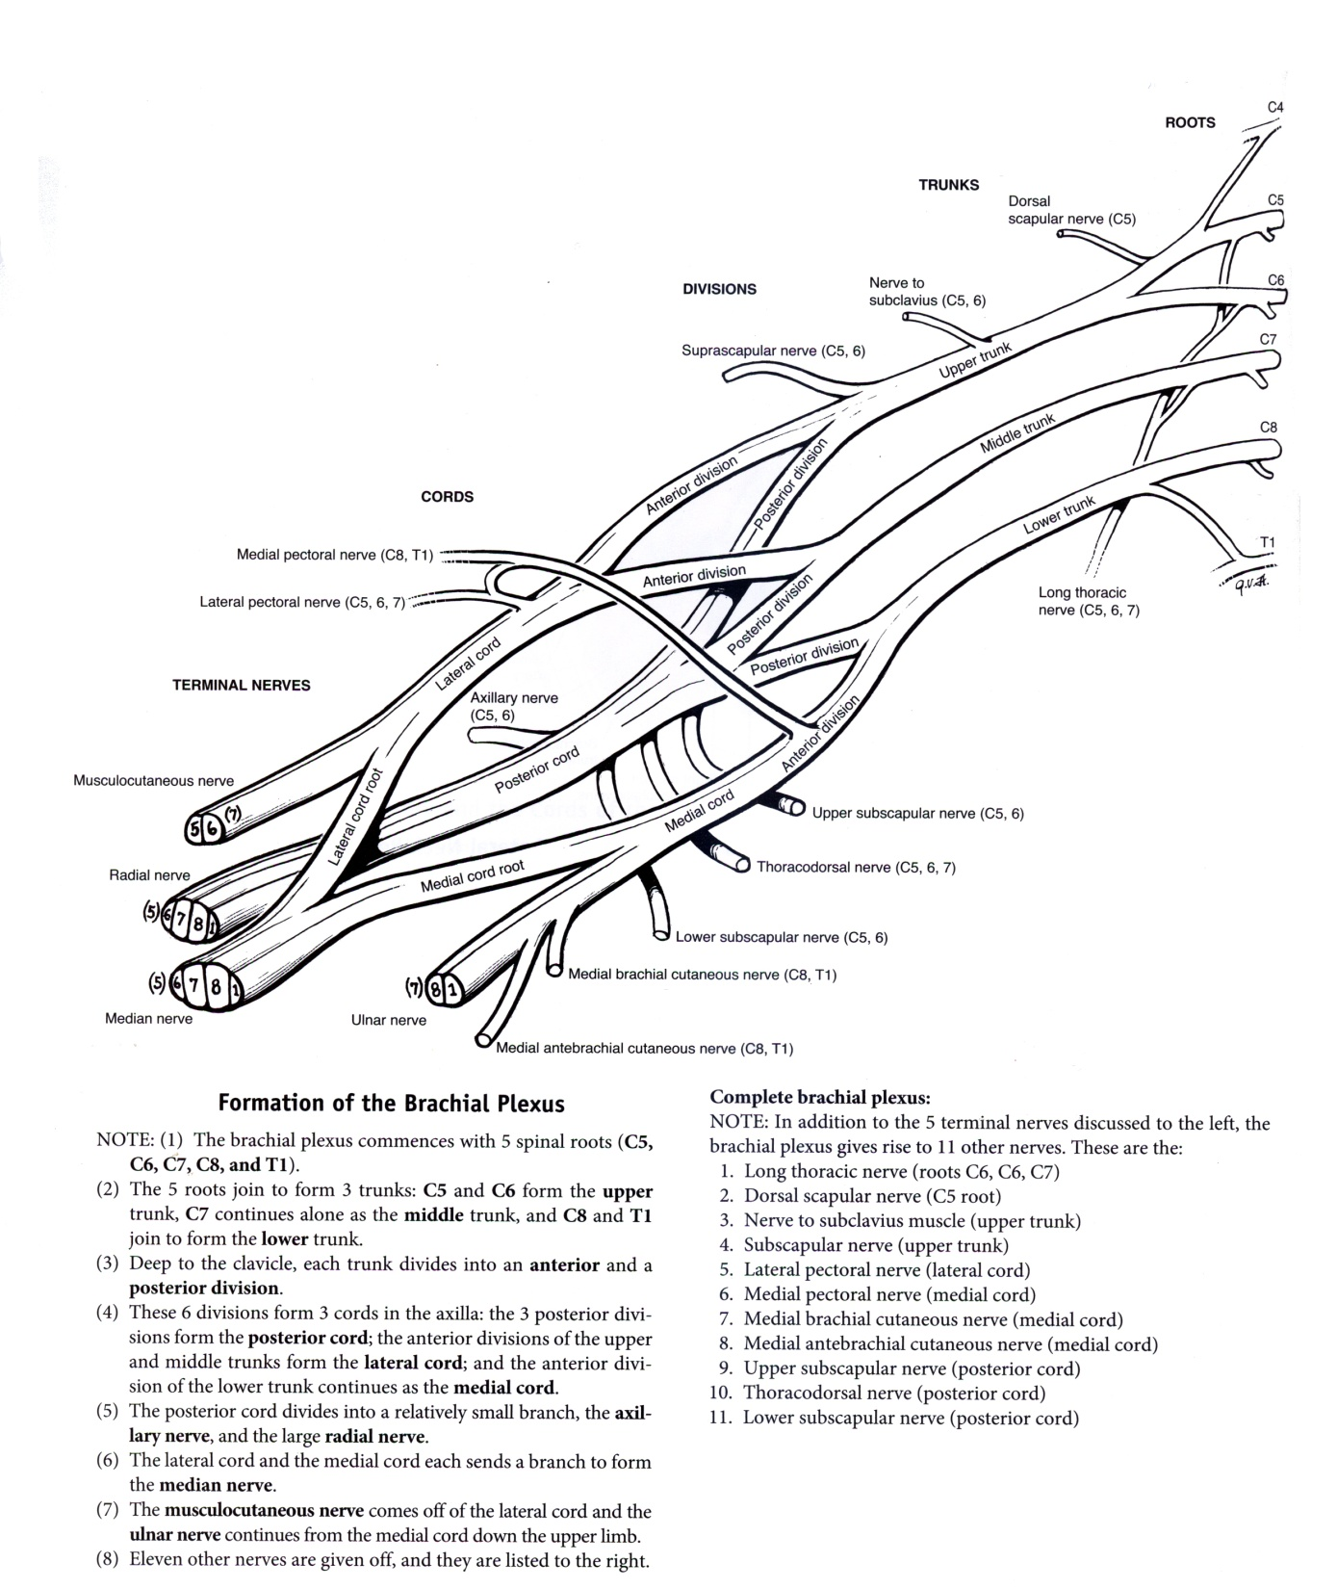

Slide 32
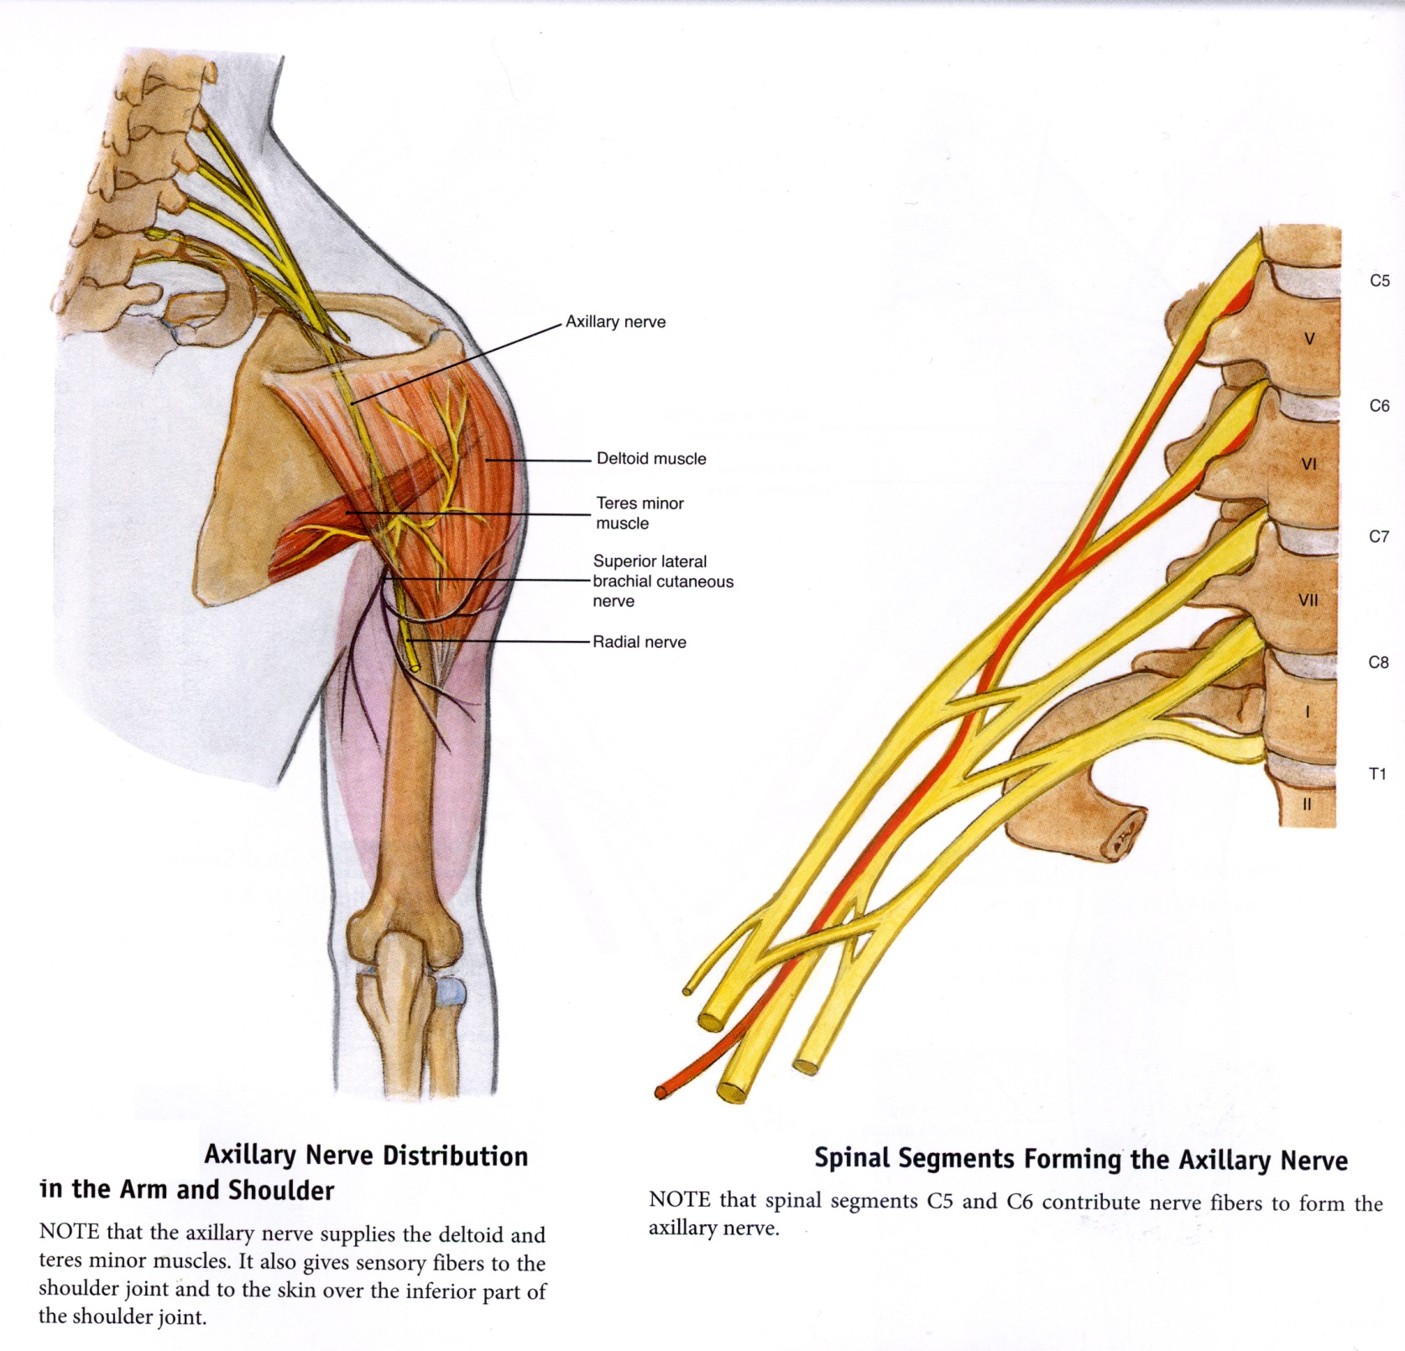

Slide 33
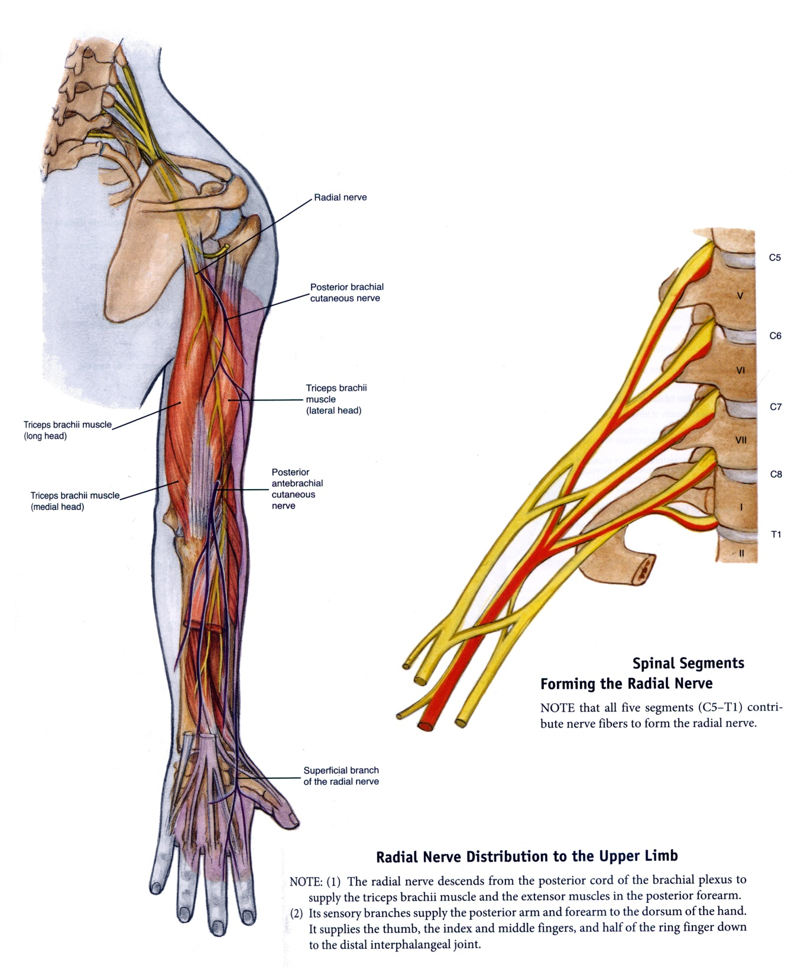

Slide 34
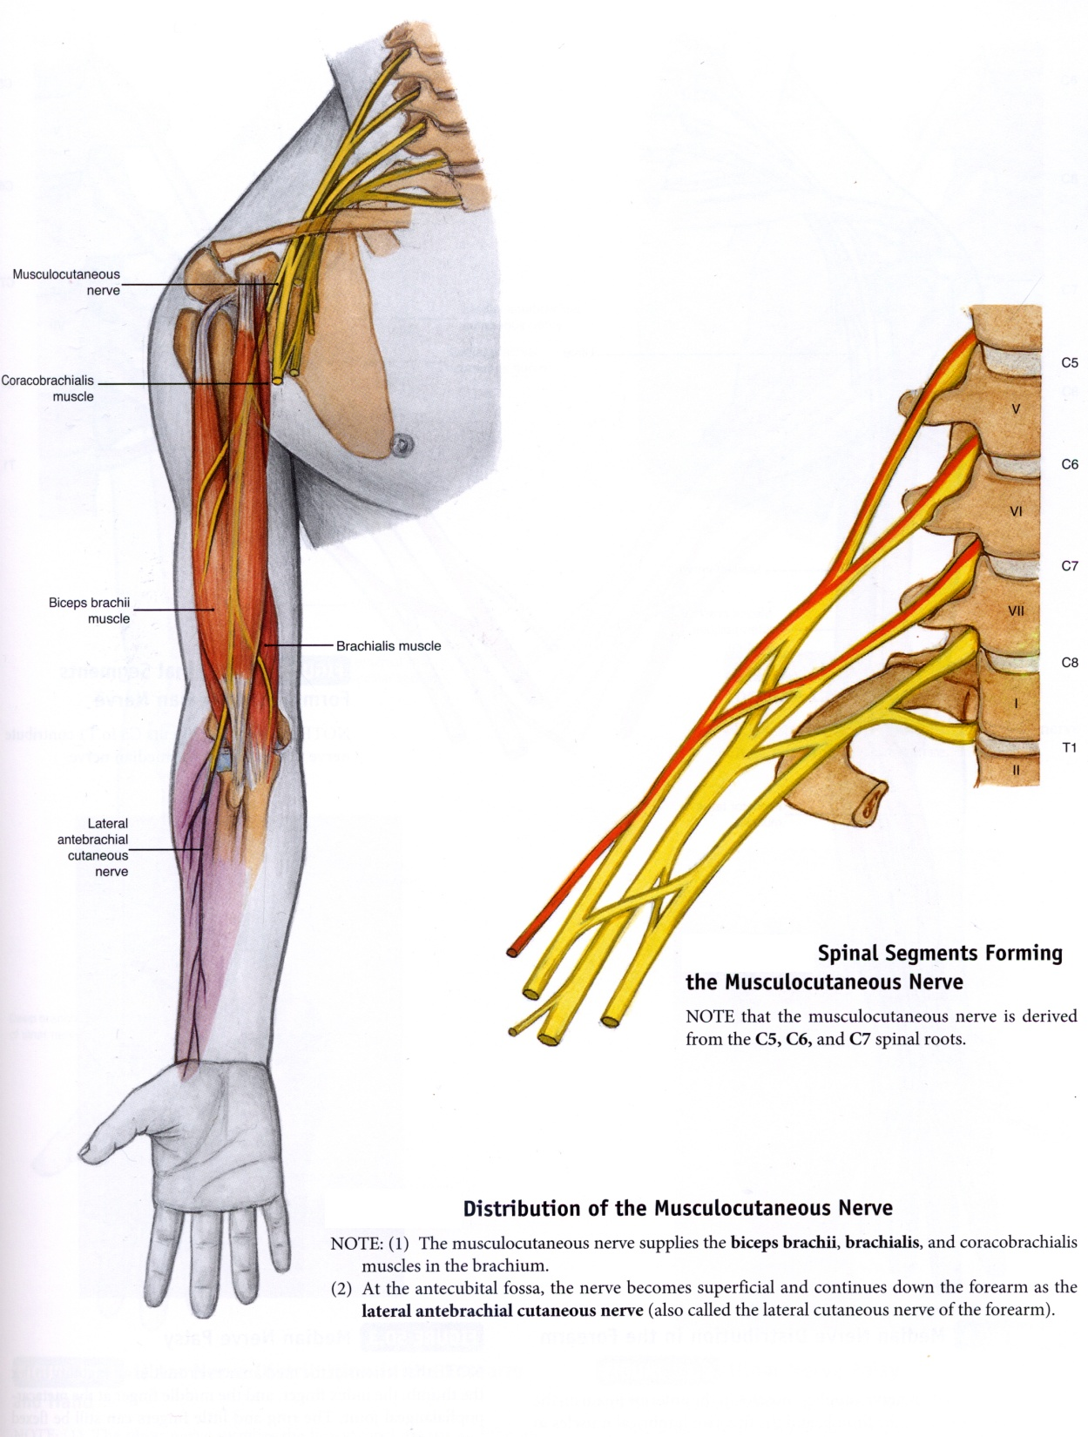

Slide 35
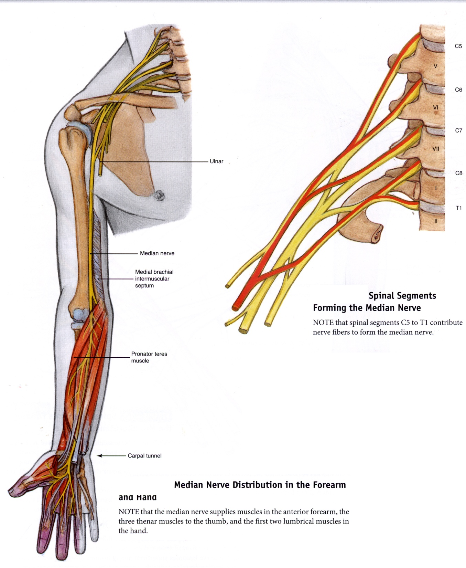

Slide 36
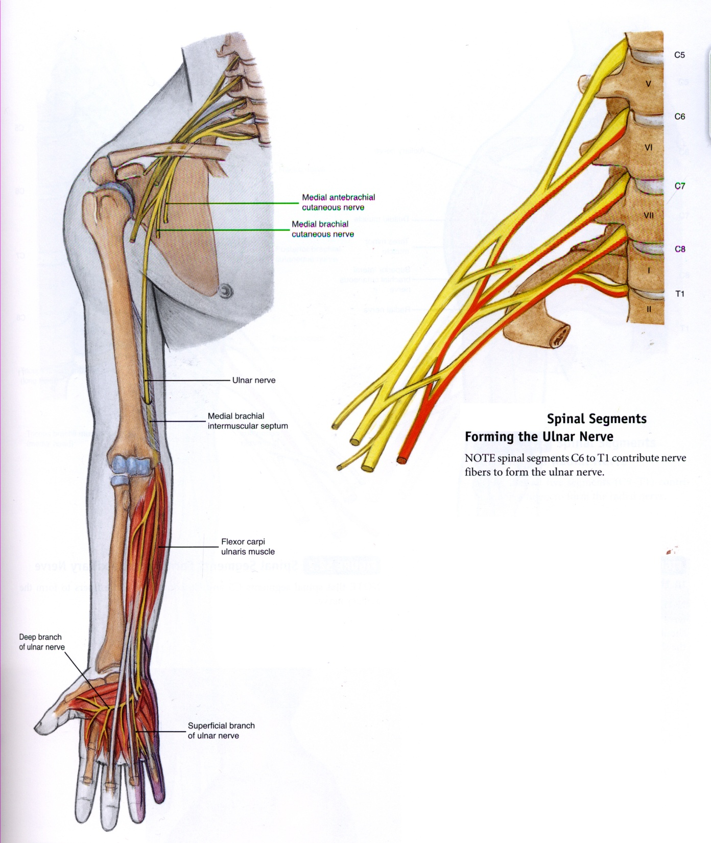

Slide 37
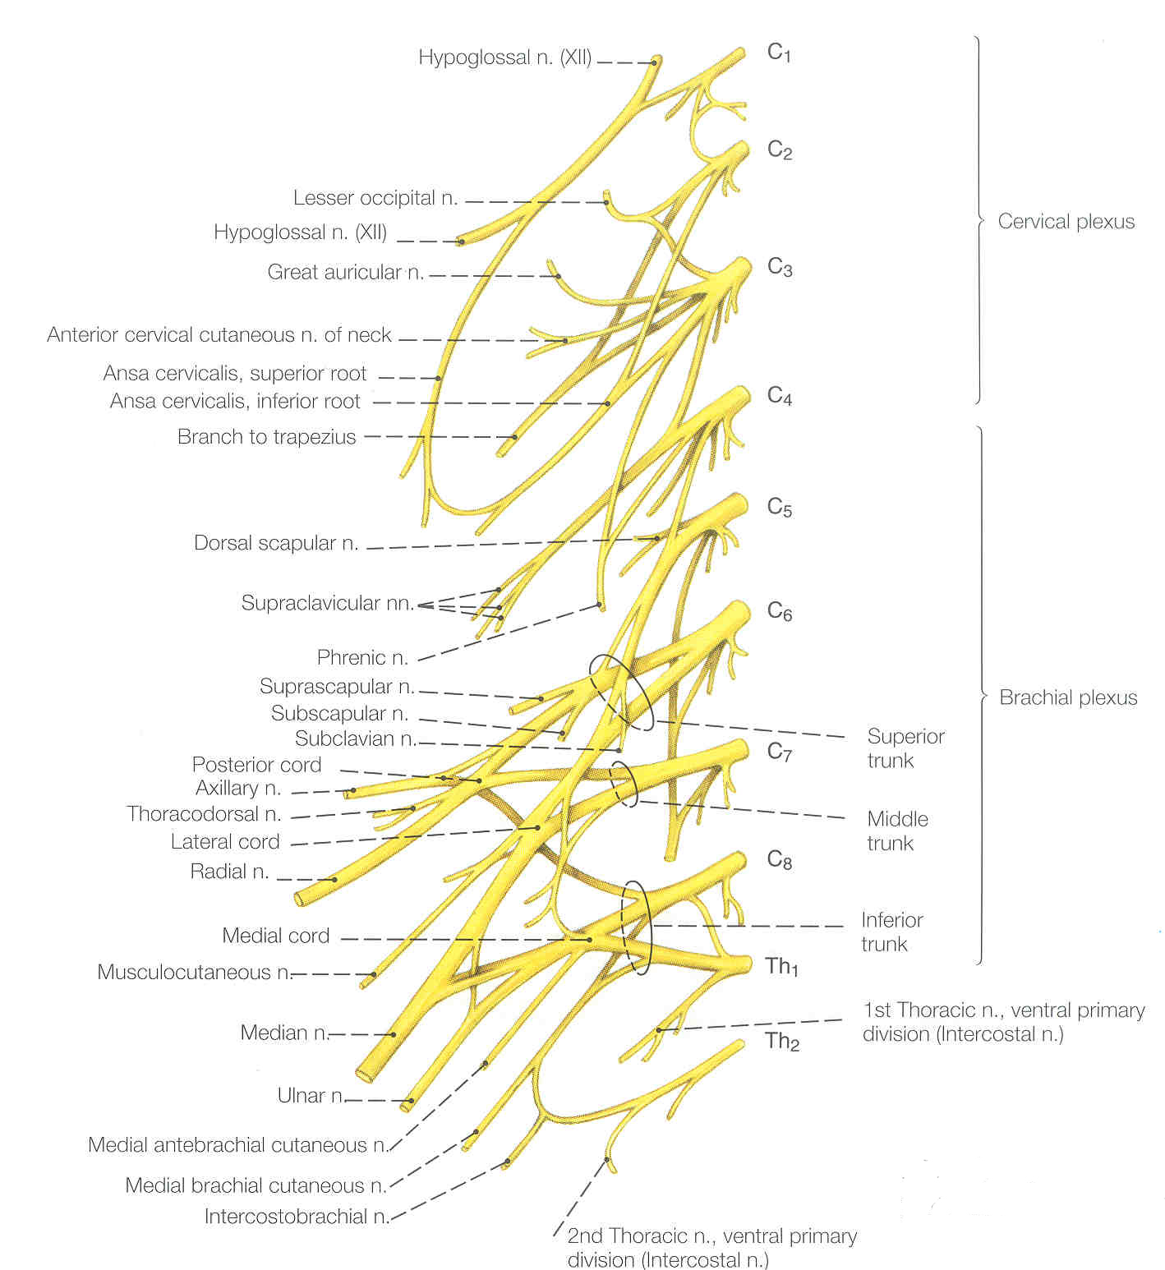

Slide 38
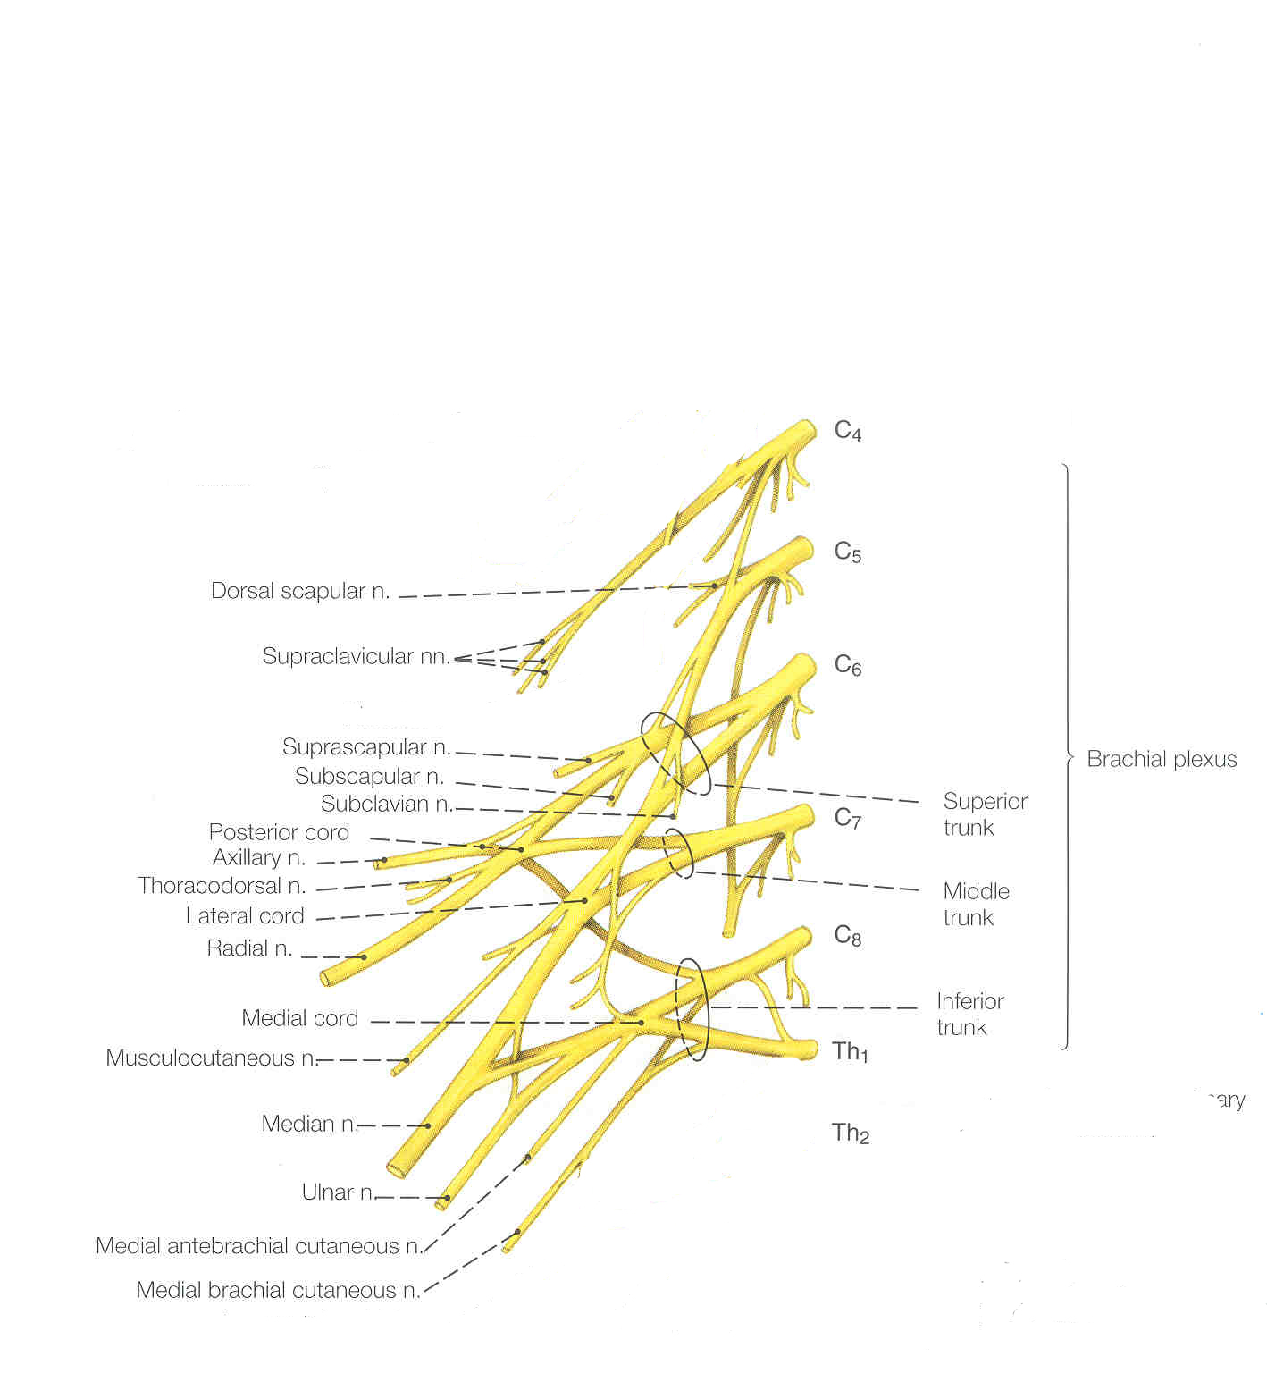

Slide 39
Autonomic Nervous System

Slide 40
Autonomic Nervous System
Visceral Motor Component of the nervous system.
TWO MOTOR NEURON system.
For motor control of most internal organs, smooth muscle of gut and blood vessels, skin glands, cardiac muscle.

Slide 41
SEPARATION OF FUNCTION
Sympathetic – Fight, flight, Fear, and F_____.
Parasympathetic – Rest, rumination (digestion), calm
Both involuntary

Slide 42
Comparisons
SYMPATHETIC
Neurotransmitter: norepinephrine
Turn OFF most gut activities.
Dilate blood vessels to somatopleure.
Constrict blood vessels to splanchnopleure.
PARASYMPATHETIC
Neurotransmitter: acetylcholine
Turn ON most gut activities.
Constrict blood vessels to somatopleure and brain.
Dilate blood vessels to splanchnopleure.

Slide 43
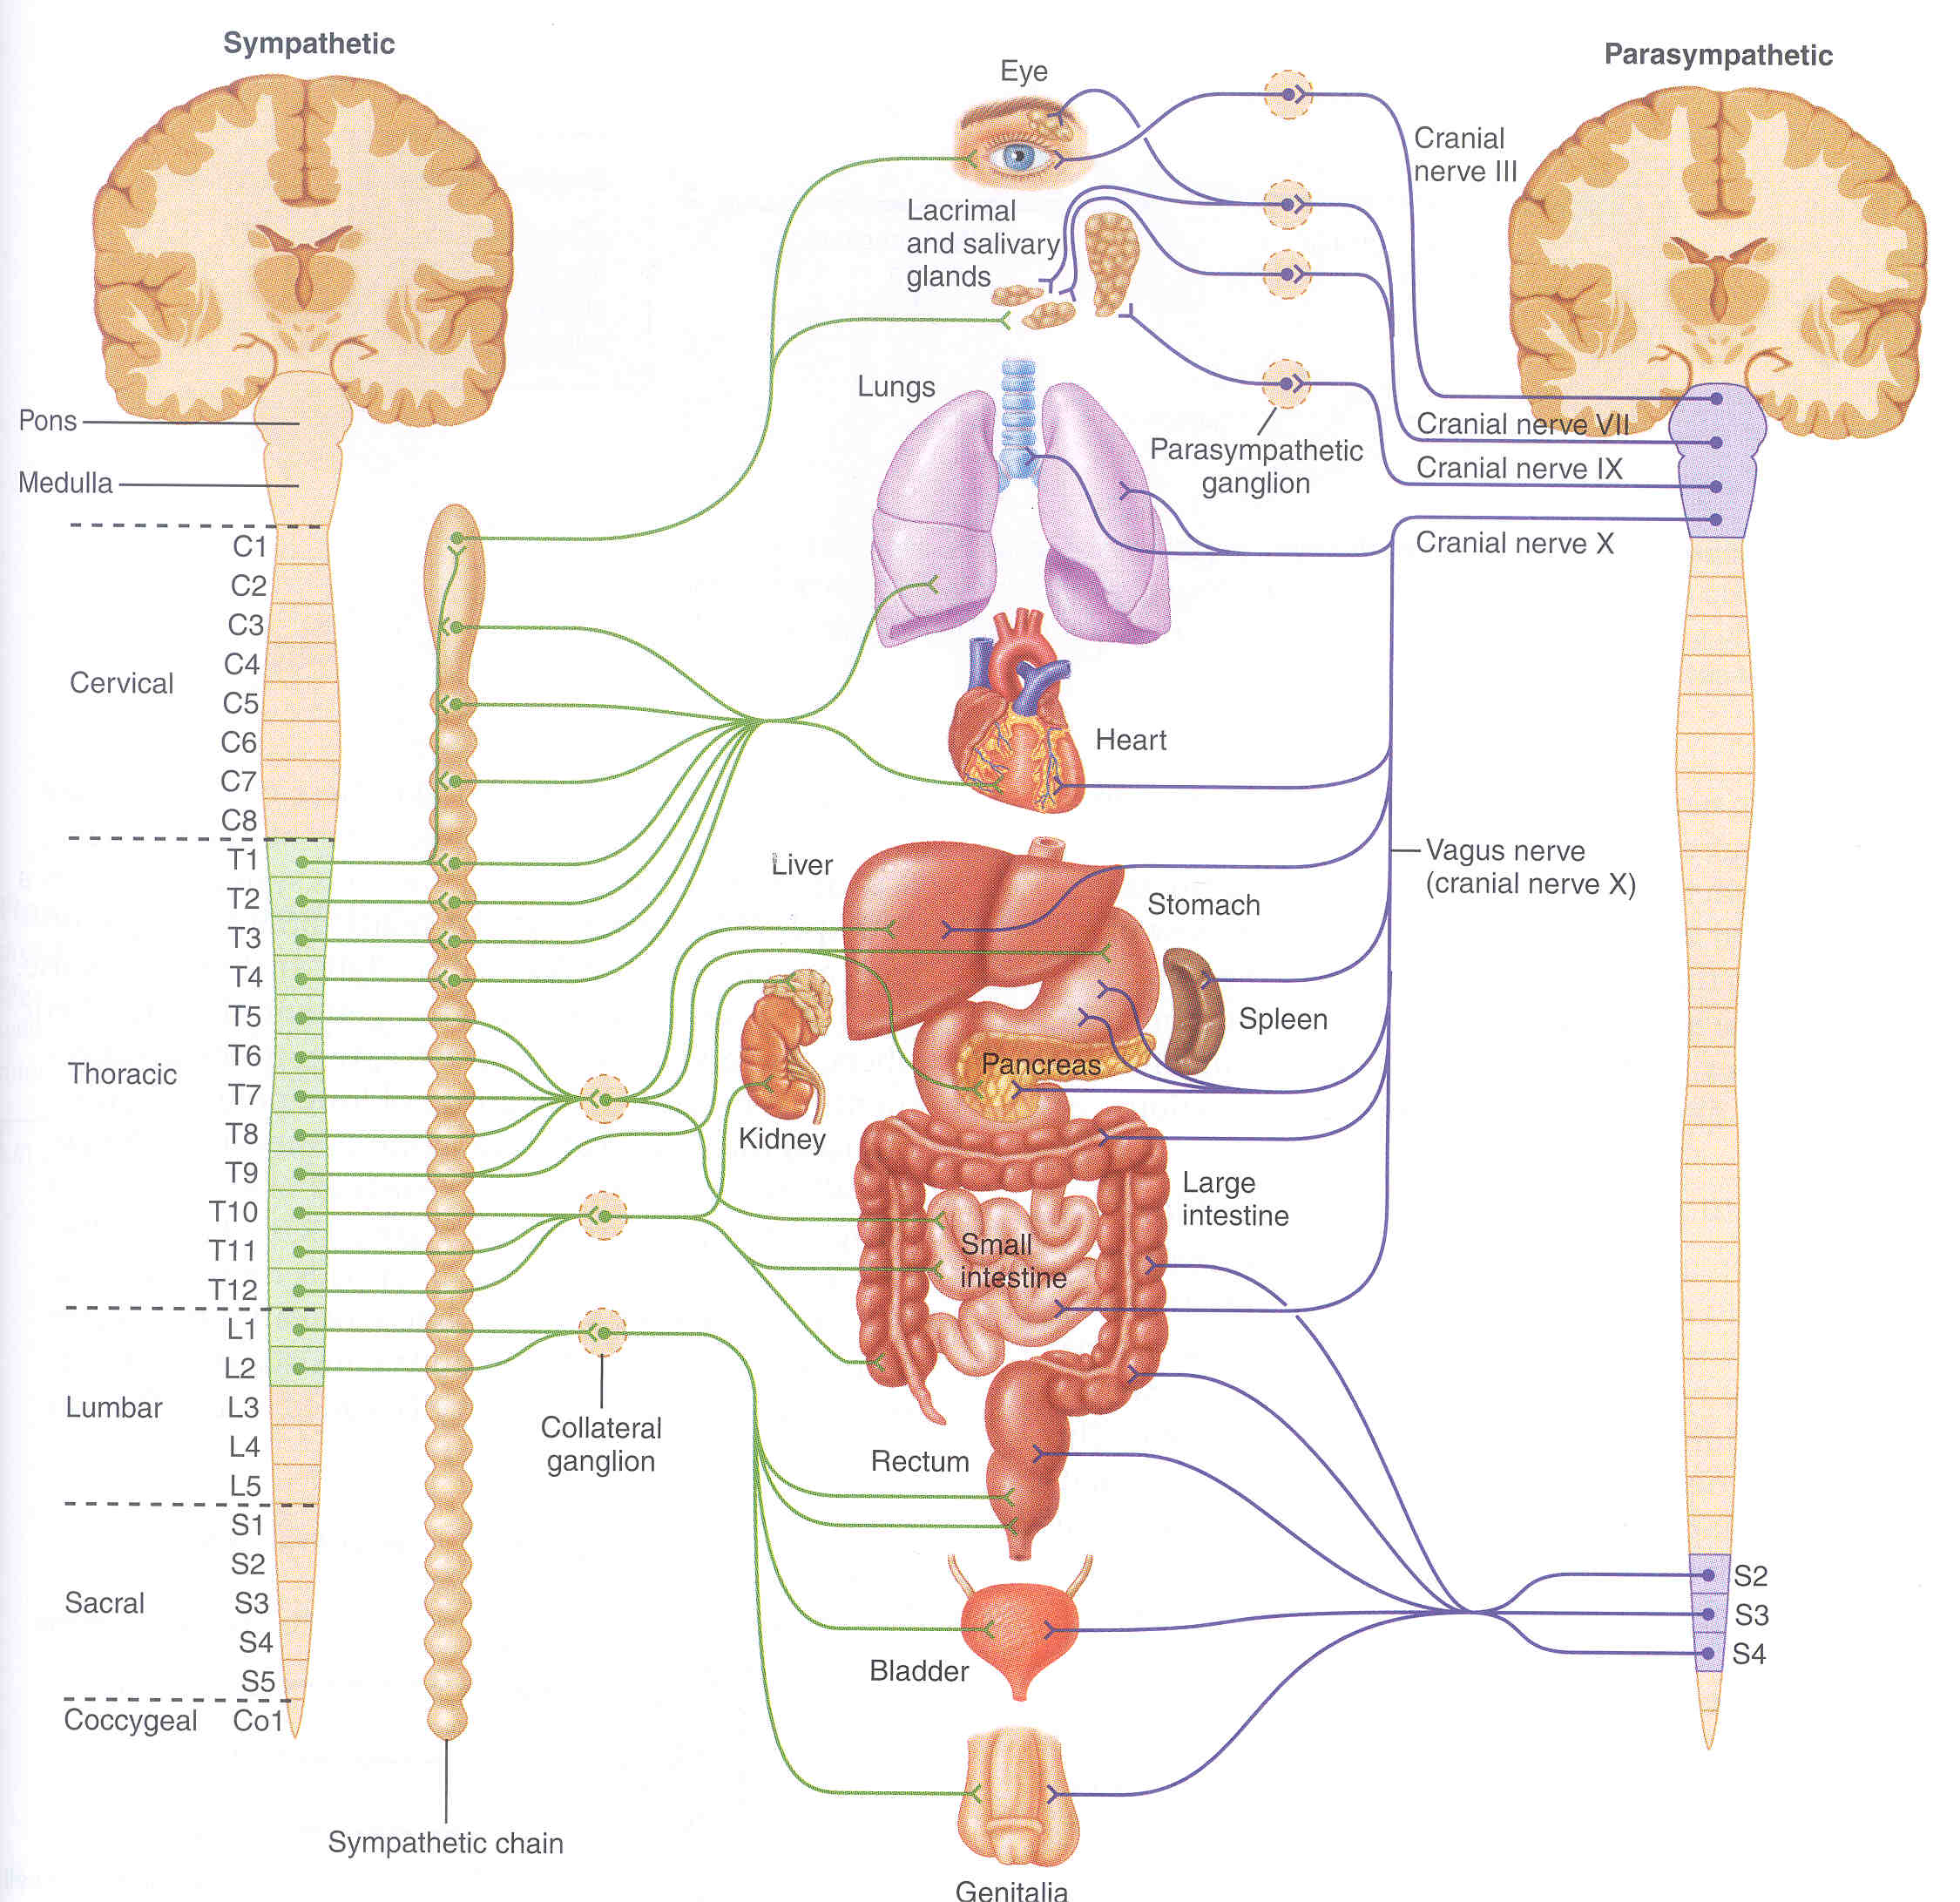
AUTONOMIC FIBER PLACEMENT:
Sympathetic – “Thoracolumbar” (T1-L2)
Parasympathetic = “Cranio-sacral” (Cnn III, VII, IX, X; S2-4

Slide 44
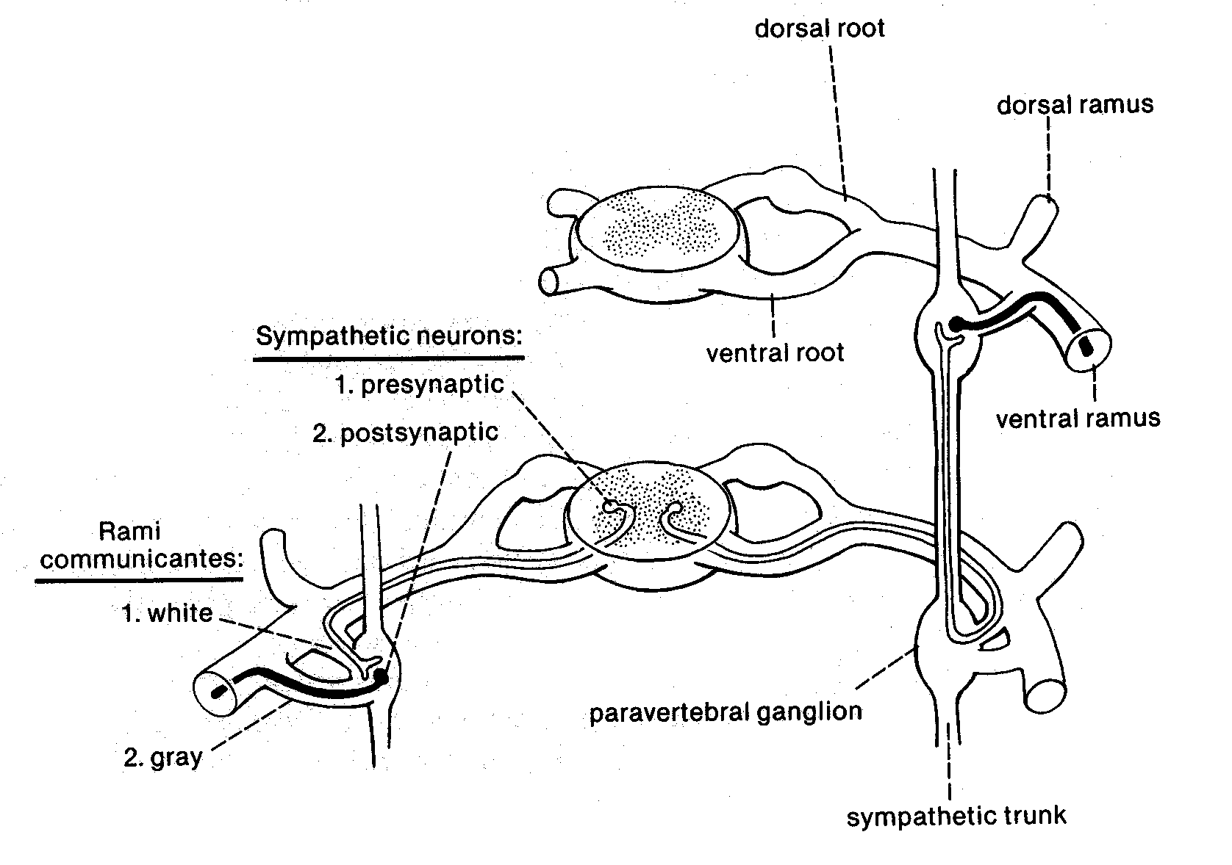
A typical sympathetic nerve

Slide 46
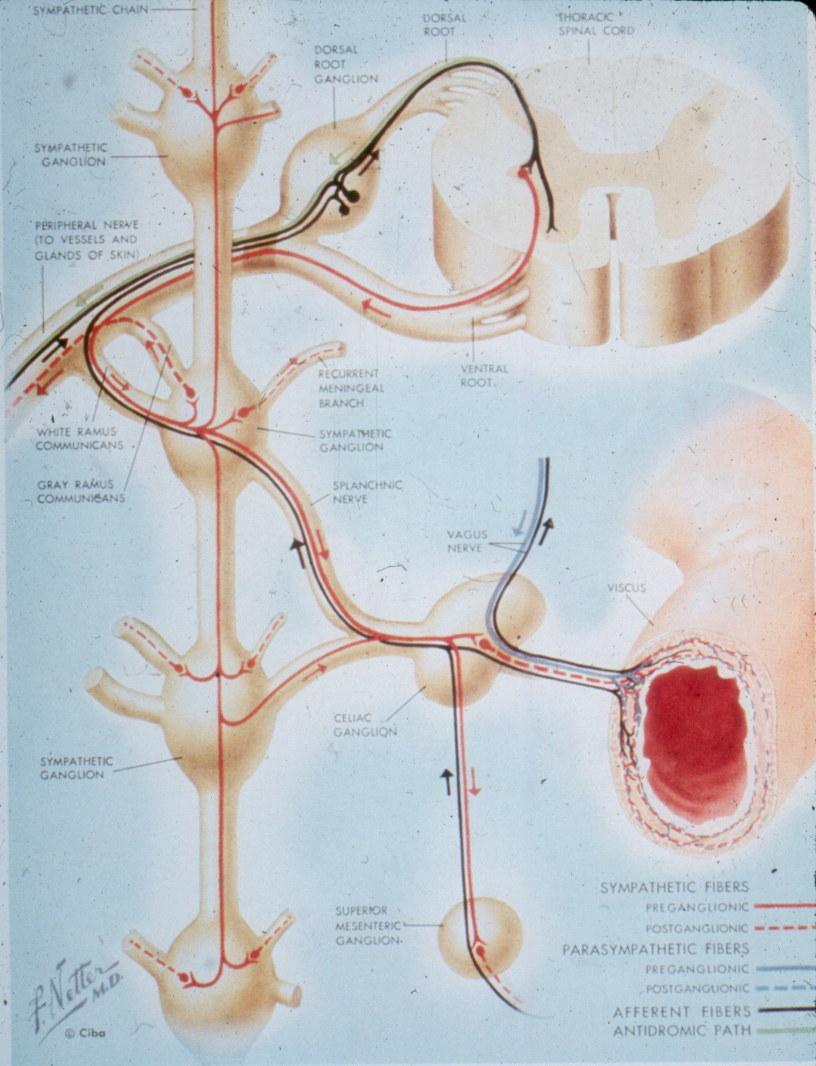

Slide 47
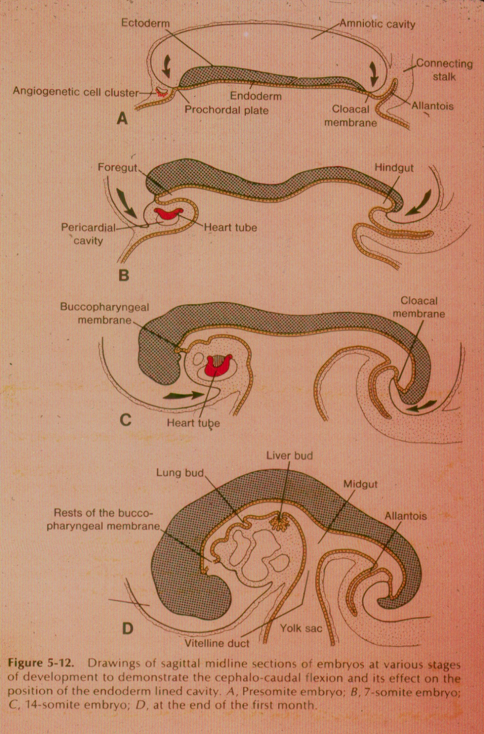

Slide 48
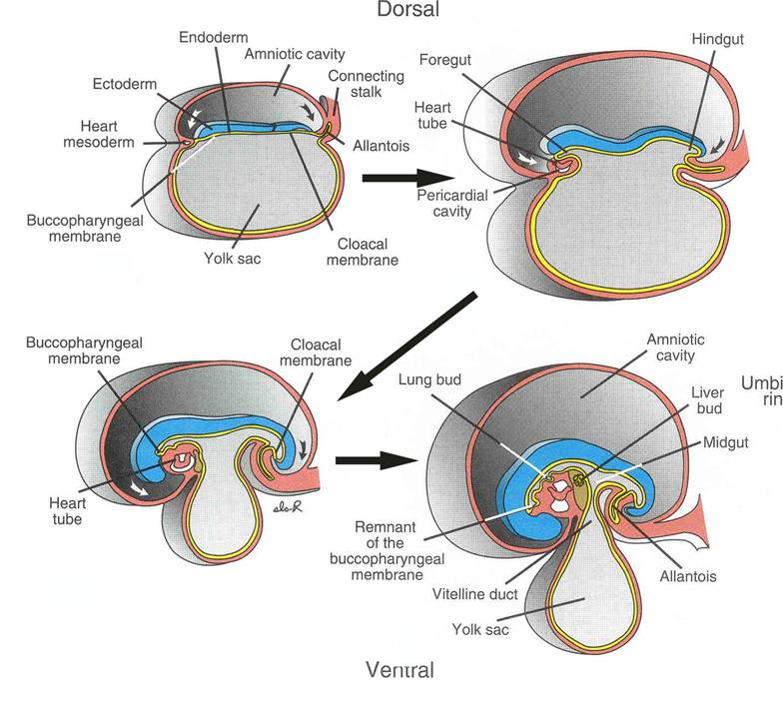

Slide 49
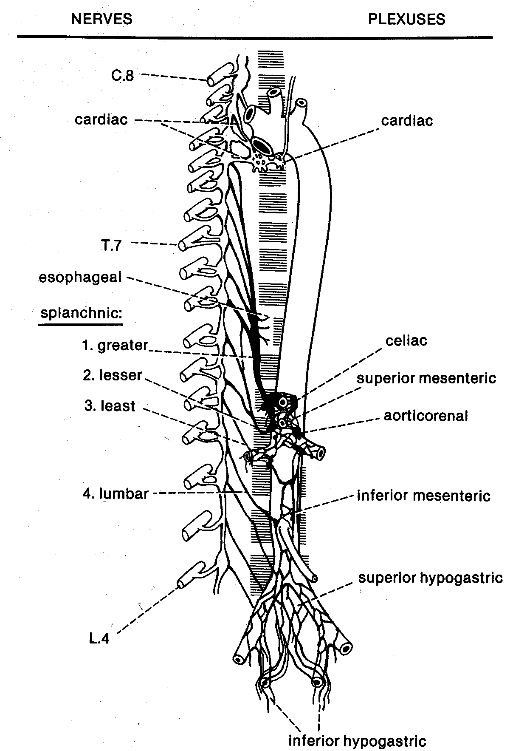

Slide 50
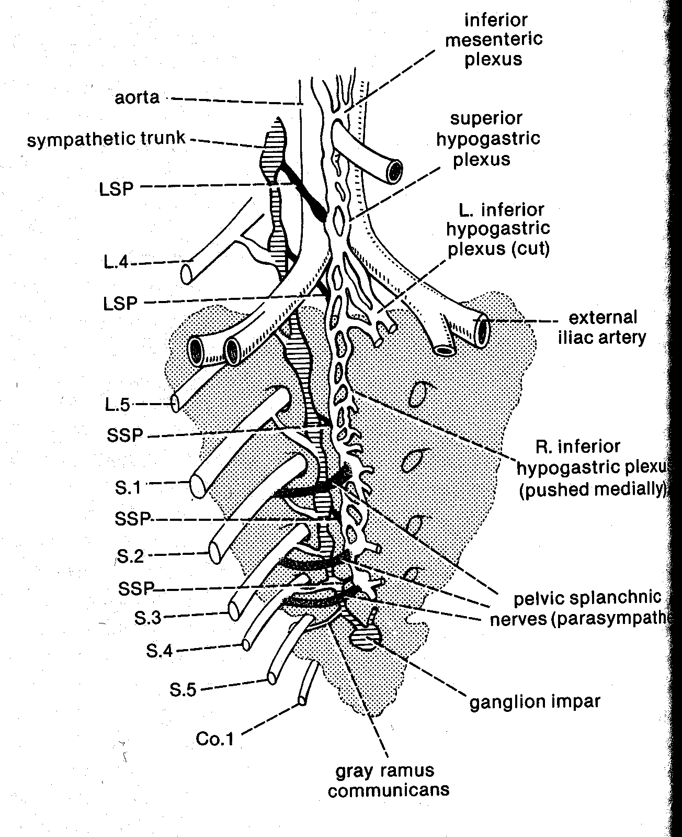

Slide 51
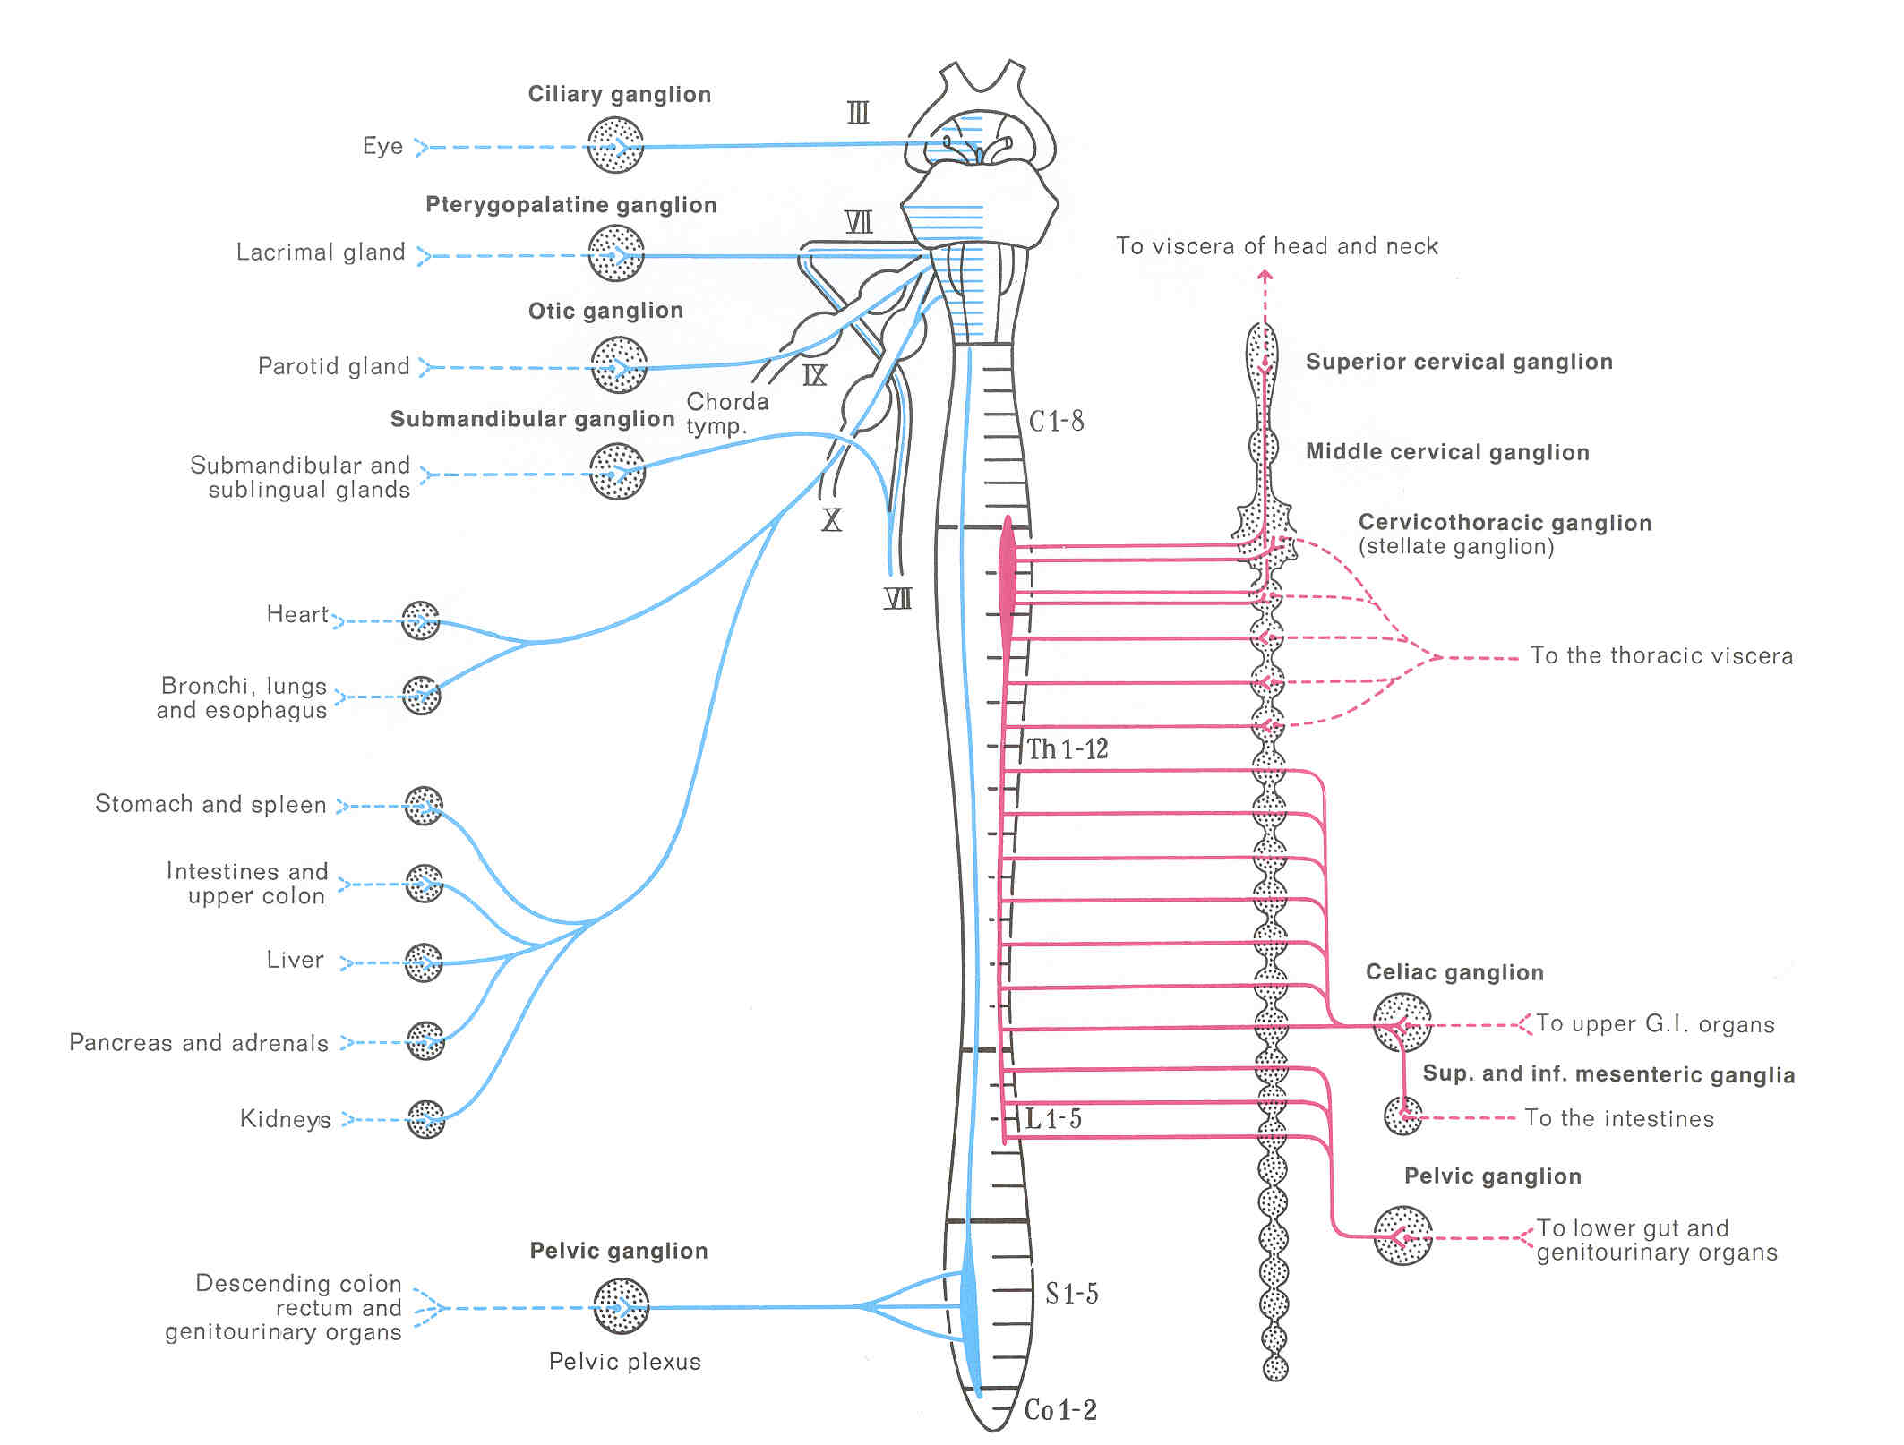

Slide 52
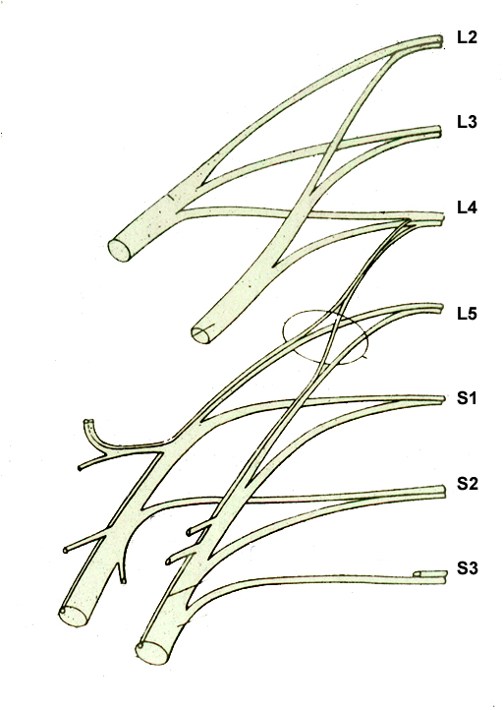
Unlabeled Lumbosacral Plexus for Practice

Slide 53
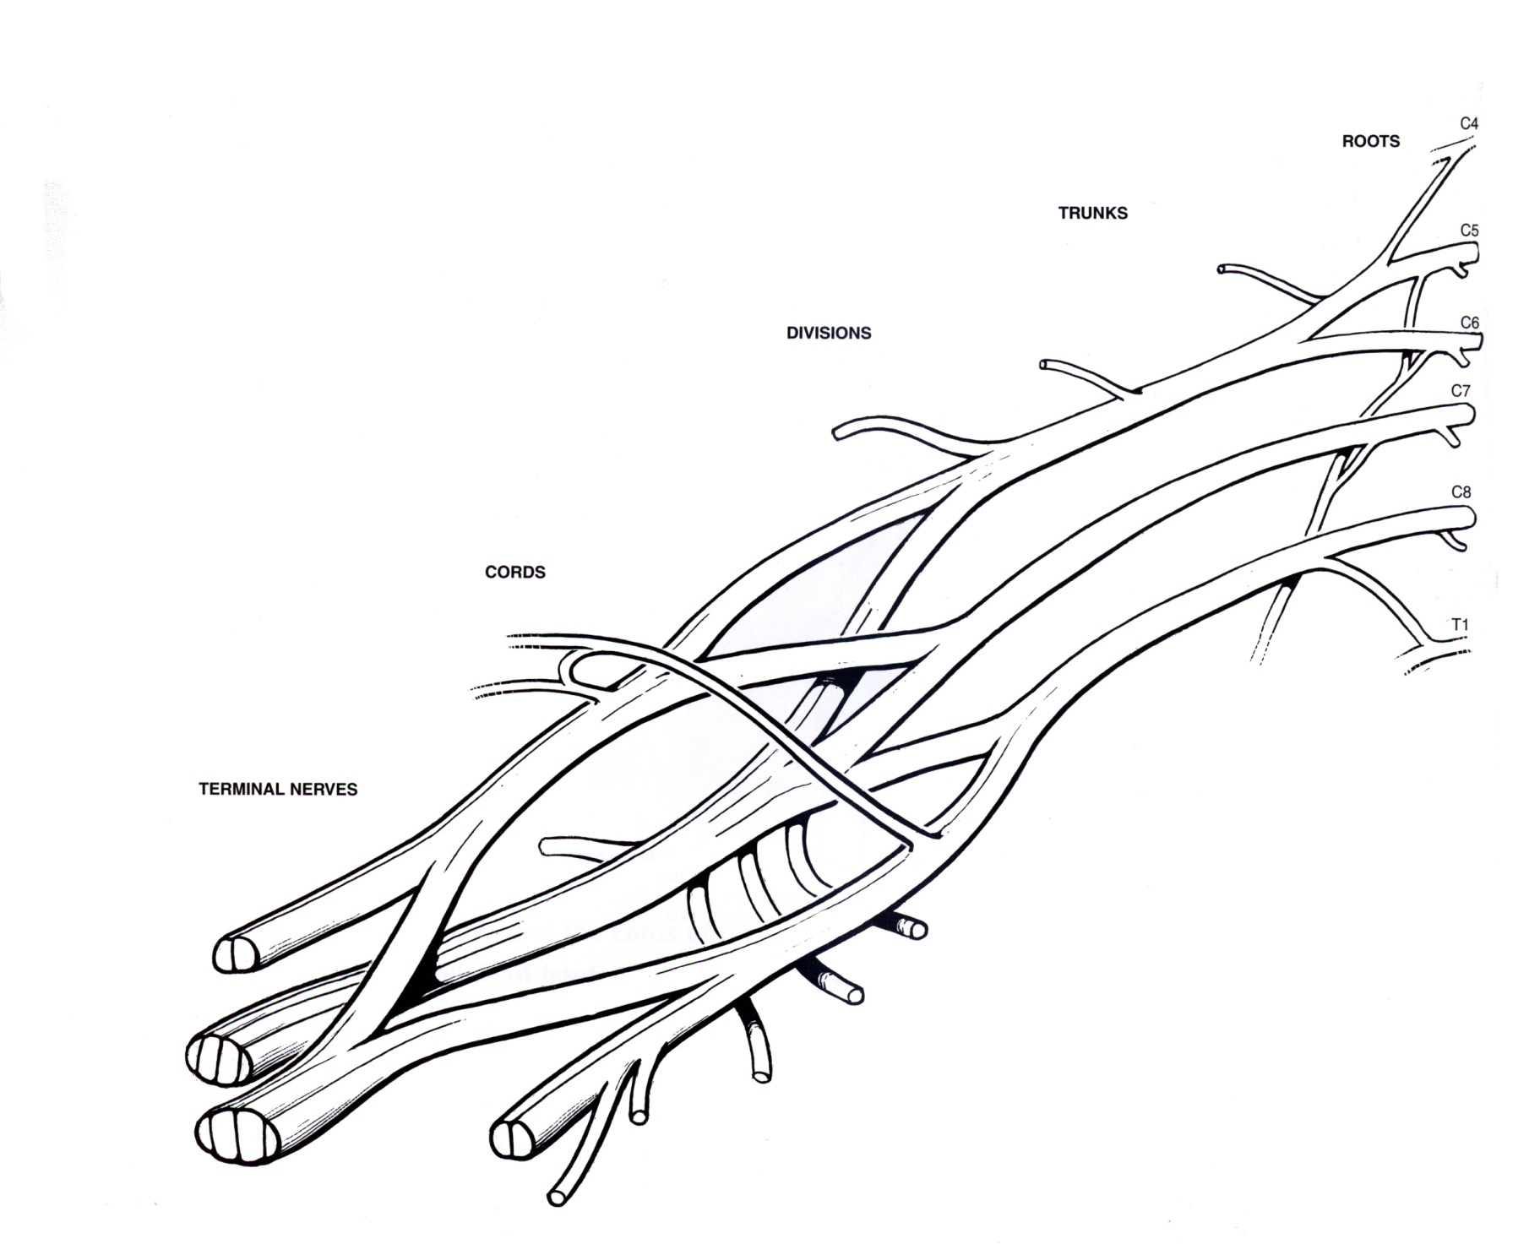
Unlabeled Brachial Plexus for Practice

