Slide 1
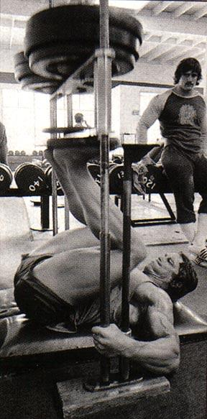
Biology 323
Human Anatomy for Biology Majors
Lecture 7
Dr. Stuart S. Sumida
Appendicular Musculature

Slide 2
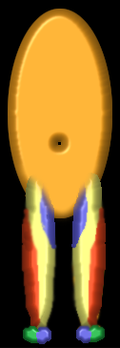
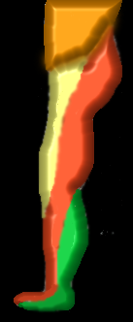
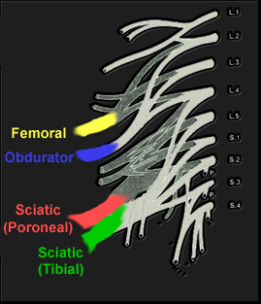

The Lumbosacral Plexus

Slide 3
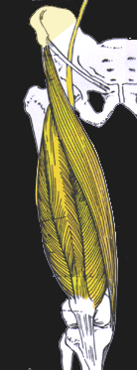
Superior/Posterior
(Cranial/dorsal)
QUADRICEPS
FEMORAL NERVE
Sartorius
Rectus Femoris
Vastus
Medialis
Vastus
Lateralis
Obturator
(Sciatic)
Peroneal

Slide 4
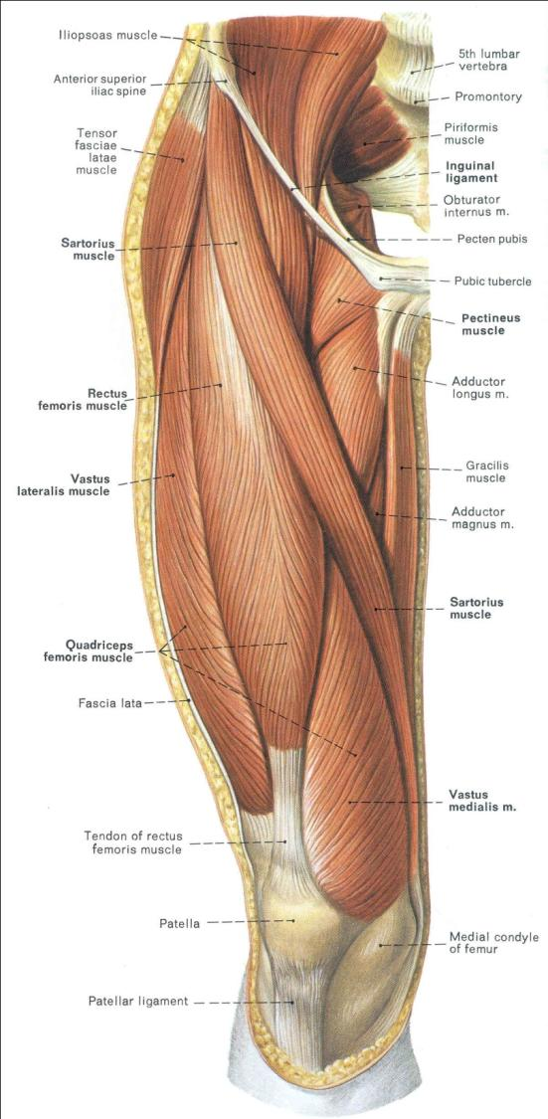
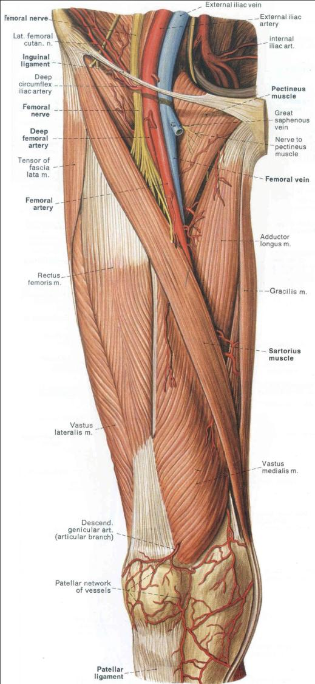

Slide 5
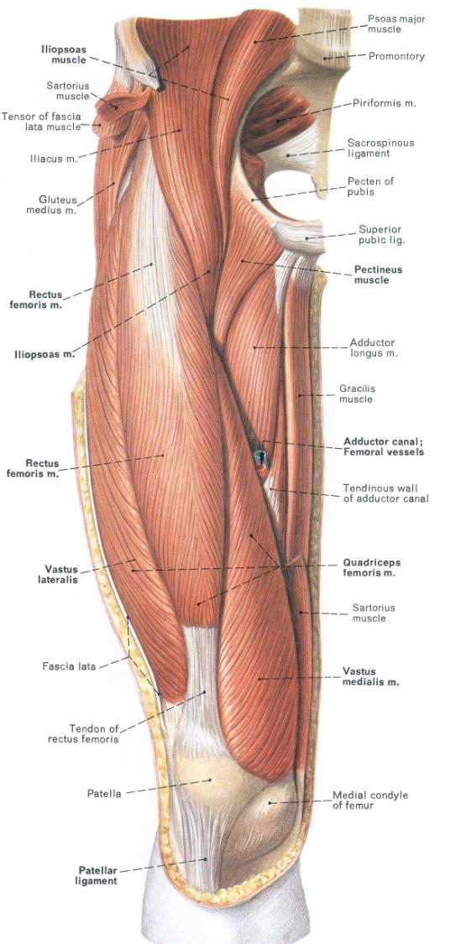

Slide 6
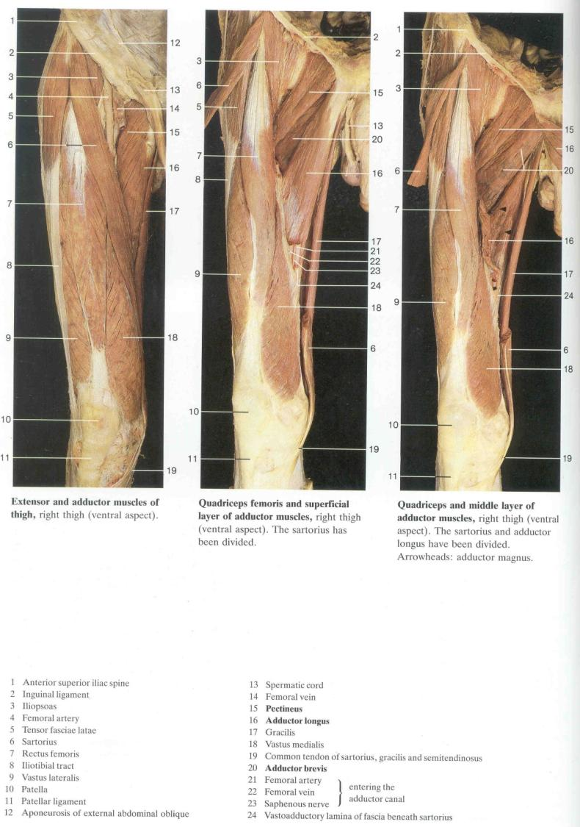

Slide 7
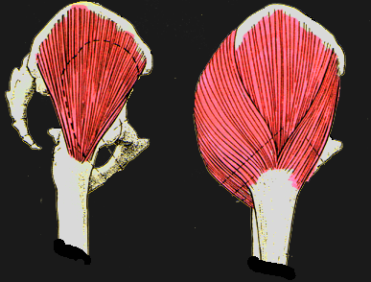
Inferior/Posterior
(Caudal/dorsal)
GLUTEAL GROUP
SCIATIC NERVE (PERONEAL)
Maximus
Tensor Fascia Latae
Minumus
Medius
Obturator
(Sciatic)
Peroneal

Slide 8
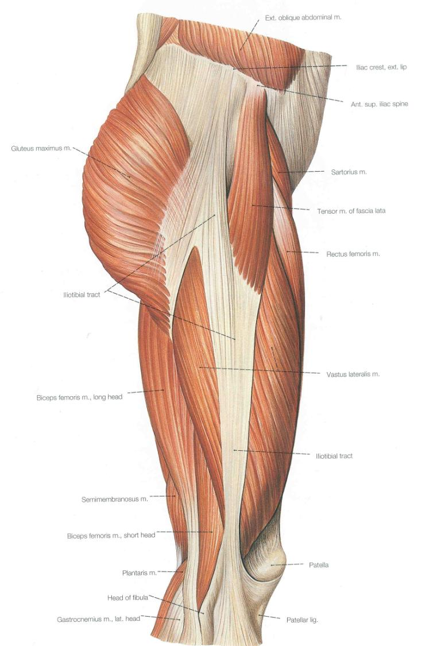

Slide 9
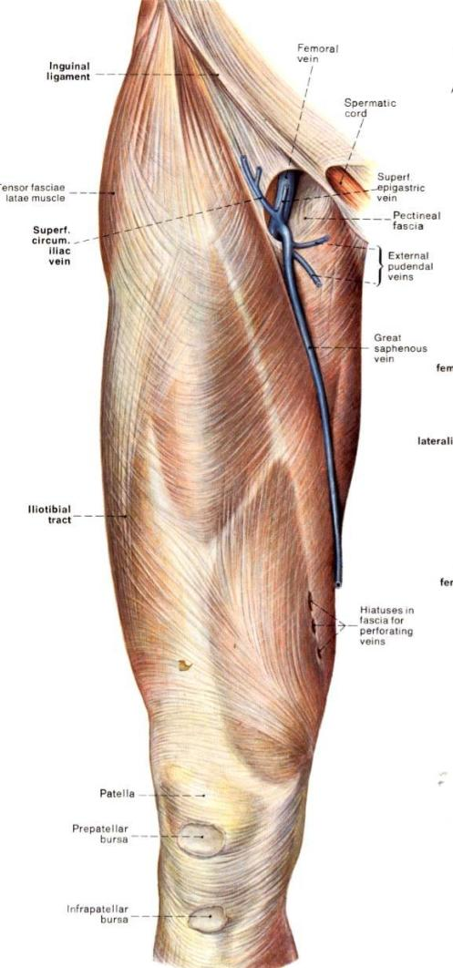
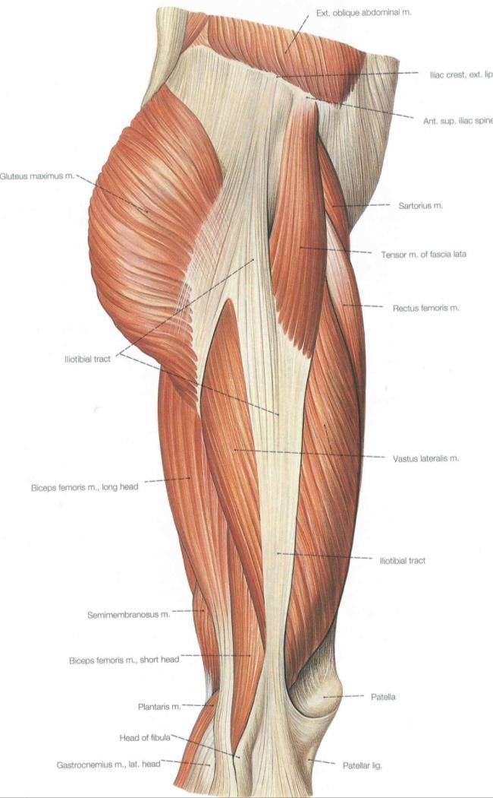
Invests thigh, leg and dorsal foot.
It is milky-white so it is called the fascia lata
THICK lateral aspect = Ilio-tibial band
IT tract = Ilio-tibial band + gluteus maximus fibers inserting on it + tensor fascia lata

Slide 10
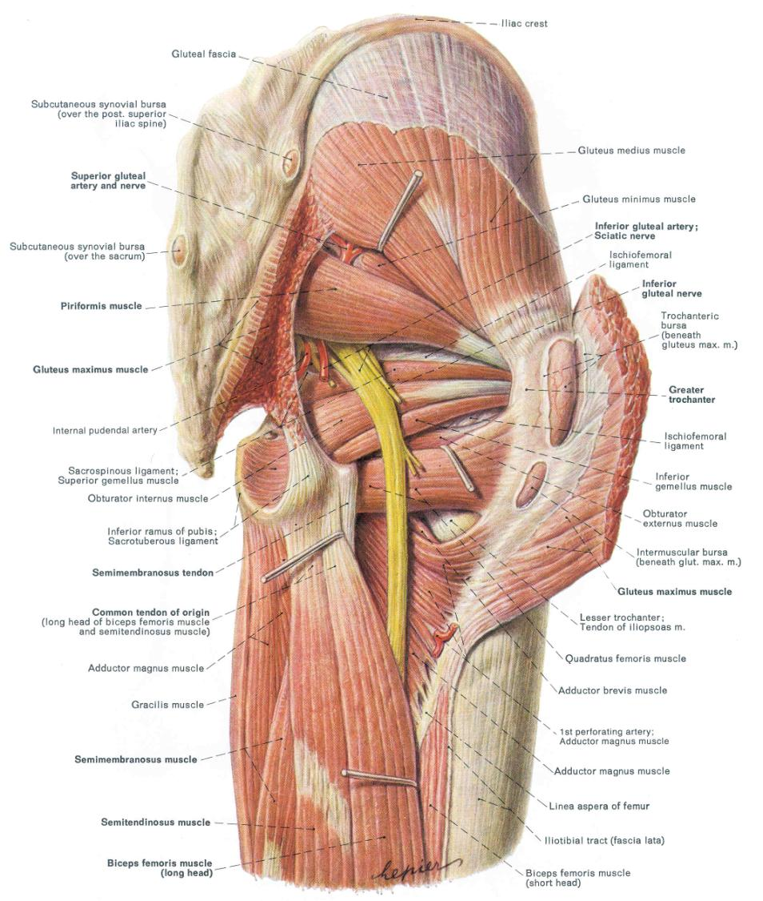

Slide 11
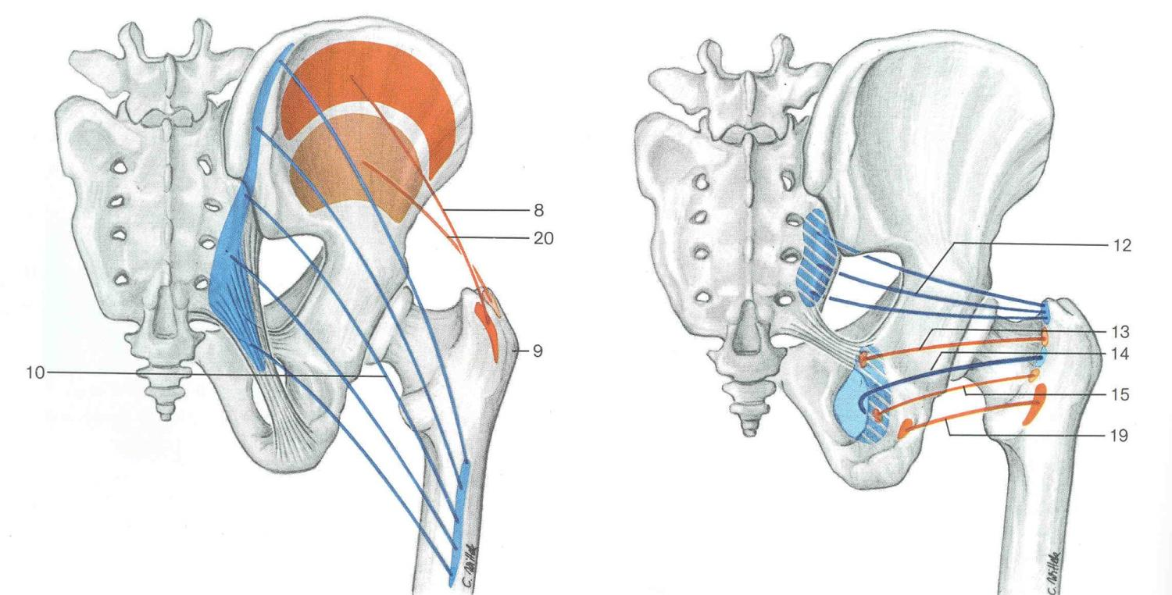
Hip (coxal) joint / Gluteal muscle group osseous attachments
GMd
GMn
Pi
GMx
SG
Obi
IG
QF

Slide 12
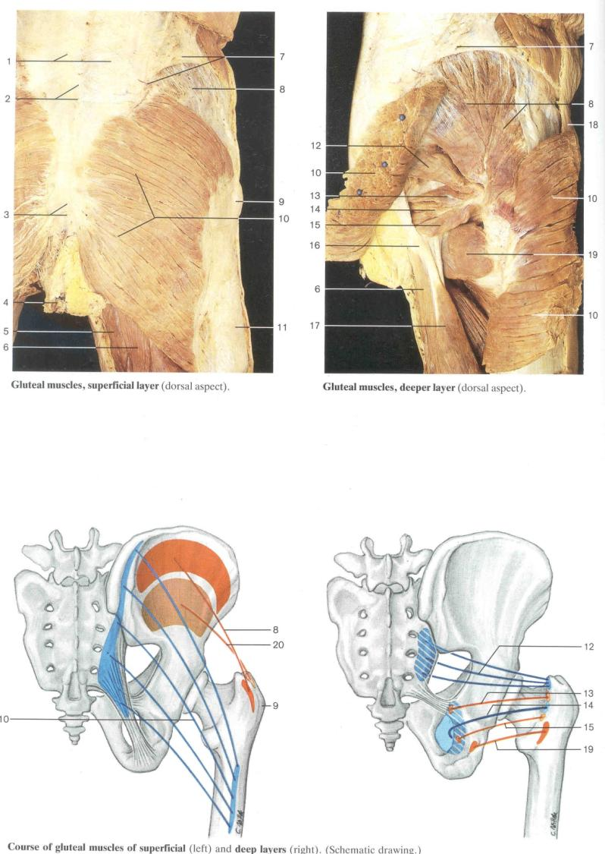

Slide 13
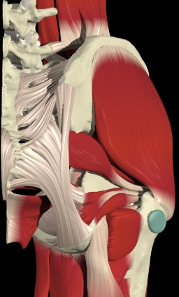
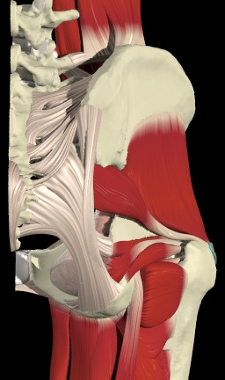
Hip (coxal) joint / GLUTEAL MUSCLE GROUP
Glut med
Glut min
Pi
Trochanteric bursa.

Slide 14
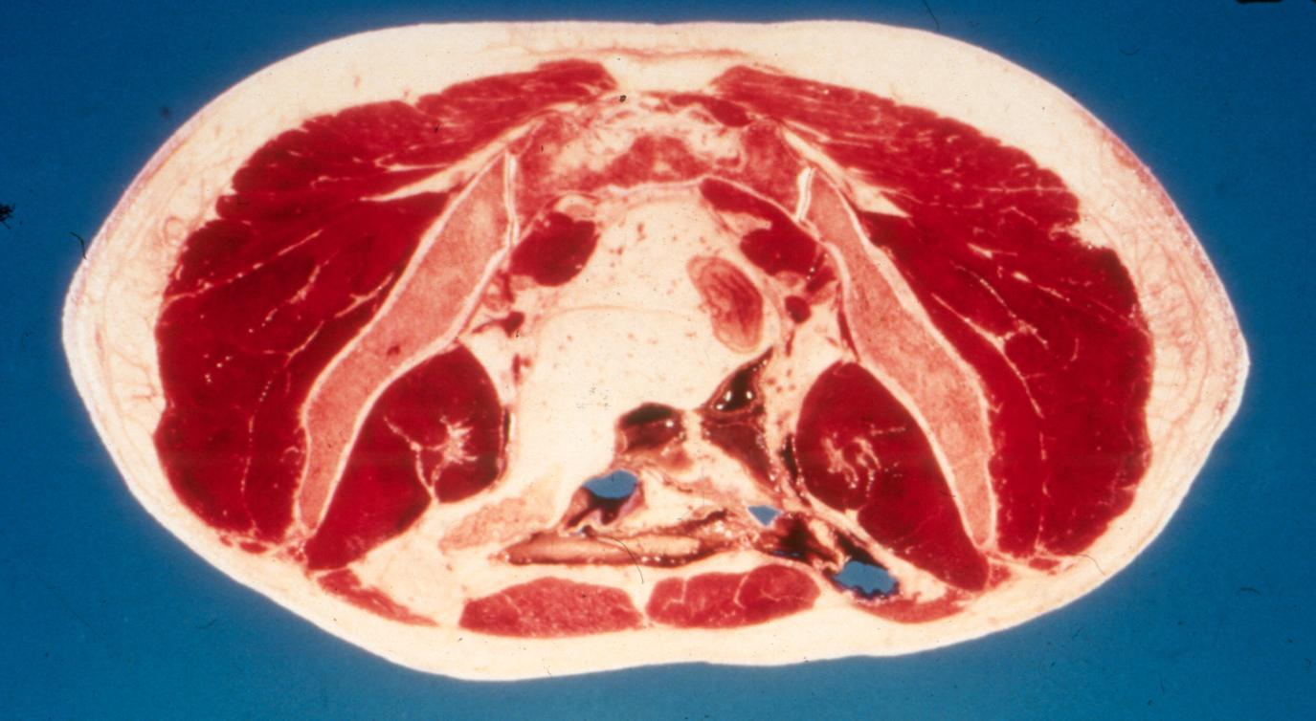
Gluteus maximus
Gluteus medius
Gluteus minimus
Tensor fascia lata

Slide 15
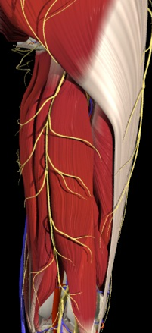
Hip (coxal) joint / GLUTEAL MUSCLE GROUP FUNCTIONS
Gluteus maximus
Powerful hip extensor
Functions:
Climbing
Walking uphill
Regaining upright posture from squatting
NOT in normal walking

Slide 16
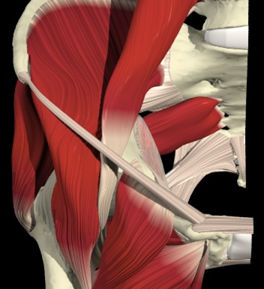
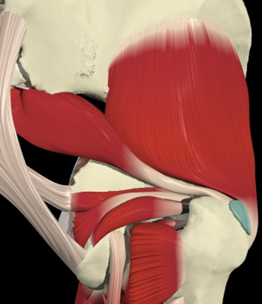
Hip (coxal) joint / GLUTEAL MUSCLE GROUP
Piriformis
Anterior View
Posterior View
Piriformis action: Piriformis laterally rotates the extended hip joint and abducts the flexed hip joint.

Slide 17

Hip (coxal) joint / LATERAL ROTATOR MUSCLE GROUP
Illiacus
Piraformis
Psoas major

Slide 18
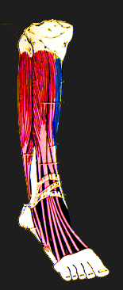
Inferior/Posterior
(Caudal/dorsal)
ANTERIOR TIBIAL GROUP
PERONEI
SCIATIC NERVE
(PERONEAL)
Tibialis Anterior
Peronius Longus
Extensor Digitorum Longus
Peronius Brevis
Extensor Hallucus Longus
Obturator
(Sciatic)
Peroneal

Slide 19
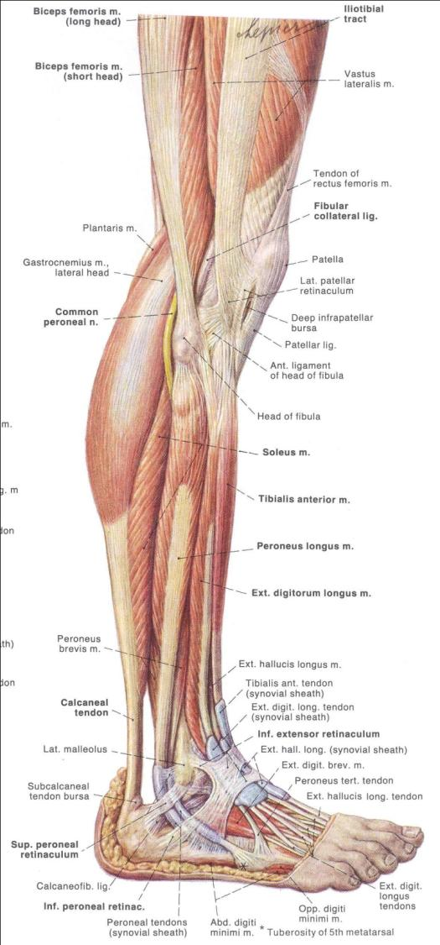

Slide 20
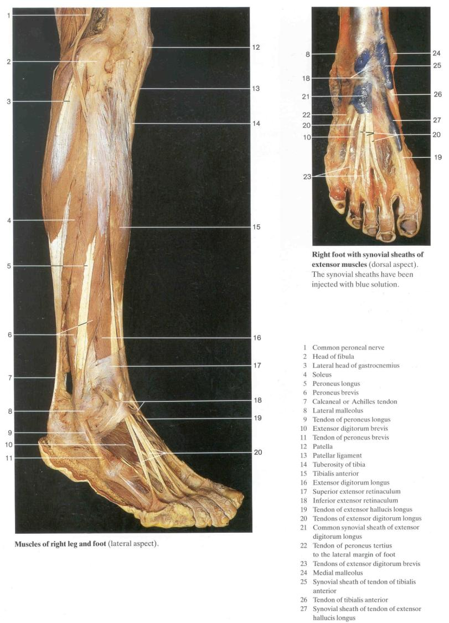

Slide 21
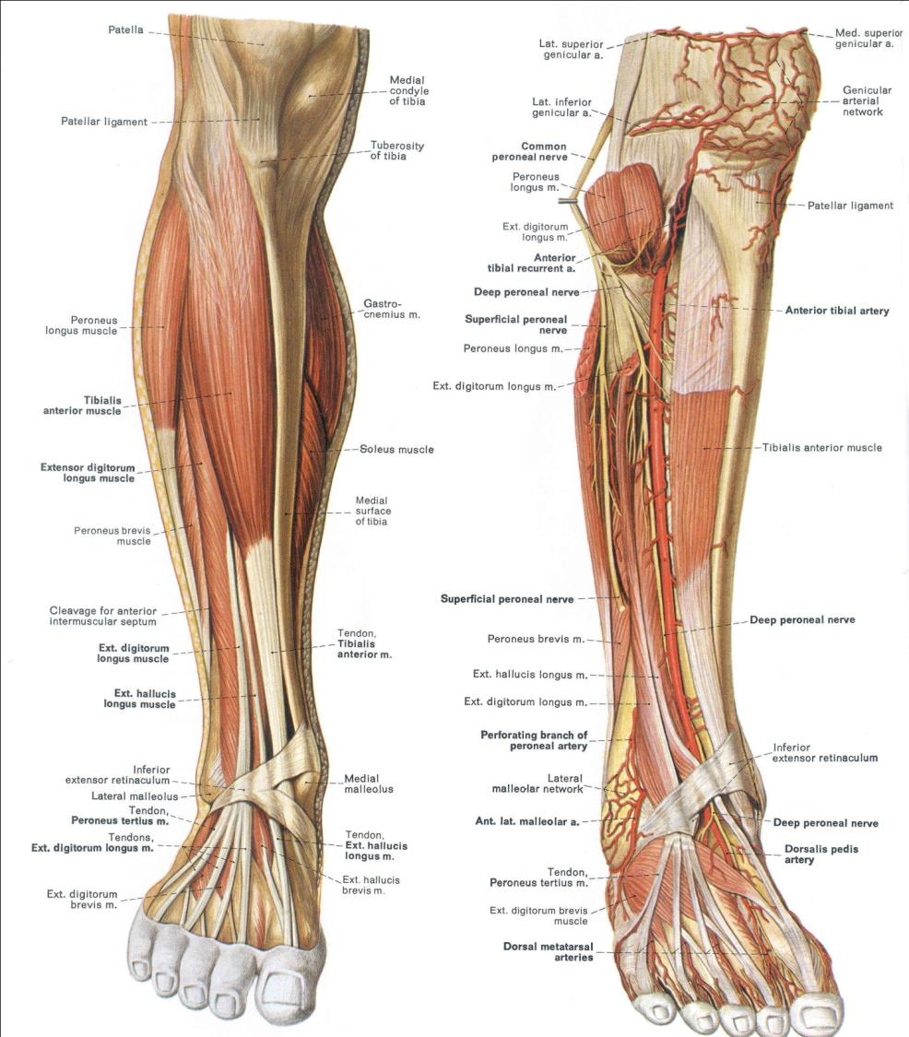

Slide 22
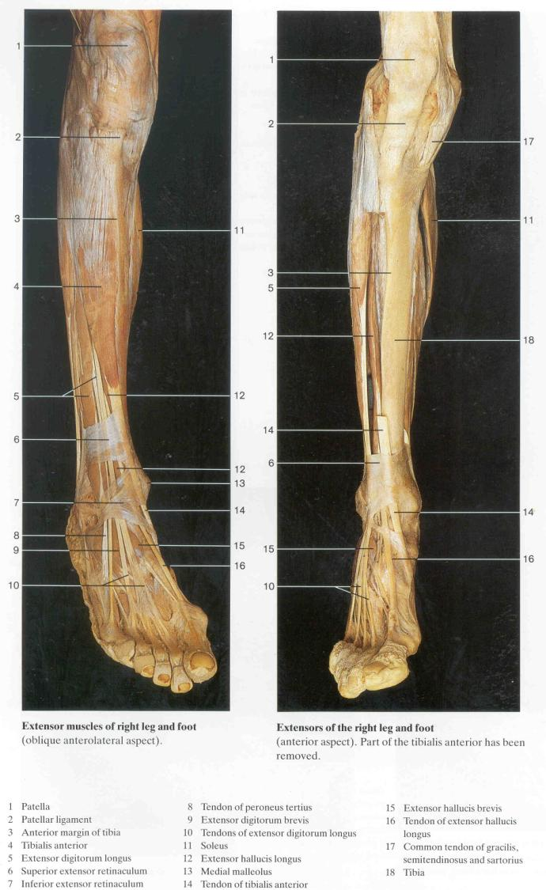

Slide 23
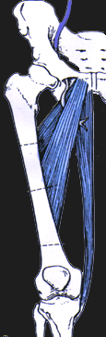
Superior/Anterior
(Cranial/ventral)
ADDUCTORS
OBDURATOR NERVE
Gracilis
Adductor Brevis
Obturator
(Sciatic)
Peroneal
Adductor Longus

Slide 24
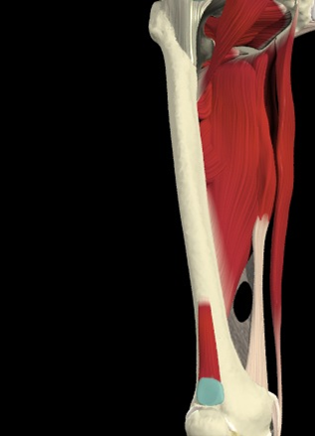
Thigh mm / MEDIALTHIGH MUSCLES/ hamstring portion of Ad. mag.
Pect.
Add. magnus
Semimembranosis
Hamstring portion Ad. Mag.

Slide 25
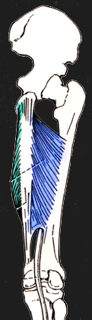
Inferior/Anterior
(Caudal/ventral)
Adductor
Magnus
(adductor part)
Obturator
(Sciatic)
Peroneal

Slide 26
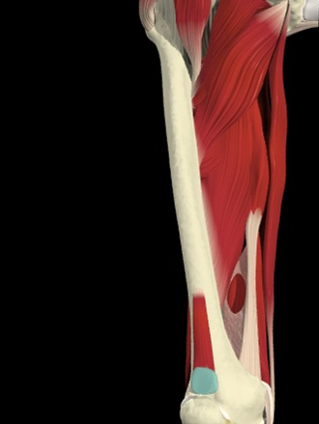
Thigh mm / MEDIALTHIGH MUSCLES/actions & function
Ad lo
Adductors of the thigh,
Flexors (especially when hip is extended)
Adductor longus and magnus mm. also can act as medial rotators of thigh, when already laterally rotated
Function: Stabilizers of the hip during closed-chain action (stance).
Other medial rotators of the thigh include gluteus medius.

Slide 27
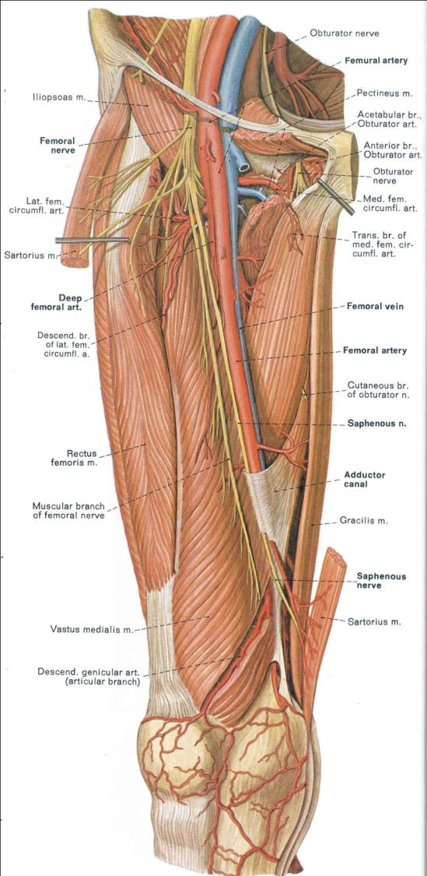

Slide 28
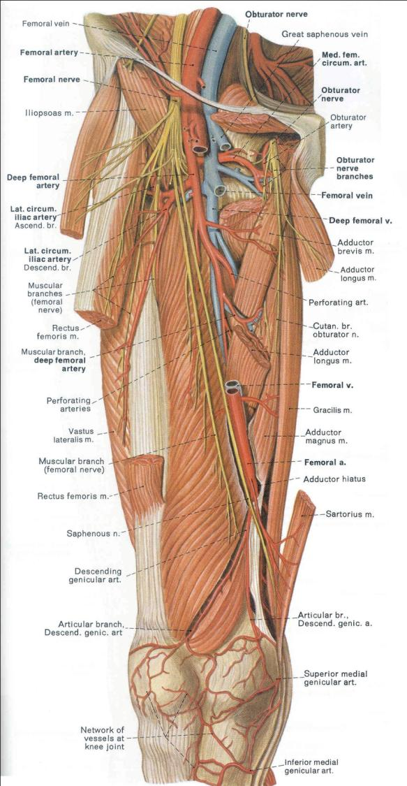

Slide 29
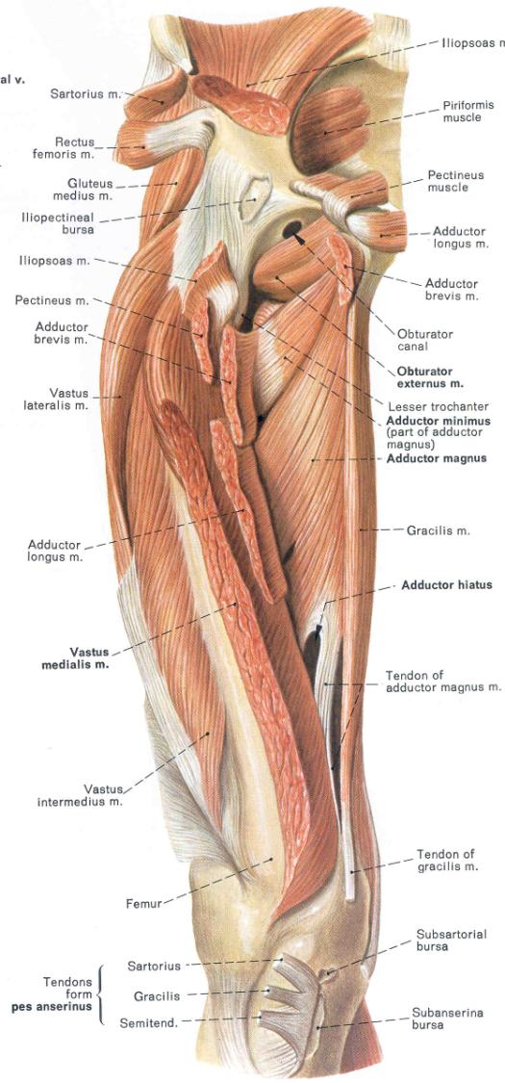

Slide 30
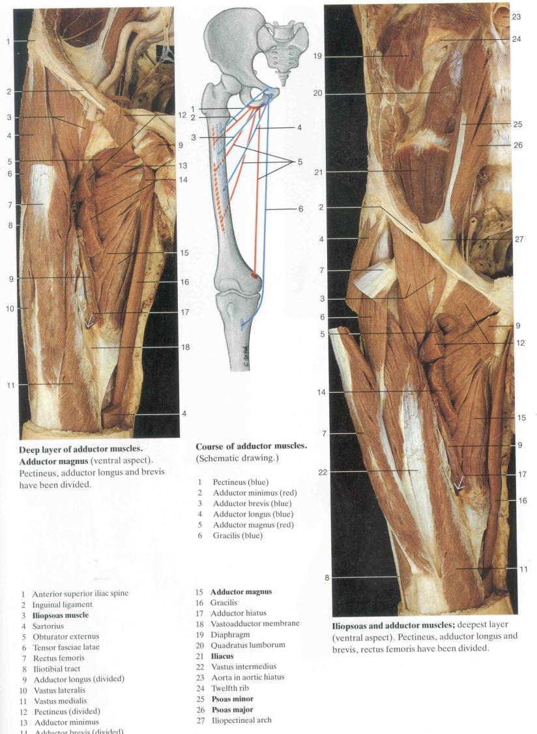

Slide 31
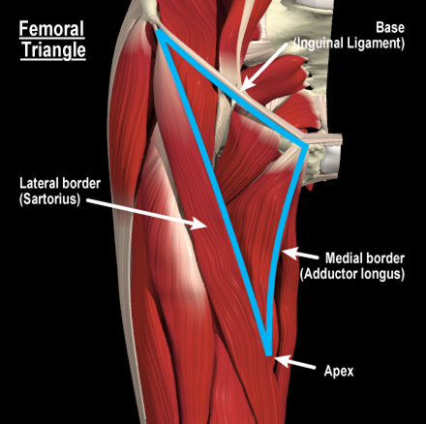
Femoral triangle / BORDERS
pectineus
Anterior view

Slide 32
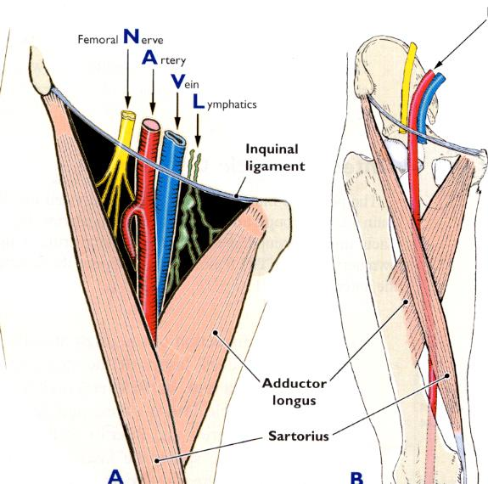
Femoral triangle / RELATIONS
Deep contents
Femoral a. & v. surrounded by femoral sheath
Profunda femoris a. – principal artery of thigh
Lat and med. femoral circumflex aa.
Deep external pudendal a.
Femoral n.
A few deeper lymph nodes --
Anterior view

Slide 33
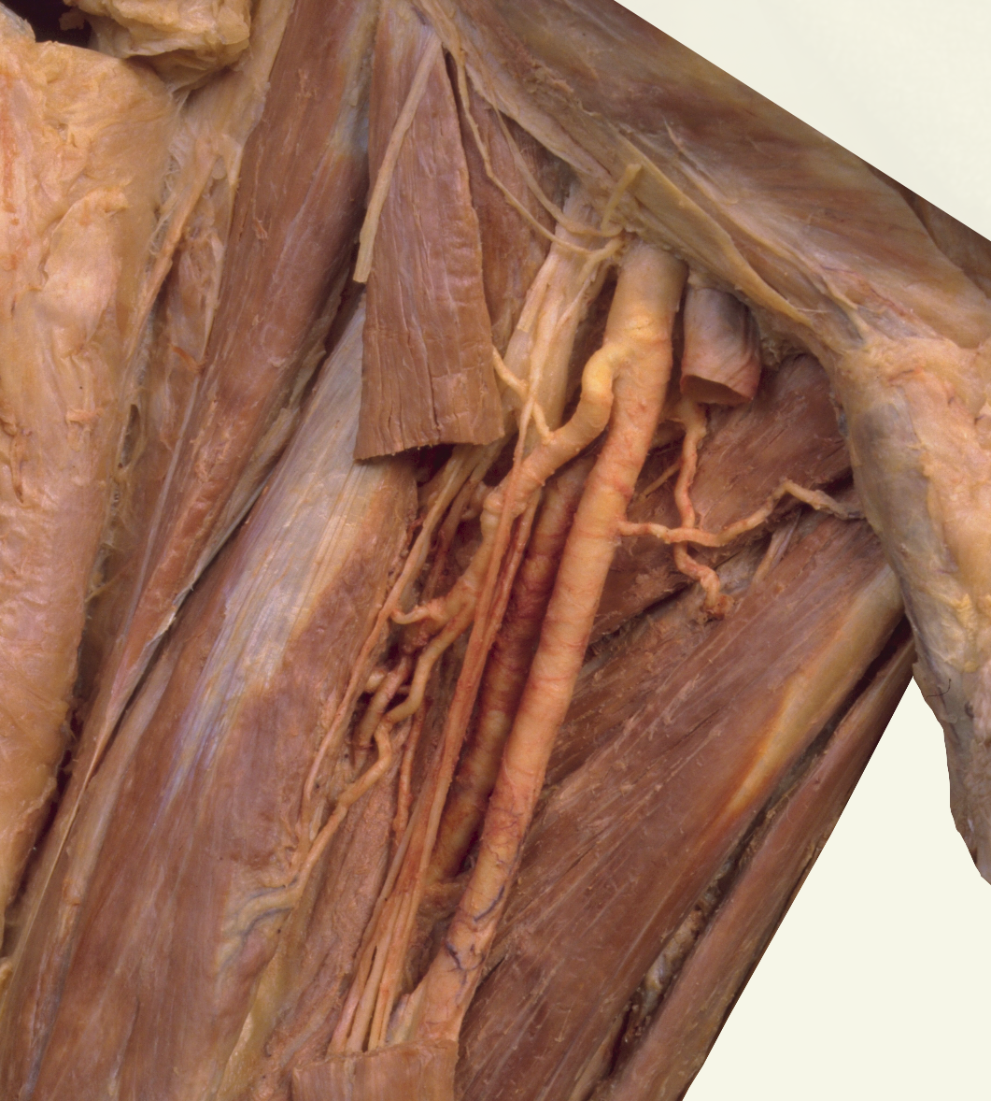
Femoral triangle / DEEP VESSELS AND NERVES
Lateral femoral circumflex artery transverse branch

Slide 34
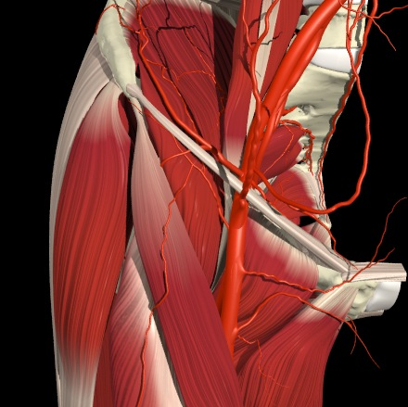
Thigh mm / ANTERIOR THIGH MUSCLES/ Relations at hip
Ilio-psoas
Tensor fascia lata
Sartorius
Rectus femoris

Slide 35
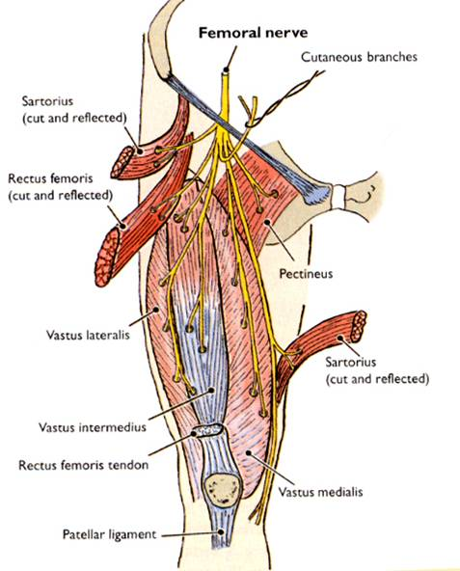
Thigh mm / ANTERIOR THIGH MUSCLES/ femoral nerve distribution

Slide 36

Inferior/Anterior
(Caudal/ventral)
HAMSTRINGS
SCIATIC NERVE (TIBIAL)
Semitendinosis
Semimembranosis
Biceps Femoris
Obturator
(Sciatic)
Peroneal

Slide 37
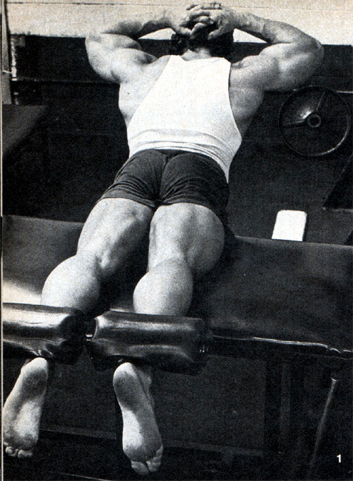
HAMSTRINGS are CRITICAL IN RUNNING. RUNNER’S “STARTING BLOCK” POSTURE MAXIMIZES EFFICIENCY OF HAMSTRINGS BY POSITIONING ISHIAL TUBEROSITY POSTERIOR & maximizing lever arm length

Slide 38
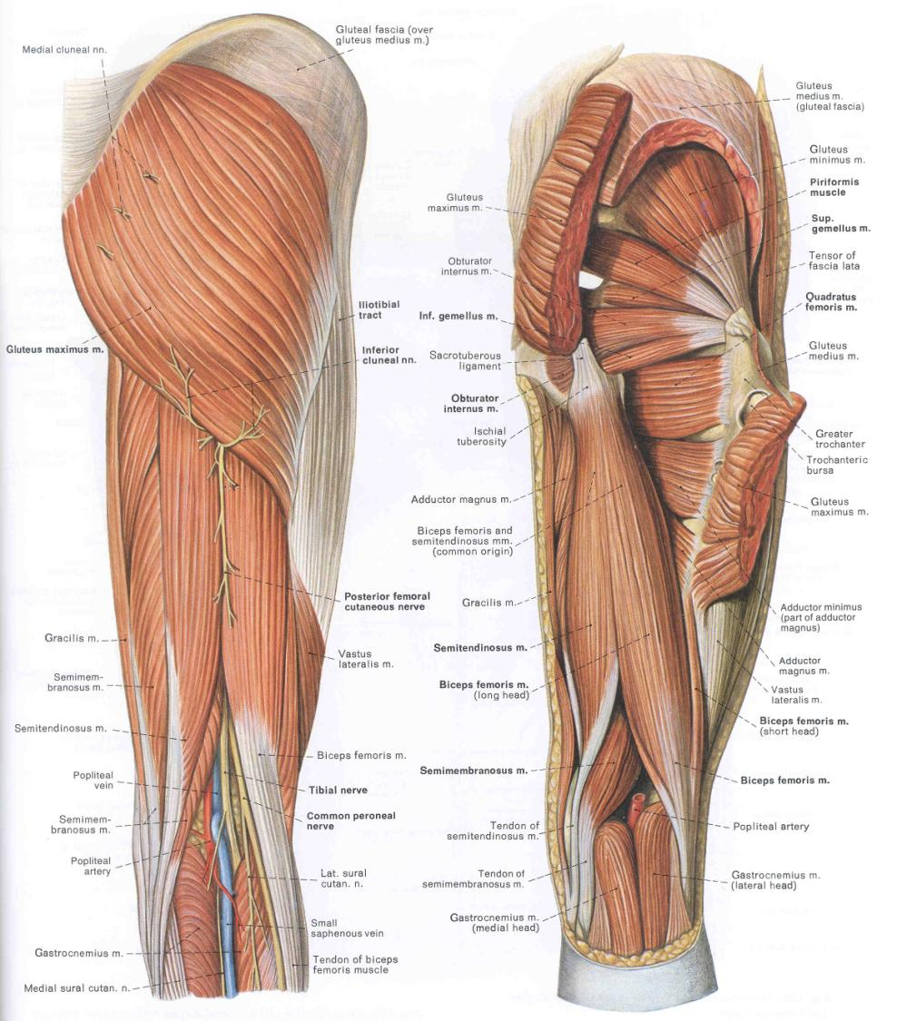

Slide 39
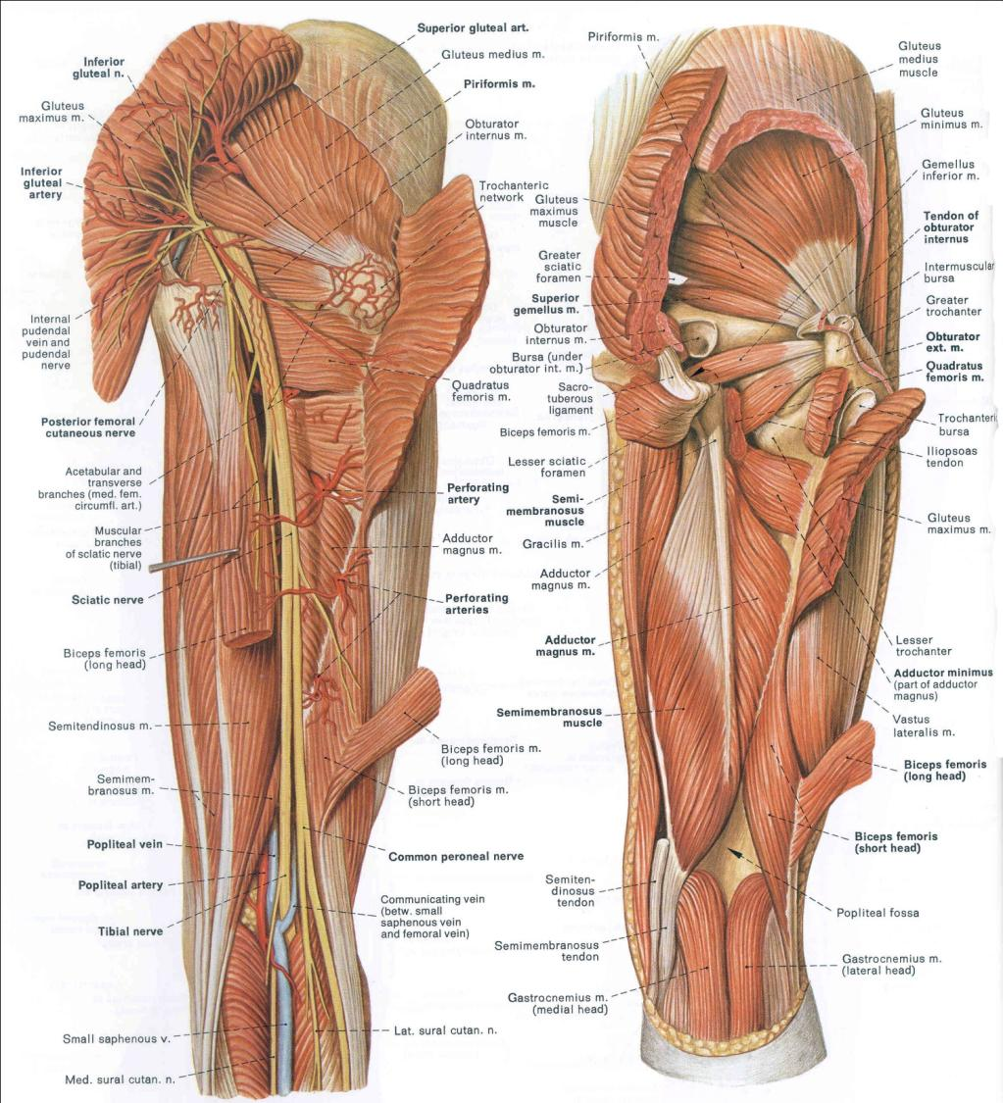

Slide 40
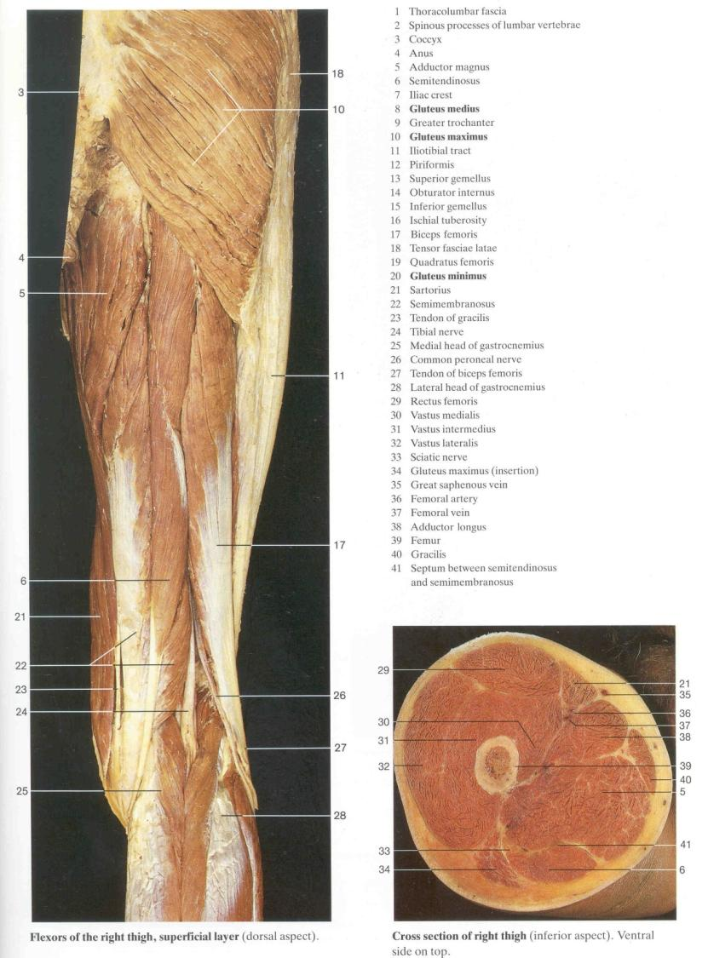

Slide 41
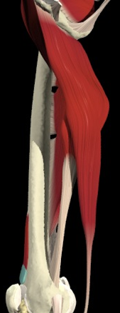
Thigh mm / MEDIAL THIGH MUSCLES/ adductor/vessel relationships
Adductor magnus fibers
Path of femoral artery & vein through adductor hiatus
Hamstring portion of adductor magnus
Popliteal artery
Medial view of thigh

Slide 42
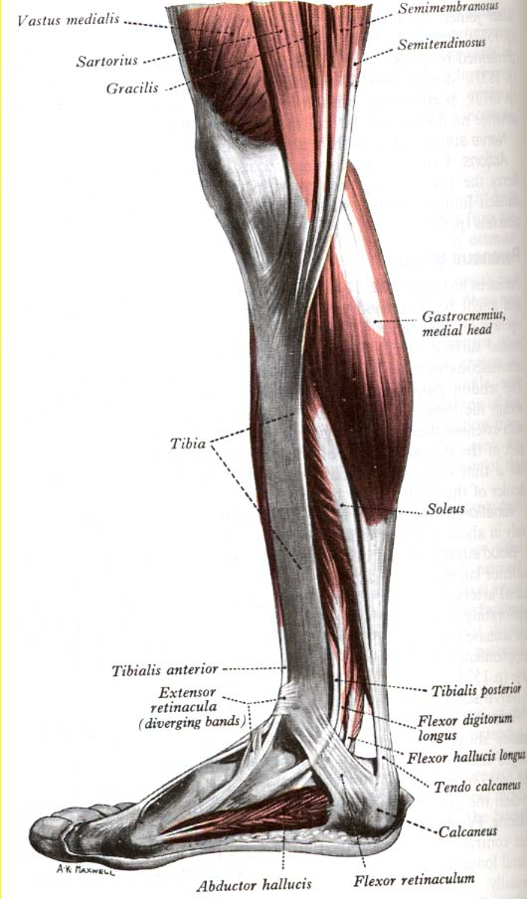
Pes Anserinus: “goose foot” Gracilis – insertion just distal to medial condyle of tibia OBTURATOR NERVE Sartorius – superficial to gracilis FEMORAL NERVE Semitendonosus – distal to gracilis TIBIAL DIVISION OF SCIATIC NERVE

Slide 43

Inferior/Anterior
(Caudal/ventral)
SCIATIC NERVE (TIBIAL)
Gastrocnemus
Obturator
(Sciatic)
Peroneal

Slide 44
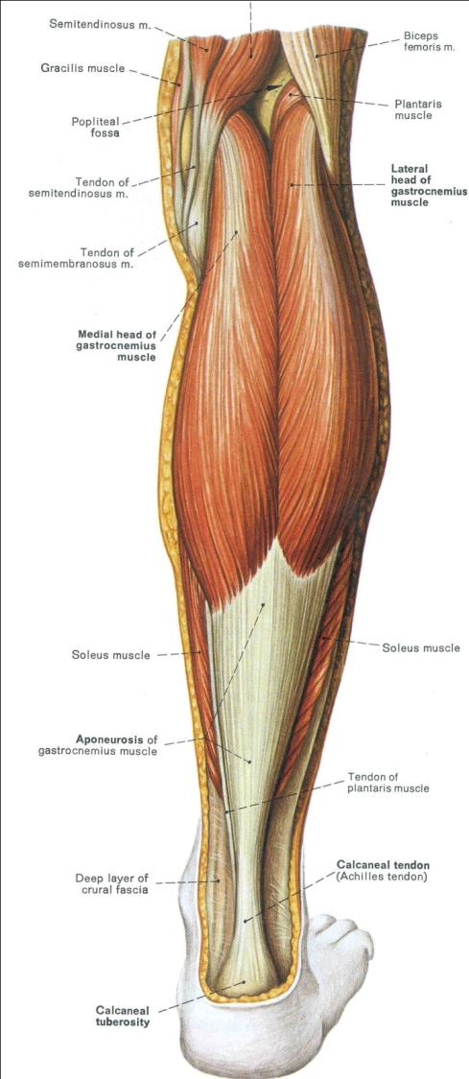

Slide 45
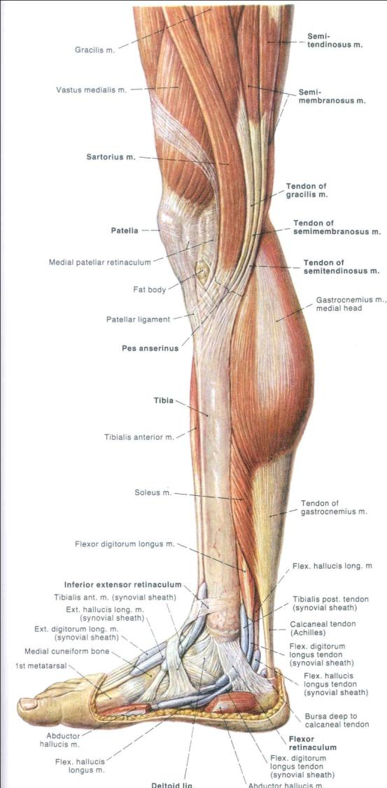

Slide 46

Inferior/Anterior
(Caudal/ventral)
SCIATIC NERVE (TIBIAL)
Soleus
Obturator
(Sciatic)
Peroneal

Slide 47
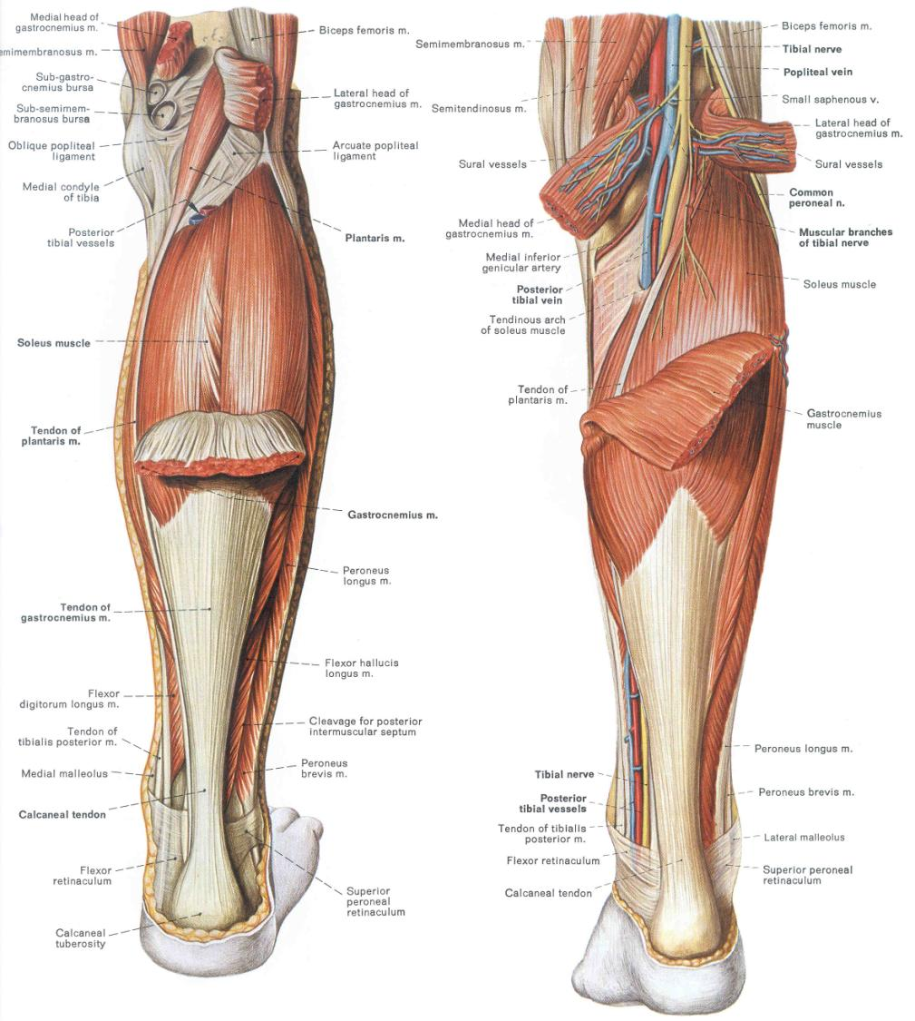

Slide 48
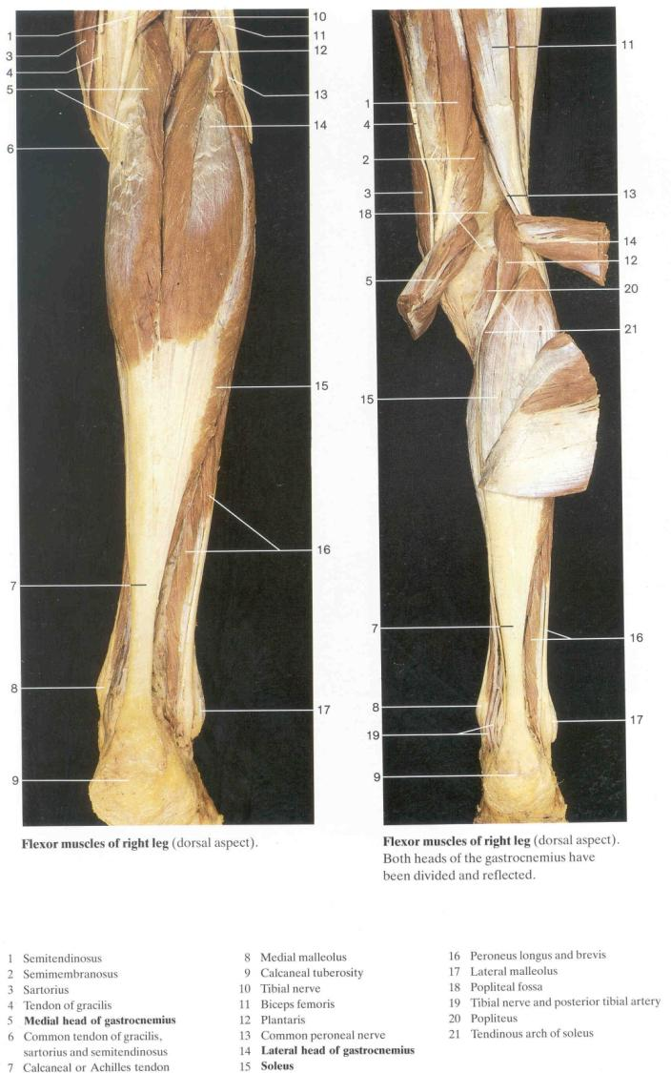

Slide 49

Inferior/Anterior
(Caudal/ventral)
SCIATIC NERVE (TIBIAL)
Flexor
Digitorum
Longus
Flexor
Hallucis
Longus
Obturator
(Sciatic)
Peroneal

Slide 50


Slide 51

Inferior/Anterior
(Caudal/ventral)
LATERAL HIP
ROTATORS
SCIATIC NERVE (TIBIAL)
Quadratis Femoris
Obturator
(Sciatic)
Peroneal

Slide 53


Slide 54


Slide 55


Slide 56


Slide 57


Slide 58


Slide 59


Slide 60

Extrinsic muscles:
Posterior compartment
Superficial – triceps surae
Deep - TDH
Anterior compartment
Lateral compartment
TDH

Slide 61

Posterior compartment
Deep – Tibialis posterior insertions

Slide 62

Posterior compartment
Deep –
Tibialis posterior
Flexor digitorum
Flexor hallicus longus insertions

Slide 63


Peroneus brevis
Peroneus longus

Slide 64

Anterior compartment
Ext. hallicus longus
Ext. digitorum
Tibialis anterior

Slide 65

Dorsal INTRINSIC MUSCLES
Ext. dig. brevis

Slide 66

DORSUM OF FOOT
TA
EDL
EHL
EDL = extensor digitorum longus
EHL = extensor hallucis longus
TA = tibialis anterior
EDB = extensor digitorum brevis
EDB
Tendon of extensor hallucis brevis

Slide 67

Tibialis anterior tendon
EDL
LATERAL VIEW
Ext. hallucis longus
EDB
PL
PB

Slide 68

Perforating branch of peroneal a.
Ant. Tibial a.
Anterio-lateral view
ant. lateral malleolar a.
ant. medial malleolar a.
Dorsalis pedis artery
peroneal a.
Lat. Tarsal branch
1st dorsal metatarsal a.
Arcuate artery

Slide 69


Slide 70

Plantar cutaneous arch v.
Abductor digiti minimi m.
Abductor hallicus m.
Calcaneal fat pad w/ medial calcaneal n.

Slide 71

Ventral INTRINSIC MUSCLES
Flex. Digitorum brevis
“hypothenar”
“thenar”

Slide 72

LAYER 1
Flexor digitorum brevis
Lat. Plantar n.
AbH
Abductor digiti minimi m.

Slide 73

MOST VASCULATURE AND NERVES BETWEEN LAYERS 1 & 2

Slide 74


Slide 75


Slide 76

LAYER 2, (MOSTLY)
lumbricals
Flexor digitorum longus
Quadratus plantae m.

Slide 77

LAYER 2 cont + 3
Flexor hallucis longus tendon
Flexor hallucis brevis
Flexor digiti minimi

Slide 78

Muscles innervated
by medial plantar n.:
Abductor hallicus
Flexor hallucis brevis
1st & 2nd lumbricals
Deep plantar arch
Medial plantar artery & “arch”
Lateral plantar a.

Slide 79

LAYER 3
Adductor hallicus
Transverse head
Oblique head
Flexor hallucis brevis
Flexor digitii minimii

Slide 80

LAYER 4, MOSTLY
PLANTAR INTEROSSEI 3 *
DORSAL INTEROSSEI 4
*
*
*
Interosseous mm.
PAD
DAB
Axis 2nd digital ray, not third

Slide 81

Plantar interossei
Axis of abduction/
adduction is digit 2
Dorsal interossei

Slide 82

Lumbricals
Quadratus plantae

Slide 83

Adductor pollicus
Flex. Hal. Brevis

