Slide 1
Biology 323
Human Anatomy for Biology Majors
Lecture 9
Dr. Stuart S. Sumida
Pelvis and Perineum
Human Walking

Slide 2
Overview of Pelvis and Perineum

Slide 3
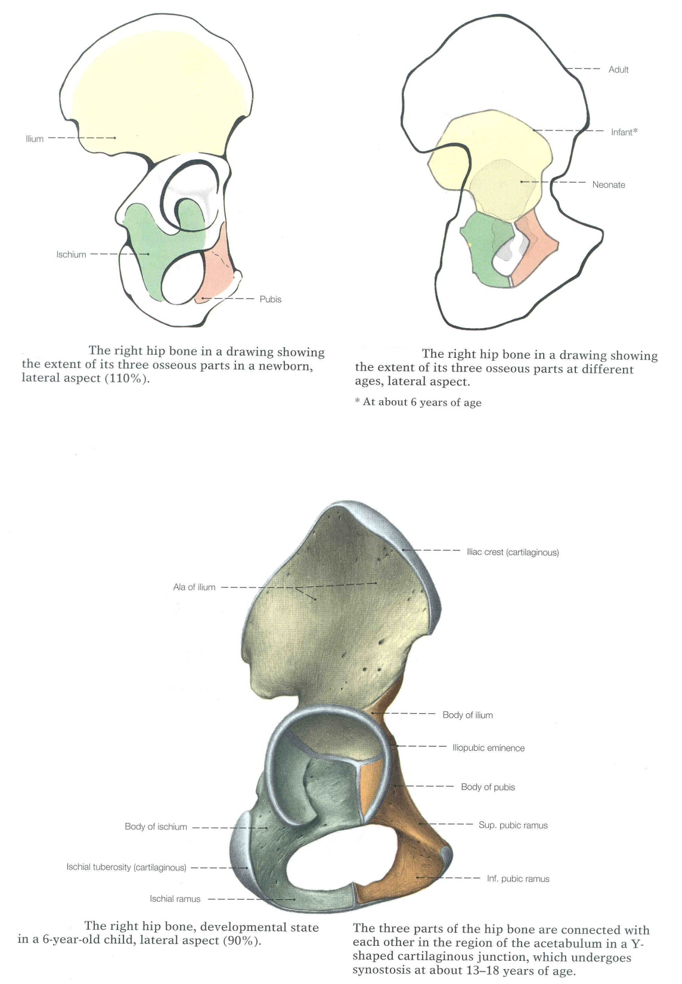

Slide 4
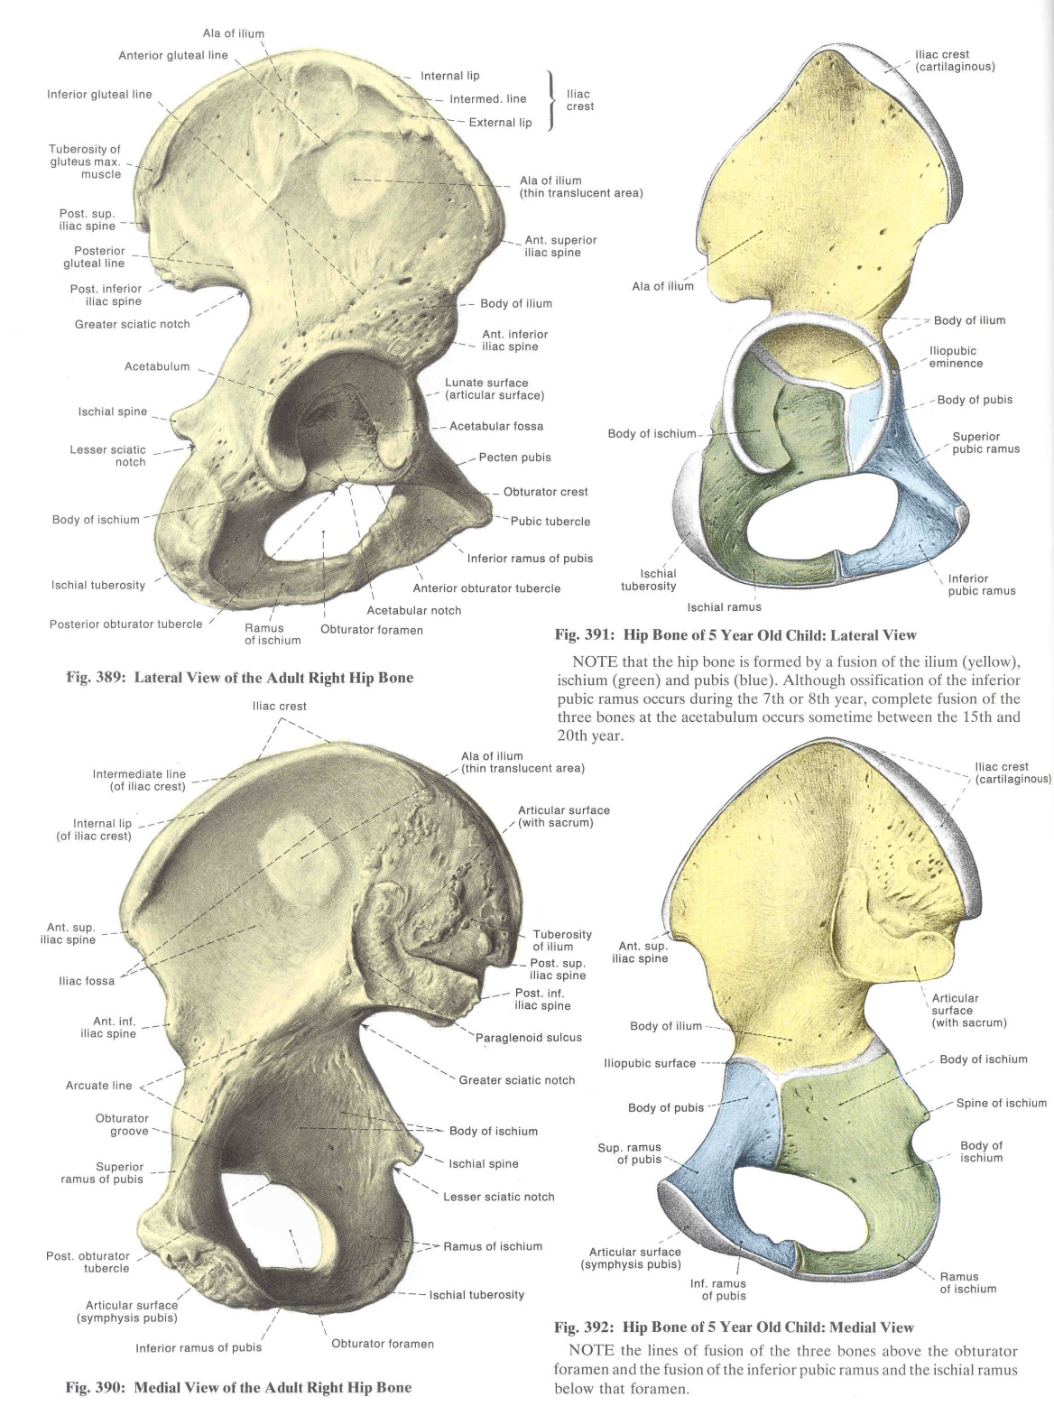

Slide 5
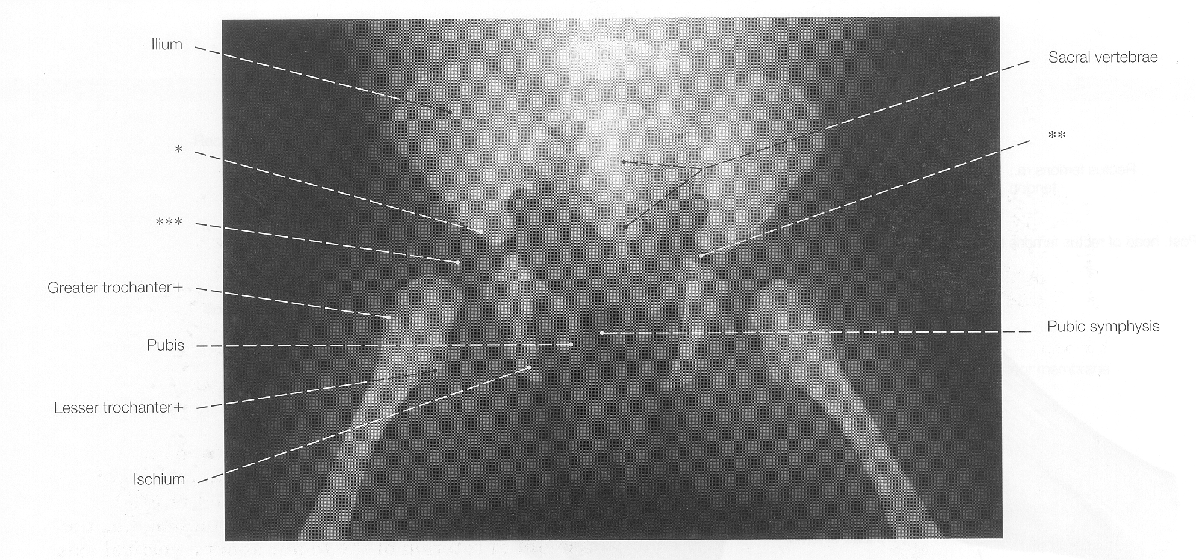

Slide 6
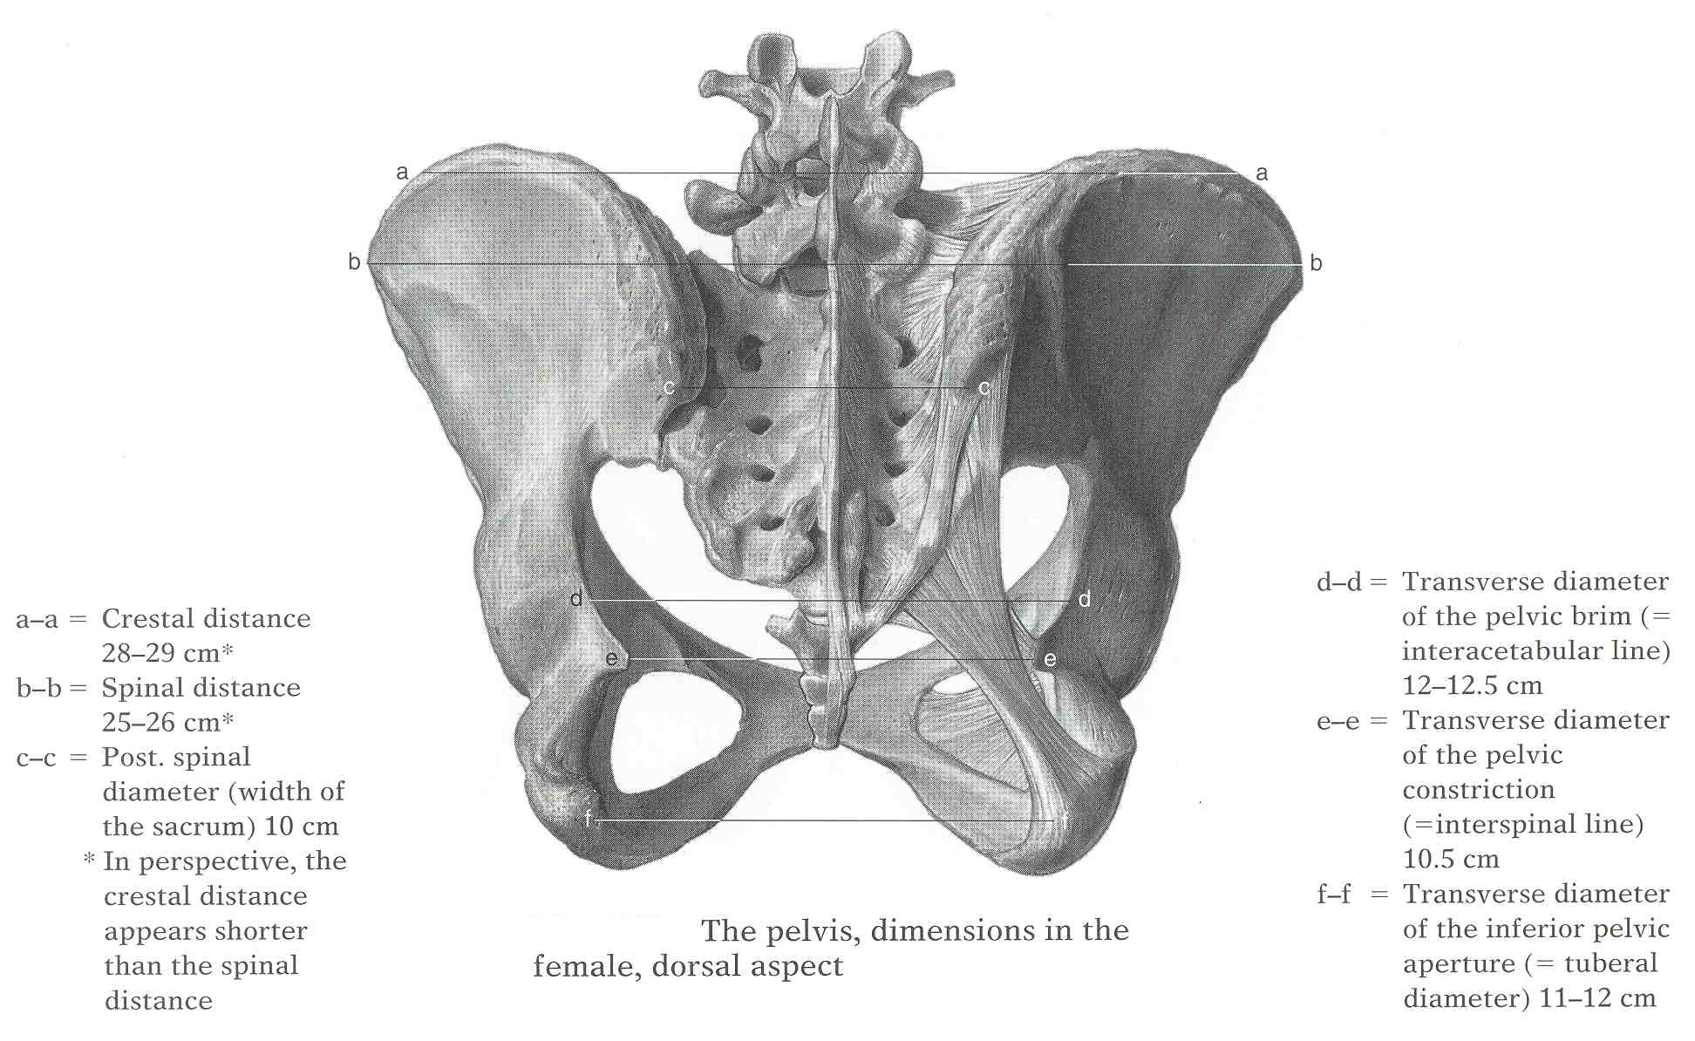
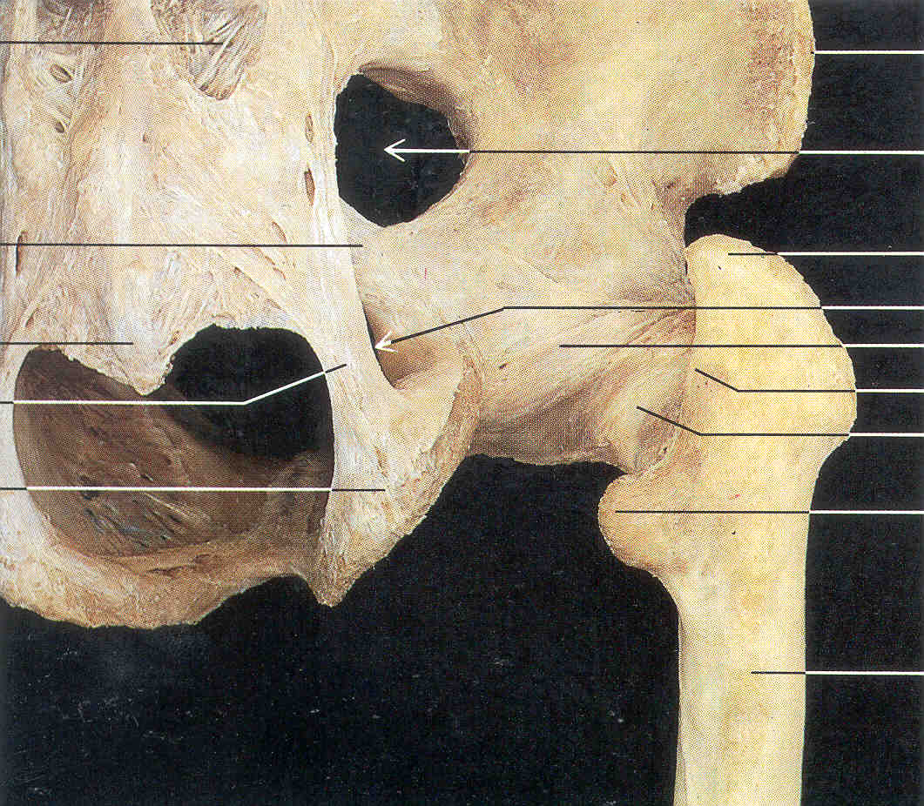

Slide 7
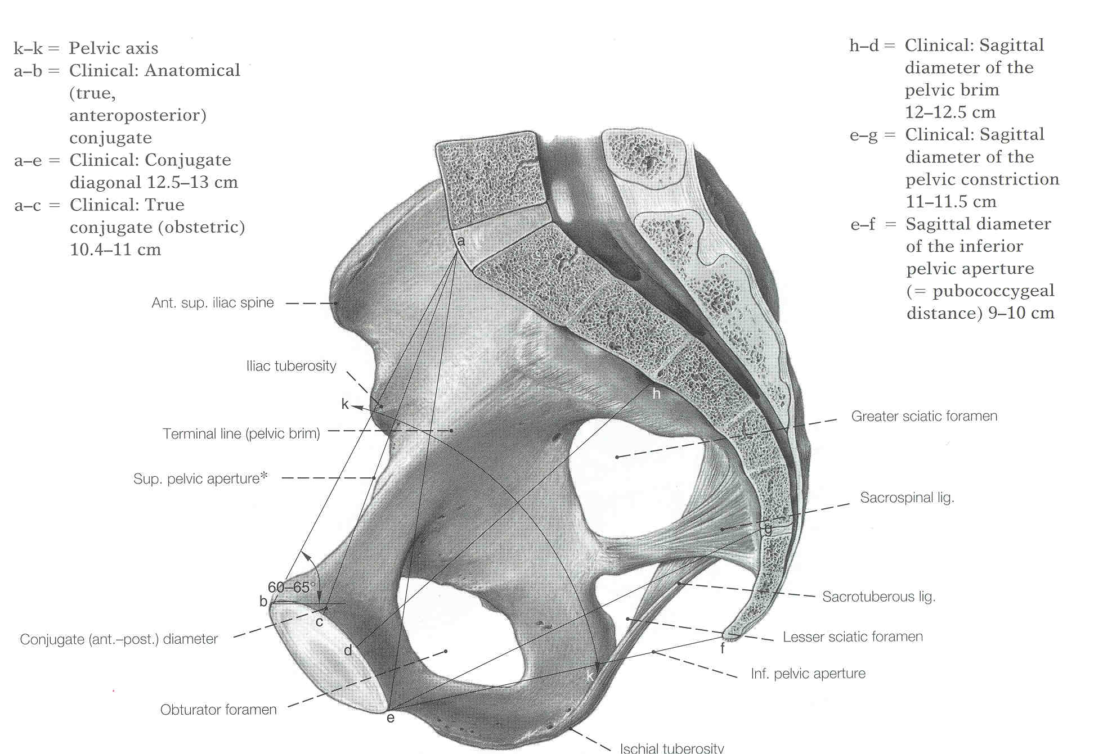

Slide 8
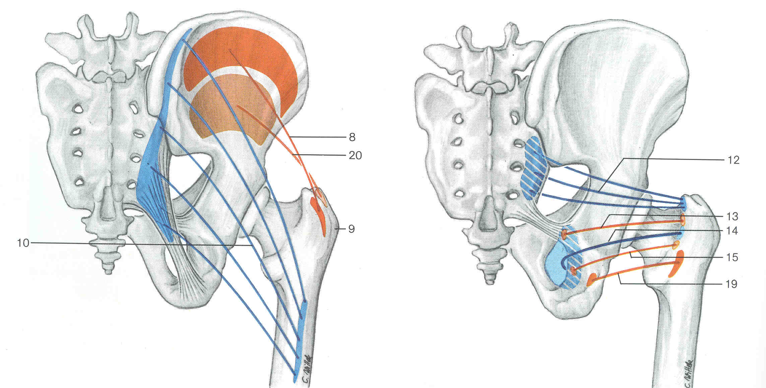

Slide 9
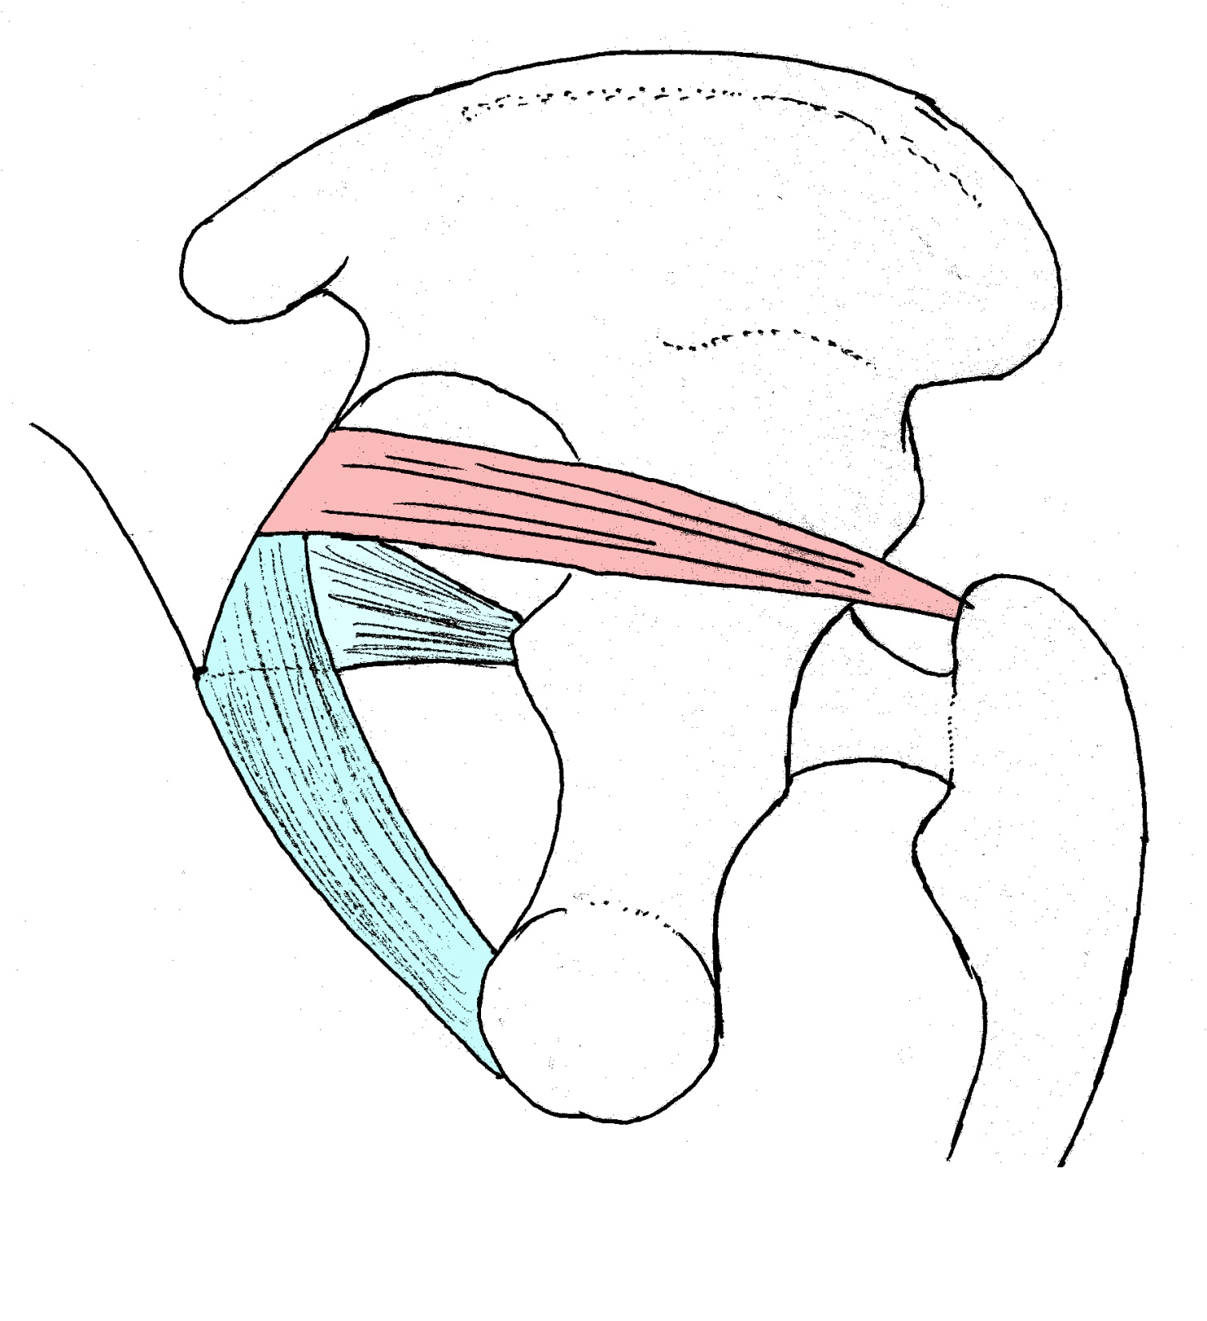

Slide 10
Piriformis muscle
Sacrospinous
Ligament
Sacrotuerous
ligament

Slide 11
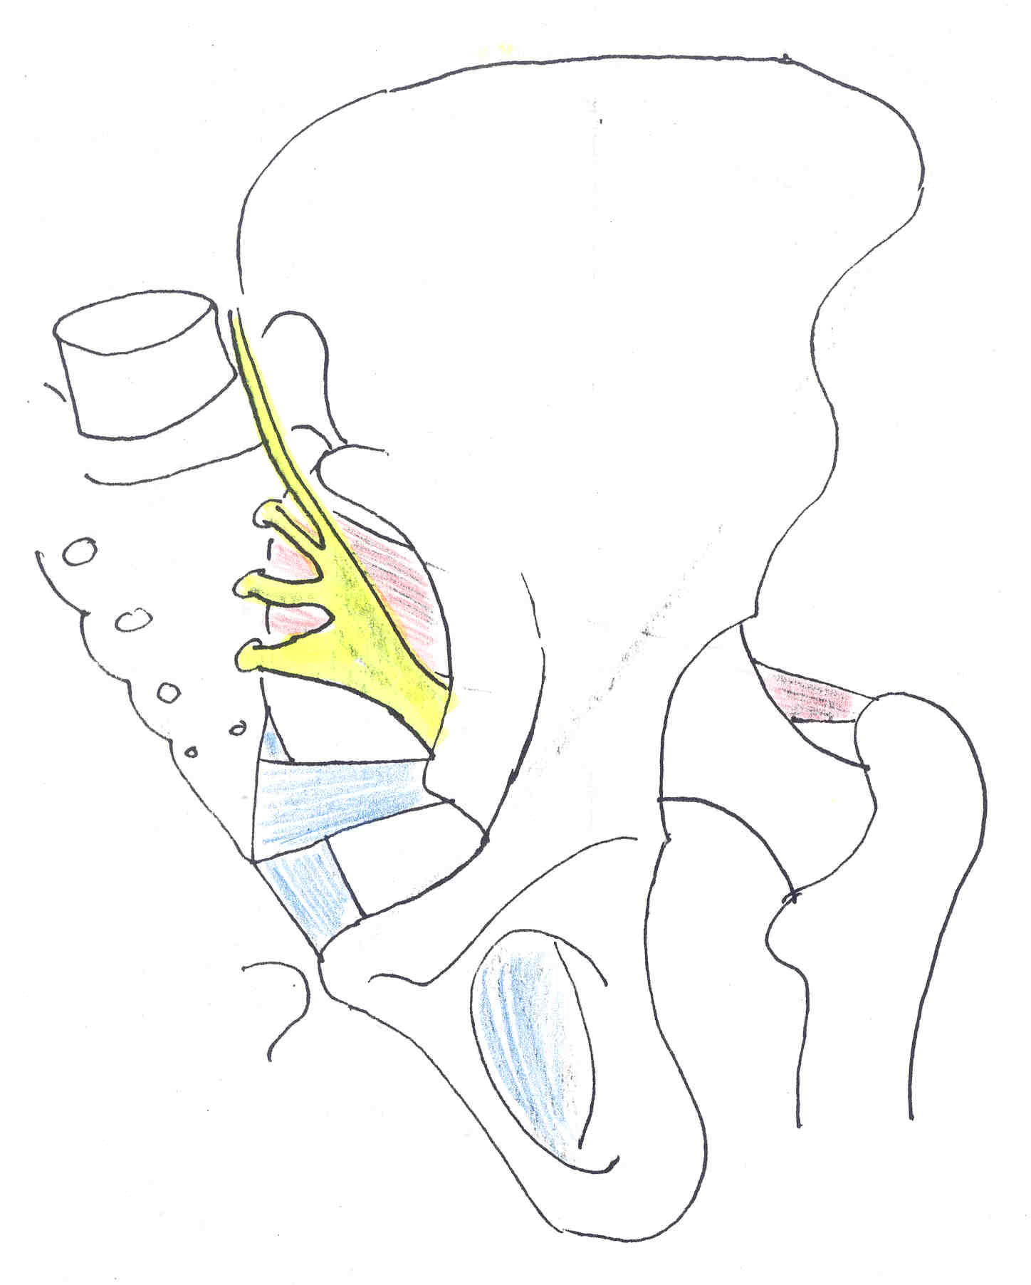

Slide 12
Piriformis muscle
Sacrospinous
Ligament
Sacrotuerous
Ligament
Obturator membrane

Slide 13
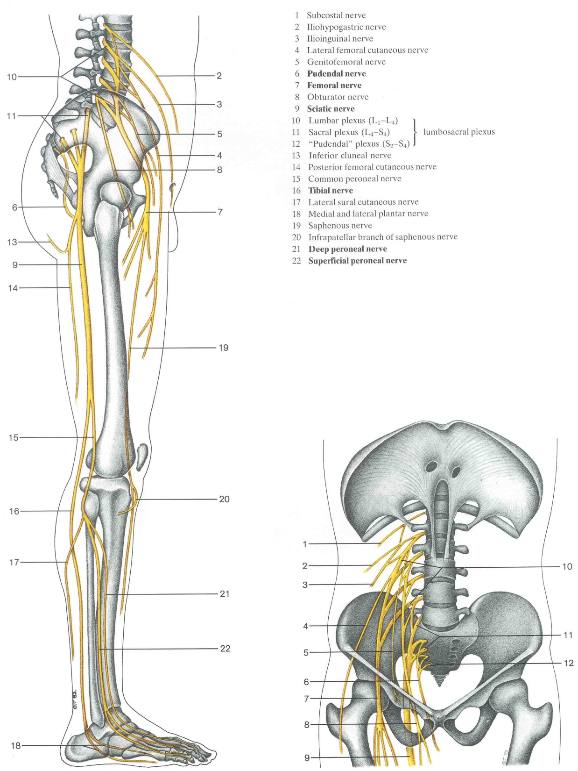

Slide 14
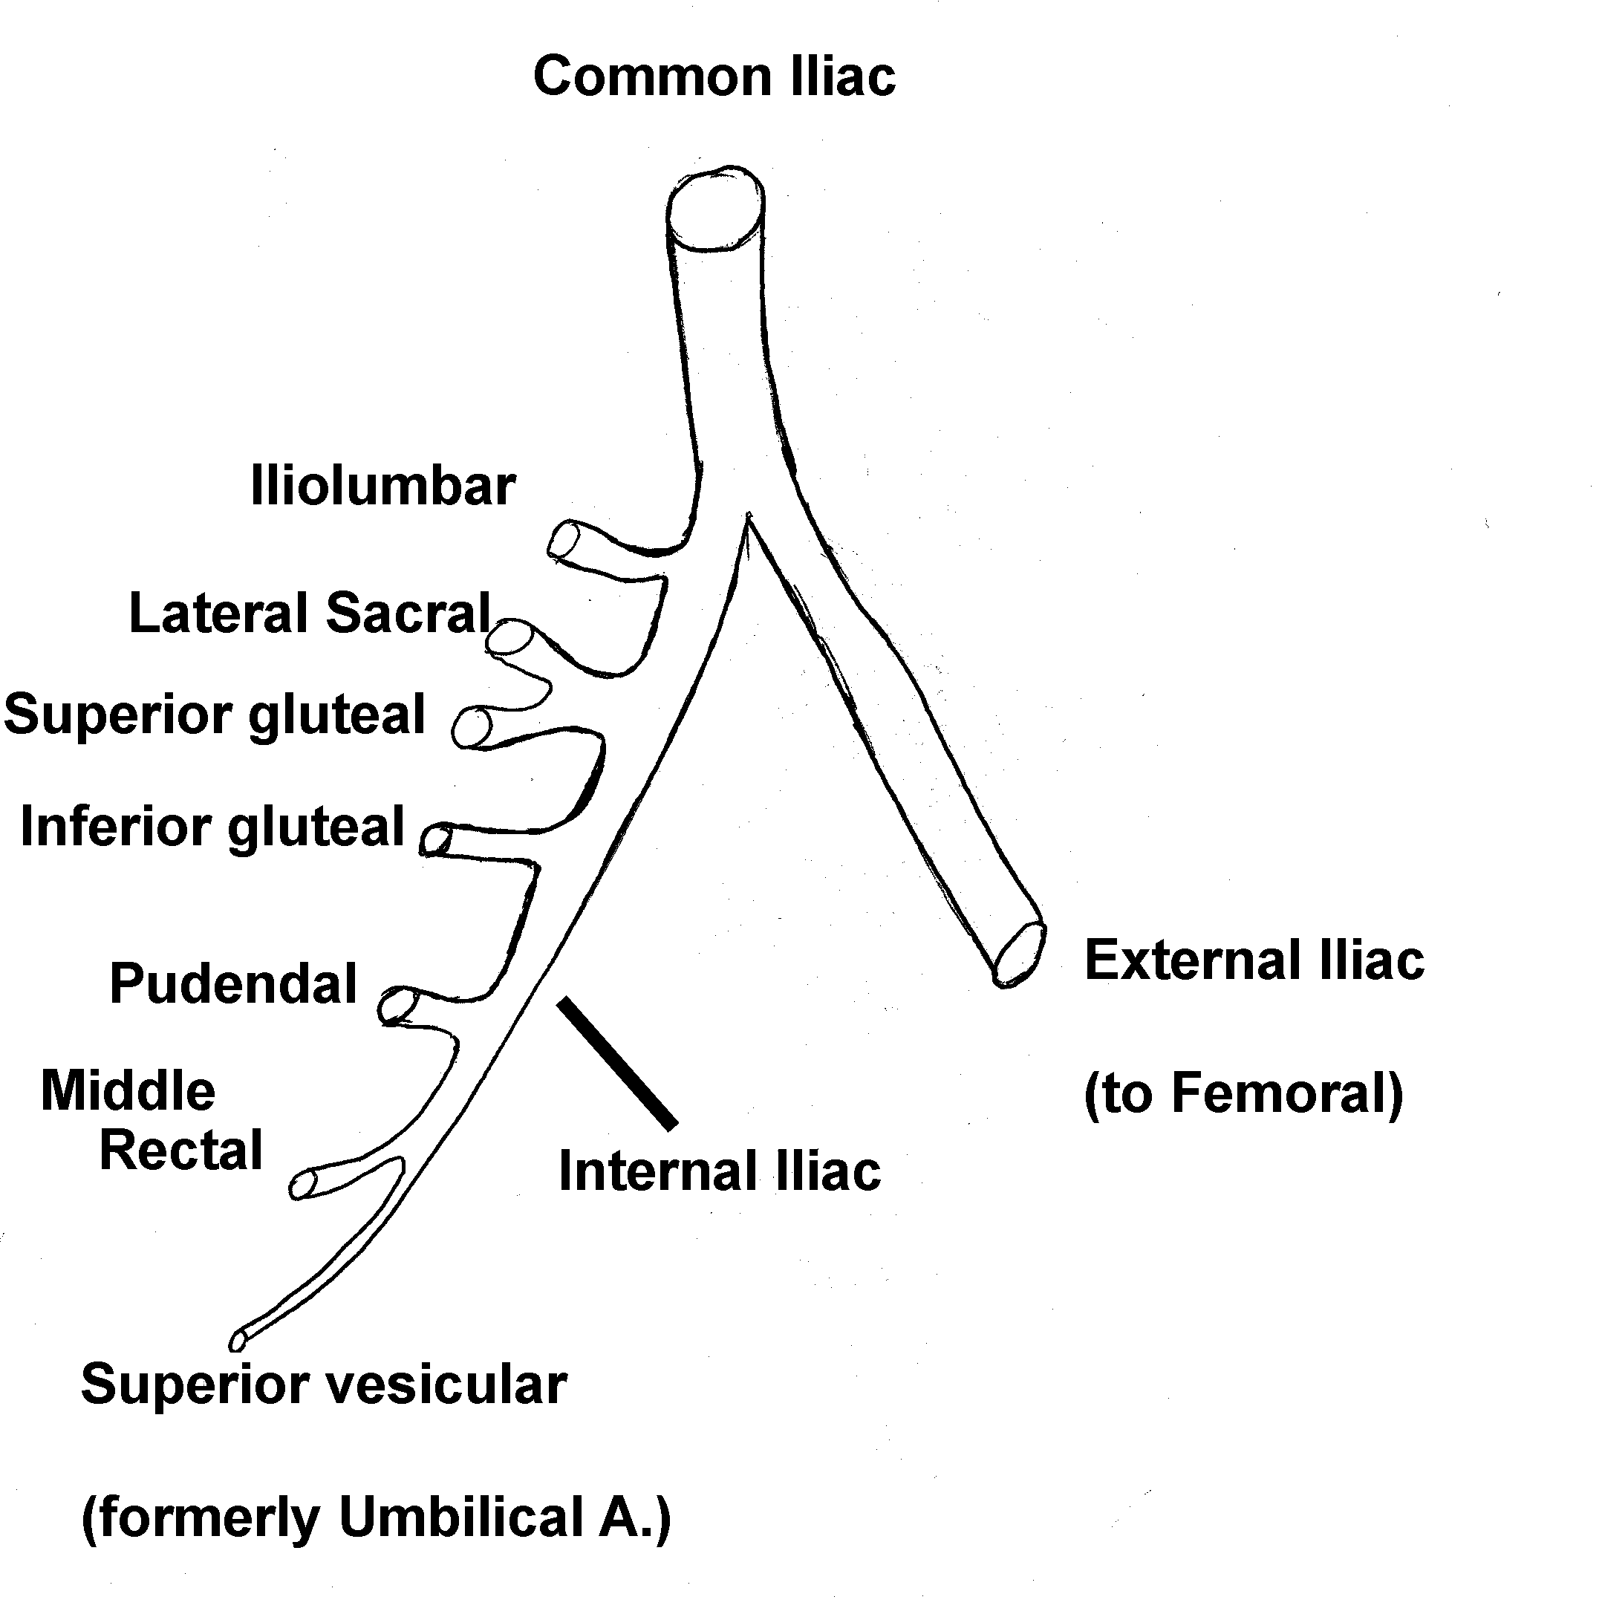

Slide 15
Factors Affecting Locomotion: Walking

Slide 16
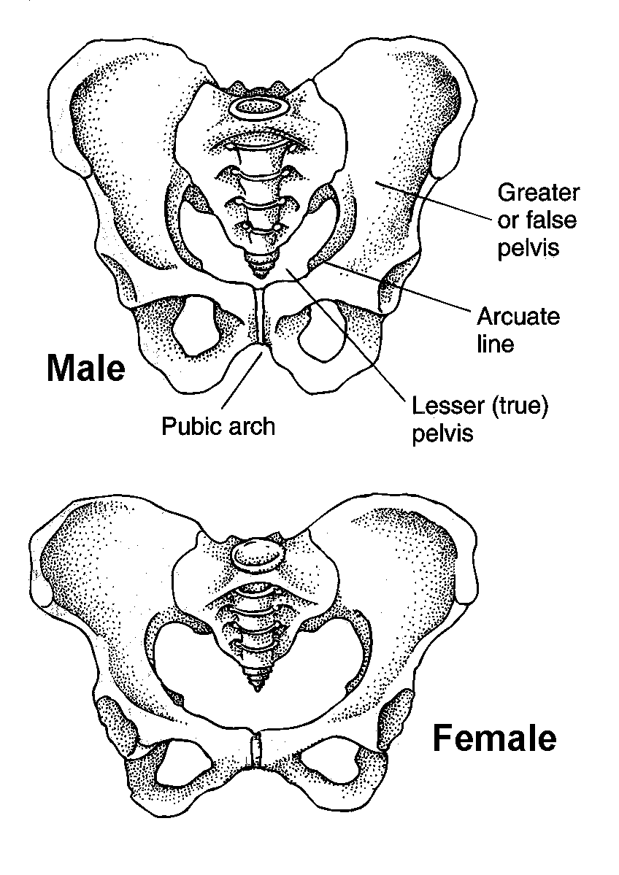

Slide 17
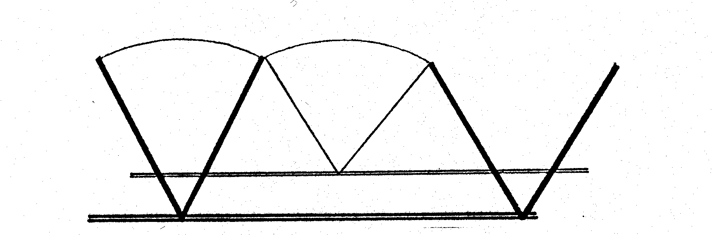
The leg is like an inverted pendulum when walking...
Compliance of the hip, knee, and foot help to smooth out walking.

Slide 18
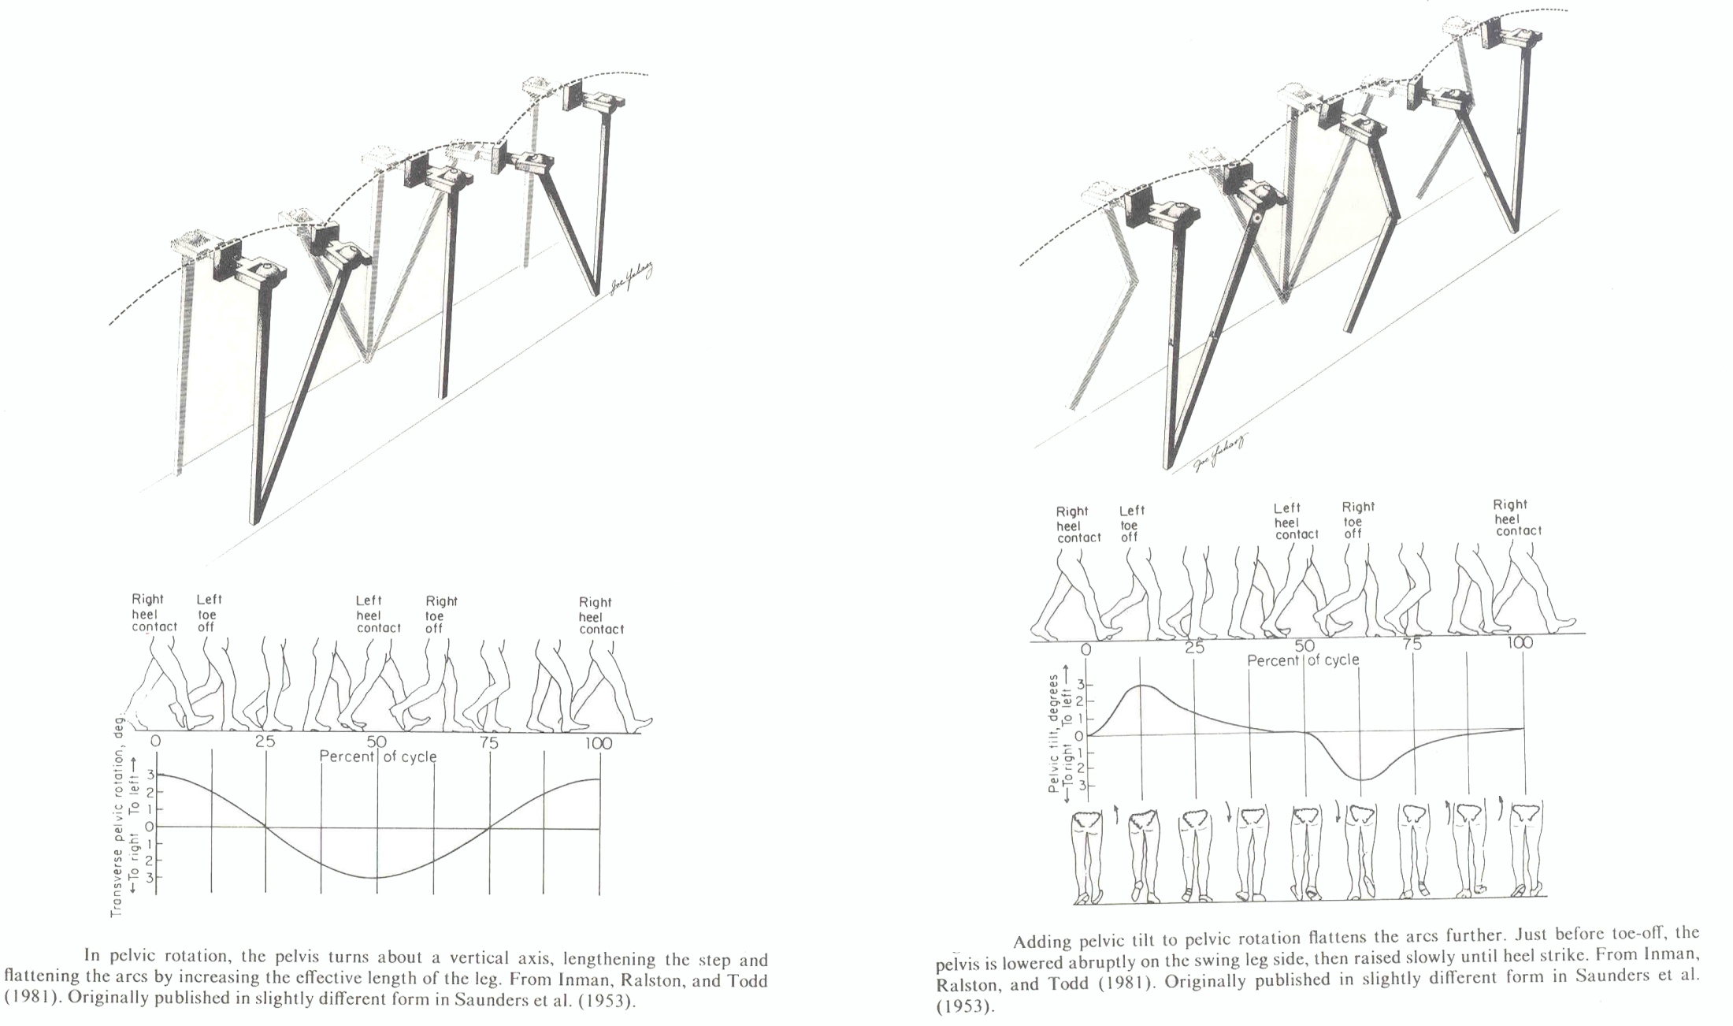

Slide 19
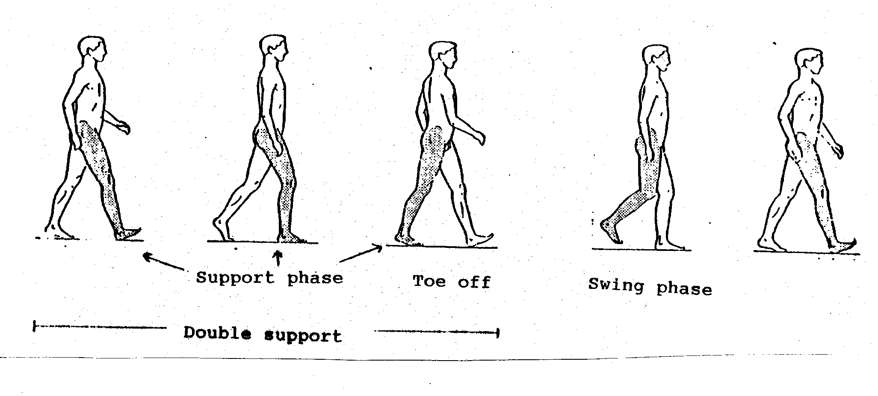
Walking: Has a Double Support Phase
Support Phase = when foot is on the ground.
DOUBLE SUPPORT SINGLE
SUPPORT
(Swing Phase)

Slide 20
Nine Factors Influencing Walking:
1. Pelvic Rotation
2. Pelvic Tilt
3. Lateral Displacement of Pelvis
4. Bending of the Knee
5. Lateral Flexion of Trunk
6. Antero-posterior Flexion of Trunk
7. Dorsiflexion of Foot
8. Plantarflexion of Foot
9. Compliance of Foot

Slide 21
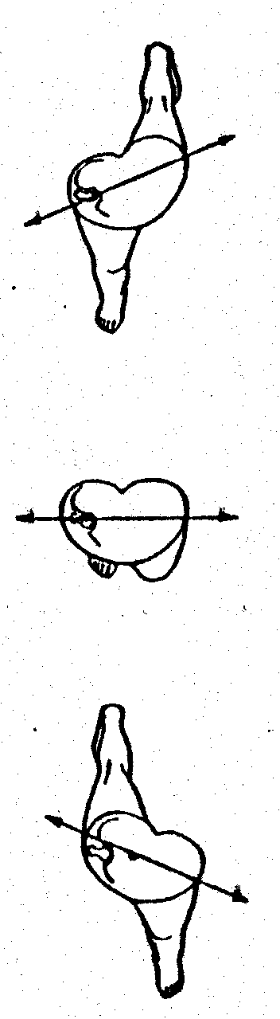
1. Pelvic Rotation
Lateral-medial axis
of pelvis rotates about
the center when walking.

Slide 22
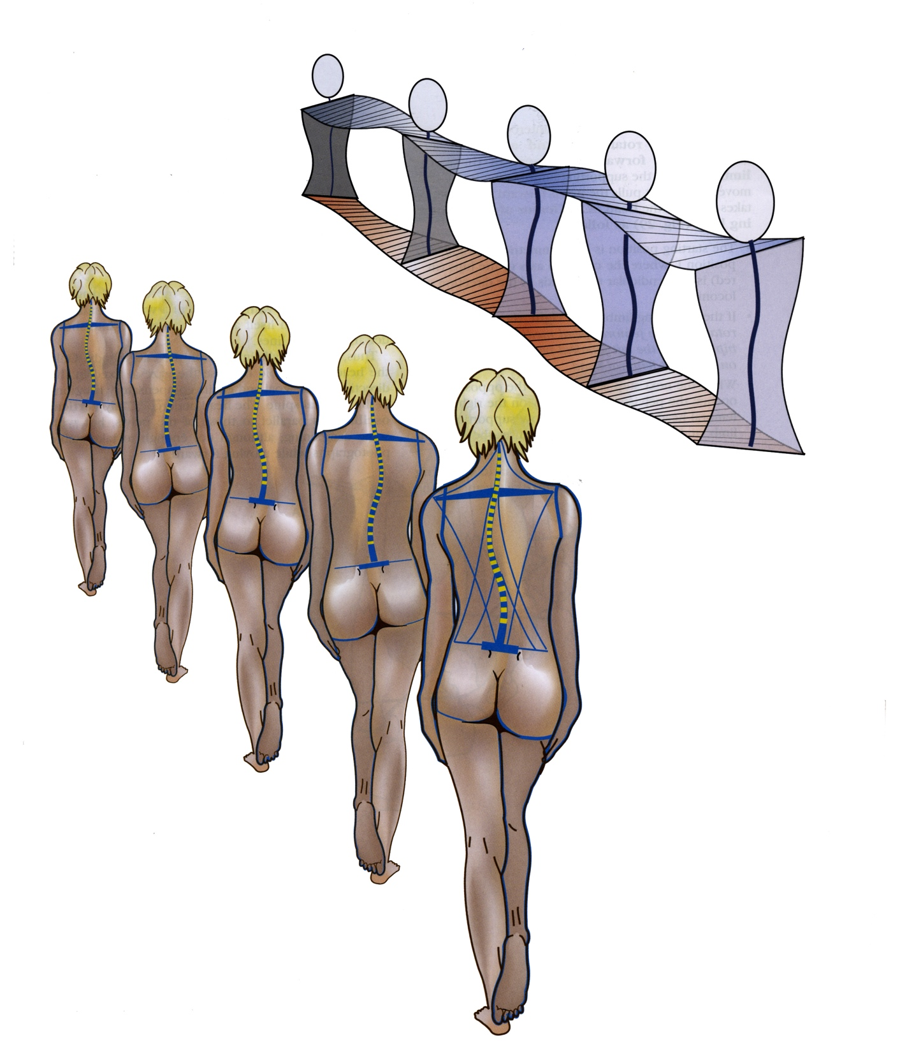
2. Pelvic Tilt
Hip tilts downward on swing leg side.
(Note how shoulder does opposite as counterbalance.)

Slide 23
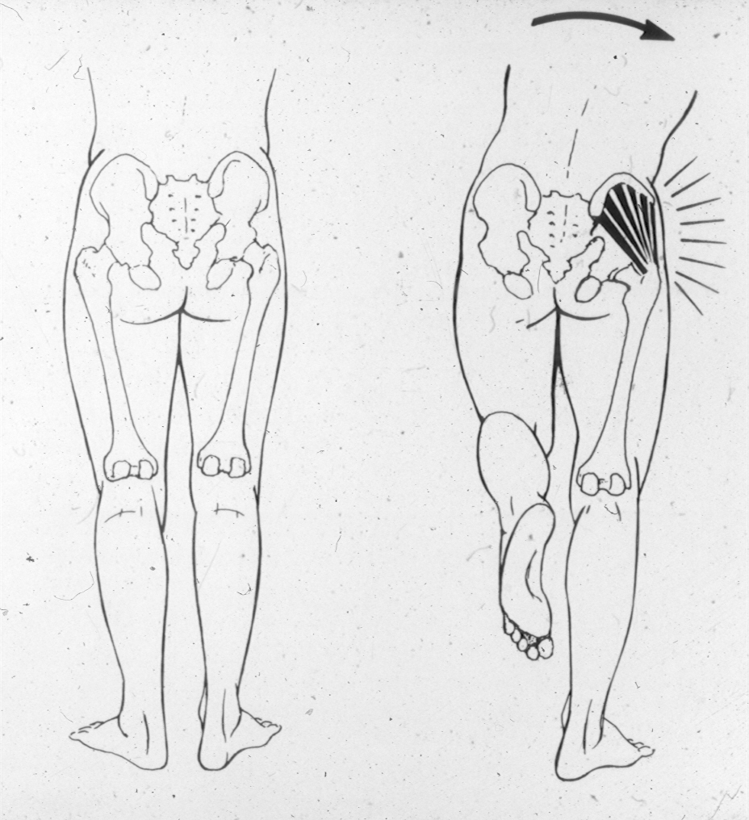

Slide 24
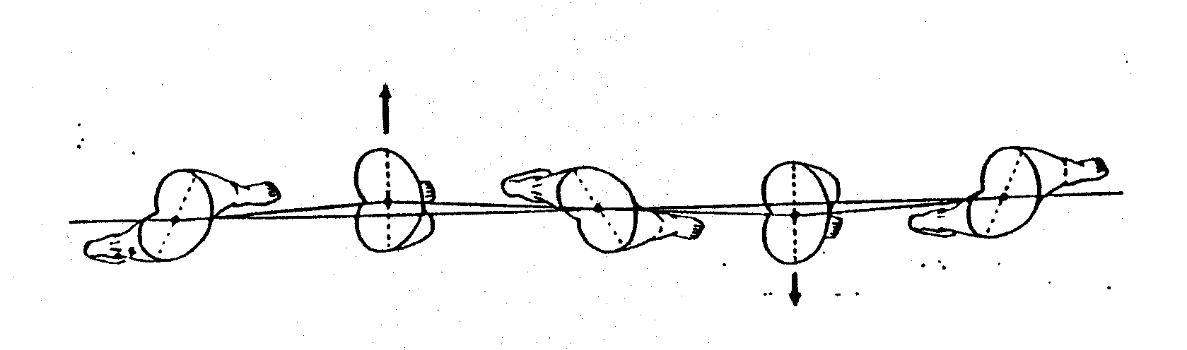
3. Lateral Displacement of Pelvis
Hips move from side to side to keep center
of mass over support limb.

Slide 25
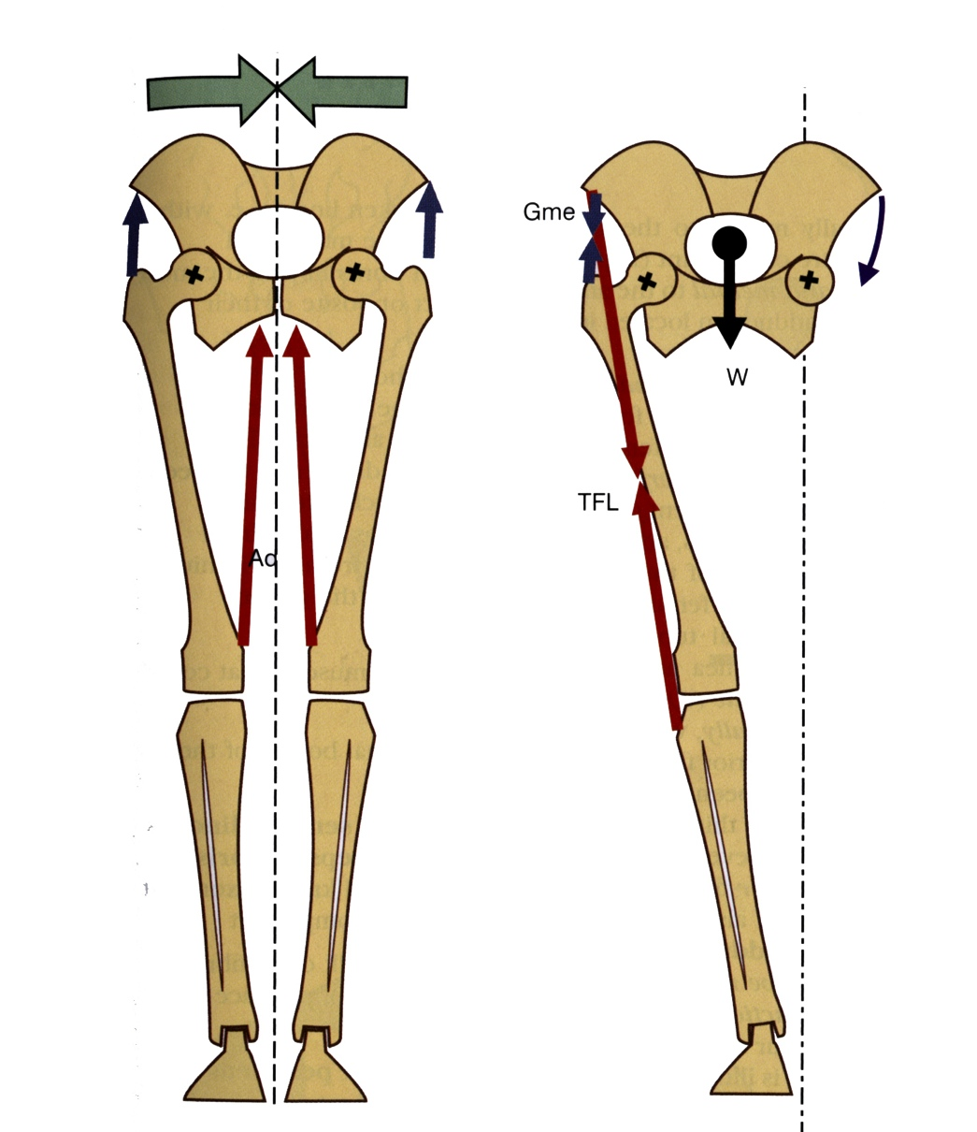
3. Lateral Displacement of Pelvis
Hips move from side to side to keep center
of mass over support limb.

Slide 26
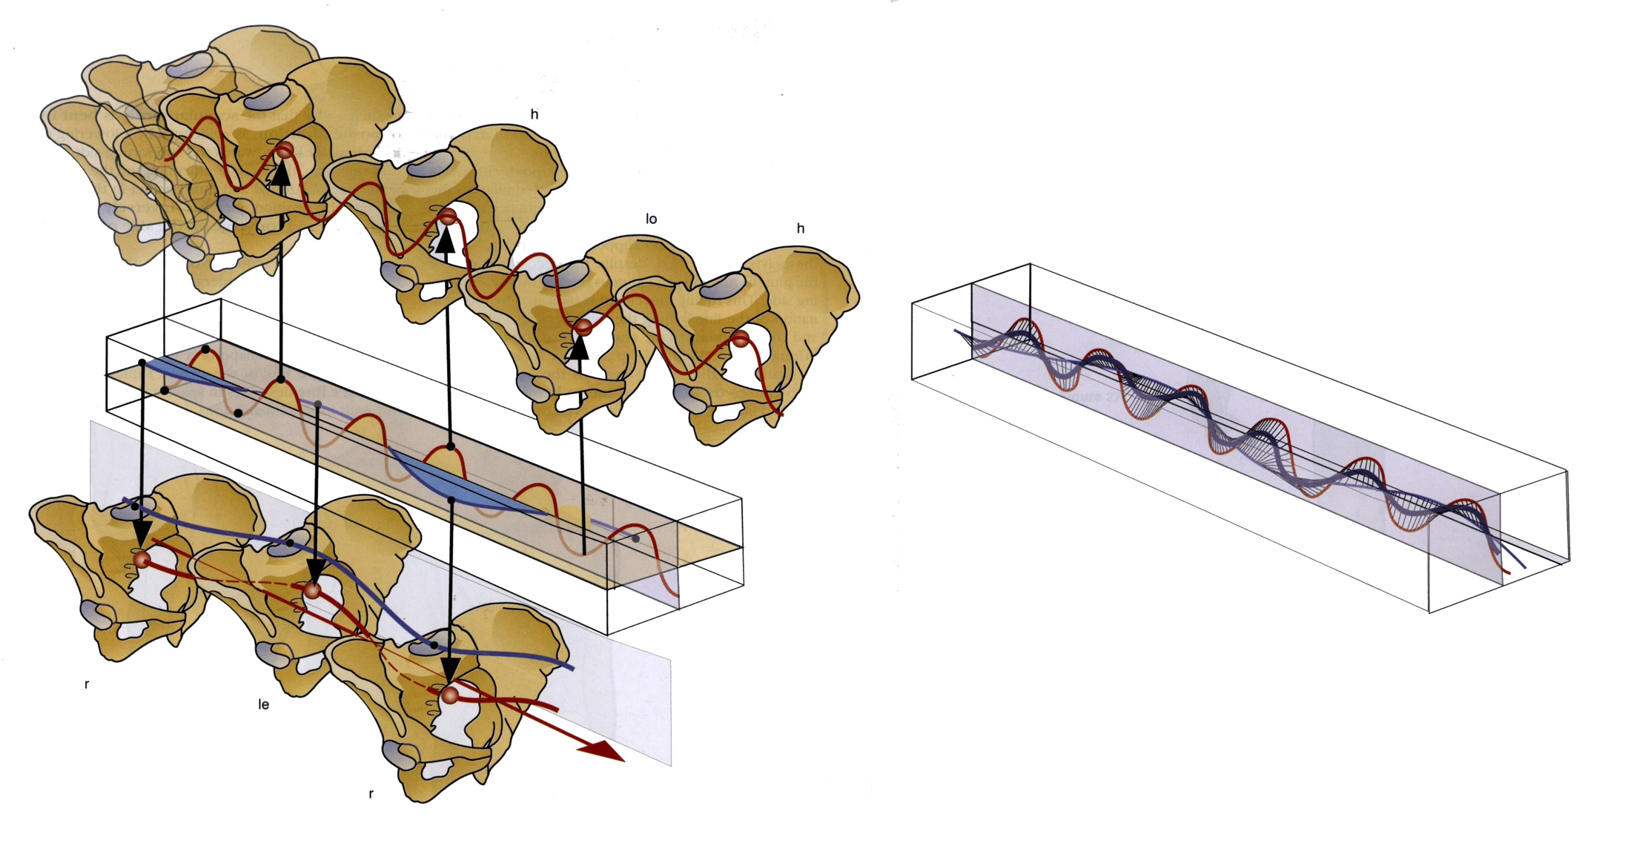
The end result is three major movements of the hip: up/down , side-to-side , and rotatory. Giving it an oscillation like a kayak paddle.

Slide 27
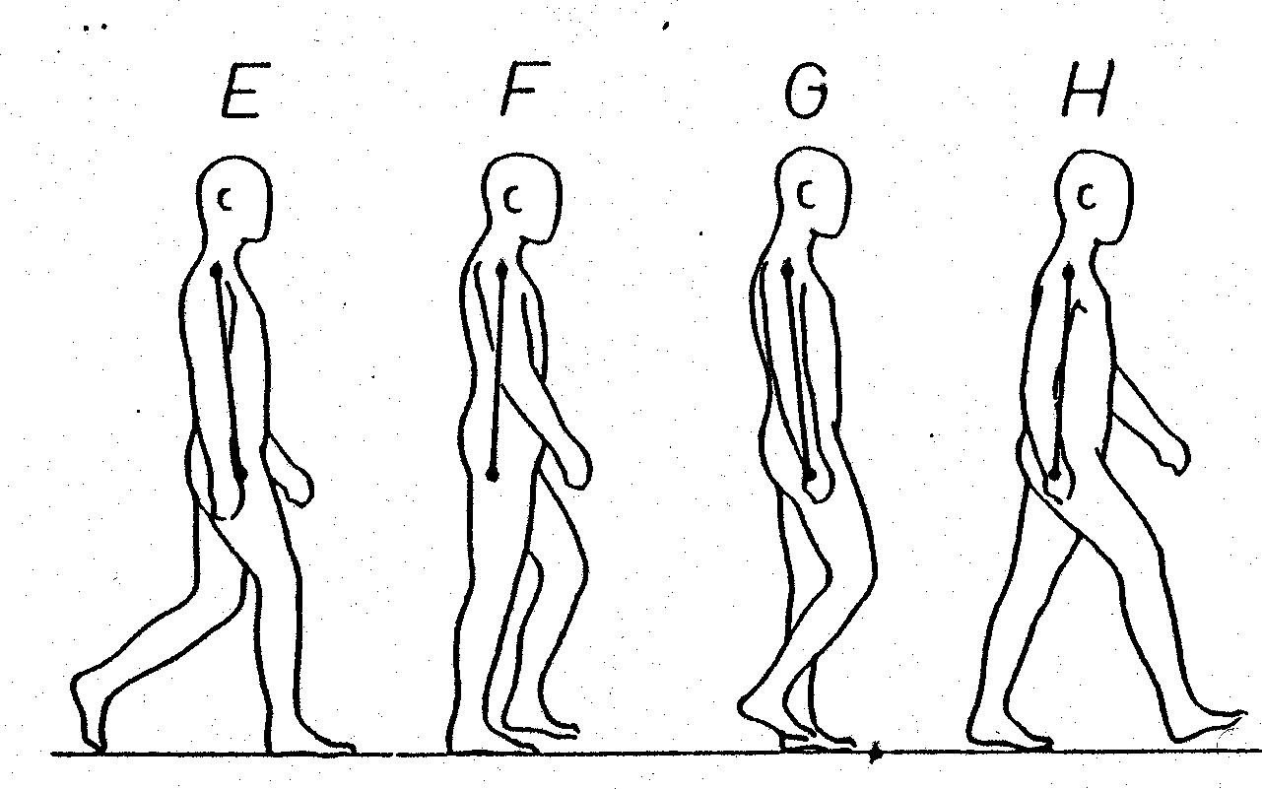
4. Bending of the Knee
Knee bends between
heel-strike and
pushoff.

Slide 28
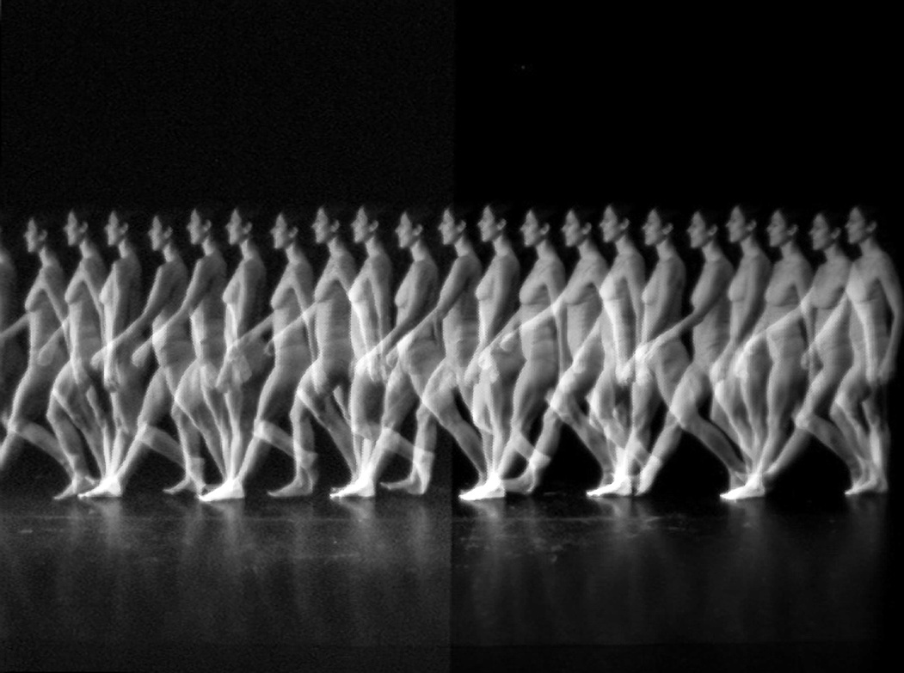

Slide 29
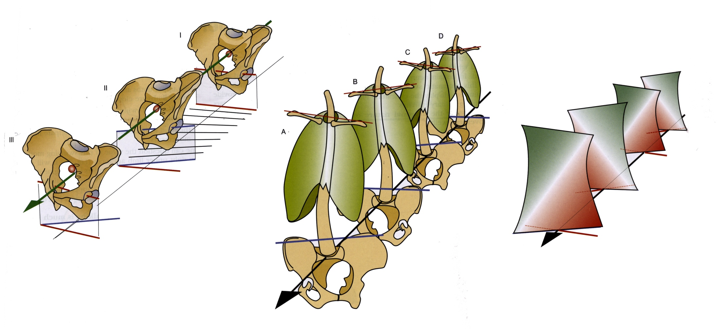
5. Lateral Flexion of Trunk
Trunk flexes laterally and twists slightly to help to keep center of mass over support limb.

Slide 30
6. Antero-posterior Flexion of Trunk
Trunk flexes anteriorly and posteriorly to help keep center of mass over support limb.

Slide 31
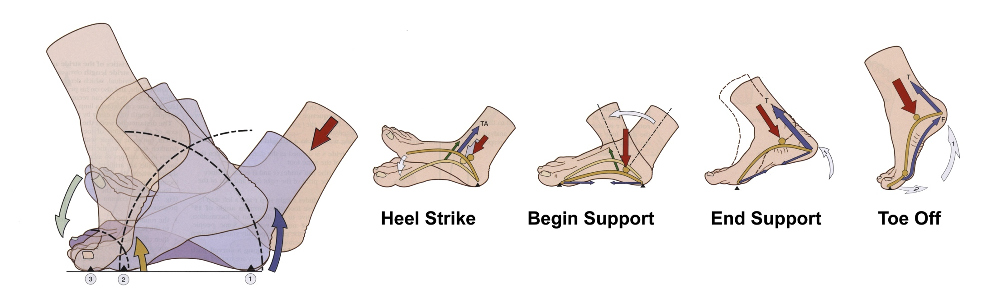
7. Dorsiflexion of Foot
Foot flexes dorsally upon heel strike (with
locked knee).
Catches falling body.

Slide 32
Plantarflexion of Foot - Plantarflexion of foot provides power for toe off.
Compliance of Foot - Flexibility of foot smooths oscillation at other joints.

Slide 33
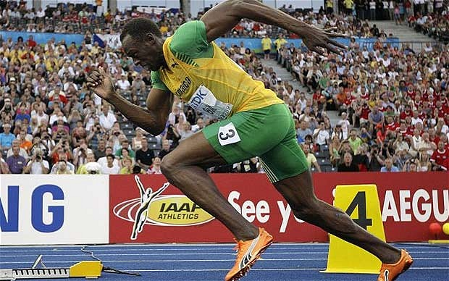
1
2
3
IN HIGH SPEED RUNNING: energy is transferred along a “muscular chain” from (1) gluteals to (2) rectus femoris (quads) to (3) gastrocnemius + soleus (calf).

Slide 34
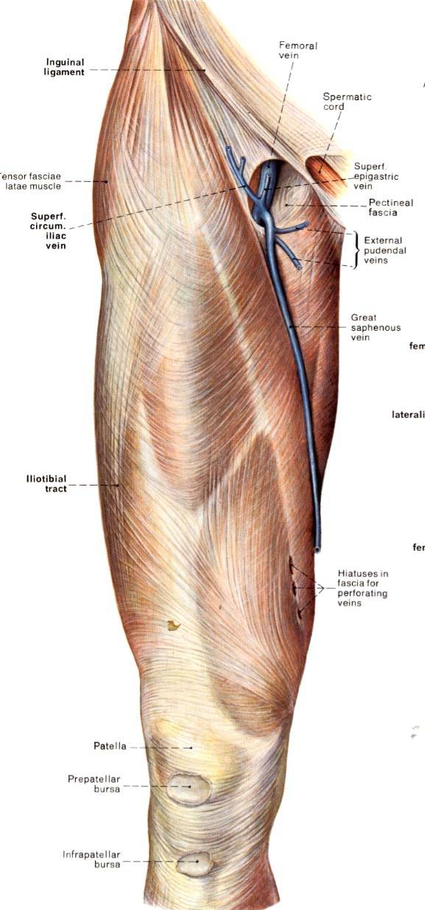
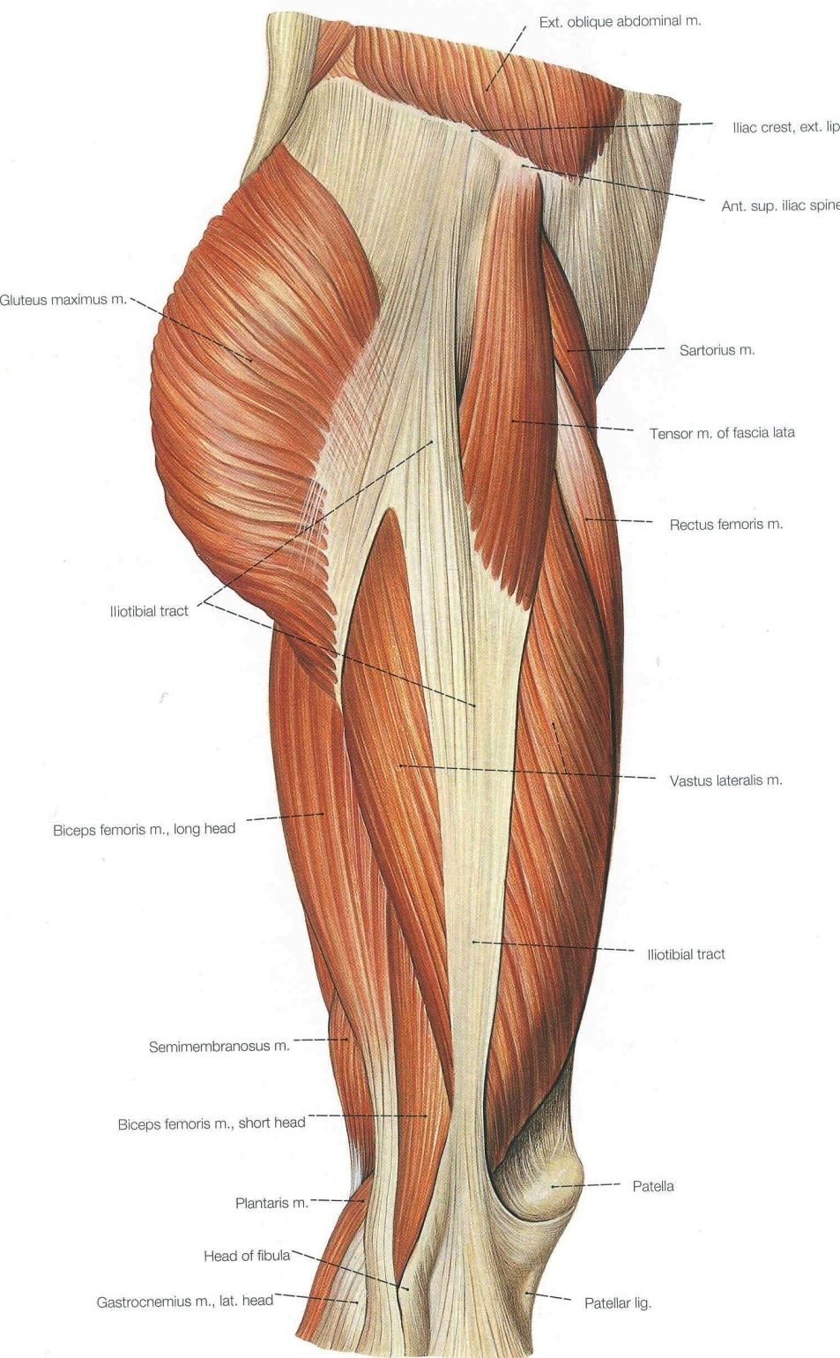

Slide 35
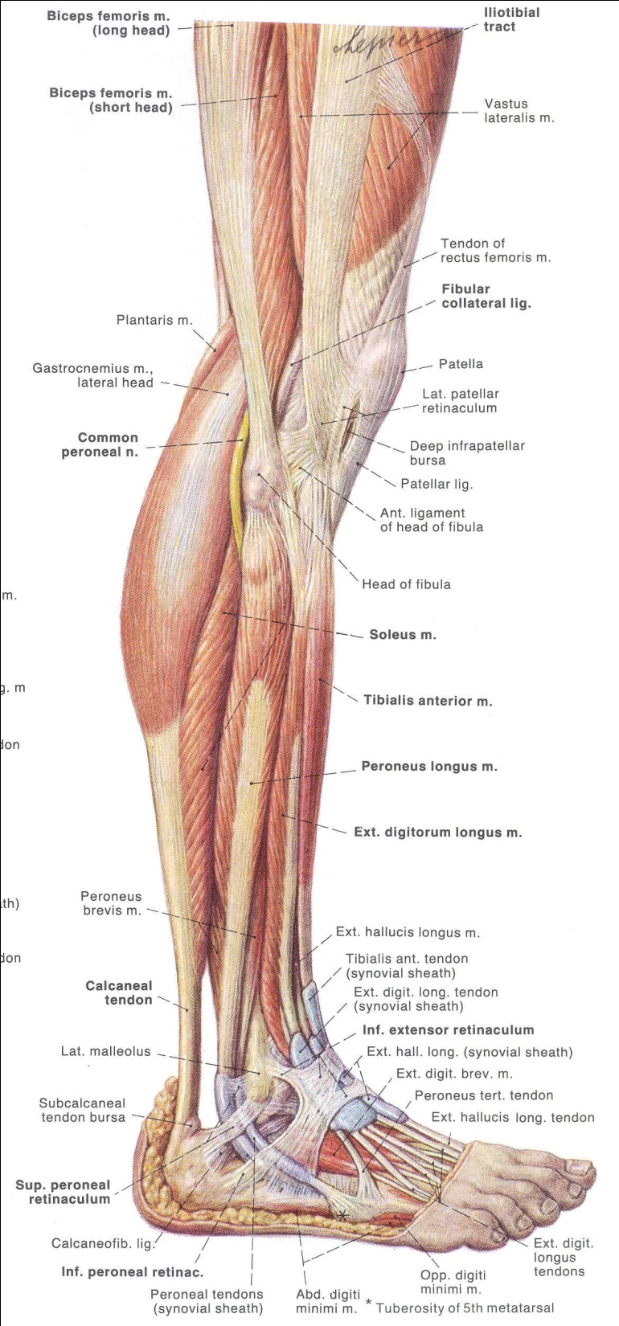

Slide 36
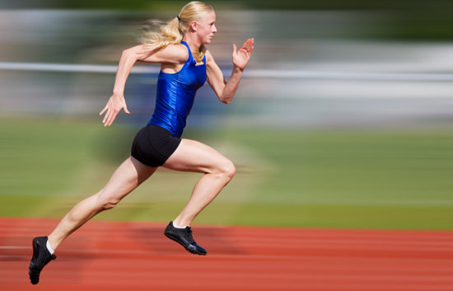
In normal walking, hip muscle barely used – if at all. Hip muscles recruited in running, going up stairs, high speed activity.

Slide 37
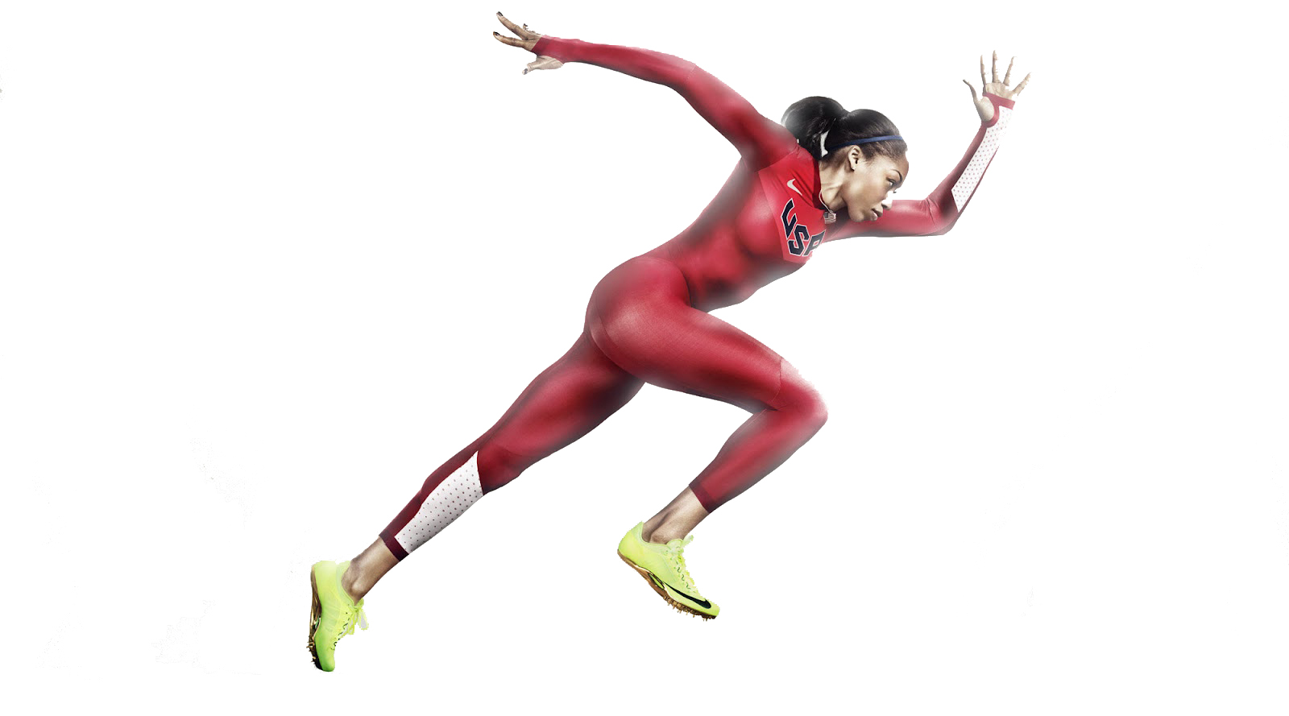
Arms act as counter-balance to leg motion.

Slide 38
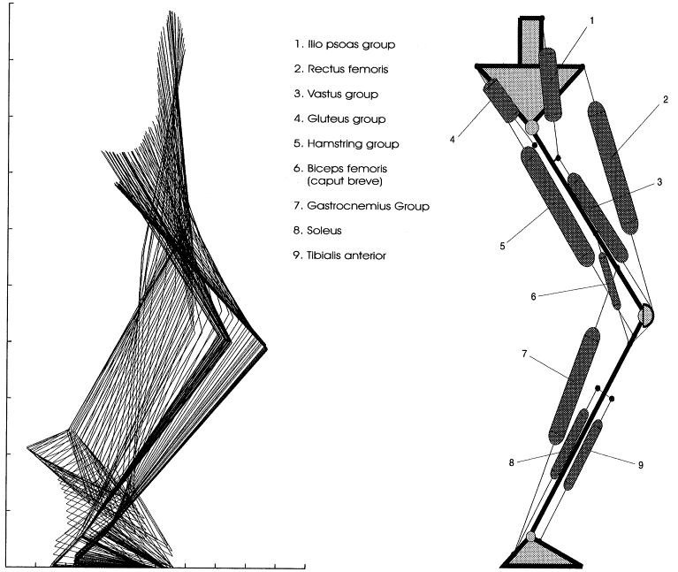
Key groups recruited for jumping

