Slide 1
Dinosaur Physiology
Charles, Aaron and Melvin

Slide 2
A Decades-Long Debate
Endotherms or Ectotherms
Lack of progress → lack of objective researchers
“They behave more like politicians & lawyers, compelled to defend their hypotheses” (Farlow 1990)
Some presume that single characteristics are sufficient to assess a whole physiological complex

Slide 3
Which Came First?
Ectothermy is the primitive condition for amniotes and vertebrates
Endothermy is the derived condition in mammals and birds
  Evolved independently in these lineages (Chinsamy and Hillenius 2004)

Slide 4
Debates on Endothermy Origin
Evolved among nonavian dinosaurs and was inherited by birds
Occurred late in evolution of Dinosaurs and coincided with origin of birds

Slide 5
Scientific Inadequacies
Warm-bloodedness associated with:
  Homeothermy
  Endothermy
  High metabolic rates
Cold-bloodedness:
  Poikilothermy
  Ectothermy
Oversimplifications fail to recognize the complexities of individuals thermal biology
Notes:
A poikilotherm is a organism whose internal temperature varies considerably …or heterothermic
An ectotherm is an organism that controls its body temperature through external means…(ectotherms can be poikilotherms)

Slide 6
Scientific Inadequacies (cont)
Endotherms
  high rates of internal heat production enables them to maintain homeothermy
Ectotherms
  Requires environment to regulate body temp
  Does not mean that they can never attain homeothermy under favorable conditions
Notes:
poikilotherms

Slide 7
Gigantothermy (Paladino, 1997)
Speculated that thermal inertia would increase with increasing body size
Deduced that by mere fact of dinosaurs giants body sizes, they could easily have been homeothermic
Extant vertebrate studies support that thermal profiles of endotherms and ectotherms can converge under certain circumstances.
Notes:
Speculated, and Deduced Large ectotherms have high thermal inertia → small SA:Volume reduces heat loss

Slide 8
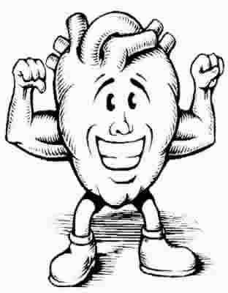
Aerobic Capacities
Endotherms metabolic rate ~10-15 > than that of ectoderms of equal mass & temperature.
  Fully separated pulmonary & systemic circulations
  Increased oxygen-carrying capacities
  Specialized lungs
  Increase blood volumes
  Increased mitochondrial density
  Increased enzymatic activity
Notes:
Definition: capacity for sustained oxidative metabolism

Slide 9
Consequences of Thermal Biology
Affect virtually every aspect of an animal’s biology.
Tachymetabolic endothermy imparts a high rate of metabolism to an animal manifested by:
  Rapid growth rates
  High aerobic capacity
  Sustained activity
Unfortunately, these modifications to support high levels of aerobic metabolism is not in fossil record.
Thus, the speculation, controversy and long heated debate on dinosaur physiology
Notes:
Which is manifested by

Slide 10
Early Thoughts on Dinosaurs
19th century
  “Oversized” reptiles-sluggish, dim-witted and cold-blooded creatures
Latter 19th century
  Thomas Huxley
  Recognized similarities between the earliest bird, Archaeopteryx, and small theropods.
  Possibility for a more advanced physiology
1970s
  John Ostrom revived Huxley’s proposal of birds and dinosaurs being related.

Slide 11
Renaissance of Dinosaur Perception
Bob Bakker ideas of John Ostrom
  Birds and dinosaurs being related
  Charismatic style & ability to convey his ideas
  Various methods of deduction
    Bone microstructure
  Concept of dinosaurs as dynamic endotherms
    Active endothermic animal models persists

Slide 12
Understanding Physiology
Anatomy, Ecology and Phylogeny
Locomotory apparatus & Biomechanical energetics
Predator/Prey ratios
Brain size
Social behavior
Bird origins
Bone histology
Nasal turbinates
Lung structure and ventilation rates
Oxygen isotopes

Slide 13
Bone Microstructure
Several studies (1907-1960s) concluded:
  High levels of vascularization
  Predominantly fibrolamellar bone
  Occurrence of Haversian Bone similar to that of large mammals

Slide 14
Ricqles (1974,’76,’80)
Strongly influential in his similarity finding between dinosaur and mammal bone.
Advocated bone histology for interpreting thermal biology of extinct animals.
Considered azonal dinosaur bone as important for deducing physiological attributes
Initially: indicative of high rates of sustained growth & high MR → suggesting endothermy
Notes:
Histological characteristics

Slide 15
The Opposition
Robin Reid (1980s)
  First to oppose Ricqles & Bakker
  “There is no distinctive characteristic of bone in endotherms or ectotherms to indicate thermal physiology and metabolic rates”
  Advocated limitations of using bone microstructure solely to make physiological deductions
  Within limitations, reasonable inferences could be made from dinosaur bones.
Notes:
However, he recognized that within limitations

Slide 16
Reid’s Proposals
  Dinosaurs were “failed endotherms”
    Made some progress towards endothermy over typical ectotherms, but not to the same level as extant endotherms.
    Dinosaurs “rely” on gigantothermy…lol
  Dinosaurs did not all grow in rapid sustained rates like extant endotherms:
    The abundance of fibrolamellar bone simply implies capacity for rapid growth
    Zonal bone implied that some dinosaurs grew in a cyclical, fluctuating manner
Notes:
Chimsamy agrees that fibrolamellar bone is indicative of bone deposited at a rapid rate, but agrees with Reid that this is not indicative of High metabolic rates or endothermy

Slide 17
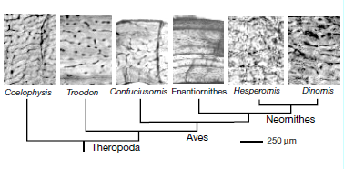
Padian, Ricqles & Horner (1992)
“CYOA”
Notes:
1992, Ricqles
Highly vascularized, Fibrolamellar bone indicates fast grow (more similar to birds than crocs)
Basal birds histology nearly avascular and non-fibrolamellar
Lack of LAGs (more similar endotherms-birds)
However, some endotherms found to have lines of arrested growth too as observed in crocs

Slide 18
Chinsamy “In Context”
Bone microstructure directly indicates how bone formed during growth (Reid-how it can)
Bone microstructure provides indications of the factors that may have affected its growth
Deductions made about physiology are speculative and must be recognized as such.
Notes:
(i.e. seasonality, ontogenetic age, lifestyle adaptations)

Slide 19
Fibrolamellar Bone & High Vascularity
Typically occurs in bones of mammals & birds
  Initially, Ricqles inferred rapid growth & high metabolic rates
  Bakker used this to infer endothermy
Chinsamy: their deductions failed to consider the range of animals that produce highly vascularized fibrolamellar bone

Slide 20
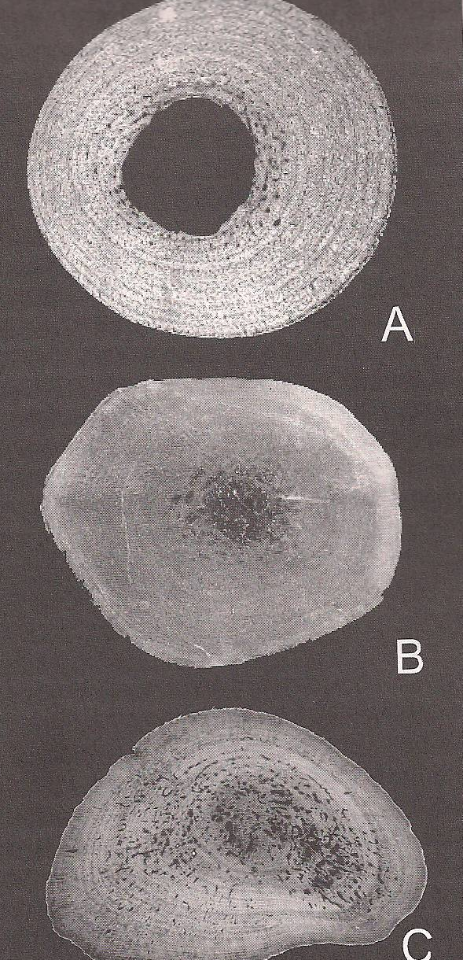
Range of Zonal Fibrolamellar Bone
Enlow & Brown (1957)
  Pelycosaurs & captohinids
Enlow (1969)
  Nile crocodile
Riclqes (1972)
  Non-mammalian synapsids
Gross (1934)
  Dicynodontians
Chinsamy & Rubidge (1993)
  Dicynodonts
Botha (2001)
  Non-mammalian cynodonts
Ray (2004)
  Scylocops
Alligator
(femur)
Crocodile
(fumer)
Turtle
(scapula)
Fig 7.1 Images courtesy of Robin Reid
Notes:
Synapsids (mammalian like reptiles or proto-mammals)

Slide 21
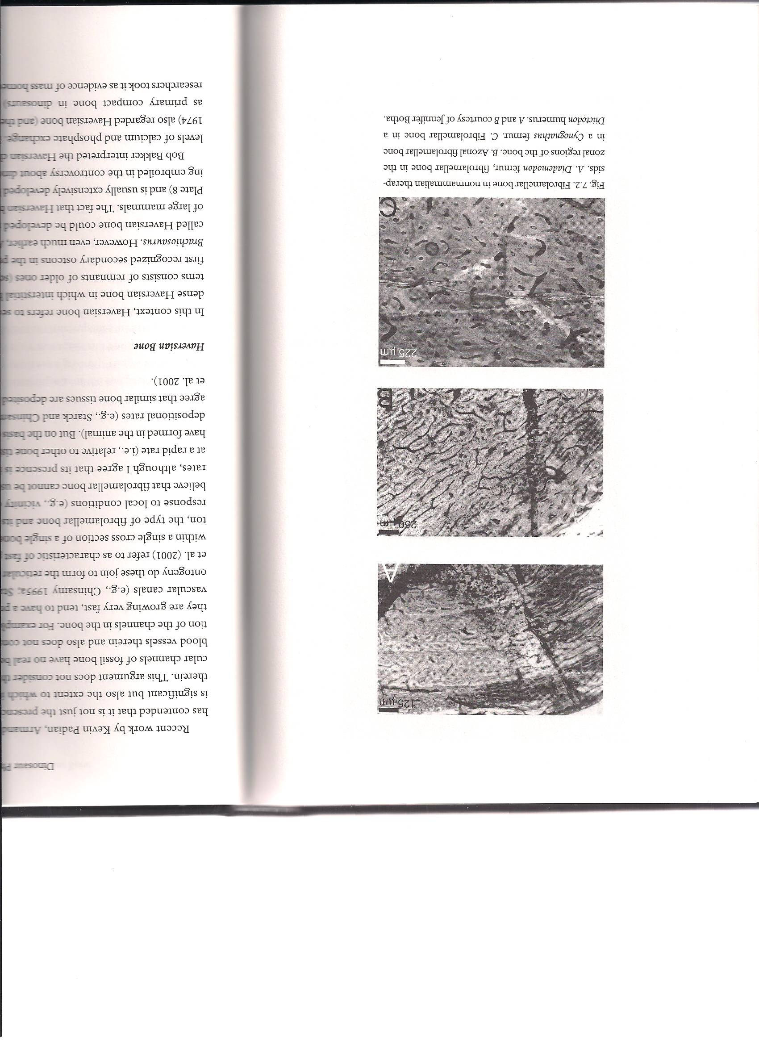
Non-mammalian cynodonts
Botha & Chinsamy (2000)
  Diademodon & Cynognathus display different growth strategies
  Reptiles
    Fibrolamellar bone is not restricted to nonavian dinosaurs, mammals & birds
    Ability to form this bone tissue is not linked to high metabolic rates or endothermy.
Diademodon
Zonal Growth
Cynognathus
Azonal Growth
Diictodon
Azonal Growth
Fig 7.2 A & B Courtesy of Jennifer Botha

Slide 22
Padian, Ricqles & Hornor (2001)
Extended the prior argument
Its not just the presence of fibrolamellar bone in dinosaurs that is significant, but the extent to which it occurs and the type of vascularization therein.
  Chinsamy argues:
    Size & shape of vascular channels have no bearing on actual size & shape of blood vessels
    They do not consider ontogenetic changes in orientation of the channels in the bone
Notes:
Bird hatchlings: vascular canals are predominantly oriented longitudinally initially but later in ontogeny they become more reticular and circumferential in orientation.

Slide 23
Haversian Bone
Important in dinosaur thermal biology controversy
Common in dinosaurs
Typically extensively developed
Various hypotheses:
  Bakker: high levels of Ca and P exchange
  Ricqles: endothermy
  Crompton: mechanical strain on bone
  Other researchers: mass homeothermy

Slide 24
Haversian Bone Today
NOT related to high standard metabolic rates
NOT present in small birds & mammals (highest metabolic rates)
NOT restricted to endotherms
  Extensively developed in reptiles
  Tortoise (Reid,1987)
Shown to be associated with various non-thermal factors
  Muscle attachment, remodeling, increases with age
Experimental studies of Alligators farmed at 23.5˚ and 27.0˚
  Showed increase in amount of Haversian bone as compared to wild forms of similar sizes
  Large dinosaurs could have similar effects.

Slide 25
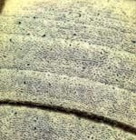
Zonal Bone
Typical of ectothermic vertebrates
NOT typical in extant mammal and birds
  Deposit fibrolamellar bone continuously
  However, documented in several marine mammals, hibernators and those that exposed to bouts of periodic cold (Ch. 3)
    Polar Bear (Chinsamy)
    Kangaroo (Leahy, 1991)
    Elk (Horner, 1999)
    Appear to be the exceptions

Slide 26
What about Dinosaurs?
Able to form both azonal and zonal bone.
Reid: simply means some dinosaurs were unable to grow at a sustained rapid rate
However, studies on ontogenetic series of dinosaurs consistently show that growth rings increase w/ age
  Used to interpret rapid rate of bone formation
  Used to obtain age estimates for several dinosaurs
Notes:
Skelotochronolists have applied this

Slide 27
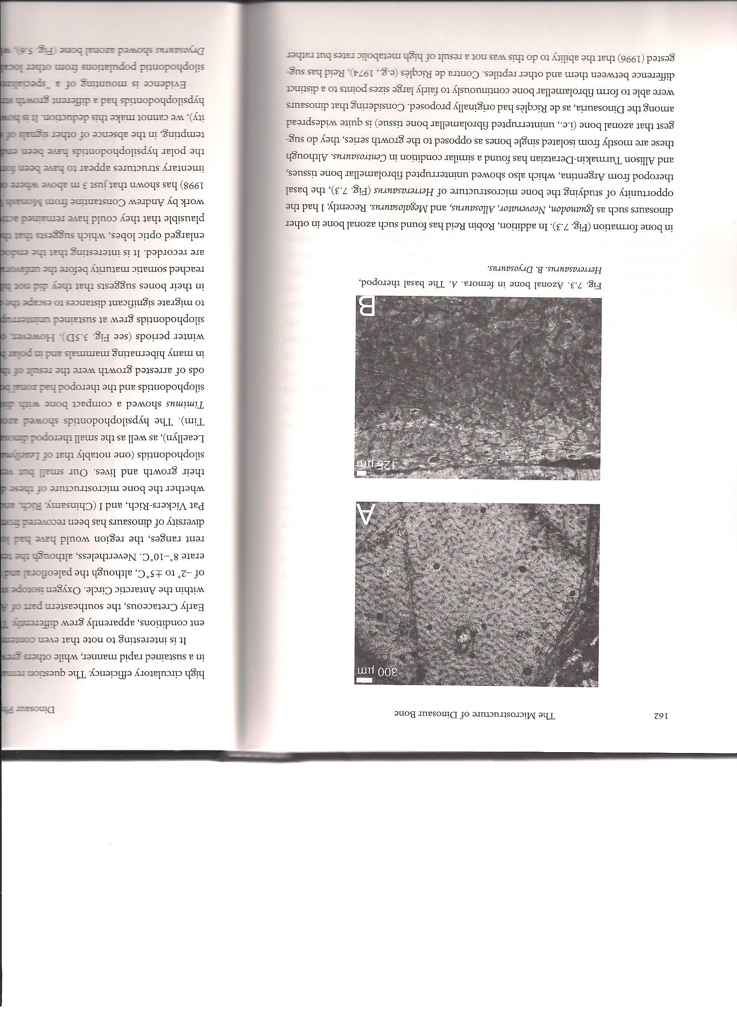
Azonal Bone in Dinosaurs
Iguanodon, Neoventor, Allosaurus, Megalosaurus
Isolated single bones
Suggests azonal bone is widespread in Dinosaurs
Illustrates distinct difference in dinosaurs & reptiles
Dryosaurus
Herrerasaurus
(Basal theropod)
Fig 7.3 Chinsamy
Notes:
But why did some dinosaurs grow in a sustained manner while others grew in a punctuated, periodic manner?
Reid said that ability to form azonal bone growth is due to “high circulatory efficiency”

Slide 28
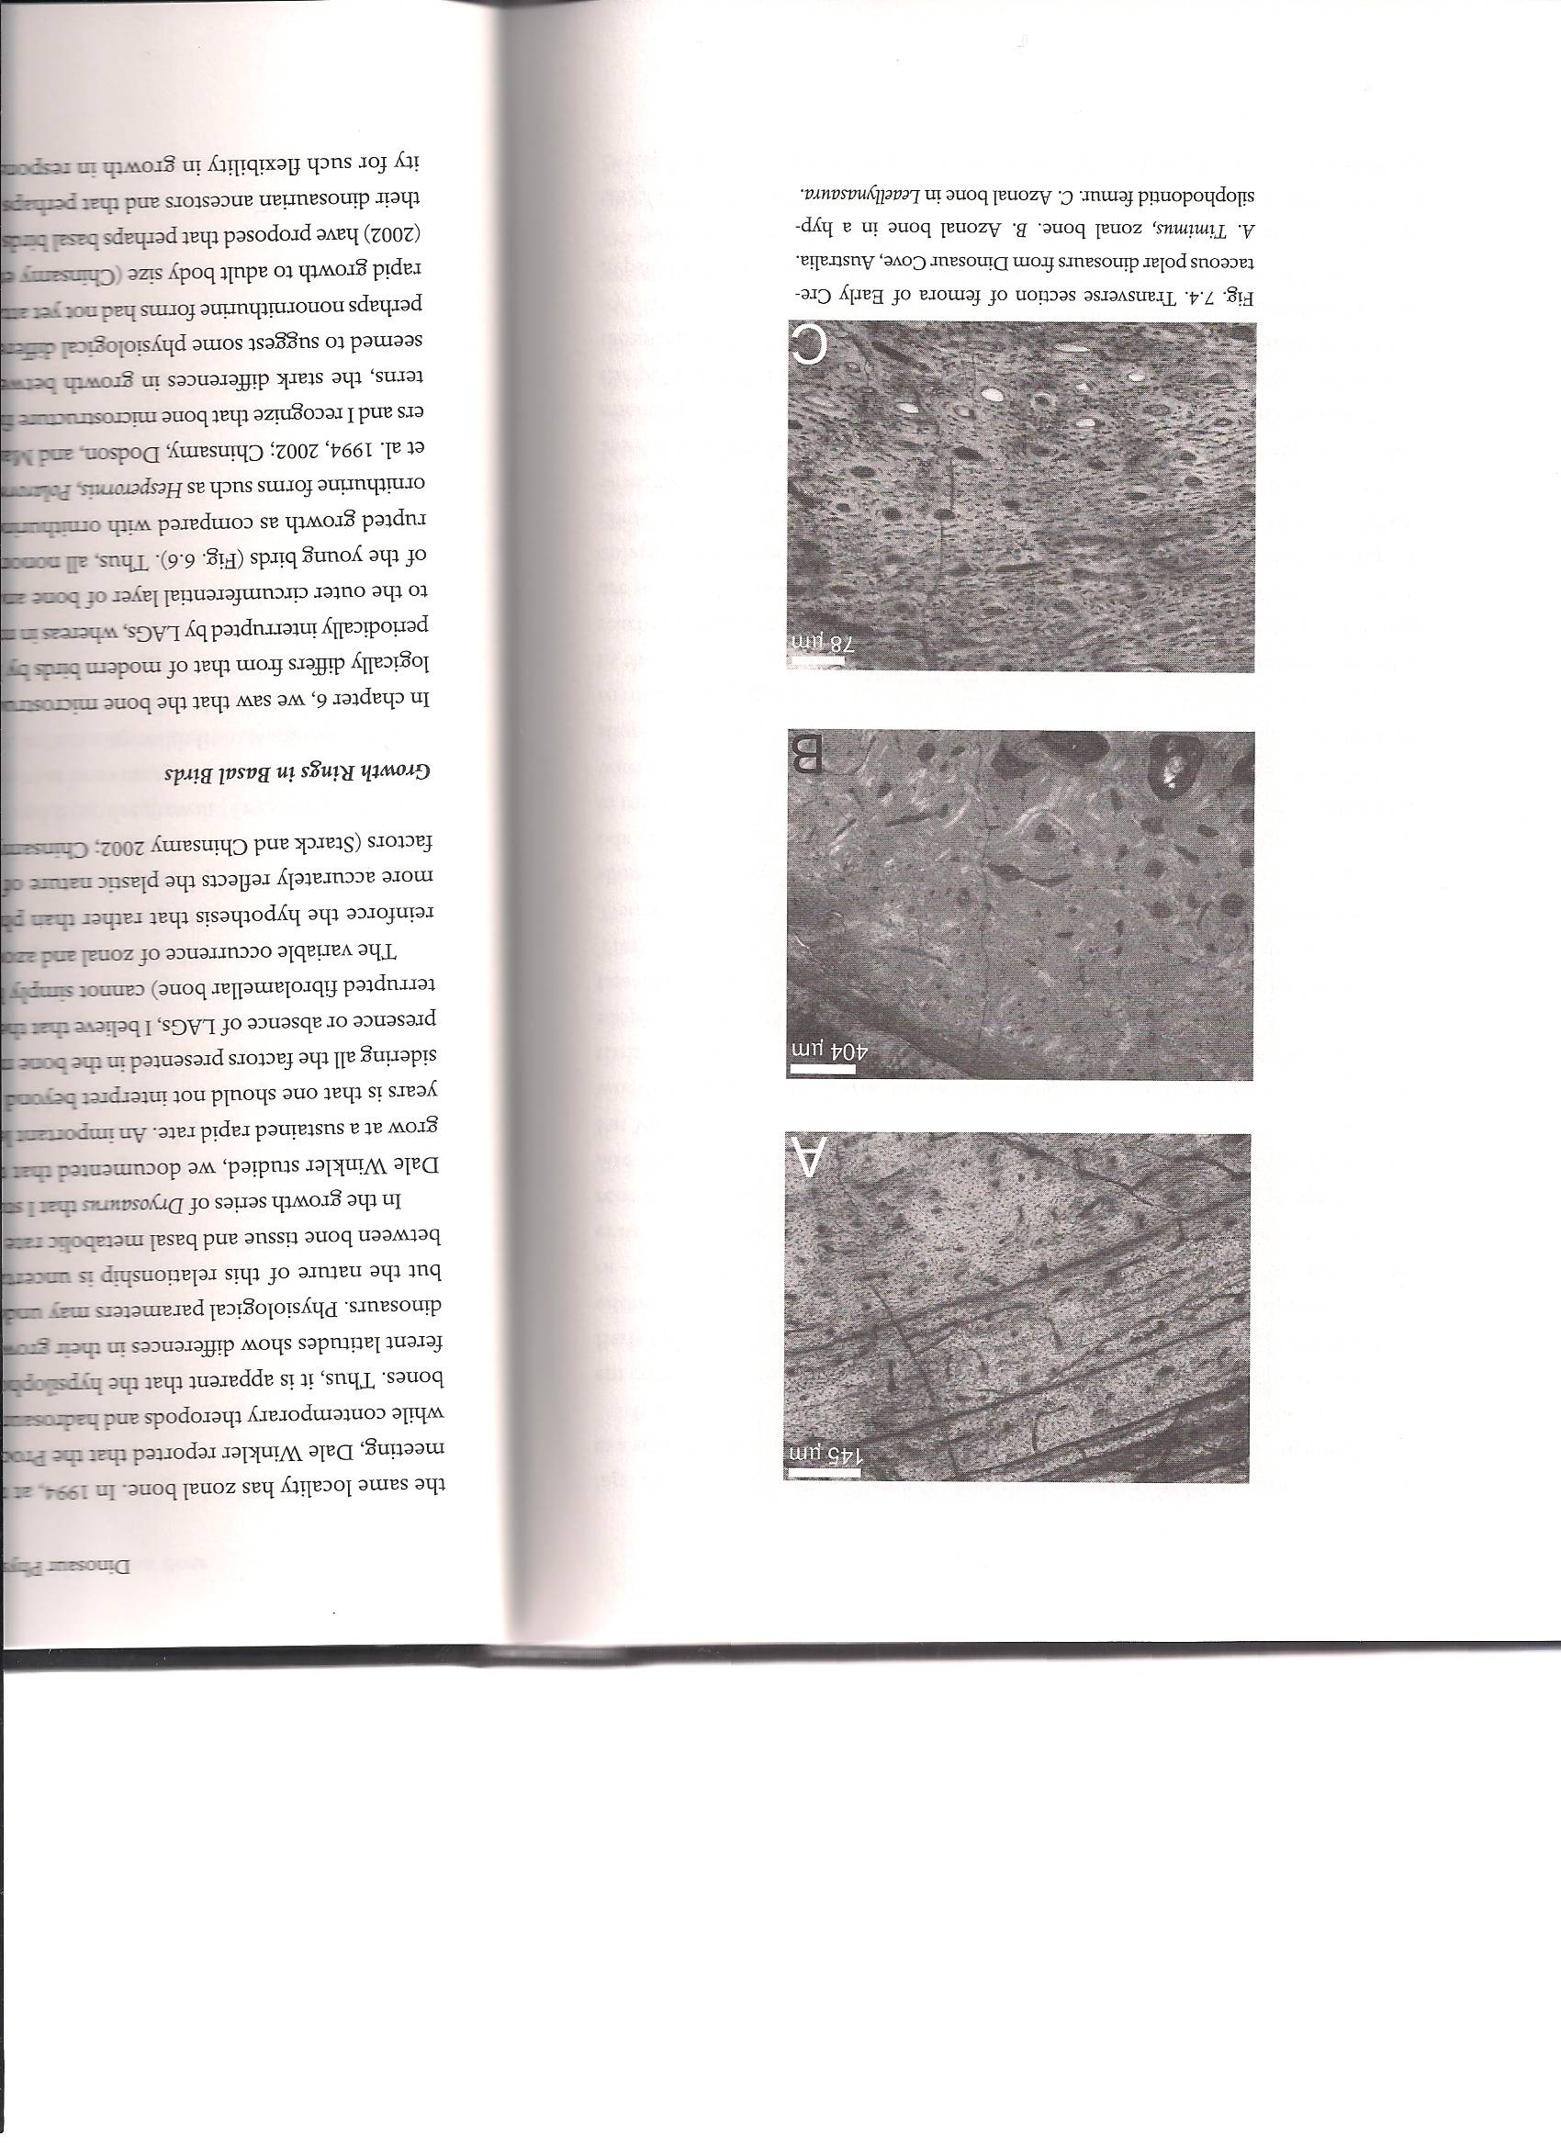
High-Latitude Study
Timimus
(theropod)
2 Hypsilophodontids & 1 theropod recovered
Hypsilophodontids showed azonal bone & Timimus zonal
Lots of possibilities suggested
Data only supports that the polar Hypsilophodontids had a different growth strategy to Timimus.
Hypsilophodontid
#1
Leaellynasaura
#2
Fig 7.4 Chinsamy, Rich, Vickers-Rich 1998
Notes:
If all 3 would have shown LAGs they could have reasoned that the LAGs were the result of long unfavorable season (like with polar bears and hibernating animals
Absence of growth rings in hypsilophodontids:
To small to migrate great distances to escape the cold winters, and did not hibernate
Reached somatic maturity before the unfavorable season, and therefore, no growth rings were recorded.
Endocast of the brain of Leaellynasaura shows enlarged optic lobes… suggests that they had enhanced vision, making it possible (not plausible) that they could have remained active during the dark polar winters.

Slide 29
“Specialized” Growth Strategy?
Other Hypsilophodontid populations showed different growth biology
Dryosaurus (Chinsamy, 1995)
  Growth series also showed azonal growth
Contemporary Kentrosaurus
  Zonal growth
  From same locality
Reinforces plasticity nature of bone & its response to environmental factors
There is no causal connection between bone tissue & MR

Slide 30
Growth Rings in Basal Birds
All basal birds bone growth is periodically interrupted by LAGs
Modern birds typically do not have usual interruption of rapid growth
  LAGs are restricted to outer circumferential layer

Slide 31
So why the difference?
Chinsamy and Starck
  Suggest physiological differences
    Basal forms didn’t attain classic endothermy to sustain rapid growth.
    Basal forms inherited flexible growth strategy from dinosaur ancestors, but lost it to selective pressure for rapid growth
    Could be explained by large island birds
      w/o strong pressure to grow rapidly retain flexible growth strategy

Slide 32
Growth Plates In Dinosaurs
Barreto (1993)
  Lizard, 8-10 month dog, 2 wk chick & hatchling Maisaura.
  Maisaura juveniles were similar to birds in their chondro-osseous junction.
  “Reasoning” that dinosaurs, like birds, experienced determinate rapid growth due to endothermy.
  Experimental design flawed
Horner (2001)
  Presence of “indistinctive” cartilage canals
  Found in mammals, birds and lizards
Notes:
comparing individuals at different stages of ontogeny

Slide 33
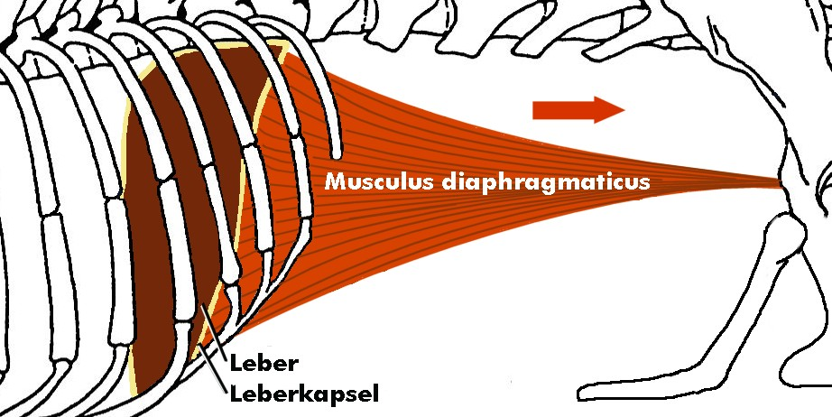
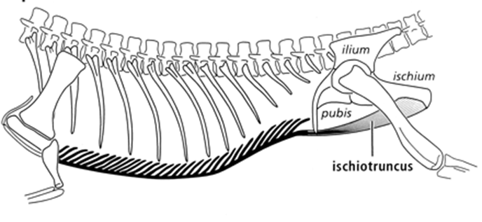
Dinosaur Lungs & Ventilation
No preserved like most soft tissue
Crocs and birds both have septate lungs
  Single oversized mammalian alveolus
  Bit more specialized in birds
Crocs: hepatic-piston ventilatory mechanism
Notes:
Nonmuscular connective tissue that adheres to the cranial surface of the liver
Longitudinal muscles that extends between between the liver, pubic bones and caudal gastrailia
Muscles contract→ pull on liver like a piston→ pulls on connective tissue→ displaces diaphragm and liver

Slide 34

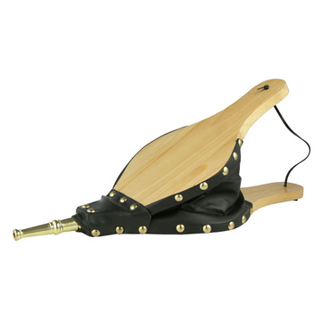
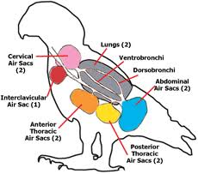
Birds: no diaphragm; use costal ventilation and air sacs (bellows)
Reptiles: diaphragm & costal ventilation

Slide 35
Support for Reptile-Like System
John Ruben (1996)
  Separation of pleurocardial & abdonimal cavity in Sinosaruopteryx and Scipionyx
    Suggestive of a diaphragm
  Presence of longitudinal muscle on the pubic in same relative position as in crocs
    Hepatic-piston ventilation mechanism
Conceivable that more data will show that their lungs were evolving toward the conditions in birds

Slide 36
Nasal Turbinates
Olfactory & respiratory turbinates occur in nasal cavity
Respiratory turbinates
  Anterior part
  Absorb moisture & heat from expiratory air
Ruben and colleagues
  Good indicator of routine ventilatory rates
Notes:
Respiratory turbinates: mammals and birds

Slide 37
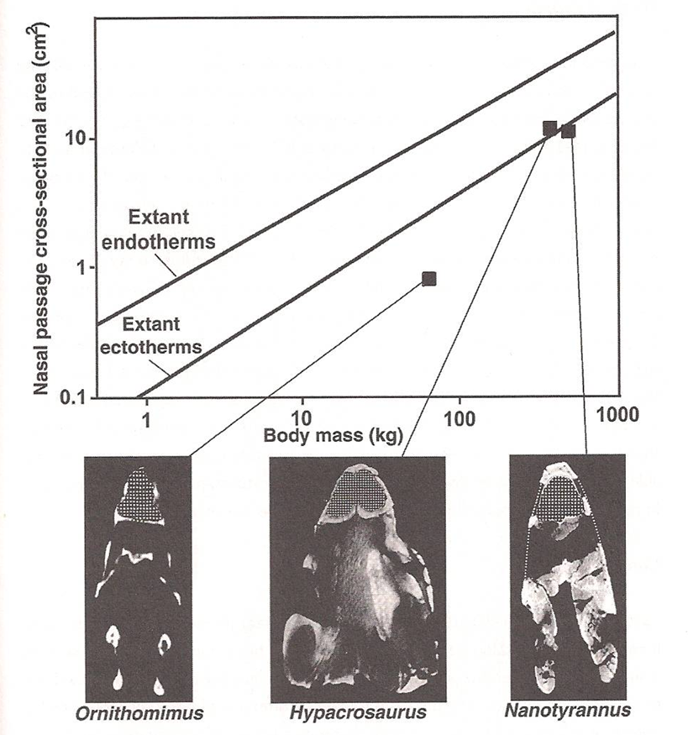
Nasal Turbinates
Bakker
  Found “resp. turbinates” in Nanotyrannus
Ruben (1997)
  CT scan skull
  No resp turbinates
  Bakker may have found nasal turbinates
  Posterior part of nasal cavity near olf region
Nasal cavities long & narrow
Absence of nasal turbinates
Notes:
Fell close to ectotherm curve
Absence of nasal turbs and presence of resp turb suggests that at least some dinosaurs had a comparatively low rate of ventilation-more ectotherm like
Cannot suggest with certainty

Slide 38
Crestaceous Ornithurine Birds
Enlarged nasal chambers (extant birds)
Ruben & Hillenius (2004)
  Suggest resp turbinates & MRs close to modern birds
  Hinged thoracic & sternal ribs
  Transversely expanded sternocostal joints as in ribcage of modern birds.
    Not present in nonornithurine birds or nonavian dinosaurs
  Endotherm, & associated high MR, evolved late in Ornithurae
Notes:
Similar specialized ventilator mechanisms

Slide 39
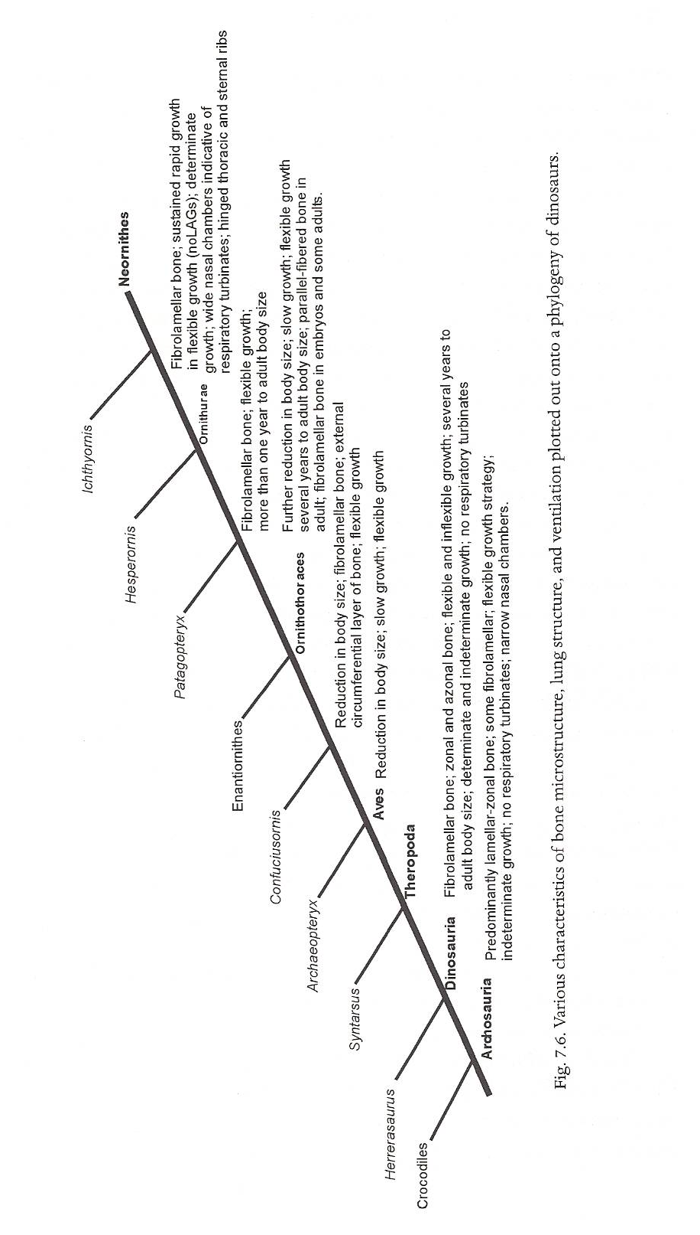

Slide 40
Conclusions
Given their large size, the proposed model of gigantothermy, no special adaptation may have been necessary to attain homeothermy
Bone growth is dependent on a number of factors & bone tissue types cannot be easily linked to metabolic rates and physiology
Fibrolamellar bone seems to be widespread among vertebrates & its presence cannot be take to signal high metabolic rates & endothermy
Haversian Bone and Zonal bone are widespread too
Notes:
Lines of evidence used to ascertain dinosaur physiology is not straight forward

Slide 41
Conclusions
With regards to Mesozoic birds, appears that:
  Ornithurine birds are able to grow at sustained, rapid uninterrupted rates
  Nonornithurine birds studied appear to have interrupted rates of growth & grew more slowly than their modern relatives
Ornithurine birds have skeletal evidence of a ventilatory mechanism as in extant birds, wide nasal development that suggests endothermy
In the evolution of Archosauria, there appears to be an increasing trend toward faster growth

Slide 42
Question
Why is it difficult to determine the thermal physiology of dinosaurs even using their closest living relatives, crocodiles and birds, as model organisms? Be sure support your answer using examples found in bone microstructure (i.e. fibrolamellar bone, Haversian bone, zonal and azonal bone, growth rings and turbinates).

