Slide 1
Dinosaur Bones Discovered
Chapter 2
Notes:
done

Slide 2
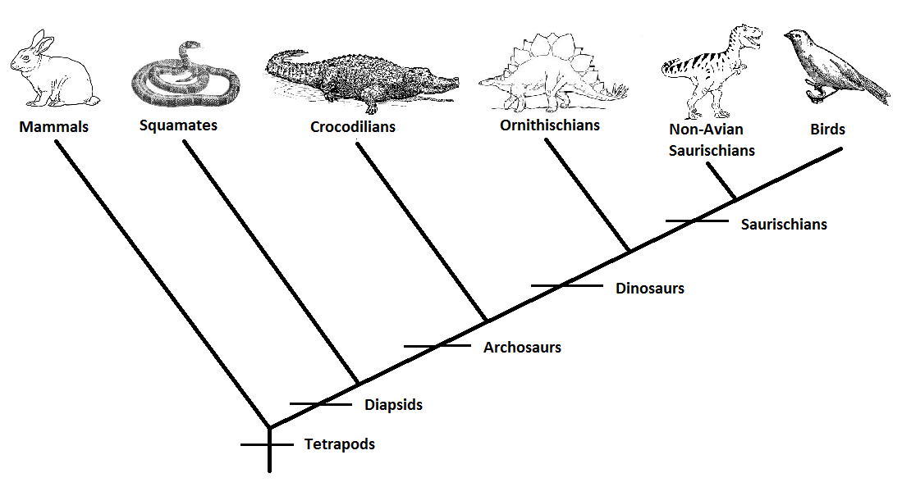
Notes:
done

Slide 3
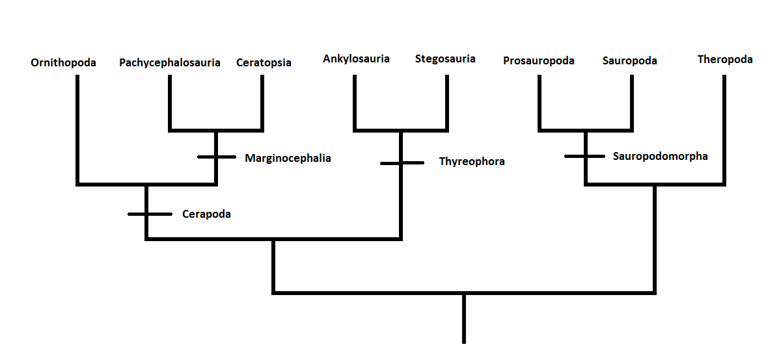
Notes:
done

Slide 4
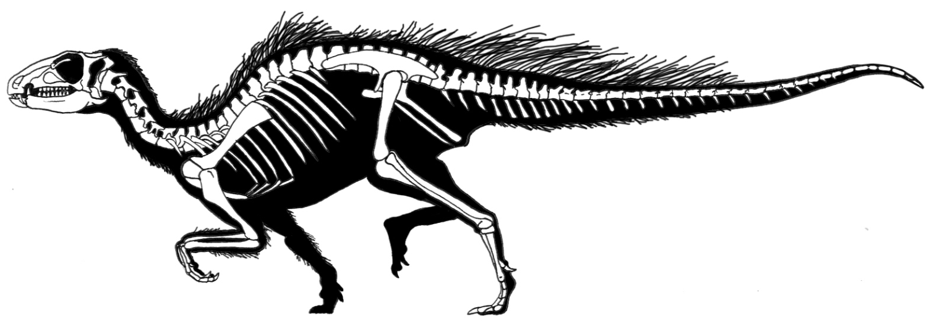
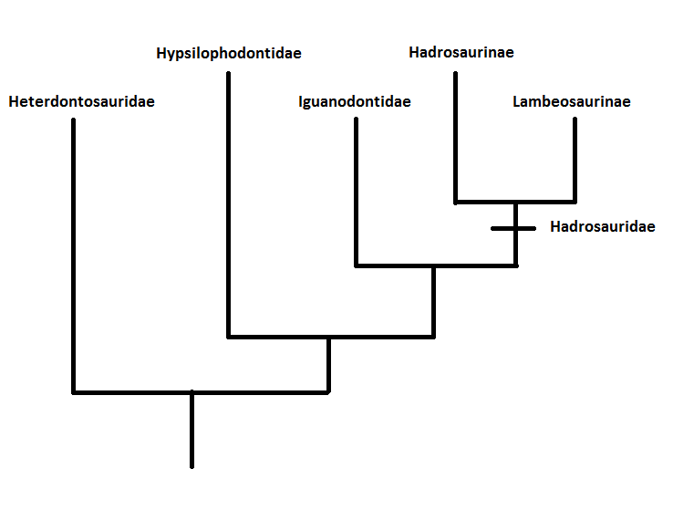
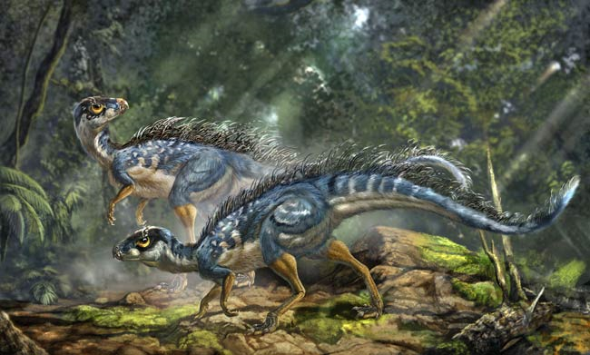
Notes:
Pictures; smallest, earliest (Triassic); bipedal; teeth

Slide 5
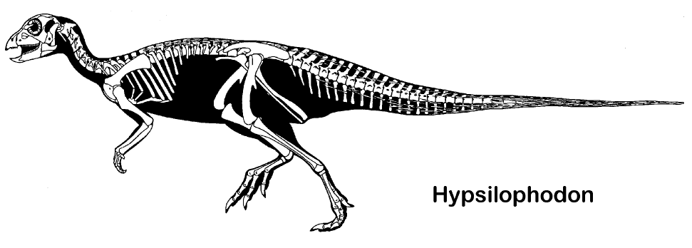
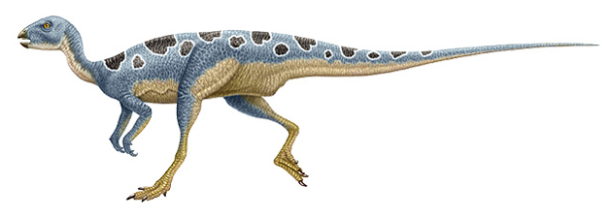
Notes:
Pictures; small, bipedal, herbivorous, paraphyletic; mid Jurassic-late Cretaceous

Slide 6
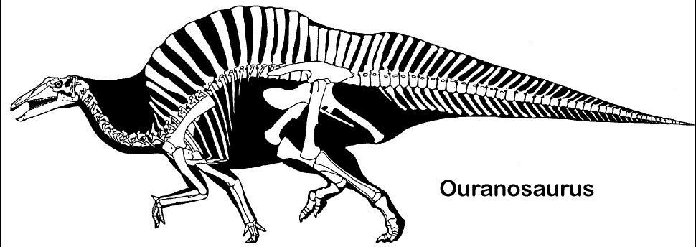
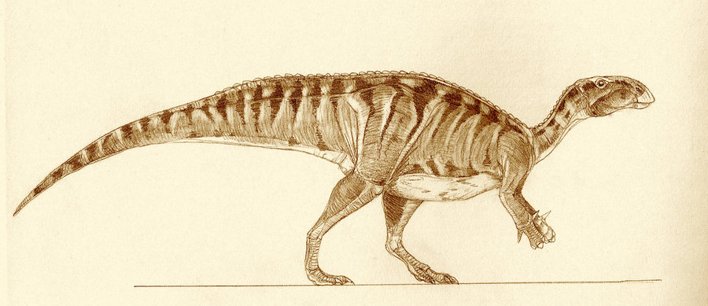
Notes:
Pictures; paraphyletic, larger, stance, early cretaceous

Slide 7
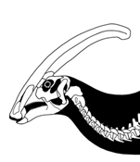
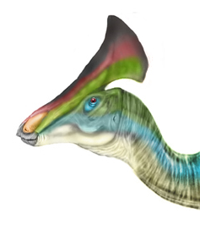
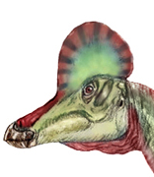
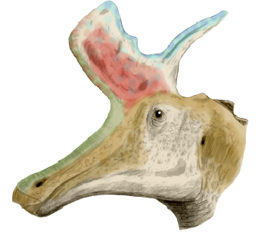
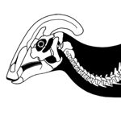
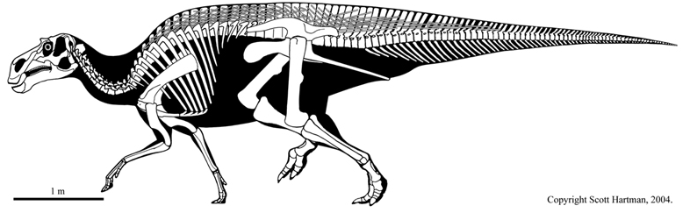
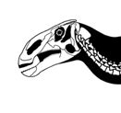
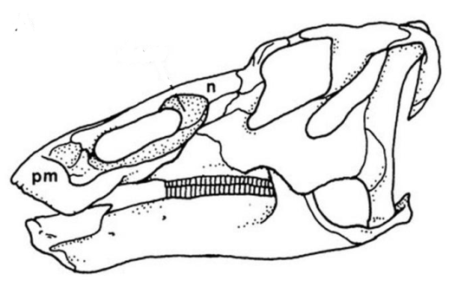
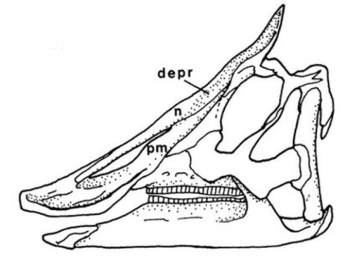
Notes:
Pictures; large, stance; eurasia, cretaceous; L = hollow head crest, lighter build, H = no crest or solid crest, bulkier

Slide 8
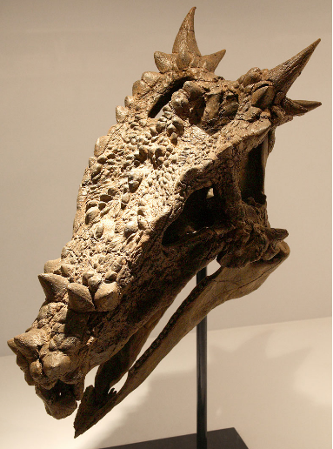
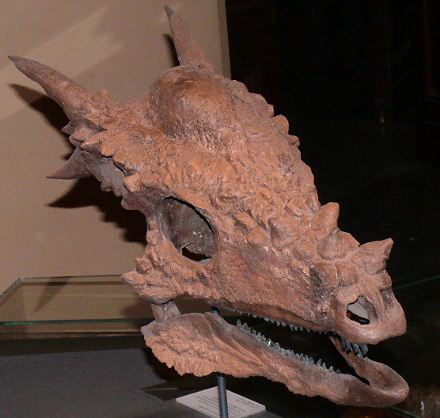
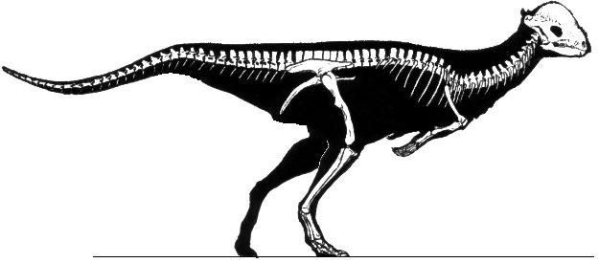
Notes:
Pictures; bipedal, thickened skulls w/ bumps (head butting controversy; ontogeny), herbivorous/omnivorous?; late cretaceous

Slide 9
Notes:
done

Slide 10
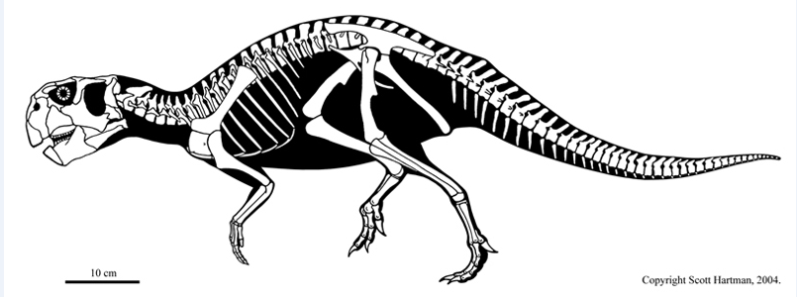
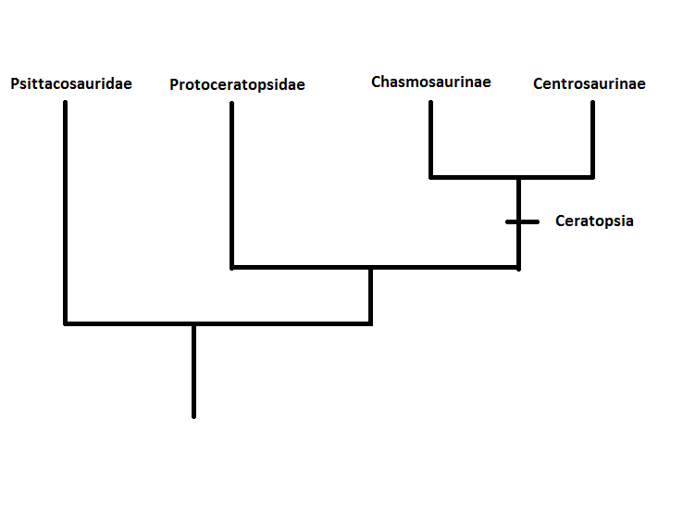
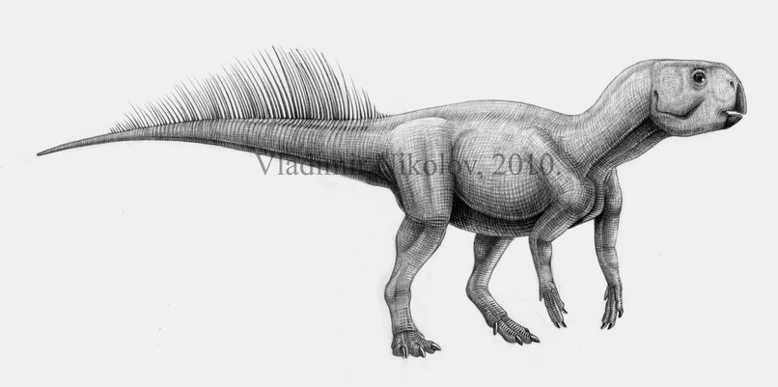
Notes:
Pictures; small, bipedal, beak, shield, filamentous integuments; early cretaceous Asia

Slide 11
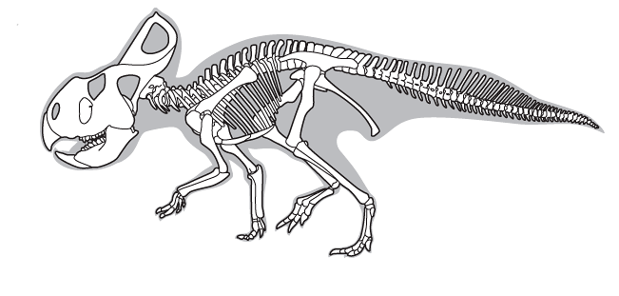
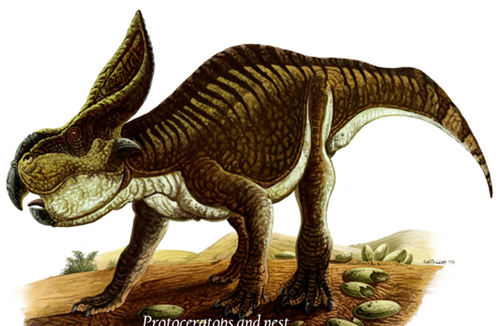
Notes:
Pictures; small, quadrupedal, larger frill; grade

Slide 12
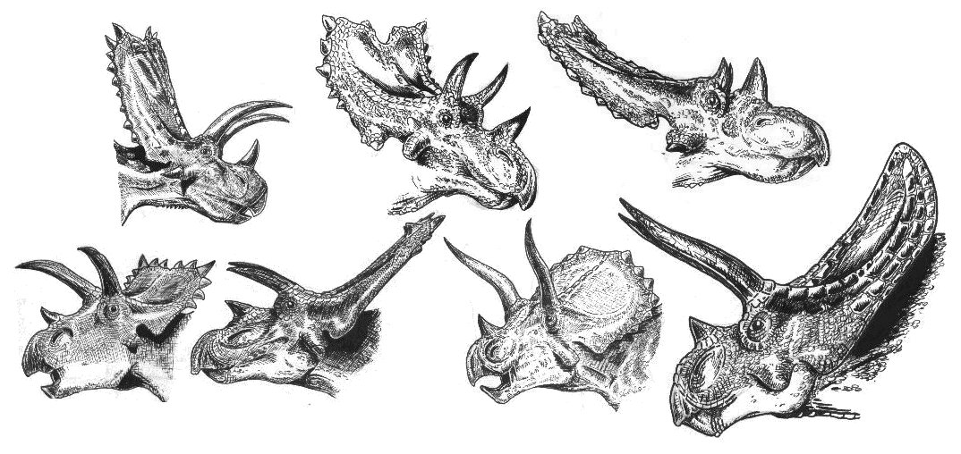
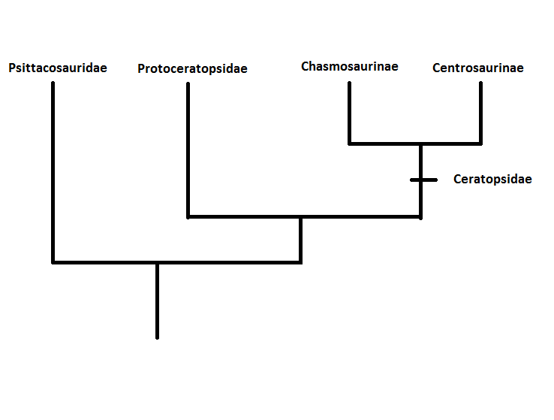
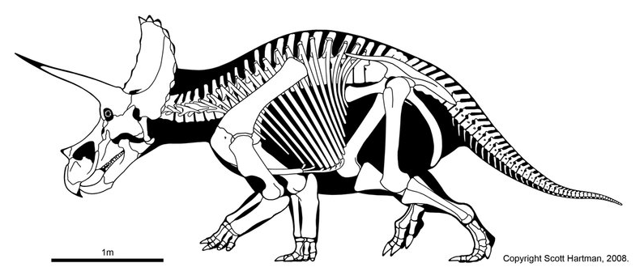
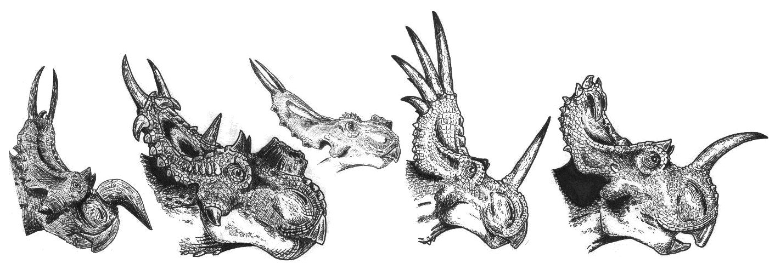
Notes:
Pictures; large, quadrupedal, large frills & horns; late cretaceous, North America Asia; Ch = long frills/browhorns, Ce = short spikey frills/long nose horns

Slide 13
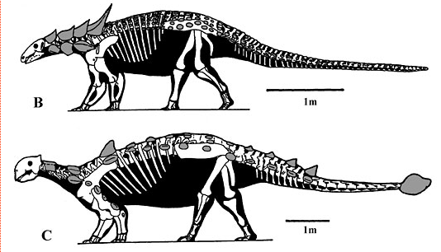
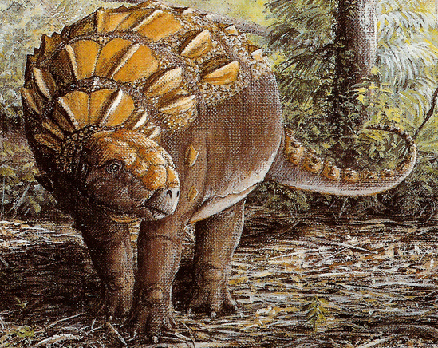
Notes:
Pictures; quadrupedal, osteoderms; rare widespread, early Jurassic; Nod = no clubs, smaller heads, spikier, Ank = broad, tail clubs (most)

Slide 14
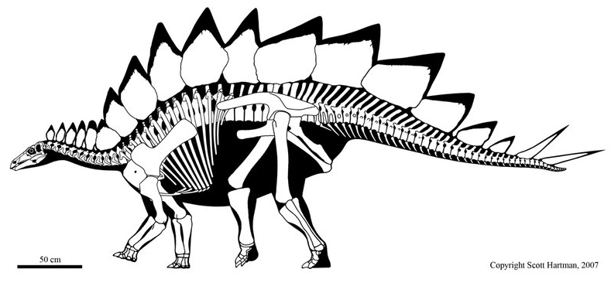
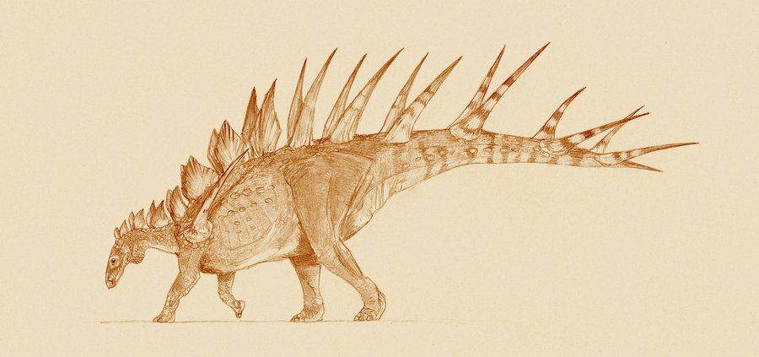
Notes:
Pictures; large, quadrupedal, osteoderms (function?); rare, Mostly northern hemisphere

Slide 15
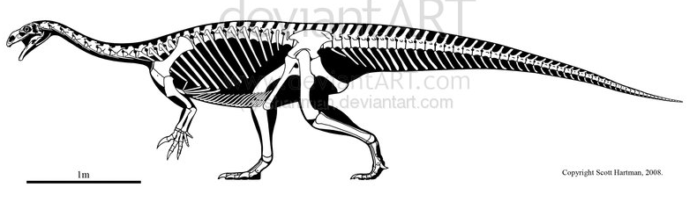
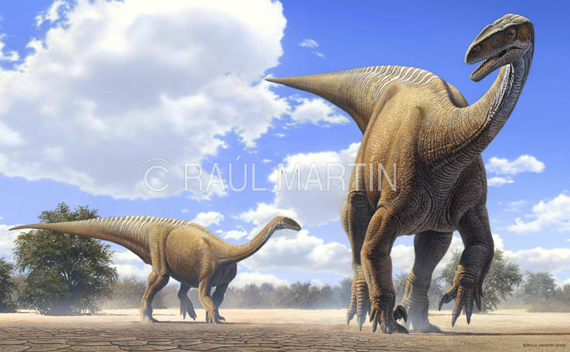
Notes:
Pictures; posture, herbivorous, paraphyletic, appeared early

Slide 16
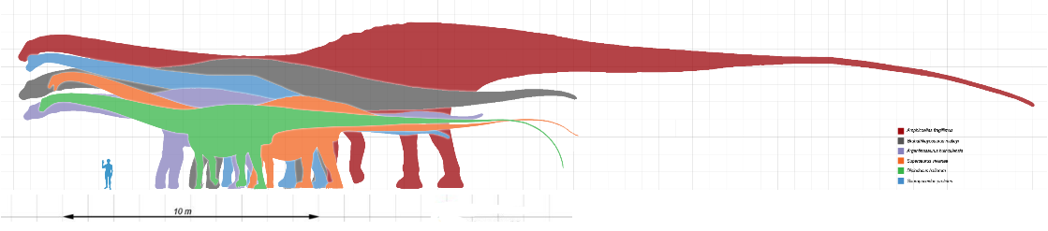
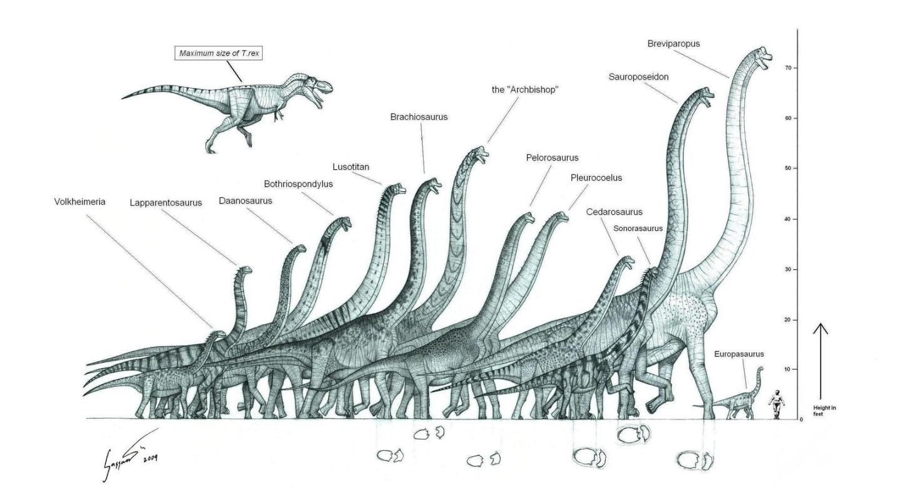
Notes:
Very large, long necks & tails, Jurassic

Slide 17
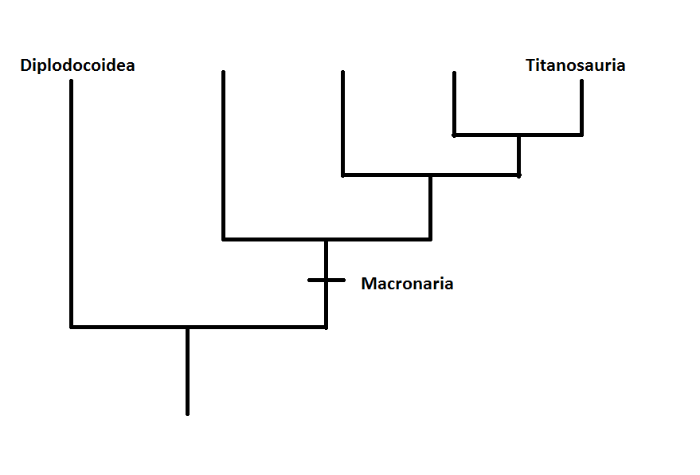
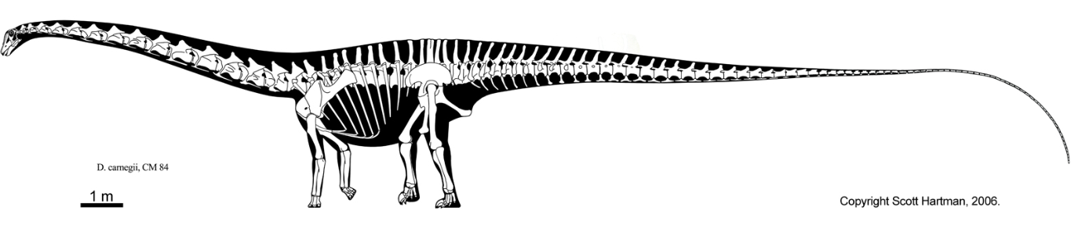
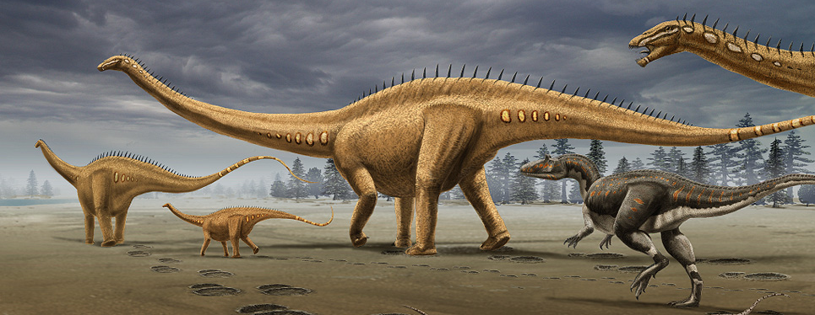
Notes:
longest

Slide 18
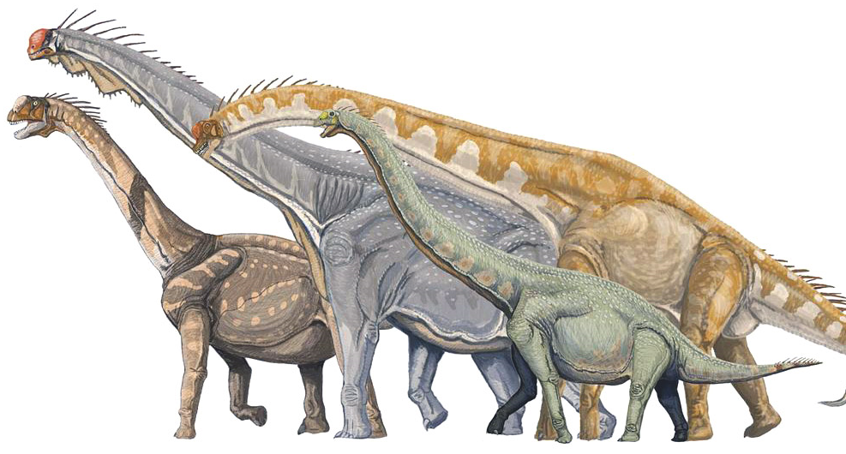
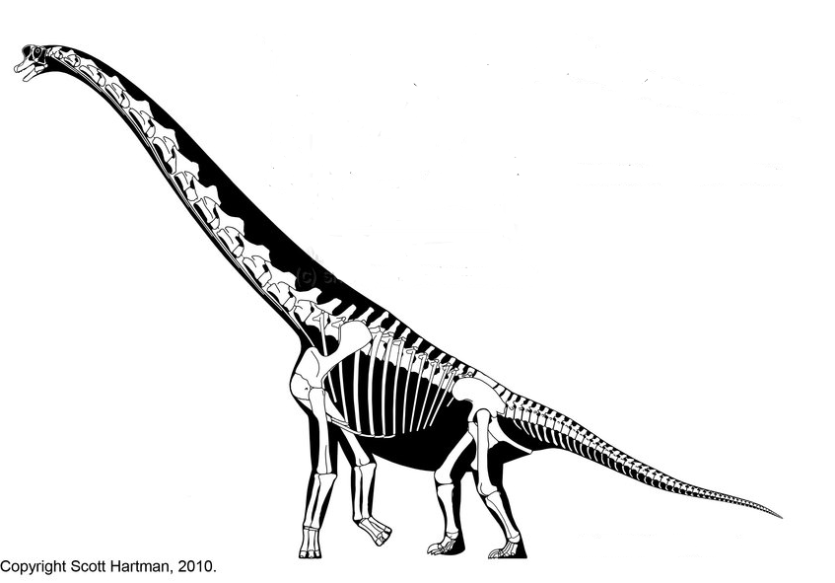
Notes:
Tallest, heaviest, large nose + crest

Slide 19
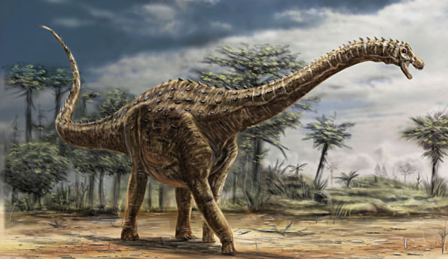
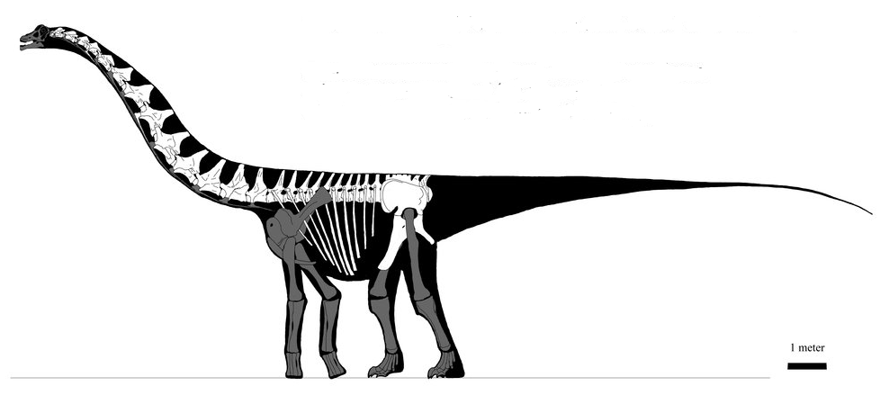
Notes:
Small heads, short necks, heaviest, osteoderms; Cretaceous, worldwide, southern hemisphere

Slide 20
Notes:
Pictures; only carnivorous dinos (some herbivorous), large size range, early & wide ranging, bird lineage

Slide 21
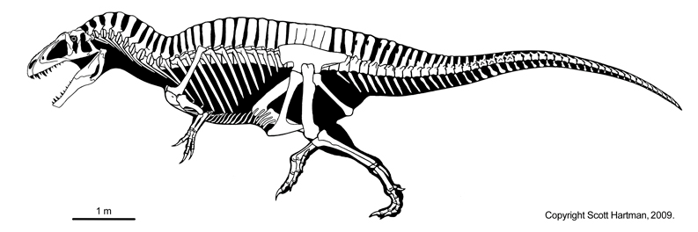
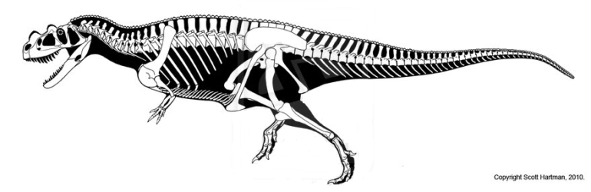
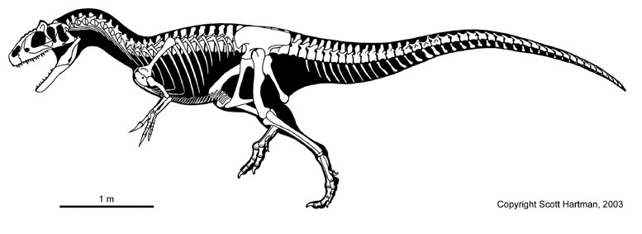
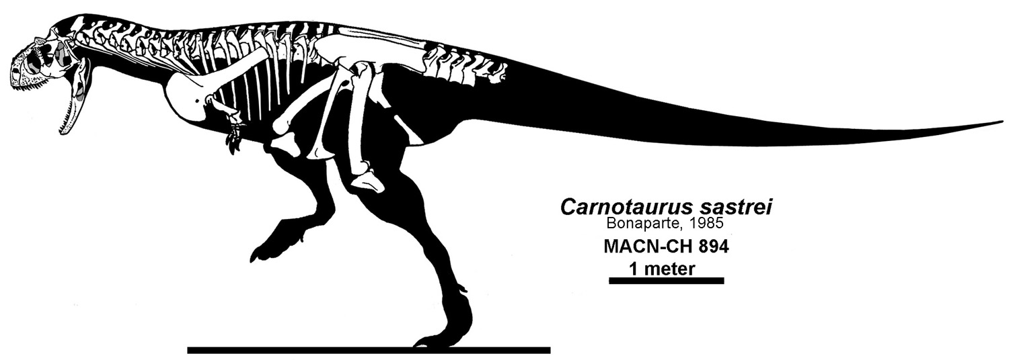
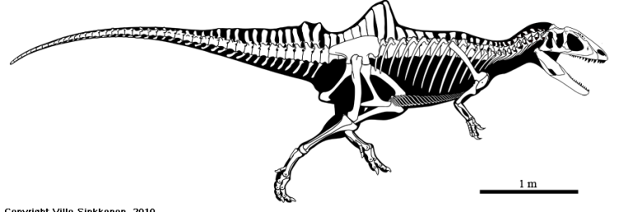



Notes:
Primitive, ceratosauria (incl. abelisauridae), allosauroidea, spinosauridae

Slide 22







Notes:
Coelurosaurs; generally small; tyrannosauids, ornithomimosaurs, therizinosaurs, oviraptors, troodontids, dromaeosaurs, birds

Slide 23

Reconstructing Dinosaurs: Evidence
Notes:
done

Slide 24


Geologic Context
Rocks => local abiotic environment
Geomagnetic data => latitude
Other fossils => local biotic environment
Local distribution => population density & solitary vs social
Global distribution => habitat preferences & evolutionary history
Trace fossils => specific behaviors
Taphonomy => predation/scavenging & postmortem transportation
Notes:
done

Slide 25
Overall Morphology
Modern relatives (Extant Phylogenetic Bracket)
Modern analogues
Mechanics
Notes:
done

Slide 26

Extant Phylogenetic Bracket
?
?
?
Notes:
done

Slide 27


Analogues
Notes:
done

Slide 28

Mechanical Studies
Math/physics/engineering
External & internal morphology
Sets limits on behaviors
Lack of soft tissue & microscopic structure => rough estimate
Notes:
done

Slide 29
Microscopic Evidence
Thin sections
Molecular evidence
Notes:
done

Slide 30
Thin Sections: Sampling
Ideal scenario: every bone in a complete individual, large numbers of individuals from every age group, both genders & across range
Reality: fragmentary remains; species w/ limited occurences; large specimens
Compromise: sample key bones from partial skeletons of common species
Notes:
done

Slide 31


Microscopes
Light microscopes (transmitted/polarized)
  Presence/absence tissue types
  Size, density & orientation of structures
  Crystalline orientation
Electron microscopes
  Surface morphology (crystalline structure/orientation of teeth & egg shells
  Elemental components
Notes:
done

Slide 32
Molecular Data
Biologic molecules
  Mostly amino acids, protein, & lipids
  Contamination is a problem
  Compare similarities w/ living taxa
Isotopes
  Stable isotopes
  O, C, N
  Contamination is a problem
  Diet, temperature
Notes:
done

Slide 33
Question
Selecting one type of dinosaur as an example: What types of evidence might be used to learn more about it and what kinds of things might you expect to learn from each line of evidence?
Notes:
done

