Slide 1
Growing Dinosaurs
Alyse Huisken
Nicole Sparks

Slide 2
Intro
The life history begins with conception and ends with death
  Growth stages are observable for extant populations
  Difficult to observe for fossil animals
It is assumed Dinosaur development had a similar pattern to birds and crocodilians

Slide 3
Development
Fertilization
Cleavage
  most likely partial because birds and reptiles have a high amount of yolk
Cleavage results in a blastoderm
Gastrulation
  Ectoderm, mesoderm, endoderm
Neurulation

Slide 4
Development
Uncertain when dinosaurs laid their eggs
Bird eggs laid early
Reptile eggs laid late

Slide 5
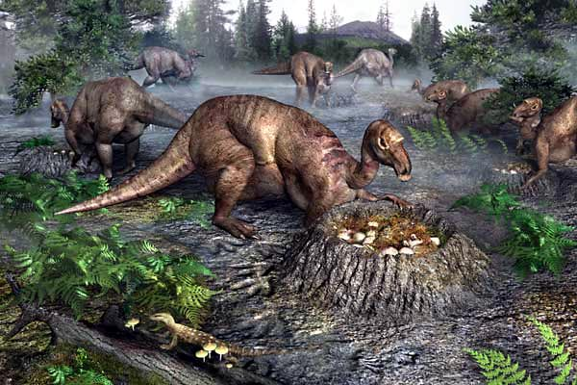
Nests
Hadrosaurs
Maiasaura peeblesorum
Jack Horner- Musuem of the Rockies in Montana
8 nests 7m part
Communal nesting
  Guarding nests and caring

Slide 6
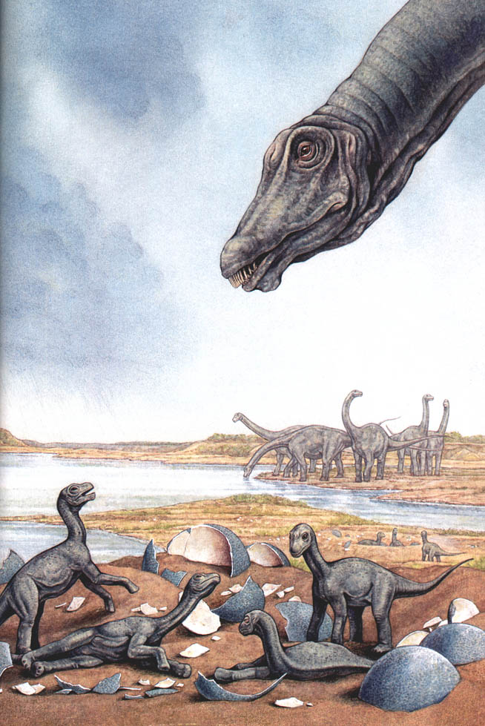
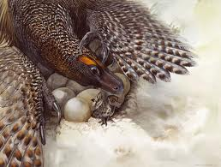
Nests
Sauropods
David Varricchio observed Troodon eggs in pairs
  Paired ovulation
Sinosauropteryx
  Pair of eggs within the body

Slide 7
Comparing nests
Comparing dinosaur nests to nesting behavior of birds and crocodiles
Paleognaths
  Shallow holes
  Body heat for incubation
Megapodes (depends on species)
  Simple holes, burrows or complex mounds
  Communal nesting
  Environmental heating for incubation
  Abandon eggs once laid
Crocodiles
  Lay eggs on the ground
  Communal nesting
  Environmental heat to incubate eggs
  Stay near the nests to protect

Slide 8
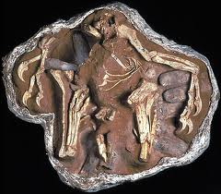
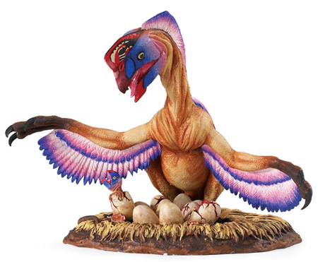
Comparing nests
Mark Norell discovered Oviraptor atop of a nest
1990 another Oviraptor on a nest
1997, Troodon with remains of its hindlimb in the nests
All demonstrating dinosaurs incubating

Slide 9
Comparing nests
Variety of nests suggests different methods of incubation
  Lack chalazae
Clutch size varied (20-30 being typical)
  Dinosaur clutch sizes suggest little parent involvement after hatching
220 egg localities worldwide
Few are of complete nest with diagnostic embryos
Unknown species
Bird’s clutch size is dependent on other factors
Nidicolous
  Remain in their nest and are psilopaedic and altrical
Nidifugous
  Leave the nest immediately and are precocial and ptilopaedic

Slide 10
Embryonic age and growth
Majority fossilized embryonic dinosaur skeletons are of late-stage embryos
  There are several fossilized embryonic growth stages
Sauropod Auca Mahuevo, Argentina
  Early stages of development
    Initial stage of diaphyseal ossification
Composition of woven bone used to determine development stage
  Bone from Alberta older than Hypacrosaurus by Horner and Currie
Gobipteryx, 2 specimens in different stages of embryogenesis
  showed a more developed fibrolamellar bone compared to the Hypacrosaurus
  Their growth strategies can be different

Slide 11
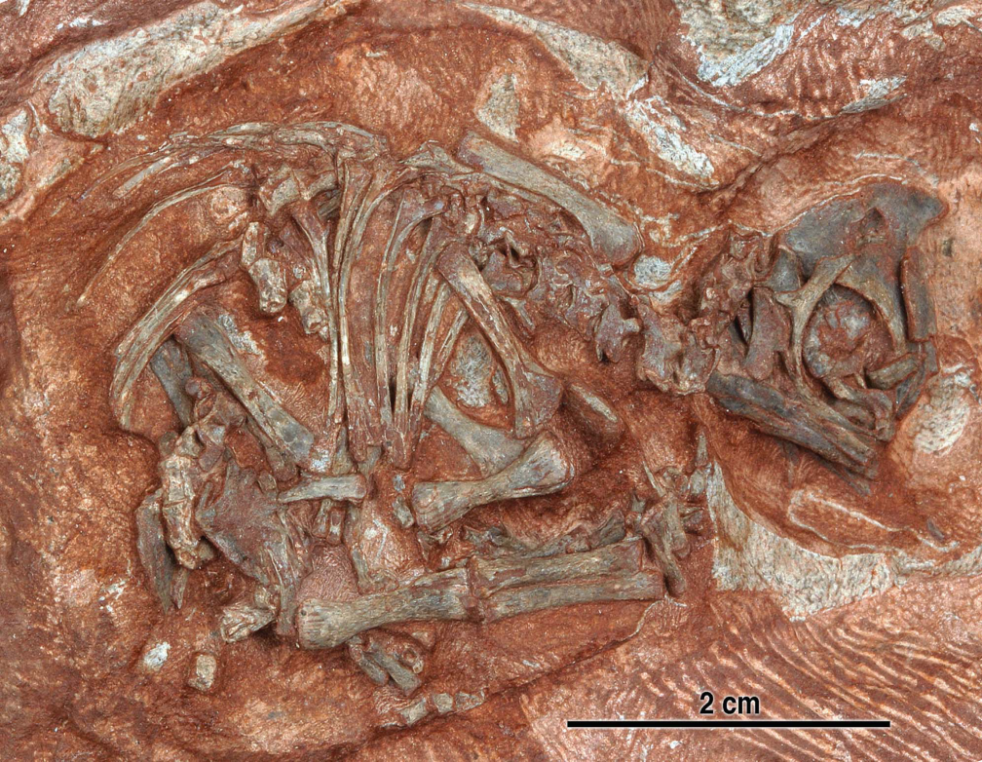
Embryonic age and growth
James Kitching (1976) collected 10 dinosaur eggs and assigned them to Massospondylus (79)
  Chinsamy and Kitching used CT scans (1999)
New preparations by Robert Reisz revealed articulated embryonic skeletons (2010)
  Close to hatching

Slide 12
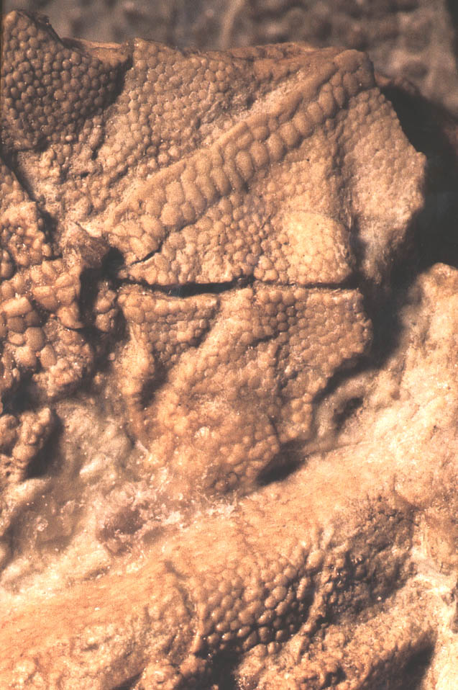
Embryonic age and growth
Auca Mahuevo embryos also had skin impressions preserved
No osteoderms
  Develop post-hatching

Slide 13
Posthatching behavior
Horner and Makela suggested Maiasaura parents cared for their young (altricial)
Unfinished articular ends
Wear facets on teeth
Troodon considered precocial
Crocodile wear facets develop within the egg
Altricial birds remove shells; not seen in Maiasaura
Barreto showed Maiasaura articular ends was similar to precocial 2-week old chicks
Geist and Jones proposed the degree of ossification of the pelvic girdle

Slide 14
Hatchling vs. Juvenile
Hatchling
  Fragile and spongy appearance
Juvenile
  lack fusion of skeletal elements, large braincase, orbits and short snout
Extensive study in the timing of skeletal fusion
  Brochu on crocodiles
    Neurocentral sutures
    Sexual maturity
Periosteal aging of ceratopsian
Juvenile skulls have parallel striations
Subadults have mixture of striated, mottled and nonstriated bone textures
Adults have no striations
Several complete growth series that have led to the understanding of how dinosaurs grew

Slide 15
Embryonic Bone Tissue
Horner and colleagues did a study on embryonic and perinatal dinosaurs, living birds and modern reptiles
  55 day old snapping turtle showed thin-walled limb bones, 12% porosity, no fibrolamellar bone
  Full-term embryonic alligator had simialr tissue to the turtle 14% porosity , some fibrolamellar bone
  <1yr alligators have 4% porosity
Did not account for variation in porosity from the compacta to the perimedullary regions

Slide 16
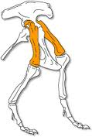
Growing Tall
How did dinosaur femora grow?
Need to study the articular ends.
The amount of calcified cartilage in the ends the long bone is an assessment of growth
Reid, proposed the ends of young long bones look like the articular ends
  Similar to crocodiles and have indeterminate growth
Should always see calcified growth in the ends of long bones

Slide 17
Growing Tall
More research is required to determine if dinosaurs grew more like crocodiles or birds
Horner and colleagues found that Troodon showed no secondary ossification center and thick pads of calcified cartilage penetrated by bone marrow tubules
Suggested cartilage canals are like modern birds and for rapid growth

Slide 18
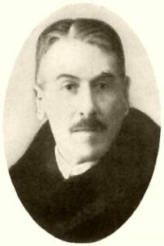
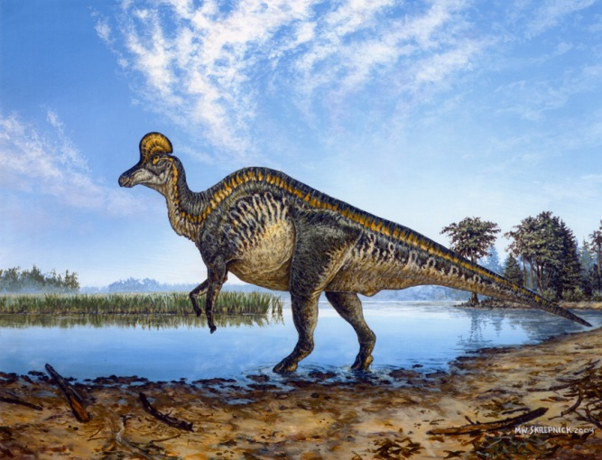
Ontogenetic Study in Bone Microstructure
The first study to use bone histology to determine ontogenetic status was in 1933 by Baron Francis Nopsca and Heidsieck
Nopsca looked at a sections of a Tetragonosaurus rib and determined it was similar to that of a semiadult of other species, therefore determining it to be a juvenile
In 1975 Peter Dodson found that Tetragonosaurus to be a juvenile Corythosaurus

Slide 19
Understanding Dinosaur Ontogeny
To perform a study to understand dinosaur ontogeny specimens would be needed from each species of dinosaur
Also the study would need to look at sections of the entire skeleton of members of each species from embryos to mature adults

Slide 20
Debate on Longevity and Growth Rates
Longevity and growth rates of dinosaurs were highly debated and based on theoretical models
Estimates of time required to reach maturity varied from very rapid growth (Greg Paul) to about 60 years (Ted Case)
In between was Arthur Dunham who estimated growth to adult size for a large hadrosaur and other large dinosaurs to be about 10 to 12 years

Slide 21
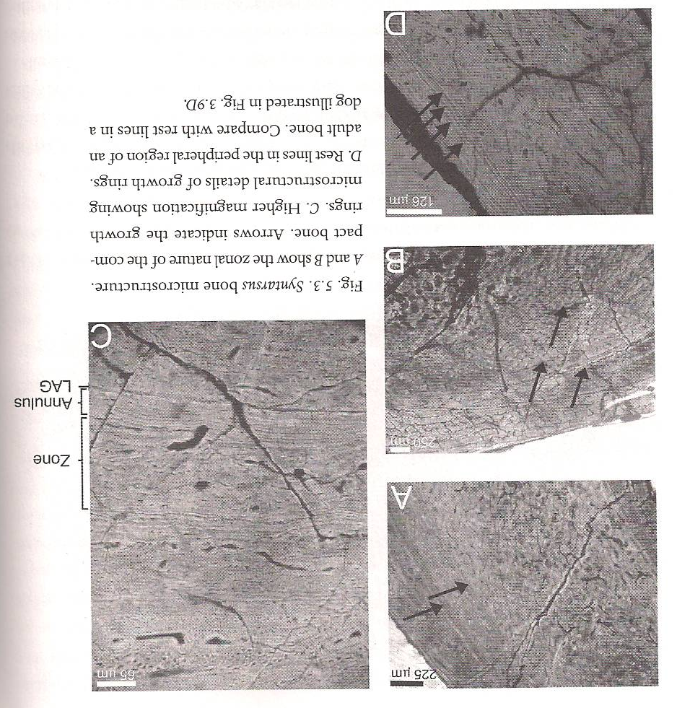
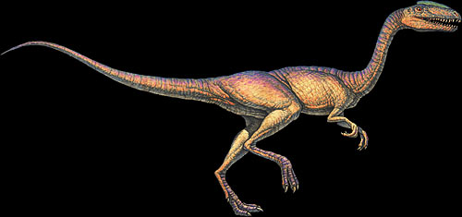
Syntarsus
Sections of the “neutral zone” in the midshaft region of the femora of twelve Syntarsus femora (from 12 to 23 cm in length)
These sections showed growth rings

Slide 22
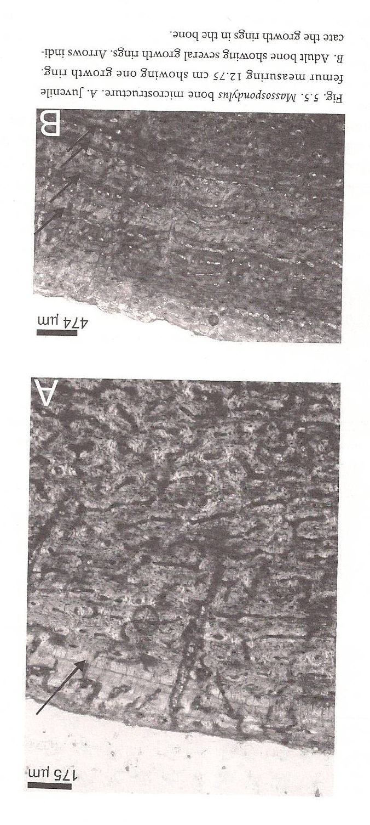
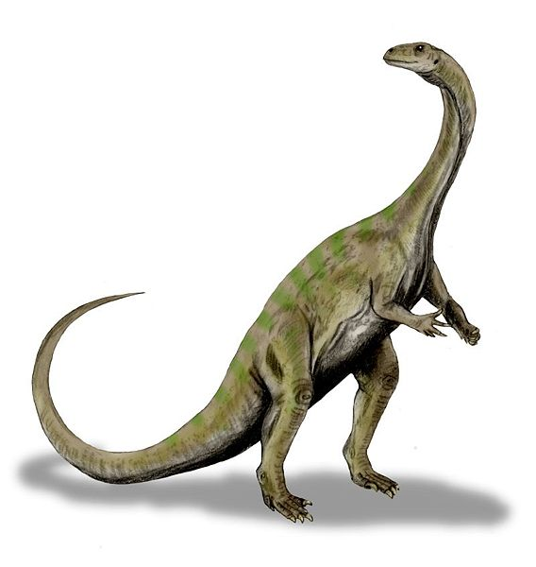
Massospondylus carinatus
Sections of nineteen femora (from 12 to 44 cm in length)
Again growth rings present

Slide 23
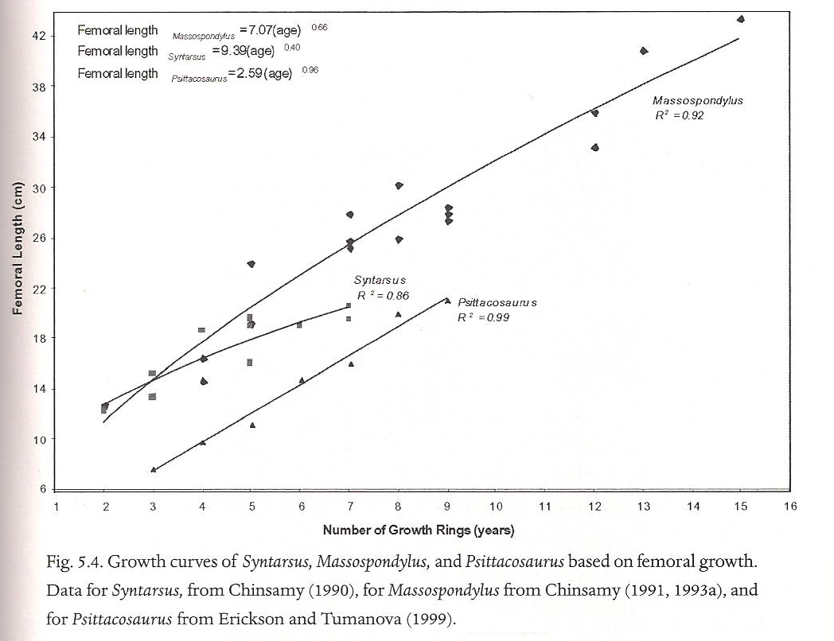
Estimated Growth Curves

Slide 24
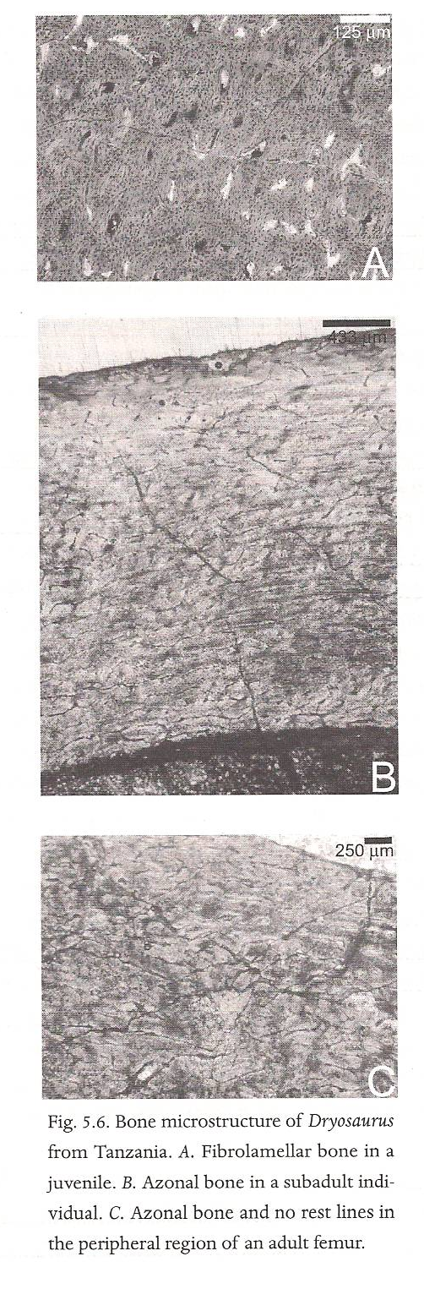
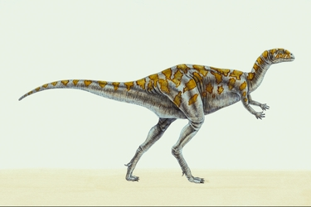
Dryosaurus
Thirteen femora of a growth series were sectioned
No annuli or lines of arrested growth present
Suggests a sustained rapid rate of growth
Nature of bone tissue showed that during early ontogeny bone was deposited at a faster rate

Slide 25
Coelopysis & Syntarsus
Greg Paul suggested that these closely related species belong to the same genus
Preliminary comparison by Chinsamy shows the microstructure to be different
  Less intensive secondary reconstruction in Coelophysis and fewer secondary osteons
  LAGs in Coelophysis are not followed or preceded by an annulus
  Bone wall of Coelophysis is much thinner than in Syntarsus

Slide 26
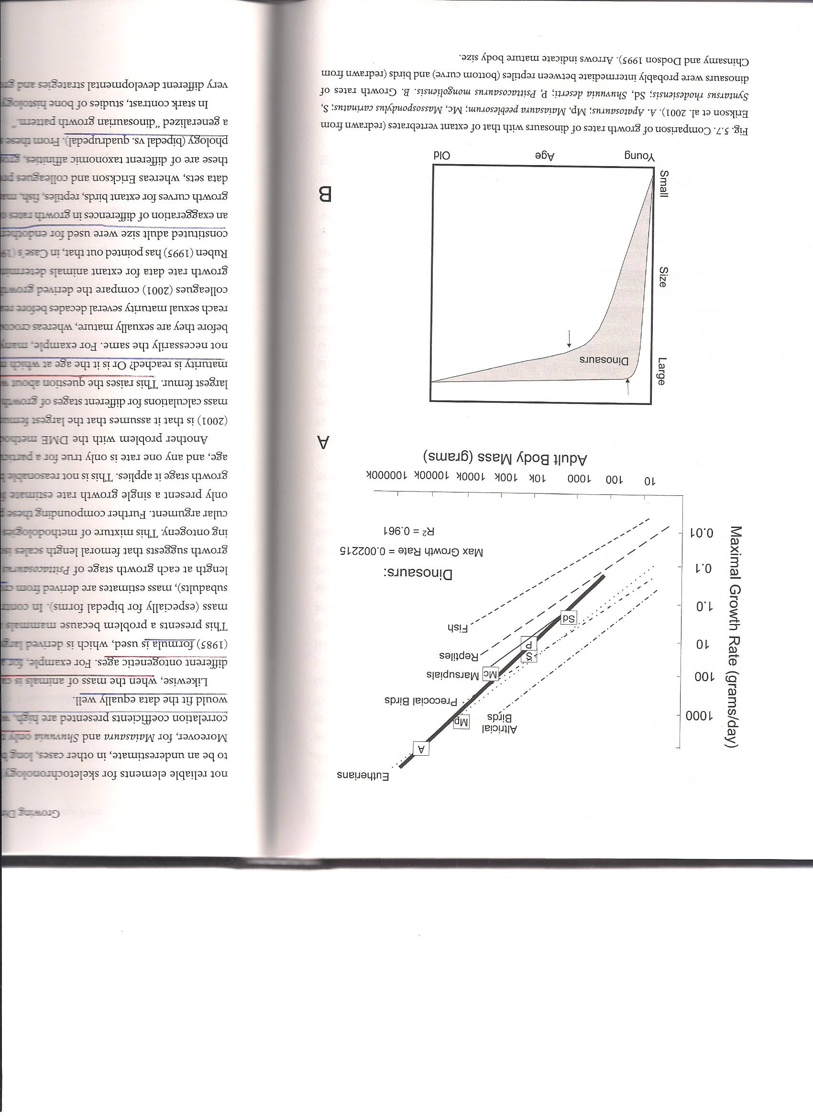
Developmental Mass Extrapolation (DME)
Developed by Erickson and Tumanova
Plotted the growth rate they determined for Psittacosaurs with rates of extant vertebrates to deduce the mass of the dinosaur at various stages of ontogeny

Slide 27
Determination of age and rate of bone formation
Thickness of cortical bone divided by the estimated number of growth rings (Rimblot-Blay on Lapparentosaurus)
Scapula size and vascular cycles (Currey on Apatosaurus)
Core samples of femora and humeri for skeletochronology (Sander on multiple sauropods)
Skeletochronology on non-weight-bearing bones (Erickson on Tyrannosaurus rex)
Skeletochronology on a fibula (Horner and Padian on Tyrannosaurus rex)
Annual bone depositional rate in the absence of growth rings, thickness of the bone between polish lines divided by 365 days (Sander and Tückmantel on Barosaurus, Janenschia, and Apatosaurus)

Slide 28
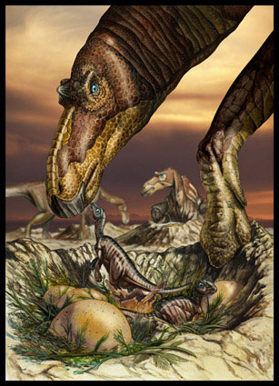
Maiasaura
Horner, de Ricqles, and Padian
Included six growth stages
  Early nestlings
  Late nestlings
  Early juveniles
  Late juveniles
  Subadult
  Adult

Slide 29
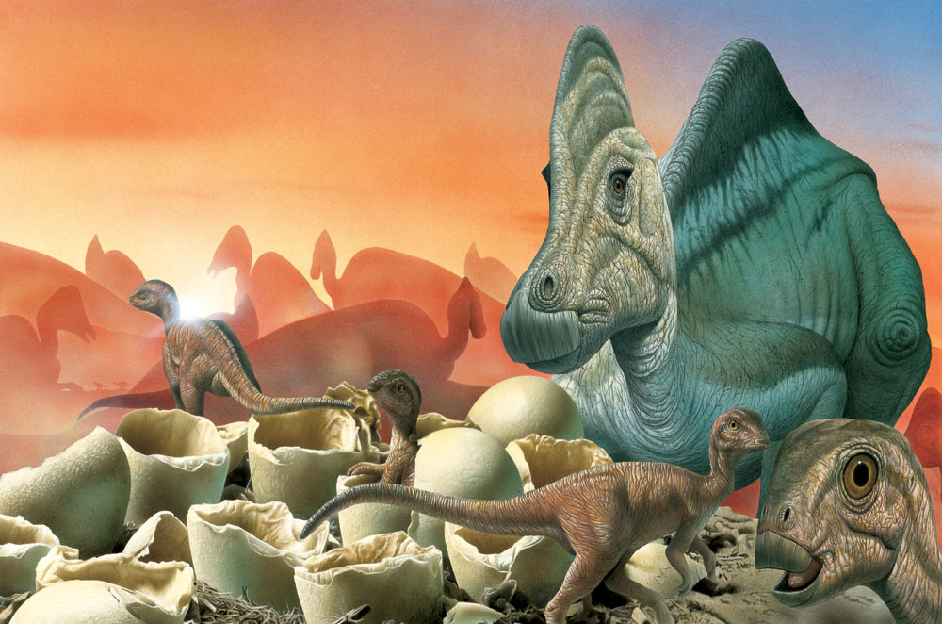
Hypacrosaurus stebingeri
Uppermost Two Medicine Formation of northern Montana and southern Alberta
Largest collection of embryos and nestlings with juveniles and adults
Horner and Currie
Histological analysis suggests rapid growth in the embryos and nestlings

Slide 30
Can we determine overall Dinosauria growth?
Insight has been found as to how a few particular taxa grew
Rates are somewhere faster than typical reptiles but lower than mammals or extant birds
Some have LAGs and annuli others do not
Bone histology shows different dinosaurs had differing developmental strategies and growth patterns

Slide 31
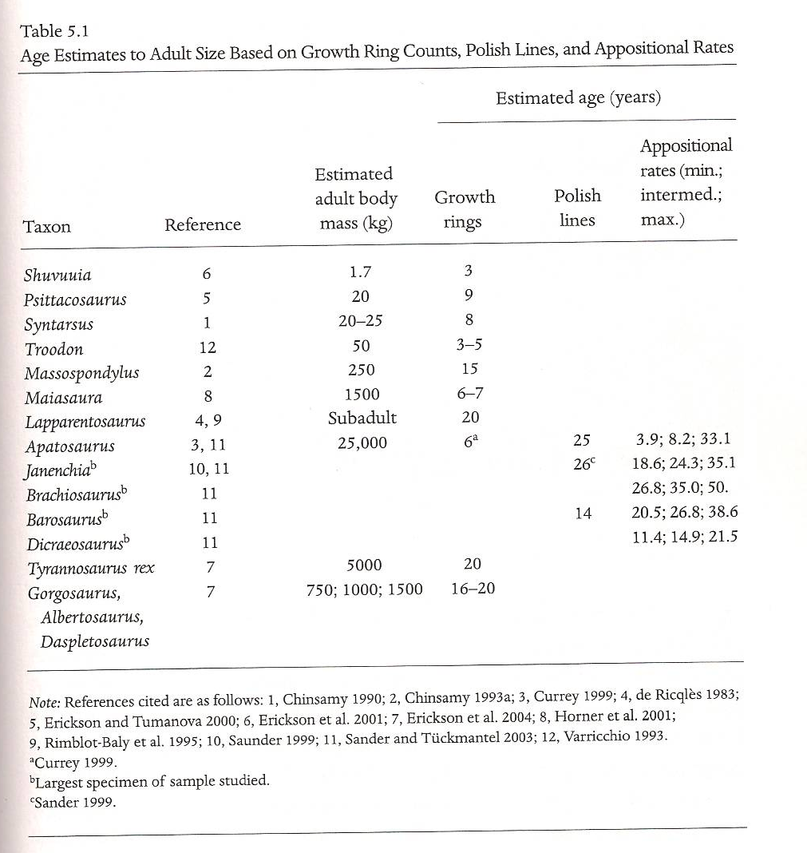
Age estimate from various sources

Slide 32
Conclusions
Changes in bone microstructure during ontogeny of several dinosour taxa allow us to make a fair assesment of associated levels of growth in other taxa that have similar growth patterns
Some dinosaurs studied have slowed or determinate growth while others have indeterminate growth
“Age” and growth rates have been determined in many specimens based on skeletochronology, but assumes growth rings are a year (which may not be the case) and some cases require back-calculations to account for growth rings that were removed due to normal remodeling processes of growth
Dinosaurs growth rate was between extant birds and reptiles
Dinosaurs appear to have had growth rates between extant endotherms and ectotherms

Slide 33
Question
Explain the current theory of the process of dinosaur ontogeny. Describe the research/examples presented from embryonic development to adulthood.

