Slide 1
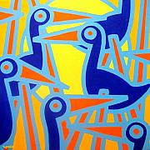
Biology of Early Birds
Chapter 6

Slide 2
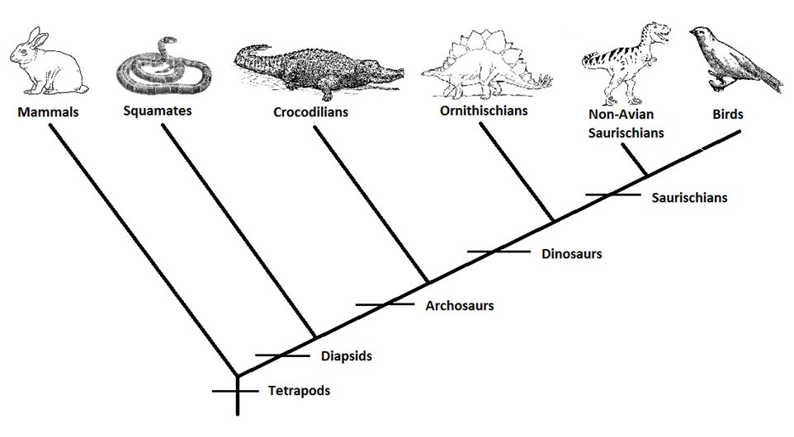
Neornithes
Modern bird lineage
Approx 10,000 species
Originated 90-100 Mya in Cretaceous

Slide 3
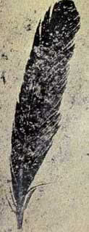
Evolutionary History
150 Mya dinosaurs & pterosaurs
1860: single feather
1861: skeletal remains
Today: 7 skeletons + feather

Slide 4

Archaeopteryx
150 My old
Earliest uncontroversial neornithine birds
  From 55 Mya
  Early Eocene (“dawn”)- 56-34 Mya
    Emergence of first modern mammals
“ancient wing”
Feathered
Anatomy btwn birds & reptiles
Today, still varying hypothesis
  Ancestory & evolution of flight

Slide 5
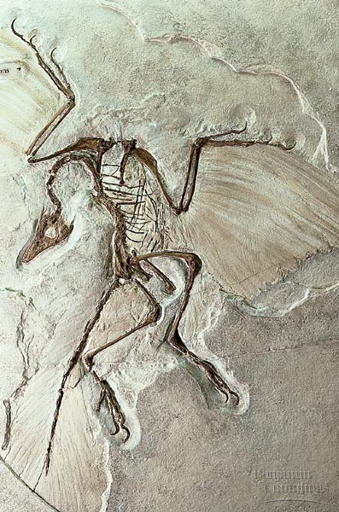

Slide 6
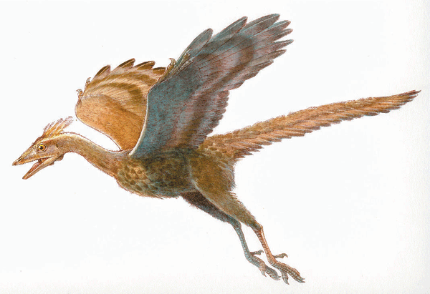

Slide 7
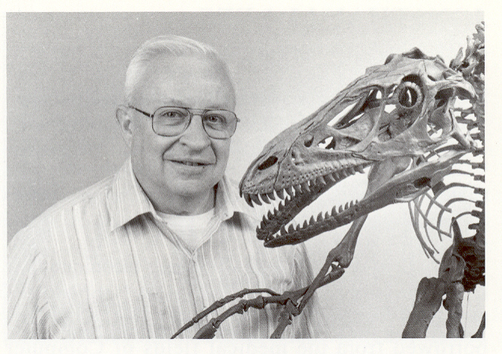
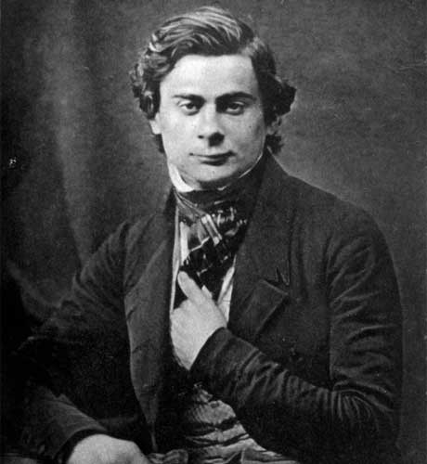
Dinosaurian hypothesis
Thomas Huxley
  1860s: proposed dinosaurian hypothesis
John Ostrom
  1970s: expanded & championed hypothesis

Slide 8
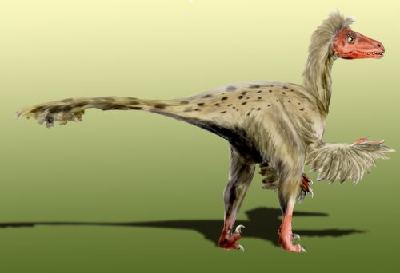
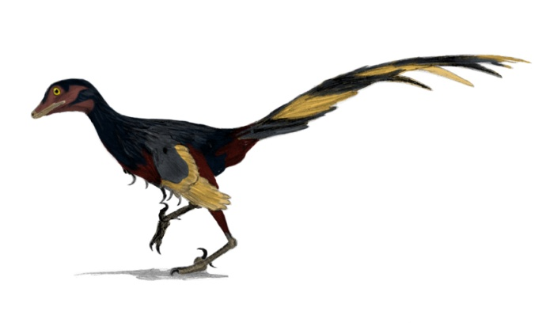
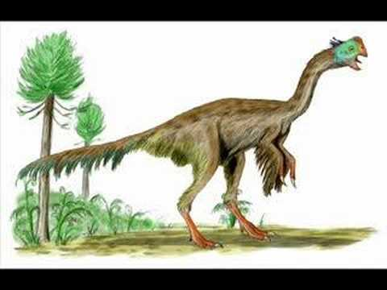
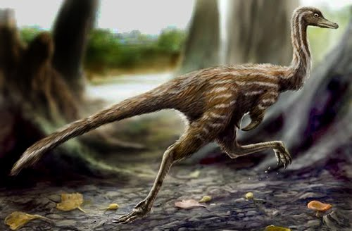
Debate Today
Birds are descendants of dinosaurs
Which dinosaurs represent sister taxon of birds?
  Dromaeosaurs
  Troodontids
  Oviraptorids
  Alvarezsaurids

Slide 9
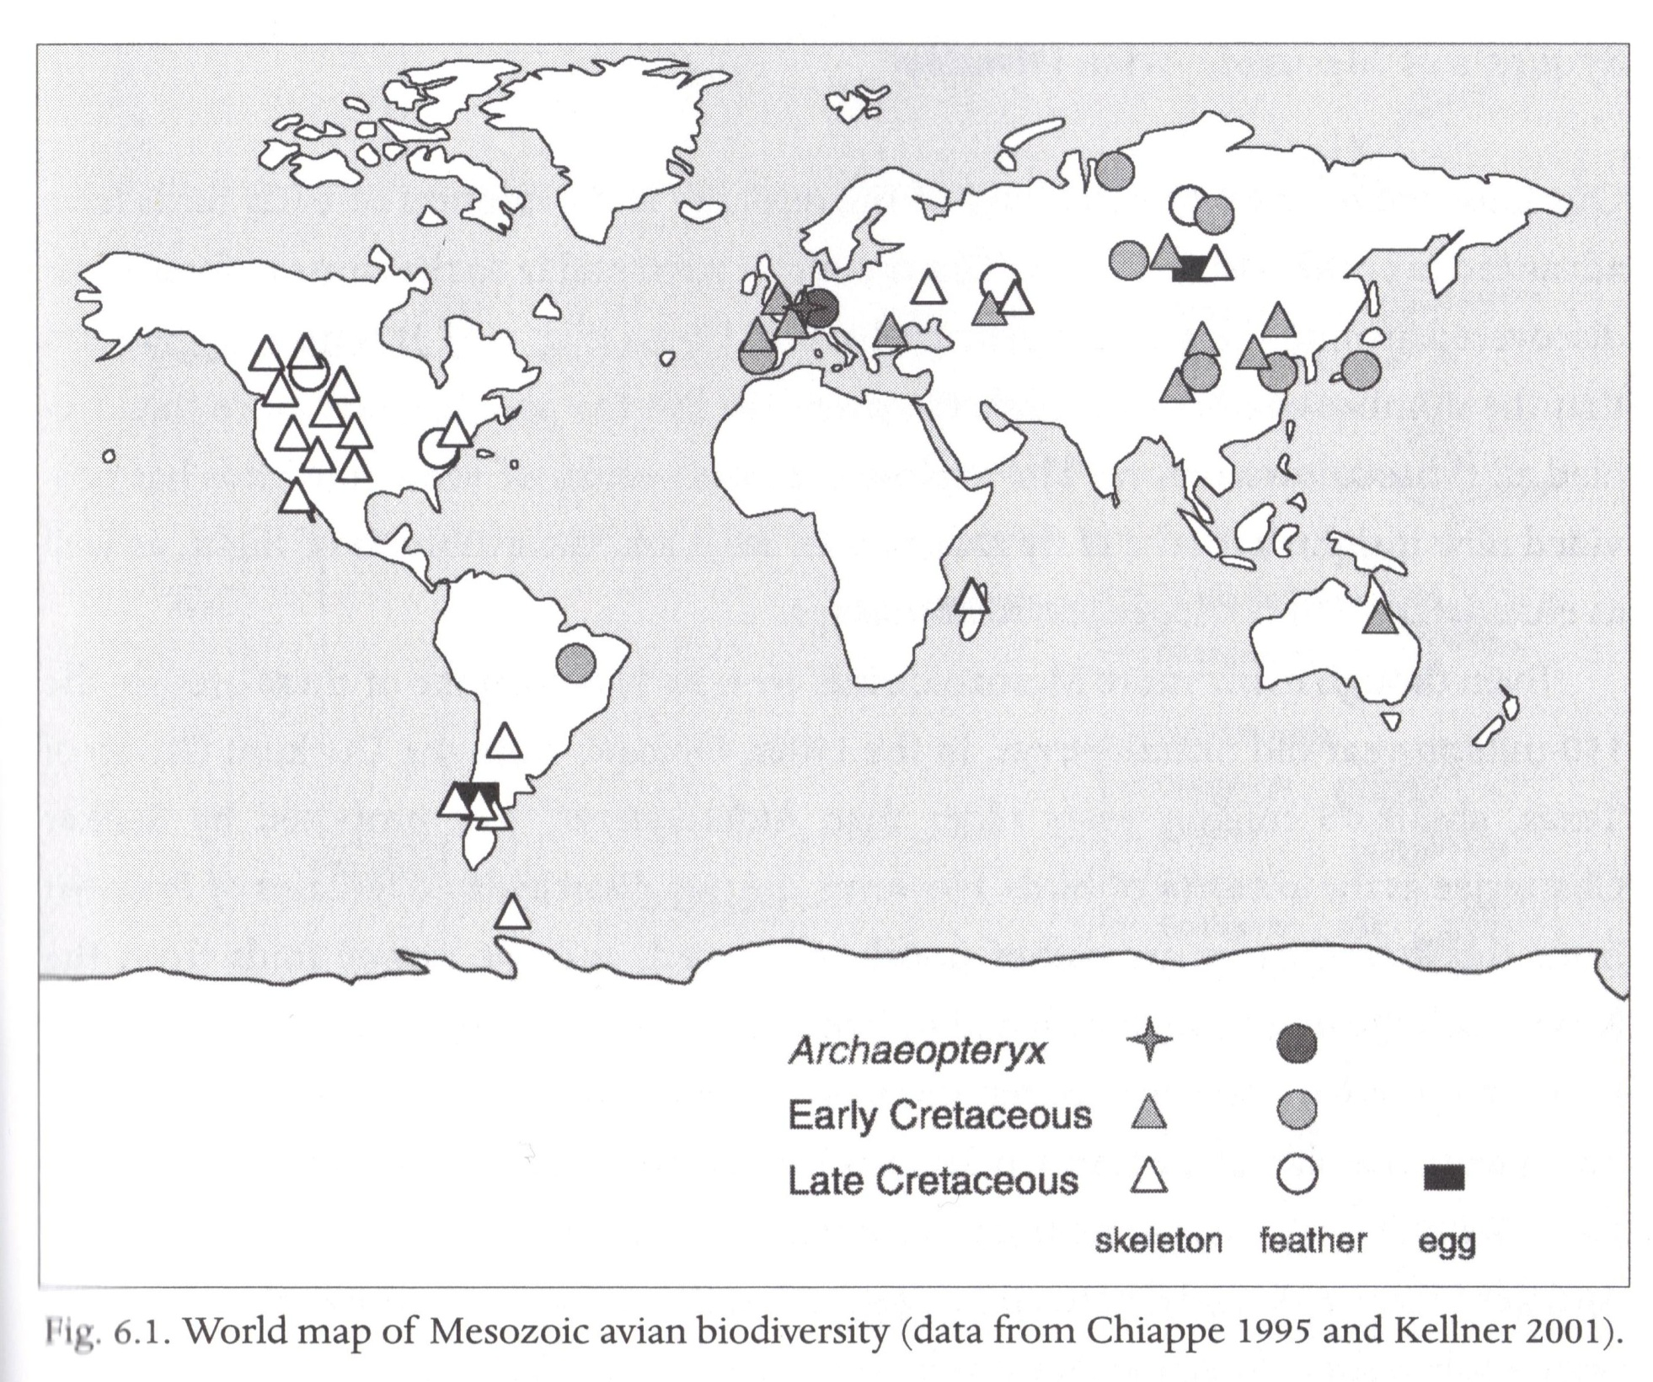

Slide 10
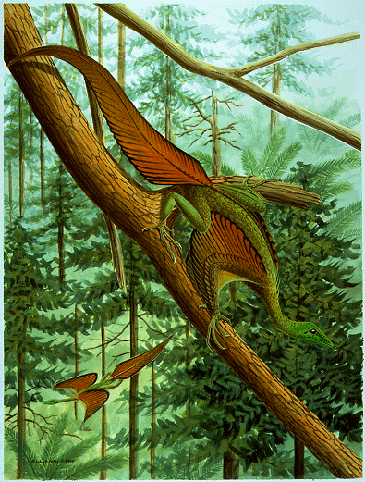
Protoavis
75 My older than Archaeopteryx
Ancestor of birds?
1980s- Texas

Slide 11
Protoavis
Post Quarry
Kirkpatrick Quarry; Late Carnian Tecovas Formation
Two remains
Poorly preserved
May be new taxa
Postcranial bone mostly
Disassociated
Witmer: may be composite
Chinsamy, Elzanowski, Chatterjee: taxonomically distinct from Protoavis

Slide 12
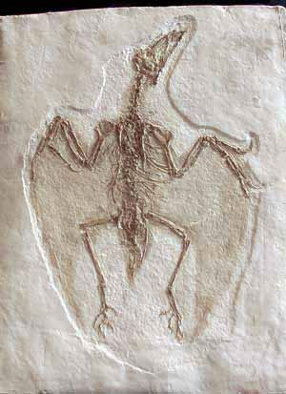
Late Jurassic birds?
“North Korean Archaeopteryx”
Confuciusornis
Lowermost Cretaceous
121-122 Mya

Slide 13
Archaeopteryx debate
Still oldest, undisputed
Lifestyle & biology?
Cursorial or arboreal?
Perching foot?
Glider? Capable of flapping flight?
Endothermic?
Dinosaurian origin…

Slide 14
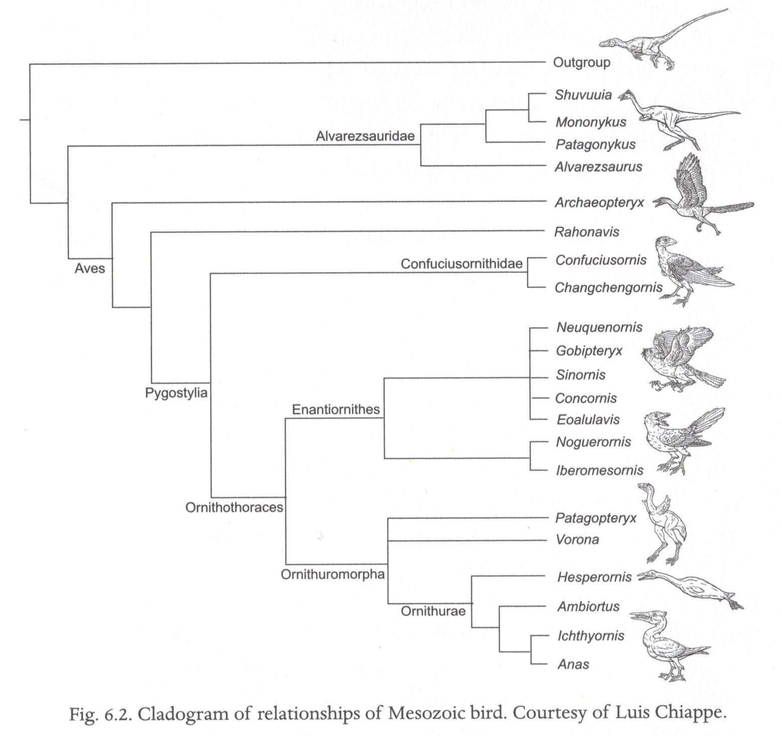

Slide 15
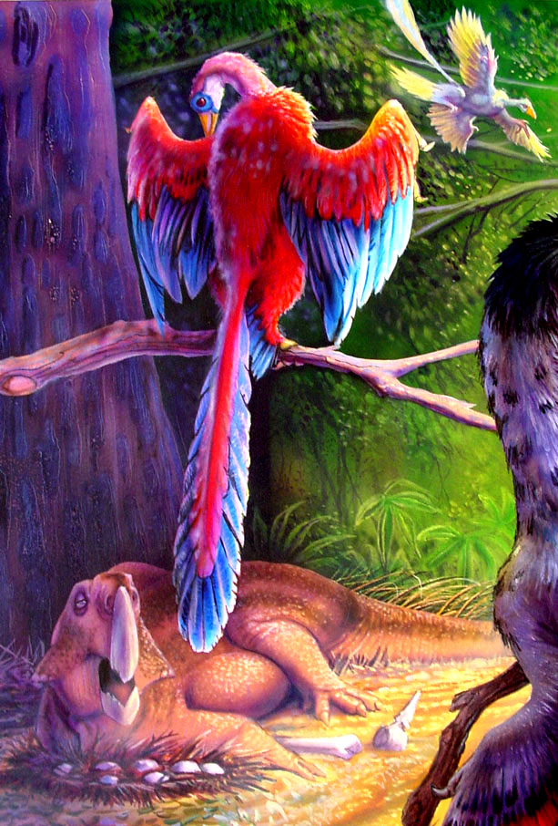
Jeholornis
Western Liaoning
Complete tail
Similar to Archaeopteryx
Seeds!
  Adaptations evolved in Mesozoic (251-65 Mya)

Slide 16
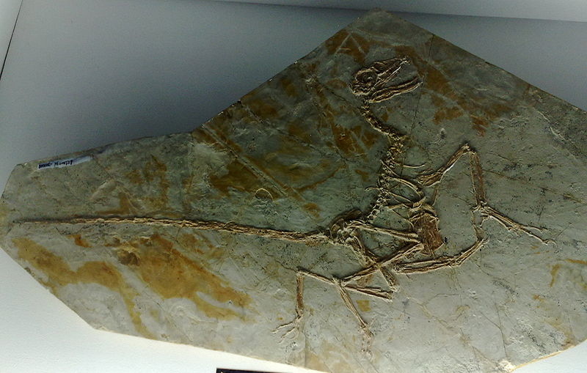
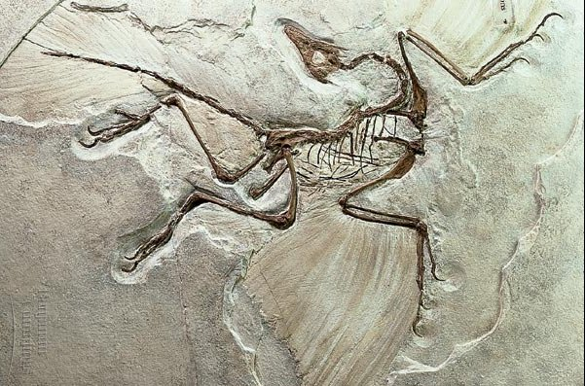

Slide 17
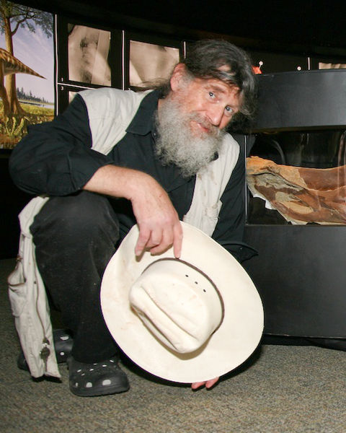
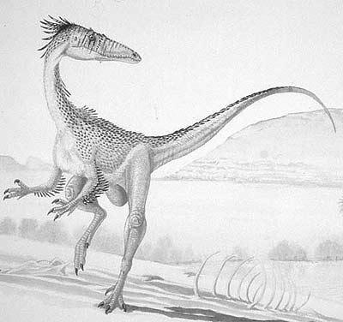
Feathered Dinosaurs
Reptile-like scales until 1996
1975- Bob Bakker

Slide 18
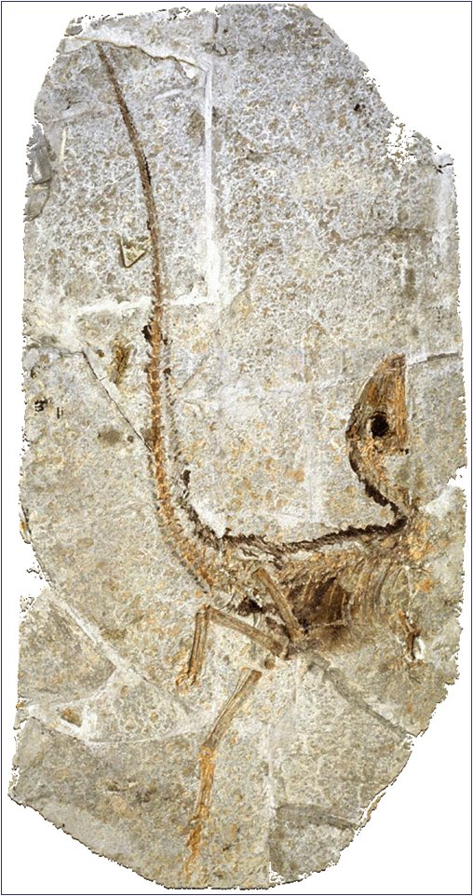
Sinosauropteryx Discovery
1996
NE China
Non-avian
Debate rekindled
Reinforced hypothesis
Protofeathers
Oviducts/ova preserved

Slide 19
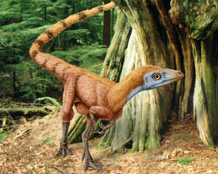
2nd Sinosauropteryx
1997
Mammal in body cavity
Also “featherlike” integument
Macerated collagen fibers?

Slide 20
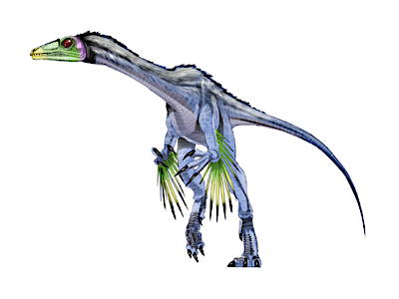
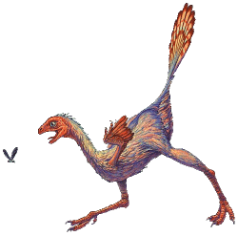
2 more feathered dinosaurs- 1998
Protarchaeopteryx robusta
Caudipteryx

Slide 21
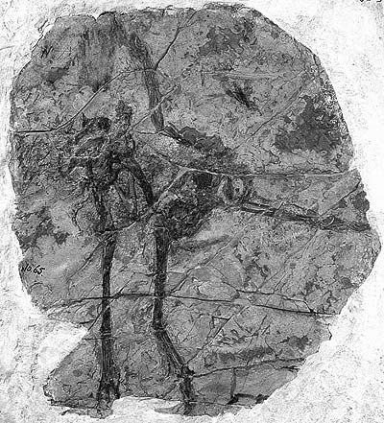
Protoarcheopteryx robusta
Turkey size
Symmetrical feathers covering body
No wing feathers preserved

Slide 22
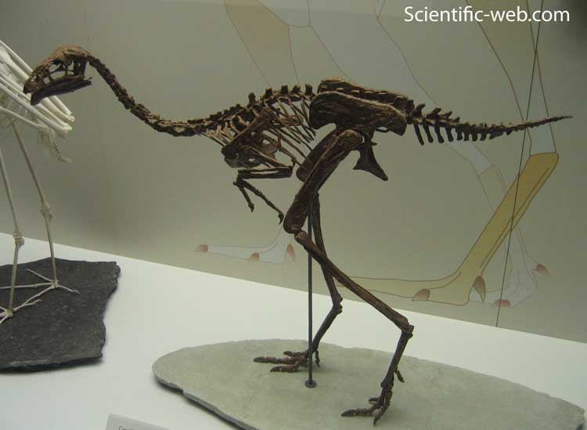
Caudipteryx
Feathers on arms & tail
Tail fan
Running mechanism
Cladistic analysis
  Non-avian, outside of Aves

Slide 23
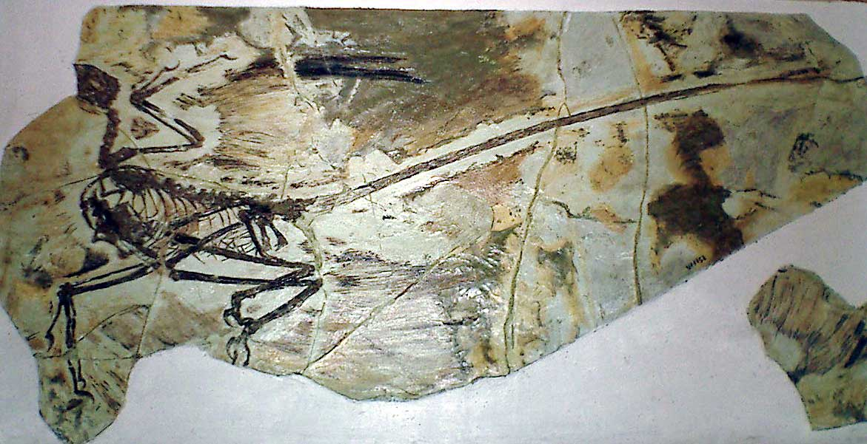
Microraptor gui
2003
Asymmetrical feathers on forelimbs & hindlimbs
Aerodynamic; gliding
Powered flight in forelimb → reduced hindwings, lost

Slide 24
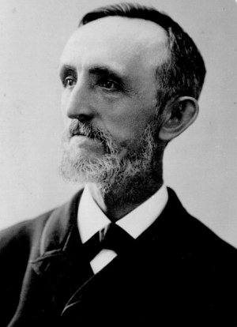
Origin of flight debate
Trees down (arboreal theory)
  Microraptor
Ground up (cursorial theory)
William Beebe: proposed avian flight evolved through 4-winged tetrapteryx stage

Slide 25
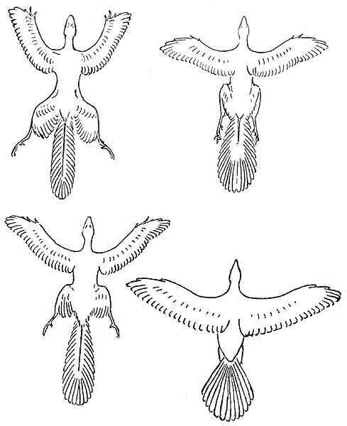

Slide 26
Feathers
8 species (6 genera) of dinosaurs that preserve feathers
Dozens yet to be described
Diverse group with variety of different feather structures:
  Sinosauropteryx (first feathered dinosaur)
    simple filamentous-like structures
  Beipiaosaurs (therizinosaurid)
    Filamentous structures as in Sinosauropteryx

Slide 27
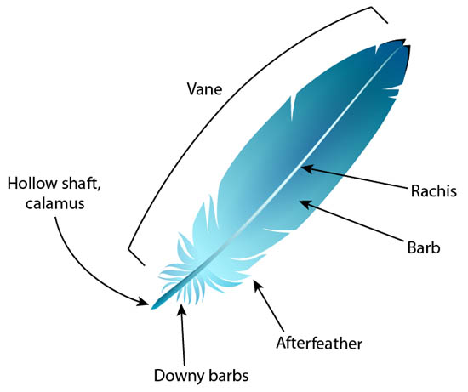
  Sinornithosaurus (andromeaosaurid)
    Tufts joined at their bases, or serially arranged along a central filament
  Caudipteryx, Protarchaeopteryx, Microrapter
    Complex feathers with vanes & shafts

Slide 28
5 stages of feather evolution model
Richard Prum 1999
1) evolution of hollow elongated tube
2) downy tuft of barbs
3) pennaceous structure
4) barbules & hooklets evolved to create a closed-vaned pennaceous feather
5) asymmetrical vanes of flight feathers

Slide 29
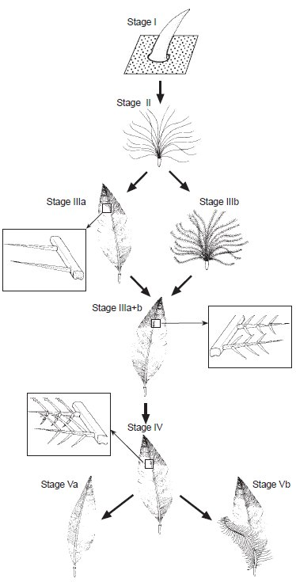

Slide 30
Support of Model
Diversity of feather types
Molecular data
Range of feathers on preserved dinosaurs from Liaoning, China

Slide 31
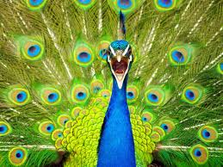
Feather evolution driving force
Not flight
Insulation?
  Uncertain.
Display?
  Modern birds- conspicuous & bright
Camouflage?
  Feather color would blend with habitat
Origin of feathers BEFORE origin of birds

Slide 32
Bone Microstructure of Mesozoic Birds
Patagopteryx
Enantiornithes
  Diverse volant group
Hesperornis
Ichthyornis
Cimolopteryx
Cretaceous Gaviiformes
  Antarctic loon

Slide 33
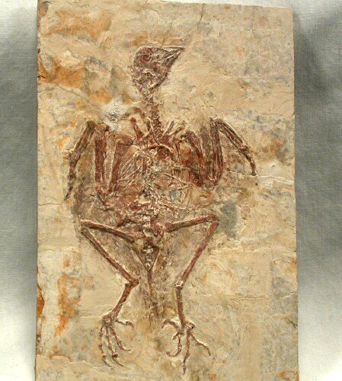

Patagopteryx
Nonornithurine, but sister group
Hen-sized, flightless, terrestrial

Slide 34
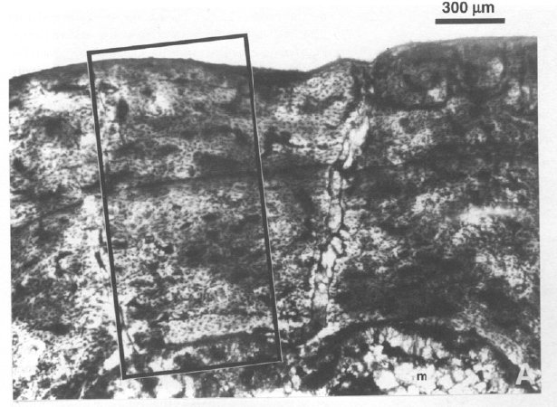
Patagopteryx
General structure of bone wall (RBT 18%)
Highly vascularized fibrolamellar bone of the compacta is interrupted by deposition of a single LAG, internal to which is a narrow band of lamellated tissue termed the annulus

Slide 35
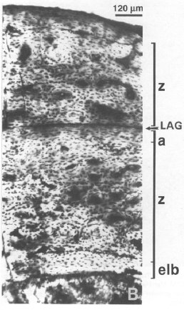
Patagopteryx
LAG→ pause in rate of bone formation
Annulus→ slower rate of bone formation
indications

Slide 36
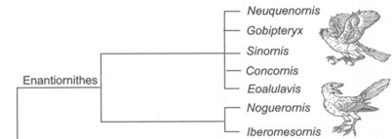
Enantiornithes
Diverse volant group
Wide distribution in Cretaceous
Varying hypothesis on relationship to Ornithurae

Slide 37
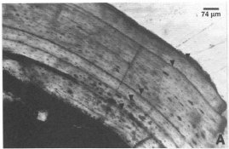
Enantiornithes
Femora: lightweight, thin walls (RBT 13.7%), free medullary cavities
Poorly vascularized compacta
5 LAGs in PVL-4273; 4 LAGs in MACN-S-01

Slide 38
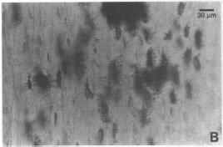
Enantiornithes
Enlarged osteocyte lacunae
Extensive canalicular development
  Facilitated assimilation and distribution of nutrients

Slide 39
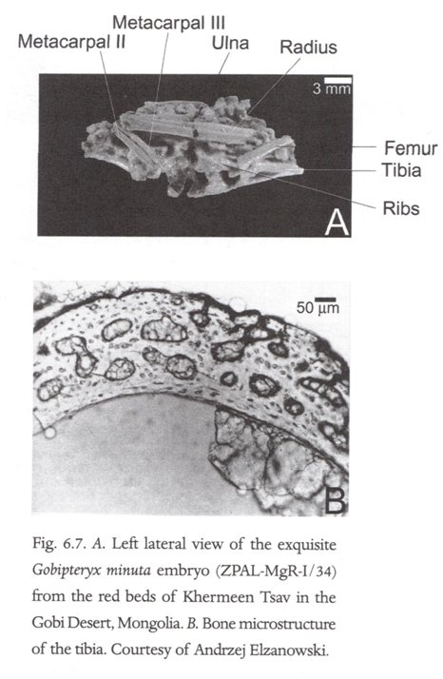
Gobipteryx embryo
Histology well preserved
Fine cancellous woven bone matrix
Large globular-shaped osteocyte lacunae
Uneven peripheral & medullary margin→ remodeling & restructuring

Slide 40
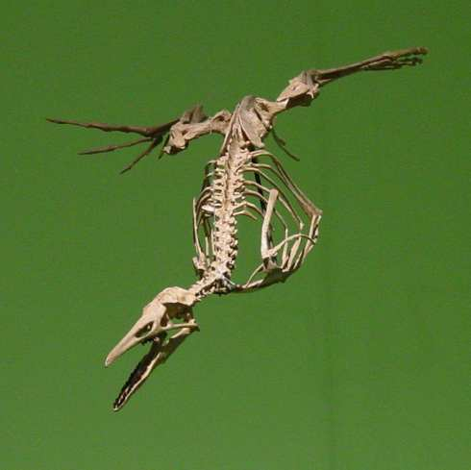

Hesperornis
Best-known Mesozoic basal ornithurines
Toothed, flightless, diving forms
Laterally compressed feet for propulsion during swimming

Slide 41
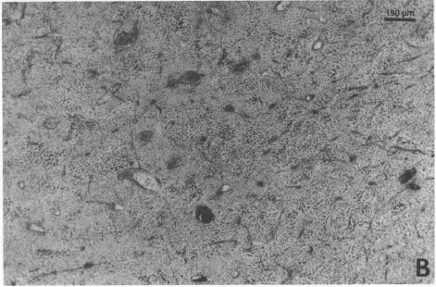
Hesperornis
Thick compact bone wall enclosing small medullary cavity= adaptions for aquatic lifestyle
No LAGs, longitudinally oriented primary osteons (tinamou tissue)

Slide 42
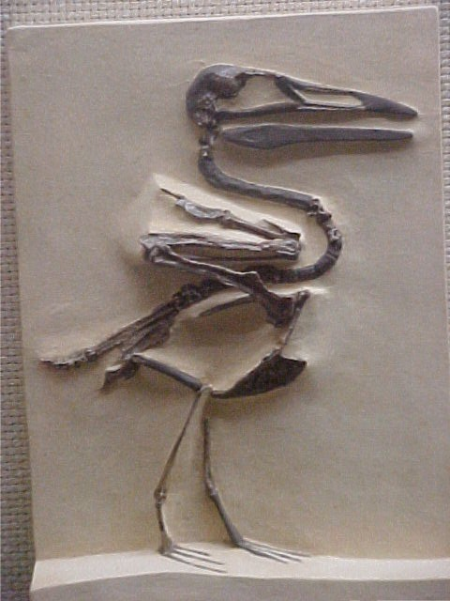
Ichthyornis
Strong wing bones
Well-developed keeled sternum for poweful flying
Long jaw w/ recurved teeth for capturing fish
Distinct from neornithes

Slide 43
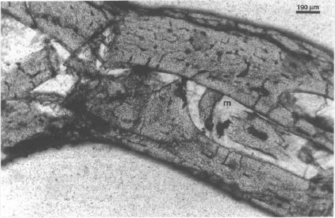
Ichthyornis
Humoral fragment
Thin bone wall
Fibrolamellar tissue
Medullary cavity lined by layer of endosteally formed lamellated bone

Slide 44
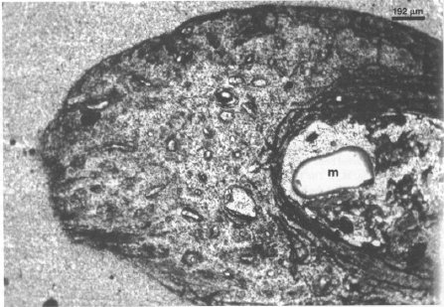
Cimolopteryx
Sister taxon, or transitional
Richly vascularized bone
Many vascular canals; several enlarged canals→2° reconstruction
Fibrolamellar, no LAGs

Slide 45
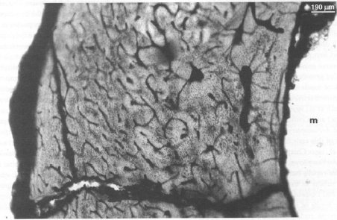
Cretaceous Gaviiformes
Antarctic loon
Foot-propelled diver
Thick, compacted bone wall, fibrolamellar
Aquatic lifestyle
1° & 2° osteons located w/in woven bone matrix

Slide 46
Archaeopteryx & Confuciusornis
Seven skeletons
Substantial size range
Youngest half size of largest
All subadults
  Limited skeletal fusions
Individuals lacking neonate features are differently sized, with smallest about 50% to 60% size of largest
Not different species

Slide 47
Summary of bone microstructure
Modern birds→ adult size w/in 1 year=fast growth, no LAGs
Hesperornis histology similar to that of modern birds
Patagopteryx & enantiornithines→ grew much more slowly as compared with modern birds
Archaeopteryx & Confuciusornis→ wide range of sizes in fossil record= slow growth rate

Slide 48
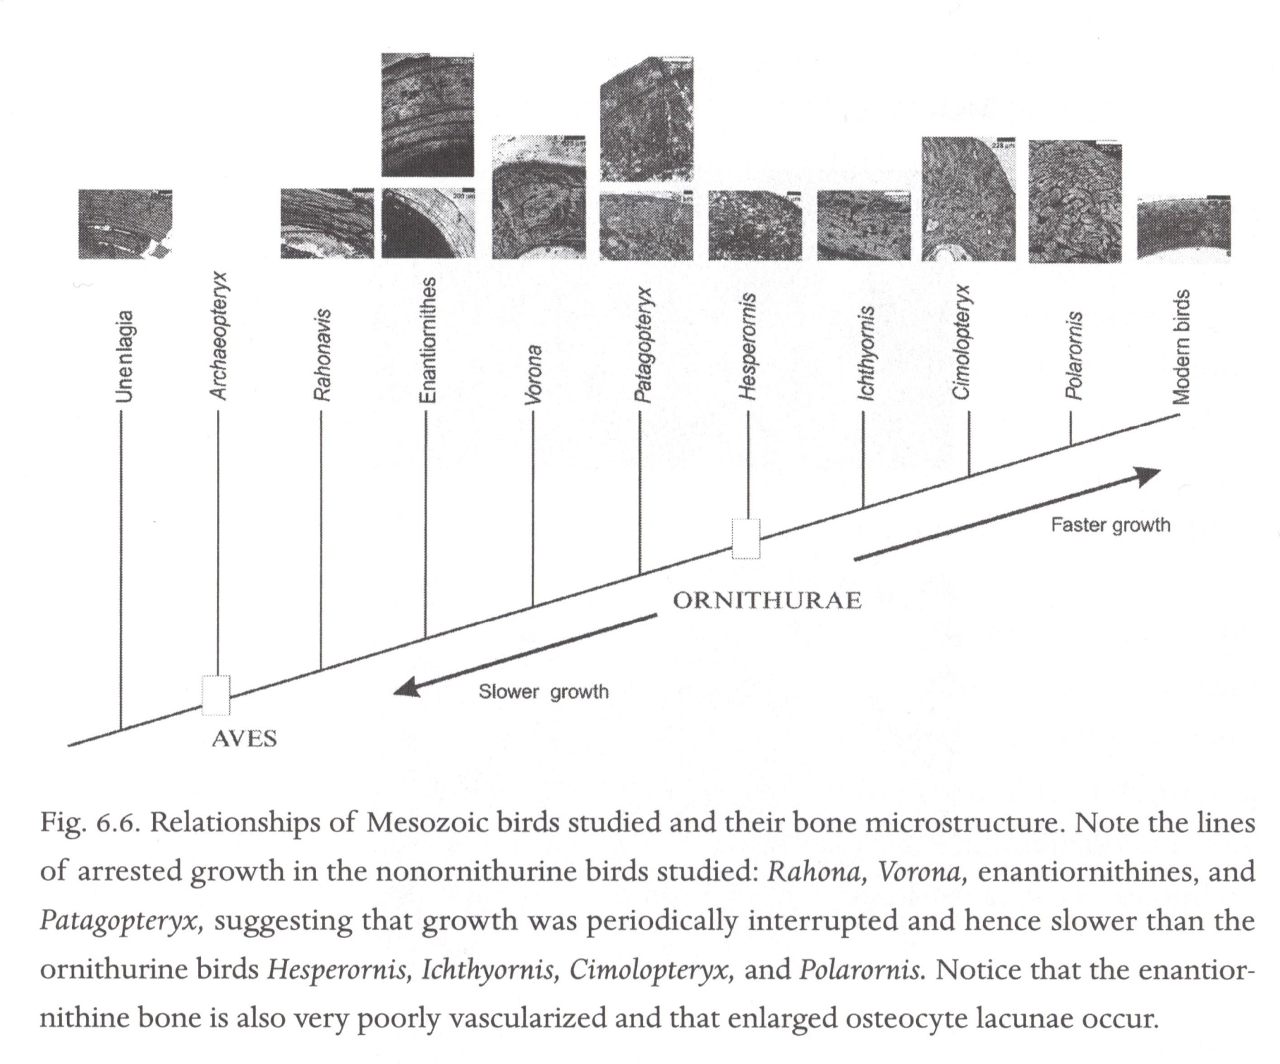

Slide 49
Looking at bone:
Tells us…
Does not tell us…
Diversity
Overall morphology
Overall phylogeny
Bone formation
Overall growth pattern
Biology
Physiology
Endotherm or ectotherm

Slide 50
Conclusions
Basal birds grew at much slower rates than modern birds
  Several years to mature size
Reduction in amount of rapidly formed bone may be linked to reduction in overall size of basal birds as compared w/ nonavian theropod ancestors, and/or linked to onset of precocial flight
Selection pressure for fast growth→ loss of primitive characteristic of flexible growth

Slide 51
Future
New fossils still being discovered
Enhanced understanding of early bird radiation and biology over next few years

Slide 52
Question
You are studying a new fossil believed to be an early neornithine bird. What evidence is present suggesting this is, indeed, a neornithes ancestor? What evidence do you look for in the bone microstructure to support/refute your theory?

